Slide 1


The Great Gatsby
Crash course

Slide 2


Slide 3


Slide 4


Slide 5
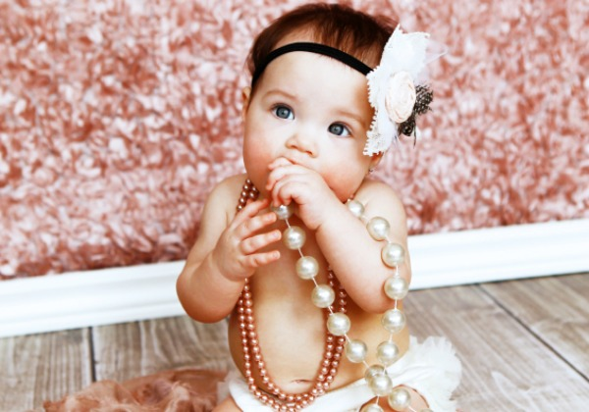
“I hope she'll be a fool — that's the best thing a girl can be in this world,
a beautiful little fool...”

Slide 6
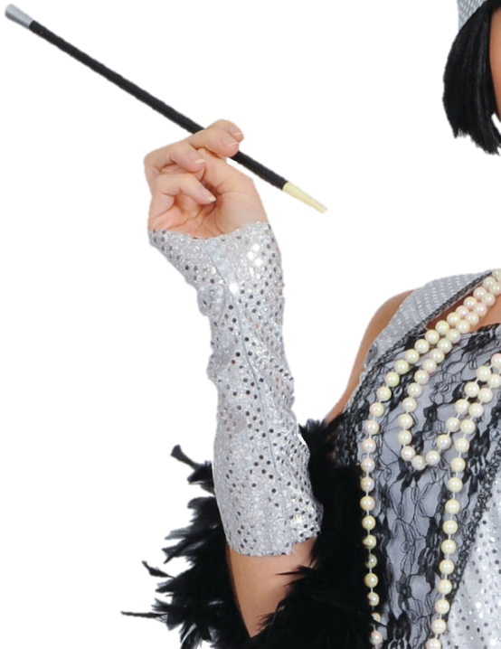

Slide 7


Slide 8


Slide 9
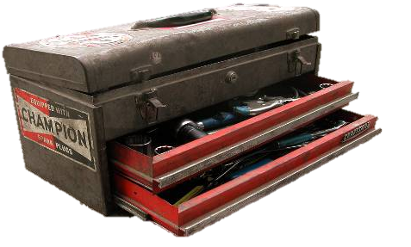
“He thinks she goes to see her sister in New York. He’s so dumb he doesn’t know he’s alive.”

Slide 10
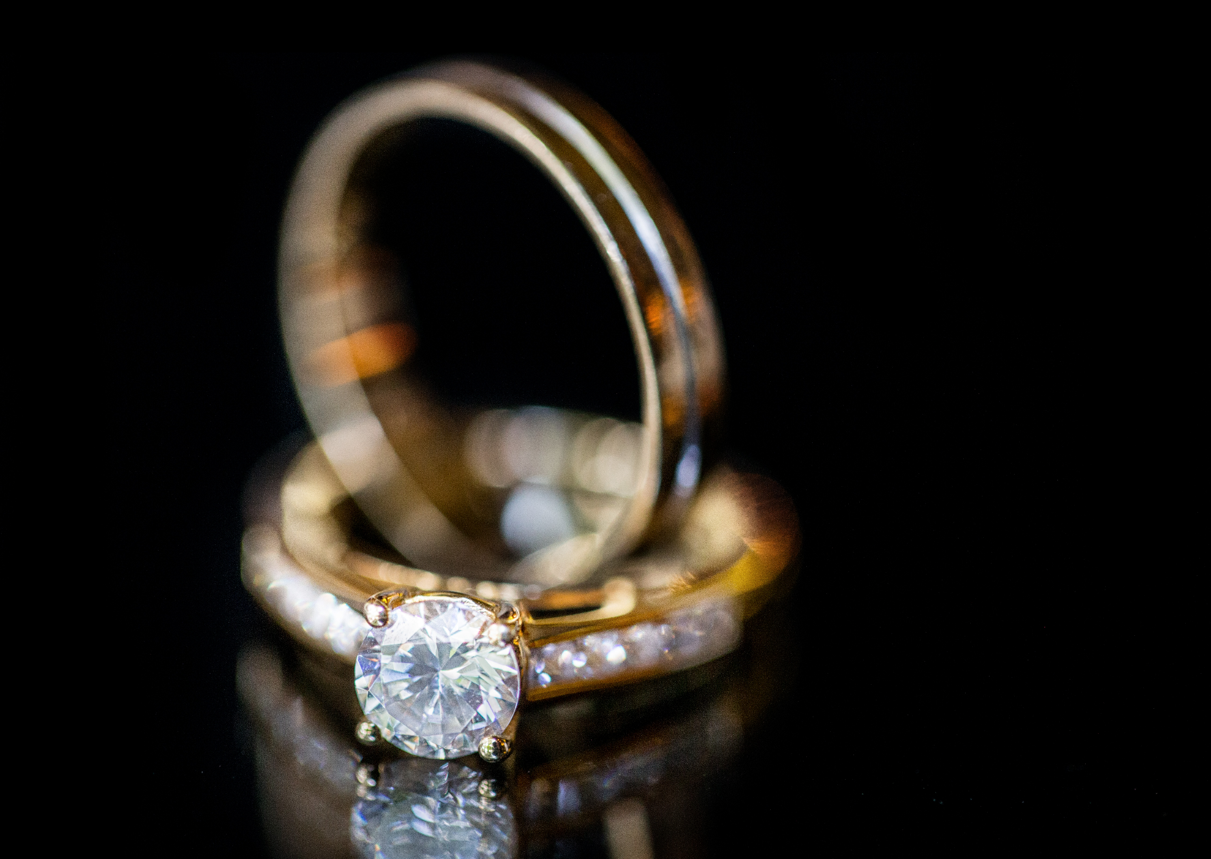

Slide 11



Slide 12



Slide 13
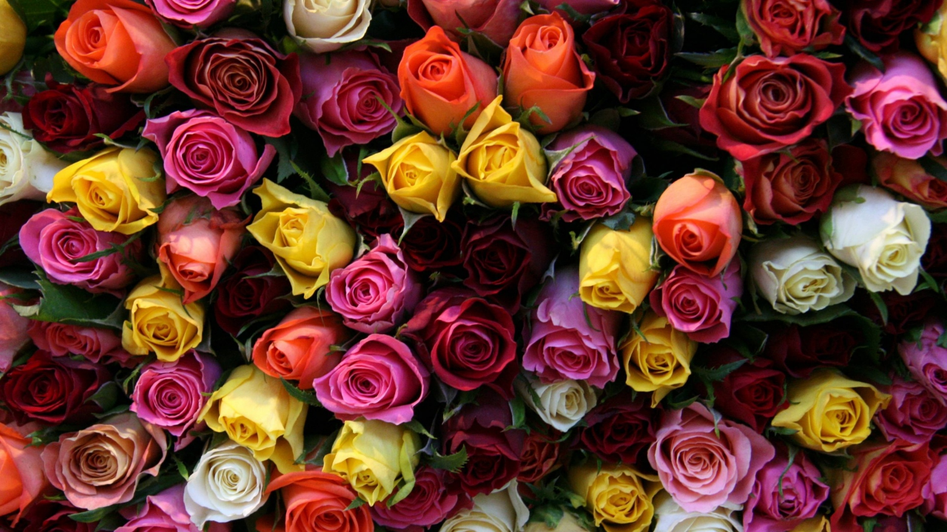
"I believe that on the first night I went to Gatsby's house I was one of the few guests who had actually been invited.
People were not invited — they went there."

Slide 14


Slide 15
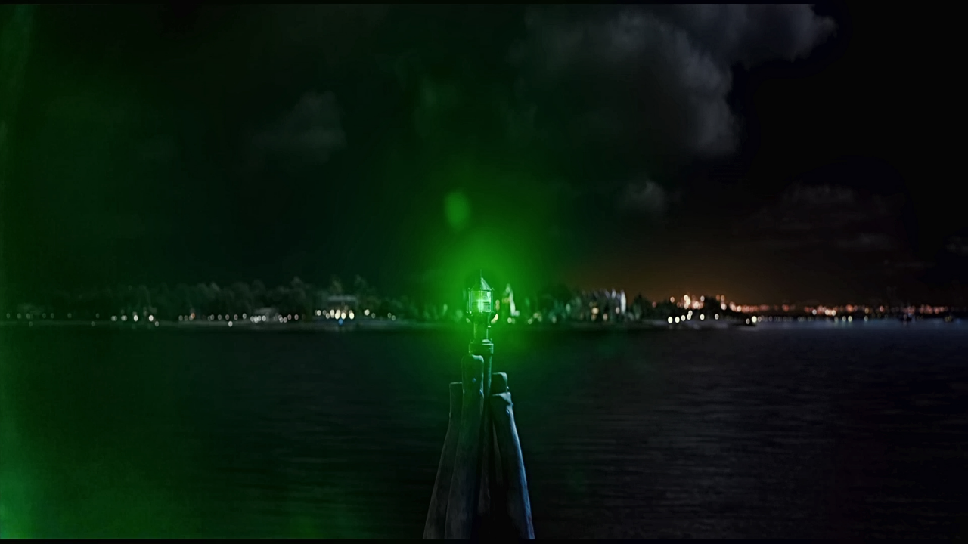

Slide 16


Slide 17
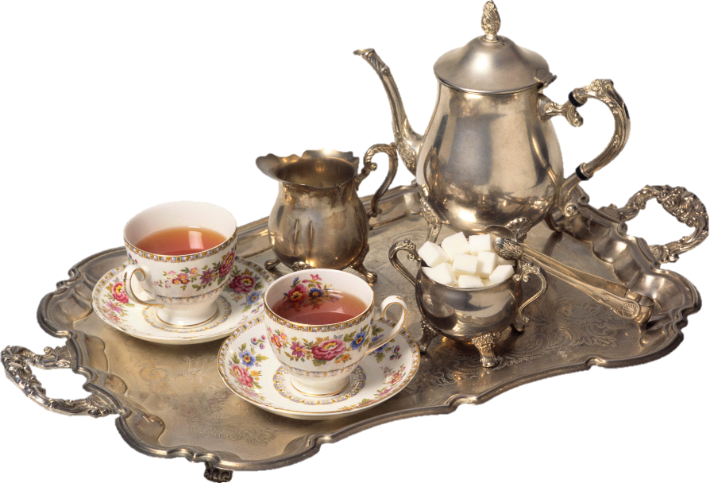

Slide 18


Slide 19
