Slide 1
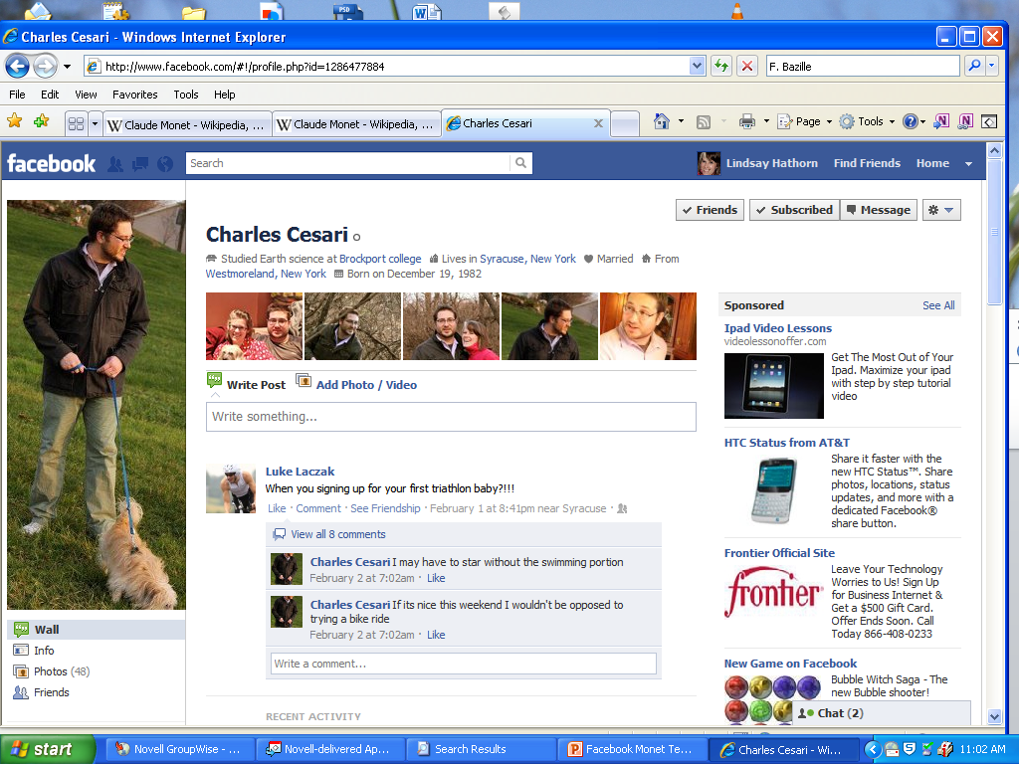
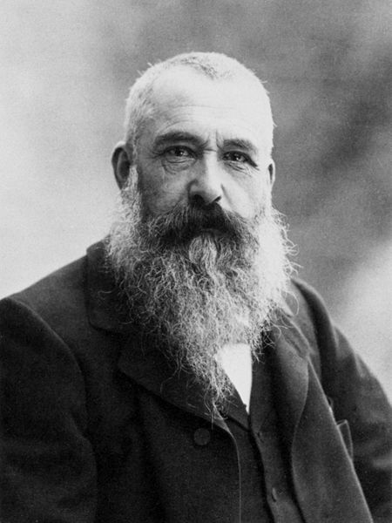
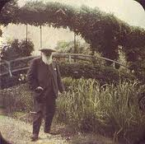
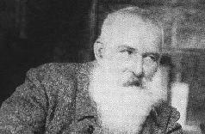
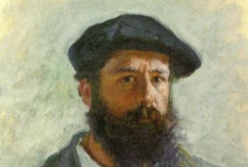
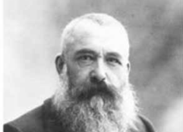
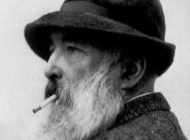
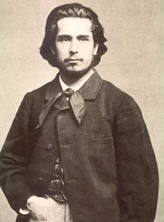
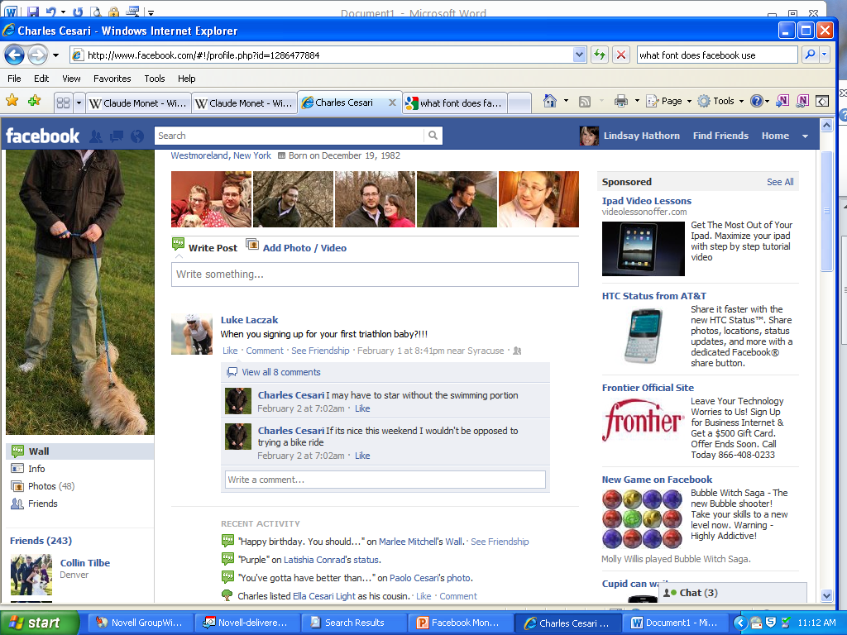
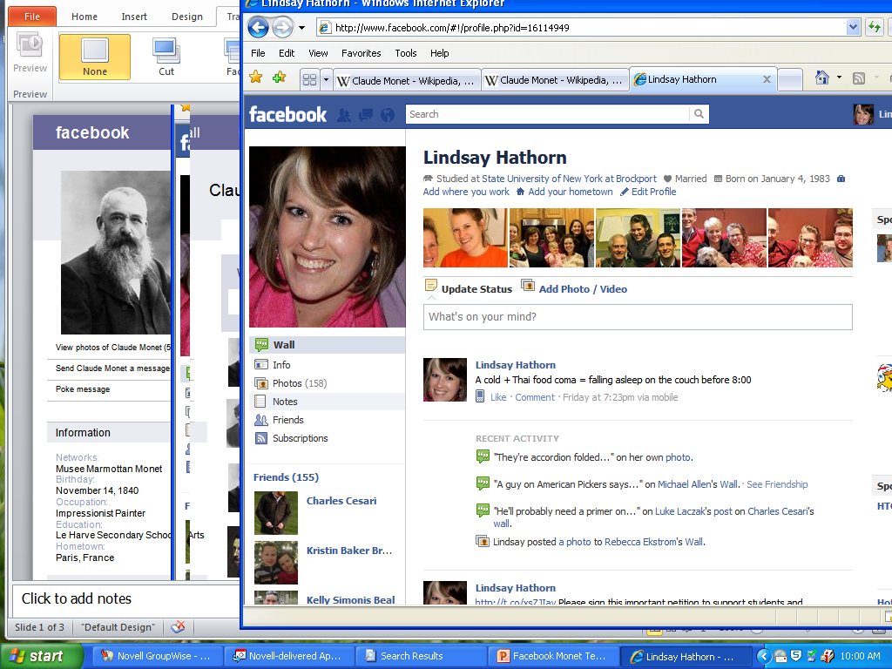
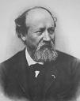
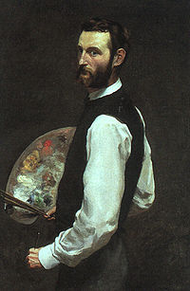
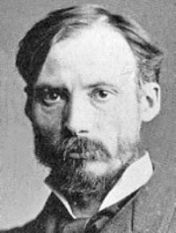
Claude Monet
Claude Monet
Studied Art at Le Harve Secondary School of the arts * Lives in Giverny, France * Married * Born on November 14, 1840
Claude Monet
Using our time in Giverny to paint “series” – these are images depicting the same subject at different times of day, in different kinds of light. Water lilies are my favorite! - with Eugene Boudin (Anderson, 75).
Eugene Boudin
Now that you’re living in Giverny, and you’re finally rich enough to purchase a house, land, and orchards, what are you painting?
Path to Fame
I always knew I wanted to be an artist. I attended the Le Harve secondary school of the arts, and made money selling charcoal sketches to locals. I also had drawing lessons from Jacques-Francois Ochard, and Eugene Boudin (Rita, par. 7).
Claude Monet
Working on a new painting: Impression, Sunrise – it’s a scene of the harbor at sunrise. I’m feeling great about it and think it might be a real winner! – with Frederic Bazille (Gascoigne, 4).
Frederic Bazille
What are you painting now? Up to anything new?
Friends
Eugene Boudin
Claude Monet
The new technique is working really well – using short brush strokes to capture the light looks great on canvas. They’re calling our style Impressionism – with Pieree-Auguste Renoir (Johnson, 2).
Pierre-Auguste Renoir
Pierre-Auguste Renoir
Loved working with you! How’s that new technique we developed working out?
Frederic Bazille

Slide 2

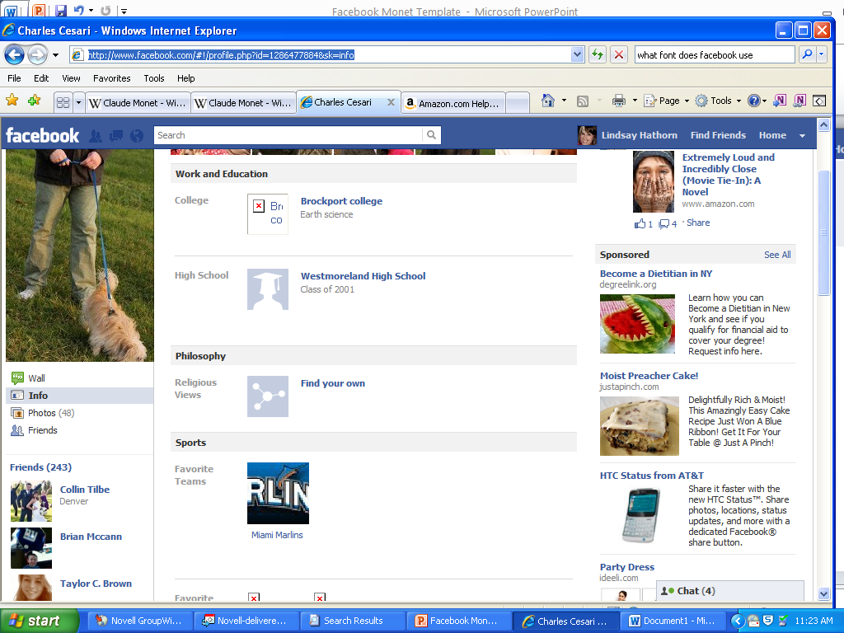
Claude Monet
Claude Monet
Claude Monet
Studied Art at Le Harve Secondary School of the arts * Lives in Giverny, France * Married * Born on November 14, 1840
Basic Info
About Claude
I’m one of the most influential Impressionist artist. I studied under a lot of other famous painters, but was probably most influenced by Manet (Johnson 2). In the beginning, my work was very unusual because my focus on unconventional compositions and bold colors was a big change from the Realist style popular at the time (Marcus 89). I love to watch the way light hits different objects and the way colors change depending on the sun and the time of day. I’m inspired by anything outdoors, but I especially love to garden. Water Lilies are one of my favorite things. My personal life hasn’t always been easy (Dudar 3). I was very poor at points, and both my wives, Camille and Alice, died before me (Anderson 1). I also lost my son, Jean. I hope I can inspire other painters to explore a more abstract style of work.
Friends
Philosophy
Eugene Boudin
Favorite
Quotations
“Just think of the illimitable abundance and the marvelous loveliness of light, or of the beauty of the sun and moon and stars.” – St. Augustine
Resources
Pierre-Auguste Renoir
Favorite
Sources
Anderson, James. Monet’s Waterlilies. New York: Penguin, 1987.
Dudar, Helen. "When light meets water: Monet on the Mediterranean." Smithsonian
July 1997: 80+. Gale Power Search. Web. 9 Feb. 2012.
Gascoigne, Laura. "Glory of the garden: Laura Gascoigne manages to dodge the crowds and find something of the magic of Monet's Giverny." Spectator 6 Aug. 2011: 40+. Gale Power Search. Web. 9 Feb. 2012.
Johnson, Jerry. "Not Just Pretty Gardens; The untamed beauty of Monet's last paintings." New York 24 May 2010. Gale Power Search. Web. 9 Feb. 2012.
Marcus, John. Monet and Manet. Purdue U, 28 Nov. 2003. Web. 10 Feb 2012
Frederic Bazille

Slide 3
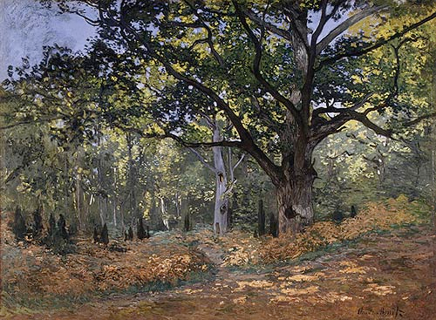
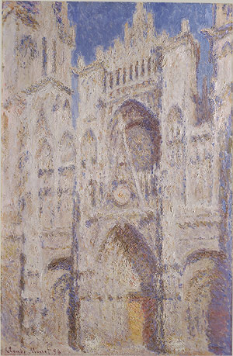
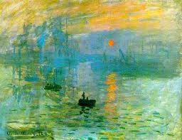
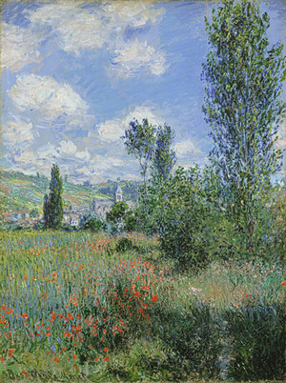
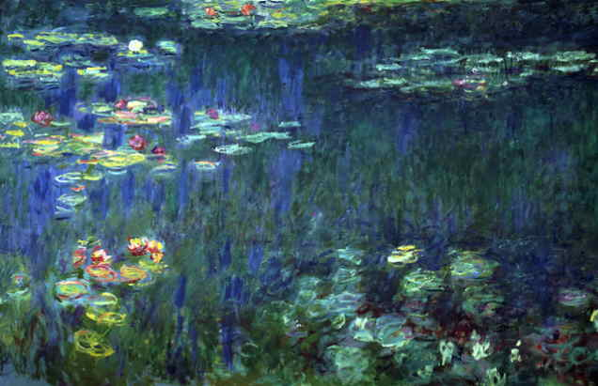
Claude Monet
My Paintings
By Claude Monet (Albums) * Updated 1 day ago
Monet’s painting of the Bodmer Oak was one of his first attempts at painting outdoors. Artists didn’t normally do this. Monet started the practice of painting outdoors because he wanted to capture the light as realistically as possible (Anderson 1).
Monet painted more than thirty different canvases of Rouen Cathedral, each at a different time of day. It captured his impression of the way the light changed the scene. It was one of his most extensive undertakings (Johnson 4).
Monet is credited with starting the Impressionist movement. In fact, the style was named after this painting, which is titled Sunrise: Impression. Critics meant the term “Impressionism” as a negative, but Monet took it as a compliment (Dudar 7).
Monet’s View of Vétheuil is an example of his unique use of color; unlike some of his contemporaries, he choose to use bright, shocking colors, that weren’t toned down with a somber golden wash used by other artists (Dudar 5.)
Monet continued to paint even when he was almost blind. His water-lilies painting took him 15 years to complete. Monet even had a special studio built to house the work because the canvases were so big (Marcus 92).

