Slide 1


Slide 2
There are places …

Slide 3
… where you can only survive …

Slide 4
… when you trust each other …

Slide 5
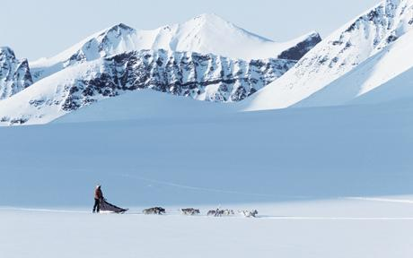

Slide 6
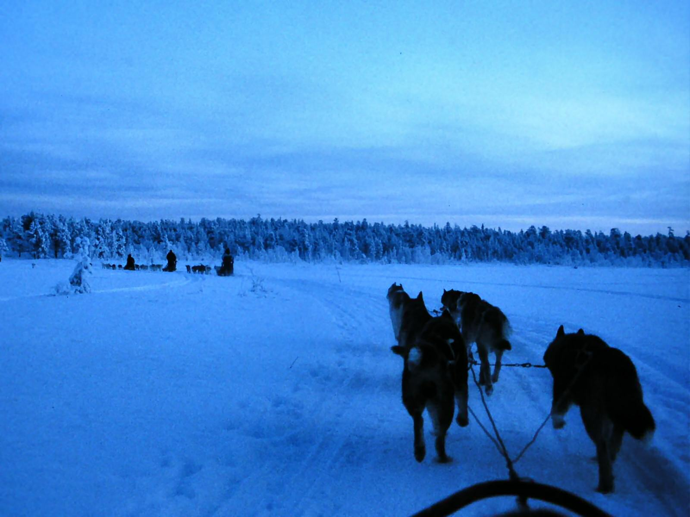
Have you ever experienced the wilderness … ?

Slide 7
Welcome …

Slide 8
… to the …

Slide 9
… wilderness …

Slide 10
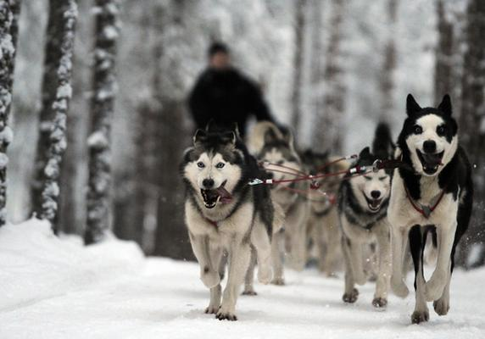

Slide 11
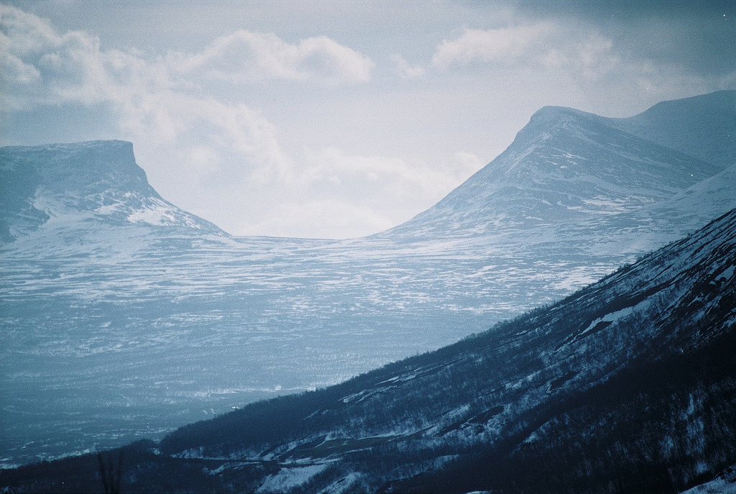

Slide 12
A movie about courage …

Slide 13
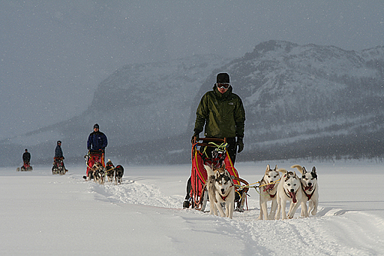

Slide 14
… faith …

Slide 15
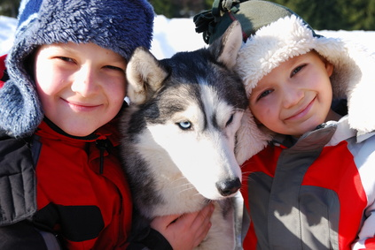

Slide 16
… and family.

Slide 17
Based on the novel by Roddy Doyle …

Slide 18
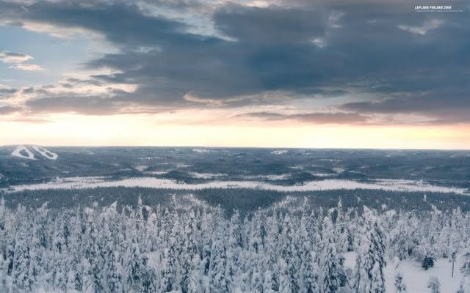
Wilderness

Slide 19
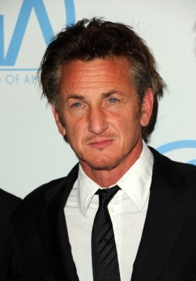
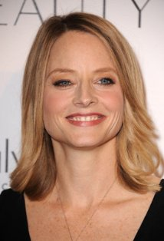
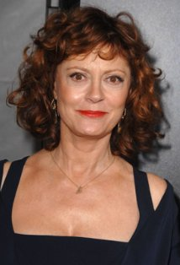
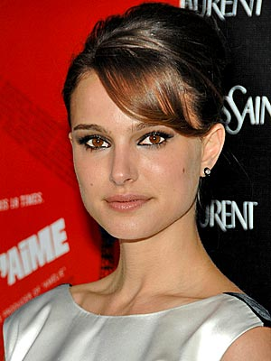
Starring
Sean Penn Jodie Foster Susan Sarandon Natalie Portman

Slide 20
… and …

Slide 21
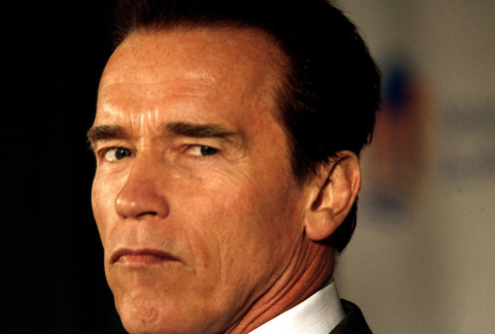
Arnold Schwarzenegger

Slide 22
Two stories …

Slide 23
… one wilderness …

Slide 24
Coming soon to your local theater

