Slide 1

ELT Project
John Doe
University of Graz
1 June 2016

Slide 2
Presentation Topic 1
This is a list
This is a list
This is a list
This is a list
This is a list

Slide 3
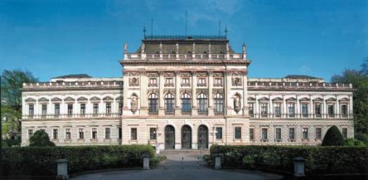
Subtitle Picture
Info Picture

Slide 4
Discussion
Point 1
Point 2
Point 3

Slide 5
Education is the most powerful weapon which you can use to change the world.
Nelson Mandela

Slide 6
Checklist
Check 1
Check 2
Check 3

Slide 7

Important Info
This is a list
This is a list
This is a list
This is a list

Slide 8
Comparison
Model 1
Model 2
Text or Media
Text or Media
Text or Media
Text or Media
Text or Media
Text or Media

Slide 9
Blank Slide

Slide 10

ELT?

Slide 11

Internet Link
www.uni-graz.at
Link Info
Link Info

Slide 12
Picture 2
Info Picture
Info Picture
Info Picture
Info Picture

Slide 13
Thank you

