Slide 1
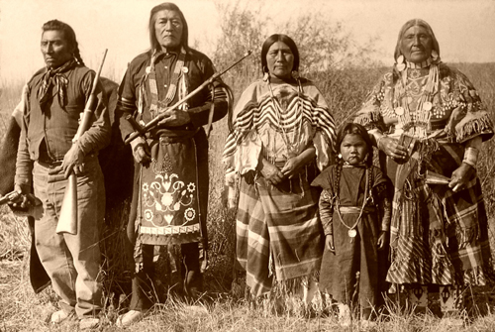
The true story of
POCAHONTAS

Slide 2
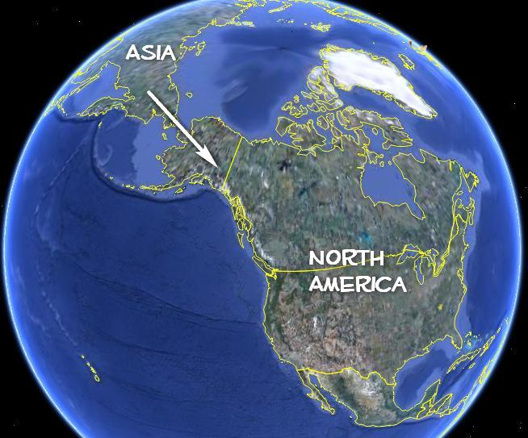
The Indians came from Asia to North America.

Slide 3
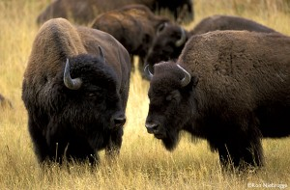
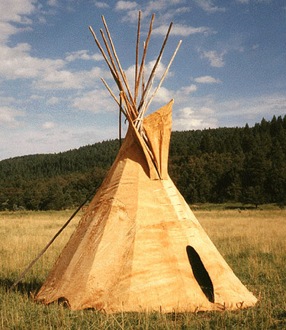
Indians were hunters.
Indians
hunted buffalos
for
food
clothing
Tepees

Slide 4
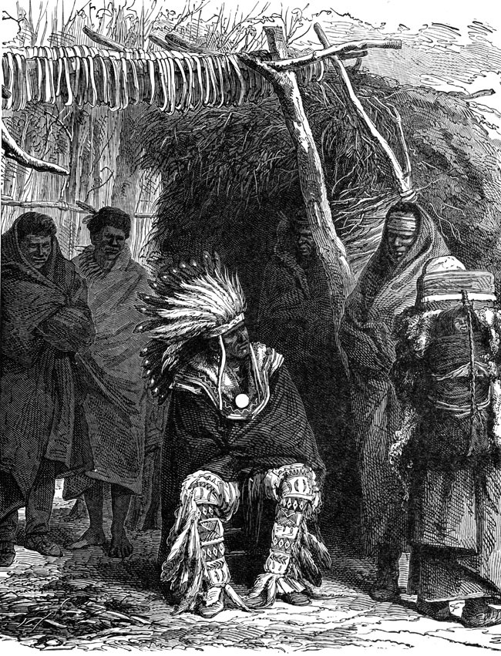
They lived in tribes.
Every tribe had
One chief.

Slide 5
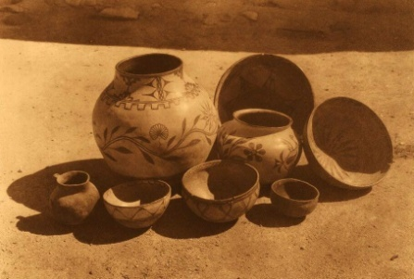
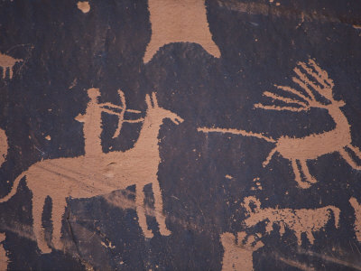
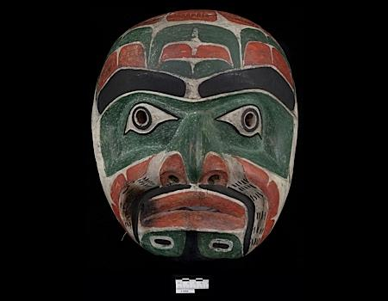
Indians
Indians
Made:
Pottery,
Pictures on stone walls
masks

