Slide 1
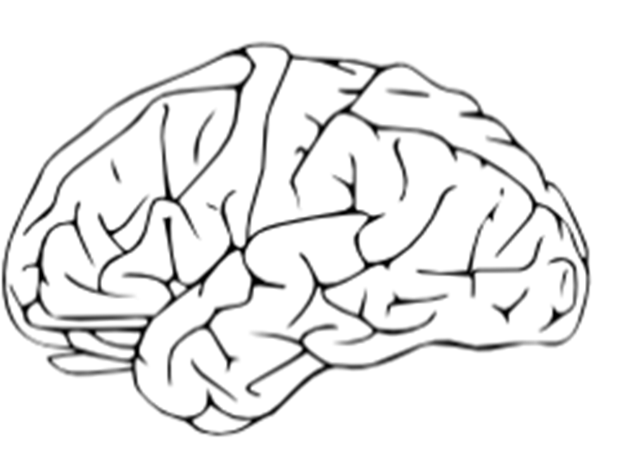



Creating Life-long Language Competence A few small changes can make a BIG difference
Elisabeth Pölzleitner

Slide 2
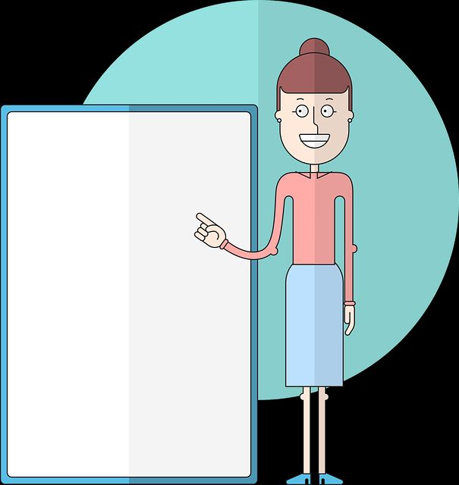
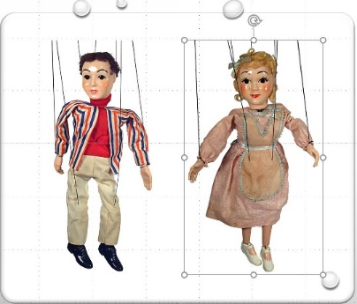
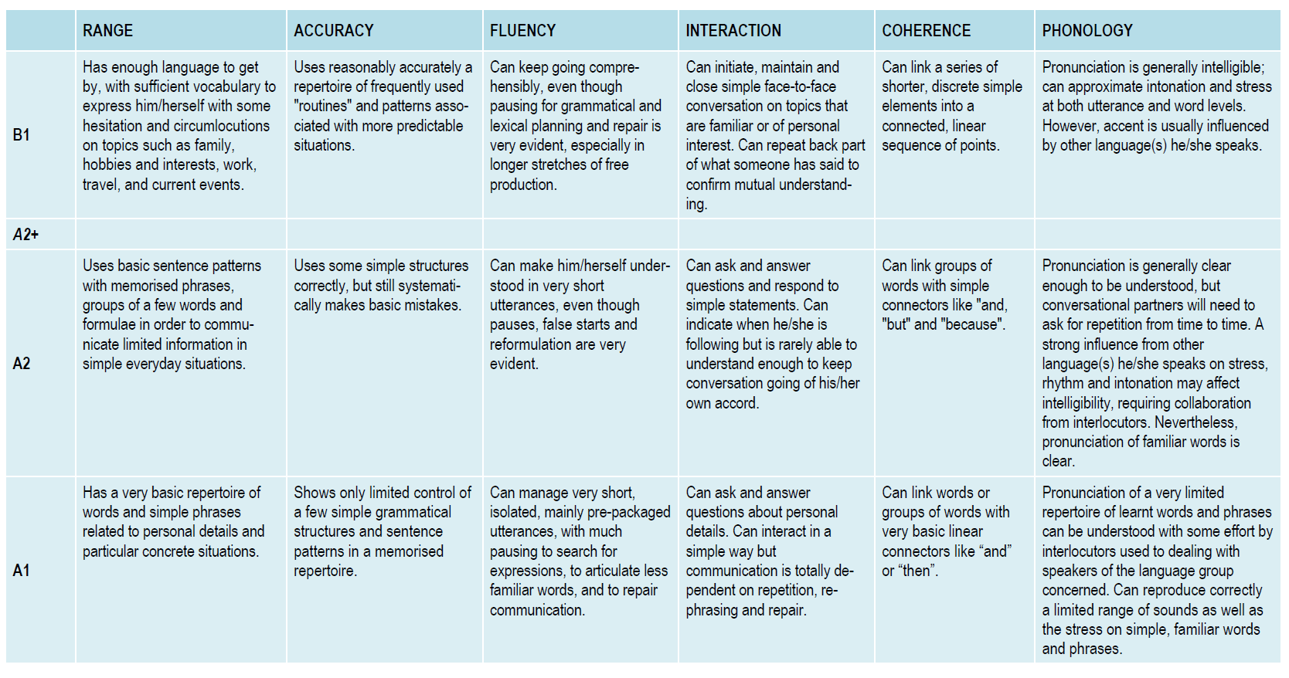
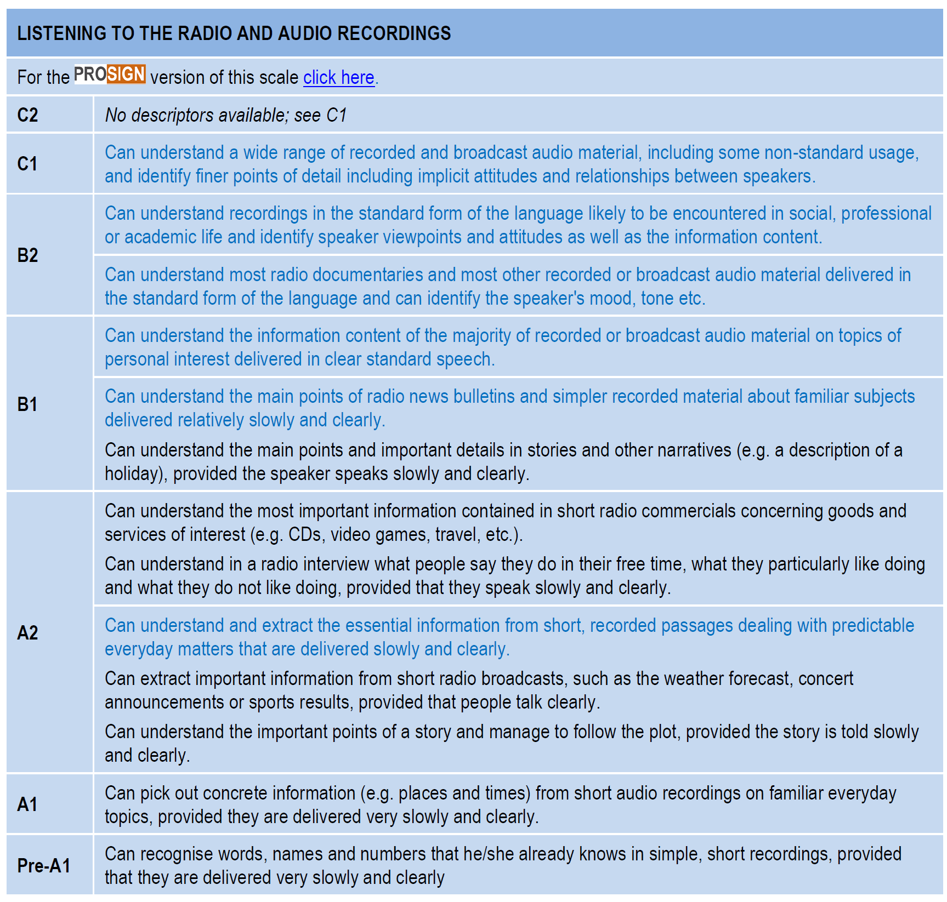

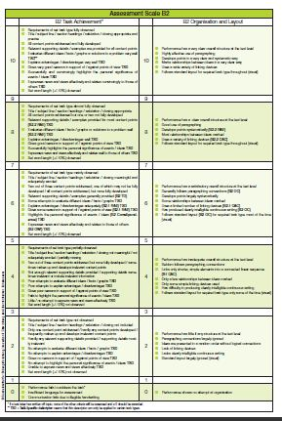
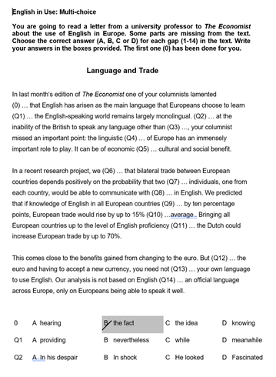


Speaking
Themenkorb
Sports and Leisure
Relationships
Travelling
Environment
Politics
Media and Technology
The status quo
Listening
LiU
vocabulary
Essay
Report
Blog
Letter / Email
Article
Brochure
grammar
Notes:
Status Quo: Engagierte LehrerIn, großer Vorbereitungsaufwand für jede Stunde – viele activities, alle skills,
Lehrbuch +/-
Meinung vieler Kollegen bei Seminaren: Meine Ideen und Vorschläge sind ja toll, ABER ich muss ja …..
Standardisierte Reifeprüfung: Vorteile und Nachteile
Üben der Formate nimmt sehr viel Zeit in Anspruch…
Frage: wie effizient ist dieses Üben? Wieviel brauchen wir wirklich?
Wenig aktive Sprechzeit der SchülerInnen, viel Teacher-talk
Kommunikativer Ansatz: wie authentisch ist die Kommunikation in der Klasse?
„Ownership of learning“

Slide 3
What’s on your mind?
What works well?
What are the problems?

Slide 4

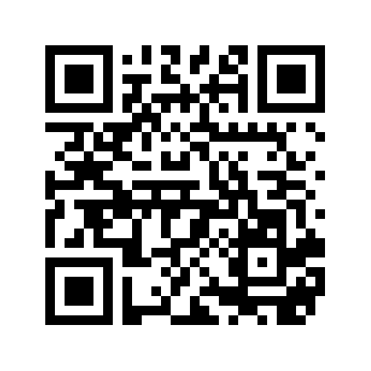
Let‘s collect our ideas
https://padlet.com/lispolzleitner/6ij61ghkhrq0
https://tinyurl.com/gr-prob

Slide 5
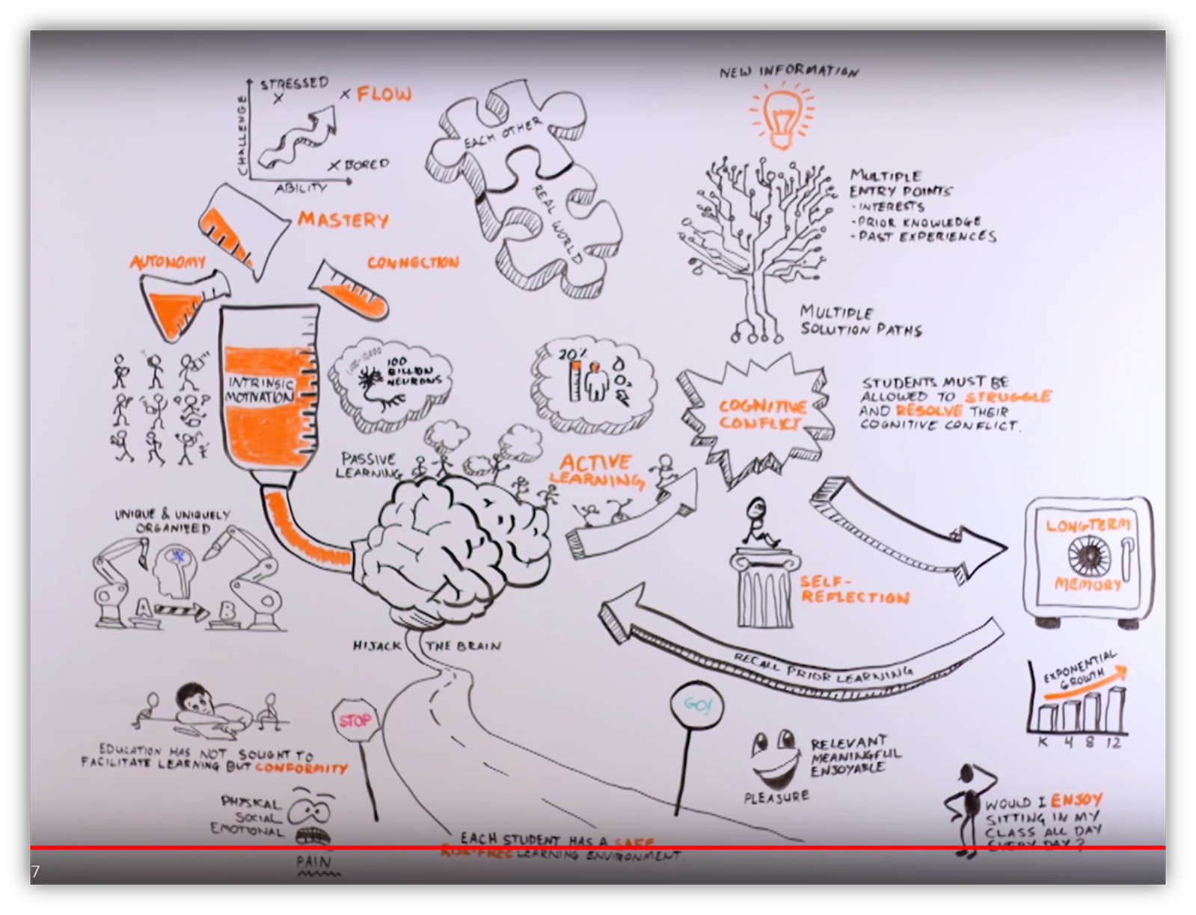


How we learn
How to „hijack“ the learners‘ brains
Active, multisensory learning and hypotheses making
How to improve intrinsic motivation
The Role of Meaning and Sense
Choice
Self-determination theory
Ownership and Pride
https://www.youtube.com/watch?v=wlaG99awCD8&t=14s&ab_channel=ForneyISD

Slide 6

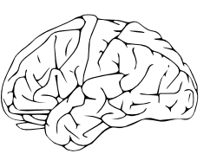


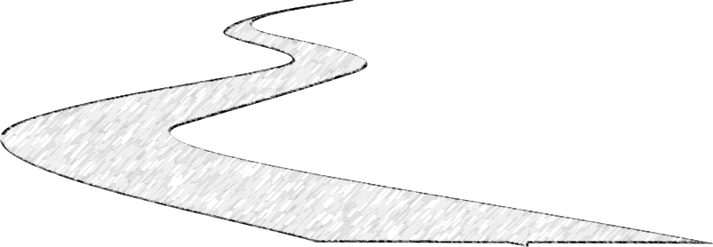
Active learning needs multiple paths in and out
How can this help learners acquire new VOCABULARY?
Notes:
Um diese CHALLENGE diese Herausforderung anzunehmen und eine Aufgabe zu Lösen, muss ich unterschiedliche Zugänge – Lösungswege und auch unterschiedlichen Input ermöglichen bzw zur Verfügung stellen.
Jedes Hirn ist anders – andere Vorkenntnisse, Erlebnisse… – andere Muster vorhanden auf die der S. aufbauen kann. Andere Interessen, andere Bedingungen… andere Zugänge
Spätestens jetzt wird klar, dass der „one size“ oder „one fits all“ Unterricht nicht funktionieren kann.
Wir sehen dann später noch genauer, warum multiple paths so wichtig sind.

Slide 7
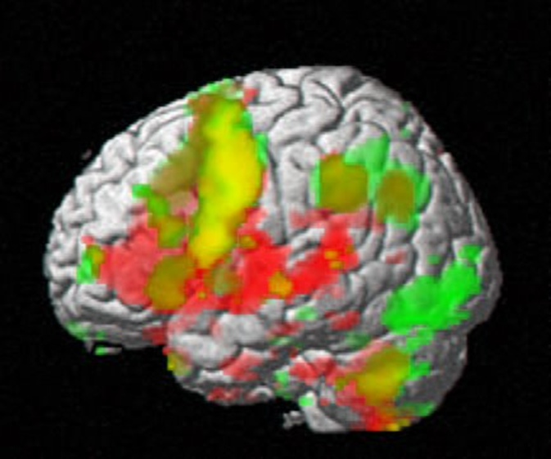
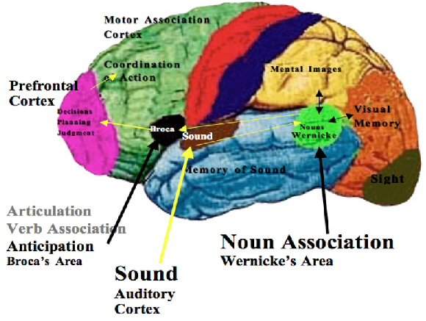
What is happening in this brain?
http://www.oocities.org/dtmcbride/science/biology/images/brain3.jpg
Notes:
Michael Drew, Beneath the cover, http://www.beneaththecover.com/surprising-broca/ Jan. 2015. retreived: Oct 2015

Slide 8
Our plan for today
How small changes can make a BIG difference
VOCABULARY
EXTENSIVE READING
GRAMMAR

Slide 9

Learning vocabulary with the whole brain
How do your students study vocabulary?
How can we improve this?

Slide 10
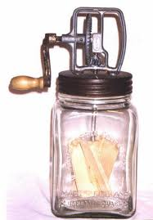

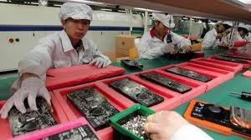

Words in context
to churn….
to churn butter, a butter churn
butter is produced by churning cream…
the Chinese factory churned out cheap copies …
Hollywood is churning out sequels of the show…
I am doing my best to churn out as many stories as I can…
watching the poor guy made my guts churn…

Slide 11
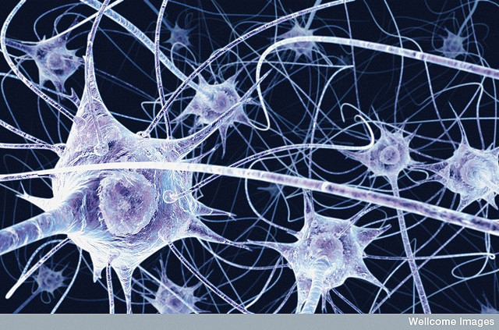
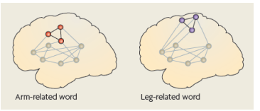
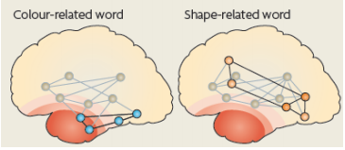
Building neural networks
Macedonia et. al, 2011, Hum Brain Mapping: http://www.percepp.com/macedonia.pdf
multidimensional networks:
neurons that fire together wire together
Notes:
p. 147 Neurodidaktik: Aufgabe des präfrontalen Kortex:…

Slide 12
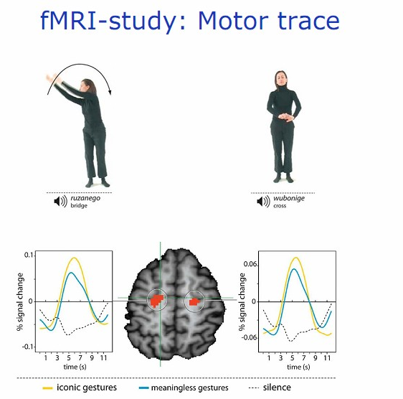
Activating several senses and parts of the brain
The role of movement
VMI: Manuela Macedonia
Notes:
Bewegungen aller Art fördern das Lernen:
nicht nur « iconic gestures » wie hier, sondern alle Bewegungen (siehe Diagramm). Auch kleine unbewusste Bewegungen wie das Angreifen von Kärtchen, Spielfiguren … sendet Reize ans Gehirn. Stricken – alle « runden Bewegungen » sind besonders hilfreich und aktivieren das Gehirn: Gehen, Radfahren (Studie am Max Plank Institut, Leipzig)…
Walk and Talk and write and check
Watch Macedonia on youtube!

Slide 13
Read the abstract of Manuela Macedonia‘s article about VMIs.
Abstract
Second language (L2) instruction greatly differs from natural input during native language (L1) acquisition.
Whereas a child collects sensorimotor experience while learning novel words, L2 employs primarily reading, writing and listening and comprehension. We describe an alternative proposal that integrates the body into the learning process: the Voice Movement Icon (VMI) approach.
A VMI consists of a word that is read and spoken in L2 and synchronously paired with an action or a gesture. A VMI is first performed by the language trainer and then imitated by the learners. Behavioral experiments demonstrate that words encoded through VMIs are easier to memorize than audio-visually encoded words and that they are better retained over time.
The reasons why gestures promote language learning are manifold.
First, we focus on language as an embodied phenomenon of cognition. Then we review evidence that gestures scaffold the acquisition of L1. Because VMIs reconnect language learning with the body, they can be considered as a more natural tool for language instruction than audio-visual activities.

Slide 14
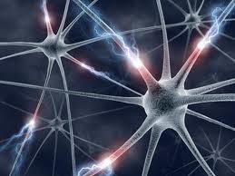
Praktische Anwendung
What does this mean for learning and teaching?
VMIs
Doodling
Colors
Sounds
Diagonal opposites
Lexical Furniture
Notes:
Praktischen Teil einschieben für diese Übungen

Slide 15
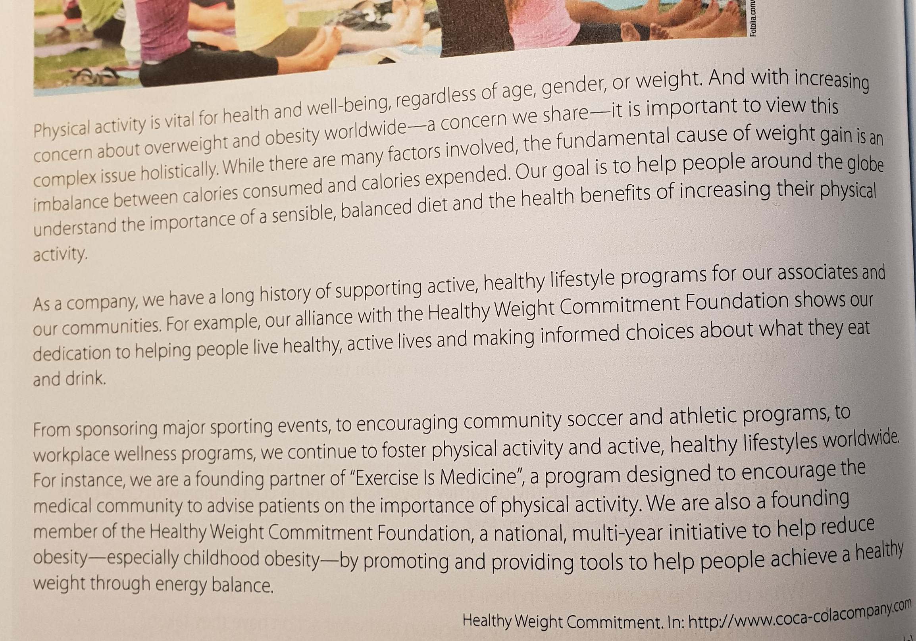
A fun activity: .
Find VMIs and colors for these words.
Share your ideas with your partners.

Slide 16
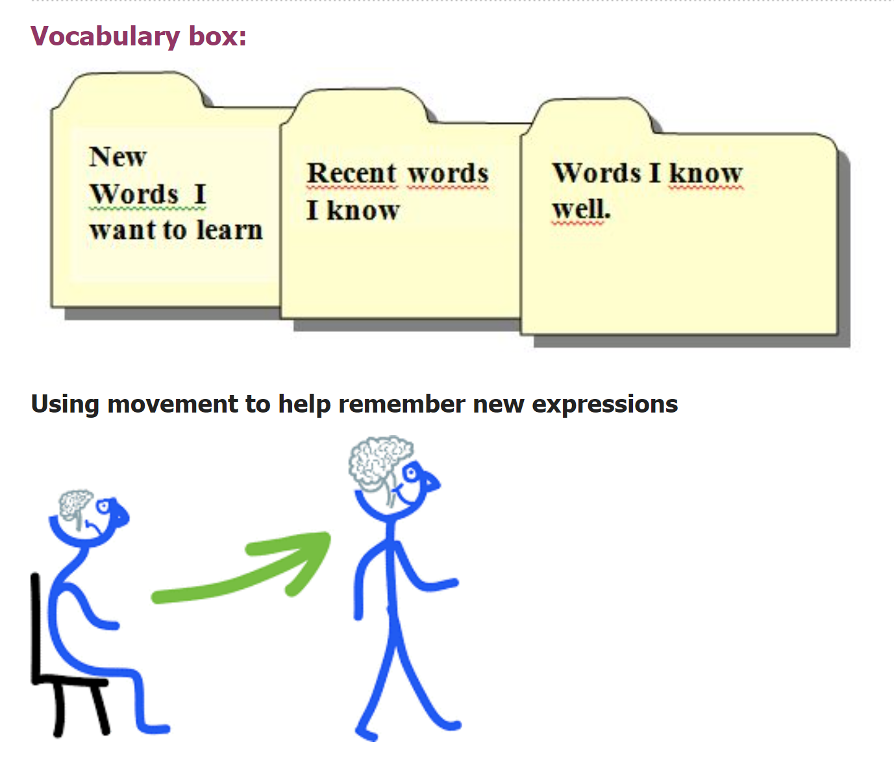
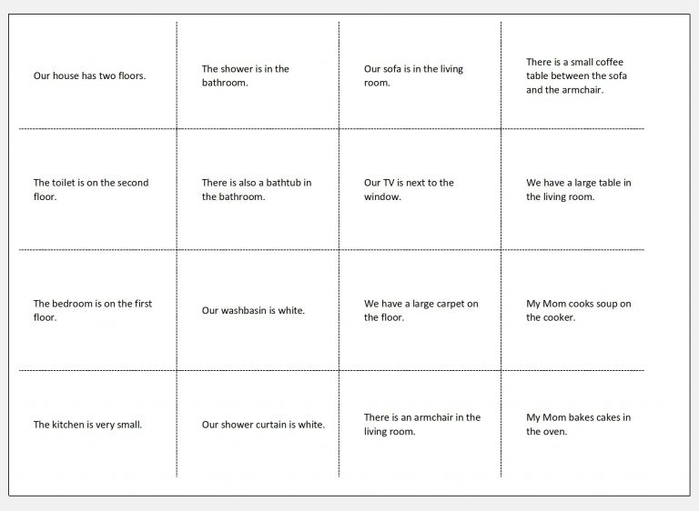
Working with the vocab box
vocab: extraordinary lives 4F
https://drive.google.com/file/d/1JmTuylZcAQFp6Pj64vTCuHzYfDlk8Vp8/view?usp=sharing

Slide 17
Vocab Work in English
Wie lernt man am schnellsten Englisch?

Slide 18
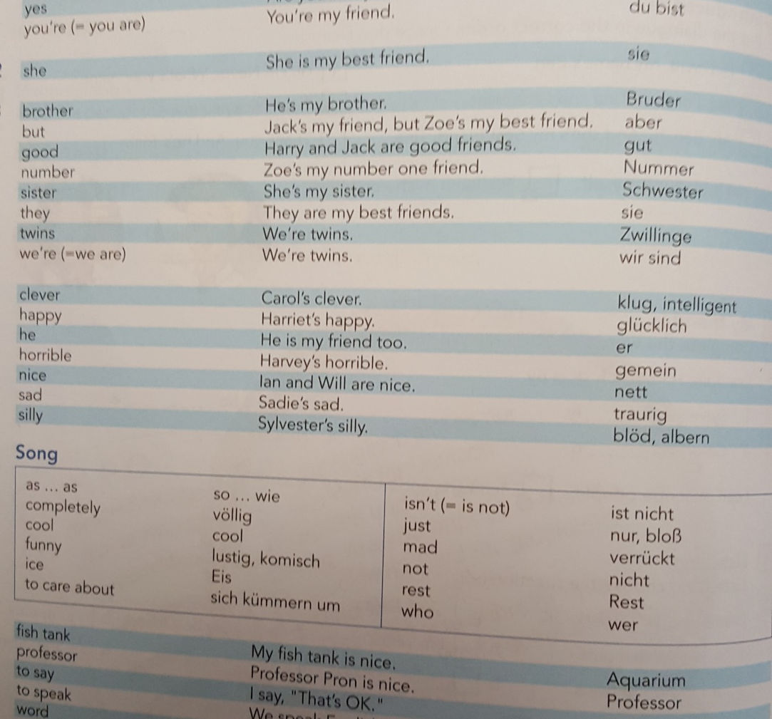

Vokabellisten
Nein
DANKE !!!

Slide 19
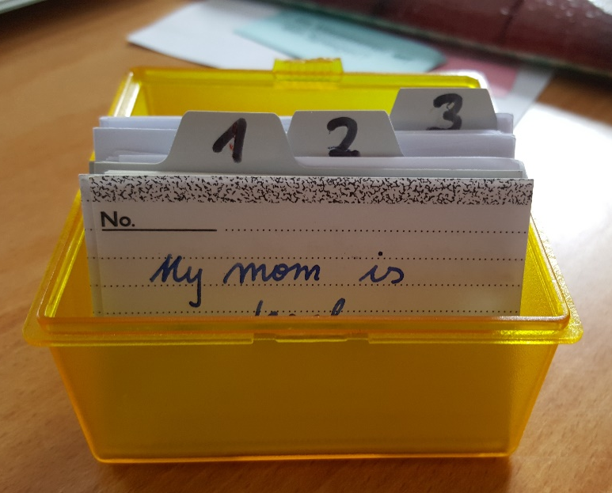

Arbeit mit der Vocab Box
Vocab practice book
neue Karten
This Photo by Unknown Author is licensed under CC BY

Slide 20

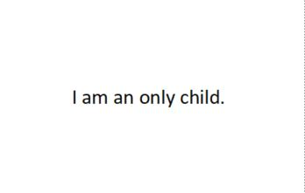
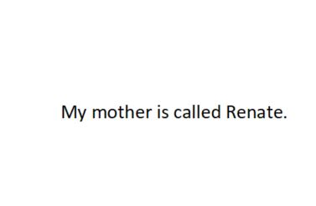
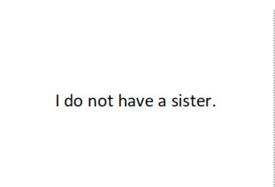
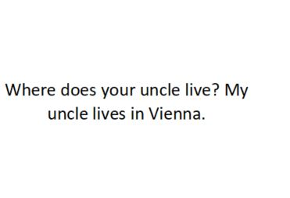
1. Walk and Talk
I am an only child.
I am an only child.
I am an only child
Sprechen
Gehen

Slide 21
Walk and Talk
My mother is called Renate..
My mother is called Renate.
My mother is called Renate.
Sprechen
Gehen

Slide 22
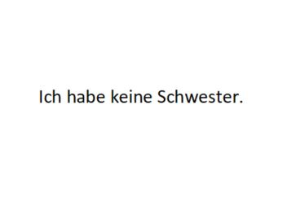



2. Write and Check
I do not have a sister
This Photo by Unknown Author is licensed under CC BY-SA
This Photo by Unknown Author is licensed under CC BY-NC-SA

Slide 23
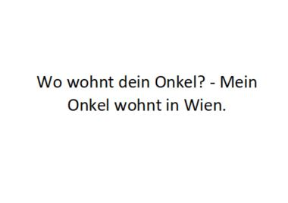

Write and check
Where does your onkl live?
uncle
This Photo by Unknown Author is licensed under CC BY-NC-SA

Slide 24
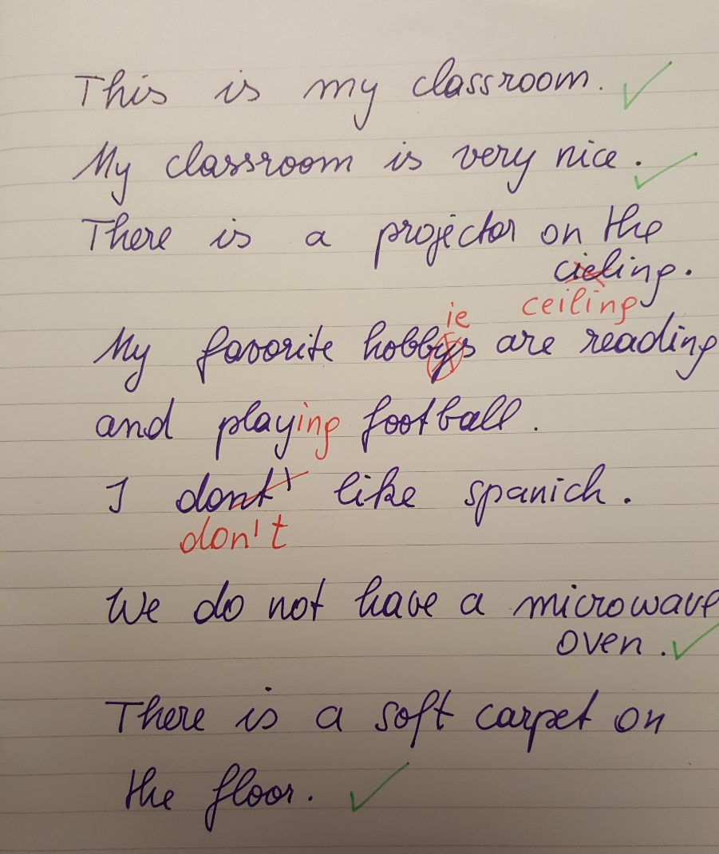
Faustregel
10 Kärtchen pro Tag
oder
10 Minuten pro Tag

Slide 25
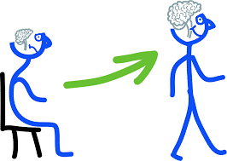
Warum ist das so Wichtig?

Slide 26
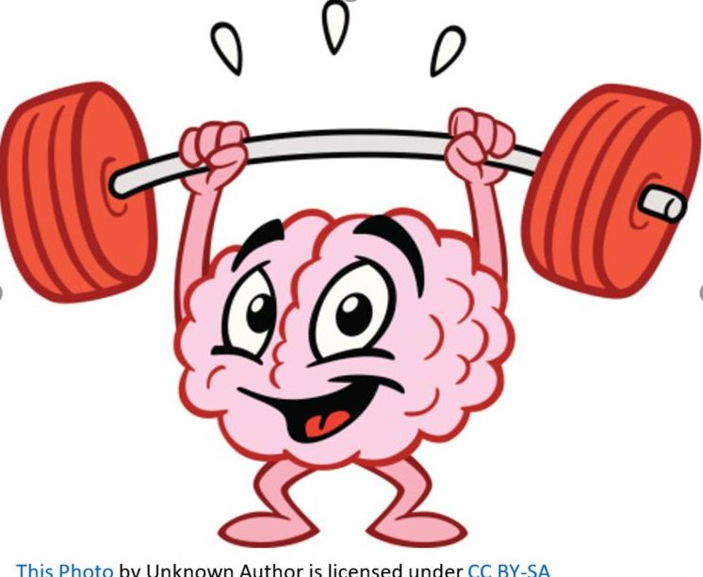
Stretch your memory

Slide 27
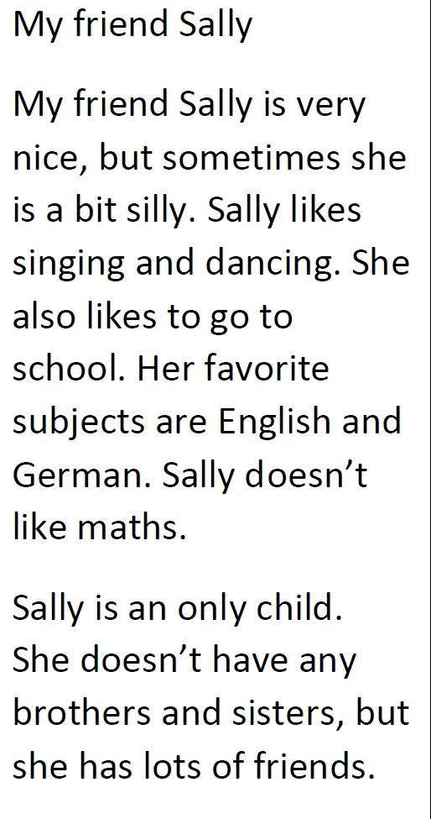
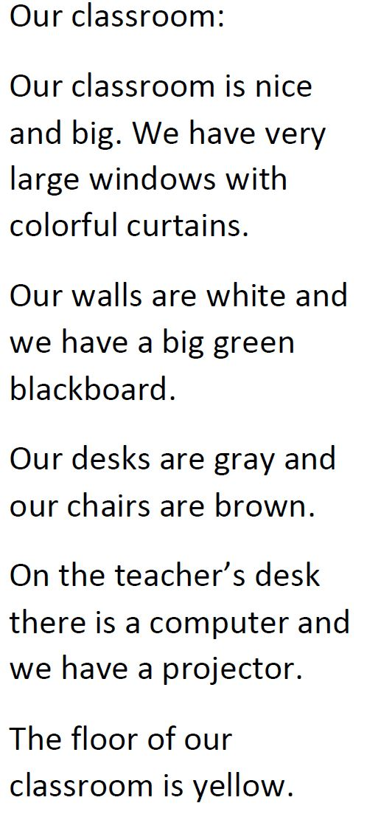

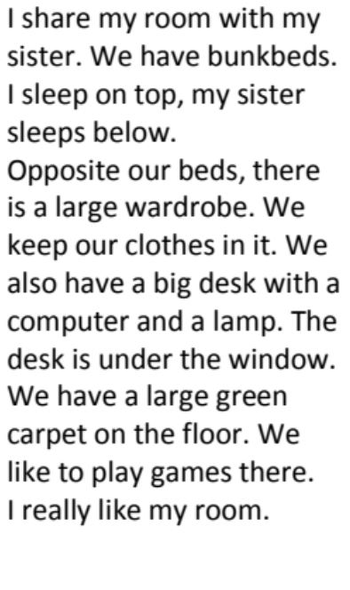
Stretch your memory

Slide 28
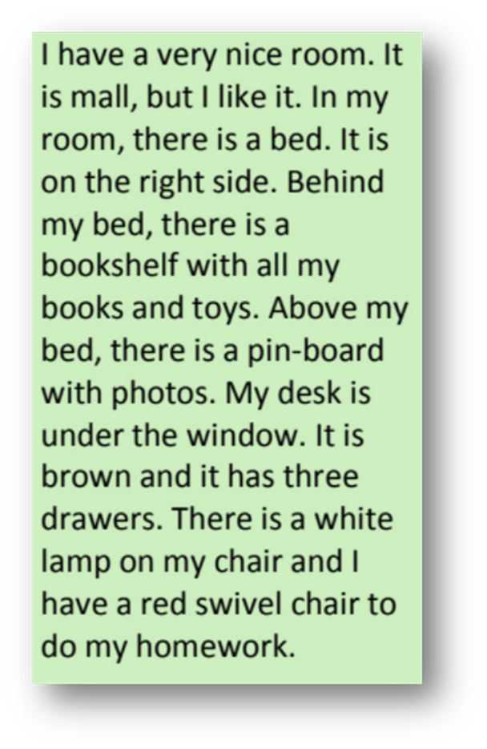


Überprüfen CHECK !!!
It is small, but I like it.
Ich merke mir einen Satz…
I have a very nice room.
In my room there is a bed.
Gehe …..möglichst weit… zu meinem Tisch…..
Ich gehe zurück und merke mir den nächsten Satz.
… und schreibe den Satz in mein Heft.
I have a very nice room.
It is small, but I like it.
there is
In my room, is a bed.

Slide 29
Warum ist das so Wichtig?

Slide 30
Now it‘s your turn
Open the following file on your computer. Do NOT download it but work online.
If possible, use the textbook Focus on Modern Business 3, unit 7, pp. 92ff. Turn the single words in the vocab list into meaningful sentences that show how the word is typically used in a context. If you do not have the textbook find good sample phrases in
vocabulary.com or MerriamWebster‘s Learner Dictionary.
Include typical collocations and „sneak in“ some grammar that needs to be revised. (e.g. an adverb, a passive, an if-clause…, an irregular verb…)
As a group, let‘s do all the sentences online. Then download the file and print the vocab cards according to the instructions on epep.at
https://drive.google.com/file/d/1JmTuylZcAQFp6Pj64vTCuHzYfDlk8Vp8/view?usp=sharing

Slide 31
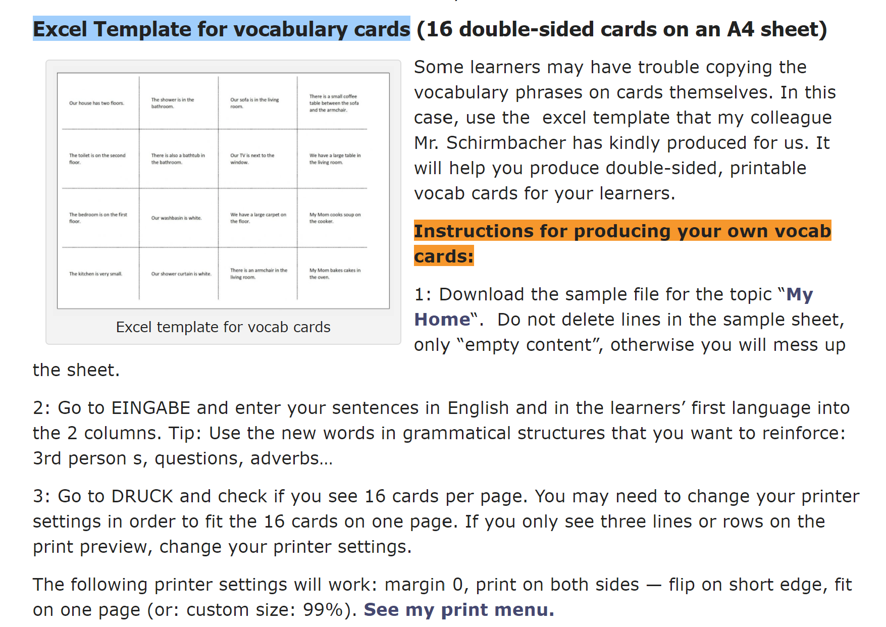
How to print the cards
…or copy the sentences into QUIZLET
https://epep.at/?page_id=67

Slide 32
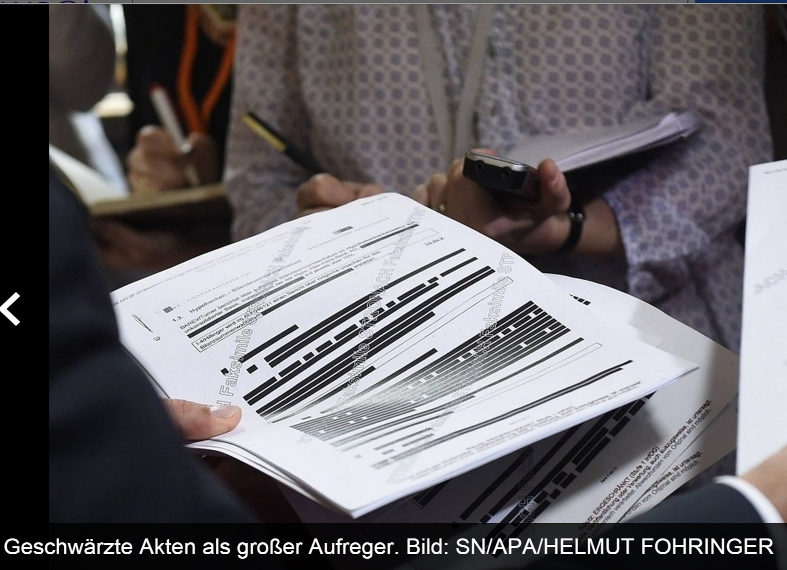
Pairwork
Vocabulary in context
“Blackout”
Read the text with your partner
Black out more and more parts and reread the text.
How much can you delete and still read the whole text?

Slide 33

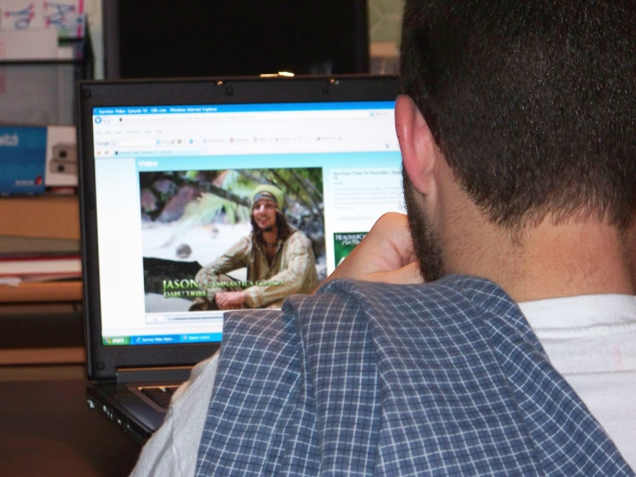
Conscious learning versus acquisition
There is an even better way to expand vocab and grammar.
FLOW:
Being LOST in a book or film
Comprehensible
Meaningful Input
Notes:
Unbewusst: wie glaubhaft ist die Lehrperson, …
wie wichtig ist das für uns alle (peer-group)
unbewusstes Wahrnehmen (vocab quilt)

Slide 34

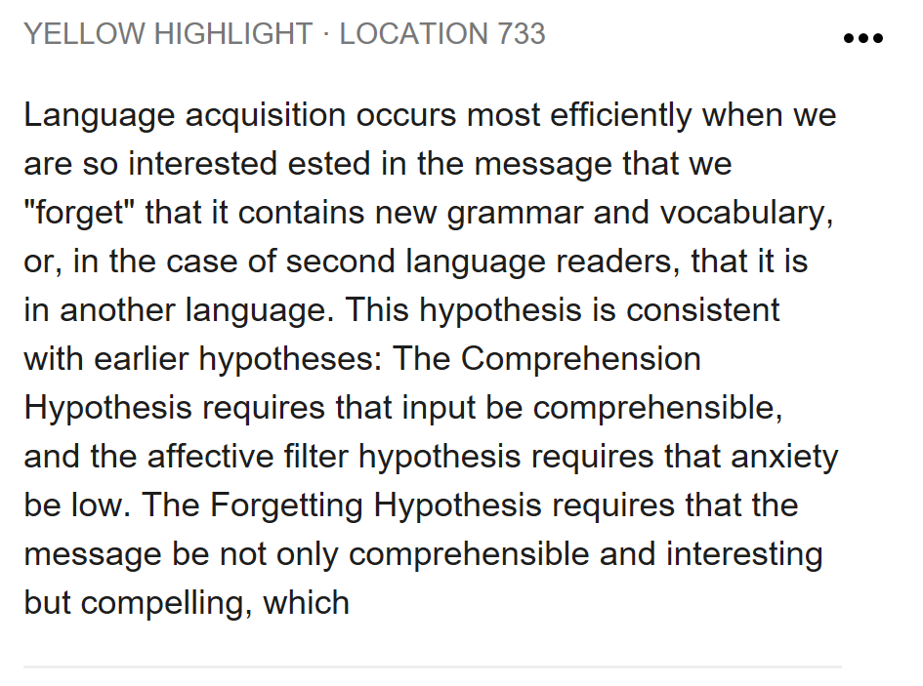
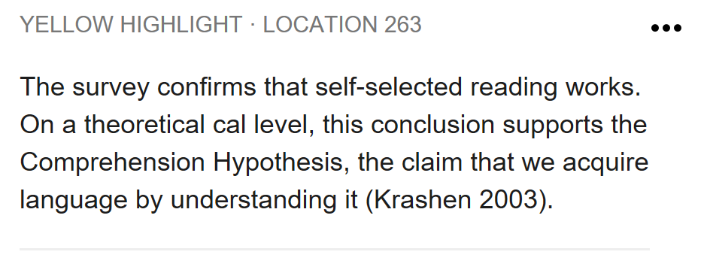
Why does reading work so well?

Slide 35
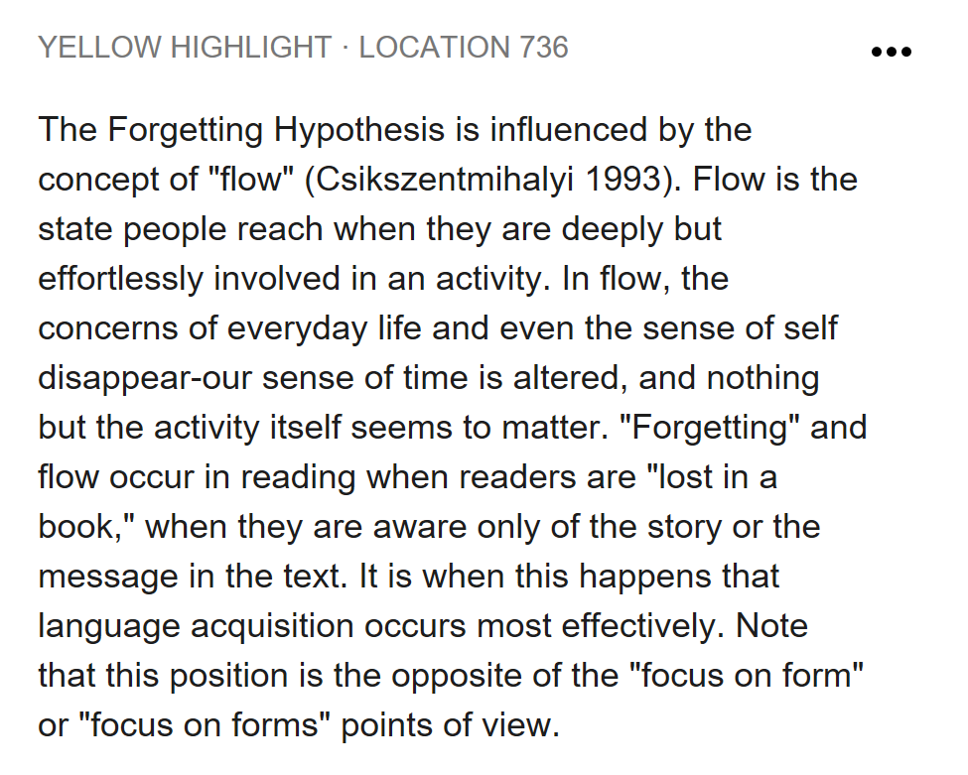
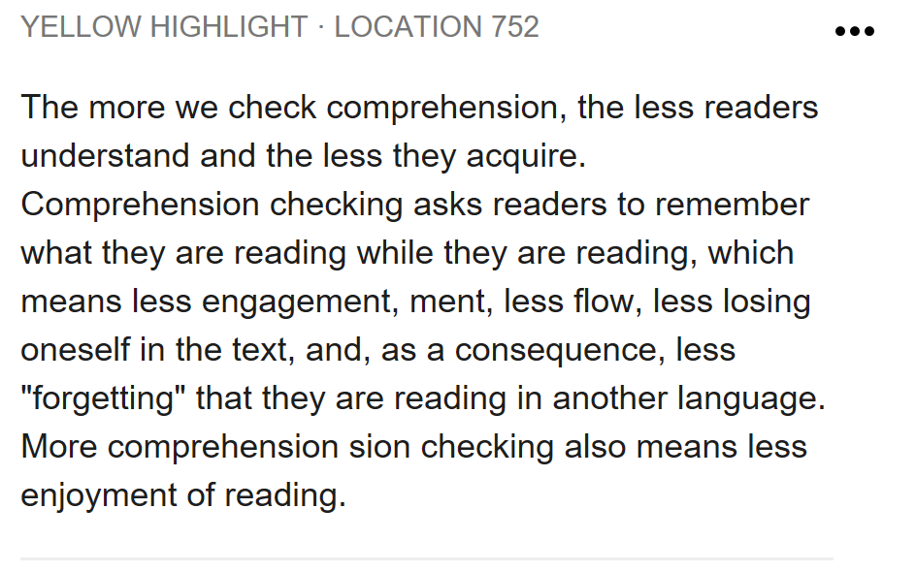
The Forgetting Hypothesis

Slide 36
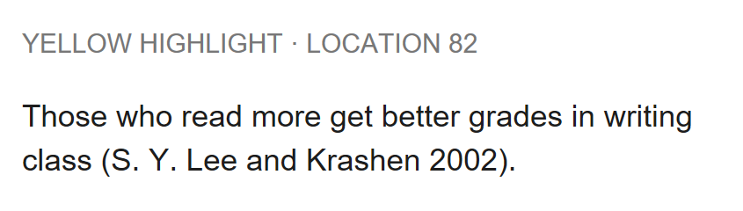
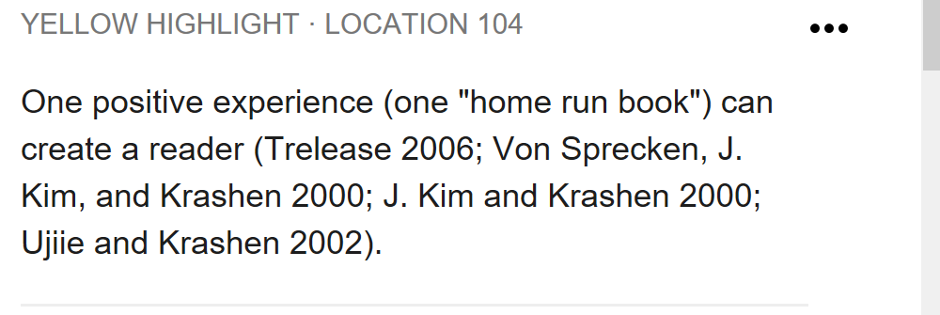
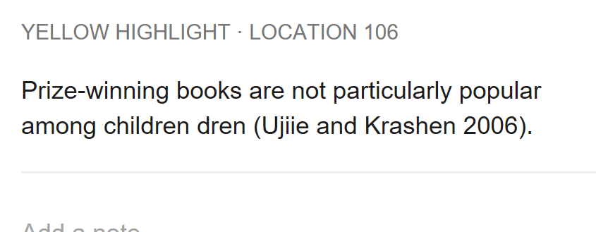

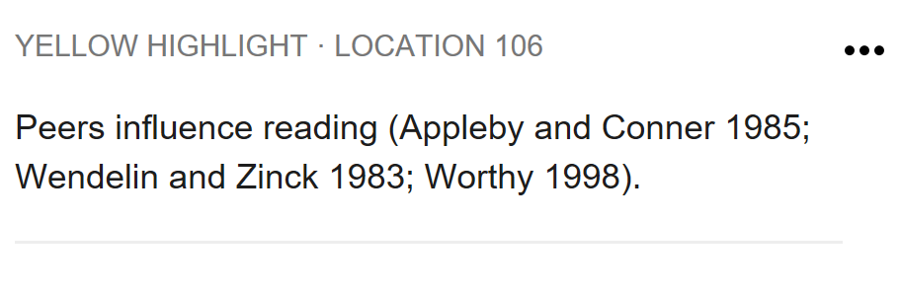

Slide 38
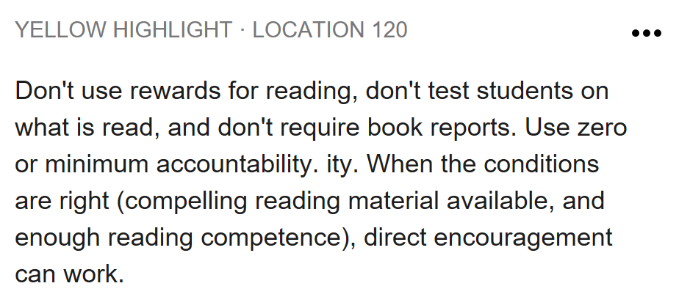



Slide 39


Tips for encouraging reading programs
Choice is vital: Ss choose books according to their interests and reading level
Reading books in groups
Minimal accountability: not too many tasks
Presenting books in class

Slide 40


Where do you find good books?
Go to: www.epep.at
or to www.readingiscool.xyz

Slide 41


Your turn: explore these pages for suitable books
For weaker readers in your 1st year
https://epep.at/?page_id=15

Slide 42


And what about your learners’ grammar???
Meanings (Notions) into Form
Grammar = Patterns in our brains
(Tanushree, 2011)

Slide 43

And what about your learners’ grammar???
Meanings give rise to forms
These meanings are defined as notions that are expressed through forms.
Notes:
By seeing grammar as part of a communicative system, we recognise that in actual language use meanings give rise to forms and not vice-versa.

Slide 44
Where do grammar rules come from?
Remember:
Grammar rules found in textbooks or grammar books do not come from God but are formulated by human beings.
Many rules found in traditional grammar books can be de-verified and prove unreliable.

Slide 45
Grammar rules must be:
valid or true: they cannot be de-verified by examples
transparent : understandable by learners
systematic: e.g. in the use of terminology
economic: not contain unnecessary information
and most importantly: Learners need LOTS of examples in typical contexts

Slide 46

Is this rule transparent and economic?
Focus on Modern Business 1, p.18

Slide 47

Is this rule valid and true?
He said that he works at Microsoft and that he can get us all the programs for free.
He said that he was working at Microsoft and could get us all the programs for free, but you know what –he works there as a janitor and cannot get us anything.
He said he will work in Spain in the summer and we can all come and stay with him.
He said he would work in Spain this summer, but I don‘t think that‘s possible. He has not even finished his studies.
Focus on Modern Carreers 1, p.91

Slide 48

A little experiment
Procedural knowledge
Ich « moodle » gerne und oft. Auch gestern habe ich ……………….
Meine Nachbarn « pferden » gerne. Letztes Wochenende haben sie den ganzen Tag ………………….
Wir « hirnen » hier den ganzen Tag. Heute habe ich schon um 6 Uhr früh ………………………………….
Ich « neuroliere » gerne. Auch gestern habe ich ganz ausführlich ……………………………….
Verben auf ---ieren bilden das Partizip Perfekt mit
--iert
Kennen Sie die Regel für die Bildung des Partizip Perfekt im Deutschen?
Können Sie die Regel anwenden?
Notes:
Wer kennt die Regel? Wer könnte das erklären? Hand heben?
Wer kann die Formen bilden…. Ohne die Regel zu kennen….

Slide 49
How does explicit and implicit SLT affect production and processing of syntax?
Declarative knowledge
Procedural knowledge
Do L1 speakers and L2 learners use different brain activation patterns?
How do they use procedural and declarative memory?
Are L1 and L2 learning different?

Slide 50

Kara Morgan-Short, Karsten Steinhauer, Cristina Sanz and Michael T. Ullman, „Explicit and Implicit Second Language Training Differentially Affect the Achievement of Native-like Brain Activation Patterns“ Journal of Cognitive Neuroscience, 24:4, pp. 933-947
Brocanto 2: artificial language for a computer game.
Explicit training versus implicit training
Tested 2x (at low proficiency and high proficiency at end of training)
2 test-types:
proficiency test (play the game)
ERP (event related potentials – show brain patterns in real time) show reaction to syntactic irregularities

Slide 51



ERP: Event Related Potential voltage maps
Notes:
image 1: Swartz Center for Computational Neuroscience, 2014)http://cognitrn.psych.indiana.edu/busey/temp/eeglabtutorial4.301/maintut/ERP_image_plotting.html (3.10.
image 2: Jewish General Hospital, Clinical Neuroscience and Applied Cognition Laboratory: http://jgh.ca/en/EEG-ERP (3.10.2014)
image 3: Steven A. Hillyard and Lourdes Anllo-Vento, „Event-related brain potentials in the study of visual selective attention“ , Proceedings of the National Academy of Sciences of the USA, vol. 95 no.3, 781 – 787 , http://www.pnas.org/content/95/3/781.figures-only (3.10.2014)

Slide 52

Behavioral data
Don‘t forget that this was a very limited set of possible phrases
Both training methods yield fairly comparable outcomes.
Notes:
at low proficiency the explicit group has learned a bit faster – but at end of training (high proficiency) the implicit goup had passed the explicit group. –

Slide 53

ERP data revealed striking differences between the groups‘ neural activity at both proficiency levels in response to syntactic violations.
This effect was EVEN STRONGER after months of no exposure.
 | Implicit group | Explicit group
High proficiency | leads to L1-like brain processing for syntax. Syntactic processing relied on the same rule-governed automatic structue building that is typical of procedural memory in L1. | Although explicit training is sufficient to develop the ability for structural reanalysis that may be under conscious (explicit) control, it does not reliably lead to the automatic early syntactic processing that is found in L1 and may depend on procedural memory.
Low proficiency | morpho-syntactic processing relies, at least in part, on lexical/semantic mechanisms and declarative memory and shows that this reliance can result from implicit training. (no rules needed) | Explicit training does not lead to a systematic and consistent reliance of syntax on either lexical/semantic or L1-like grammatical processes at low proficiency nor does their syntax rely on any other neurocognitive processes that would be reflected in ERP components.
Notes:
ERP image: p. 941
quotes: p. 942 – 943
effect stronger after months of no exposure: Morgan-Short K, Finger I, Grey S, Ullman MT (2012) Second Language Processing Shows Increased Native-Like Neural Responses after Months of No Exposure. PLoS ONE 7(3): e32974. doi:10.1371/journal.pone.0032974

Slide 54
What does this mean for teaching?

Slide 55



Since we do not have time to look at all these aspects today, let‘s start with the most important one: Proceduralization
Students need lots of good examples in typical contexts.
Ideally, they will do lots of SPEAKING exercises to practice the new structures using several senses.
How can we teach C+C grammar
Efficient grammar teaching must consider the necessary learning stages:
Awareness raising
Conceptualization
Proceduralization in scaffolded conditions
Performance in real-time context

Slide 56

Is this rule efficient?
Adverbs of frequency
Our friend helps us. (always)
I go shopping in Paris. (never)
She is late. (usually)
I get headaches. (often)
He forgets my birthday. (always)
You are right. (usually)
They stay in bed late. (sometimes)

Slide 57
Example: She always goes to school by bus.
Use the HELP CARD.
Work with a partner.
Think of a classmate.
Say TRUE sentences about him/her.
How far can you go before your partner finds out who it is?
He/she
often…
He/she
rarely…
He/she
sometimes
START
He/she
usually…
He/she
never…
He/she
usually…
He/she
never…
He/she
rarely…
END
He/she
always…
He/she
sometimes
He/she
usually...
He/she
rarely…
He/she
never…
He/she
often
He/she
normally..
He/she
never…
He/she
sometimes…
He/she
rarely
He/she
always…
He/she
never…
He/she
often…
He/she
always…

Slide 58

Help-card
Use these verbs:
eats
goes to school,
wears jeans / t-shirt/ colorful sweaters…
watches…
does…
rides his/her bike
takes the bus
takes the tram
plays…
practices vocabulary
plays soccer
goes home…
has …. for breakfast / lunch/ dinner
fights with…
forgets…
speaks very loudly / quietly
plays … on his/her mobile phone
reads…
talks on the phone with…
Examples:
He always eats the vegetarian meal in the school cafeteria.
She never drinks Coke. She hates it.
She sometimes practices vocabulary before dinner but she usually does it after dinner.

Slide 59


All my uni students know these rules, …but in their reflections they write…
…some kids shout very aggressive and they write very sloppy in their books. They do not take student-teachers serious when I tell them to be quiet.
Why???

Slide 60

Awareness Raising
Teachers‘ Conference: What your teachers have said about you….
Most students of 2b do their homework regularly. | Some students are a bit disorganized and forget to hand in their homework.
Most students do their work carefully. | Some kids hand in sloppy work.
Most kids work quietly in class. | A few kids are very noisy.
Most students work quickly and efficiently in class. | Many students are nervous during tests.
Some students work slowly but very carefully. | Some kids are impatient.
The class can sing beautifully. | The reading diaries are really beautiful.
The students of 2b work well in projects and workshops. | The workshops are excellent.
The students can think creatively and they can use the new language creatively. | The kids can write very creative stories.
The students act very responsibly and treat their classmates well. | The teachers would like to know who is responsible for collecting the mobile phones.
What do you notice?
Find the rule.
another option: Grammar-book 2

Slide 61



Conceptualization --Proceduralization
Manner Mimes
Simon
Hertz
smokes heavily
Robert
Quinn
reads quickly

Slide 62
What about your skills?
Talk to your partner:
How good are you at the following things?
Do you know anybody who can do these things perfectly – or very badly?
Describe how these people do it.
Count how many different adverbs you and your partner can use in this little conversation. The group with most adverbs wins the game.
French / Spanish/ other languages
dance
sing
ski or snowboard
run / jog
type
knit

Slide 63

Focus on Modern Business 1
The minefield approach

Slide 64


What kinds of processing will learners be doing here?
https://www.ego4u.de/de/cram-up/grammar/passive/exercises?present-perfect

Slide 65

Passive : How much processing do ss need here?
How can you improve this very easily?
Focus on Modern Business 1, p. 120

Slide 66


What can you do instead?
Do you know how ketchup is made?
Do you know how chocolate is made?
Do you know how I-phones are made?
Go to epep.at – Grammar – Passive Voice for some examples. See how the learners have to process meanings (world knowledge) and forms.

Slide 67


Try these…
https://epep.at/?page_id=2440

Slide 68
Is this rule valid and true?
He said that he works at Microsoft and that he can get us all the programs for free.
He said that he was working at Microsoft and could get us all the programs for free, but you know what –he works there as a janitor and cannot get us anything.
He said he will work in Spain in the summer and we can all come and stay with him.
He said he would work in Spain this summer, but I don‘t think that‘s possible. He has not even finished his studies.
Focus on Modern Carreers 1, p.91

Slide 69

The Reporting Circle

Slide 70

David Newby: on Reporting or Announcing

Slide 71

Why would anyone want to report these…?
Announcing something important /interesting?
Neutral (distanced) reporting?
Doubt or distrust?
Past, and no longer valid?
Focus on Modern Careers 2, BMS, p. 90

Slide 72

Why would anyone want to report these…?
Announcing something important /interesting?
Neutral (distanced) reporting?
Doubt or distrust?
Past, and no longer valid?
Focus on Modern Business 2, p. 52

Slide 73
From Rules to Reasons Grammar as a political statement
Ken Kollman, director of research and a professor at the Center for Political Studies at the University of Michigan, said Trump is challenging the results in Detroit even though there have been only scattered allegations of voting irregularities there in recent years.
Orlando Owens, chair of the Milwaukee North branch of the county’s Republican Party, said the GOP effort in Wisconsin is aimed at counties that have high concentrations of Democratic voters.
“It just so happens that a lot of Black voters are Democrats,” he said, noting that the University of Wisconsin at Madison is in Dane County, where there are a number of college voters but only 6 percent of county residents are Black.

Slide 74

From Rules to Reasons: Grammar as a political statement
“I don’t believe race has anything to do with it,” said Rick Baas, who heads the Republican Party of Milwaukee County’s media committee.
Bauer and other legal experts have repeatedly stressed that Trump’s efforts to block the certification of votes in Michigan’s Wayne County or reverse the outcome of the race in Wisconsin is unlikely to succeed.
“People are anxious over that slim glimmer that he could somehow actually change the outcome,” said Fred Royal, president of the Milwaukee chapter of the NAACP. “But more than that, he’s trying to do all of this in the middle of this pandemic, where people are tired, and people are unemployed, and they are trying to feed their family, and teach their children who are not in school, and now he is putting us back through this recount process.”
Royal and other community leaders said they are angered that Trump is suggesting that there are more votes than people.
BUT: Trump claims: https://www.washingtonpost.com/graphics/politics/trump-claims/
If you want to express your distance, doubt or mistrust and say that the claims are false, use TENSES to do this.

Slide 75
Trump‘s false claims…
Trump: "I've been talking about mail-in voting for a long time. It's really destroyed our system. It's a corrupt system and it makes people corrupt.“
Trump: "They mailed out tens of millions of unsolicited ballots without any verification measures."
Mexico Will Pay For the Wall
“The Democrats are really looking at something that is very dangerous for our country. . . .They want to have illegal immigrants pouring into our country, bringing with them crime, tremendous amounts of crime,” said Trump on December 6, 2017.
Can you think of a few more…?
https://www.forbes.com/sites/stuartanderson/2020/10/26/fact-checkers-say-trump-built-a-wall-of-false-claims-on-immigration/?sh=7858cdb57d73

Slide 76


Sources
Newby, D., Grammar for Communication, Vienna, Bundesverlag: 1989*
Newby, D., Grammar for Communication: Exercises and Activities, Vienna, Bundesverlag: 1992*
Newby, D., 'Theory and Practice in Communicative Grammar' in R. de Beaugrande, M. Grosman, B. Seidlhofer, (eds.) (1998) Language Policy and Language Education in Emerging Nations, Series: Advances in Discourse Processes Vol. LXIII, pp 151-164. Stamford, Conneticut: Ablex Publishing Corporation
National Education Association. Doubts & Certainties, January/February 1994. Material adapted from Renate Nummela Caine and Geoffrey Caine, Making Connections: Teaching and the Human Brain, ASCD, 1991; Addison Wesley, 1994. online: http://www.nea.org/teachexperience/braik030925.html , 25.02.2014

