Slide 1


Using AI in the Language classroom
Elisabeth Pölzleitner
Practical examples

Slide 2
AI – What can it do for language learners?
AI – What can it do for language teachers?
Correct and improve a text, list the mistakes and explain them
Give examples of usage (vocabulary or grammar)
Practice speaking (role play, talking to AI-tutors)
Translate words or phrases (from audio or writing)
Practice reading and listening comprehension (produce questions + answers for a text or video)
Summarize and/or transcribe videos, create captions
Text to audio (for pronunciation and listening practice)
Create texts on a topic
Create differentiated versions of a text (different levels)
Create tasks (questions, discussion topics etc. for a text or topic)
Create transcripts of videos
Create tasks (questions, discussion topics etc. for a video
Create lesson plans
Give feedback, correct mistakes
Help with assessment
Using AI meaningfully and ethically
Classroom examples
AI needs good prompts
Trying out some tools
Data security, legal and ethical issues
Today’s topics
What can AI NOT do well?

Slide 3
The 1st Rule of using AI: Outsource your doing, not your thinking
• Kompetenz ist die Integration von Wissen, Können und Einstellungen zur Problemlösung.
• Kompetenz erfordert konzeptuelles, prozedurales und strategisches Wissen.
Don‘t trust the machine, use your brain!

Slide 4

Have you tried using AI for your preparation or teaching?
3 minutes
Please follow this link and share your experiences.
https://docs.google.com/forms/d/e/1FAIpQLSfmmhSvHsXhEQmvcSzOfjmSWPupt_XIAprJa2tuQiN2YCWGnQ/viewform?usp=header

Slide 5
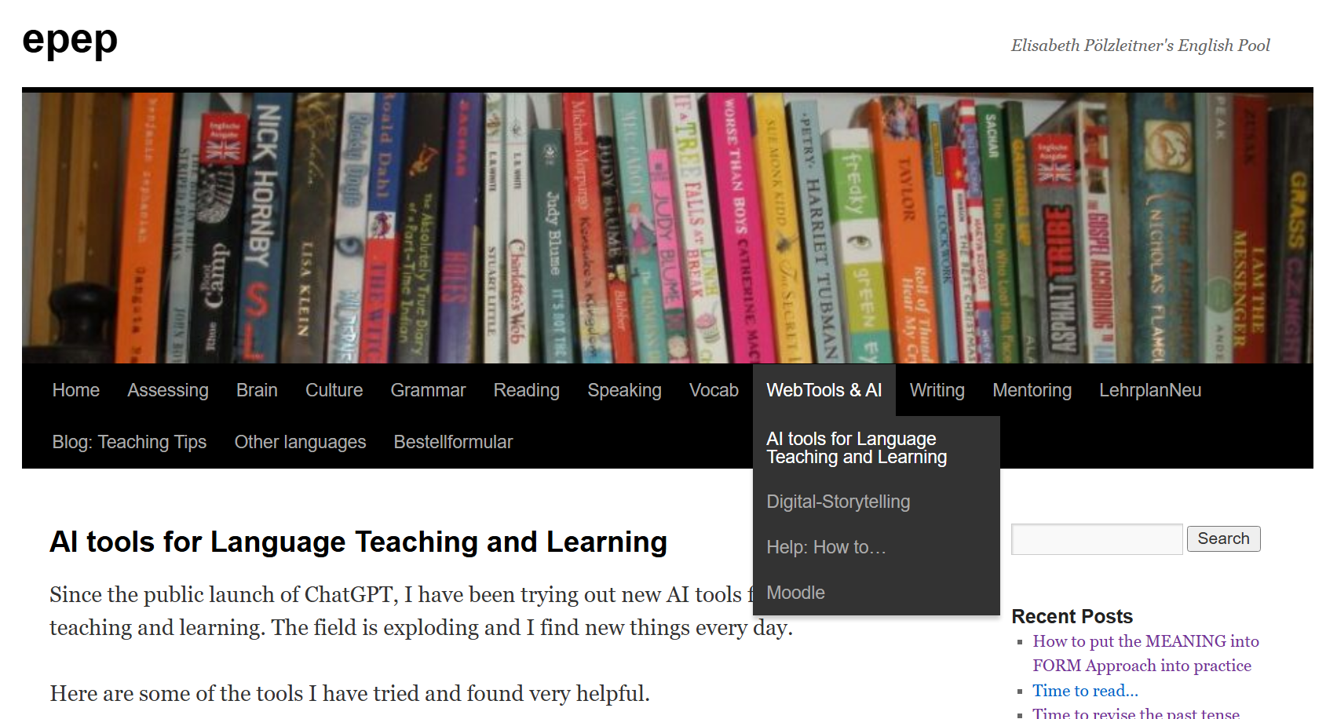
Find some Useful tools here: https://epep.at/?page_id=7418

Slide 6

Use Cases for Language Teachers
Create a text on topic x
Differentiation: Create versions according to certain criteria (style, register, level, vocabulary, perspective, text-type…)
Create questions and quizzes from content (from video, text, audio)
Generate exercises and activities for topics, texts, videos…
Text to audio // text to picture
Create model sentences (to show usage of words or grammar)
Assess texts according to rubrics and generate feedback
Create worksheets
Create lesson plans

Slide 7

AI engines + some useful Prompt Generators
ChatGPT: Generative Pretrained Transformer (generates texts, pretrained on human data, transforms these data to produce text)
Perplexity
DeepL and DeepL-Write
Bing, Microsoft Copilot
Gemini (Google)
DeepSeek
Claude
Image Creators: Stable Diffusion XL, OpenAI DALL E 2, OpenAI DALL E 3, Midjourney, Craiyon
DIFFIT and Twee
Fobizz
NotebookLM, Elevenlabs, PlayAI (text-to-speech)
DeepL-Write, Writify, Grammarly…
Magicschool.ai.
TalkpalAI, Gliglish, Langotalk (chatbots)
AI integrations in powerpoint, word, Padlet and many more…

Slide 8
Good prompts are essential
Good prompts must be: Clear and specific and give the AI tool all the following information:
Format: | Write a short article
Audience | For a teen magazine for ESL learners at A2 level
Topic | About the topic: Use of social media, pros and cons for teens
Length | About 300- 400 words,
Special wishes | Include 2-3 interview bits in the form of direct speech answers from kids.

Slide 9



IT’s your Turn
10 minutes
Write a clear prompt
Choose a topic that you are going to teach in the near future.
Ask AI to produce an appropriate text for this topic.
Refine your prompt to get exactly what you want.
………………………………………………………………………………………………………………………
Plenary discussion: How useful are the responses?
Choose onel of the options:
Chat.openai.com
Sign up with your e-mail address
Or: Microsoft Edge, Copilot:
Or: Fobizz (anonymous)
If you do not want to use your e-mail address, use this shared space and chat with AI:
Find the FOBIZZ link here:
https://go.fobizz.com/?token=488109b87c955bd0

Slide 10
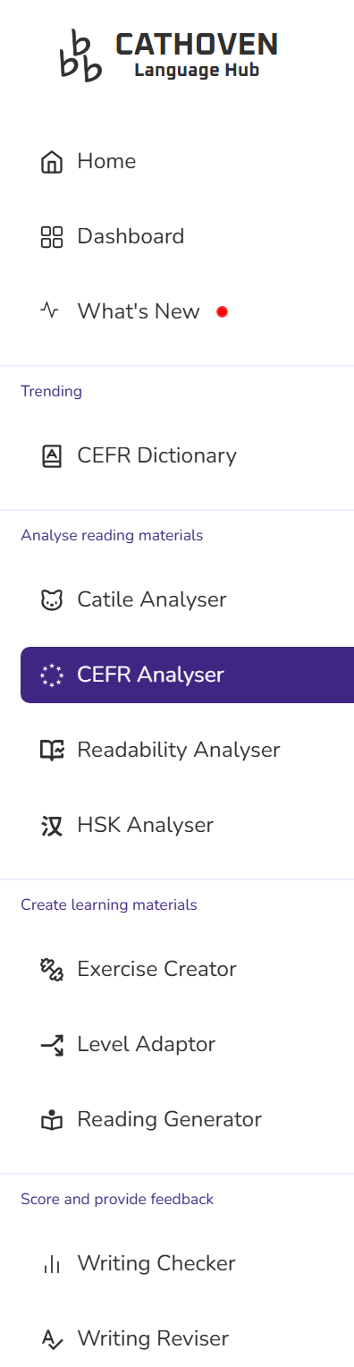


Let’s check the CEFR Level of your text. Is it suitable for your learners?
https://www.cathoven.com/cefr-checker/

Slide 11

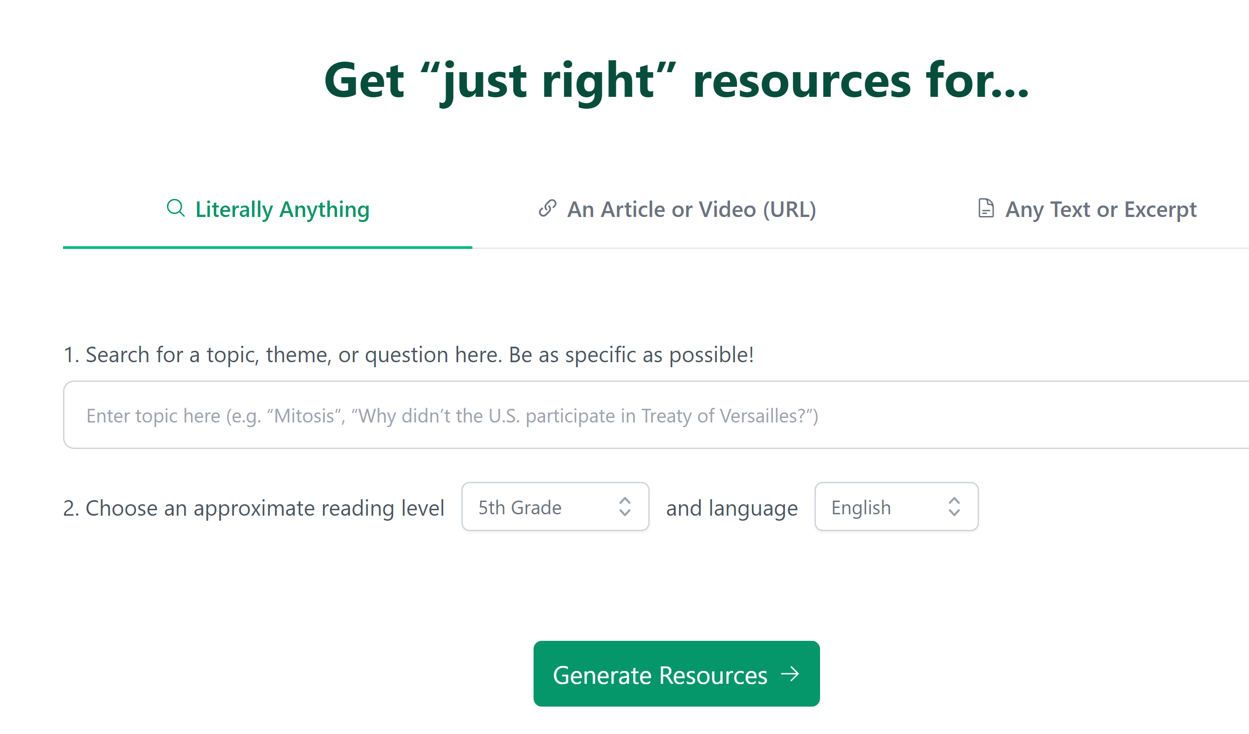
Now let’s do some Magic
Diffit.me

Slide 12
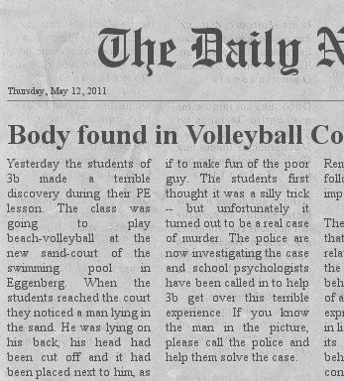
Let’s try this out
15 minutes
Working with TEXTS:
Choose a topic you are going to teach in the near future.
Ask Diffit to create a text for this topic/level/purpose.
Refine your prompt to get exactly what you want. (length, level)
Find some suitable teaching activities provided by Diffit and download them.
Let’s discuss your experiences in the plenary.
https://app.diffit.me/

Slide 13

Let’s try this out
15 minutes
Working with Videos
Now find a short youtube video for your topic.
Ask Diffit and produce all kinds of materials for your video. Download them as a pdf and save them.
Let’s discuss your experiences in the plenary.
https://app.diffit.me/

Slide 14
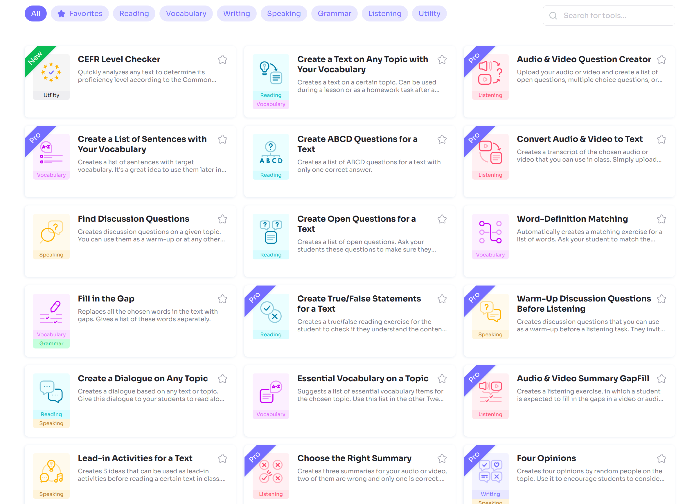
TWEE.com
…more useful activities
CEFR Level Checker
Fill in the Gap
Create a dialog on any topic
Essential vocabulary on a topic
Lead-in activities for a text
List of pros and cons…
And many more
Try some of the useful tools yourself

Slide 15
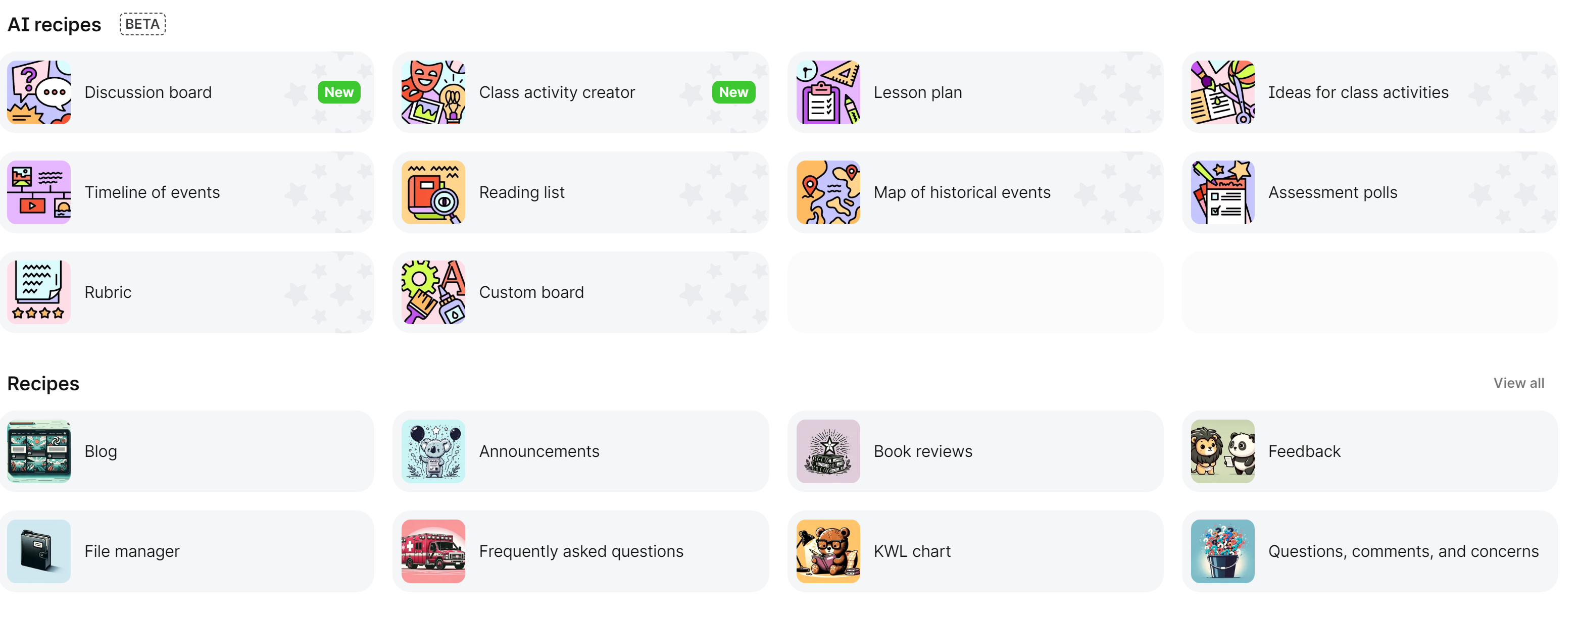
A bit of Magic with padlet
https://padlet.com/referrals/lispolzleitner

Slide 16
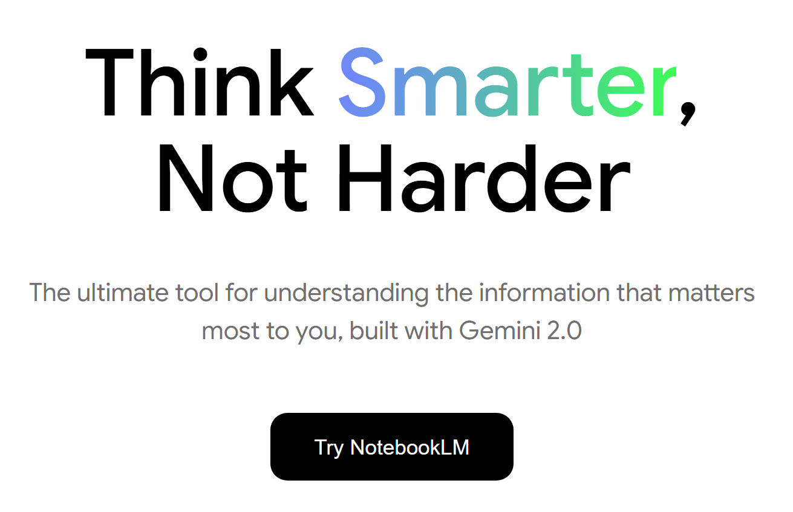

Let’s create a study guide, a briefing doc and a podcast
Tip: install the Chrome FireShot extension to download webpages as pdfs.

Slide 17

It’s your turn
10 minutes
Follow the link and create an account on Padlet.
Find fitting lesson plan ideas for one of your classes.
Plenary discussion: How helpful are the suggested materials and ideas?
https://padlet.com/referrals/lispolzleitner
https://padlet.com/referrals/lispolzleitner

Slide 18

Why should I learn to do this, if AI can do it much better?
Self-determination theory of motivation (Deci & Ryan, 1993)
Autonomy: having control over one's own life
Competence: The desire to feel capable and effective, to expand skills.
Connectedness: with other people, in school e.g. cooperative learning.
You’ll need to do it yourself in your tests and exams. AI cannot help you there.
Set rules
What media and tools are permitted.
You are responsible for the way you work.
Specify the tools you have used.
No rules without exception.
AI leads to a new exam culture:
More complex tasks but with some help.
Paper and pencil when appropriate
Semi-automated feedback and evaluations
Improve your media competency.
Learn to spot fake news, framing and bias.

Slide 19



How do students use AI?
Good Prompting:
Take on the role of an English teacher and help me write a blog entry about the use of social media.
The text should be about 200 words long and should be written for 12–13-year-old ESL learners at A2 level on the CEFR.
This is the assignment I got from my teacher: Write a short blog entry about the use of social media in your class. Tell us how you and your classmates use social media and share your opinion about different social media platforms and the effects on young people.
Do NOT write the text for me and do not give me any examples but give me tips for each step. Your answers should be short (not more than 2-3 sentences per interaction and in simple English (B1). End each of your answers by telling me what to do next.
Let’s start with collecting ideas for the blog.
Ghostwriter: AI does the work for them
Writing Tutor: AI assists them, gives tips and feedback
Writing Partner: Human and AI cooperate and interact

Slide 20

Safe and ethical Use cases for Language Learners
Correct and improve a text, list the mistakes and explain them
Give examples of usage (vocabulary or grammar)
Practice speaking (role play, talking to AI-tutors)
Translate words or phrases (from audio or writing)
Practice reading and listening comprehension (produce questions + answers for a text or video)
Summarize and/or transcribe videos, create captions
Text to audio (for pronunciation and listening practice)

Slide 21

Fobizz a Safe Toolbox for teachers and learners
Fobizz is SAFE!

Slide 22
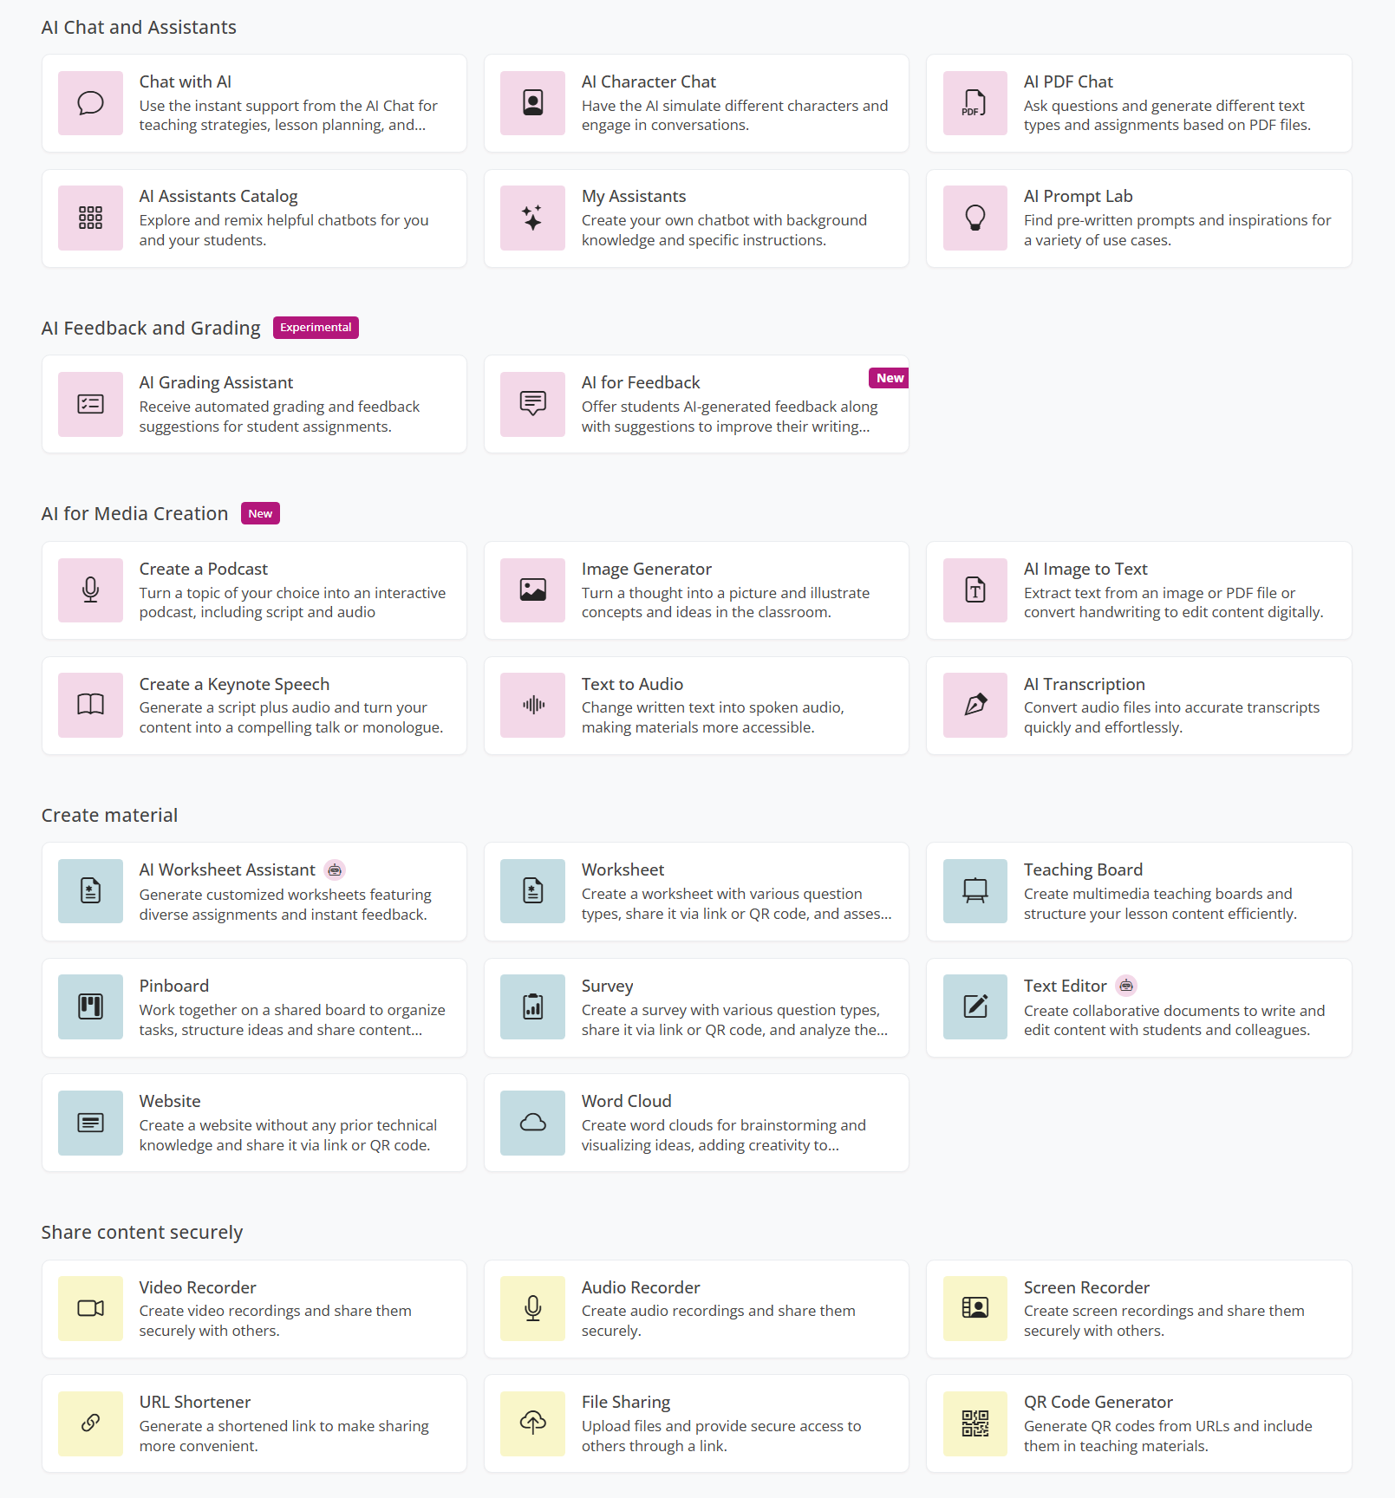








Fobizz: Safe platform for teachers and students
Choose one of these options:
Fobizz (anonymous)
If you do not want to use your e-mail address, use this shared space and chat with AI:
Let’s create a Fobizz Safe Space

Slide 23
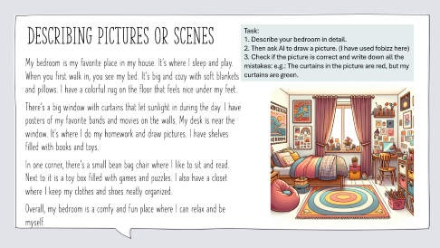
Now it’s your turn
15 minutes
Try out some of the Fobizz tools
How could these tools make your next teaching unit more engaging?
Chat with AI (you can choose different AI models)
AI Character Chat
Image Generator (e.g.: Ss describe their dream room, AI generates the image)
AI for Feedback: https://tools.fobizz.com/pupil_feedback/assignments/f77f4c2e-10f4-4441-aef3-991b274d0190/public_responses/new?token=c4d97b4463efcf28171037cf2888dca4
AI Image to Text (for handwriting!)
Create a Podcast
Text to Audio
…………………………………………………………………………………………………………
Let’s discuss your experiences in the plenary.
Notes:
Character chat: ask Malala: Can you tell me what school was like for you before the Taliban took over? --- then ask: Did this change happen suddenly or gradually? Can your remember any specific events that were important for you?

Slide 24
Using Fobizz tools for Feedback
1. Set up a new assignment for your students.
Title
Task description
Feedback Criteria
2. Share the link with your students.
3. The students upload or paste their texts into the tool and get instant feedback according to the criteria that you have defined for this task.
https://tools.fobizz.com/pupil_feedback/assignments/f77f4c2e-10f4-4441-aef3-991b274d0190/public_responses/51dfe020-af34-44dc-8fb4-792a693dd0d4?token=d4b98d5675529b947c9985ccc416979d

Slide 25
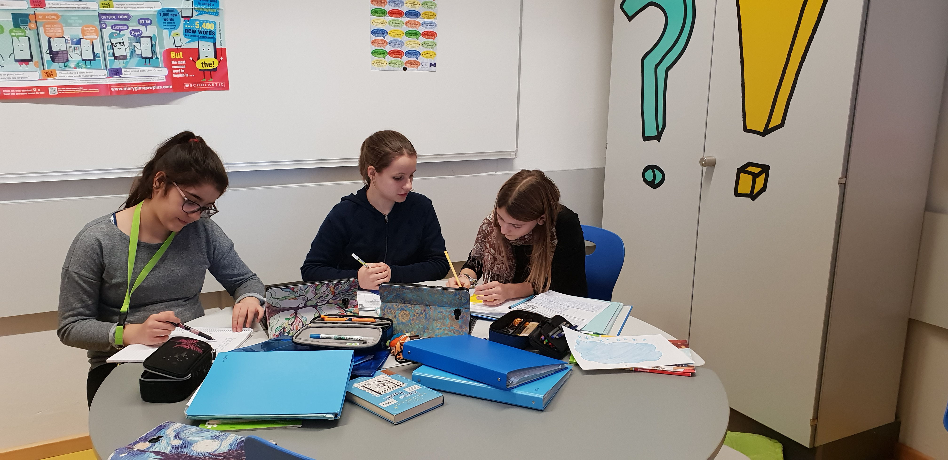
How can Chat GPT help improve my learners’ writing skills?
A first example:
Setting:
ESL classes in middle school (age 10-14)
CEF Level: A2 – B1

Slide 26
How can Chat GPT help improve my learners’ writing skills?
A first example:
Setting:
ESL classes in middle school (age 10-14)
CEF Level: A2 – B1

Slide 27
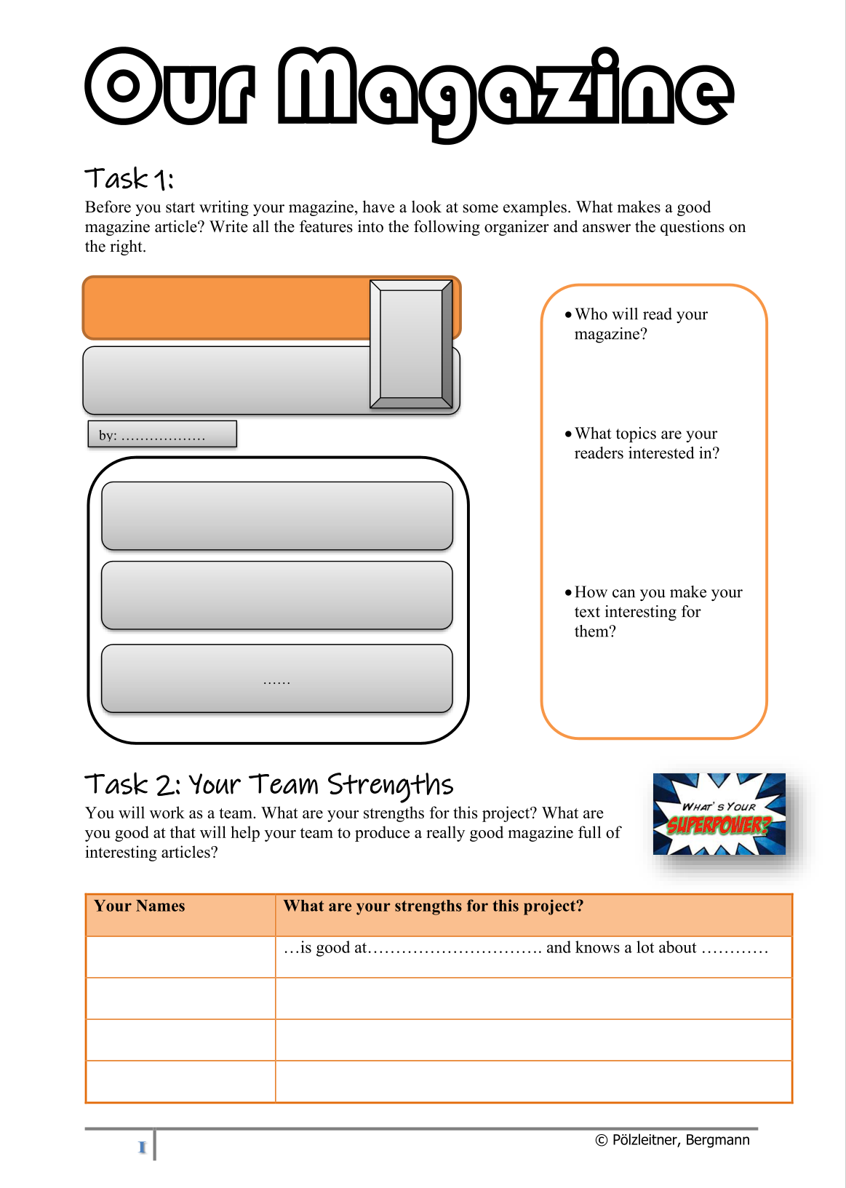
Example 2: Students use CHAT GPT themselves
Magazine Writing, year 4
Phase 1:
Students write group magazines (groups of 4, 3 texts each)
Peer feedback – then magazines are printed
Phase 2:
Students use Chat GPT to write the same articles. They only feed content requests in keywords and required text length matching their own articles. Ss then create a second issue of their magazines using the AI texts.
Phase 3: Reading and comparing the magazines: Which of the articles do you prefer? Why?

Slide 28

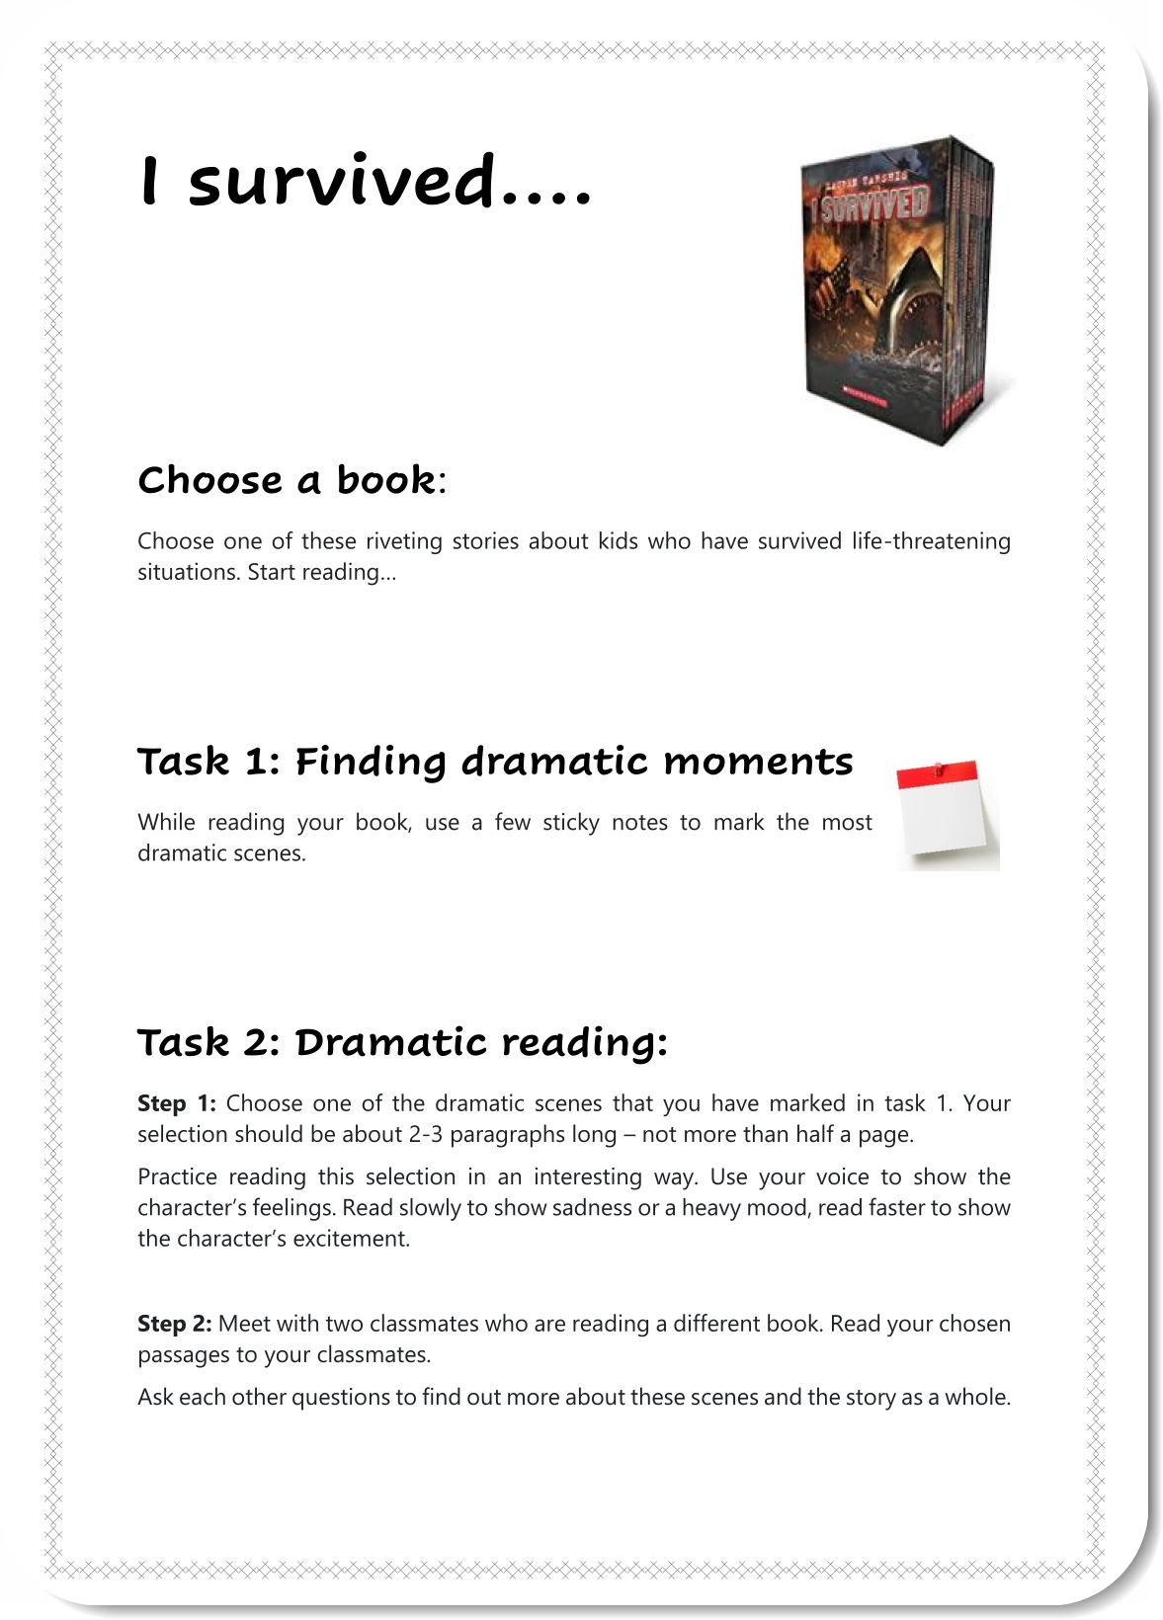
Example 1: year 3 -- Blog writing
Students write their blog text
Teachers use Chat GPT to correct and improve the texts.
Students get a printout of the improved texts.
Students have to compare the 2 versions, highlight the changes and decide which ones they want to include in their own version.

Slide 29

How does this work for the learners? Pros and Cons
More advanced learners can easily see the differences and pick out phrases they want to use in the future. For them AI can be an excellent tutor.
Weaker learners are happy with the improved version, but do not automatically see the differences or even try to find them. They need a lot more scaffolding to use Chat GPT meaningfully.

Slide 30
Instructions that help weaker learners
Copy your text into Chat GPT and ask it to correct and improve your text.
Ask Chat GPT to list all changes and explain them in simple English. Ask your teacher for help if you do not understand the explanations.
Go through all the changes and decide if and how you can use them in your original text. Highlight all the changes that you have made in your text.
Choose 5 phrases that you would like to remember and write them on vocab cards.

Slide 31
Write a short text about your viewing habits (~120 words). Use at least 3 quantifiers in your text. (quantifiers see EASY p. 110 / ex 1a) Mark the quantifiers in bold.
My first draft: What type of viewer am I?
I dont have tiktok because I think that tiktok is stealing my data. But if I use my phone I use youtube, snapchat, discord and whatsapp. I use my phone like 1 ore 1 and a have hours a day. Moust of the time I am on snapchat and youtube ore some times spotify. I don‘t wach tv often but If I am waching tv I am waching with my dad Grip. I realy like to play video games with my frinds so I spent moust of my free time on my pc. The games and programs that i use on my pc are discord and minecraft and alsow some times fortnite. I use my pc like 2 hours a day.
Chat GPT corrected version: "What type of viewer am I?
I don't have TikTok because I believe it may compromise my data. However, I do use my phone for YouTube, Snapchat, Discord, and WhatsApp, for around 1-1.5 hours per day. I spend most of my phone time on Snapchat and YouTube, and occasionally use Spotify. I don't watch TV frequently, but when I do, it's usually with my dad, watching a show called "Grip." I enjoy playing video games with my friends, and spend most of my free time on my PC. The games and programs I use on my PC include Discord, Minecraft, and sometimes Fortnite. I use my PC for around 2 hours a day.
The changes that chat GPT 3 made:
--Corrected spelling errors, such as "ore" to "or" and "moust" to "most"
--Capitalized proper nouns like "YouTube," "Snapchat," and "Fortnite"
--Added missing punctuation, such as periods at the end of sentences
--Reworded some sentences to improve clarity and flow
--Changed "viewer" to "user" to better fit the context
--Added a space after some commas for readability
--Expanded "Grip" to "a show called 'Grip'" to provide more context.

Slide 32
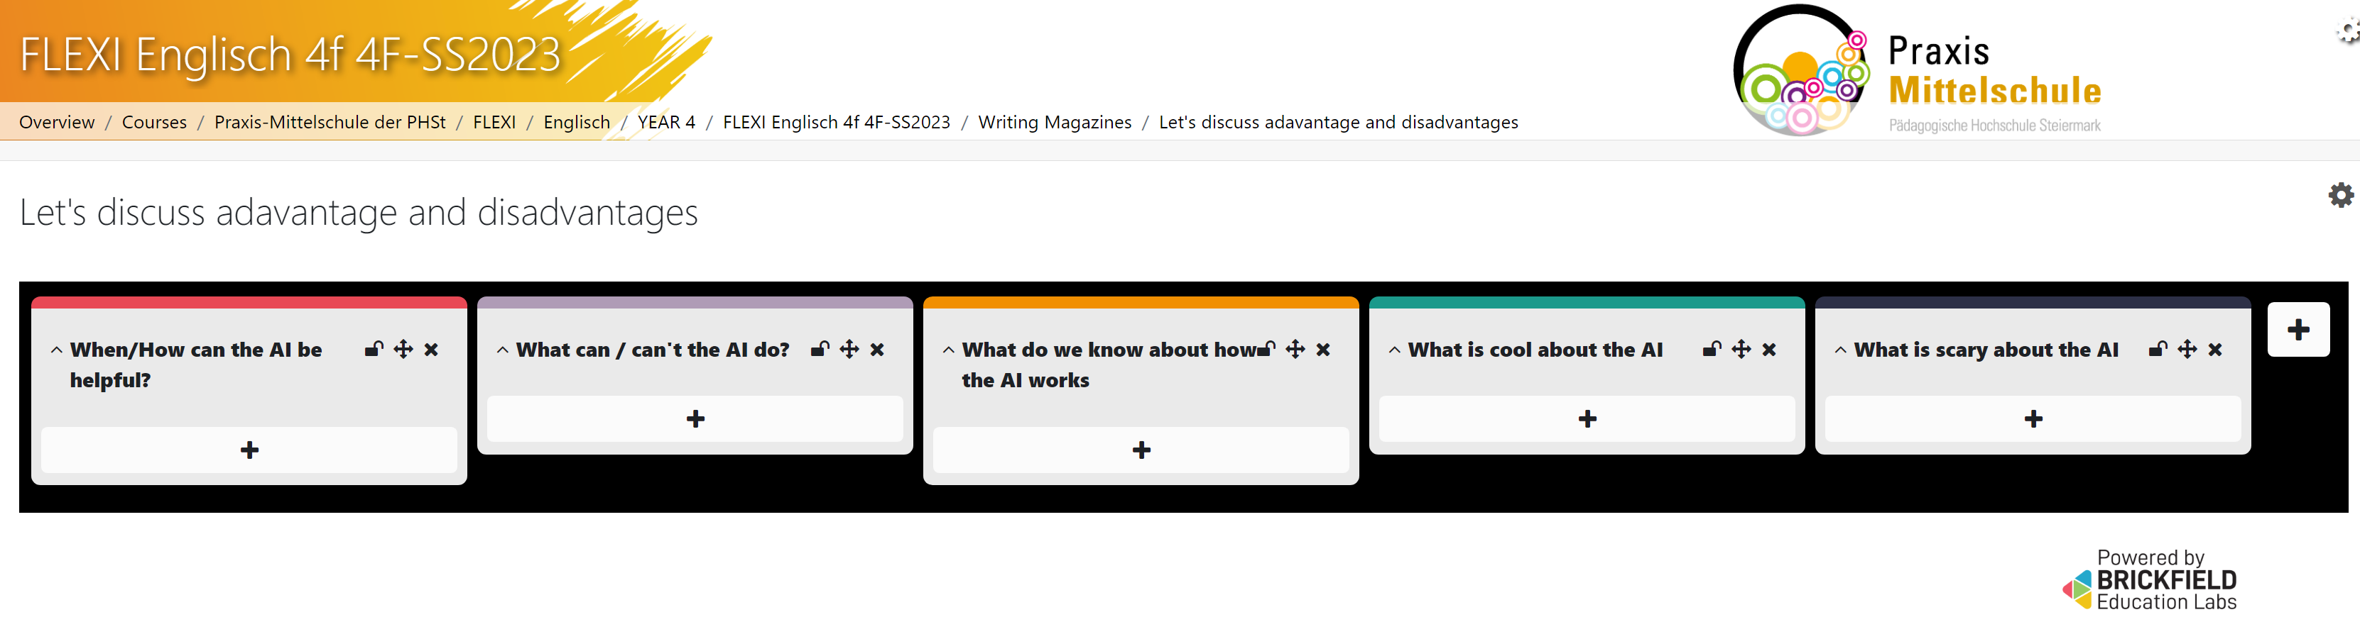
Discussion Phase: Advantages and Disadvantages of AI

Slide 33
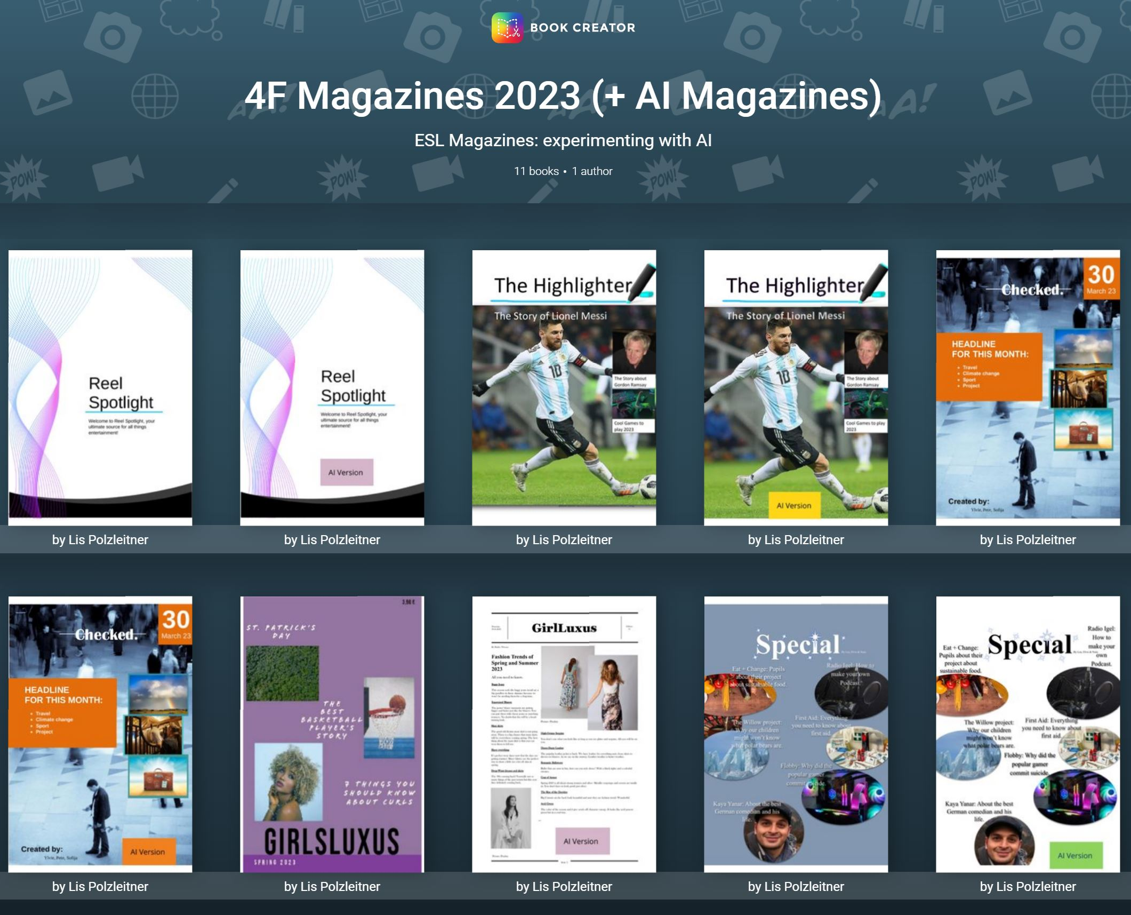
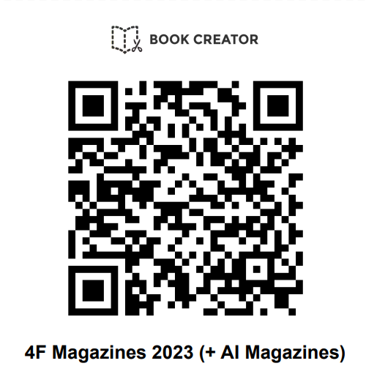
4f Magazines and AI-Versions
https://read.bookcreator.com/library/-NXeyhk7xV3qqGOTbpJk

Slide 34
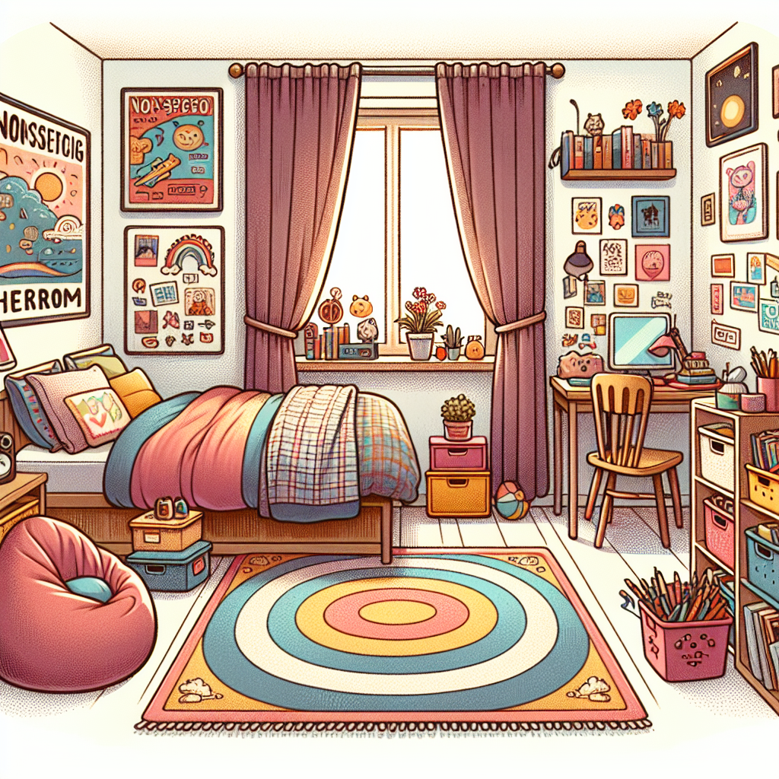
Describing pictures or scenes
Task:
1. Describe your bedroom in detail.
2. Then ask AI to draw a picture. (I have used fobizz here)
3. Check if the picture is correct and write down all the mistakes: e.g.: The curtains in the picture are red, but my curtains are green.
My bedroom is my favorite place in my house. It's where I sleep and play. When you first walk in, you see my bed. It's big and cozy with soft blankets and pillows. I have a colorful rug on the floor that feels nice under my feet.
There's a big window with curtains that let sunlight in during the day. I have posters of my favorite bands and movies on the walls. My desk is near the window. It's where I do my homework and draw pictures. I have shelves filled with books and toys.
In one corner, there's a small bean bag chair where I like to sit and read. Next to it is a toy box filled with games and puzzles. I also have a closet where I keep my clothes and shoes neatly organized.
Overall, my bedroom is a comfy and fun place where I can relax and be myself.

Slide 35

Writing Feedback given by AI tools

Slide 36
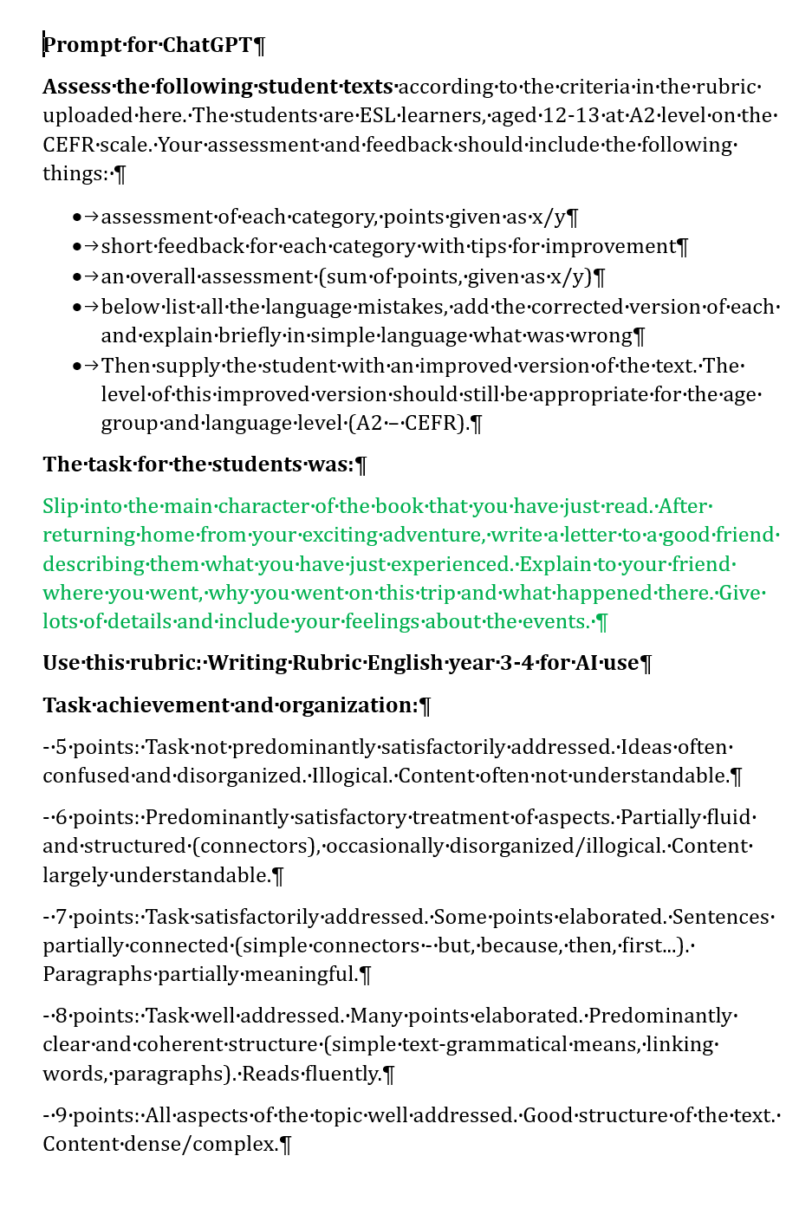
Feedback and help with formative Assessment
Prompt for ChatGPT
Assess the following student texts according to the criteria in the rubric uploaded here. The students are ESL learners, aged 12-13 at A2 level on the CEFR scale. Your assessment and feedback should include the following things: assessment of each category, points given as x/y. Short feedback for each category with tips for improvement. An overall assessment (sum of points, given as x/y). Below list all the language mistakes, add the corrected version of each and explain briefly in simple language what was wrong. Finally, add an improved version of the text. The improved version should be appropriate for the age-group and language level (A2 on the CEFR).
Use this rubric: paste your rubric in here.
Task description for the learners: paste in the task description for the students

Slide 37
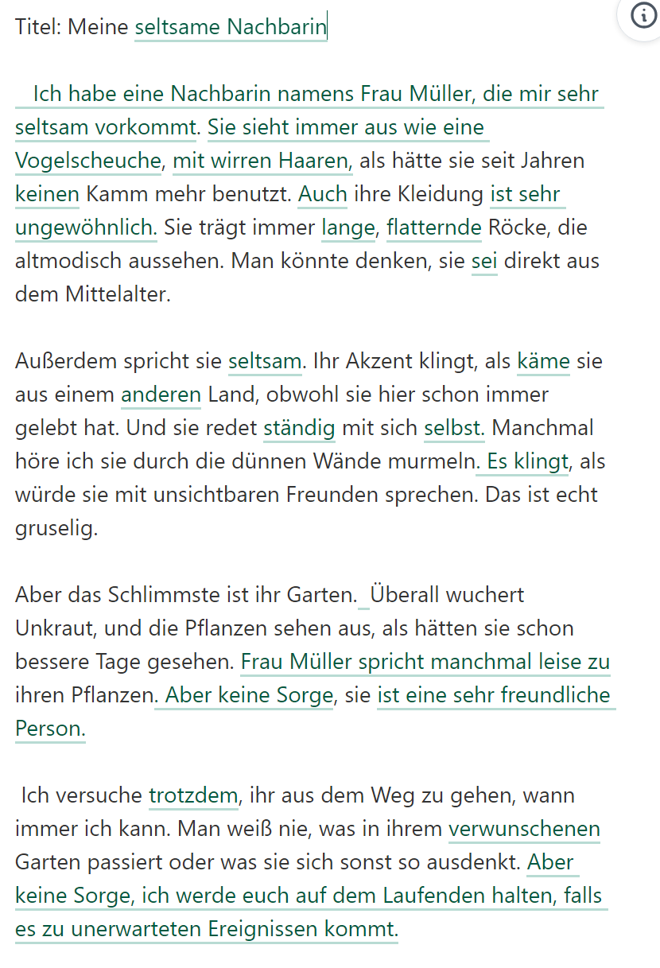
Textimprovement with DeepL Write
Titel: Meine komische Nachberin
Also, ich hab da diese Nachbarin. Sie ist echt seltsam. Ihr Name ist Frau Müller, glaub ich. Jedenfalls sieht sie immer aus wie ein Vogelscheuche. Ihre Haare sind so wirr, als hätte sie seit Jahren keinem Kamm mehr benutzt. Und ihre Kleidung! Sie trägt immer diese langen, flatternden Röcke, die total altmodisch aussehen. Man könnte denken, sie ist direkt aus dem Mittelalter heraus gekommen.
Außerdem spricht sie komisch. Ihr Akzent klingt, als würde sie aus einem anderem Land kommen, obwohl sie hier schon immer gelebt hat. Und sie redet auch mit sich selber, ständig! Manchmal höre ich sie durch die dünnen Wände murmeln, als würde sie mit unsichtbaren Freunden sprechen. Das ist echt gruselig.
Aber das Schlimmste ist ihr Garten. Der sieht aus wie ein Dschungel! Überall wuchert Unkraut, und die Pflanzen sehen aus, als hätten sie schon bessere Tage gesehen. Manchmal glaube ich, dass sie mit ihren Pflanzen spricht, denn ich sehe sie oft dabei, wie sie leise zu den Blumen flüstert. Wer weiß, was sie denen erzählt.
Insgesamt ist Frau Müller echt ein komischer Vogel. Ich versuche, ihr aus dem Weg zu gehen, wann immer ich kann. Man weiß nie, was in ihrem verwunschenem Garten passiert, oder was sie sich sonst so ausdenkt.
DeepL-Write

Slide 38

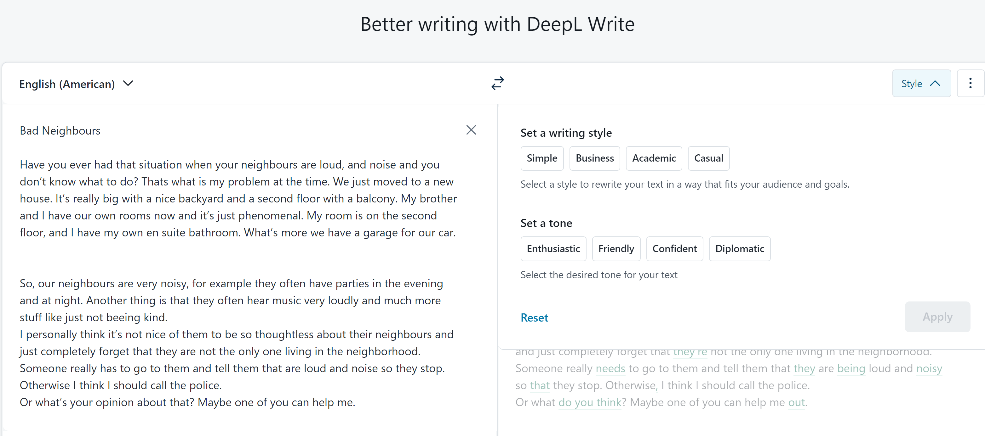

Slide 39
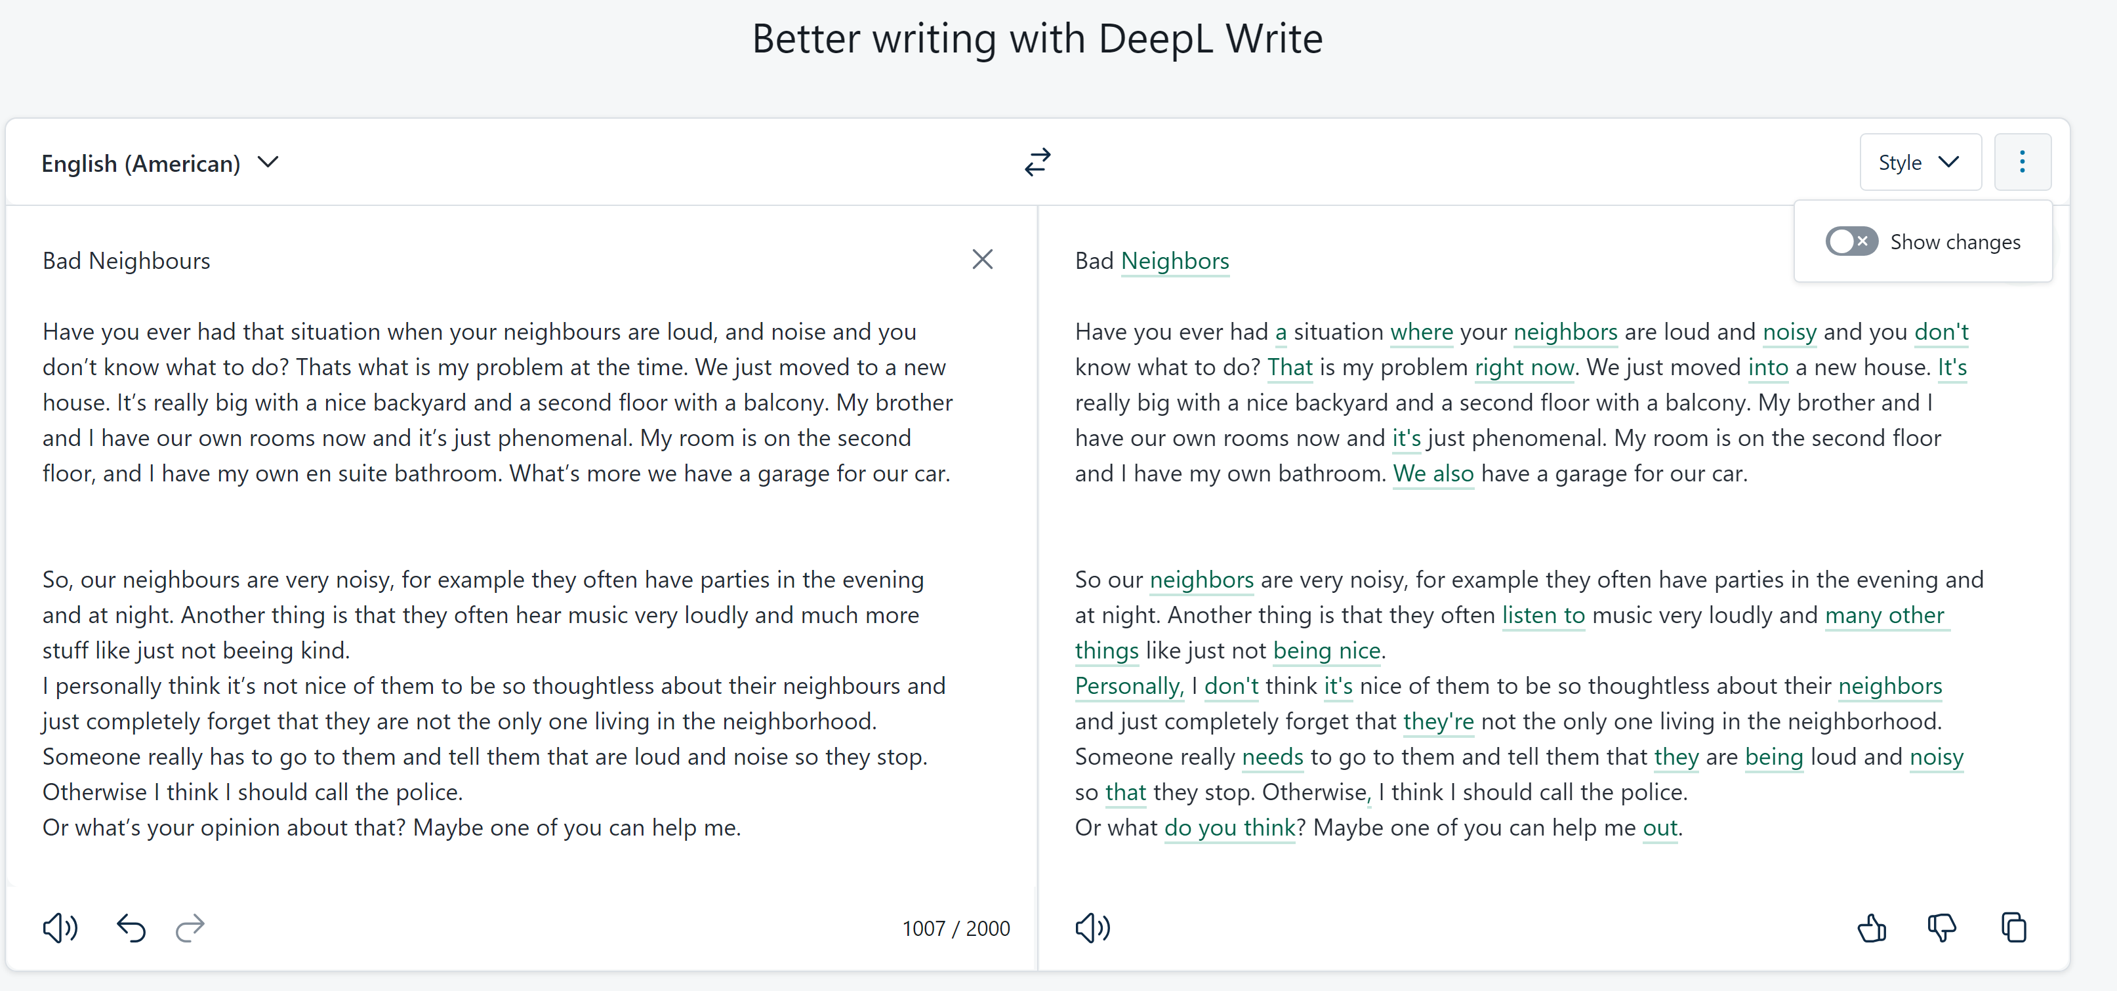
DeepL Write: corrections only

Slide 40
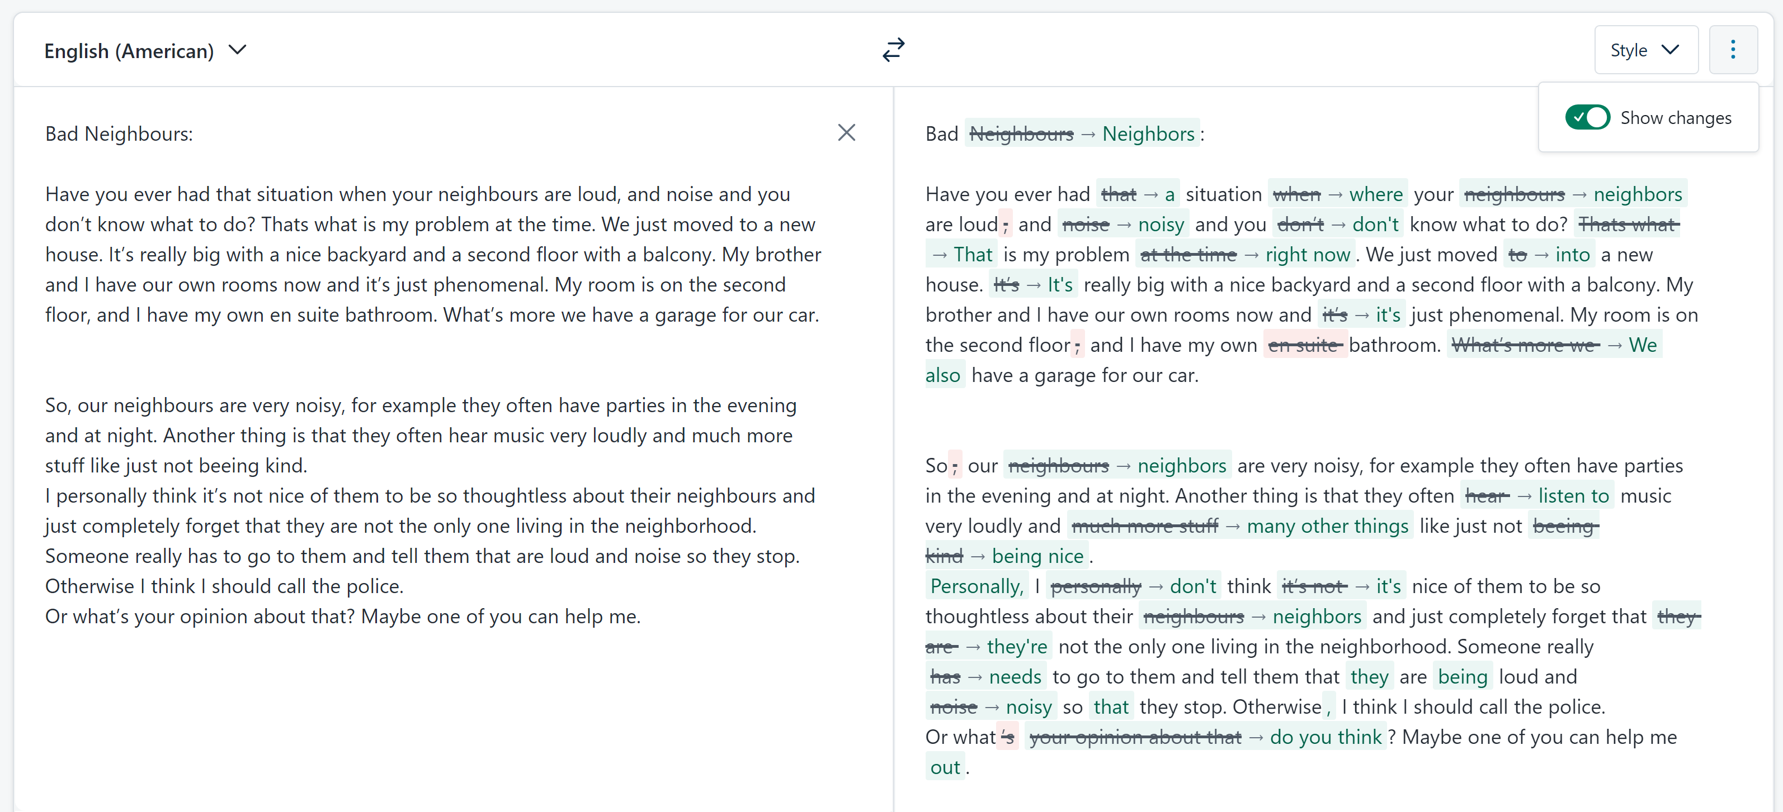
DeepL Write: corrections only – show changes

Slide 41
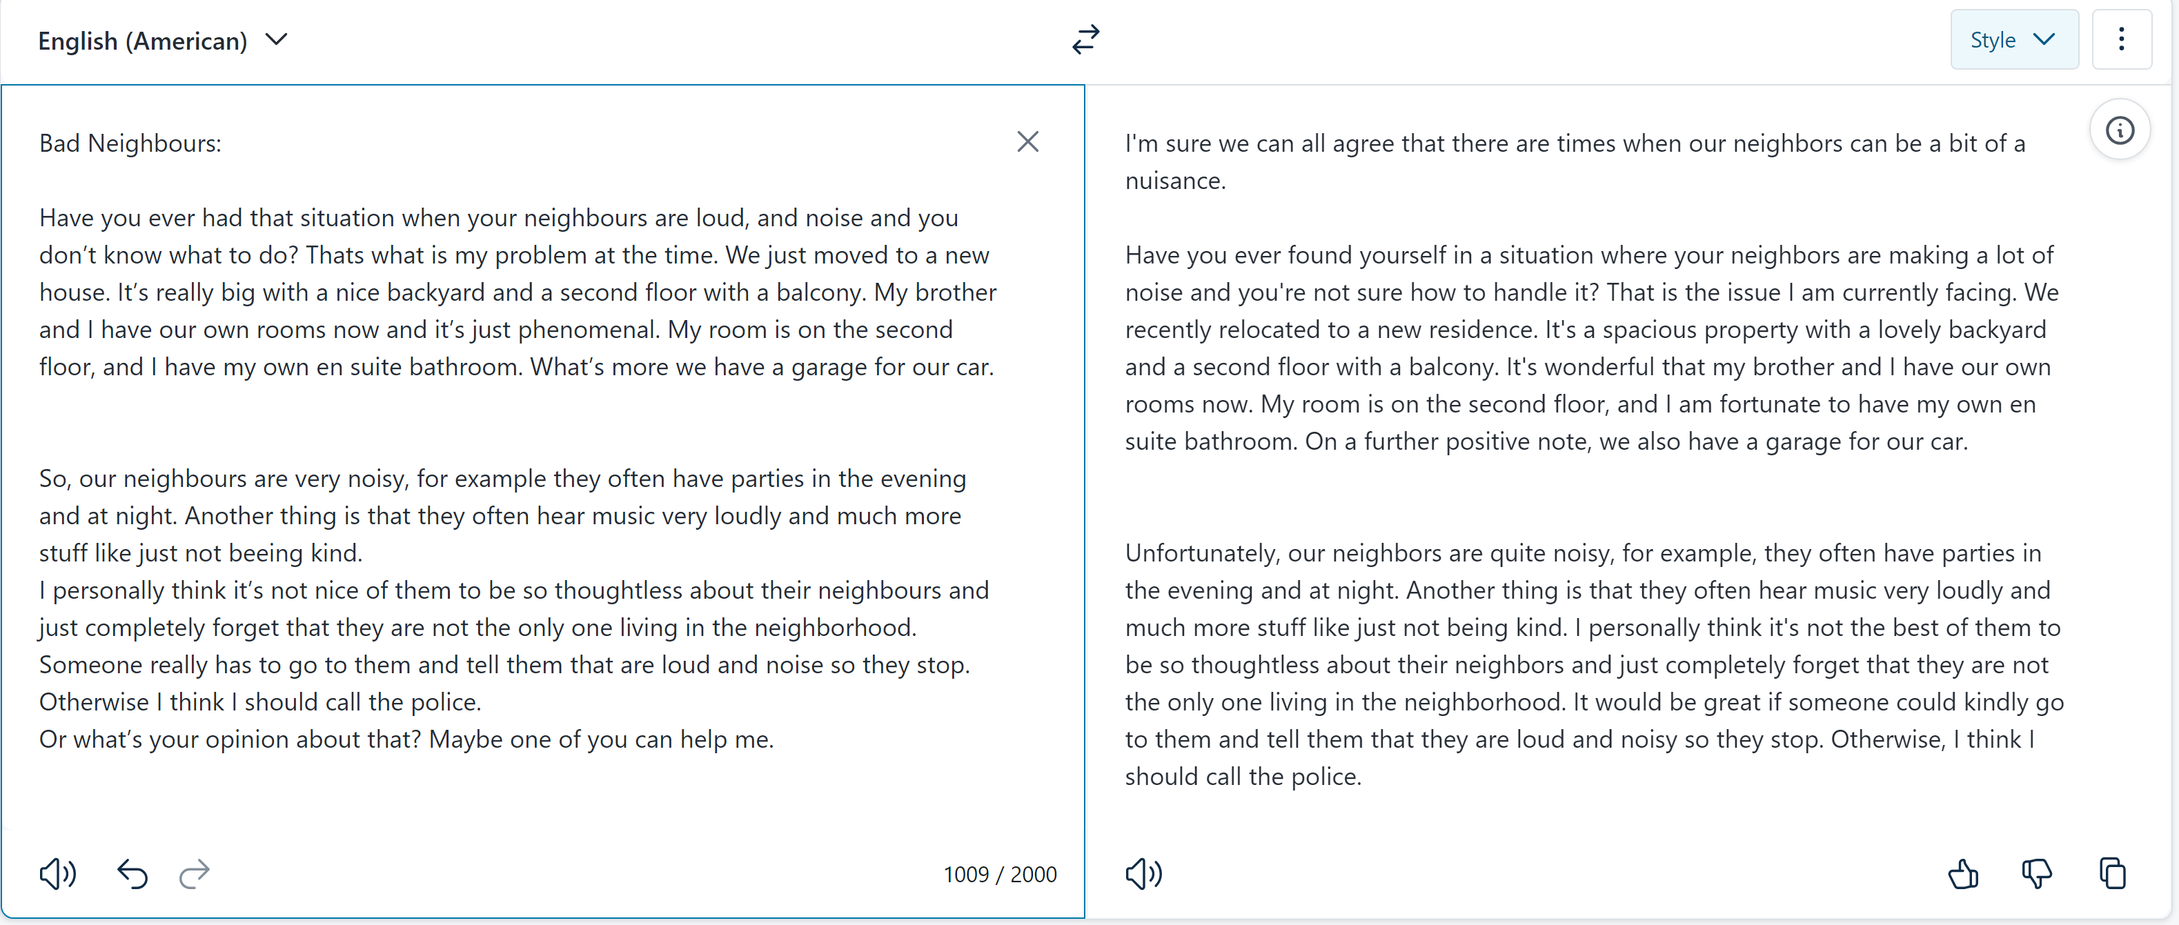
DeepL Write – diplomatic tone

Slide 42
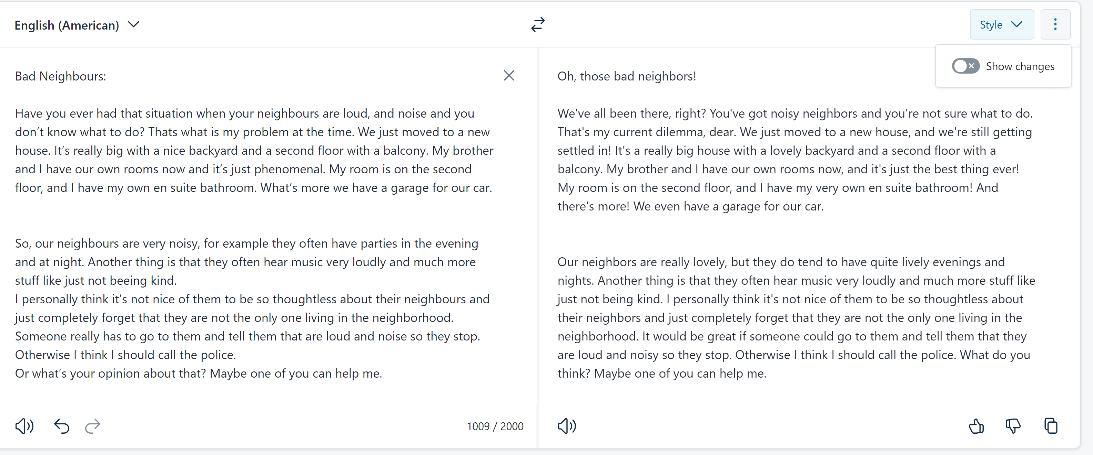
DeepL write: Friendly tone

Slide 43

Bad Neighbours: original text written by ESL student, age 15
Have you ever had that situation when your neighbours are loud, and noise and you don’t know what to do? Thats what is my problem at the time. We just moved to a new house. It’s really big with a nice backyard and a second floor with a balcony. My brother and I have our own rooms now and it’s just phenomenal. My room is on the second floor, and I have my own en suite bathroom. What’s more we have a garage for our car.
So, our neighbours are very noisy, for example they often have parties in the evening and at night. Another thing is that they often hear music very loudly and much more stuff like just not beeing kind.
I personally think it’s not nice of them to be so thoughtless about their neighbours and just completely forget that they are not the only one living in the neighborhood. Someone really has to go to them and tell them that are loud and noise so they stop. Otherwise I think I should call the police.
Or what’s your opinion about that? Maybe one of you can help me.
WRITIFY.AI: Here is the paragraph rewritten in a neutral tone of voice:
"New Neighbors Some individuals may find themselves in a situation where their neighbors are noisy, and they are unsure of how to address the issue. This appears to be the case for the writer. They have recently moved to a new, larger house with a nice backyard, a second floor with a balcony, and individual rooms for the writer and their brother. The writer's room is on the second floor and has an en-suite bathroom. Additionally, the house has a garage for their car. While the new living situation seems quite favorable, the writer is facing a challenge with their neighbors' noise levels.“
The neighbors are quite noisy. They frequently have parties in the evenings and at night. Additionally, they often play music at a high volume. There are other inconsiderate behaviors as well.
It seems the neighbors are not mindful of the impact their actions have on the surrounding community. Someone may need to have a conversation with them to make them aware of the disturbances they are causing. Alternatively, contacting the authorities could be an option if the issues persist.
What are your thoughts on the best approach to address this situation? Perhaps you have a suggestion that could help resolve the matter.

Slide 44
Friendly Neighbors (Writify.AI, Friendly tone)
Hey there! Have you ever found yourself in a situation where your neighbors are just a little too loud, and the noise is really getting to you? Well, that's the predicament I'm in right now. You see, we just moved into a brand new house, and it's absolutely fantastic. It's a really spacious place with a lovely backyard and a second floor with a balcony. My brother and I each have our own rooms now, which is just incredible. My room is on the second floor, and I even have my own private bathroom. And the best part? We have a garage for our car. It's just been such a wonderful experience settling into this new home, you know? The only downside is that the neighbors can be a bit noisy at times, but I'm sure we'll figure out a way to work through that. Overall, I'm just so grateful for this new chapter in our lives."
"I'm sorry to hear that your neighbors are being so noisy and inconsiderate. It must be really frustrating to deal with that. I can understand why you're feeling annoyed with them.
It sounds like they often have loud parties and play music at high volumes, which can be really disruptive, especially at night. That's not very considerate of them towards the rest of the neighborhood.
If I were in your shoes, I would try talking to them first, in a friendly and polite way, to see if they'd be willing to be more mindful of the noise level. Maybe they're not even aware of how much it's impacting you and the others around them. It's worth a try to see if you can resolve it amicably.
However, if they continue to be uncooperative and the noise persists, then I think calling the police would be a reasonable next step. You shouldn't have to put up with that kind of disturbance, especially in your own home.
I hope you're able to find a solution that works for you. Let me know if you need any other suggestions or advice. I'm happy to lend an ear and provide any support I can."
Problematic Neighbors (Writify.AI, Formal)
It is not uncommon to encounter situations where one's neighbors exhibit disruptive behavior, such as excessive noise, which can be quite challenging to address. This is precisely the predicament I find myself in at the present moment. My family and I have recently relocated to a new, spacious residence, complete with a sizable backyard and a second floor featuring a balcony. My brother and I now have our own private quarters, which is a remarkable improvement. My personal living space is situated on the second level and includes a private en-suite bathroom. Furthermore, we have the added convenience of a garage to accommodate our vehicle.
The residents adjacent to my dwelling place exhibit a significant degree of noise disturbance. For instance, they frequently hold social gatherings in the evening and late-night hours. Additionally, they often play music at an excessively high volume. Furthermore, they display a general lack of consideration for their neighbors.
Personally, I believe their inconsiderate behavior is unacceptable. They appear to disregard the fact that they are not the sole occupants of the local community. I believe it would be prudent for someone to approach them directly and inform them that their actions are disruptive. Failing a resolution through this approach, I may be compelled to contact the relevant authorities.
I welcome any opinions or suggestions you may have regarding this matter. Perhaps one of you could provide guidance on the most appropriate course of action.

Slide 45
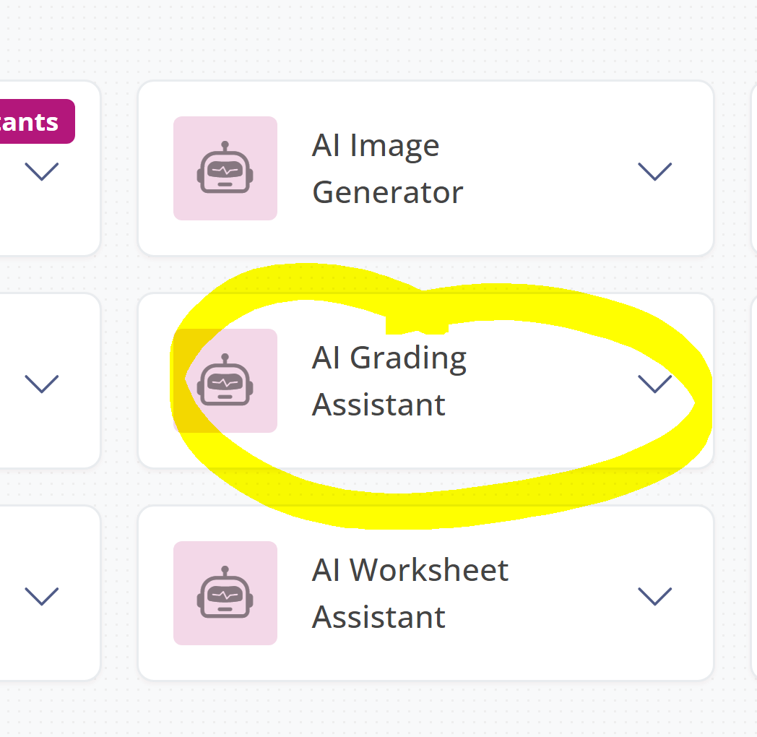

Let’s assess the same texts with Fobizz
Sign in to Fobizz
Go to AI Assistance Tools
Choose: AI Grading Assistant
Fill in all the relevant information
Choose relevant criteria and weightings
Finetune your prompts a bit
Compare the results with ChatGPT

Slide 46
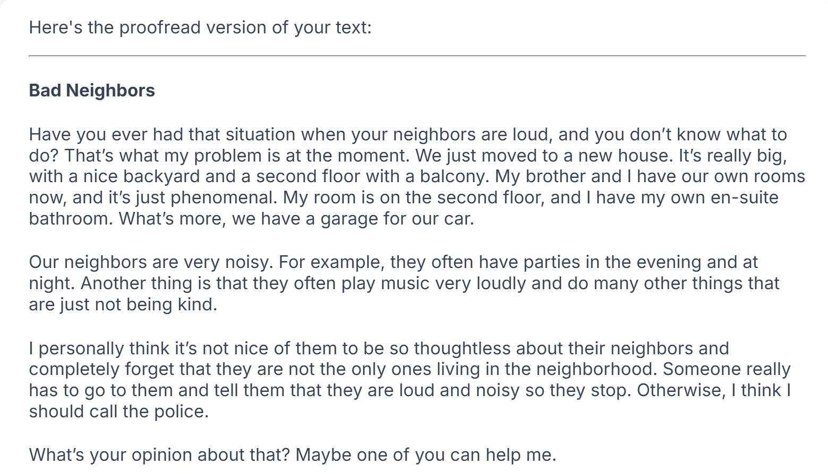


Slide 47
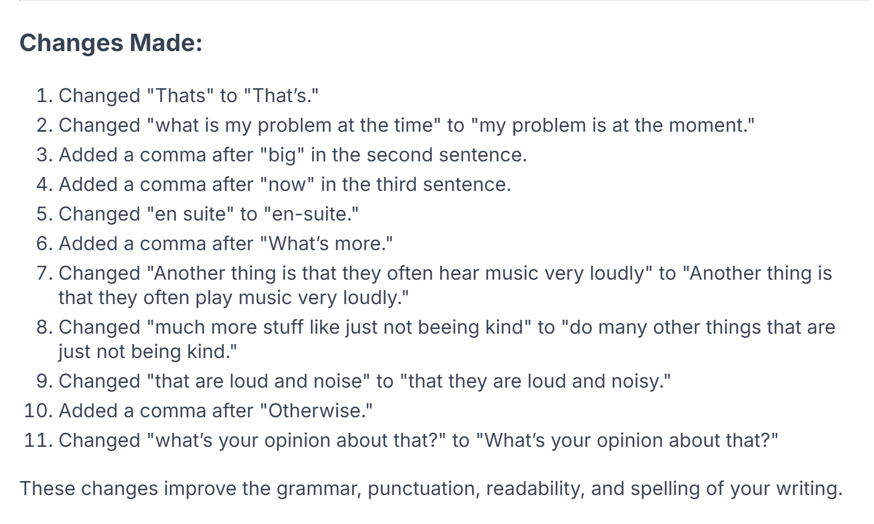
Unfortunately, the changes are not marked in the text and therefore not easy to spot for the learners.
They need to consult the list of changes, but do not see them in context.

Slide 48
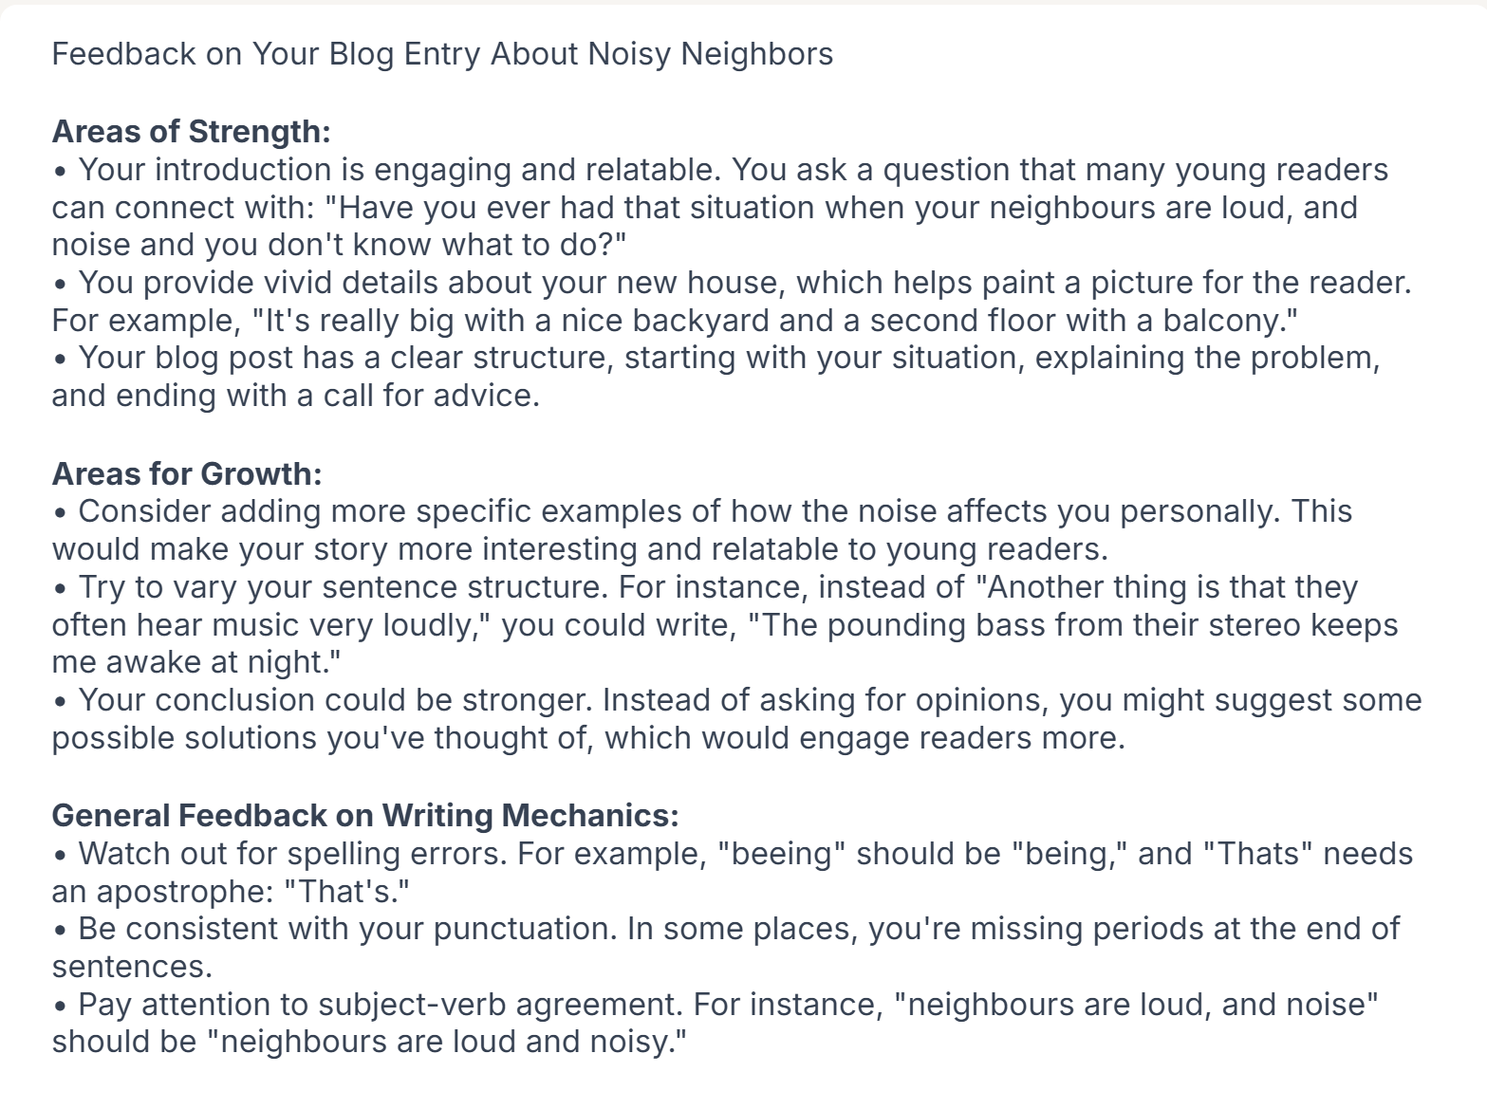
Helpful feedback for revising and editing.

Slide 49
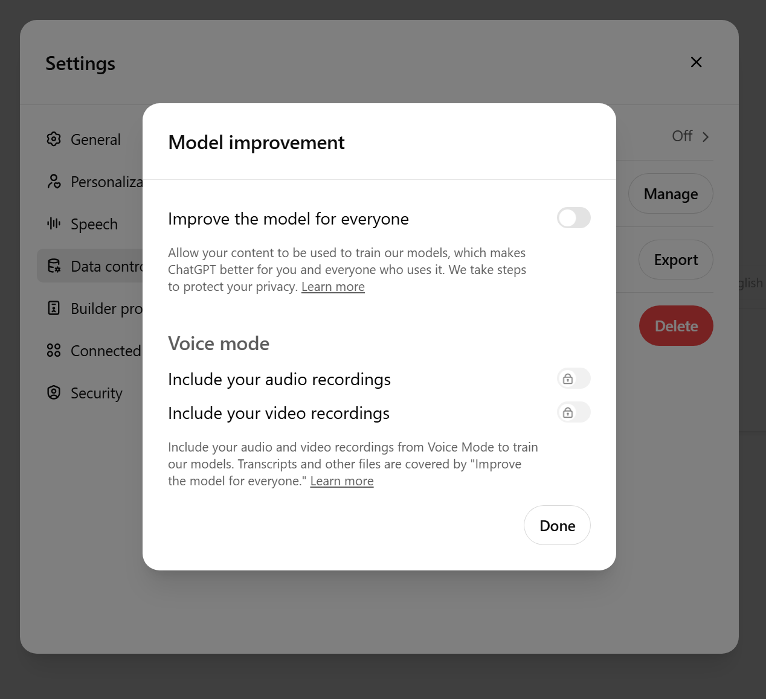
Data Security ???
Viele US-Anbieter; NICHT DSGVO-konform; jedenfalls in Einstellungen Chat History & Training deaktivieren!
Besser: datenschutzkonform nutzen mit https://fobizz.com/

Slide 50
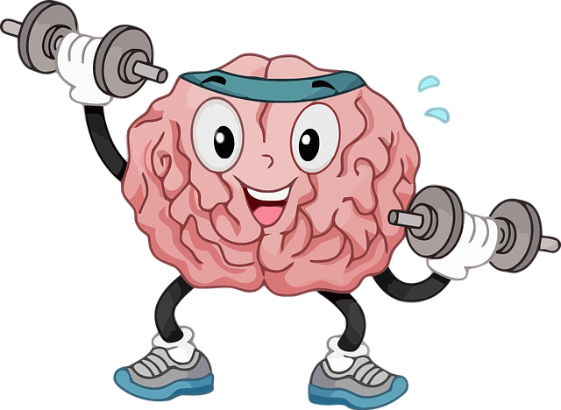
Now it’s your turn
Find two or three texts written by your students. (Different quality if possible)
Play around ChatGPT, DeepL-Write or Fobizz
Ask AI for
Error correction
Text improvement
Assessment and Feedback
Use your brain!

Slide 51
Find some Useful tools here: https://epep.at/?page_id=7418

Slide 52
Please do not forget to answer the PH-NÖ feedback survey that has been sent to you by mail.
Thank you!

