Slide 1

KI in der Schule
Elisabeth Pölzleitner
Praktische Beispiele

Slide 2
KI für Schüler/innen Hilfe bei Verständnisfragen Brainstorming, Argumente sammeln Textüberarbeitung, Fehleranalyse, Feedback Sprechtraining
KI für Lehrpersonen:
Unterrichtsplanung
Materialien erstellen
KI sinnvoll und ethisch verwenden
KI Spielplatz
Probieren Sie selbst!
Beispiele aus dem Unterricht
Prompt writing
KI braucht klare Anleitungen
Datensicherheit
???
Was erwartet Sie heute?
Was KI nicht gut kann.

Slide 3
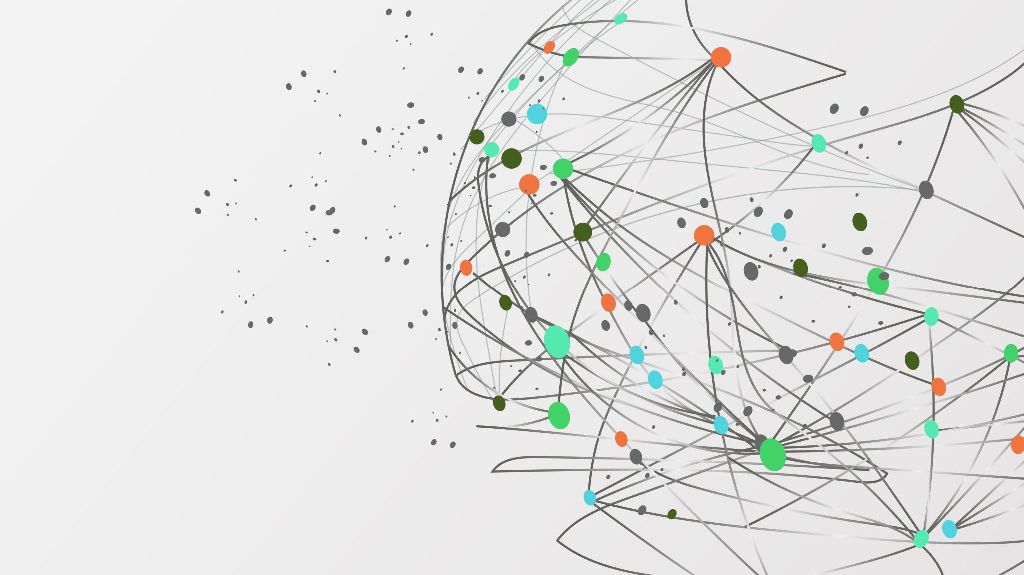
Die 1. Regel für den Einsatz von KI: Outsourcen Sie Ihr Tun, nicht Ihr Denken
Vertraue nicht auf die Maschine, benutze deinen Verstand

Slide 4

Anwendungen für Lehrer/Innen
Texte zu einem Thema x erstellen
Differenzierung: Versionen nach bestimmten Kriterien (Niveau, Stil, Register, Wortschatz, Perspektive, Textart...)
Erstellen von Verständnisfragen zum Inhalt (Video, Text, Audio)
Erstellen von Übungen und Aktivitäten für Themen, Texte, Videos...
Erstellen von Arbeitsblättern
Ideen für die Unterrichtsplanung
Bilder erstellen, Bilder beschreiben
Erstellen von Modellsätzen oder Definitionen (zB: um die Verwendung von Wörtern oder Grammatik zu zeigen)
Texte anhand von Rubriken bewerten und Feedback geben

Slide 5

Haben Sie schon einmal versucht, AI für Ihre Vorbereitung oder Ihren Unterricht einzusetzen?
Bitte schreiben Sie kurze Kommentare in den Chat.

Slide 6

KI + hilfreiche Prompt Generators
ChatGPT: Generative Pretrained Transformer (generates texts, pretrained on human data, transforms these data to produce text)
DeepL und DeepL-Write
Bing, Microsoft Copilot
Google Bard / jetzt Gemini
Image Creators: Stable Diffusion XL, OpenAI DALL E 2, OpenAI DALL E 3, Midjourney, Craiyon
DIFFIT and Twee
PlayHT (text-to-speech)
DeepL-Write and Grammarly
Fobizz
Magicschool.ai
TalkpalAI, Gliglish, Langotalk (chatbots)
AI integrations in powerpoint, word, padlet …

Slide 7
Klare Anweisungen (Prompts)
Gute Prompts schreiben:
Format: | Write a short article
Adressaten | For a teen magazine for ESL learners at A2 level
Thema | About the topic: Use of social media, pros and cons for teens
Umfang/ Textlänge | About 300- 400 words,
Sonstiges | Include 2-3 interview bits in the form of direct speech answers from kids.

Slide 8



Probieren SIE Selbst!
10 minutes
Schreiben Sie einen Prompt
Wählen Sie ein Thema das Sie im Unterricht demnächst behandeln werden.
Lassen Sie sich von einer der vorgestellten KI Anwendungen einen geeigneten Text erstellen.
Verfeinern Sie Ihren Prompt, um genau das zu erhalten was Sie brauchen.
………………………………………………………………………………………………………………………
Diskussion im Plenum: Wie brauchbar sind die Ergebnisse?
Wählen Sie eine der Optionen
Chat.openai.com
Sign up with your e-mail address
Or: Microsoft Edge, Copilot:
Or: Fobizz (anonymous)
If you do not want to use your e-mail address, use this shared space and chat with AI:
Find the FOBIZZ link here:
https://go.fobizz.com/?token=488109b87c955bd0

Slide 9

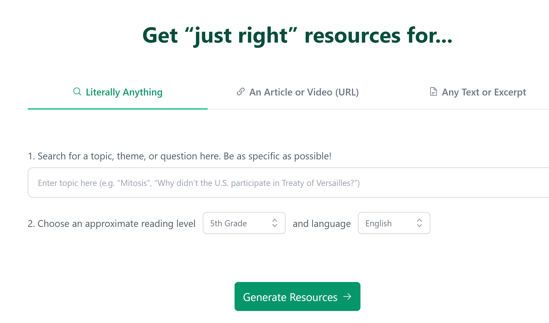
Now let’s do some Magic
Diffit.me

Slide 10
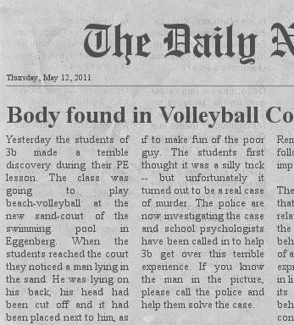
Probieren SIE Selbst!
20 minutes
Arbeiten mit Texten
Wählen Sie ein Thema das Sie im Unterricht demnächst behandeln werden.
Lassen Sie sich von Diffit einen geeigneten Text erstellen.
Verfeinern Sie gegebenenfalls die Angabe um einen perfekt passenden Text zu erhalten.
Ändern Sie jetzt das Niveau des Textes für mögliche Differenzierung.
Durchsuchen Sie das Aufgabenangebot von Diffit und wählen Sie mindestens 3 geeignete Aufgabenstellungen für Ihre SchülerInnen.
Speichern Sie das Material auf Ihrem Gerät um es später im Plenum zu besprechen und/oder im Unterricht zu verwenden.
…………………………………………………………………………………………………………………………….
Diskussion im Plenum: Wie brauchbar sind die Ergebnisse?
https://app.diffit.me/

Slide 11

Probieren SIE Selbst!
20 minutes
Arbeiten mit Videos
Wählen Sie ein Thema das Sie im Unterricht demnächst behandeln werden.
Suchen Sie ein kurzes geeignetes you-tube Video zu diesem Thema.
Lassen Sie sich von Diffit ein Transkript, eine Zusammenfassung und Verständnisfragen erstellen.
Wählen Sie die geeigneten Fragen aus – editieren bzw. löschen Sie gegebenenfalls ungeeignete Fragen.
Durchsuchen Sie das Aufgabenangebot von Diffit und wählen Sie mindestens 3 geeignete Aufgabenstellungen zu diesem Video für Ihre SchülerInnen.
Speichern Sie das Material auf Ihrem Gerät um es später im Plenum zu besprechen und/oder im Unterricht zu verwenden.
…………………………………………………………………………………………………………………………….
Diskussion im Plenum: Wie brauchbar sind die Ergebnisse?
https://app.diffit.me/

Slide 12
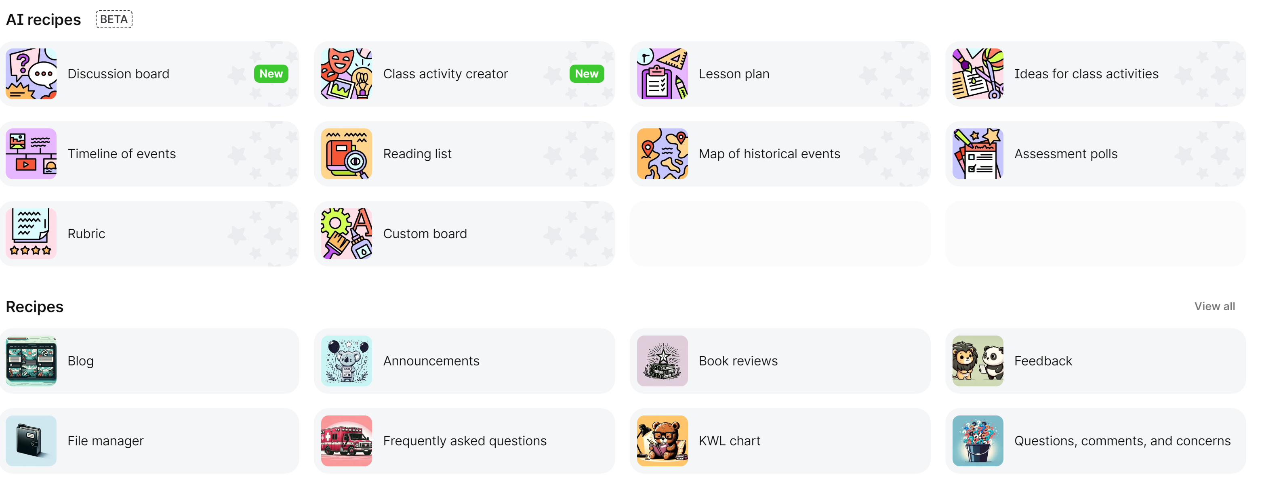
A bit of Magic with padlet
https://padlet.com/referrals/lispolzleitner

Slide 13

Probieren Sie Selbst!
20 minutes
Folgen Sie dem Link und melden Sie sich bei Padlet an.
Suchen Sie nach passenden Unterrichtsideen für ein Thema das Sie demnächst unterrichten werden.
Plenum: Wie hilfreich sind die Ideen?
https://padlet.com/referrals/lispolzleitner
https://padlet.com/referrals/lispolzleitner

Slide 14

Hören statt Lesen
Play.ht

Slide 15

Ki Anwendungen für Schüler/innen
Erklärungen in einfacher Sprache finden: erkläre mir wie… warum… den Unterschied zwischen…
Lese- und Hörverstehen üben (Fragen und Antworten zu einem Text oder Video erstellen)
Zusammenfassen und/oder Transkribieren von Videos, Erstellen von Untertiteln
Texte korrigieren und verbessern, die Fehler auflisten und sie erklären
Beispiele für Sprachverwendung geben (Vokabeln oder Grammatik)
Sprechen üben (Rollenspiele, Gespräche mit AI-Tutoren, Gespräche über Sachthemen)
Übersetzen von Wörtern oder Sätzen (vom Audio oder schriftlich)
Text zu Audio (für Aussprache- und Hörübungen)

Slide 16
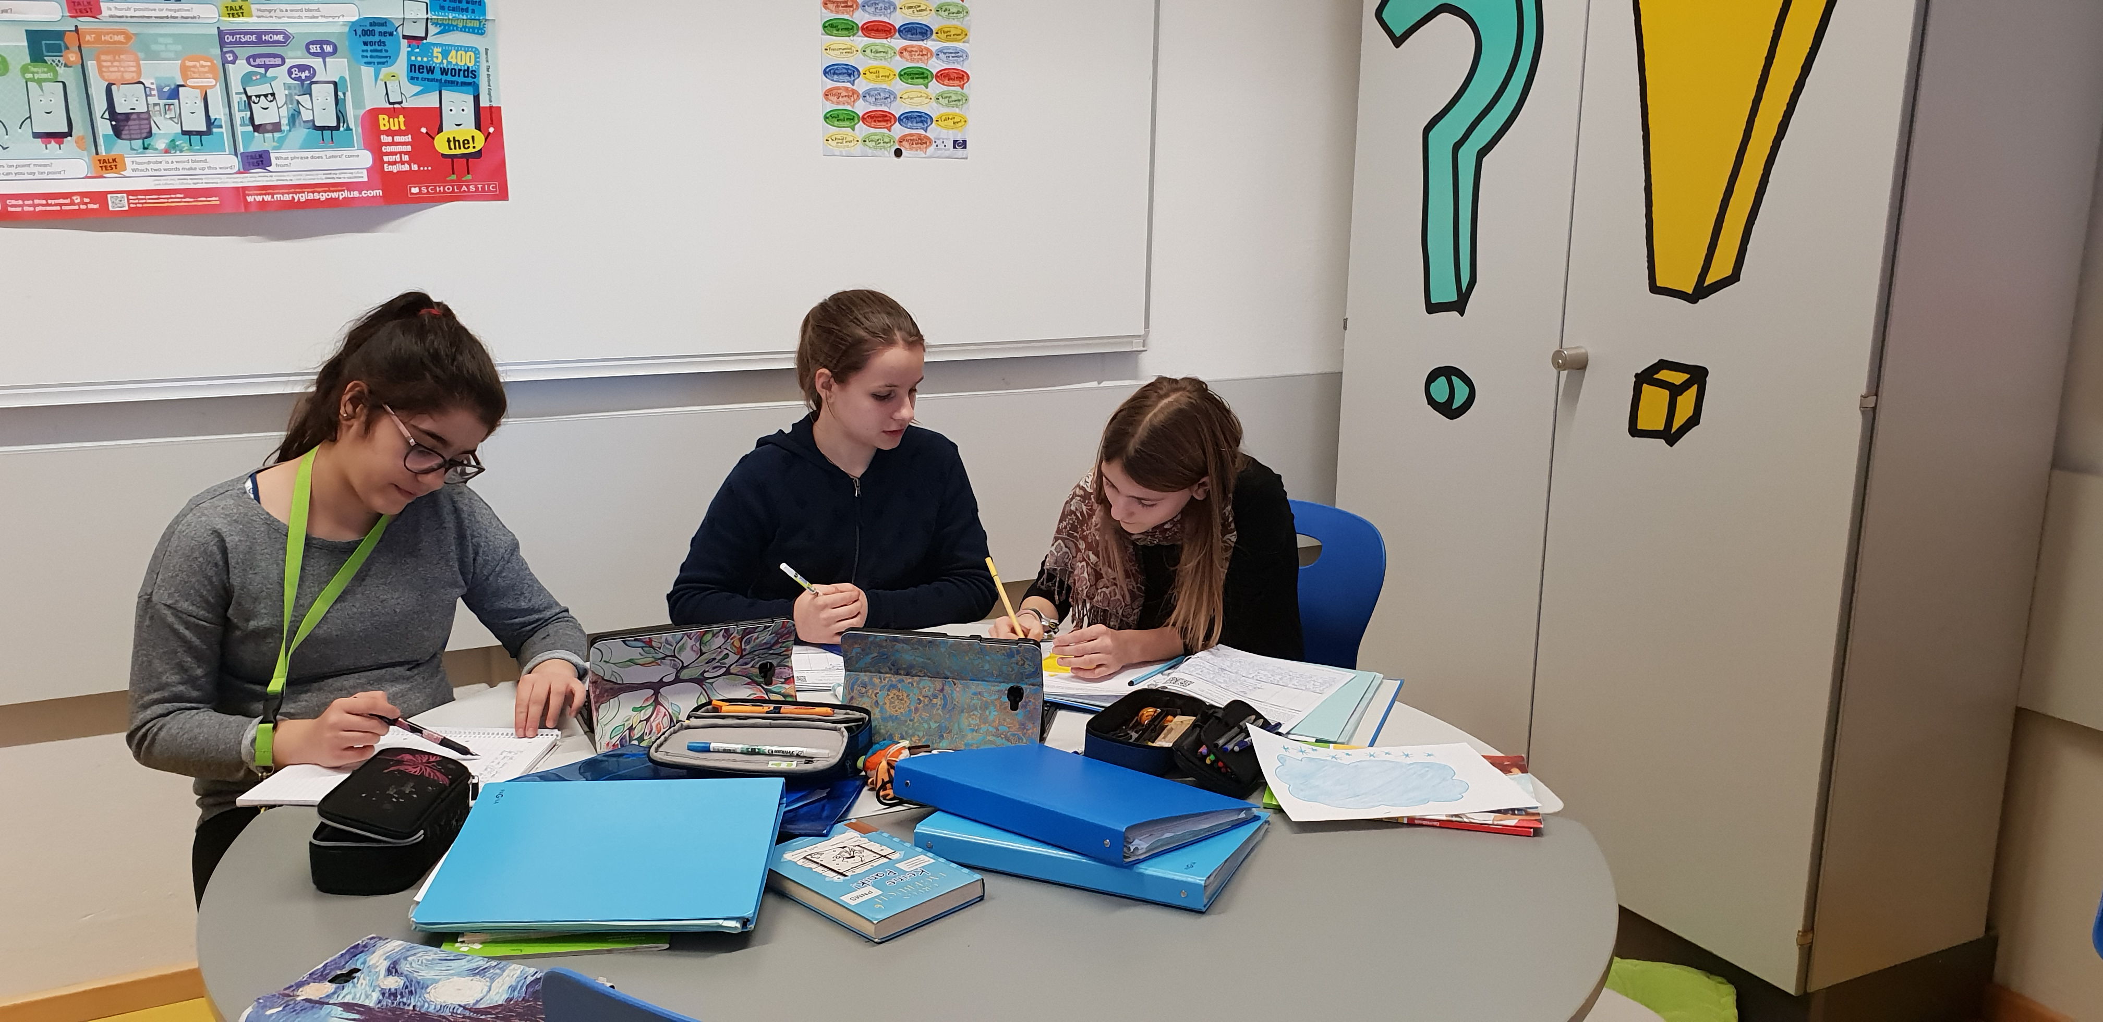
Besser Schreiben mit Hilfe von Chat GPT
A first example:
Setting:
ESL classes in middle school (age 10-14)
CEF Level: A2 – B1

Slide 17

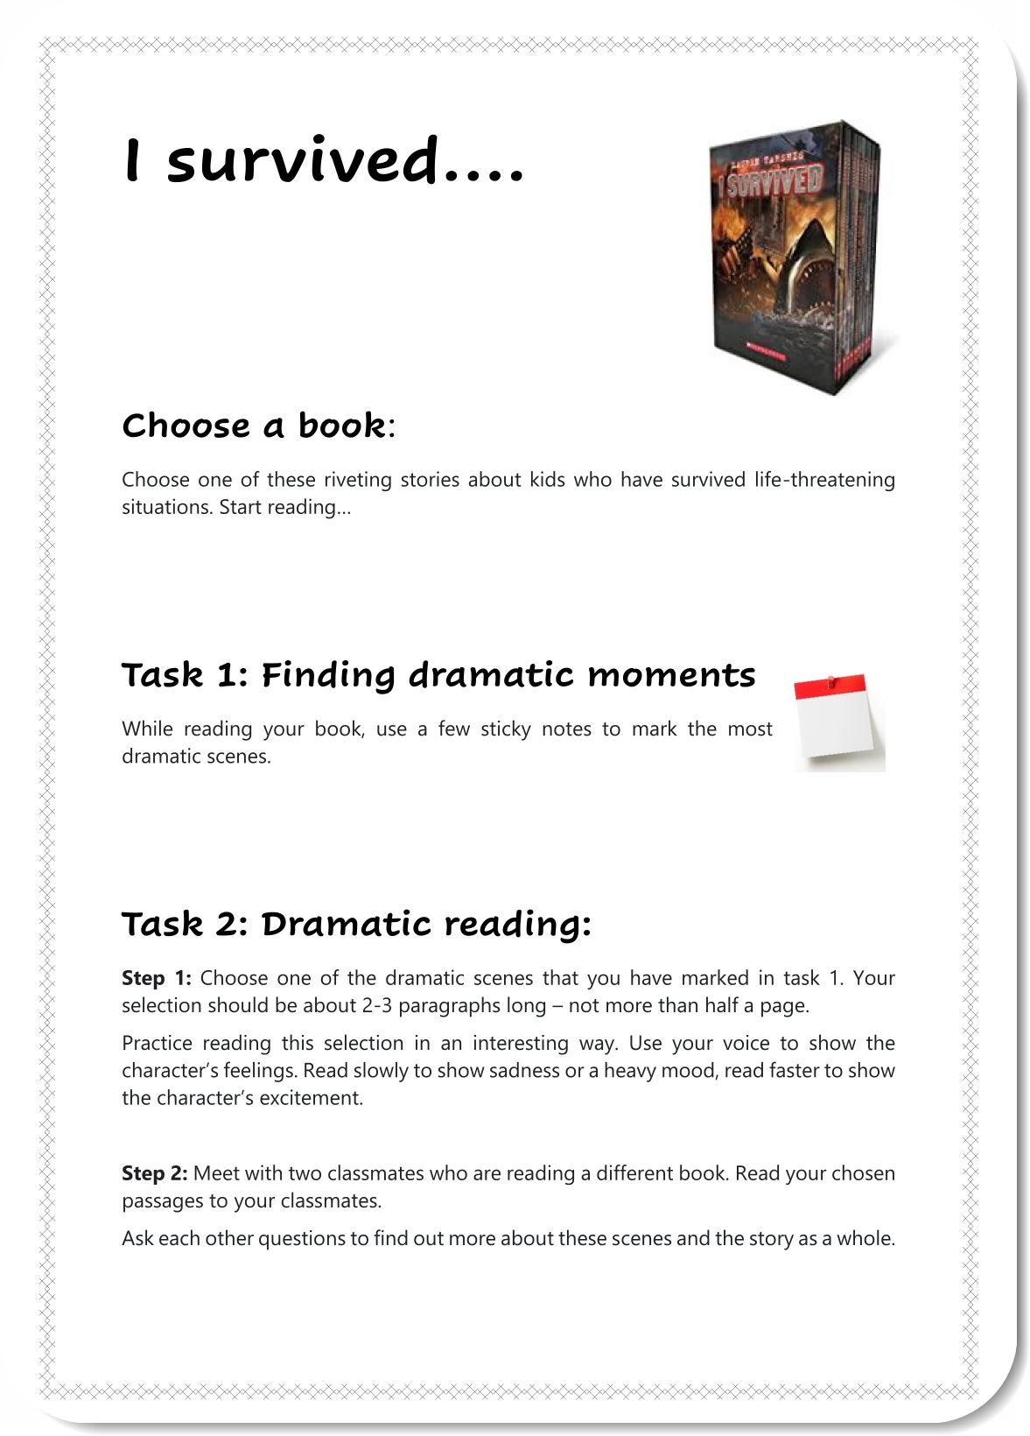
Example 1: year 3 -- Blog writing
Students write their blog text
Teachers use Chat GPT to correct and improve the texts.
Students get a printout of the improved texts.
Students have to compare the 2 versions, highlight the changes and decide which ones they want to include in their own version.

Slide 18

How does this work for the learners? Pros and Cons
More advanced learners can easily see the differences and pick out phrases they want to use in the future. For them AI can be an excellent tutor.
Weaker learners are happy with the improved version, but do not automatically see the differences or even try to find them. They need a lot more scaffolding to use Chat GPT meaningfully.

Slide 19
Instructions that help weaker learners
Copy your text into Chat GPT and ask it to correct and improve your text.
Ask Chat GPT to list all changes and explain them in simple English. Ask your teacher for help if you do not understand the explanations.
Go through all the changes and decide if and how you can use them in your original text. Highlight all the changes that you have made in your text.
Choose 5 phrases that you would like to remember and write them on vocab cards.

Slide 20
Write a short text about your viewing habits (~120 words). Use at least 3 quantifiers in your text. (quantifiers see EASY p. 110 / ex 1a) Mark the quantifiers in bold.
My first draft: What type of viewer am I?
I dont have tiktok because I think that tiktok is stealing my data. But if I use my phone I use youtube, snapchat, discord and whatsapp. I use my phone like 1 ore 1 and a have hours a day. Moust of the time I am on snapchat and youtube ore some times spotify. I don‘t wach tv often but If I am waching tv I am waching with my dad Grip. I realy like to play video games with my frinds so I spent moust of my free time on my pc. The games and programs that i use on my pc are discord and minecraft and alsow some times fortnite. I use my pc like 2 hours a day.
Chat GPT corrected version: "What type of viewer am I?
I don't have TikTok because I believe it may compromise my data. However, I do use my phone for YouTube, Snapchat, Discord, and WhatsApp, for around 1-1.5 hours per day. I spend most of my phone time on Snapchat and YouTube, and occasionally use Spotify. I don't watch TV frequently, but when I do, it's usually with my dad, watching a show called "Grip." I enjoy playing video games with my friends, and spend most of my free time on my PC. The games and programs I use on my PC include Discord, Minecraft, and sometimes Fortnite. I use my PC for around 2 hours a day.
The changes that chat GPT 3 made:
--Corrected spelling errors, such as "ore" to "or" and "moust" to "most"
--Capitalized proper nouns like "YouTube," "Snapchat," and "Fortnite"
--Added missing punctuation, such as periods at the end of sentences
--Reworded some sentences to improve clarity and flow
--Changed "viewer" to "user" to better fit the context
--Added a space after some commas for readability
--Expanded "Grip" to "a show called 'Grip'" to provide more context.

Slide 21
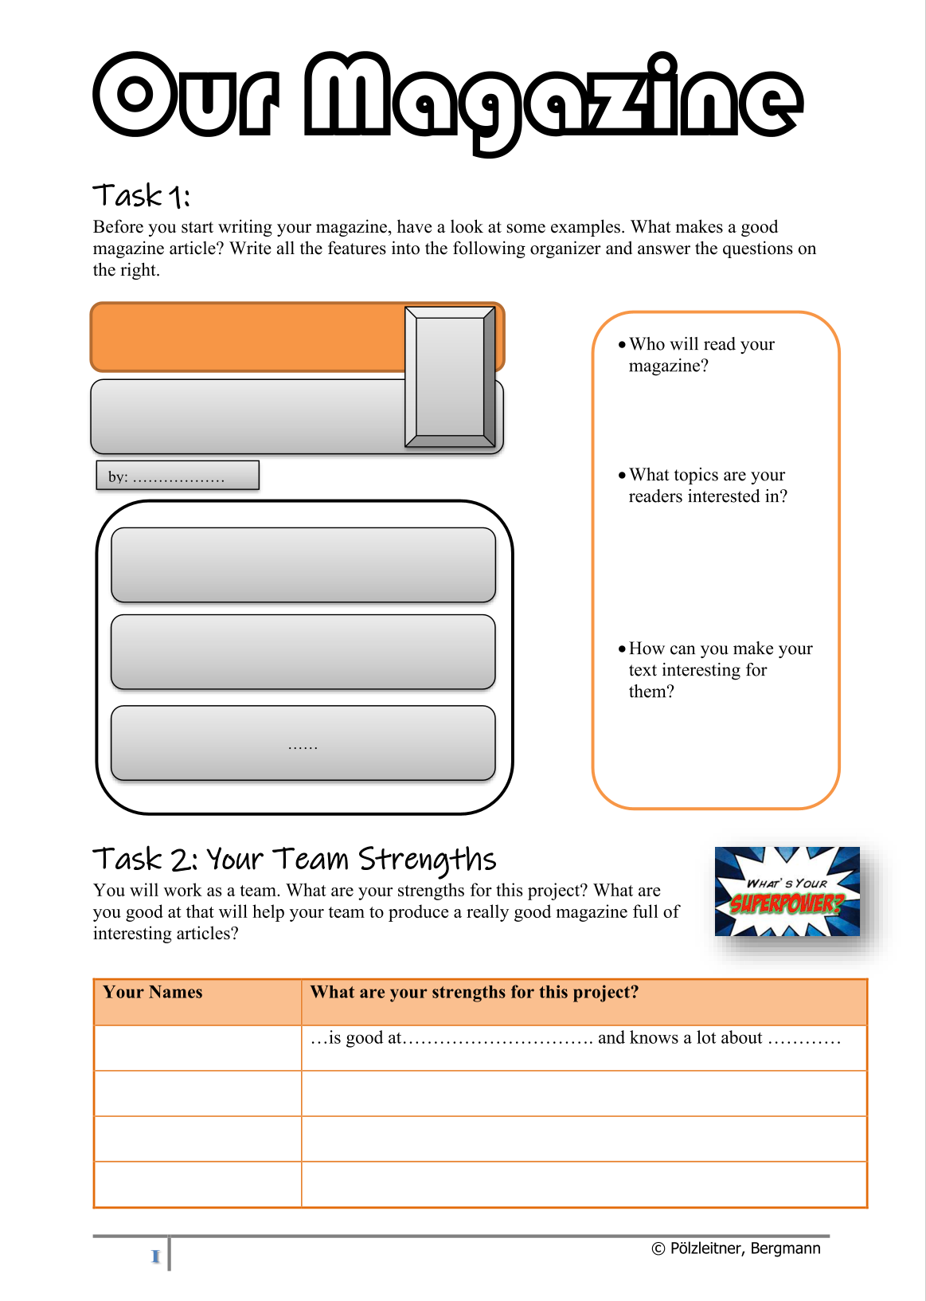
Example 2: Students use CHAT GPT themselves
Magazine Writing, year 4
Phase 1:
Students write group magazines (groups of 4, 3 texts each)
Peer feedback – then magazines are printed
Phase 2:
Students use Chat GPT to write the same articles. They only feed content requests in keywords and required text length matching their own articles. Ss then create a second issue of their magazines using the AI texts.
Phase 3: Reading and comparing the magazines: Which of the articles do you prefer? Why?

Slide 22
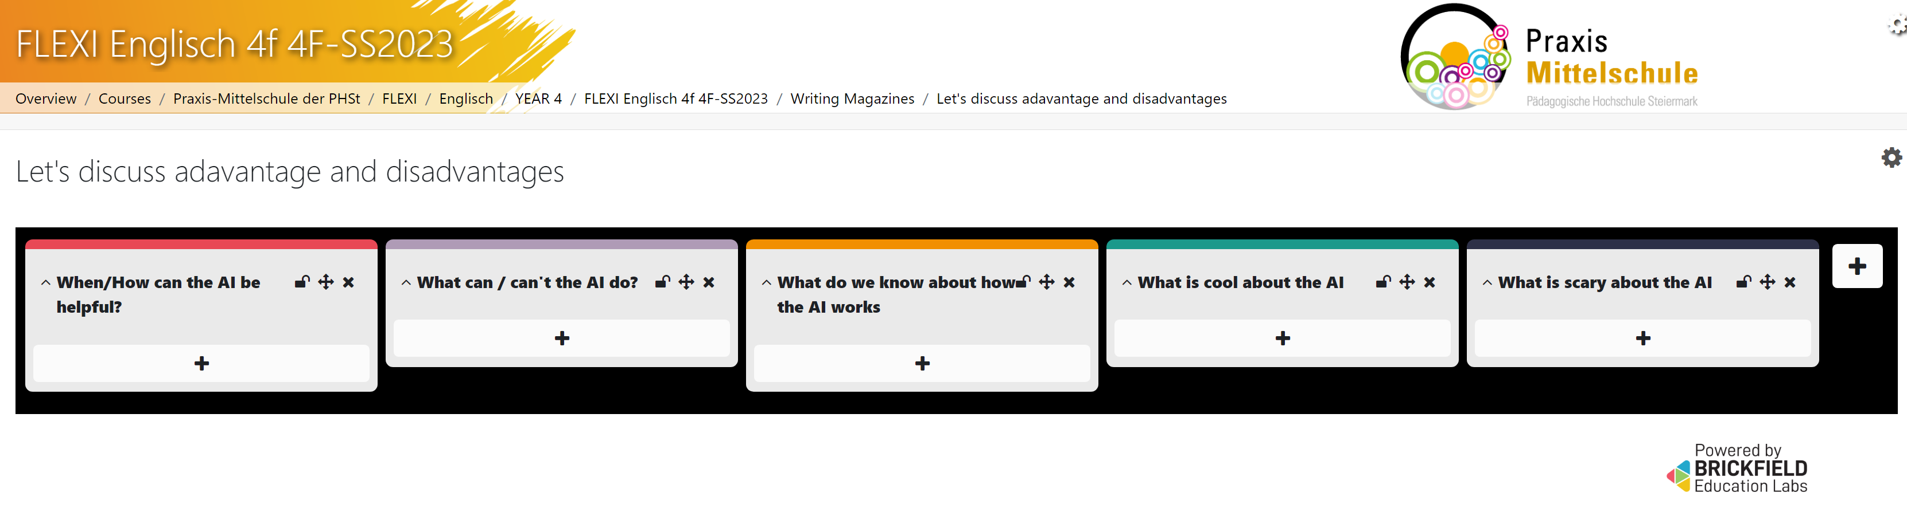
Discussion Phase: Advantages and Disadvantages of AI

Slide 23
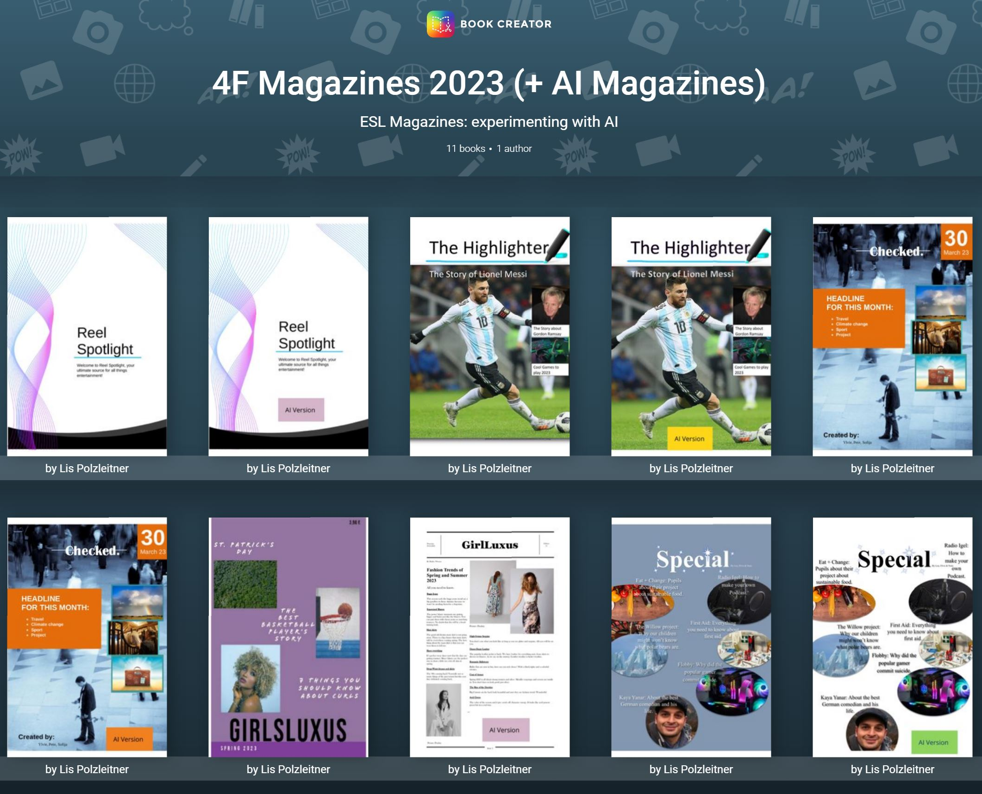

4f Magazines and AI-Versions
https://read.bookcreator.com/library/-NXeyhk7xV3qqGOTbpJk

Slide 24
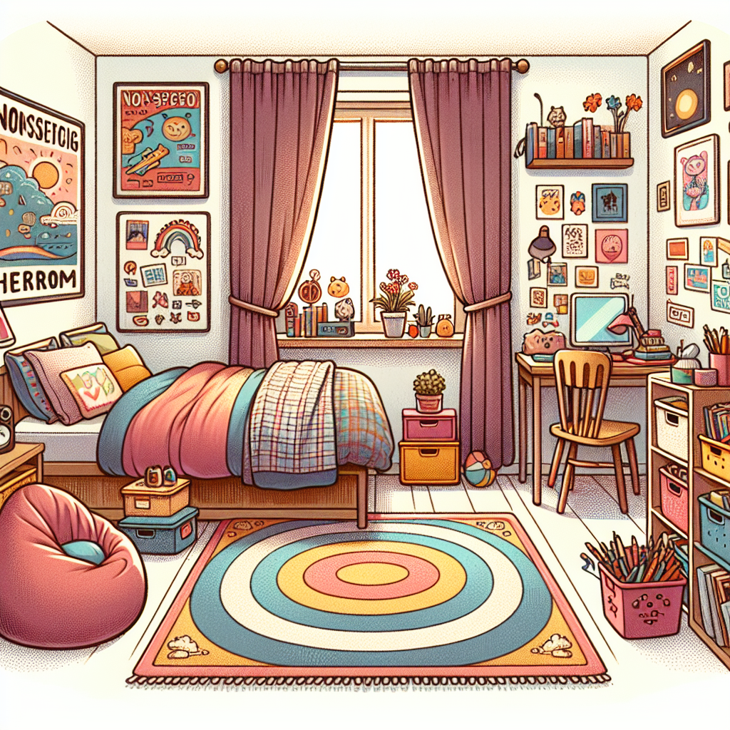
Describing pictures or scenes
Task:
1. Describe your bedroom in detail.
2. Then ask AI to draw a picture. (I have used fobizz here)
3. Check if the picture is correct and write down all the mistakes: e.g.: The curtains in the picture are red, but my curtains are green.
My bedroom is my favorite place in my house. It's where I sleep and play. When you first walk in, you see my bed. It's big and cozy with soft blankets and pillows. I have a colorful rug on the floor that feels nice under my feet.
There's a big window with curtains that let sunlight in during the day. I have posters of my favorite bands and movies on the walls. My desk is near the window. It's where I do my homework and draw pictures. I have shelves filled with books and toys.
In one corner, there's a small bean bag chair where I like to sit and read. Next to it is a toy box filled with games and puzzles. I also have a closet where I keep my clothes and shoes neatly organized.
Overall, my bedroom is a comfy and fun place where I can relax and be myself.

Slide 25
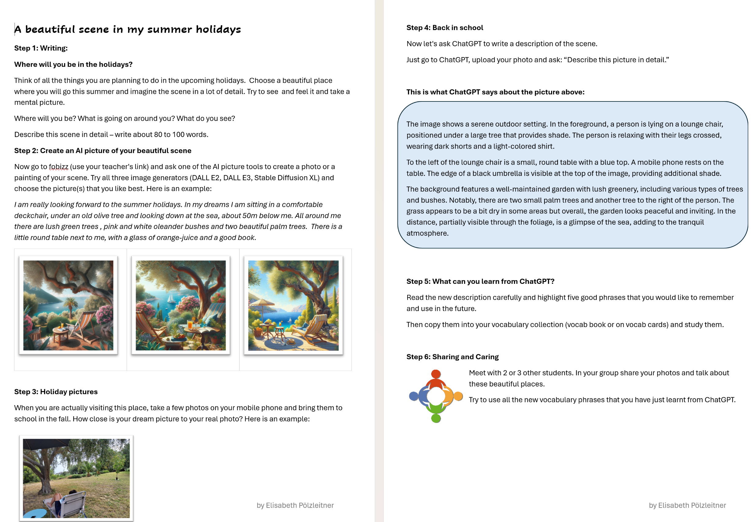
Describing pictures or scenes
https://www.polzleitner.com/epep/0-AI-project/sample-units-for-teaching/holiday-pictures-future-and-past.docx

Slide 26

Writing Feedback given by AI tools

Slide 27
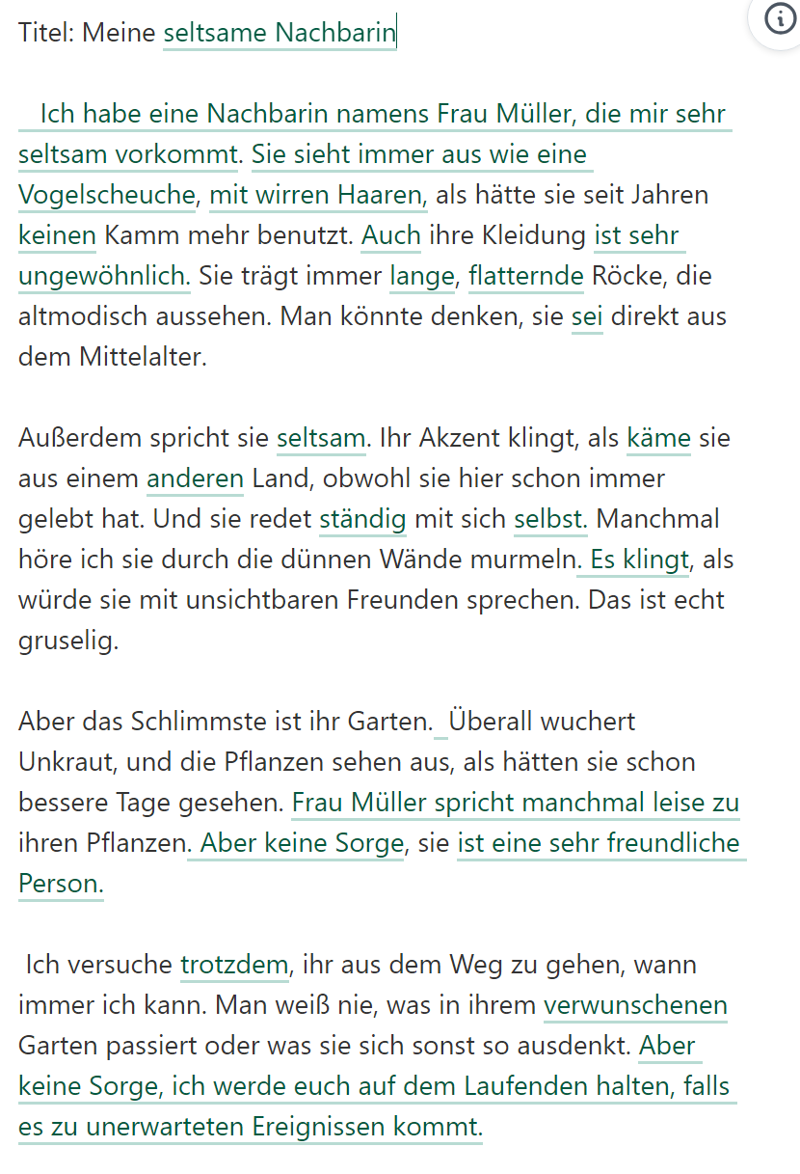
Textüberarbeitung mit DeepL Write
Titel: Meine komische Nachberin
Also, ich hab da diese Nachbarin. Sie ist echt seltsam. Ihr Name ist Frau Müller, glaub ich. Jedenfalls sieht sie immer aus wie ein Vogelscheuche. Ihre Haare sind so wirr, als hätte sie seit Jahren keinem Kamm mehr benutzt. Und ihre Kleidung! Sie trägt immer diese langen, flatternden Röcke, die total altmodisch aussehen. Man könnte denken, sie ist direkt aus dem Mittelalter heraus gekommen.
Außerdem spricht sie komisch. Ihr Akzent klingt, als würde sie aus einem anderem Land kommen, obwohl sie hier schon immer gelebt hat. Und sie redet auch mit sich selber, ständig! Manchmal höre ich sie durch die dünnen Wände murmeln, als würde sie mit unsichtbaren Freunden sprechen. Das ist echt gruselig.
Aber das Schlimmste ist ihr Garten. Der sieht aus wie ein Dschungel! Überall wuchert Unkraut, und die Pflanzen sehen aus, als hätten sie schon bessere Tage gesehen. Manchmal glaube ich, dass sie mit ihren Pflanzen spricht, denn ich sehe sie oft dabei, wie sie leise zu den Blumen flüstert. Wer weiß, was sie denen erzählt.
Insgesamt ist Frau Müller echt ein komischer Vogel. Ich versuche, ihr aus dem Weg zu gehen, wann immer ich kann. Man weiß nie, was in ihrem verwunschenem Garten passiert, oder was sie sich sonst so ausdenkt.
DeepL-Write

Slide 28
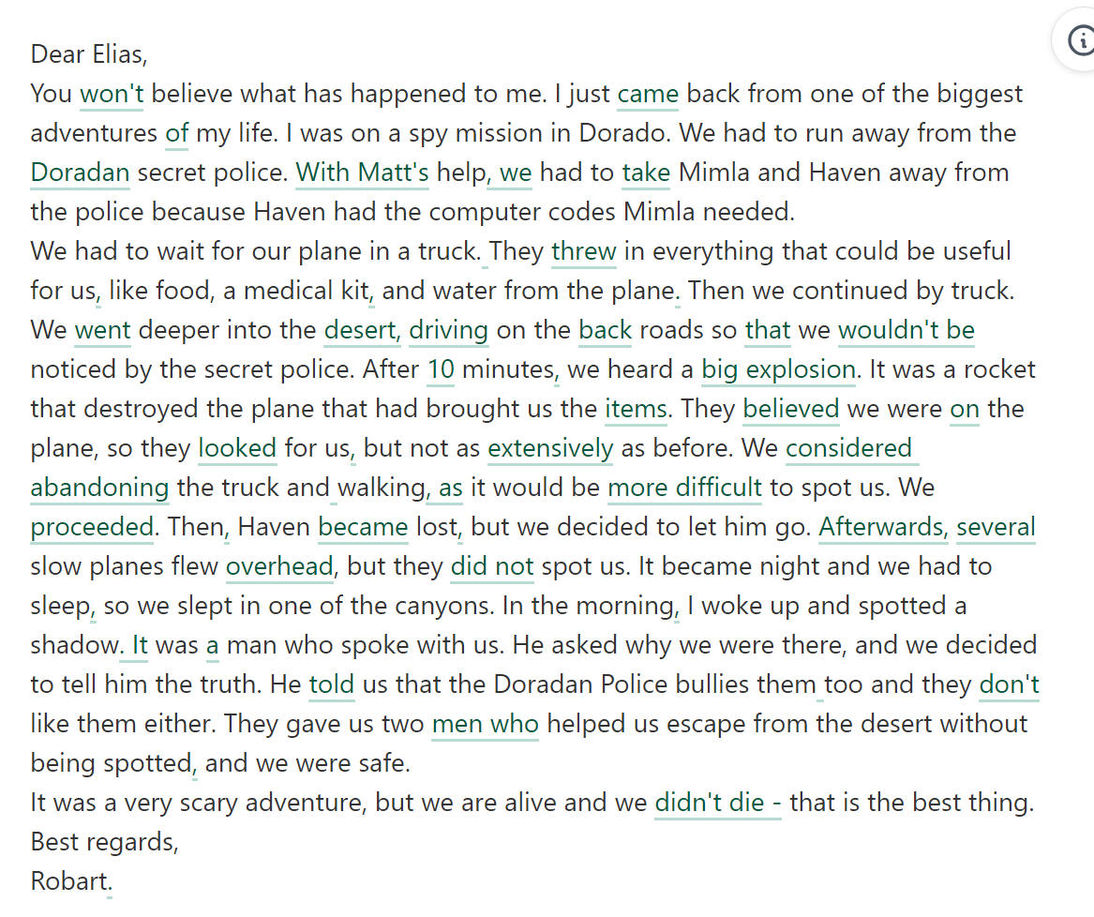
Deepl Write: Fehlerkorrekutur, Stil und Register
Dear Elias, You won’t believe what has happened to me . I have just come back from one of the biggest adventures in my life. I was on a spy mission in Dorado. We had to run away from the doradan secret police. with the help of Matt We had to bring Mimla and Haven away from the police because Haven had the computer codes Mimla needed.We had to wait for our plane in a truck.They throw in everything that could be useful for us like food, a medical kit and water from the plane for us(?). Then we continued by truck. We got deeper into the desert. We had to drive on the desert roads so we would not get noticed by the secret police. After 1o minutes we heard a BOOOOM. It was a rocket that destroyed the plane that had brought us the things. They thought we were in the plane, so they searched for us but not as much as before. We thought about leaving the truck and walking because then it would be harder to spot us. We continued. Then Haven got lost but we decided to let him go. Then a lot of slow planes flew above us, but they didn’t spot us. It became night and we had to sleep so we slept in one of the canyons. In the morning I woke up and I spotted a shadow - it was man who spoke with us. He asked why we were there, and we decided to tell him the truth. He telled us that, the Doradan Police bullies them too, and they don’t like them either. They gave us two man that helped us escape from the desert without being spotted and we were safe.It was a very scary adventure, but we are alive and we don’t died that is the best thing.Best regards, Robart

Slide 29

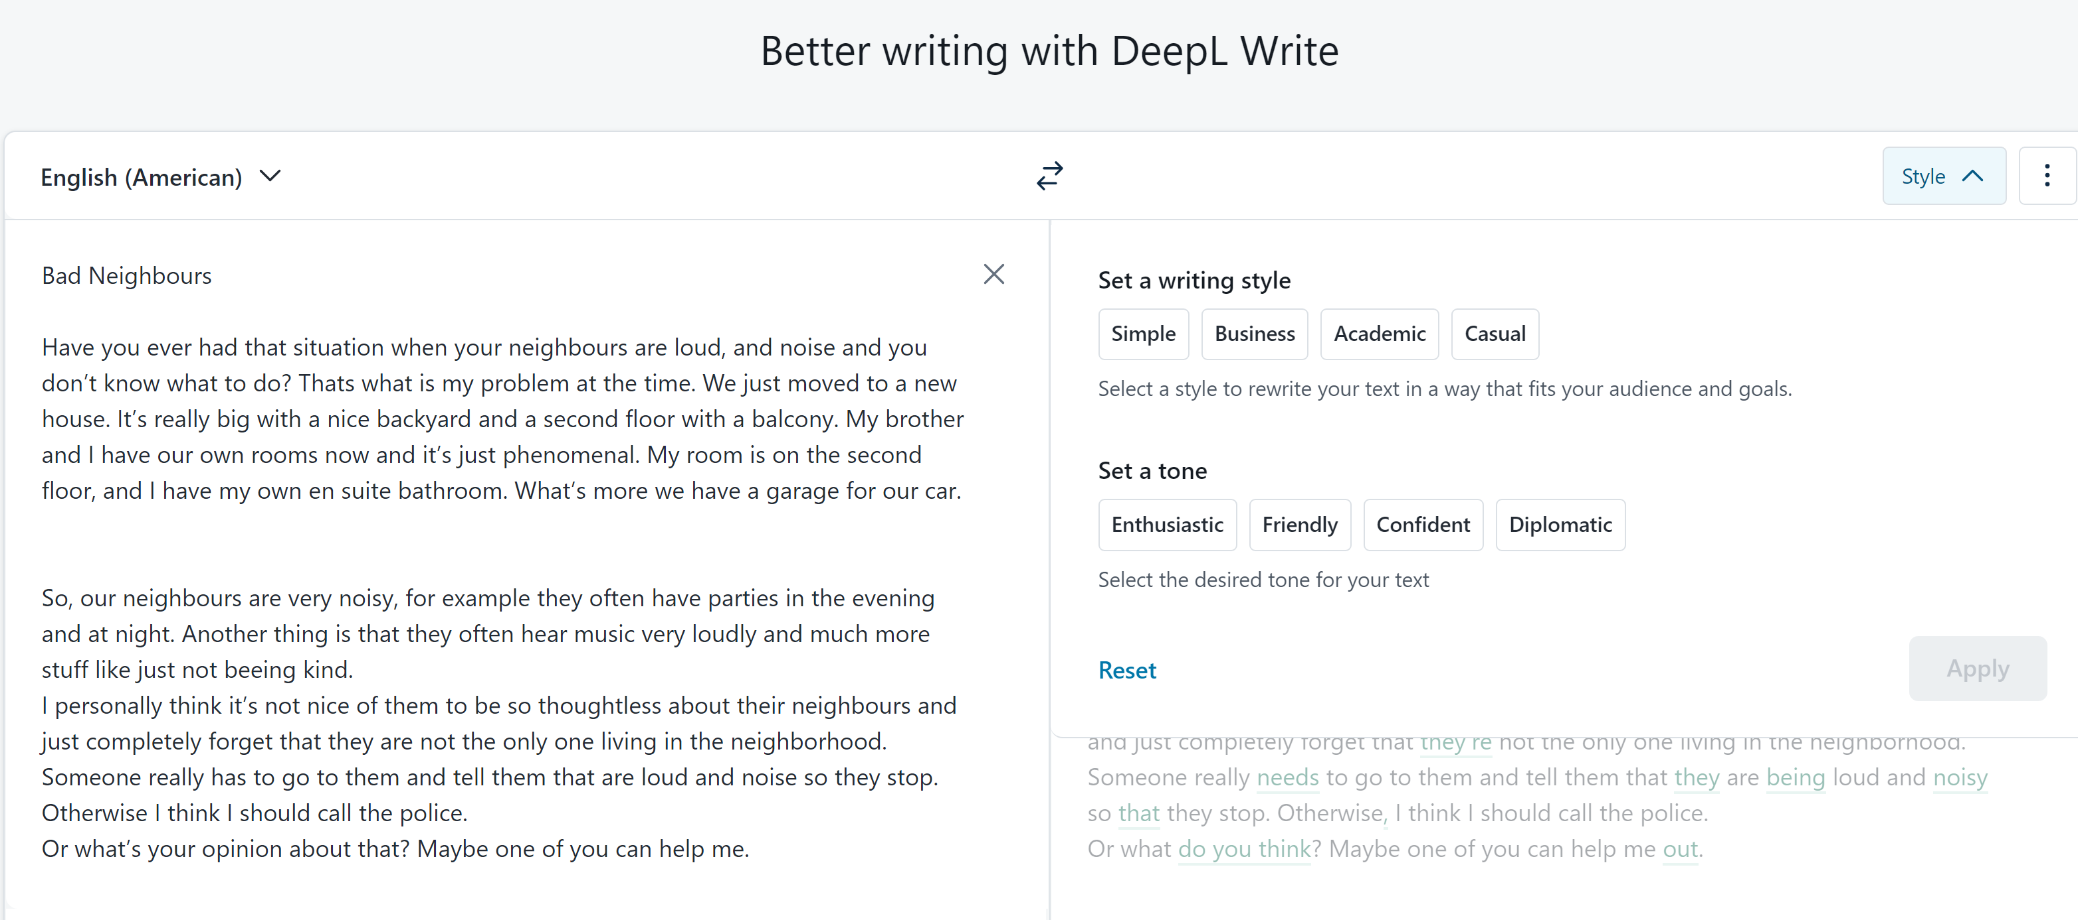

Slide 30
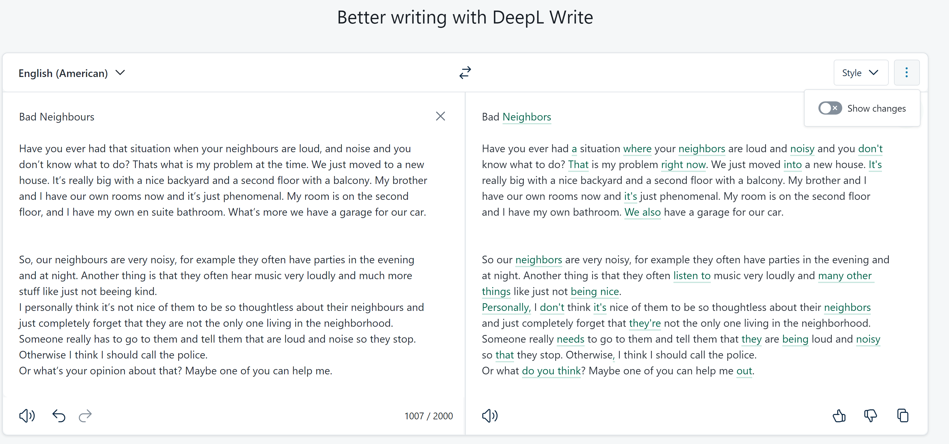
DeepL Write: corrections only

Slide 31
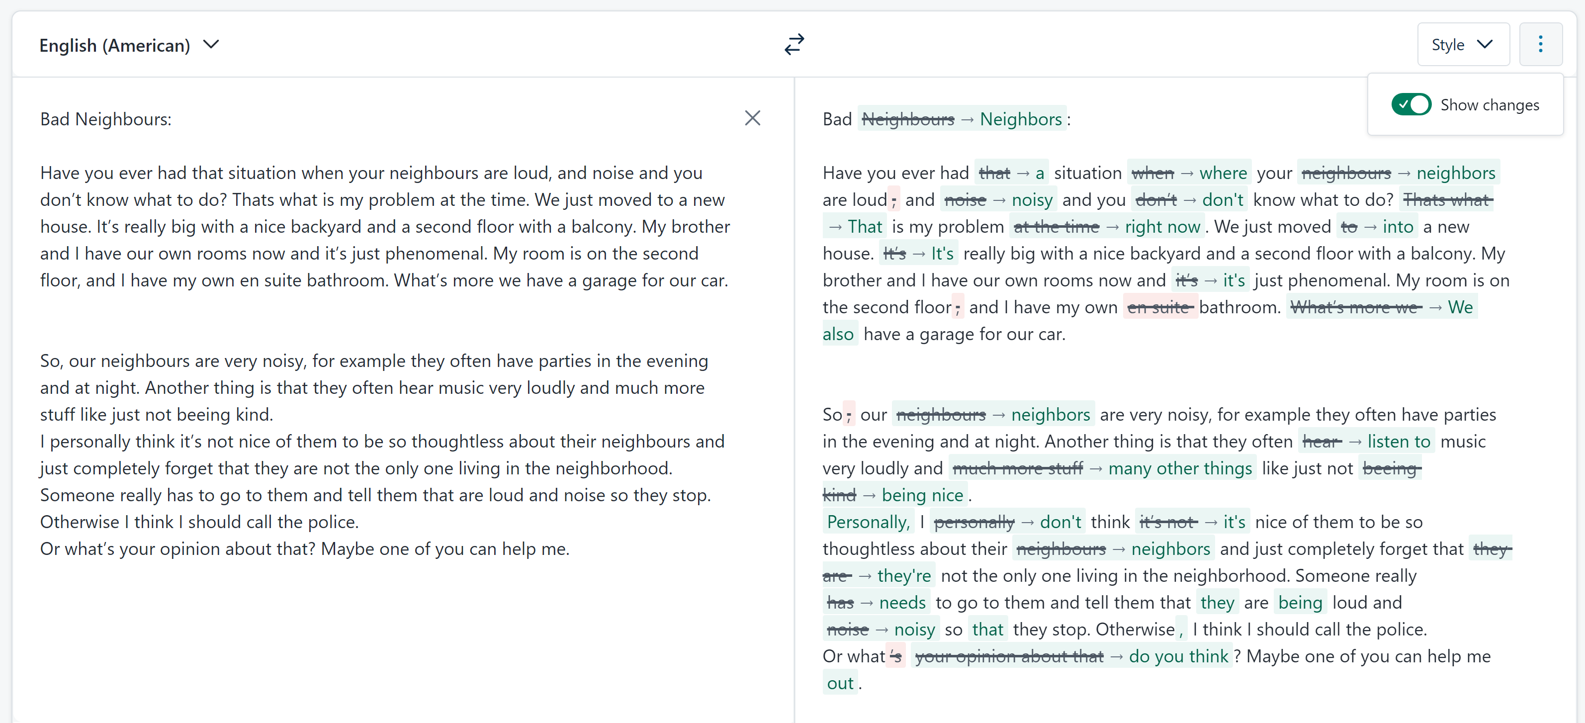
DeepL Write: corrections only – show changes

Slide 32
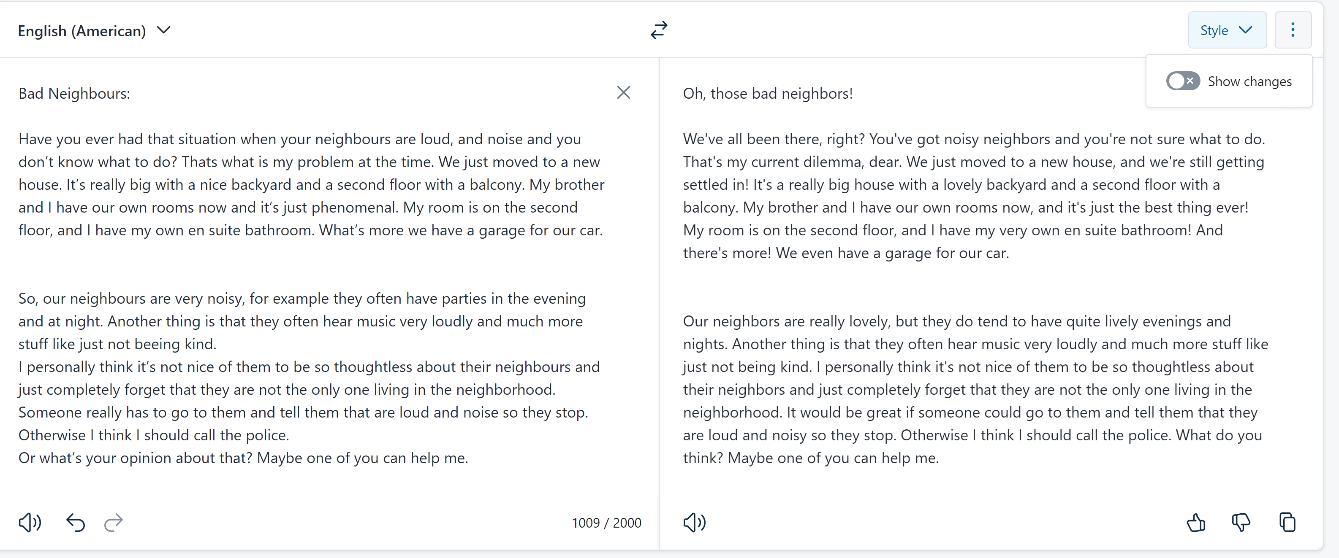
DeepL Write: : Friendly tone

Slide 33
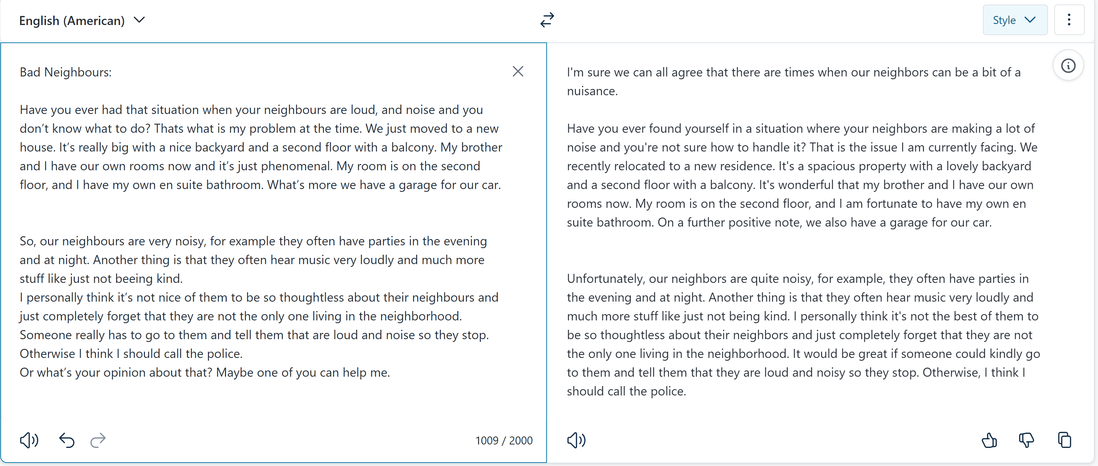
DeepL Write: : Diplomatic tone

Slide 34

Bad Neighbours: original text written by ESL student, age 15
Have you ever had that situation when your neighbours are loud, and noise and you don’t know what to do? Thats what is my problem at the time. We just moved to a new house. It’s really big with a nice backyard and a second floor with a balcony. My brother and I have our own rooms now and it’s just phenomenal. My room is on the second floor, and I have my own en suite bathroom. What’s more we have a garage for our car.
So, our neighbours are very noisy, for example they often have parties in the evening and at night. Another thing is that they often hear music very loudly and much more stuff like just not beeing kind.
I personally think it’s not nice of them to be so thoughtless about their neighbours and just completely forget that they are not the only one living in the neighborhood. Someone really has to go to them and tell them that are loud and noise so they stop. Otherwise I think I should call the police.
Or what’s your opinion about that? Maybe one of you can help me.
WRITIFY.AI: Here is the paragraph rewritten in a neutral tone of voice:
"New Neighbors Some individuals may find themselves in a situation where their neighbors are noisy, and they are unsure of how to address the issue. This appears to be the case for the writer. They have recently moved to a new, larger house with a nice backyard, a second floor with a balcony, and individual rooms for the writer and their brother. The writer's room is on the second floor and has an en-suite bathroom. Additionally, the house has a garage for their car. While the new living situation seems quite favorable, the writer is facing a challenge with their neighbors' noise levels.“
The neighbors are quite noisy. They frequently have parties in the evenings and at night. Additionally, they often play music at a high volume. There are other inconsiderate behaviors as well.
It seems the neighbors are not mindful of the impact their actions have on the surrounding community. Someone may need to have a conversation with them to make them aware of the disturbances they are causing. Alternatively, contacting the authorities could be an option if the issues persist.
What are your thoughts on the best approach to address this situation? Perhaps you have a suggestion that could help resolve the matter.

Slide 35
Friendly Neighbors (Writify.AI, Friendly tone)
Hey there! Have you ever found yourself in a situation where your neighbors are just a little too loud, and the noise is really getting to you? Well, that's the predicament I'm in right now. You see, we just moved into a brand new house, and it's absolutely fantastic. It's a really spacious place with a lovely backyard and a second floor with a balcony. My brother and I each have our own rooms now, which is just incredible. My room is on the second floor, and I even have my own private bathroom. And the best part? We have a garage for our car. It's just been such a wonderful experience settling into this new home, you know? The only downside is that the neighbors can be a bit noisy at times, but I'm sure we'll figure out a way to work through that. Overall, I'm just so grateful for this new chapter in our lives."
"I'm sorry to hear that your neighbors are being so noisy and inconsiderate. It must be really frustrating to deal with that. I can understand why you're feeling annoyed with them.
It sounds like they often have loud parties and play music at high volumes, which can be really disruptive, especially at night. That's not very considerate of them towards the rest of the neighborhood.
If I were in your shoes, I would try talking to them first, in a friendly and polite way, to see if they'd be willing to be more mindful of the noise level. Maybe they're not even aware of how much it's impacting you and the others around them. It's worth a try to see if you can resolve it amicably.
However, if they continue to be uncooperative and the noise persists, then I think calling the police would be a reasonable next step. You shouldn't have to put up with that kind of disturbance, especially in your own home.
I hope you're able to find a solution that works for you. Let me know if you need any other suggestions or advice. I'm happy to lend an ear and provide any support I can."
Problematic Neighbors (Writify.AI, Formal)
It is not uncommon to encounter situations where one's neighbors exhibit disruptive behavior, such as excessive noise, which can be quite challenging to address. This is precisely the predicament I find myself in at the present moment. My family and I have recently relocated to a new, spacious residence, complete with a sizable backyard and a second floor featuring a balcony. My brother and I now have our own private quarters, which is a remarkable improvement. My personal living space is situated on the second level and includes a private en-suite bathroom. Furthermore, we have the added convenience of a garage to accommodate our vehicle.
The residents adjacent to my dwelling place exhibit a significant degree of noise disturbance. For instance, they frequently hold social gatherings in the evening and late-night hours. Additionally, they often play music at an excessively high volume. Furthermore, they display a general lack of consideration for their neighbors.
Personally, I believe their inconsiderate behavior is unacceptable. They appear to disregard the fact that they are not the sole occupants of the local community. I believe it would be prudent for someone to approach them directly and inform them that their actions are disruptive. Failing a resolution through this approach, I may be compelled to contact the relevant authorities.
I welcome any opinions or suggestions you may have regarding this matter. Perhaps one of you could provide guidance on the most appropriate course of action.

Slide 36
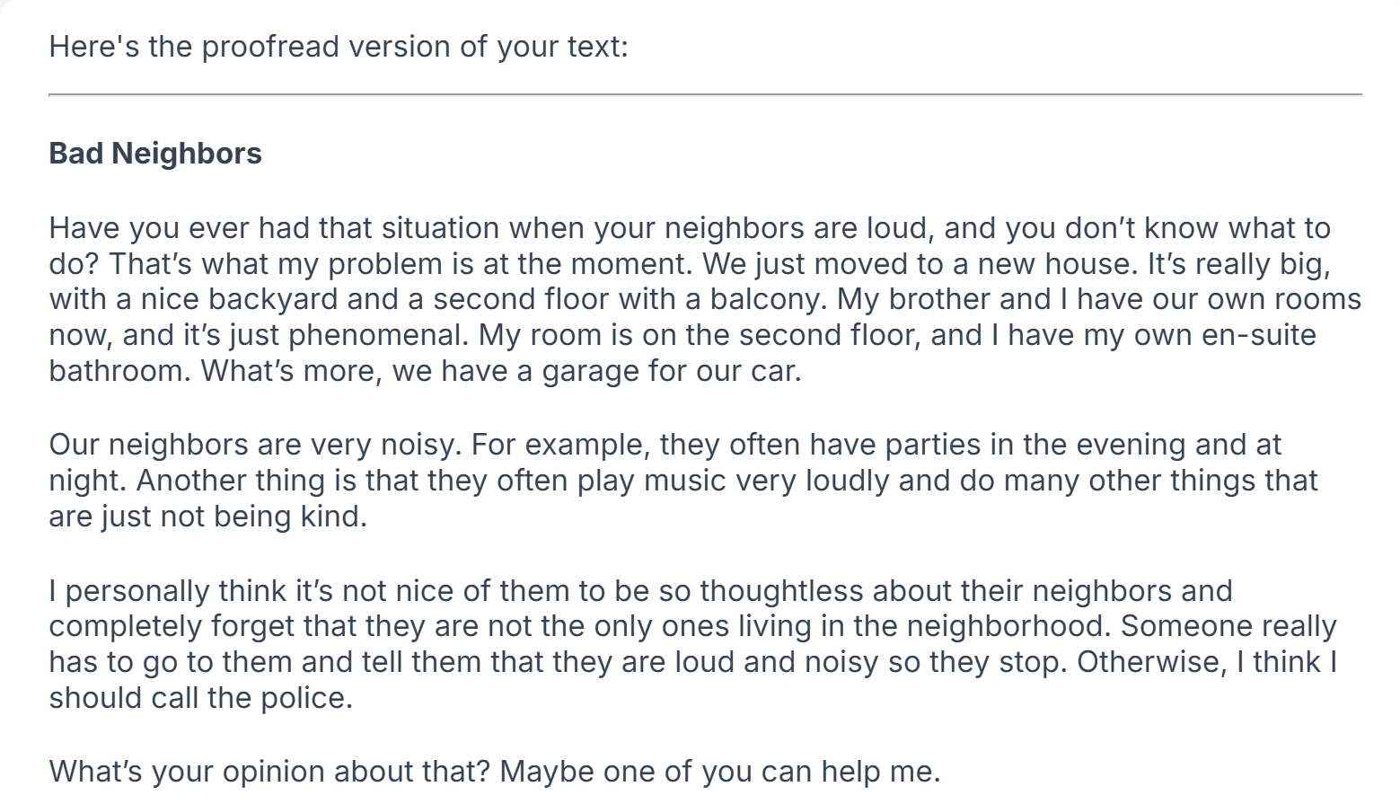


Slide 37
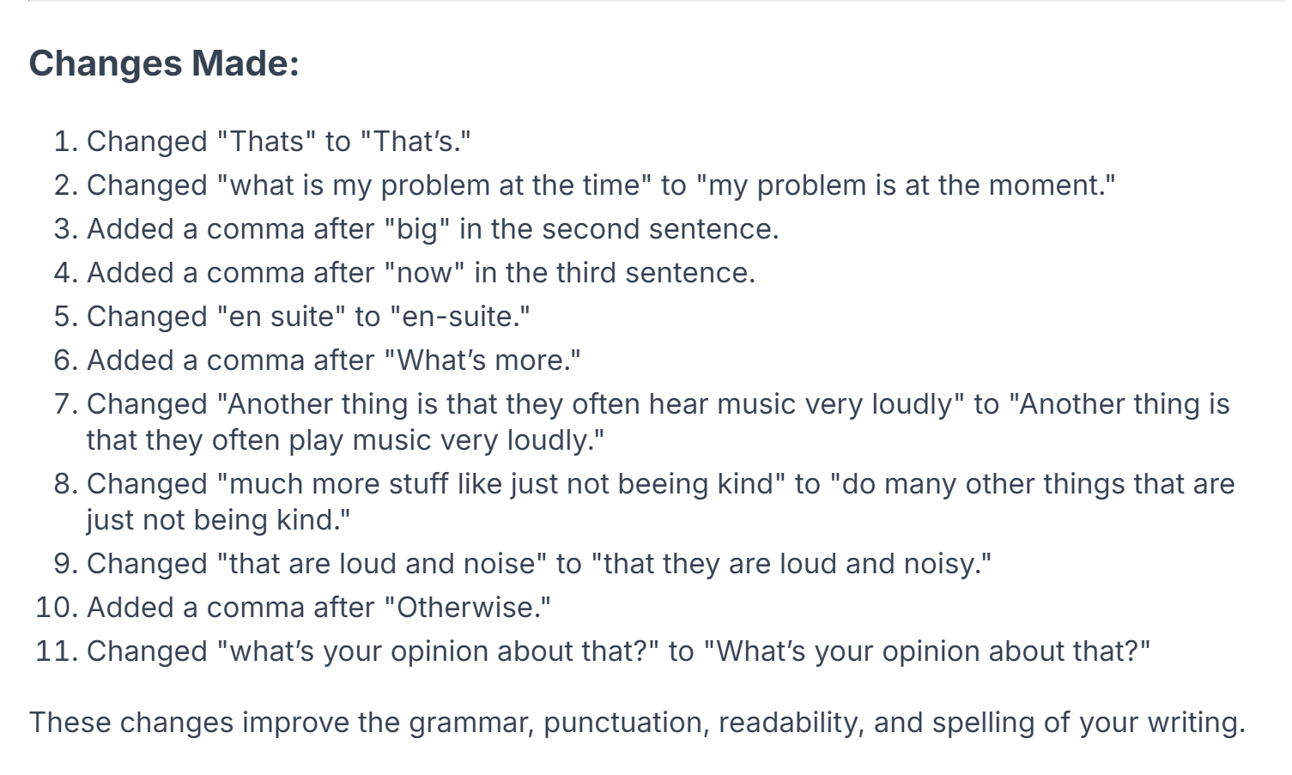
Unfortunately, the changes are not marked in the text and therefore not easy to spot for the learners.
They need to consult the list of changes, but do not see them in context.

Slide 38
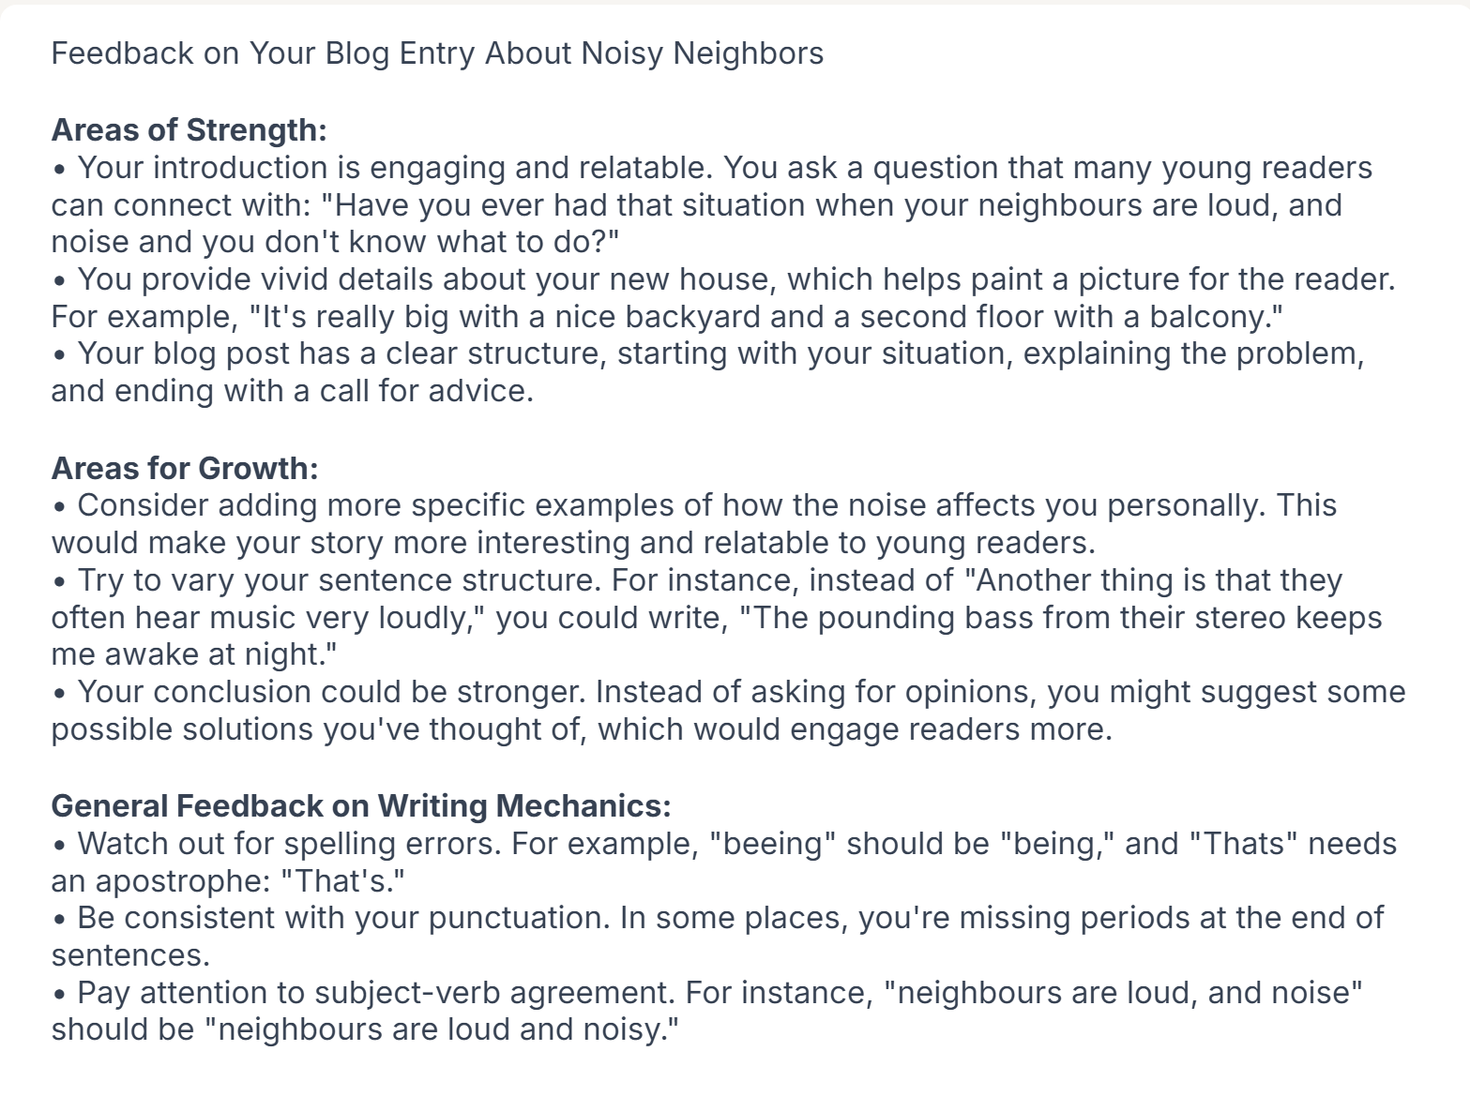
Helpful feedback for revising and editing.

Slide 39
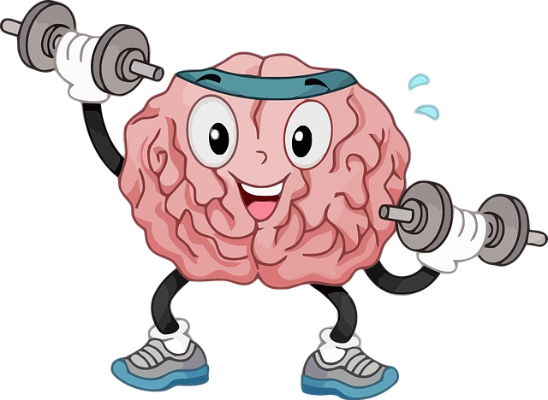
Probieren Sie selbst!
Bearbeiten Sie 2-3 Texte Ihrer eigenen SchülerInnen (ananymisiert!).
Verlangen Sie
Fehlerkorrektur
Stilistische Verbesserung
Feedback und Tipps zur Verbesserung
Wie hilfreich ist das Feedback?
Urteilen Sie selbst!

Slide 40
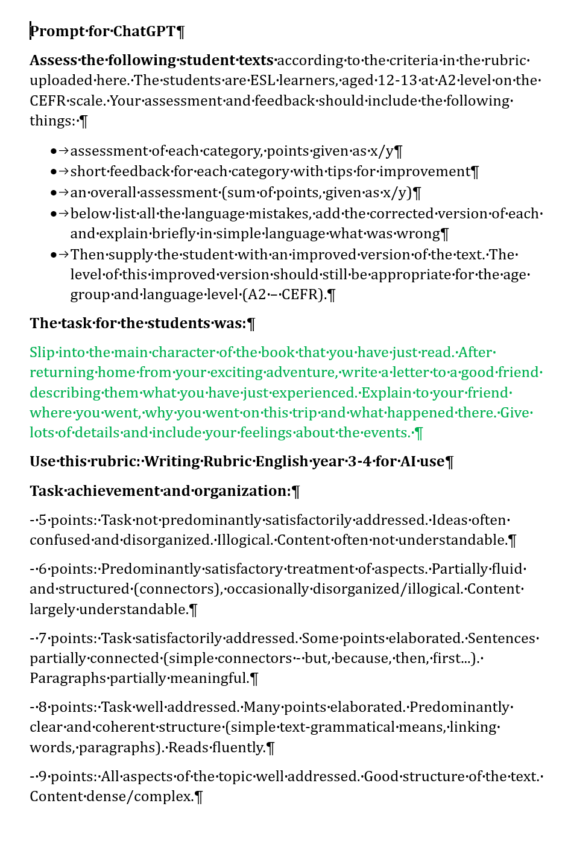
Feedback und Bewertungshilfe für Texte
Prompt for ChatGPT
Assess the following student texts according to the criteria in the rubric uploaded here. The students are ESL learners, aged 12-13 at A2 level on the CEFR scale. Your assessment and feedback should include the following things: assessment of each category, points given as x/y. Short feedback for each category with tips for improvement. An overall assessment (sum of points, given as x/y). Below list all the language mistakes, add the corrected version of each and explain briefly in simple language what was wrong. Finally, add an improved version of the text. The improved version should be appropriate for the age-group and language level (A2 on the CEFR).
Use this rubric: paste your rubric in here.
Task description for the learners: paste in the task description for the students

Slide 41
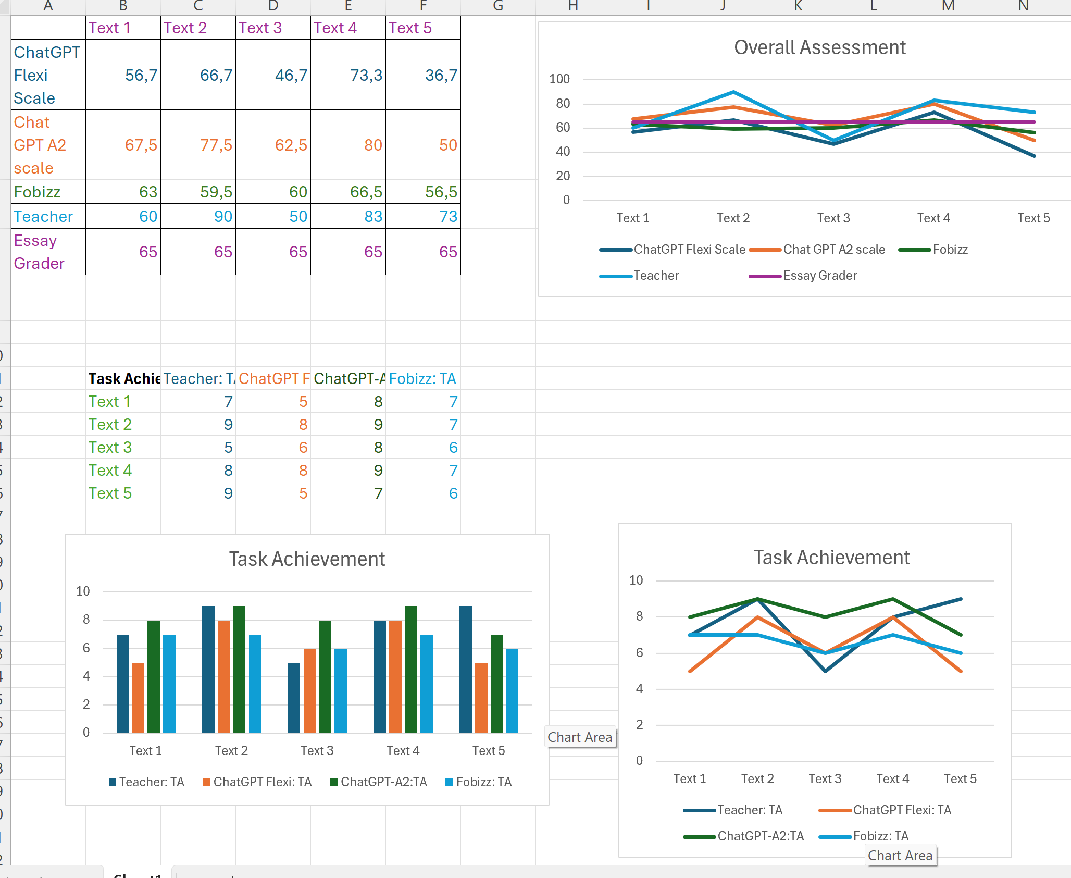

Hilfe für das bewerten von Schülertexten
Mit Vorsicht!
https://www.polzleitner.com/epep/0-AI-project/grading-samples/new-version/5-texts-AI-grading-new.xlsx
5Texts5Tools

Slide 42

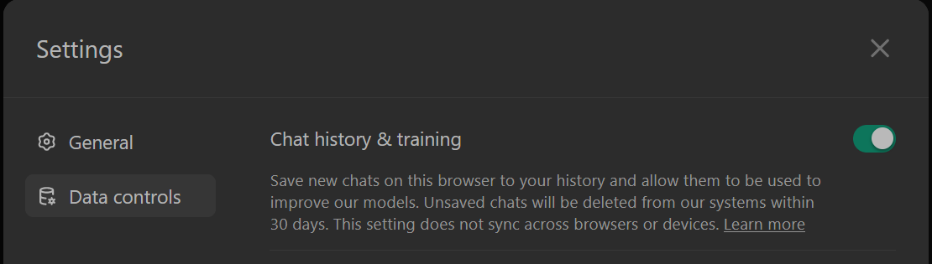
Data Security ???
Viele US-Anbieter; NICHT DSGVO-konform; jedenfalls in Einstellungen Chat History & Training deaktivieren!
Besser: datenschutzkonform nutzen mit https://fobizz.com/
Shared space today:
https://go.fobizz.com/?token=488109b87c955bd0
This Photo by Unknown Author is licensed under CC BY-SA

Slide 43

Fobizz, ein sicherer Einstieg für Schüler/innen
Melden Sie sich bei Fobizz an und Probieren Sie einige der Anwendungen aus.
Chat with AI (sicherer Zugang zu ChatGPT, kann alles was CHatGPT kann.
AI PDF Chat (kann Schüler/innen beim Textverständnis helfen, kann Textstellen und Inhalte erklären.)
AI Image Generator (Anwendungsbeispiel: SuS beschreiben eine Situation oder ein Objekt, KI zeichnet das passende Bild. Genaues, detailliertes Beschreiben lernen)
AI Transcription (kann video und audio files transkribieren)
AI Character Chat (SuS können sich zB mit historischen oder berühmten Personen unterhalten)
AI Image to Text (kann zB Schülerhandschrift digitalisieren)
AI Grading Assistant (hilft bei der Bewertung von Schülertexten und gibt gutes Feedback)
Erstellen Sie einen safe space für Ihre Klasse
Wählen Sie die Tools die die SuS verwenden dürfen
Welche Einsatzmöglichkeiten sehen Sie für Ihren Unterricht?
This Photo by Unknown Author is licensed under CC BY-SA

Slide 44
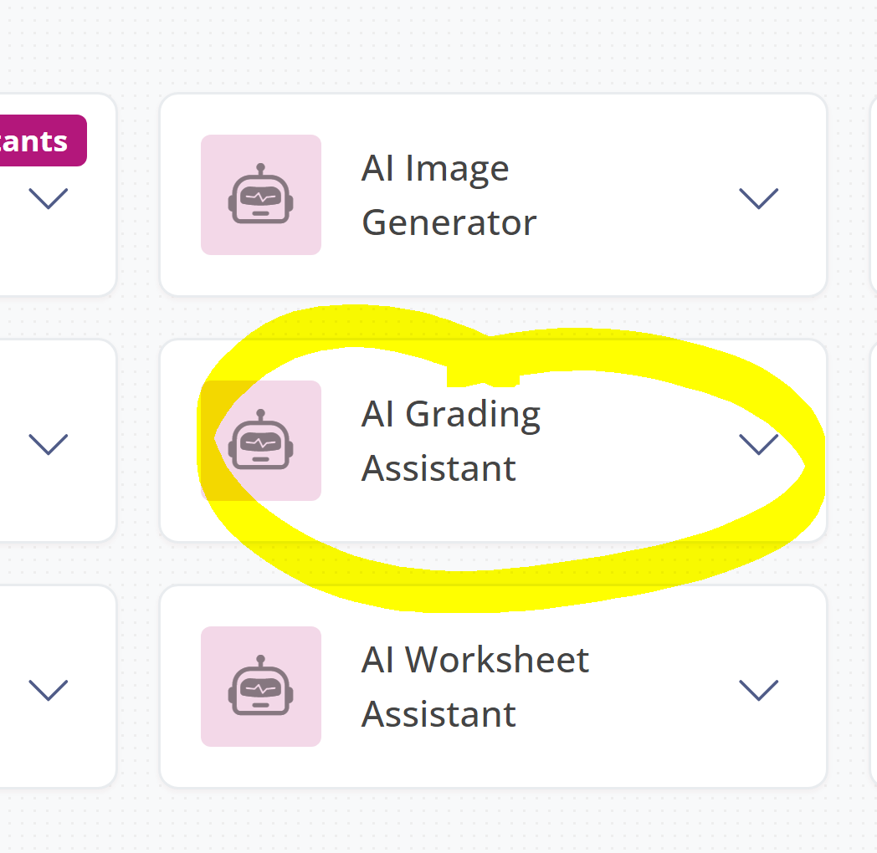
Bewerten von Texten mit Fobizz
Sign in to Fobizz
Go to AI Assistance Tools
Choose: AI Grading Assistant
Fill in all the relevant information
Choose relevant criteria and weightings
Finetune your prompts a bit
Compare the results with ChatGPT
Wie hilfreich sind die Ergebnisse?
This Photo by Unknown Author is licensed under CC BY-SA

