Slide 1
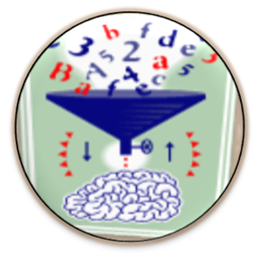
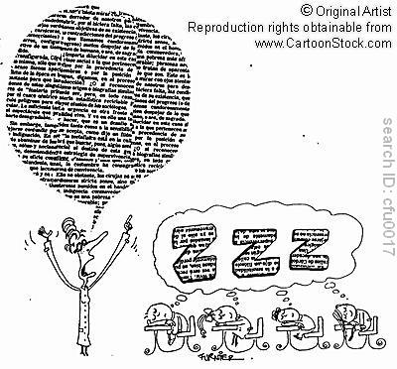

Do your recognize this?
Adjectives and Adverbs
An adjective is a word or set of words that modifies a noun or pronoun.
Examples:
That is a cute puppy.
That puppy is cute.
That puppy looks cute.
An adverb is a word or set of words that modifies verbs, adjectives, or other adverbs.
Examples:
He speaks slowly
She takes it very seriously
He is especially clever
How can we put the presented principles into practice?

Slide 2
Awareness Raising and Hypotheses building
Teachers’ conference:
This is what your teachers said about your class:
Most students of 2b do their homework regularly. | Some students are a bit disorganized and forget to hand in their homework.
Most students do their work carefully. | Some kids hand in sloppy work.
Most kids work quietly in class. | A few kids are very noisy.
Most students work quickly and efficiently in class. | Many students are nervous during tests.
Some students work slowly but very carefully. | Some kids are impatient.
The class can sing beautifully. | The reading diaries are really beautiful.
Notes:
Lernende müssen selbst neue Formen, Strukturen, Bedeutungen wahrnehmen und Hypothesen bilden.
Typisch: Kinder denken in BEDEUTUNGEN – sie sehen nicht das –ly – sondern sehen inhaltliche Regelmäßigkeiten (die Guten links, die schlechten rechts. Wenn es viele Kinder sind links, Wenn nur manche rechts….)

Slide 3
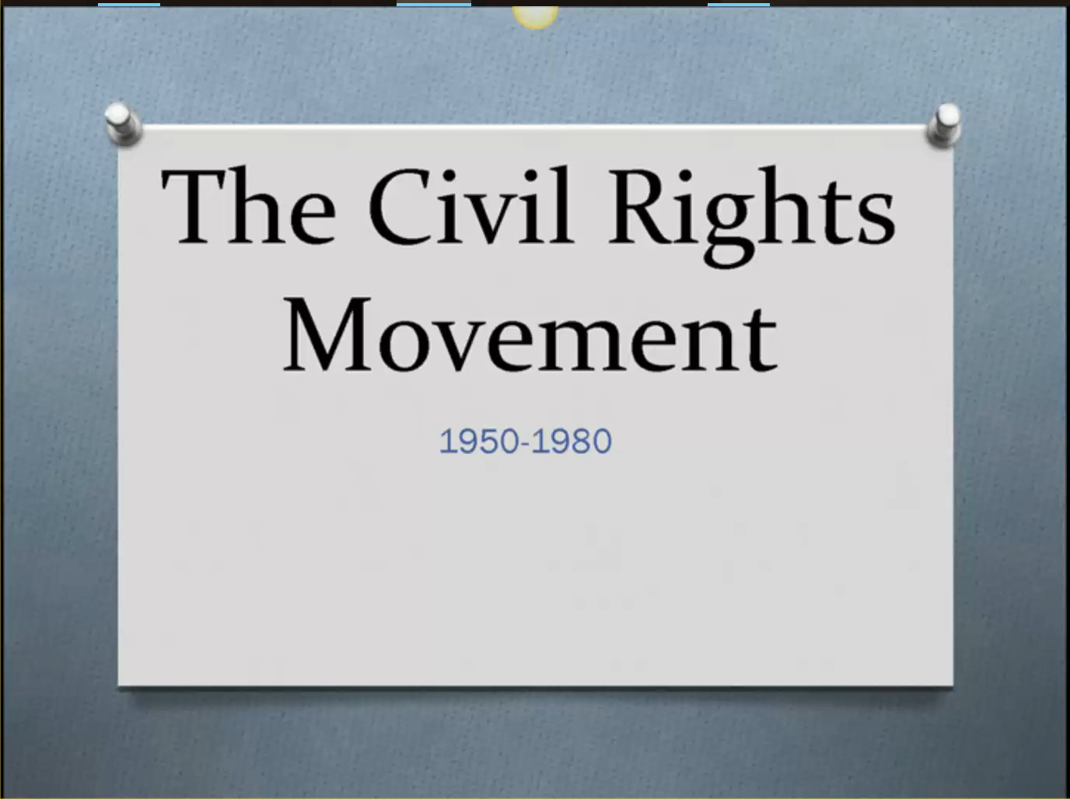

Presenting a topic or book
using new language actively in a meaningful context
presenting ideas coherently

Slide 4
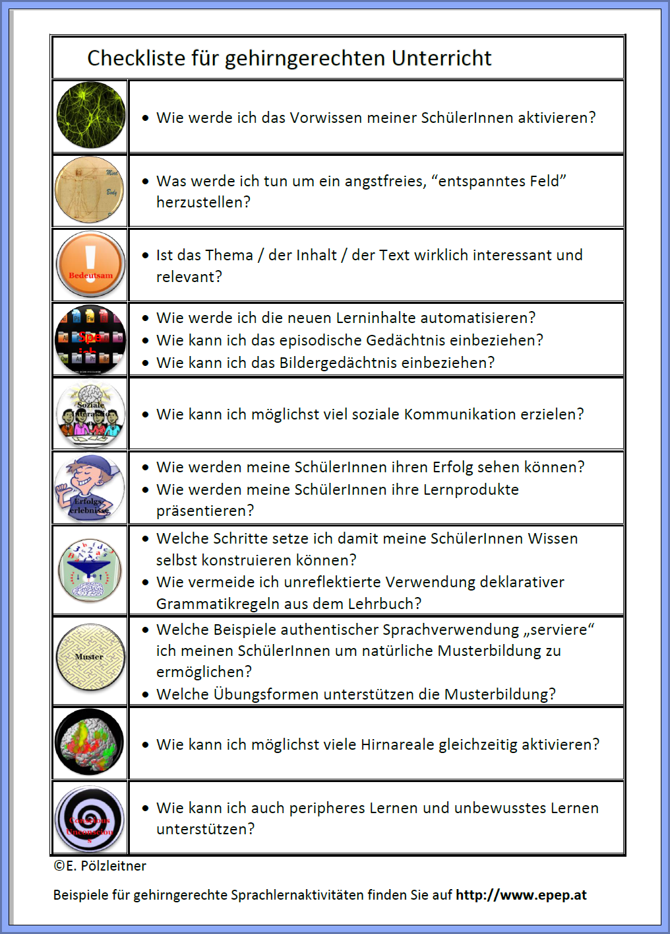
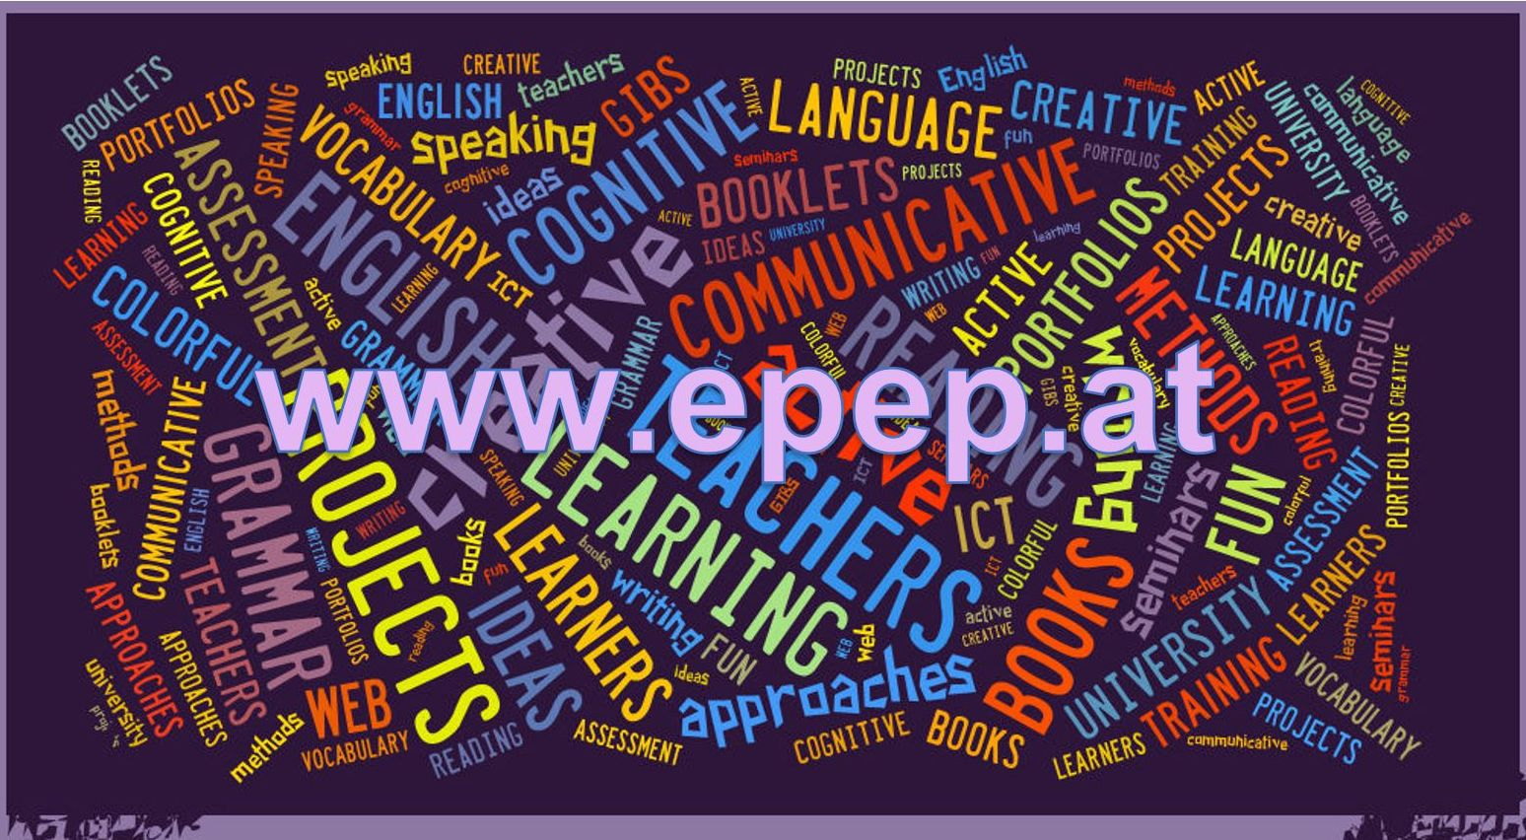
Download
Find more examples and materials for brain-friendly language learning on…

Slide 5
Sources
Sources
Ahsen, A. "ISM: The triple code model for imagery and psychophysiology." Journal of Mental Imagery 8.4 (1984): 15-43.
Caine, R.N. and G. Caine. "Understanding a Brain-Based Approach to Learning and Teaching." Educational Leadership 48.2 (1990): 66-70. 06 11 2011. <http://www.sedl.org/scimath/compass/v03n02/1.html>.
Caspary, Ralf. "Dopamindusche im Klassenzimmer." Caspary, Ralf. Lernen und Gehirn. Freiburg im Breisgau: Herder, 2006.
Hannaford, Carla. Smart Moves: Why learning is not all in your head. Arlington, Virginia: Great Ocean Publishers,, 1995.
Herrmann, Ulrich. "Gehirnforschung und die neurodidaktische Revision schulisch organisierten Lehrens und Lernens." Herrmann, Ulrich. Neurodidaktik. Weinheim und Basel: Beltz, 2006.
Lewis, Michael. Teaching Collocation. Heine, 2000.
Macedonia, Manuela and Karsten Müller. "The impact of iconic gestures on foreign language word learning and its neural substrate." Human Brain Mapping (2011): 982-998.
Macedonia, Manuela. “Mit Händen und Füßen” in Gehirn und Geist, Spektrum, 12.2. 06.12.2012. http://www.macedonia.at/uncategorized/gehirn-und-geist-und-brain-cast/
Mercer, Sarah. "Mindful Use of Praise." erscheint demnächst. 2011.
Newby, David. Grammar for Communication. Wien: Österreichischer Bundesverlag, 2001.
—. Grammar for Communication: Exercises and Creative Activities. Wien: Österreichischer Bundesverlag, 2001.
Roth, Gerhard. "Warum sind Lehren und Lernen so schwierig?" Herrmann, Ulrich. Neurodidaktik: Grundlagen und Vorschläge für gehirngerechtes Lehren und Lernen. Weinheim und Basel: Belz, 2006.
Schachl, Hans. Was haben wir im Kopf? Die Grundlagen für gehirngerechtes Lehren und Lernen. Linz: Veritas, 2006.
Spitzer, Manfred. Lernen. Gehirnforschung und die Schule des Lebens. Heidelberg/Berlin, 2002.
Spitzer, Manfred. "Medizin für die Schule." Caspary, Ralf. Lernen und Gehirn. Freiburg im Breisgau: Herder, 2006.
Stevick, Earl W. Memory, Meaning and Method. Boston: Heinle, 1996.
Szabos, Janice and Vanessa Filkins. Reading, A Novel Approach. Good Apple Inc., 1984.
Zull, James. The Art of Changing the Brain: enriching teaching by exploring the biology of learning. Sterling, Virginia: Stylus Publishing, 2002.

