Slide 1



Speaking and the Brain: Part II
Let‘s recap…
Create authentic, interesting activities that the learners want to engage with.
Create a relaxed atmosphere where errors are seen as stepping stones of learning.
Use as many senses and parts of the brain as possible
Create tasks that require the learners to make associations with their previous knowledge and experiences
Speaking activities do this perfectly!
Notes:
Let‘s recap part 1: How can we create conditions that enhance learning?
´Click:
First of all we want to create authentic, interesting activities that the learners want to engage with. They must be relevant and related to the learners‘ lives, experiences and interests.
Click
Secondly , we need to create a relaxed atmosphere that invites learners to participate and to speak without worrying about mistakes.
Click
Thirdly, we want to involve as many senses and parts of the brain as possible. Speaking exercises will involve seeing, hearing, moving, and any other parts of the brain that are necessary to process language.
Click
Last but not least, we want to create tasks that require the learners to make associations with their previous knowledge and experiences and thus add new connections to their neural networks.
Click
Let‘s create speaking activities that do all this.

Slide 2
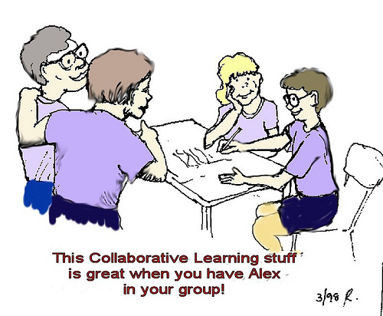
Speaking practice for beginners (A1, A2)
example
Talk about your favorite day in the year
Speaking homework: Students record a 2-3 minute presentation on a topic that has been dealt with in class.
By planning and preparing their speeches they practice new vocabulary and structures
Most learners record their speeches more than once. This gives them extra practice.
High quality language, because students see and hear themselves and can thus monitor their production
My Room
Modern technology and its influence on communication and social patterns among young people.“
Notes:
We all know that class-time is short and it is difficult to give all the learners enough speaking time. Group-activities can of course help, but they are not always efficient, especially at A1 and A2 level. One way to give learners extra speaking practice is speaking homework.
I do this all the time and it works perfectly. This is how we do it:
Click
For speaking homework the students record a short presentation on a topic that has been dealt with in class. These topics can be very basic – such as: click talk about your favorite day in the year --- or click describe your room ---click
Or they can be advanced talks in preparation for their final exams, such as „talk about your views on modern technology and its influence on communication and social patterns among young people.“
Click
By planning and preparing their speeches the learners practice new vocabulary and structures and learn to talk to an audience.
Click
They get immediate feedback and notice flaws in the content, the language and their pronunciation and often produce a second or third draft.
Click
We usually get high quality language, because the students see and hear themselves and can thus monitor their production.
In most cases the learners are asked to prepare a few simple images of the things they are going to talk about. Young learners draw a few pictures, older learners prepare a few powerpoint slides. These images structure the presentations and it feels more natural to the learners to show something and talk about it, rather than just talking into their webcams. Showing pictures also discourges the learners from reading a text from the screen – which is not the same as talking freely about the same topic. You‘d hear the difference in intonation and wording immediately.
Let‘s look at a few examples of such speaking homework produced by beginners.

Slide 3
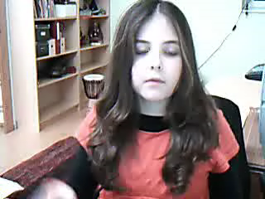


Examples of speaking homework
examples
Notes:
The following examples were all produced in the learners‘ first year of English after we had learned about the topics in class.
In the first example, Laura talks about her favorite day in the year. This was the first speaking homework, we always do it after about 3 months of English when we have learned to tell the time and to talk about general routines and habits. SHOW
In the second example Birgit talks about her room. She uses all the furniture words and tells us where things are in her room. SHOW
In the 3rd example Pilar presents her dream house and shows how she can be very creative and go far beyond the boring textbook houses that have 2 windows and a door.

Slide 4



Elevator Speeches: Talking about a topic
example
In an elevator speech learners have 1 or 2 minutes to deliver their message.
Step 1: make a mindmap of your main points
Step 2: organize your ideas into an efficient order
Step 3: practice your speech and look up necessary words and phrases
Step 4: record your speech
Example:
Architecture makes your life more colorful
Notes:
More advanced learners talk about more complex issues. Here we have a so called „elevator speech“ . click
In an elevator speech learners have 1 or 2 minutes to deliver their message. The term is used in business communication. Imagine you are Click riding the elevator with your boss and you have 2 minutes to convince him or her that your new project idea is worth pursuing. You have only got 2 minutes to get your message across.
This is excellent practice for essay writing – learners must package their message clearly and efficiently. By doing this orally, they learn to speak fluently and effectively about fairly complex topics. If you have only 1 or 2 minutes your word choice must be effective and clear – you do not have time to paraphrase and beat about the bush.
To plan their elevator speeches the studnets follow a few basic steps: Click
…
Let‘s listen to an example. The learners had worked on a topic of their choice and had to convince their classmates to read their project folders. They recorded elevator speeches to advertise their projects and to get the others interested.
In our example the girl is going to talk about Architecture and how it makes your life more colorful.
Play…-- fade…

Slide 5
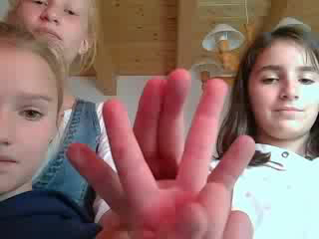


Practicing irregular verbs actively
example
by speaking and hearing them
by adding movement (iconic gestures)
What is happening in these brains?
Notes:
Let‘s look at another example. Even boring things like irregular verbs can be practiced more actively.
The kids in this short video are speaking – hearing – moving – producing meaning – and having fun.
Watch –
Then click
If we could look inside their brains, we‘d find a lot of activity – huge networks of neurons firing at the same time. (click) I bet some Acetylcholine is beeing released here as well – and new spines are growing on the kids‘ dendrites.

Slide 6

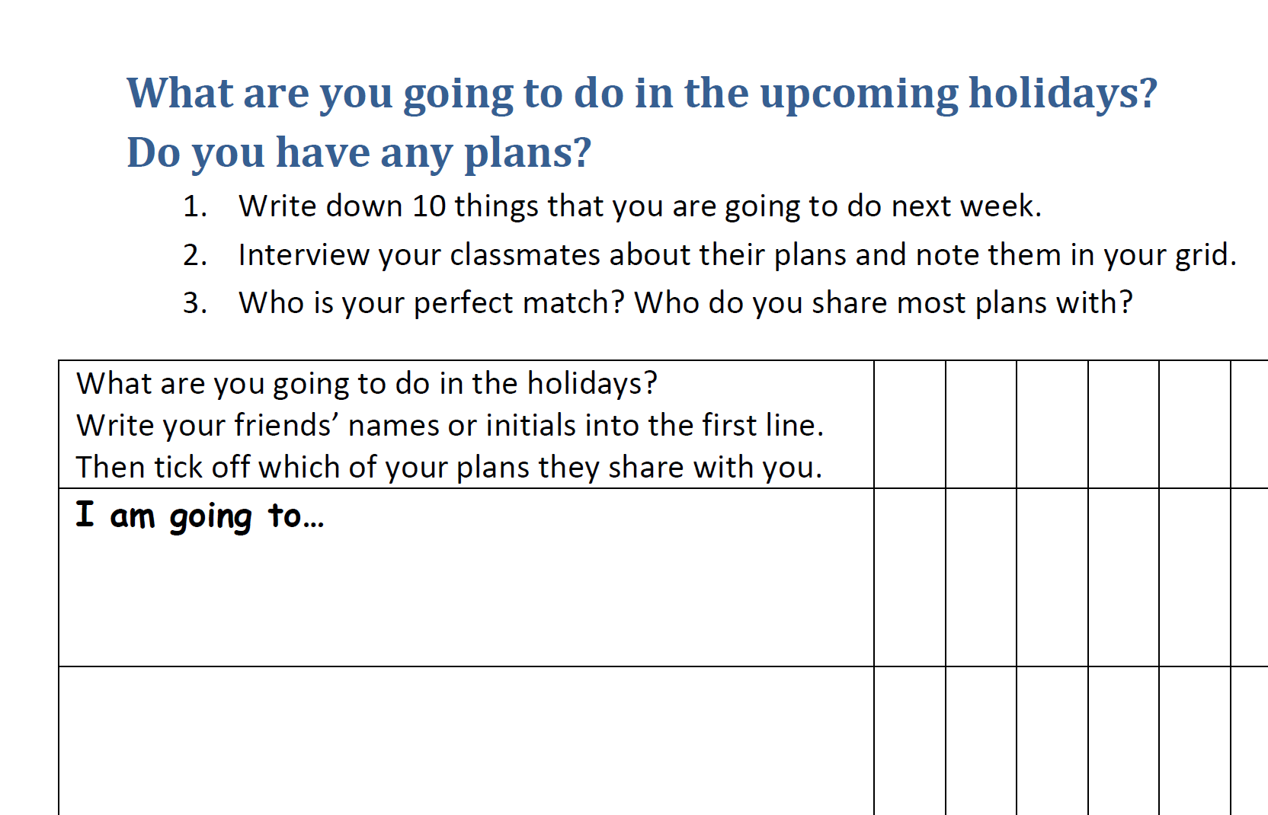
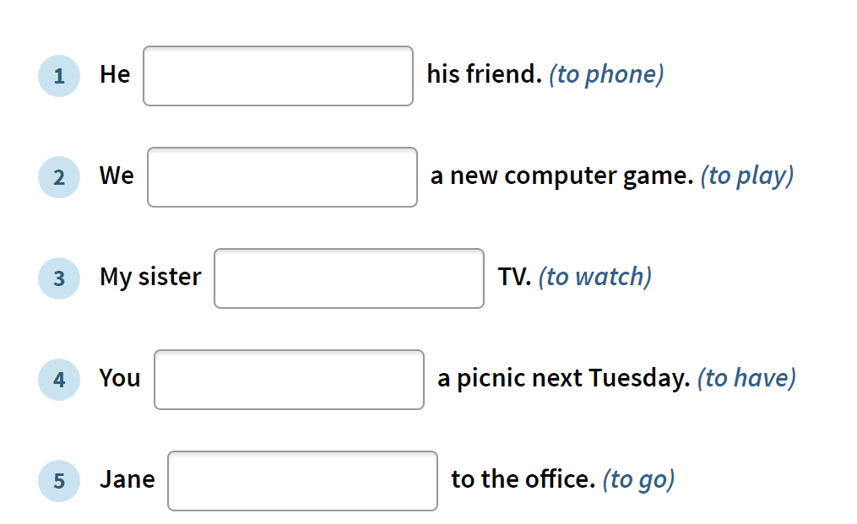

Talking about Plans and Intentions: Going –to Tying new grammar to personal networks
Which of the two examples will activate bigger neural networks?
http://www.englisch-hilfen.de/en/exercises/tenses/going_to_future_statements.htm
Notes:
Speaking tasks are also perfect for teaching grammar. Let‘s compare two tasks here:
Both exercises aim at teaching the going-to future.
Which of the two requires more brain activity?
Which of the two ties the new form (going-to) to the learners‘ real plans and intentions?
…
The exercise on the left is the typical grammar exercise you find in workbooks or online. It practices a form – but does not tie it to any personal meanings. Often it is really hard to find a possible context for the sample sentences. Just look at them again. You‘d have to think hard to creat a new context for each one and to find out who is talking about his or her plans or intentions here. The concept of „intentions“ is totally blurred here – learners will NOT be able to see it – they are just practicing a meaningless form.
In the example on the right, the learners are thinking about their own plans, the real plans they have for an upcoming long weekend or holiday. By doing the activity they will tie the new form – the going –to – to the concept of „talking about plans“ – to their personal plans. After writing down their 10 personal examples, they will use the structure many, many times by interviewing their classmates. They will speak, move, hear – and listen to their classmates‘ answers. By finding similarities with other kids‘ plans the activity serves the brain‘s emotional center – we want to be part of a group – we want to belong and share things, have things in common.
So… the winner here is the personalized speaking activity on the right.

Slide 7
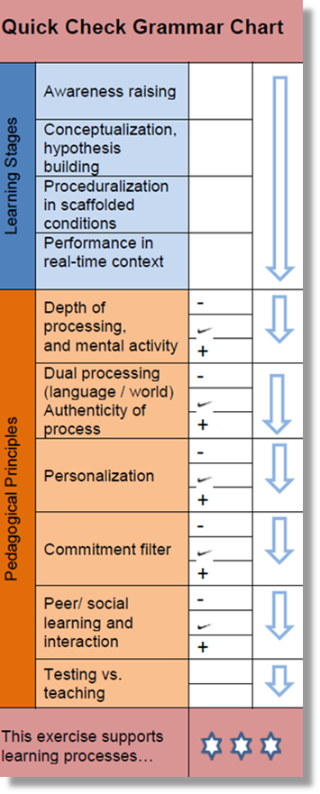
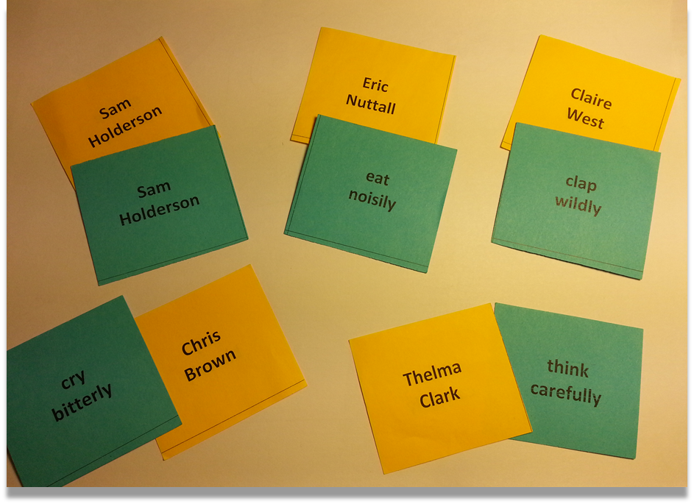


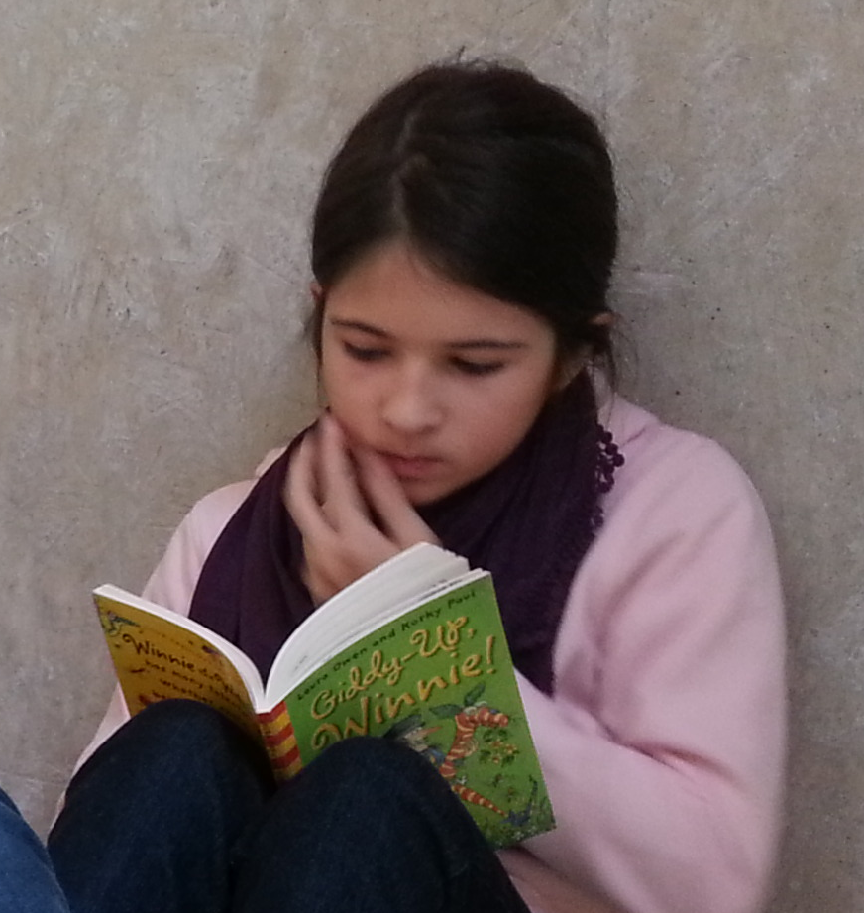
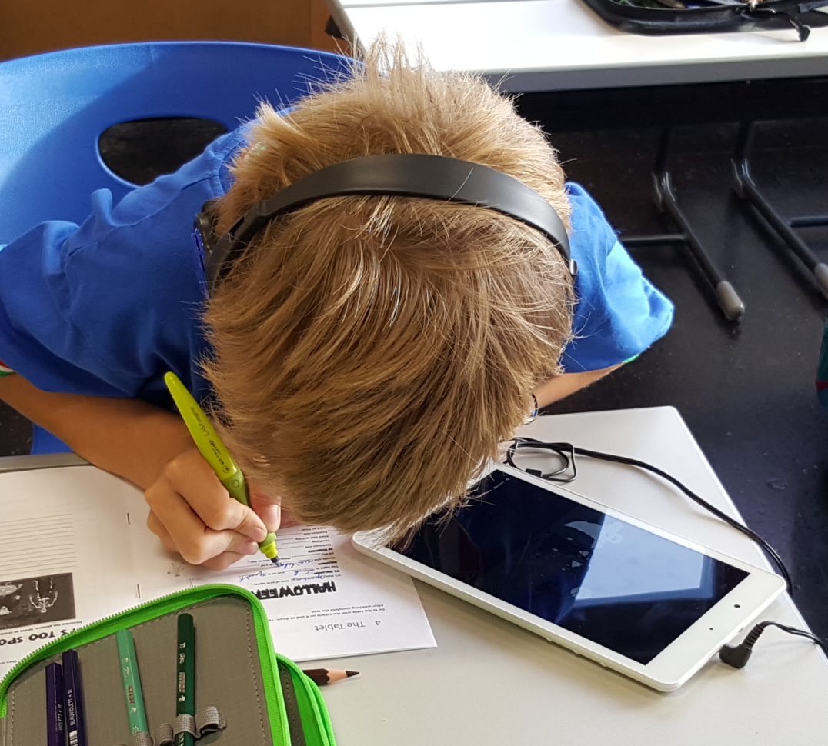

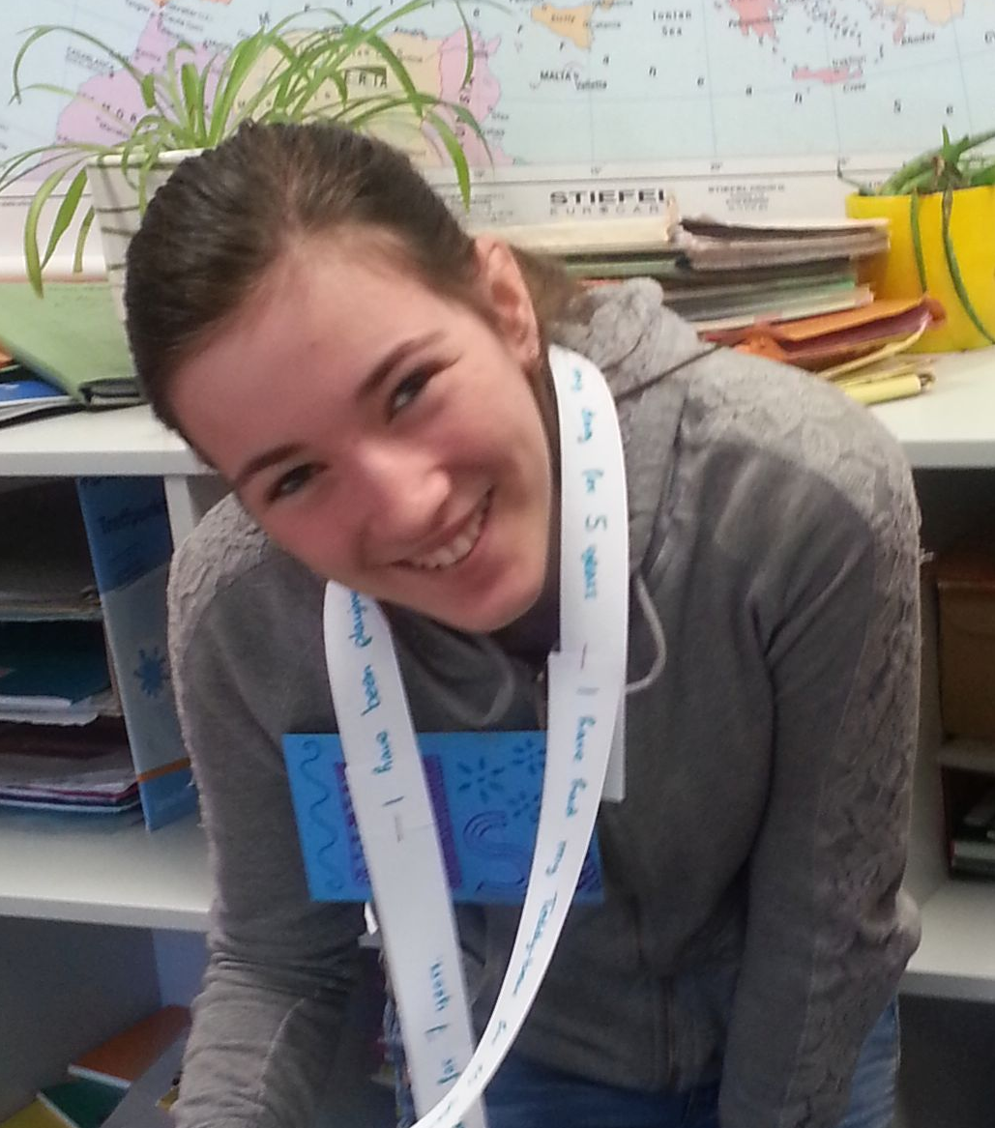
Practicing Grammar: Adverbs
example
Lenny
Casey
listen
carefully
Rita
Quinn
read
quietly
Susan
Haley
smile
happily
Notes:
Let me show you another example of a highly active speaking exercise. This one is called Manner Mimes and is based on an exercise in David Newby‘s Grammar for communication. I‘ve just turned the exercise into a speaking game.
For German speakers adverbs are a tricky topic. In German adverbs are not marked – we use the same form for adjectives and adverbs. Therefore learners tend to produce sentences like „I ran very quick to catch the bus.“
Even university students of English often forget to use adverbs. They all know the traditional rule that „adverbs modify verbs“ and they can complete a traditional fill-in exercise for adverbs and adjectives correctly, but in spontaneous production hardly any adverbs are used.
The activity I am going to show you, can make a real difference.
The game consits of a set of cards (20 or more) that show a firstname and lastname on the front – and an activity on the back. For example: Eric Nutall – is eating nosily. Notice that the names and the activities always start with the same initials.
The learners play in groups of 3-4. One player reads and shows the name on the first card and then acts out the activity – while the other players are trying to guess what Eric Nutall is doing and how he is doing it.
Let‘s try this out: Lenny Casey --- Can you say what he is doing here?
Right – the is listening carefully
Let‘s do another one: Rita Quinn: What is she doing?
She is reading quietly.
And
Susan Haley? She is smiling happily.
The game is fun, it is quite loud – and the learners connect the idea of HOW you do someting – to their brains. Movement plays an important role in this game – HOW we DO something is always connected to some movement – and thus, the concept of adverbs is linked to how we move – how we DO things in the learners‘ brains. The learners act, speak, hear and see – it is all happening simultaneously.
I have never had a class who did not use adverbs after playing this game.
If you are getting interested in exploring these ideas a bit more, check out my website www.epep.at
You can download the game and you will find more examples of brain-friendly grammar activities there.

Slide 8
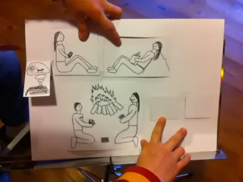
Learning a new grammatical concept
example
By creating a story
By speaking
By creating a visual aid that emphasiszes the new concept
www.epep.at
Notes:
Here‘s another example where the learners practice a new grammatical concept. They learn how to use the past progressive form to describe the setting, atmosphere or circumstances in a story …. and the past simple to talk about events.
The learners prepare their story flip-flaps and decide very consciously what goes in the front (the setting) and what goes in the back – behind the flaps. This is a real eye-opener for most students.
The flip-flaps will then help the learners use the correct tense forms when they tell their stories.
Let‘s watch this example so you understand what I mean.
This is only a small part of the spooky story project that I use in order to teach the grammatical notions of Circumstances versus Events. If you would like to see the whole project, go to click epep.at and search for „spooky stories“.

Slide 9

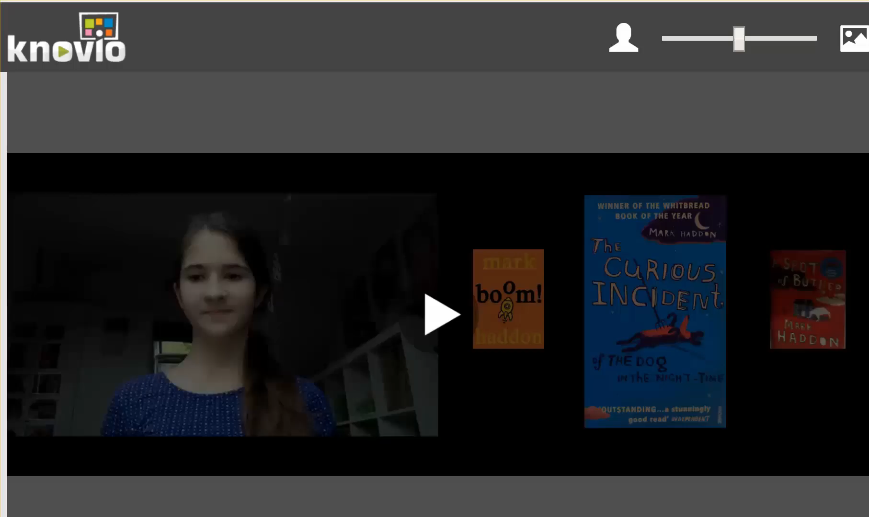


Simple book trailers produced by learners
examples
Notes:
Another interesting speaking activity are book trailers produced by the learners. After reading a young adult novel, they produce a short video where they present the book and advertise it to other kids online.
Book trailers are great speaking activities and they help share the reading-bug and encourage other kids to read these cool books.
These book trailers use very basic technology: The kids simply talk to their webcam as in the example on top
or they upload a few powerpoint slides and use the online tool Knovio.
You‘ll find the instructions for both versions on my website and on readingiscool.xyz.
Check out readingiscool.xyz and browse my students‘ favorite books.
Let‘s watch the two examples to see the two different methods.
In the first one Elsa is presenting us the book SELECTION.
Thanks, Elsa. Even thought I am not a fan of love stories, Elsa has convinced me to read this book and I must agree, she is right. It is an excellent page turner. I could not put it down.
Let‘s now see what the KNOVIO version of a book trailer looks like.
We‘ll only wath part of Sophia‘s presentation here – to see the whole trailer, go to readingiscool.

Slide 10
Technical tips
Speaking homework does not need any fancy technical tools.
All the examples have been produced with free and easy to use online tools that even young learners can use.
For detailed instructions and more examples go to my website: www.epep.at and check out the page on Web & ICT.
For more examples of book trailers go to www.readingiscool.xyz
Notes:
At this point you might be saying „I cannot do this, I don‘t have the technical skills to do all this“.
Don‘t worry. Speaking homework does not need any fancy tachnical tools or know-how.
All the examples have been produced with fjree and easy to use online tools that even young learners can use on their own.
For detailed instructions on how to produce these videos go to my website www.epep.at and check out the page on Web and ICT. There you will find lots of examples, detailed instructions and step-by-step guides for using the web-tools.
Give it a try – it is really easy and will add a whole new dimension to your teaching and to your students’ learning.

Slide 11


Let‘s sum up…
Speaking to an audience is one of the most efficient ways of learning a language because speaking uses many parts of the brain simultaneously. When speaking to an audience the learners must
plan and organize their thoughts in the frontal lobes
use new vocabulary and/or concepts in meaningful contexts
make associations with previous knowledge and personal memories and feelings across the brain
assemble language in the Broca area
hear and understand what they are saying
produce language by moving their lips, tongue and mouth
This will activate HUGE neuronal networks that will FIRE and WIRE together.
Notes:
Just read it off…

Slide 12




Speaking and the Brain

