Slide 1
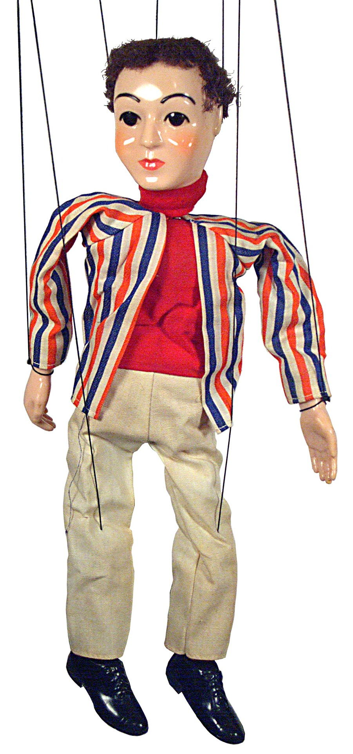
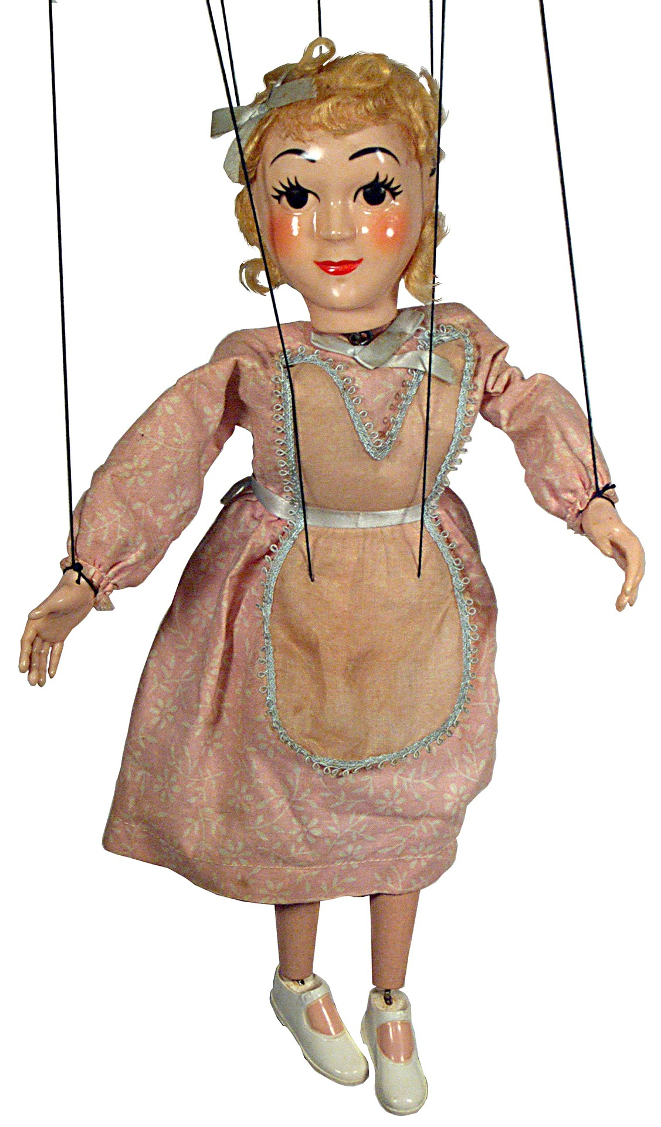
Warum Marionetten schlecht Sprachen lernen
Notes:
Introduce myself…
Achtung…Folien auf Engl, spreche aber Deutsch

Slide 2


The importance of choice what to expect…
Status quo and problems
In a nutshell: why do we need choice?
How we learn
Turning the brain on: sense and meaning
Active learning
Deep learning and cognitive conflict
Intrinsic motivation: autonomy – mastery – connection
How to engage students with choice: practical examples
This Photo by Unknown Author is licensed under CC BY
Notes:
Mein Ziel: ich will Sie überzeugen, dass CHOICE – Wahlmöglichkeiten – etwas Freiheit und Lernerautonomie nicht nur Ihren Beliebtheitsgrad als LehrerIn steigert…☺ sondern ganz große Auswirkungen in den Gehirnen Ihrer SchülerInnen hat und zu besserem Lernzuwachs führt.
Ich werde erklären WARUM das so ist und
WIE sie das in der Praxis relativ einfach umsetzen können
Lernen wird dadurch wesentlich effizienter.

Slide 3

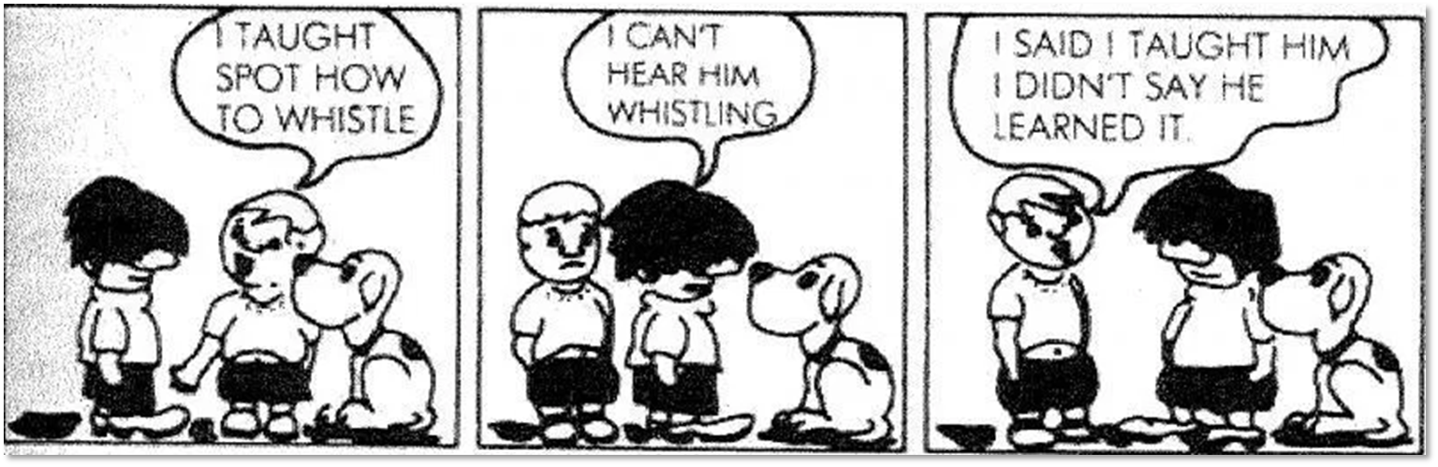
Notes:
und dann kommt das heraus: Stress f. die Lehrerin, but not much learning --

Slide 4
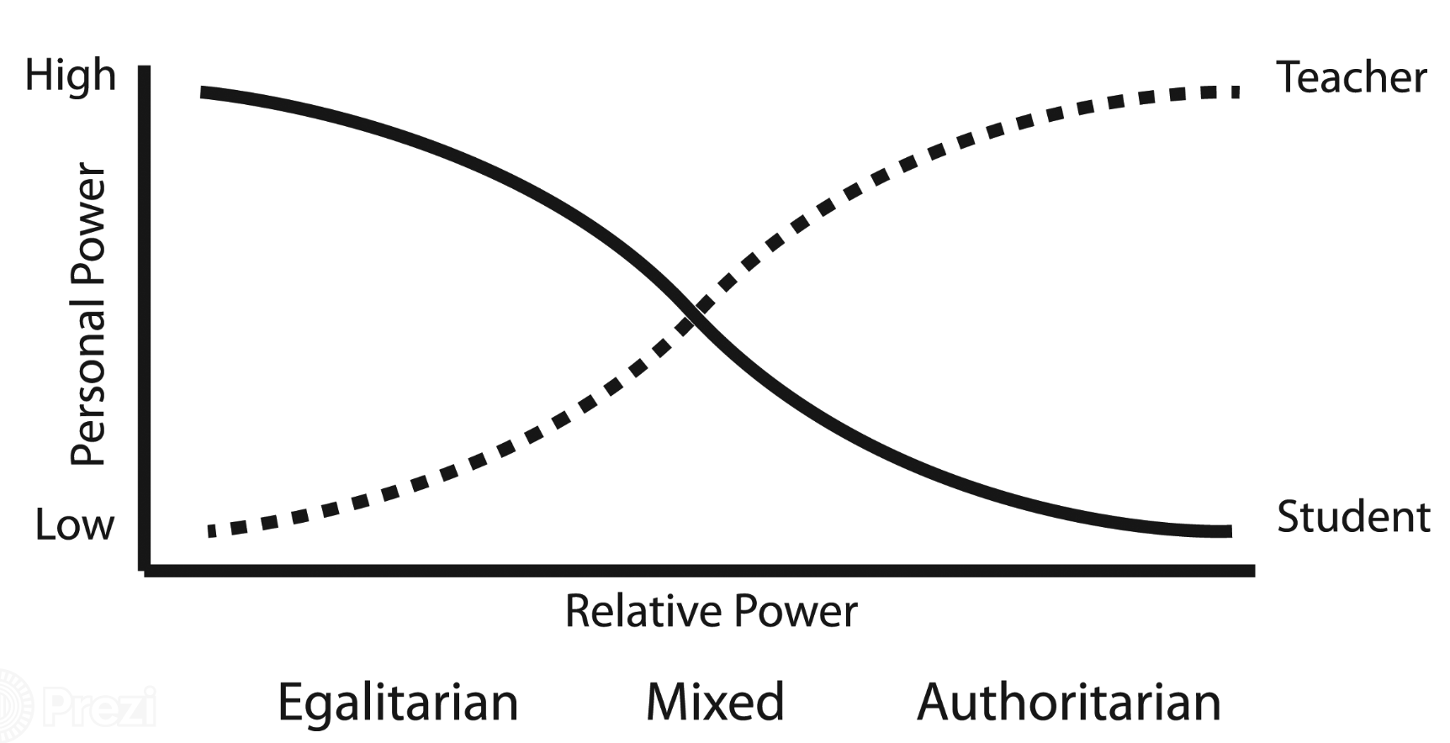
Porter‘s continuum
Where are you and your students now?
Porter, L. (2000) Student behaviour: Theory and practice for teachers, 2nd Editioon, Sydney: Allen & Unwin.
http://slideplayer.com/slide/6836578/23/images/5/Porter%E2%80%99s+Continuum+Source:+Lane,+J.+(2009).+EDU+4205+Lecture+2.+Retrieved+on+26+August+2009+from+ECU+Blackboard:.jpg
Notes:
Hier sollen sich die Teilnehmer selbst einschätzen. Ev. Liste mit Unterfragen vorbereiten – oder einblenden, dann vielleicht ein pollev.com einfügen.

Slide 5
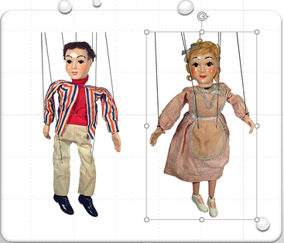
Choice in your classroom
How much freedom do your students have?
Who chooses the topics?
Who chooses the activities / exercises/ tasks?
Who chooses the products? (assignments, homework…)
Who writes or chooses comprehension questions?
Who chooses the resources (texts, books, videos…)
Who selects vocabulary?
Who checks the students‘ work?
always the teacher | sometimes the students | often the students | usually the students
Notes:
Stimmungsbild im Raum erheben. Wo sind wir jetzt – was ist unser starting point?
Auf Handout: answer these questions for yourself– take a minute.
Then poll
Poll is anonymous, do not enter your name (click Skip)

Slide 6
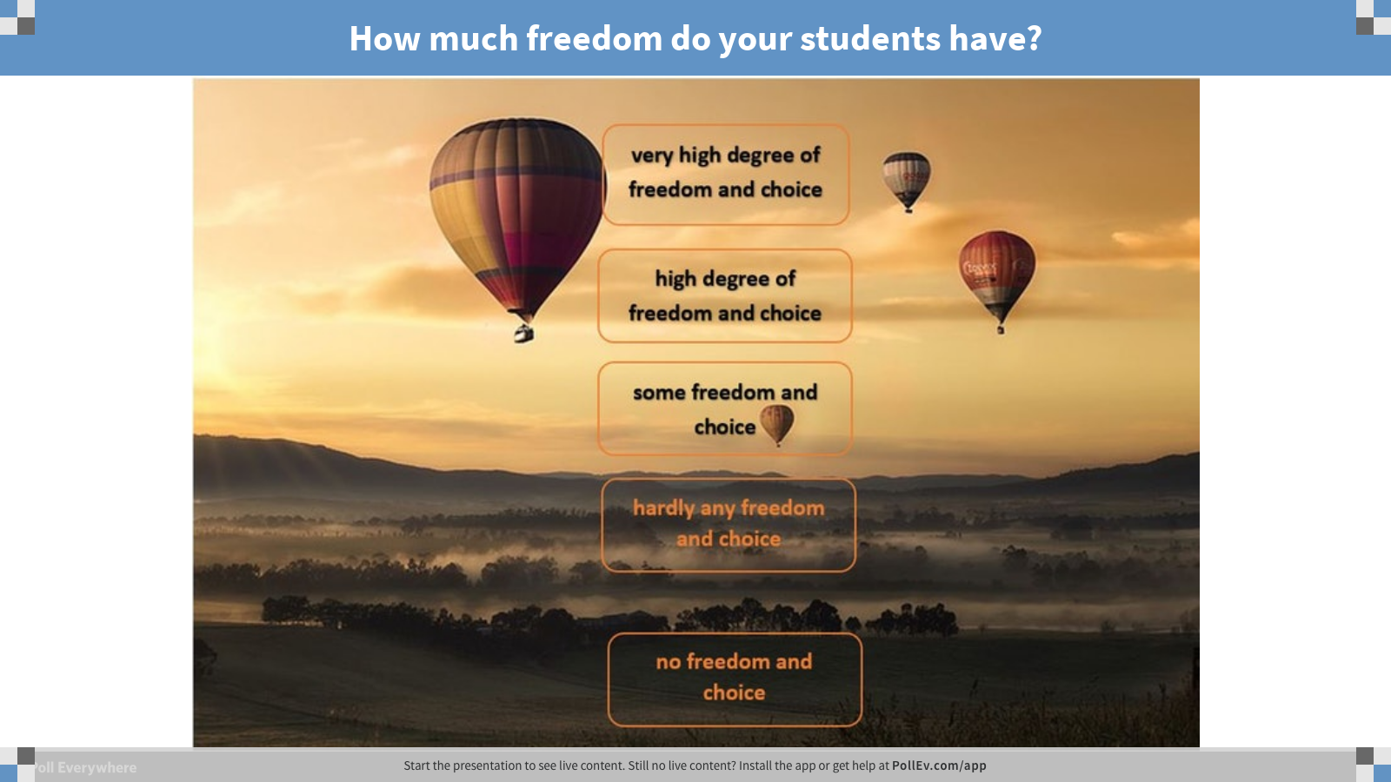
Notes:
Poll Title: How much freedom do your students have? https://www.polleverywhere.com/clickable_images/cqmXpTaWWnKUK5b

Slide 7

John Hattie on teacher talk
“Students seem to come to school to watch teachers working!”
„One of the difficulties of so much teacher talk is that it demonstrates that teachers are the owners of suject content, and controllers of the pacing and sequencing of learning, andit reduces opportunities for students to impose their own prior achievement, understanding, sequencing, and questions.“
“The current dominance of monologue may cause less damage for brighter students, who can engage in learning with their typically greater access to learning strategies and self-talk about the learning. Monologue is less satisfactory for the struggling students, the disengaged, and the confused.”
John Hattie, Visible Learning
Notes:
Stimmungsbild deckt sich // deckt sich nicht --- mit Hattie‘s Einschätzungen.

Slide 8


John Hattie: Visible Learning
“Often we have been much more concerned with teaching rather than learning.”
“The key is what is going on in each student’s mind - because influencing these minds is the point of the lesson.”

Slide 9


You don’t
Some people think you learn a language to use a language
You use a language to learn a language
This Photo by Unknown Author is licensed under CC BY-NC-ND
Notes:
„Man lernt eine Sprache um sie dann SPÄTER zu verwenden“ – ok – aber so LERNT man sie nicht wirklich. Man LERNT sie durchs Benützen! Learning by doing.
Fehlerkultur: Mistakes are stepping stones in learning – wenn wir nur true-false zulassen oder auf Satzebene arbeiten, kann sich keine echte Unwrap your voice:
Sprachkompetenz entwickeln. Experimentieren, Versuch mit Händen und Füßen zu kommunizieren, aus einigen Brocken einen Sinn zu erzeugen – sind ganz wichtig um letztlich eine Sprache zu beherrschen. Die ersten Seile, die wir durchschneiden müssen sind die, die uns suggerieren dass Fehler um jeden Preis zu vermeiden sind.

Slide 10
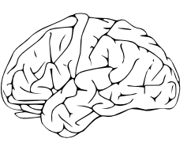

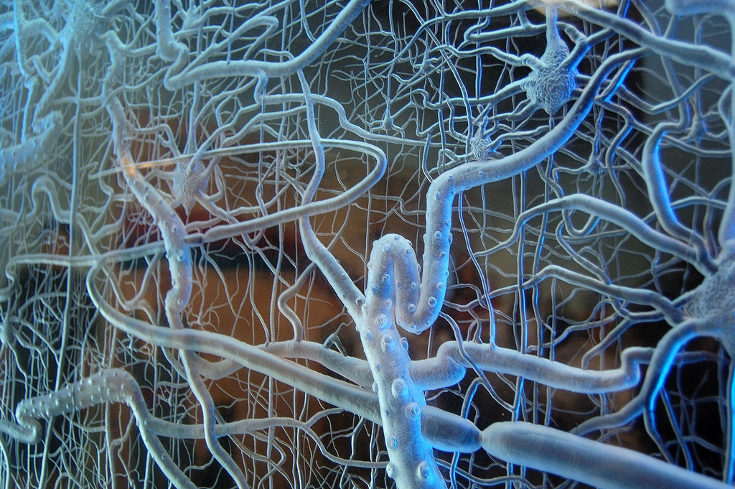
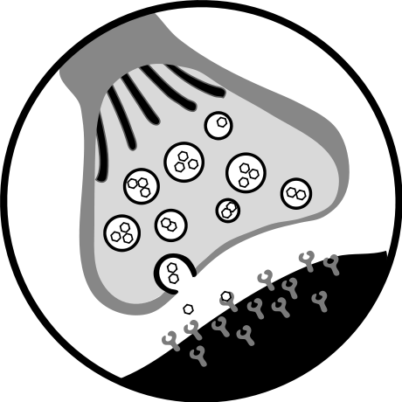
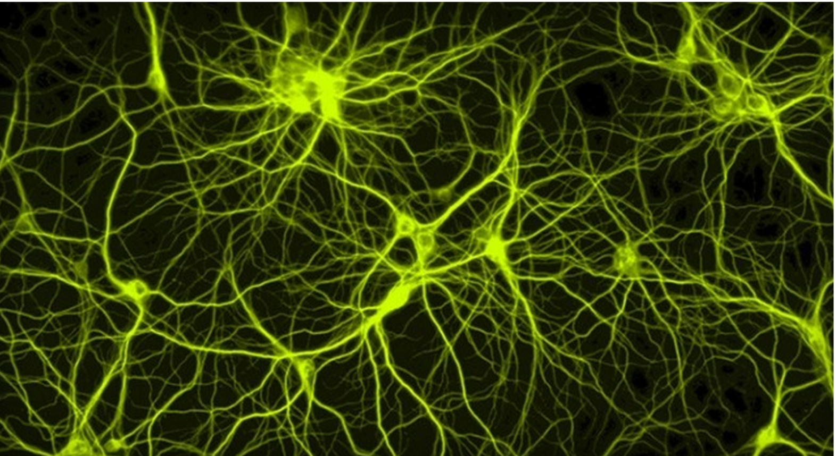
How do we learn? Why do we need choice?
every brain is unique
our existing networks determine what we notice and how we learn new things: interests, gender, readiness levels, learning preferences…
choice triggers an exciting chain reaction on a psychological AND chemical level
choice = freedom = a strong motivating factor engagement and empowerment
acetylcholine improves synapse communication and growth of new connections.
Neurons that fire together
wire together
Learning = making new connections or strengthening existing ones
Notes:
Ich möchte in diesem Vortrag erklären warum WAHLmöglichkeiten so essenziell f. das Lernen sind.
Im Großen und Ganzen (in a nutshell) geht es um folgende
Jedes Gehirn ist einzigartig -- organisiert nach den Eindrücken und Erlebnissen…hat andere Assoziationen, Vorlieben, Zugänge – Wenn wir alle Schüler gleich unterrichten, wenn alle das selbe tun, lernen aber nicht alle das selbe.
Wichtig ist nicht die Zahl der Neuronen, sondern deren Verbindungen: Wie bringe ich die Gehirnzellen dazu zu „feuern“ und neue Verknüpfungen zu bauen.
James Zull: Teaching is the art of changing the brain.
Um das Lernen (also die Kommunikation zwischen den Synapsen) zu fördern spielt WAHL – CHOICE – eine gewisse Freiheit und Empowerment (Ermächtigung) eine wichtige Rolle – werden wir später noch sehen.

Slide 11

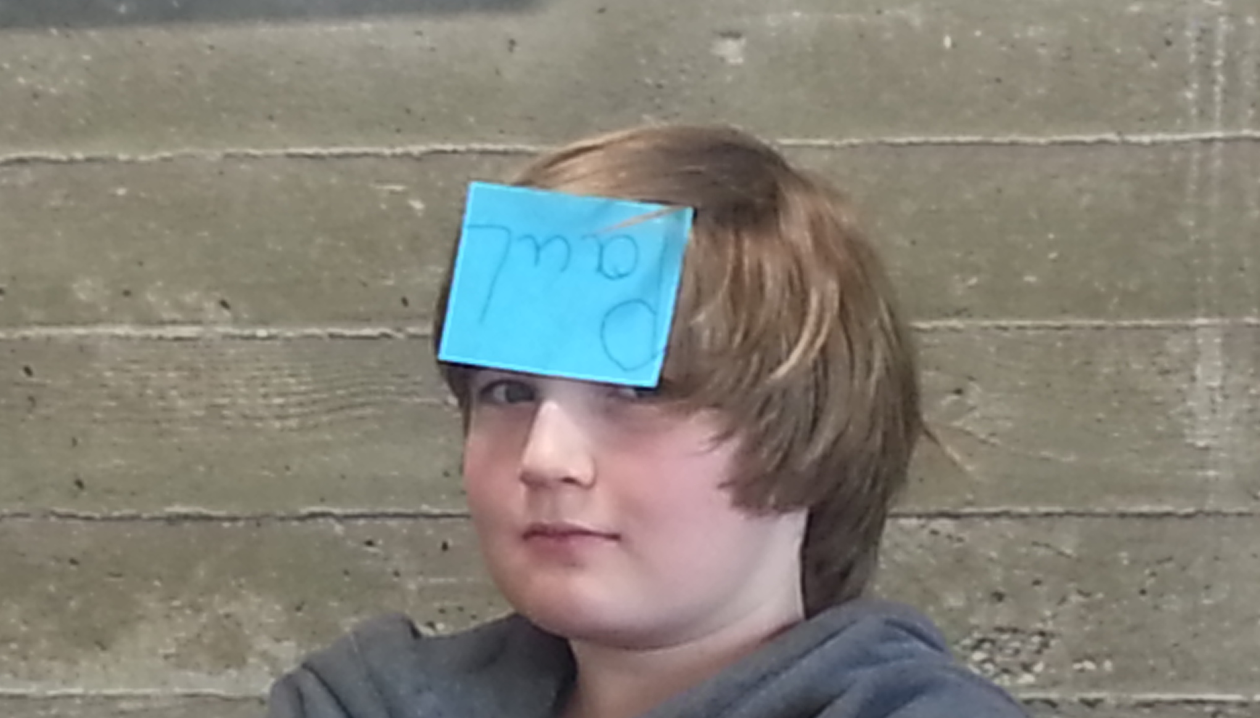



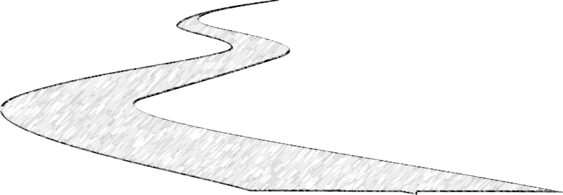
How to get in…
Cut STRESS !
Making mistakes is ok.
Create a safe and pleasurable environment.
Notes:
Wie kommen wir jetzt ins Hirn hinein um es zu verändern.
2 Ways in: Pain or Pleasure:
Pain is stronger: if the s suffers from stress, fear, emotional distress, the PAIN will hold their attention.
Pleasure: every student needs a stress-free, safe, pleasurable environment.
Schauen wir uns das etwas genauer an was da passiert.
Ich muss also dafür sorgen, dass die kids ihre „Kaputzen“ herunternehmen können und sich sicher fühlen auch Fehler machen zu dürfen.

Slide 12

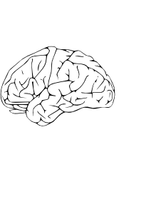

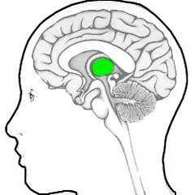
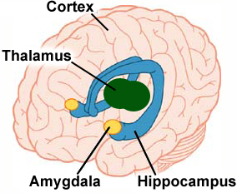



Hijacking the brain : Emotions are the key to the brain
Stimulus
Thalamus
Amygdala
Hippocampus and Cortex
Important
Ok, harmless
unimportant
dangerous
Alarm-system!
fight
flight
Notes:
click
Let’s follow the brain along the typical steps from input to learning.
A stimulus – in this case let’s assume it is sound waves – the teacher’s voice – enters the brain and reaches the (click) Thalamus. The Thalamus is an important part of our limbic system – our emotional center.
Here we have 2 options: (click) The Thalamus filters incoming information: if the incoming signal is marked as irrelevent, it will be discarded – in our picture it goes into the (click) bin. This is an important filter – we do not want to worry about all kinds of background noise, cars passing by and other irrelevant signals in our environment.
(click)
If the stimulus is perceived as important –(click) or at least potentially important, the Thalamus will let it through – and pass it on to the (click) Amygdala. In our picture we see two of these yellow, almond-shaped objects. Here incoming signals are checked for their emotional content. Is the incoming stimulus associated with (click) danger? … or does it seem (click) harmless? Some of these « danger » signals are innate – we are born with them. Humans and many animals are afraid of fire – even if we have not yet been burned. Other dangers need to be learned and acquired in the course of our lives.
Whenever an incoming stimulus is marked as dangerous, the amagdala sends signals to the Hypothalamus and the brain stem and our body prepares for (click) flight or (click) fight. Adrenalin and other neurotransmitters are released, our blood pressure and pulse frequence rise, oru muscle tonus rises. (click)
As our body is preparing for fight or flight reflexes – higher order thinking is turned off.
This cycle can save lives (in the wild!!) but does it help in exams?
I like to call this the AAA reaction: Amygdala-Adrenalin-Anxiety
It produces a cognitive style that facilitates basic, automatic routines
but prevents free associations and higher order thinking.
Let’s go back to the incoming signal and assume that the amygdala has decided that it is(click) harmless.
Only then is the stimulus passed on to the (click) hippocampus and the cortex and only then will any (click) higher order processing(click) take place in the cortex. (click)
What does this mean: fear and anxiety prevent learning – we must create a relaxed, safe atmosphere to open our learners’ brains.
This is really important for speaking activities – here danger may not only come from a teacher who penalizes every little mistake – danger might also come from classmates, who laugh at you or find fault in your presentation. In all these cases no learning will happen.

Slide 13
Hijacking the Brain : Emotionen sind der Schlüssel zum Gehirn
Stimulus
Thalamus
Amygdala
Hippocampus and Cortex
Important
Ok, harmless
unimportant
dangerous
Alarm-system!
fight
flight
Notes:
Let’s follow the brain along the typical steps from input to learning.
A stimulus – in this case let’s assume it is sound waves – the teacher’s voice – enters the brain and reaches the (click) Thalamus. The Thalamus is an important part of our limbic system – our emotional center.
Here we have 2 options: (click) The Thalamus filters incoming information: if the incoming signal is marked as irrelevent, it will be discarded – in our picture it goes into the (click) bin. This is an important filter – we do not want to worry about all kinds of background noise, cars passing by and other irrelevant signals in our environment.
(click)
If the stimulus is perceived as important –(click) or at least potentially important, the Thalamus will let it through – and pass it on to the (click) Amygdala. In our picture we see two of these yellow, almond-shaped objects. Here incoming signals are checked for their emotional content. Is the incoming stimulus associated with (click) danger? … or does it seem (click) harmless? Some of these « danger » signals are innate – we are born with them. Humans and many animals are afraid of fire – even if we have not yet been burned. Other dangers need to be learned and acquired in the course of our lives.
Whenever an incoming stimulus is marked as dangerous, the amagdala sends signals to the Hypothalamus and the brain stem and our body prepares for (click) flight or (click) fight. Adrenalin and other neurotransmitters are released, our blood pressure and pulse frequence rise, oru muscle tonus rises. (click)
As our body is preparing for fight or flight reflexes – higher order thinking is turned off.
This cycle can save lives (in the wild!!) but does it help in exams?
I like to call this the AAA reaction: Amygdala-Adrenalin-Anxiety
It produces a cognitive style that facilitates basic, automatic routines
but prevents free associations and higher order thinking.
Let’s go back to the incoming signal and assume that the amygdala has decided that it is(click) harmless.
Only then is the stimulus passed on to the (click) hippocampus and the cortex and only then will any (click) higher order processing(click) take place in the cortex. (click)
What does this mean: fear and anxiety prevent learning – we must create a relaxed, safe atmosphere to open our learners’ brains.
This is really important for speaking activities – here danger may not only come from a teacher who penalizes every little mistake – danger might also come from classmates, who laugh at you or find fault in your presentation. In all these cases no learning will happen.

Slide 14


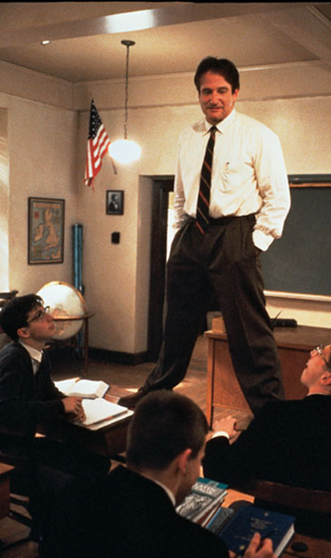
Turning the brain on
meaningful
authentic and reliable
relevant and interesting
relaxed and non-threatening
Notes:
For learning to happen,
Children decide quickly and unconsciously whether to turn their brains click « on » or stay in standby mode. click
Within seconds, their brains’ emotional center – click that is the limbic system will decide
Whether the teacher’s words, voice and body-language match and therefore seem authentic and reliable
Whether the topic is relevant and interesting
whether the situation in the classroom is relaxed or threatening…
…………………………………….(extra, for me)
Neocortex: höheres Denken, kann Sprache verarbeiten.
Limbisches System: kann nur Gefühle verstehen – über verbale Impulse nicht erreichbar. (It doesn’t feel right – kann es aber nicht erklären)
Gute Info: https://www.youtube.com/watch?v=59VT8FCA66o&t=36s

Slide 15

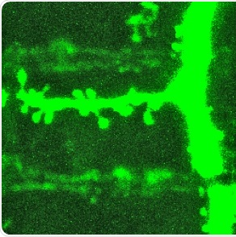
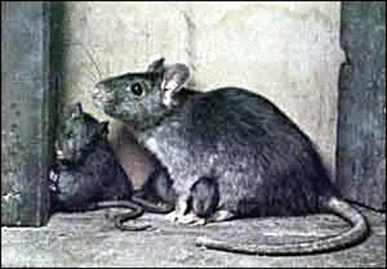
Why is engagement so important? Sense and Meaning
“Teaching is the art of changing the brain. …. I mean, creating conditions that lead to change in a learner’s brain.”
James E. Zull, p.5
Acetylcholine
© MPI von Neurobiologie Meyer, in http://www.news-medical.net/news/20140422/791/German.aspx
Notes:
Sense: Verstehen – ich verstehe den Text…
Meaning: es ist für mich bedeutsam
Nur wenn etwas verständlich ist UND als bedeutsam erlebt wird, wird Acetylcholine ausgeschüttet.
Beispiel:
Für das Lernen ist eine hohe Acetylcholinkonzentration wichtig. Dadurch wird eine Nervenzelle stärker und länger angesprochen, als dies sonst der Fall ist. Eine abzuspeichernde Information wird so für die Nervenzelle viel wichtiger, so dass die Information besser behalten wird.
Ratten werden hohen Tönen ausgesetzt. (James Zull). Im auditory cortex vermehrte Bildung von Zellverbindungen– allerdings nur dann wenn die hohen Töne mit Futter assoziiert werden. Sonst kaum Zuwachs.
Passiv
Aus dem Zusammenhang gerissene Konstruktion von Sätzen oder Umwandlung von aktiv ins passive ist kontraproduktiv:
zB: el fuego/ destruir/ bibliotheka
the fire / destruct / library
http://necessarysufficient.net/standard/cgi-bin/shop.pl/sciencemath/necessarysufficient.577221390
Bedeutungen können sogar in ganz kleinen Grammatikübungen von den SchülerInnen sinnvoll konstruiert werden.
Beispiel: Passive Bricks oder Passive Pairs
Si-Sätze // If-clauses

Slide 16

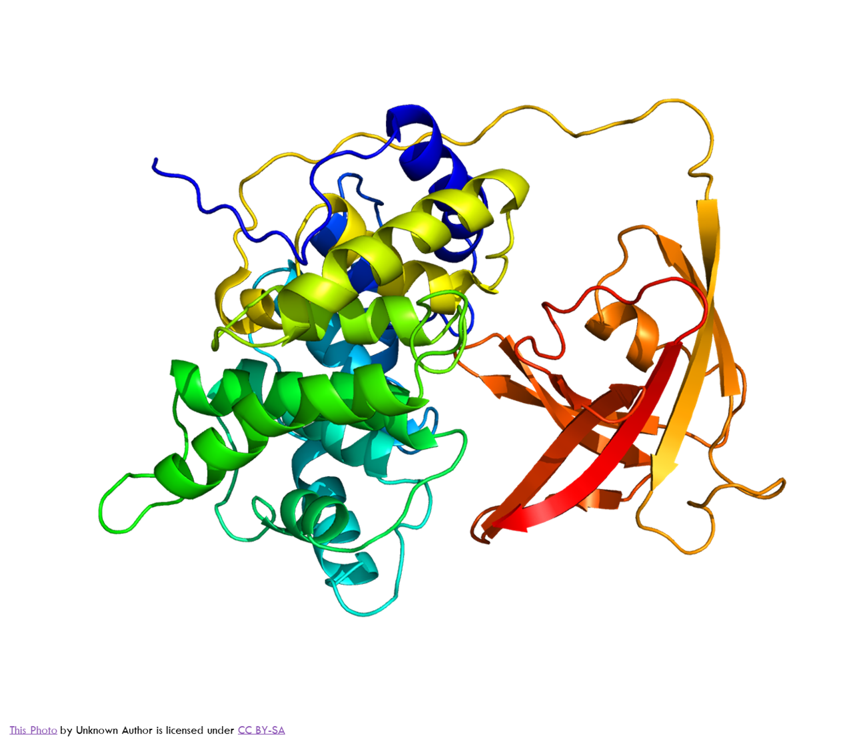
Active learning
Notes:
Jetzt sind wir „drinnen“ -- Active learning vs. passive learning
Passive learning– S. dreht Hirn bald wieder ab, es passiert nicht viel. Wir wollen ACTIVE Learning: d.h. unter anderem, möglichst viele Bereiche aktivieren
dann gleich weiter zur nächsten Folie – let‘s look what‘s happening inside

Slide 17
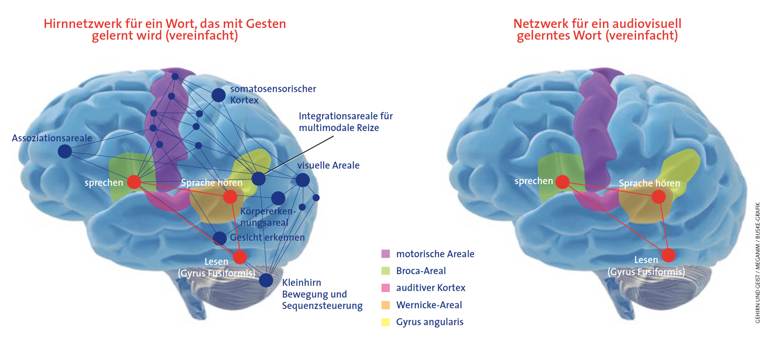

Active Learning = simultaneous activation of neural networks
Macedonia, Manuela. “Mit Händen und Füßen” in Gehirn und Geist, Spektrum, 12.2. 06.12.2012. http://www.macedonia.at/uncategorized/gehirn-und-geist-und-brain-cast/
Notes:
Aktive learning heißt einerseits: Alle Bereiche gleichzeitig…. talk about examples: Walk and talk, irregular verbs raps, speaking activities with props or pictures. Meaningful sentences: He is flying above the roofs. vs. Santa Claus is flying above the roofs.
Active learning ist also ganz anders als Ausfüllen von Lücken in einem Text oder „put active into passive“. Um das im Unterricht zu tun, müssen wir schon von den Sesseln aufstehen, das Lehrbuch schließen und da und dort neue Wege gehen.

Slide 18


Deep learning needs cognitive conflict
Students must be allowed to struggle.
Notes:
Langristiges, effizientes Lernen braucht auch DEEP LEARNING
heißt sich wirklich damit auseinandersetzen, damit kämpfen, um eine Lösung ringen.
Example: Grammar: schon von Anfang an aus Beispielen selbst Muster erkennen (a/an… Zeitenverwendung…awareness raising)

Slide 19
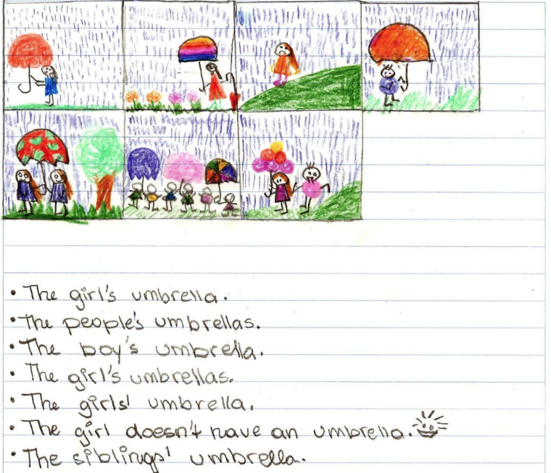
Cognitive conflict
Challenge them!
“Complex learning is enhanced by challenge and inhibited by threat associated with helplessness. (Caine & Caine 2000)
Notes:
Beim DEEP LEARNING kommt es unweigerlich zu Cognitive Conflict – D.h. geistiger Anstrengung – CHALLENGE – aber ohne Stress.

Slide 20

Challenge: find the rule
What do you notice?
This is Mrs. Pölzleitner.
She lives in a blue house in Graz. She is an English teacher. She loves reading books and learning languages. She speaks English, German, French, Italian and Greek. She also likes sports. In winter she goes skiing and in summer she goes jogging. She rides her bike to school every day. Her favorite food is Indian curry. She is vegetarian, so she does not eat meat.
Hello, I am Mrs. Pölzleitner.
I live in a blue house in Graz. I am an English teacher. I love reading books and learning languages. I speak English, German, French, Italian and Greek. I also like sports. In winter I go skiing and in summer I go jogging. I ride my bike to school every day. My favorite food is Indian curry. I am vegetarian, so I do not eat meat.

Slide 21
Active learning needs multiple paths in and out
Notes:
Um diese CHALLENGE diese Herausforderung anzunehmen und eine Aufgabe zu Lösen, muss ich unterschiedliche Zugänge – Lösungswege und auch unterschiedlichen Input ermöglichen bzw zur Verfügung stellen.
Jedes Hirn ist anders – andere Vorkenntnisse, Erlebnisse… – andere Muster vorhanden auf die der S. aufbauen kann. Andere Interessen, andere Bedingungen… andere Zugänge
Spätestens jetzt wird klar, dass der „one size“ oder „one fits all“ Unterricht nicht funktionieren kann.
Wir sehen dann später noch genauer, warum multiple paths so wichtig sind.

Slide 22
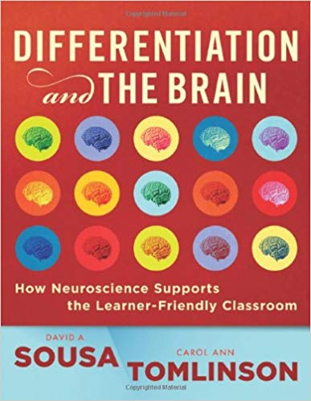
Why we need choice
all brains are different
student readiness
student interest
learning styles and preferences
cultural background
gender

Slide 23
Long-term learning needs intrinsic motivation
Autonomy
Mastery
Connection
Notes:
Ganz kurz, kommUm längerfristiges ACTIVE Learning zu ermöglichen ist außerdem unbedingt intrinsische Motivation notwendig.
Dazu braucht es 3 Aspekte: Autonomy, Mastery (dazu gehören Erfolgserlebnisse, Stolz etwas geschafft zu haben…) und Connection (Zugehörigkeit zur Klasse, Freunde, Gesellschaft --

Slide 24

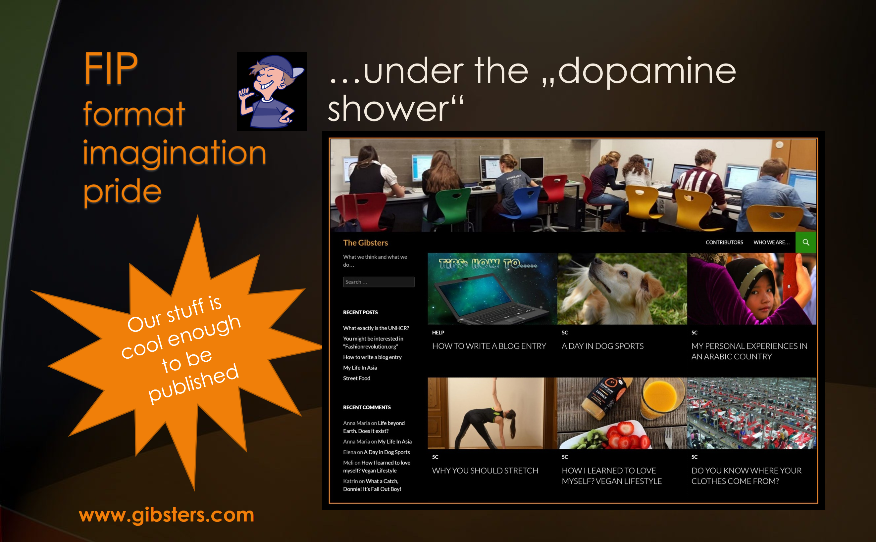


Factors leading to intrinsic motivation
Autonomy
Mastery
Connection
Choice
Challenge
Social connections, peers
Self-determination
FIP
Format- Imagination- Pride
Ownership
Personal Meaning
Notes:
Überblick – wir schauen uns jeden der drei Bereiche genauer an. Alle drei sind psychologisch wichtig und haben aber Folgen auf chemisch – neuronaler Ebene. (Transmitter – Synapsenwachstum… growth cones…)
Intrinsic Motivation: Dopaminspirale!!! Will mehr und mehr von diesem Erfolg.
Mastery: Stolz auf den Erfolg

Slide 25
Autonomy: Choice theory (William Glasser)
Five basic needs
In an effective classroom…
Basic survial
Need for belonging
Need for power
Need for freedom
Need for fun
We address these needs by creating opportunities for the students to express themselves individually or to work with others
By allowing students to choose activities of interest that are playful yet challenging
And by empowering students through active learning and decision making.
(Judith Dodge, Differentiation in Action, p. 51)
Our 5 basic needs drive our choices. We choose to behave in a way that will satisfy most of these needs.
Notes:
Ich muss in der Klasse versuchen möglichst viele dieser Bedürfnisse zu befriedigen. Sonst findet wenig Lernen statt.

Slide 26

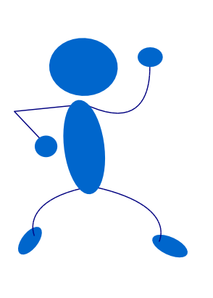
Autonomy and Choice
Engaging students means
Empowering students means
getting them excited about OUR topics, interests, content
giving them the skills and knowledge to pursue their own interests, passions and future
Notes:
Dieses Empowerment / Ermächtigung – kann schon im Anfangsunterricht stattfinden: zB: Wir lernen uns selbst vorzustellen. Statt eine fertige Vocab Liste auszuteilen kann ich fragen: Was willst du über dich selbst sagen können. Wie willst du dich vorstellen? Was ist dir wichtig?

Slide 27
Autonomy – Mastery - Connection Lernen unter der Dopamindusche
Our stuff is cool enough to be published
Challenge them!
Trust them!
“Complex learning is enhanced by challenge and inhibited by threat associated with helplessness. (Caine & Caine 2000)
Create opportunities for success
FIP
Format – Imagination - Pride
http://www.cainelearning.com/wp-content/uploads/2013/08/Principles-Wheel.png

Slide 28
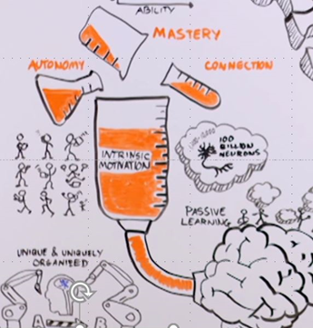
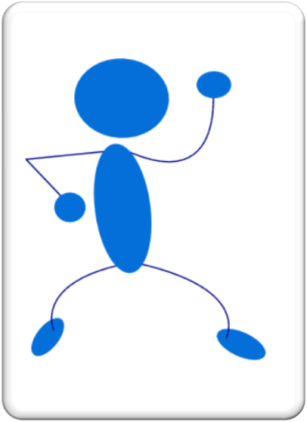

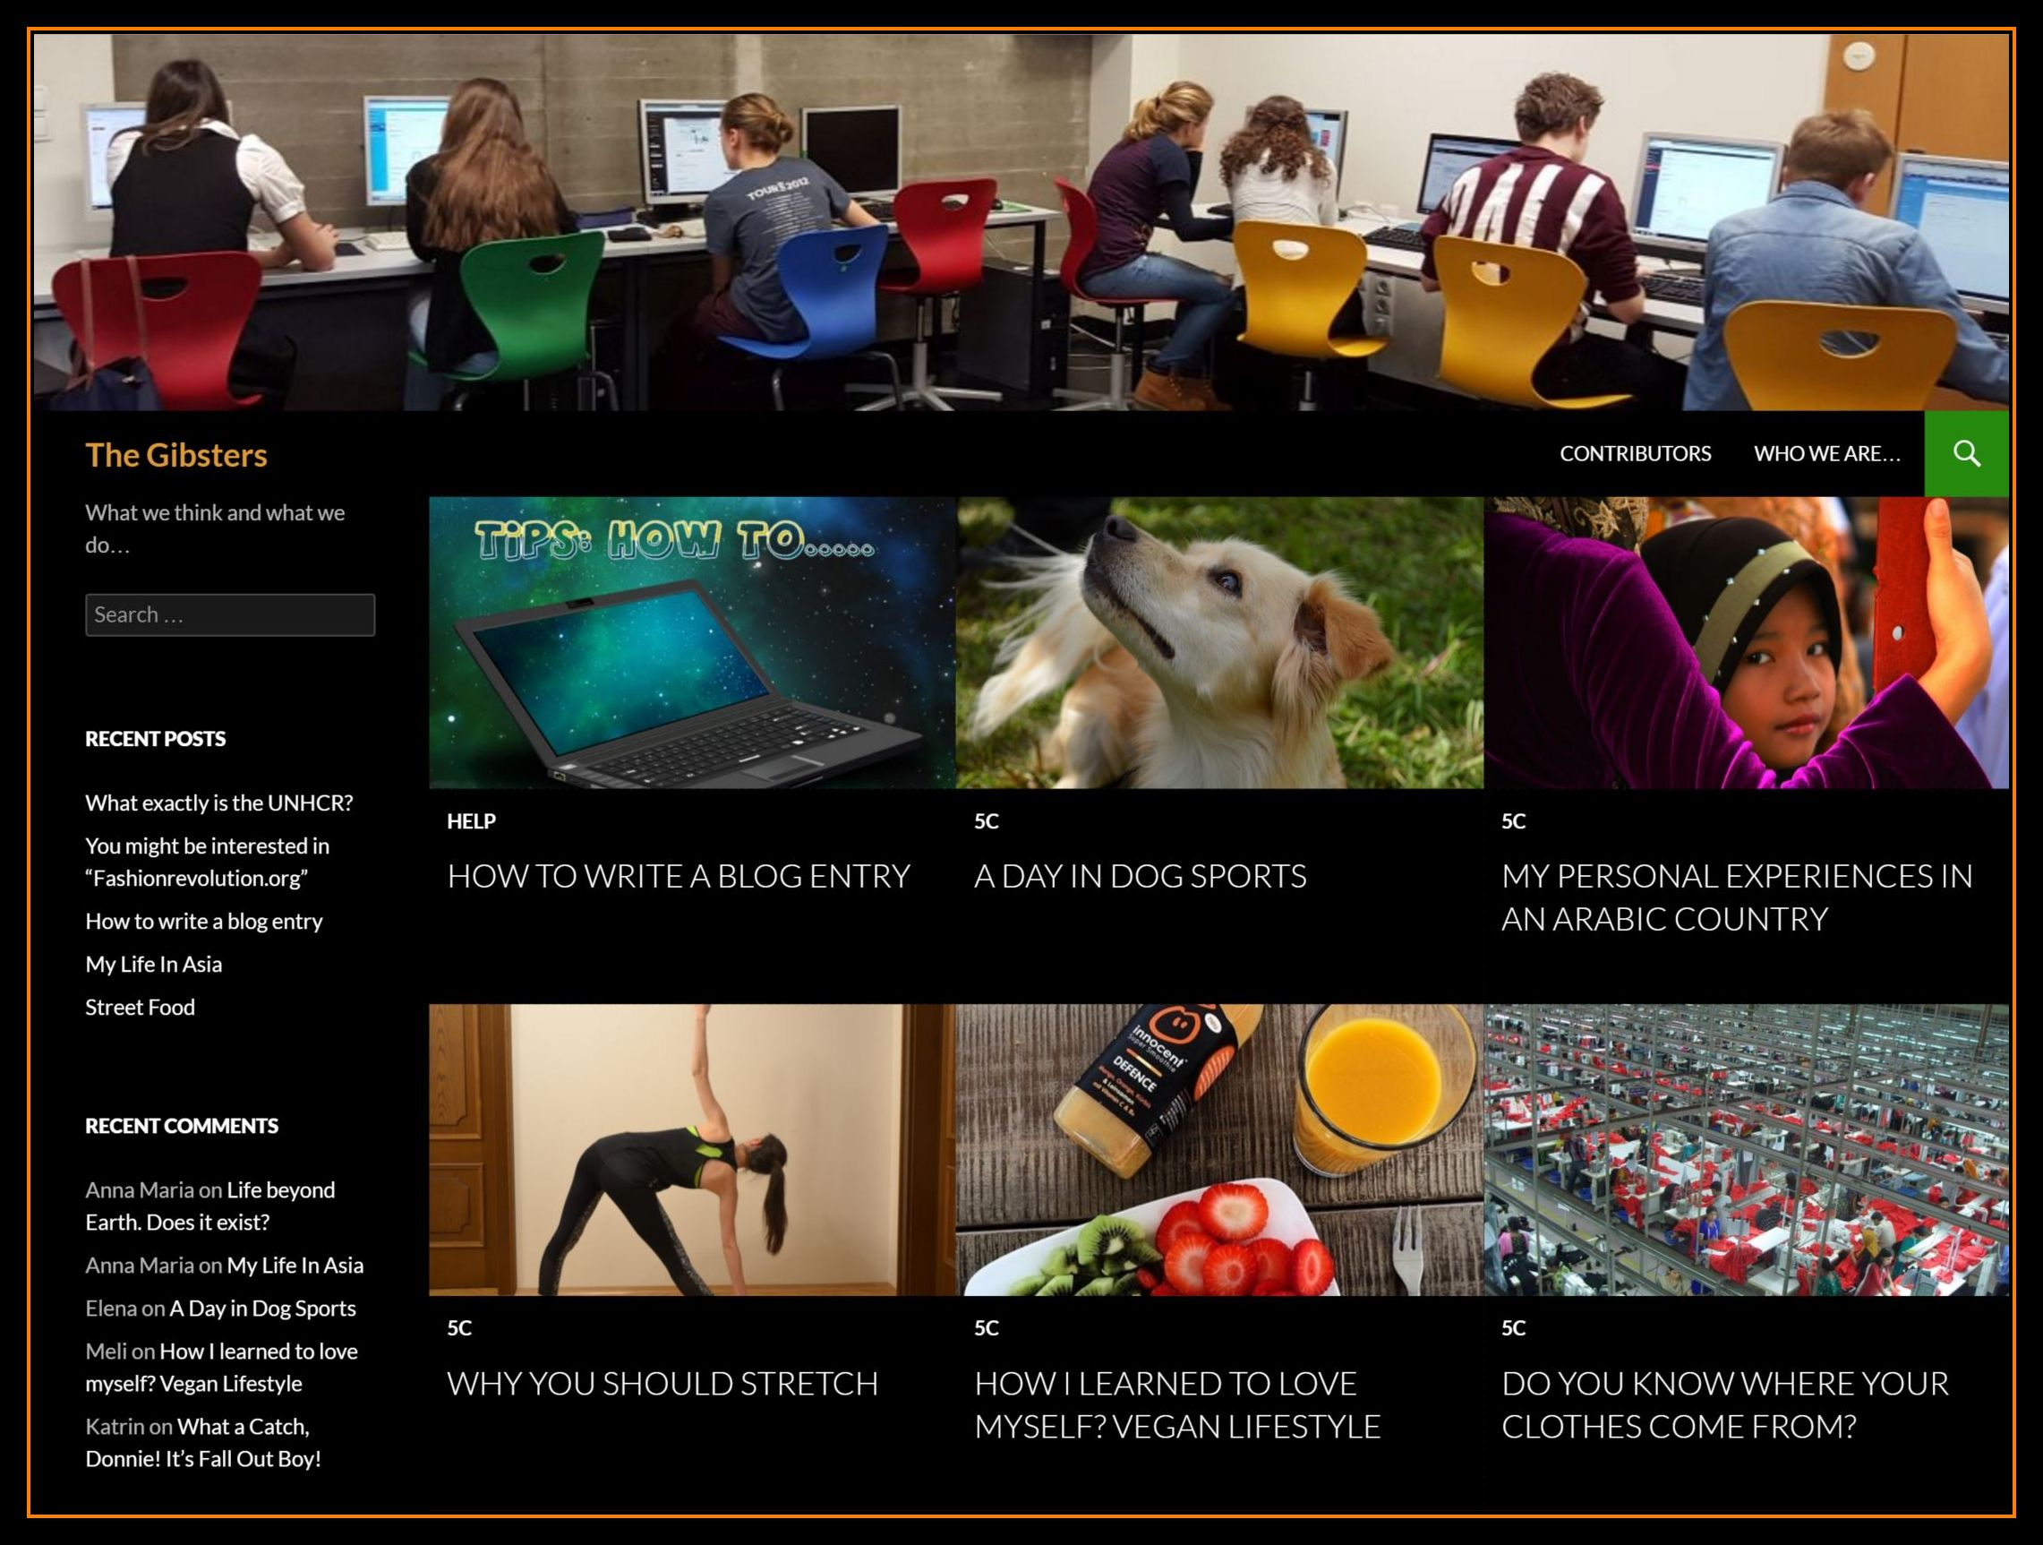

Examples Autonomy – Mastery - Connection Lernen unter der Dopamindusche
Notes:
Wie können die 3 Bedürfnisse: Autonomy, Mastery und Connection in der Klasse befriedigt werden.
Mastery: Stolz! Coole Produkte --- das löst eine Dopaminausschüttung aus – und verlangt nach MEHR – also Motivationsspirale nach oben.
Connection: Group projects, making work visible (flipgrid)

Slide 29


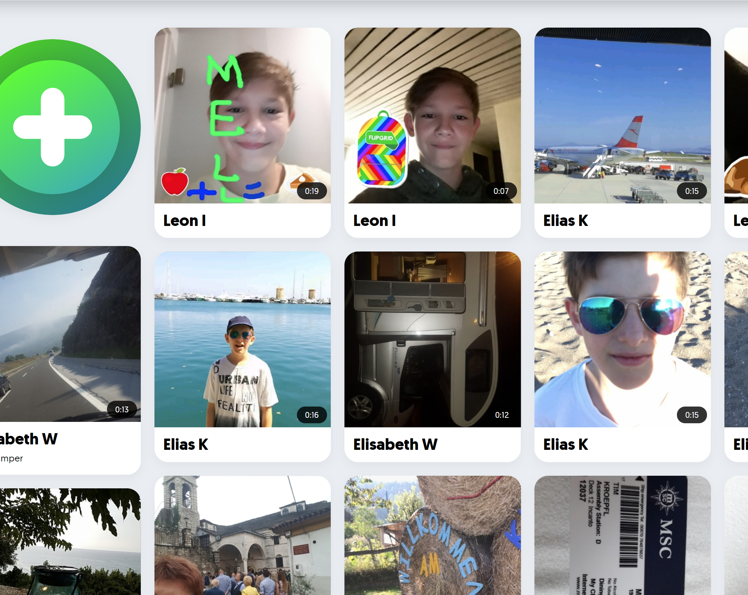
Connection Belonging Sharing
Notes:
Connection – Belonging- Sharing extrem wichtig: Meine eigene Schulzeit: Null davon – immer nur Heft an Lehrer – nie gesehen was andere tun.
Gegenbeispiel: Flipgrid: -- in den FERIEN kamen 55 englische videos zusammen – in einer 1. Klasse NMS!!!
Der schwächste Schüler hat noch am Weg in die Schule eine engl. message gepostet.
Angstfrei in der Fremdsprache mit Freunden kommunizieren -- == LERNEN

Slide 30
How can this work? Where can we give students choice?
Themes and topics of interest
Resources and materials
Route and strategy: how do you want to learn this?
Real questions: students ask questions based on their own sense of wonder
Product: how do you want to show that you have learned it? (Video, audio, texttype, format…)
Scaffolding: what kind of help do you need? (Textbook, handout, instruction video, peers, teacher…)
Setting and social preferences: groupwork, individual work, quiet place, classroom, outside…
Pace: how much time do you need?
Self assessment: where are you? What will be the next step?

Slide 31

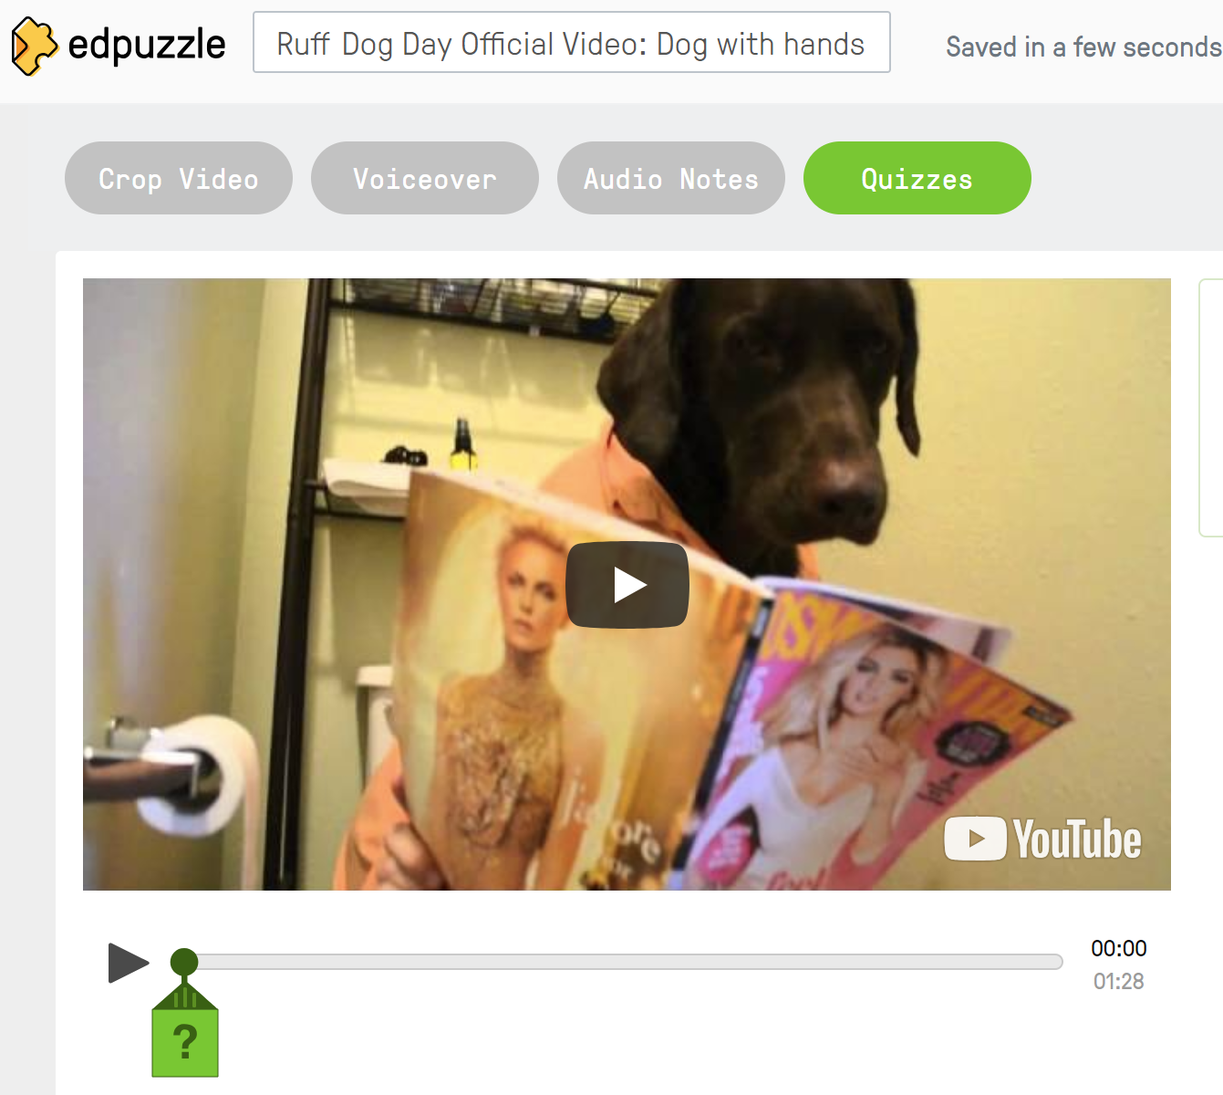
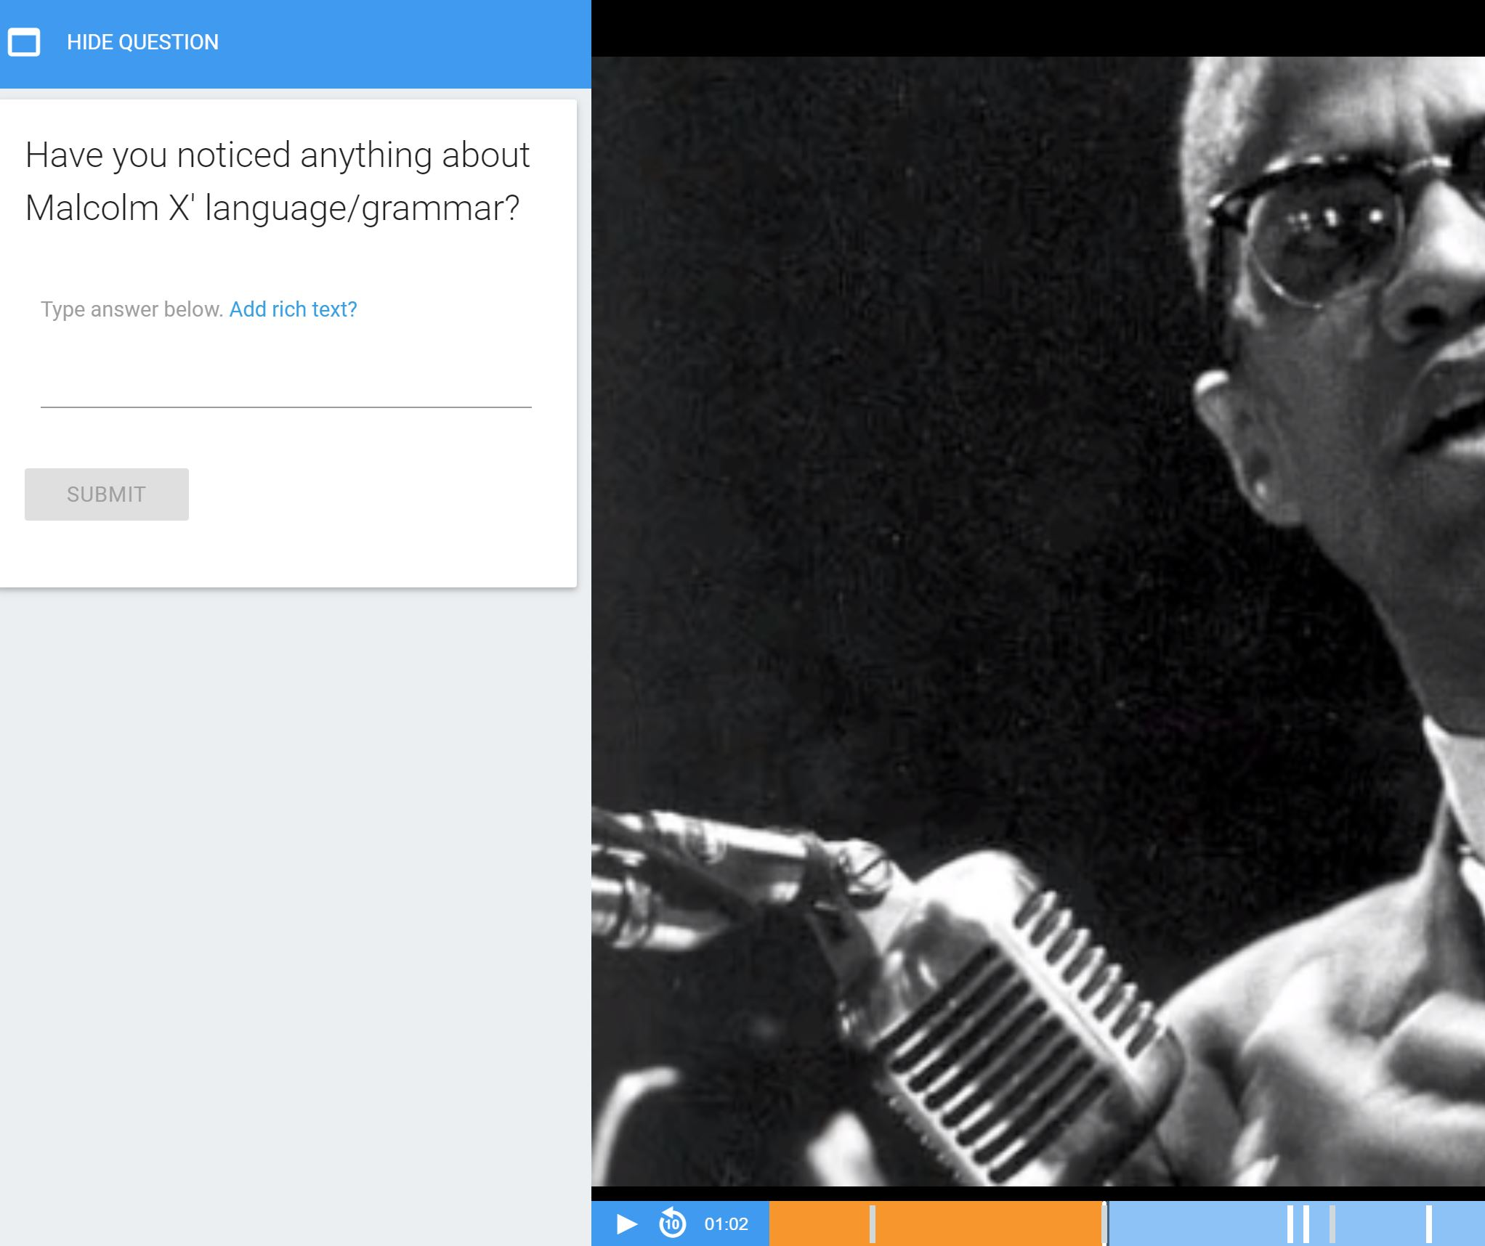

Questions: students ask questions based on their own sense of wonder
Choose an article that interests you.
What are the most interesting facts in this text?
Write 5 questions about these facts.
Ask another student to answer your questions.

Slide 32

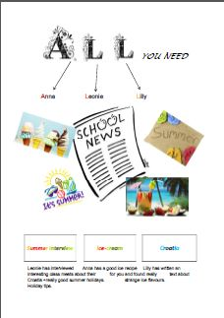


Choice of topic

Slide 33
Choice of topic
Blogging
www.gibsters.com

Slide 34
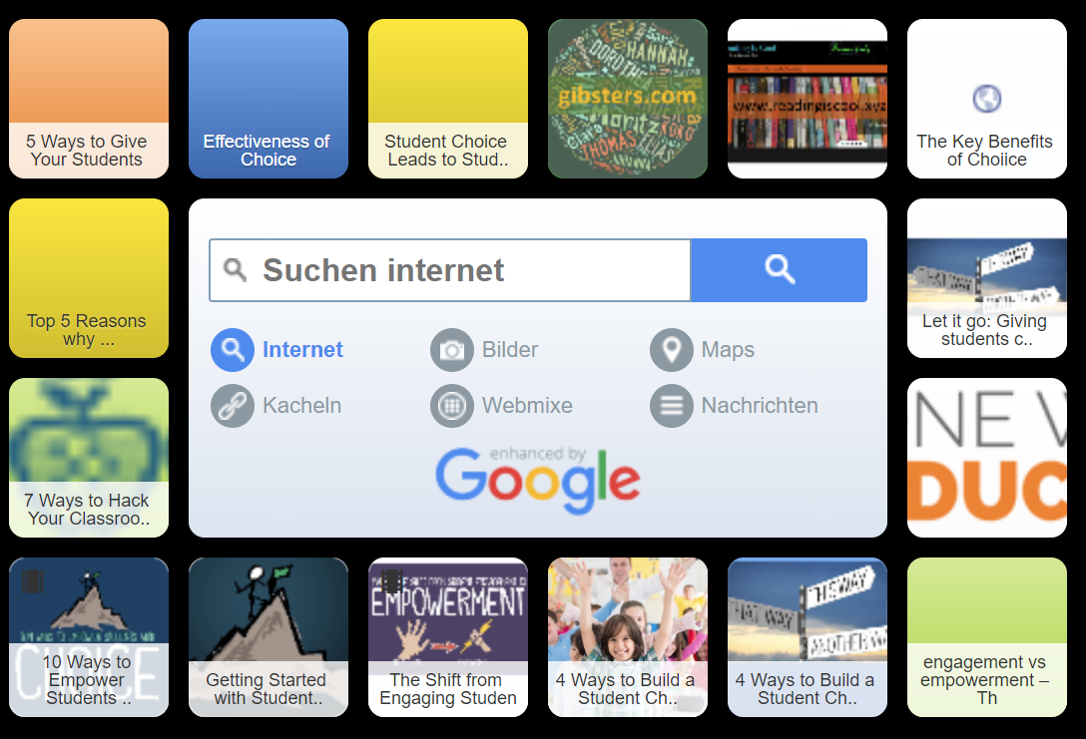
Choice of resources and materials

Slide 35
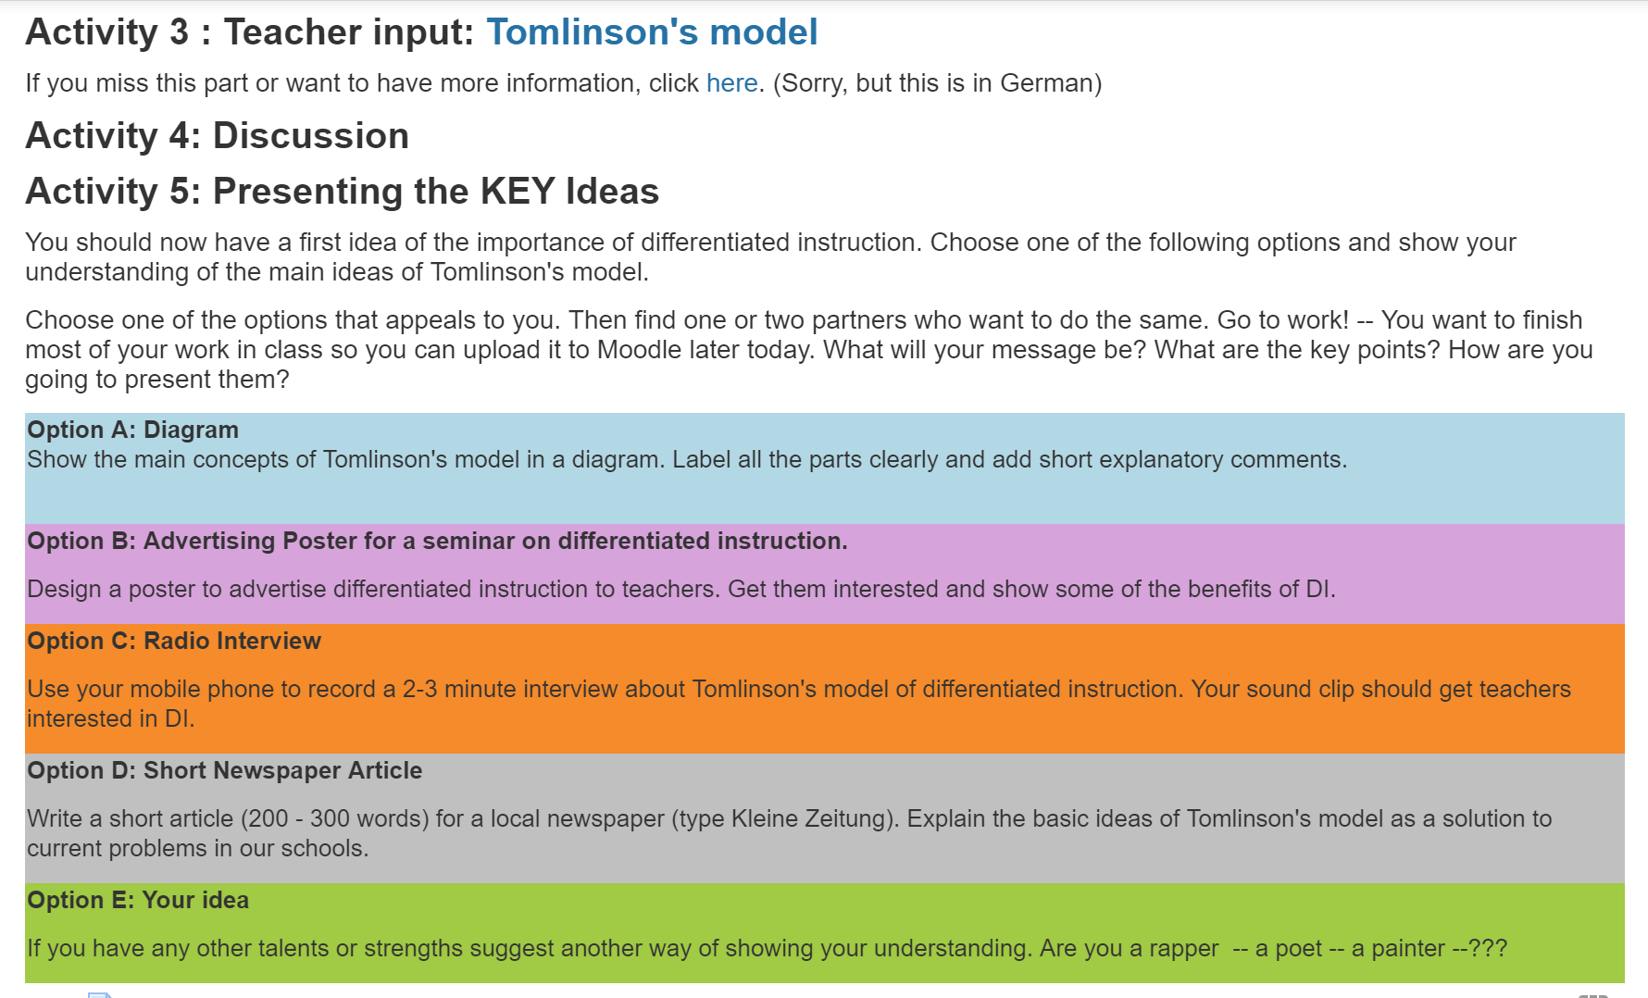
Choice of product

Slide 36
Choice boards, menus and tic-tac-toe
Different work, not more or less
Same learning goals for all – different paths
More motivating – choice = empowerment
Cater for different interests and preferances
Allow choice for different readiness levels (easier tasks, more challenging tasks -- or choiceboards at different levels)
All tasks must be equally interesting and meaningful. No mindless exercises.
Maintain teacher control and give students some freedom within a given framework
Can be used for a single task or a whole project (where students choose 3 or 4 tasks and cover different skills)
Can be used at all levels and for all subjects

Slide 37
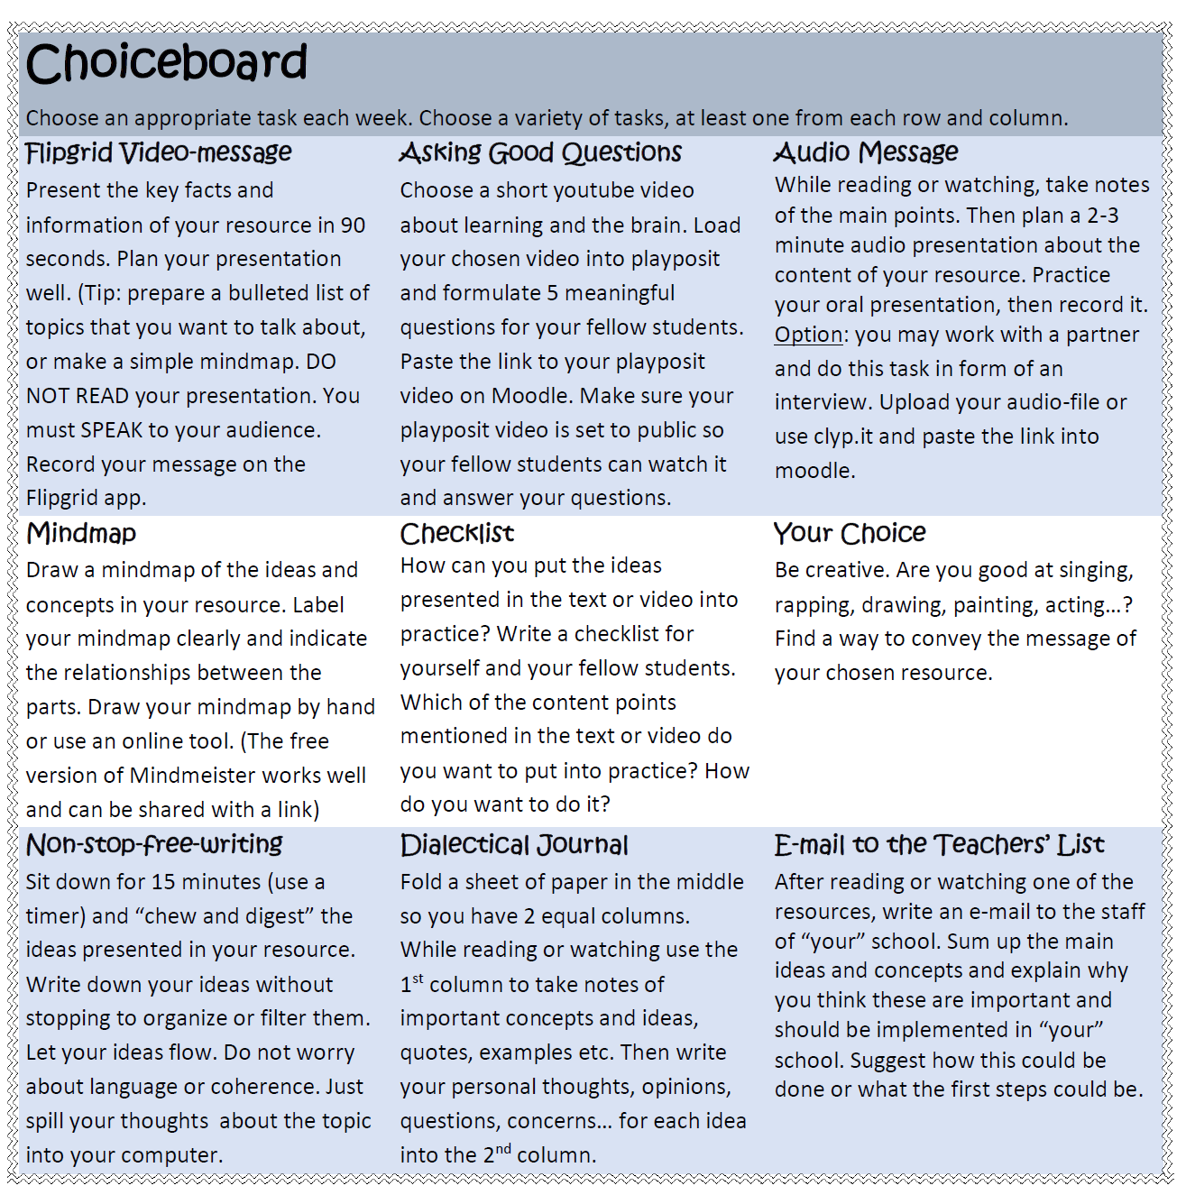
Choice of product

Slide 38
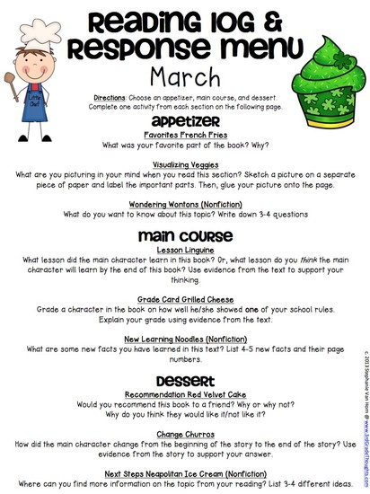
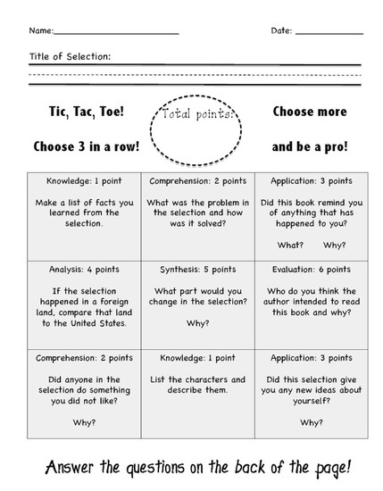
Examples
examples
https://www.smore.com/z12ay-tic-tac-toe-choice-boards-menus

Slide 39

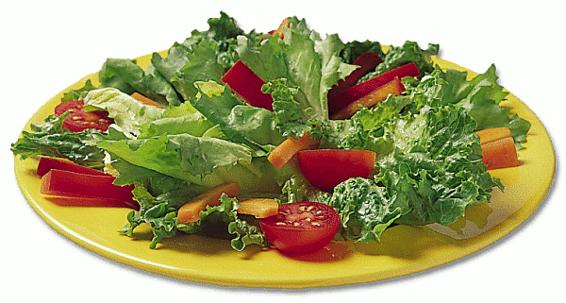
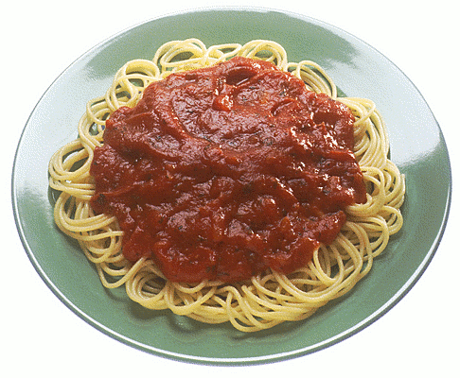

My Home
examples
Choose one option from each course: 1 soup or salad, 1 main course, 1 dessert
Soup or salad | Mindmap Make a mindmap of all the new vocabulary for describing your home. Make good categories. | Drawing Draw a plan or picture of your apartment. Label all the rooms and the furniture in the rooms.
Main Course | Video message on Flipgrid Make a flipgrid video where you describe your home to the class. You can show us your floorplan or drawing and describe all the rooms. or You can walk around your home and describe the rooms you are in. Tip: Stand still while you are talking and do not move the camera too much. | Tea and Talk: Sharing photos Bring 2-3 photos of your home to “Tea and Talk”. Practice describing them in detail. Then present your home to your friends. Tell us what you like and don’t like about the rooms.
Dessert | A short letter to your penfriend Tell your new penfriend about your home. Describe the rooms and furniture and say what you like and don’t like about your home. Start like this: Dear xx, Thank you for your long letter. Now I know a lot about your home. Your room is really cool. Now, I am going to describe my home to you: | Matching pictures and text Bring a picture of your room or another room in your home. On an extra sheet describe the room in detail. Do not write your name on the sheet. We will then post all the pictures and all the texts on the wall. Your classmates will have to find the matching pairs.

Slide 40
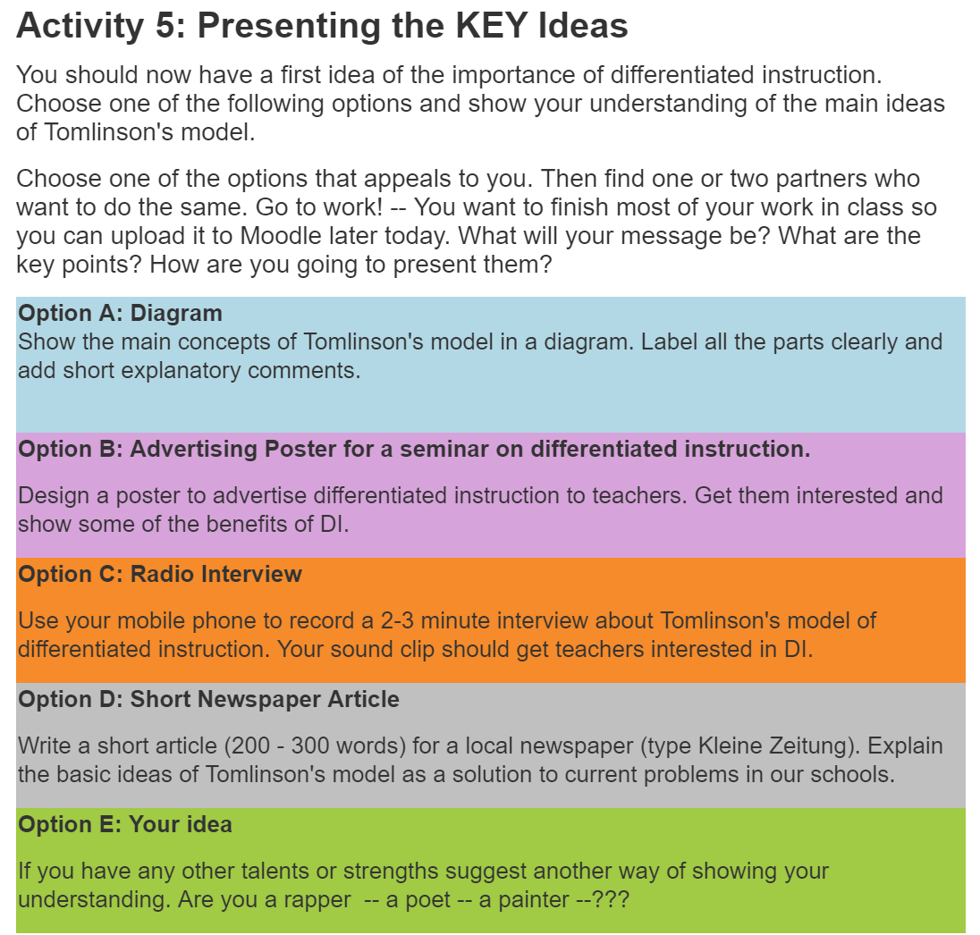
A choice board for students of PPS 2: Communicative language teaching in Practice II
examples

Slide 41
How to get started
Define your learning goal: what should your learners be able to DO? How can this be shown?
Provide different resources: textbook, other texts, videos, audio material, web-sites, learning games…
Create a set of tasks where the learners can SHOW that they have achieved the goal(s)
Make sure your tasks cover different skills: reading and listening (resources) and speaking and writing (for the products)
Make sure you cater for different interests, skills, learning preferences (visual learners will like mindmaps, auditive learners will prefer videos and audio input and tasks…

Slide 42
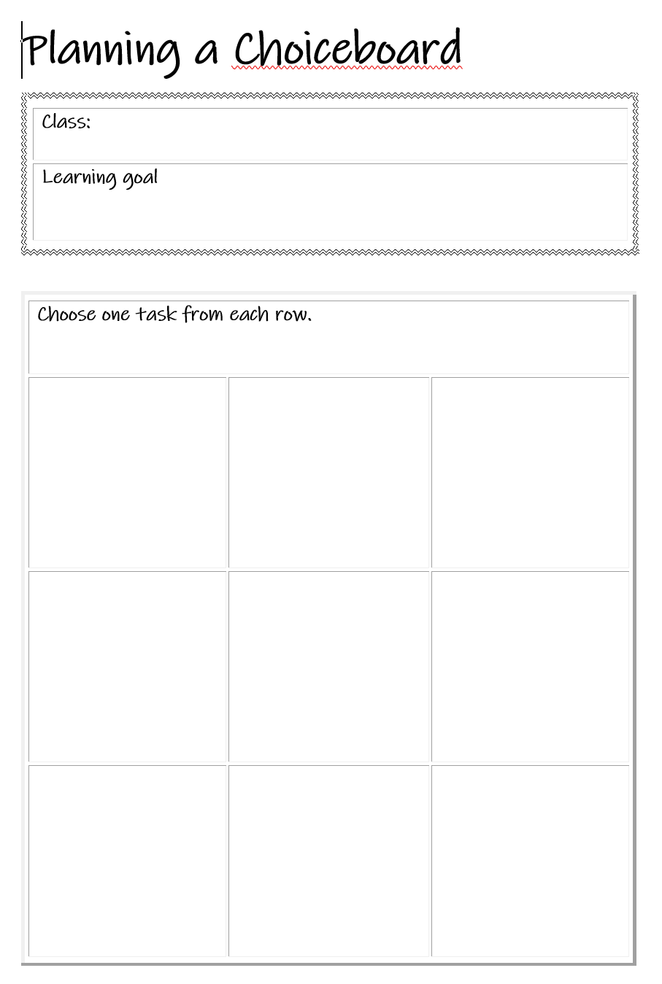
Let‘s take a first step… Plan a choiceboard for one of your classes.
Audio tasks
2-minute radio program
telphone conversation
interview
radio commercial
act out a dialog
…
Writing tasks
letter
postcard
diary
e-mail
blog-comment
article
how-to instructions
quiz: 5 questions for your partner
…
Visual tasks
mindmap
checklist
diagram
timeline
…
Video tasks (Flipgrid)
act out a scene
interview
TV commercial
how to: instructions video
…

Slide 43
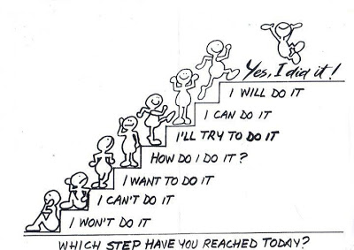
Let‘s take a first step…
Which of the ideas in this presentation seem most relevant for your own teaching?
Plan one first step to give your students more choice: what is it going to be?
This Photo by Unknown Author is licensed under CC BY-NC-ND
This Photo by Unknown Author is licensed under CC BY-SA

Slide 44
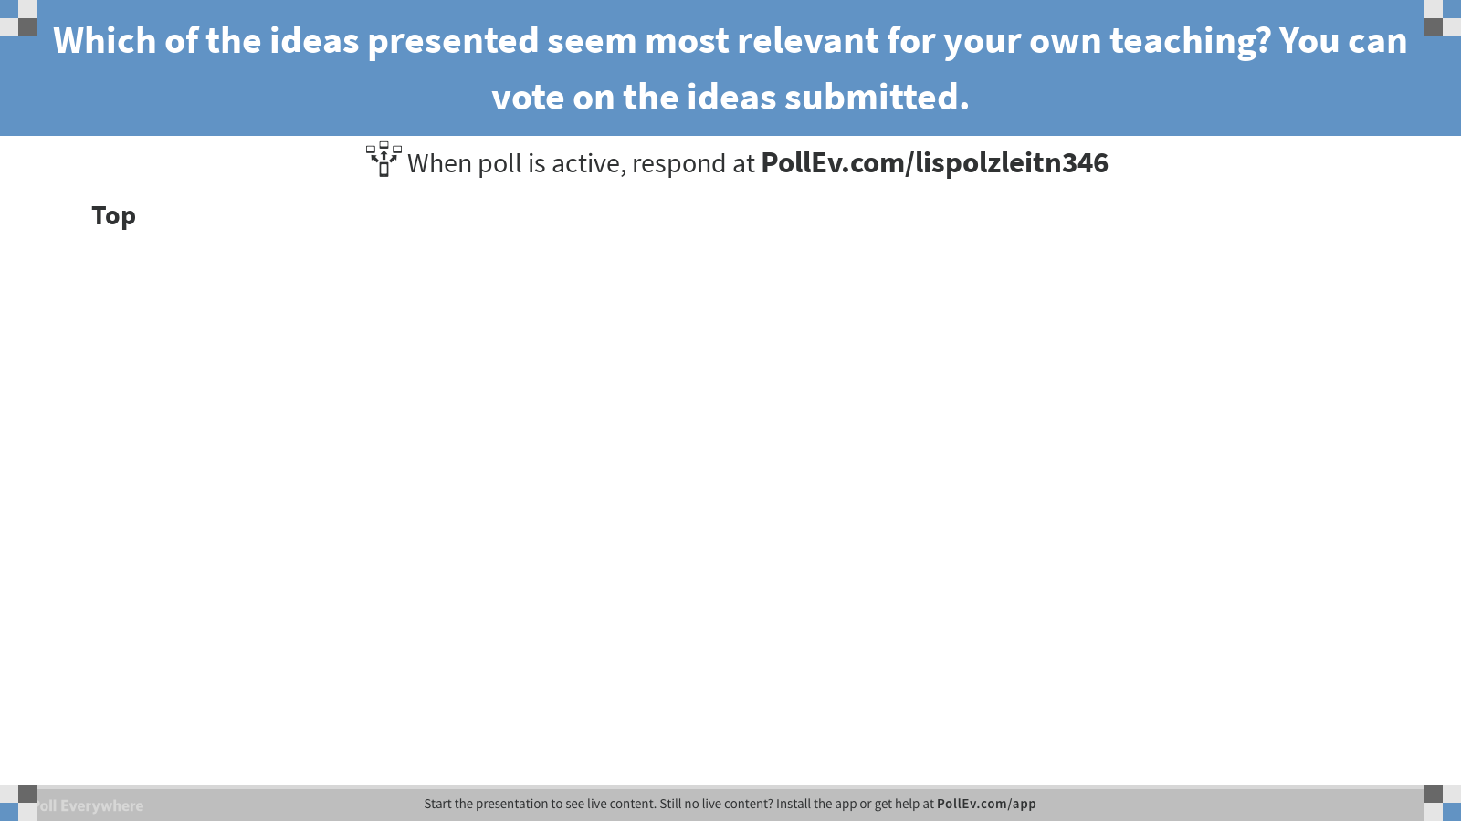
Notes:
Poll Title: Which of the ideas presented seem most relevant for your own teaching? You can vote on the ideas submitted. https://www.polleverywhere.com/discourses/p1wuYXeUylHiVvm

Slide 45
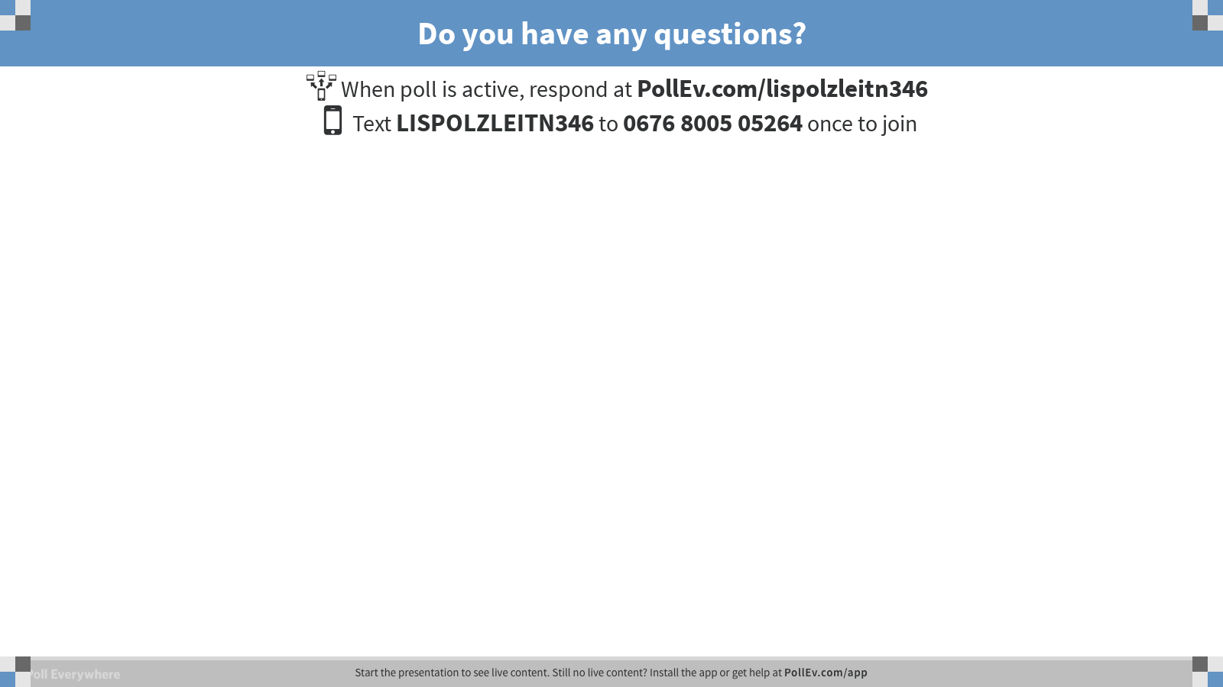
Notes:
Poll Title: Do you have any questions? https://www.polleverywhere.com/free_text_polls/kCdHjCGywtGNVey

Slide 46

Thanks for your attention
Find out more on
www.epep.at
www.gibsters.com
www.readingiscool.xyz
This Photo by Unknown Author is licensed under CC BY-NC-ND

Slide 47
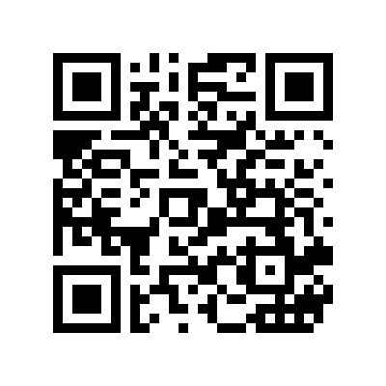
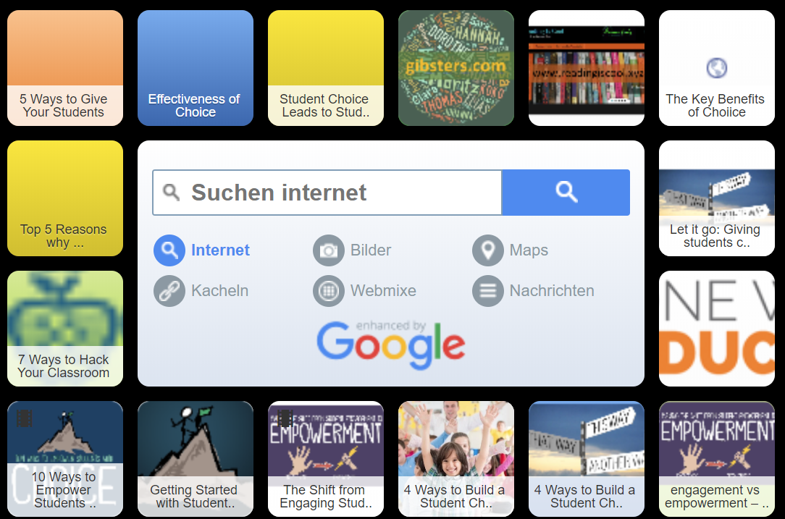
Resources
https://tinyurl.com/choiceboard-recources

Slide 48
Now it‘s your turn
A mini choice board for this session
Do one of the tasks from the choice board.
Be prepared to present your product to the group in the last 15 minutes of this session.
Poster Make a poster that presents the advantages of choice-boards to your colleagues in school. You can then show the poster to your colleagues during the next pedagogical conference or subject teacher meeting. | Video message on Flipgrid Record a short video message explaining the benefits of choice-boards to other teachers. Record the message on flipgrid. You can also do this with a partner in form of an interview or a questions- answer session. Flipgrid: https://flipgrid.com/fcff38f6 | Explain to your students Explain the idea of choice-boards to your students in school. Think of a specific class that you are teaching at the moment. Do this in the language you are teaching. Prepare 3-5 powerpoint slides (or sketch them on paper if you did not bring your computer).
E-mail to a colleague Write an e-mail to a colleague of yours. (Maybe the colleague who is teaching a parallel group.) Explain the benefits of choice-boards and invite him/her to try it out with you. | Letter to the editor Write a short letter to the editor of your local newspaper. Explain the importance of differentiation and choice for effective learning and argue for inclusion and against early segregation in schools. | Design your first choice board Design a basic choice board for one of your classes. Define your learning objectives. Then offer options for students to choose from. Consider: different language skills, interests, readiness levels, learning preferences
Mindmap Make a detailed mind map about choice boards: benefits and how-to-tips. | Questions Write a set of meaningful comprehension and discussion questions for one of the texts or videos about choice-boards. Provide an answer sheet (in keywords). | Why I do NOT like choice boards Explain why you do NOT want to use choice-boards in your classes. What are the disadvantages for you and your leaners? Choose any format: video, e-mail, mind map of disadvantages, checklist of disadvantages…

Slide 49


Let‘s share…
Results and products
Any further questions
Where else could you give choice to your learers?
This Photo by Unknown Author is licensed under CC BY-SA-NC
This Photo by Unknown Author is licensed under CC BY-SA

