Slide 1
Choice boards
Better learning with CHOICE

Slide 2
Choice boards, menus and tic-tac-toe
Different work, not more or less
Same learning goals for all – different paths
More motivating – choice = empowerment
Cater for different interests and preferances
Allow choice for different readiness levels (easier tasks, more challenging tasks -- or choiceboards at different levels)
All tasks must be equally interesting and meaningful. No mindless exercises.
Maintain teacher control AND give students some freedom within a given framework
Can be used for a single task or a whole project (where students choose 3 or 4 tasks and cover different skills)
Can be used at all levels and for all subjects

Slide 3

How to get started
Define your learning goal: What should your learners be able to DO? How can this be shown?
Provide different resources: textbook, other texts, videos, audio material, web-sites, learning games…
Create a set of tasks where the learners can SHOW that they have achieved the goal(s)
Make sure your tasks cover different skills: reading and listening (resources) and speaking and writing (for the products)
Make sure you cater for different interests, skills, learning preferences (visual learners will like mindmaps, auditive learners will prefer videos and audio input and tasks…

Slide 4
How can this work?
Where can we give students choice?
Themes and topics of interest
Resources and materials
Route and strategy: how do you want to learn this?
Real questions: students ask questions based on their own sense of wonder
Product: how do you want to show that you have learned it? (Video, audio, texttype, format…)
Scaffolding: what kind of help do you need? (Textbook, handout, instruction video, peers, teacher…)
Setting and social preferences: groupwork, individual work, quiet place, classroom, outside…
Pace: how much time do you need?
Self assessment: where are you? What will be the next step?

Slide 5

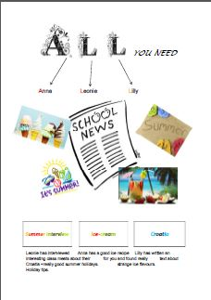


Choice of topic

Slide 6
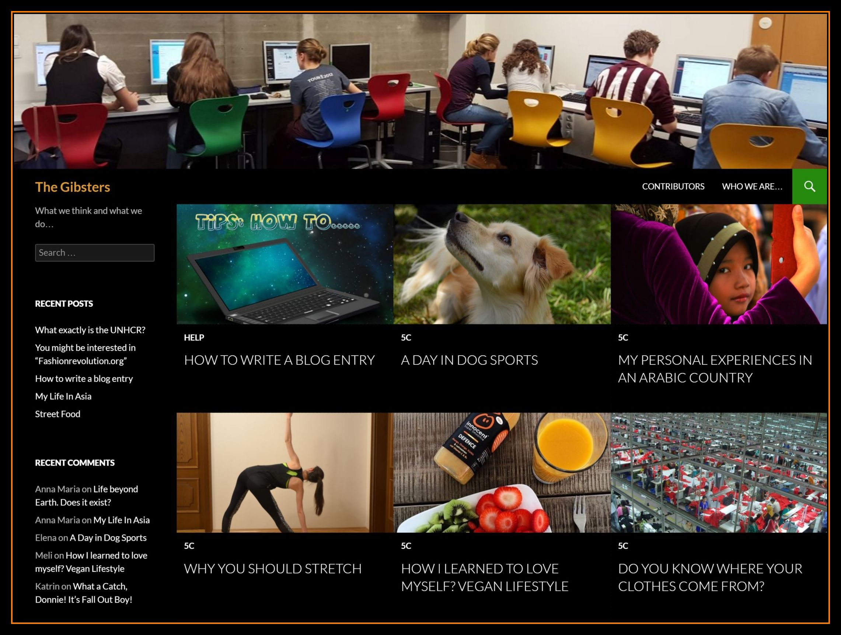
Choice of topic
Blogging
www.gibsters.com

Slide 7

Choice of books they read
www.readingiscool.xyz
Notes:
Themen für boys and girls, reading level!!!! dünn und dick –
oder auch audio-books or even movies

Slide 8
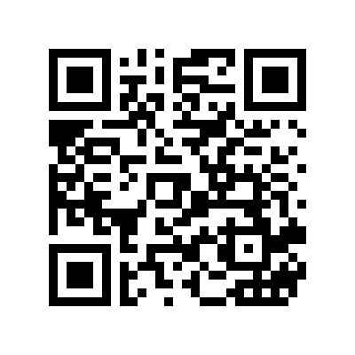
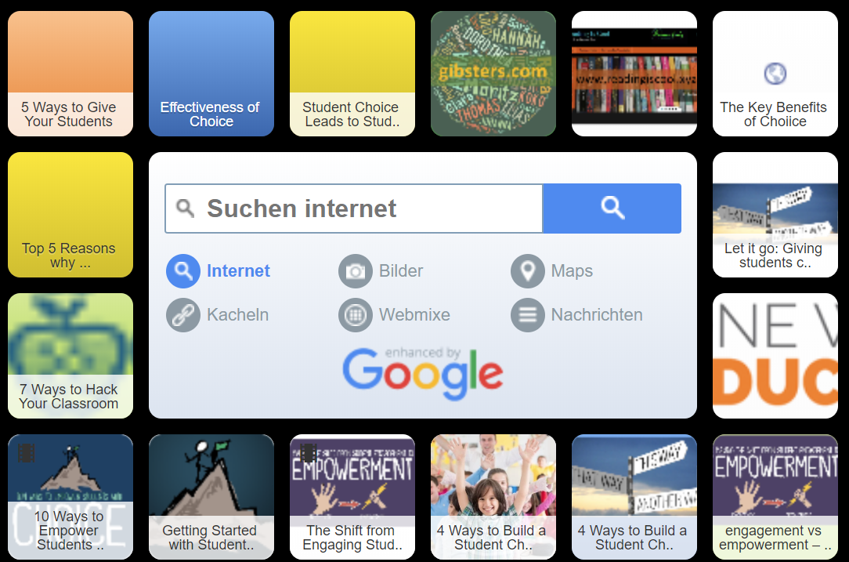
Resources
https://tinyurl.com/choiceboard-recources

Slide 9
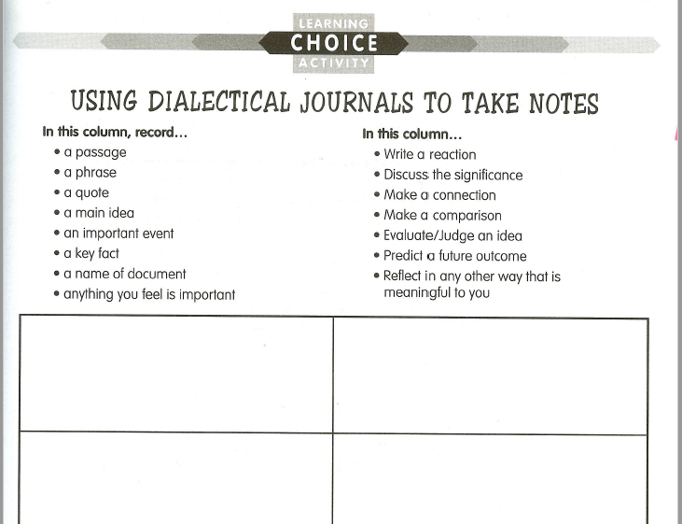
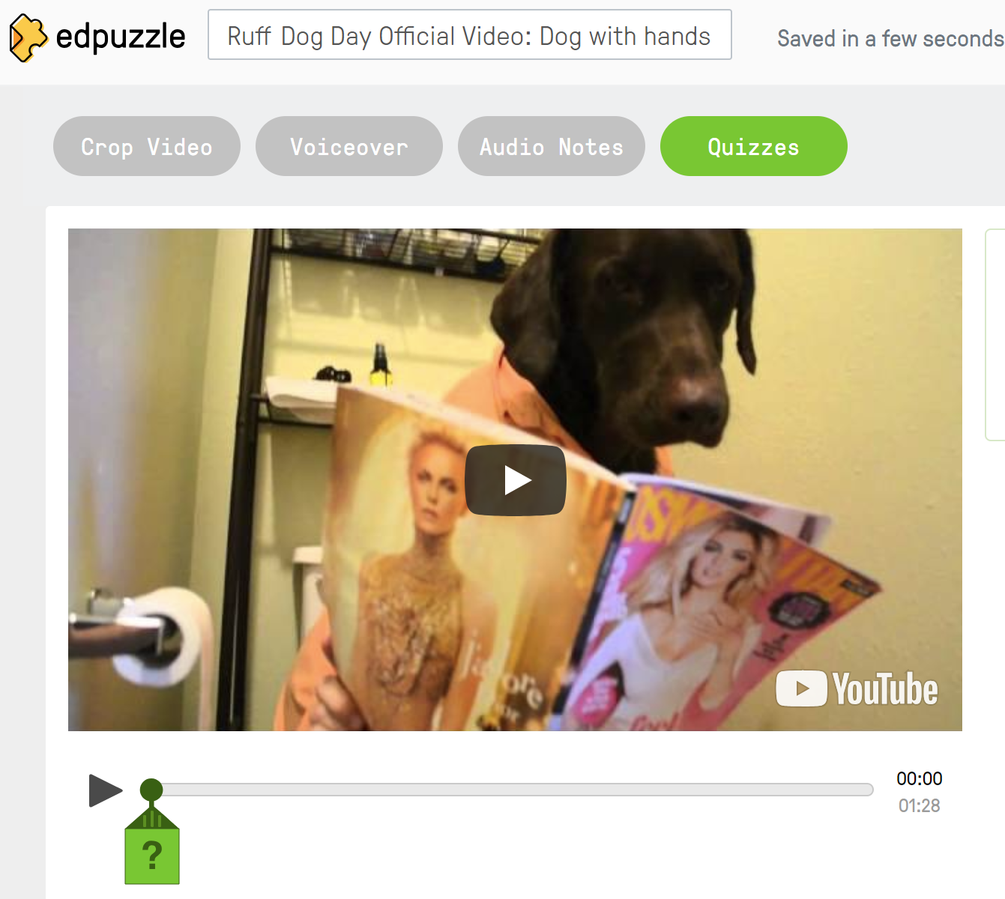
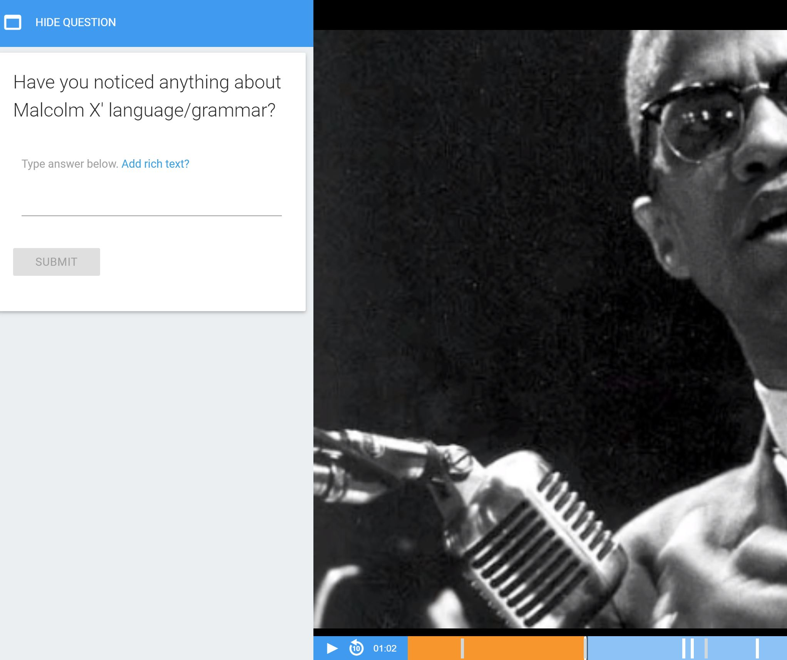

Questions: students ask questions based on their own sense of wonder

Slide 10
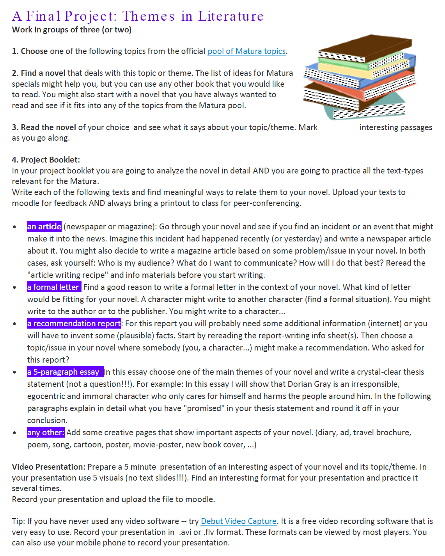
Choice of
resource (book)
and
topic / perspective / message /opinion

Slide 11
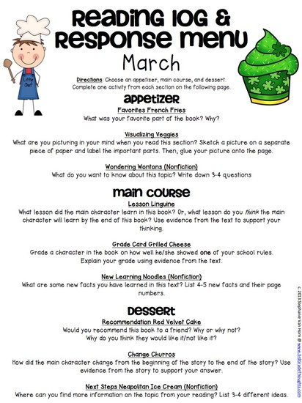
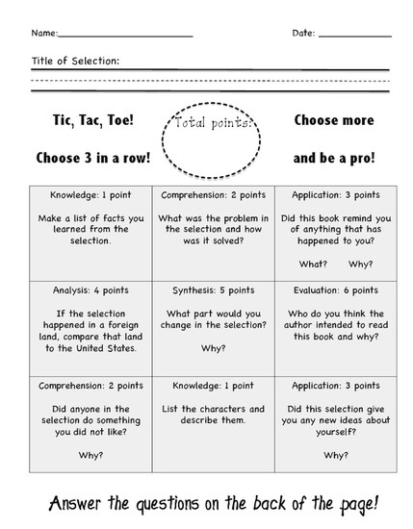
Examples
examples
https://www.smore.com/z12ay-tic-tac-toe-choice-boards-menus

Slide 12

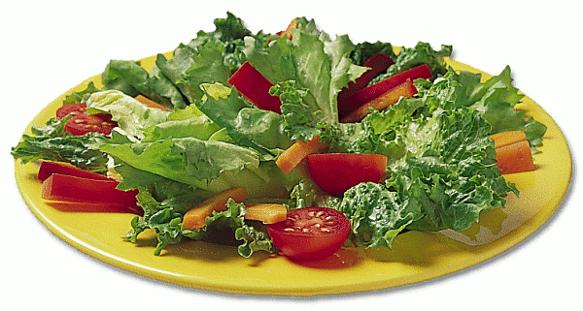
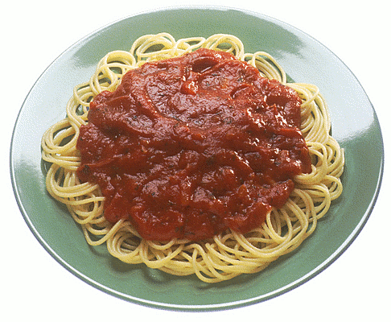

My Home
examples
Choose one option from each course: 1 soup or salad, 1 main course, 1 dessert
Soup or salad | Mindmap Make a mindmap of all the new vocabulary for describing your home. Make good categories. | Drawing Draw a plan or picture of your apartment. Label all the rooms and the furniture in the rooms.
Main Course | Video message on Flipgrid Make a flipgrid video where you describe your home to the class. You can show us your floorplan or drawing and describe all the rooms. or You can walk around your home and describe the rooms you are in. Tip: Stand still while you are talking and do not move the camera too much. | Tea and Talk: Sharing photos Bring 2-3 photos of your home to “Tea and Talk”. Practice describing them in detail. Then present your home to your friends. Tell us what you like and don’t like about the rooms.
Dessert | A short letter to your penfriend Tell your new penfriend about your home. Describe the rooms and furniture and say what you like and don’t like about your home. Start like this: Dear xx, Thank you for your long letter. Now I know a lot about your home. Your room is really cool. Now, I am going to describe my home to you: | Matching pictures and text Bring a picture of your room or another room in your home. On an extra sheet describe the room in detail. Do not write your name on the sheet. We will then post all the pictures and all the texts on the wall. Your classmates will have to find the matching pairs.

Slide 13
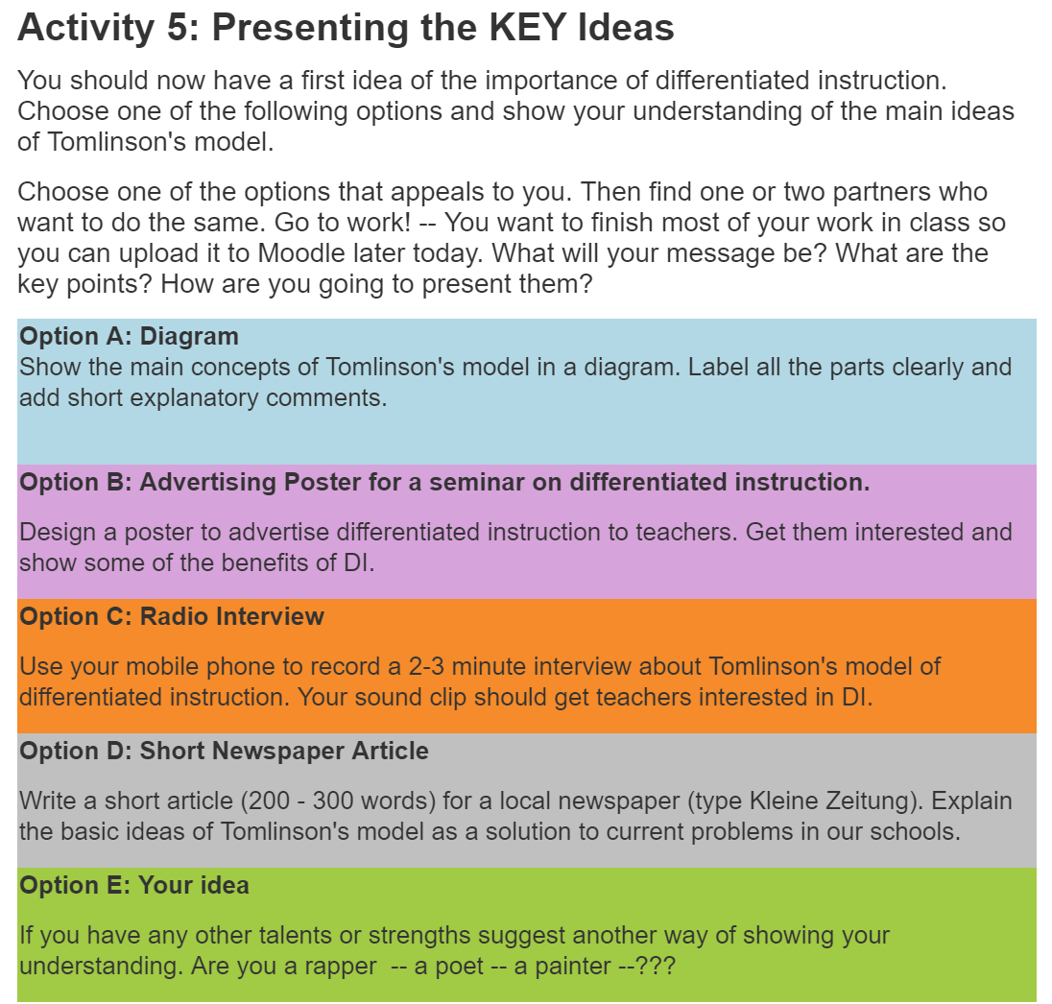
A choice board for students of PPS 2:
Communicative language teaching in Practice II
examples

Slide 14
A choiceboard for the course:
Focus on language and the learner
The students find the resources for these tasks on Moodle

Slide 15
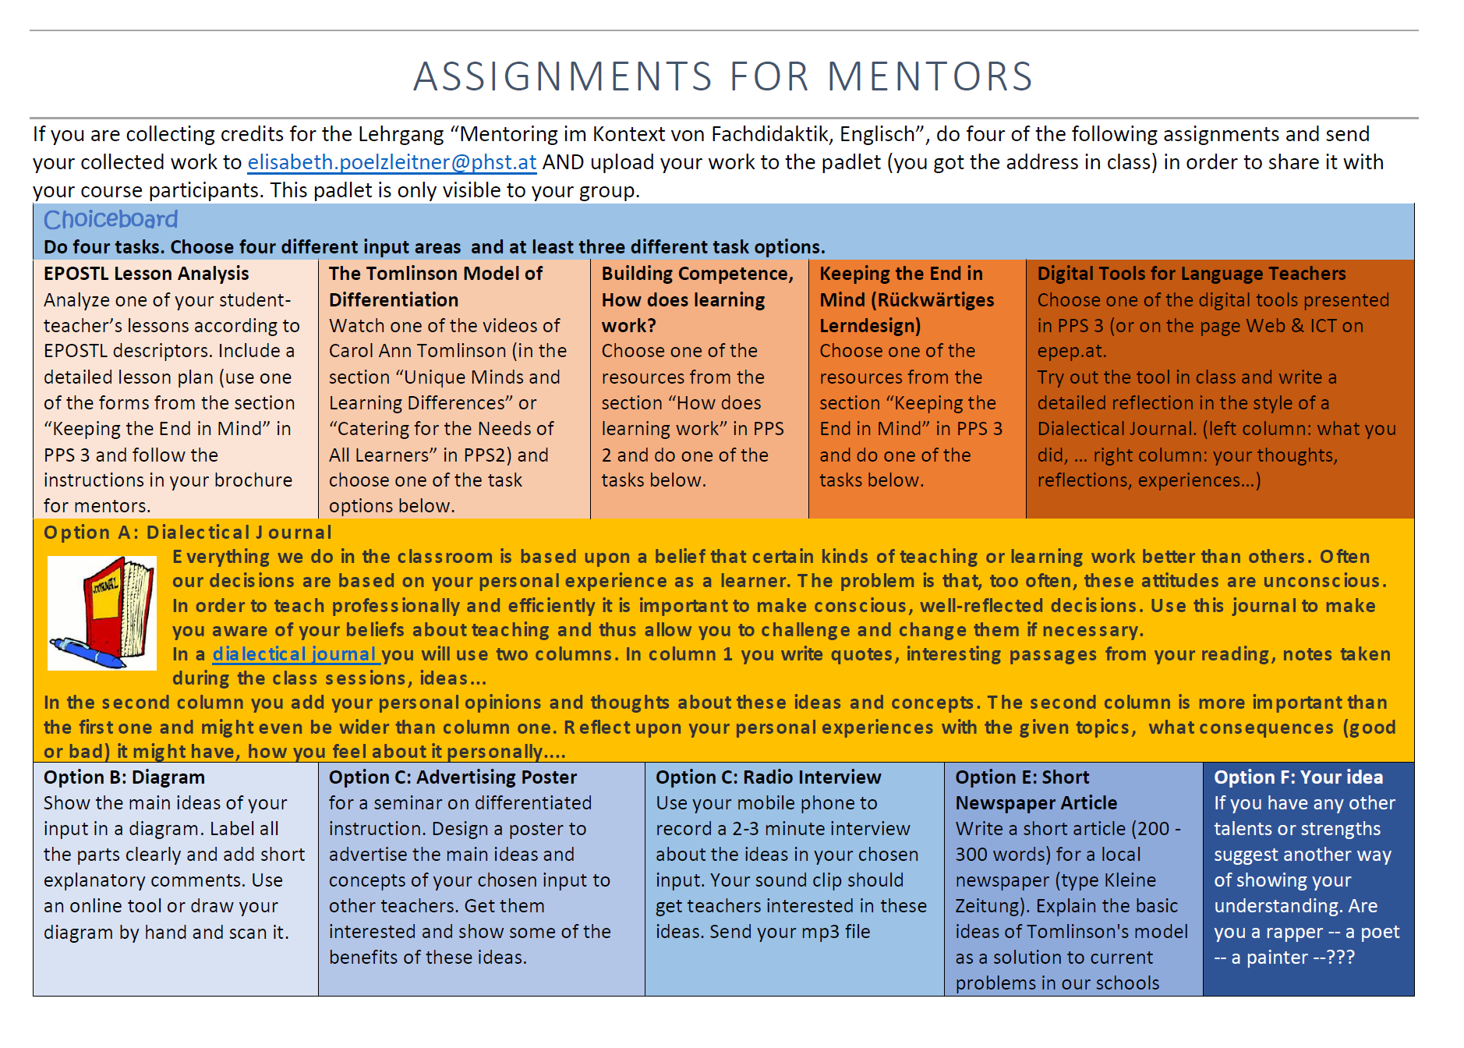
examples
Resources
Products

Slide 16
Now it‘s your turn
A mini choice board for this session
Do one of the tasks from the choice board.
Be prepared to present your product to the group in the last 15 minutes of this session.
Poster Make a poster that presents the advantages of choice-boards to your colleagues in school. You can then show the poster to your colleagues during the next pedagogical conference or subject teacher meeting. | Video message on Flipgrid Record a short video message explaining the benefits of choice-boards to other teachers. Record the message on flipgrid. You can also do this with a partner in form of an interview or a questions- answer session. Flipgrid: https://flipgrid.com/fcff38f6 | Explain to your students Explain the idea of choice-boards to your students in school. Think of a specific class that you are teaching at the moment. Do this in the language you are teaching. Prepare 3-5 powerpoint slides (or sketch them on paper if you did not bring your computer).
E-mail to a colleague Write an e-mail to a colleague of yours. (Maybe the colleague who is teaching a parallel group.) Explain the benefits of choice-boards and invite him/her to try it out with you. | Letter to the editor Write a short letter to the editor of your local newspaper. Explain the importance of differentiation and choice for effective learning and argue for inclusion and against early segregation in schools. | Design your first choice board Design a basic choice board for one of your classes. Define your learning objectives. Then offer options for students to choose from. Consider: different language skills, interests, readiness levels, learning preferences
Mindmap Make a detailed mind map about choice boards: benefits and how-to-tips. | Questions Write a set of meaningful comprehension and discussion questions for one of the texts or videos about choice-boards. Provide an answer sheet (in keywords). | Why I do NOT like choice boards Explain why you do NOT want to use choice-boards in your classes. What are the disadvantages for you and your leaners? Choose any format: video, e-mail, mind map of disadvantages, checklist of disadvantages…

