Slide 1
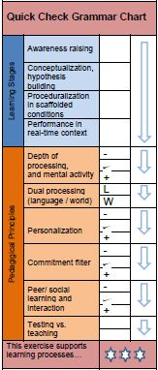
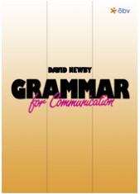
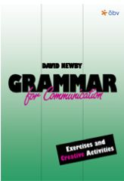
Teaching Vocabulary and Grammar
Creative Approaches to teaching Communicative Grammar and Vocabulary

Slide 2
Teaching and learning grammar
What works well?
What are the problems?

Slide 3

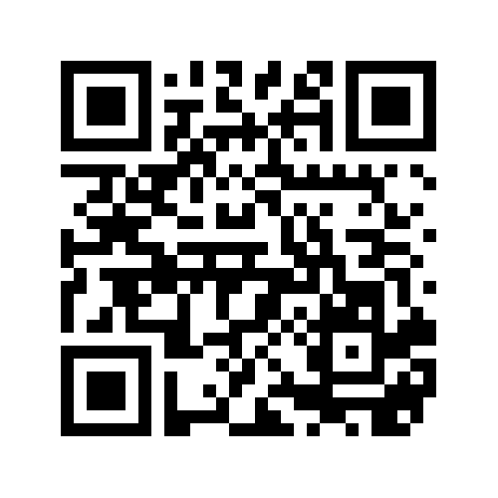
Let‘s collect our ideas
https://padlet.com/lispolzleitner/6ij61ghkhrq0
https://tinyurl.com/gr-prob

Slide 4
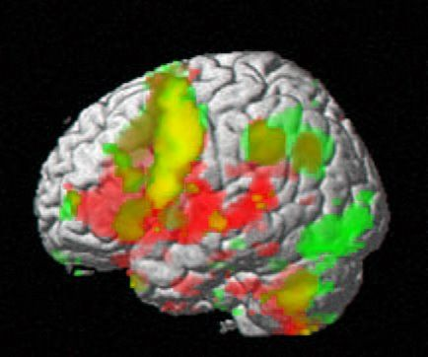
Learning vocabulary with the whole brain
How do your students study vocabulary?
How can we improve this?

Slide 5

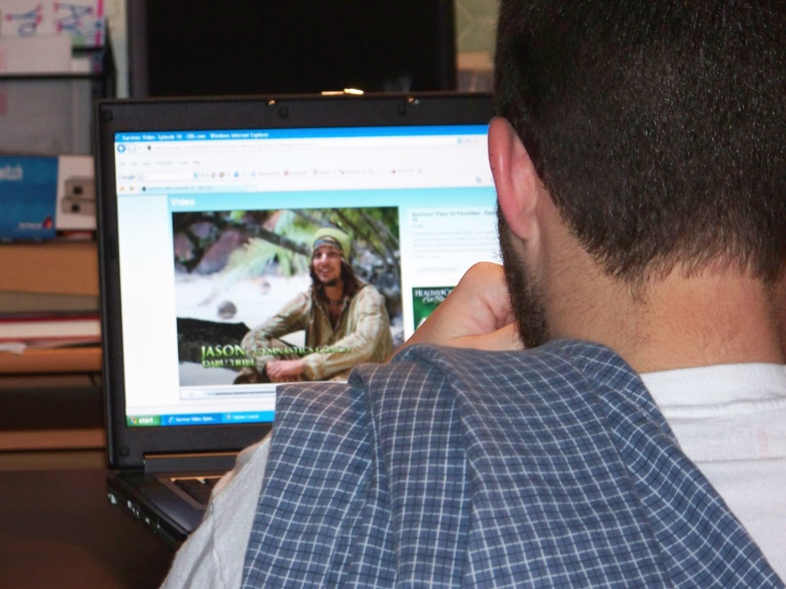
Conscious learning versus acquisition
FLOW:
Being LOST in a book or film
Comprehensible
Meaningful Input
Notes:
Unbewusst: wie glaubhaft ist die Lehrperson, …
wie wichtig ist das für uns alle (peer-group)
unbewusstes Wahrnehmen (vocab quilt)

Slide 6
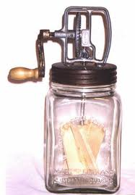

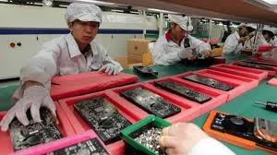
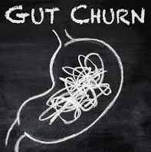
Words in context
to churn….
to churn butter, a butter churn
butter is produced by churning cream…
the Chinese factory churned out cheap copies …
Hollywood is churning out sequels of the show…
I am doing my best to churn out as many stories as I can…
watching the poor guy made my guts churn…

Slide 7
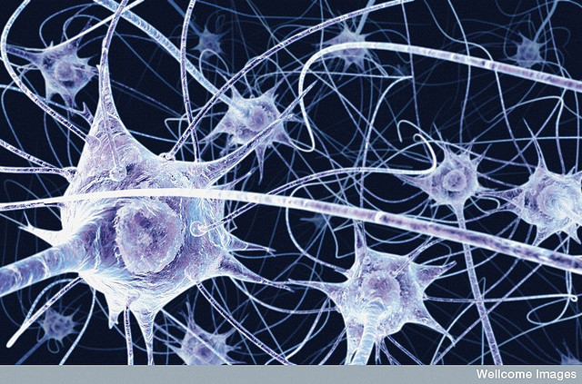
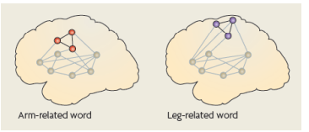
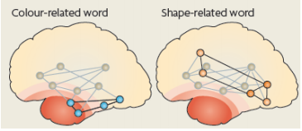
Building neural networks
Macedonia et. al, 2011, Hum Brain Mapping: http://www.percepp.com/macedonia.pdf
multidimensional networks:
neurons that fire together wire together
Notes:
p. 147 Neurodidaktik: Aufgabe des präfrontalen Kortex:…

Slide 8
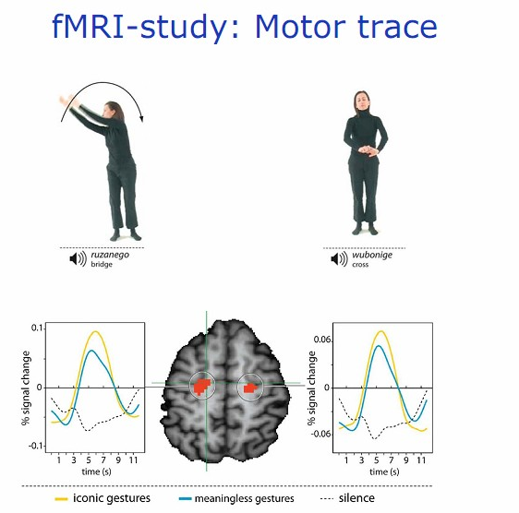
Activating several senses and parts of the brain
The role of movement
VMI: Manuela Macedonia
Notes:
Bewegungen aller Art fördern das Lernen:
nicht nur « iconic gestures » wie hier, sondern alle Bewegungen (siehe Diagramm). Auch kleine unbewusste Bewegungen wie das Angreifen von Kärtchen, Spielfiguren … sendet Reize ans Gehirn. Stricken – alle « runden Bewegungen » sind besonders hilfreich und aktivieren das Gehirn: Gehen, Radfahren (Studie am Max Plank Institut, Leipzig)…
Walk and Talk and write and check
Watch Macedonia on youtube!

Slide 9
Read the abstract of Manuela Macedonia‘s article about VMIs.
Abstract
Second language (L2) instruction greatly differs from natural input during native language (L1) acquisition.
Whereas a child collects sensorimotor experience while learning novel words, L2 employs primarily reading, writing and listening and comprehension. We describe an alternative proposal that integrates the body into the learning process: the Voice Movement Icon (VMI) approach.
A VMI consists of a word that is read and spoken in L2 and synchronously paired with an action or a gesture. A VMI is first performed by the language trainer and then imitated by the learners. Behavioral experiments demonstrate that words encoded through VMIs are easier to memorize than audio-visually encoded words and that they are better retained over time.
The reasons why gestures promote language learning are manifold.
First, we focus on language as an embodied phenomenon of cognition. Then we review evidence that gestures scaffold the acquisition of L1. Because VMIs reconnect language learning with the body, they can be considered as a more natural tool for language instruction than audio-visual activities.

Slide 10
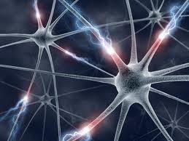
Praktische Anwendung der Prinzipien 1 - 4
What does this mean for learning and teaching?
  the ISM M0del
  VMIs
  Doodling
  Colors
  Sounds
  Diagonal opposites
  Lexical Furniture
Notes:
Praktischen Teil einschieben für diese Übungen

Slide 11
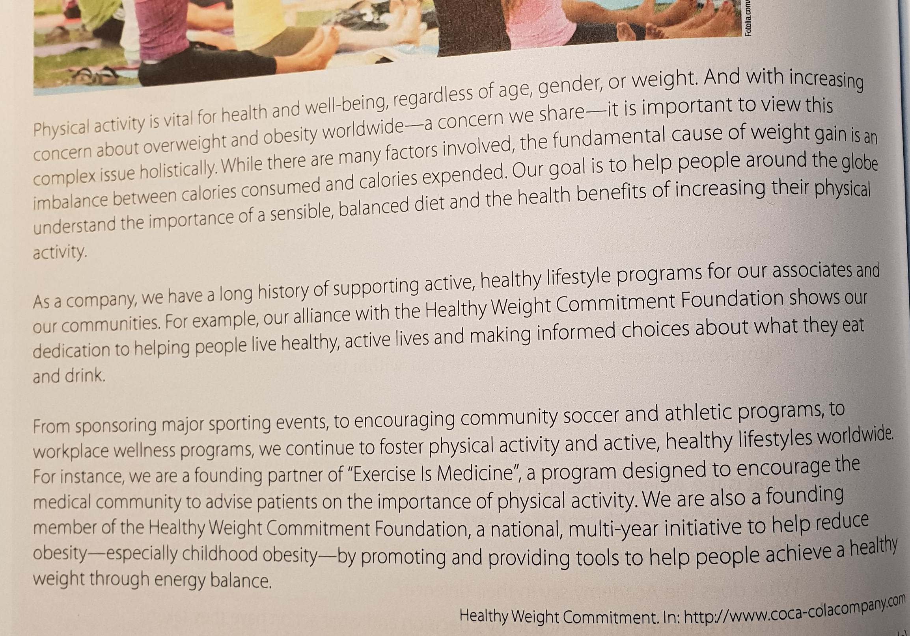
A fun activity:
1. highlight 3 words that your students might not know.
2. find VMIs and colors for these words.
3. Share your ideas with your partners.

Slide 12

Let‘s fly high…
and learn some new words and expressions

Slide 13
For all the following slides, follow these 3 steps:
1. Think: find your own answer
2. Share it with your group and explain your movement. You must use the new word in each of your sentences.

Slide 14
VMI:
Find a fitting gesture for each of these words.
Abstract
Second language (L2) instruction greatly differs from natural input during native language (L1) acquisition.
Whereas a child collects sensorimotor experience while learning novel words, L2 employs primarily reading,
writing and listening and comprehension. We describe an alternative proposal that integrates the body into the
learning process: the Voice Movement Icon (VMI) approach. A VMI consists of a word that is read and spoken
in L2 and synchronously paired with an action or a gesture. A VMI is first performed by the language trainer and
then imitated by the learners. Behavioral experiments demonstrate that words encoded through VMIs are easier
to memorize than audio-visually encoded words and that they are better retained over time. The reasons why
gestures promote language learning are manifold. First, we focus on language as an embodied phenomenon of
cognition. Then we review evidence that gestures scaffold the acquisition of L1. Because VMIs reconnect
language learning with the body, they can be considered as a more natural tool for language instruction than
audio-visual activities.

Slide 15
What color are these words in your mind?
Abstract
Second language (L2) instruction greatly differs from natural input during native language (L1) acquisition.
Whereas a child collects sensorimotor experience while learning novel words, L2 employs primarily reading,
writing and listening and comprehension. We describe an alternative proposal that integrates the body into the
learning process: the Voice Movement Icon (VMI) approach. A VMI consists of a word that is read and spoken
in L2 and synchronously paired with an action or a gesture. A VMI is first performed by the language trainer and
then imitated by the learners. Behavioral experiments demonstrate that words encoded through VMIs are easier
to memorize than audio-visually encoded words and that they are better retained over time. The reasons why
gestures promote language learning are manifold. First, we focus on language as an embodied phenomenon of
cognition. Then we review evidence that gestures scaffold the acquisition of L1. Because VMIs reconnect
language learning with the body, they can be considered as a more natural tool for language instruction than
audio-visual activities.

Slide 16
What sounds do you hear for these words?
Abstract
Second language (L2) instruction greatly differs from natural input during native language (L1) acquisition.
Whereas a child collects sensorimotor experience while learning novel words, L2 employs primarily reading,
writing and listening and comprehension. We describe an alternative proposal that integrates the body into the
learning process: the Voice Movement Icon (VMI) approach. A VMI consists of a word that is read and spoken
in L2 and synchronously paired with an action or a gesture. A VMI is first performed by the language trainer and
then imitated by the learners. Behavioral experiments demonstrate that words encoded through VMIs are easier
to memorize than audio-visually encoded words and that they are better retained over time. The reasons why
gestures promote language learning are manifold. First, we focus on language as an embodied phenomenon of
cognition. Then we review evidence that gestures scaffold the acquisition of L1. Because VMIs reconnect
language learning with the body, they can be considered as a more natural tool for language instruction than
audio-visual activities.

Slide 17
Find diagonal opposites:
Abstract
Second language (L2) instruction greatly differs from natural input during native language (L1) acquisition.
Whereas a child collects sensorimotor experience while learning novel words, L2 employs primarily reading,
writing and listening and comprehension. We describe an alternative proposal that integrates the body into the
learning process: the Voice Movement Icon (VMI) approach. A VMI consists of a word that is read and spoken
in L2 and synchronously paired with an action or a gesture. A VMI is first performed by the language trainer and
then imitated by the learners. Behavioral experiments demonstrate that words encoded through VMIs are easier
to memorize than audio-visually encoded words and that they are better retained over time. The reasons why
gestures promote language learning are manifold. First, we focus on language as an embodied phenomenon of
cognition. Then we review evidence that gestures scaffold the acquisition of L1. Because VMIs reconnect
language learning with the body, they can be considered as a more natural tool for language instruction than
audio-visual activities.

Slide 18
Sort the highlighted words into these categories:
Abstract
Second language (L2) instruction greatly differs from natural input during native language (L1) acquisition.
Whereas a child collects sensorimotor experience while learning novel words, L2 employs primarily reading,
writing and listening and comprehension. We describe an alternative proposal that integrates the body into the
learning process: the Voice Movement Icon (VMI) approach. A VMI consists of a word that is read and spoken
in L2 and synchronously paired with an action or a gesture. A VMI is first performed by the language trainer and
then imitated by the learners. Behavioral experiments demonstrate that words encoded through VMIs are easier
to memorize than audio-visually encoded words and that they are better retained over time. The reasons why
gestures promote language learning are manifold. First, we focus on language as an embodied phenomenon of
cognition. Then we review evidence that gestures scaffold the acquisition of L1. Because VMIs reconnect
language learning with the body, they can be considered as a more natural tool for language instruction than
audio-visual activities.

Slide 19
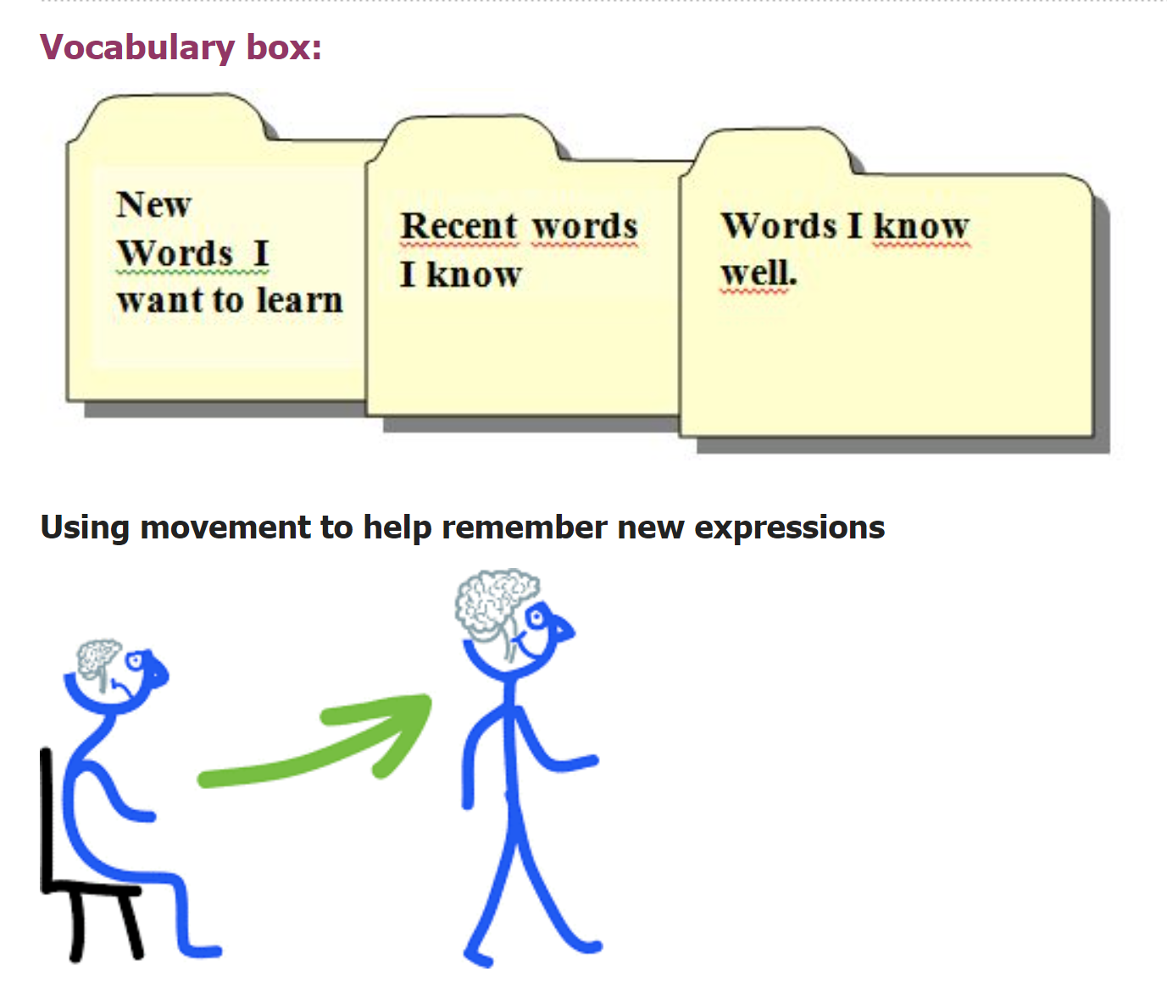
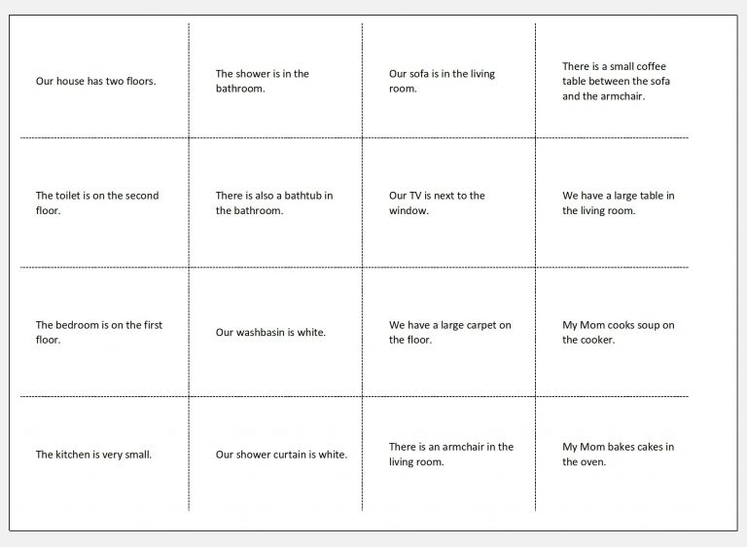
Working with the vocab box
vocab: extraordinary lives 4F

Slide 20
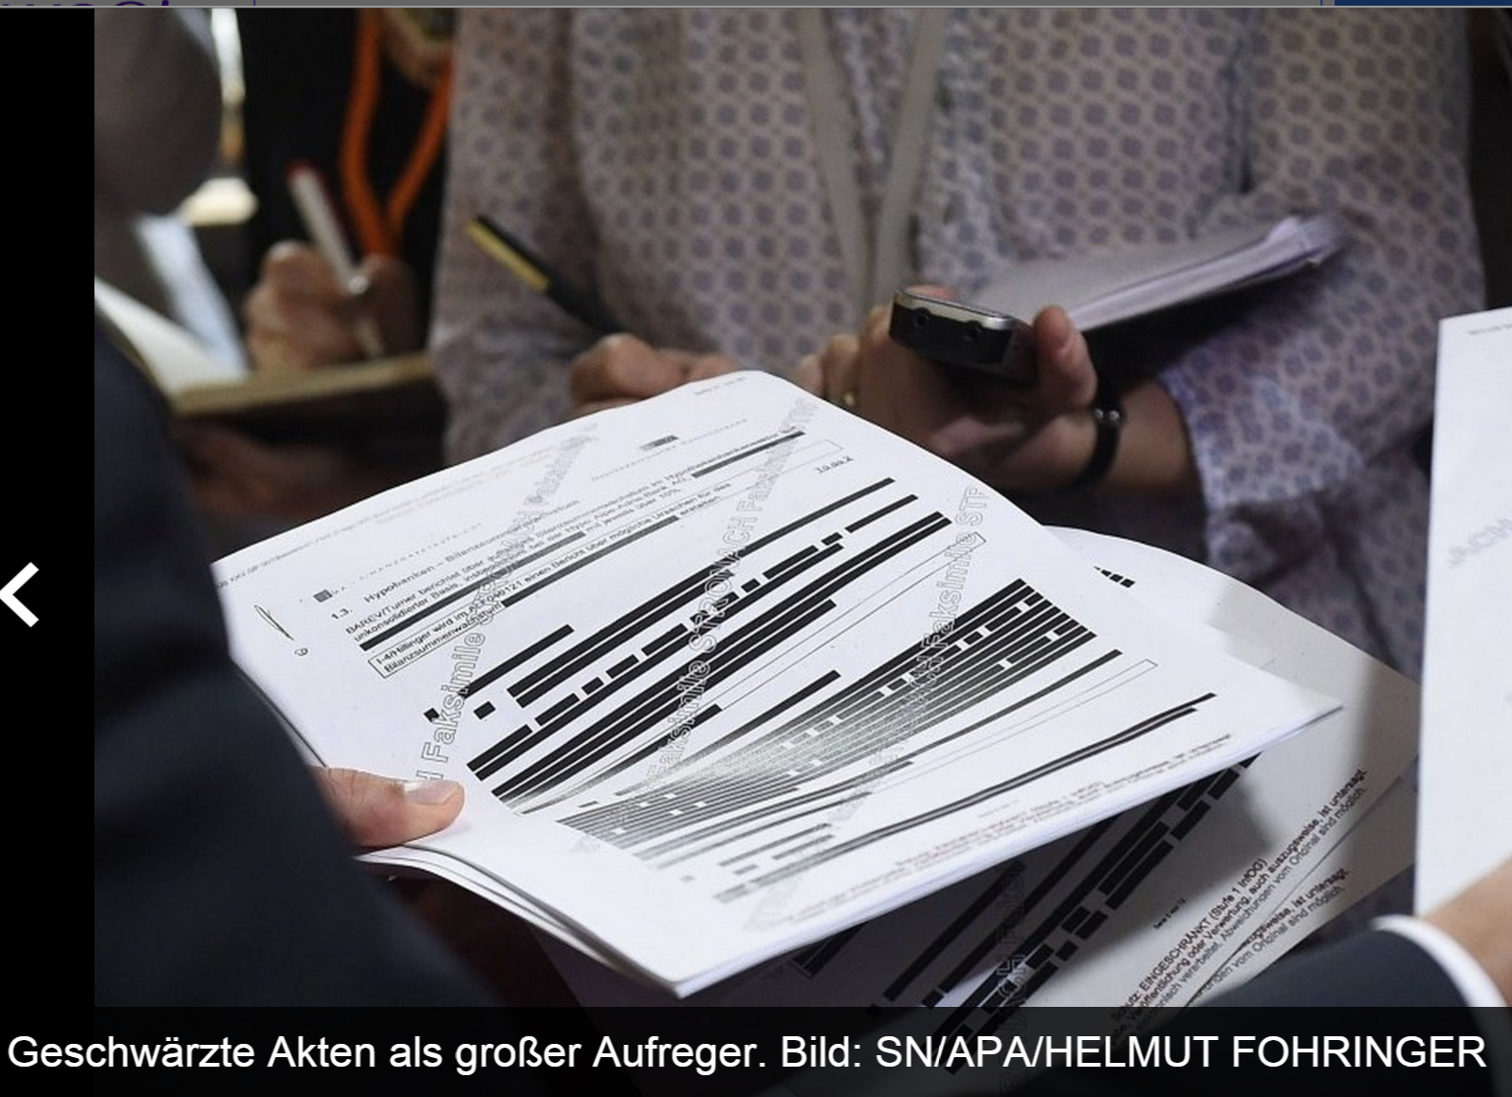
Pairwork
Vocabulary in context
“Blackout”
Read the text with your partner
Black out more and more parts and reread the text.
How much can you delete and still read the whole text?

Slide 21
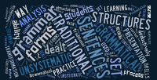
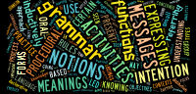
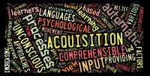
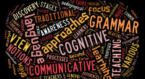
Approaches to teaching grammar
Traditional grammar
Communicative grammar
Acquisition-based grammar
Cognitive grammar

Slide 22
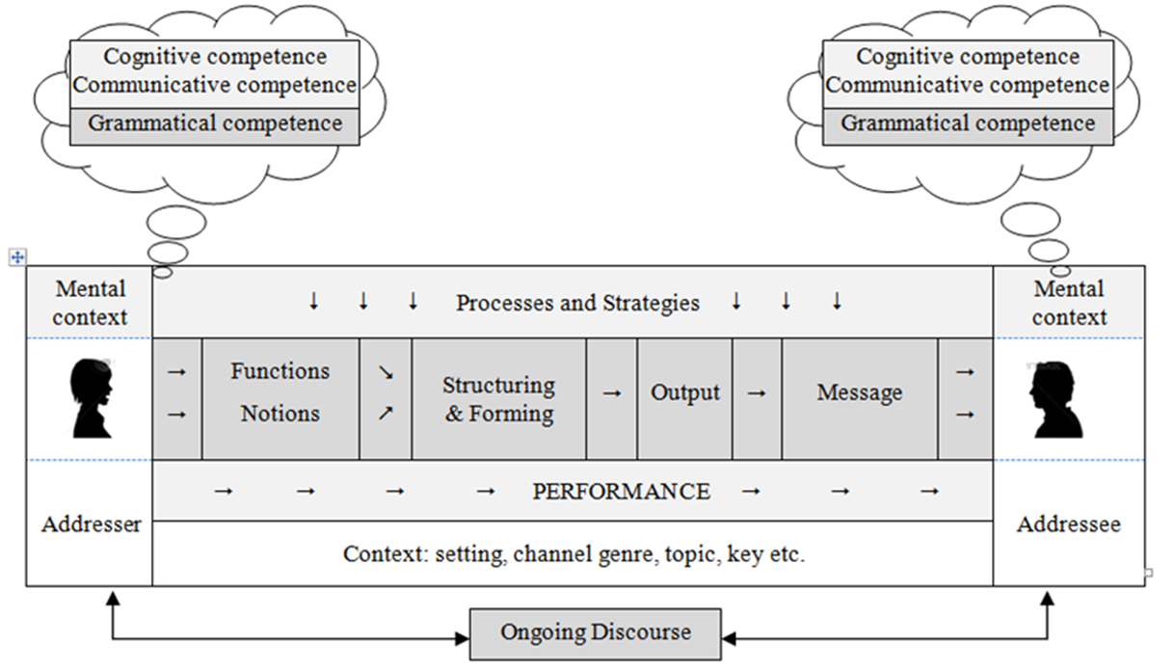
Grammar as a communicative event
Meanings give rise to forms
These meanings are defined as notions that are expressed through forms.
Notes:
By seeing grammar as part of a communicative system, we recognise that in actual language use meanings give rise to forms and not vice-versa.

Slide 23
Where do grammar rules come from?
Remember:
Grammar rules found in textbooks or grammar books do not come from God but are formulated by human beings.
Many rules found in traditional grammar books can be de-verified and prove unreliable.

Slide 24
Grammar rules must be:
valid or true: they cannot be de-verified by examples
transparent : understandable by learners
systematic: e.g. in the use of terminology
economic: not contain unnecessary information

Slide 25
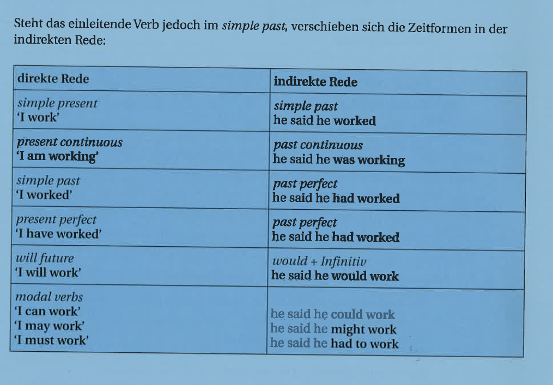
Is this rule valid and true?
He said that he works at Microsoft and that he can get us all the programs for free.
He said that he was working at Microsoft and could get us all the programs for free, but you know what –he works there as a janitor and cannot get us anything.
He said he will work in Spain in the summer and we can all come and stay with him.
He said he would work in Spain this summer, but I don‘t think that‘s possible. He has not even finished his studies.
Focus on Modern Carreers 1, p.91

Slide 26
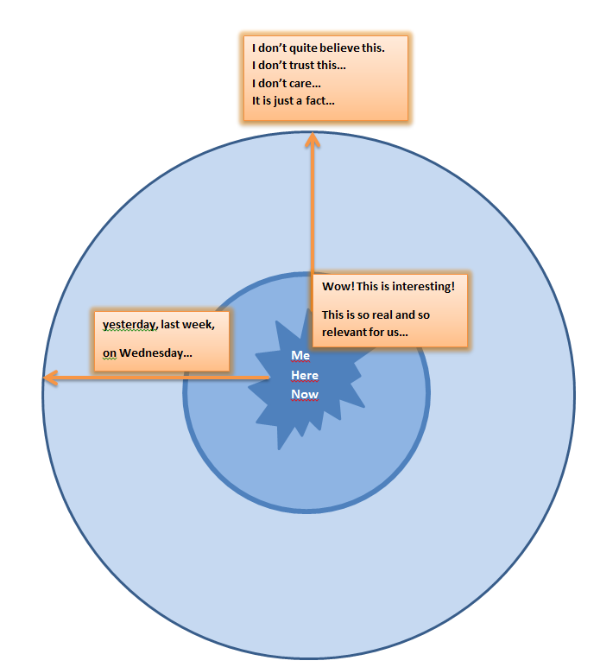
The Reporting Circle

Slide 27
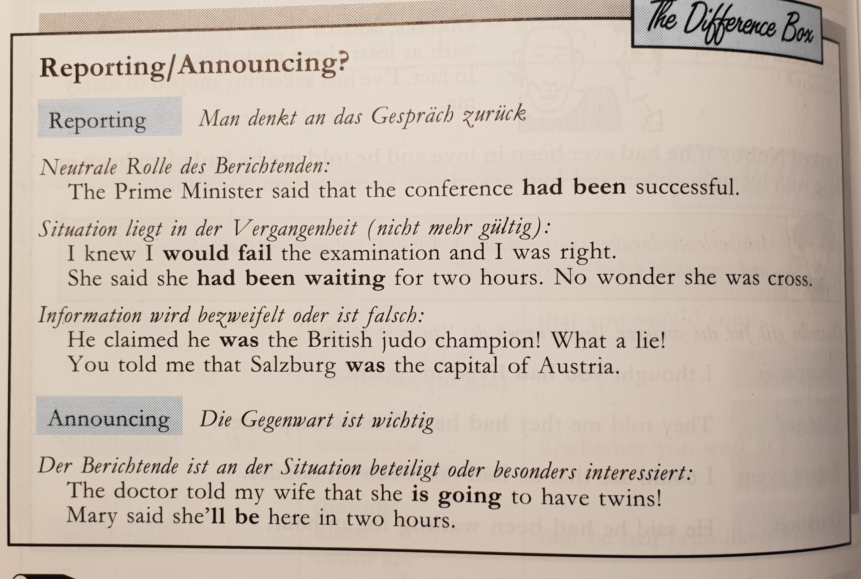
David Newby: on Reporting or Announcing

Slide 28
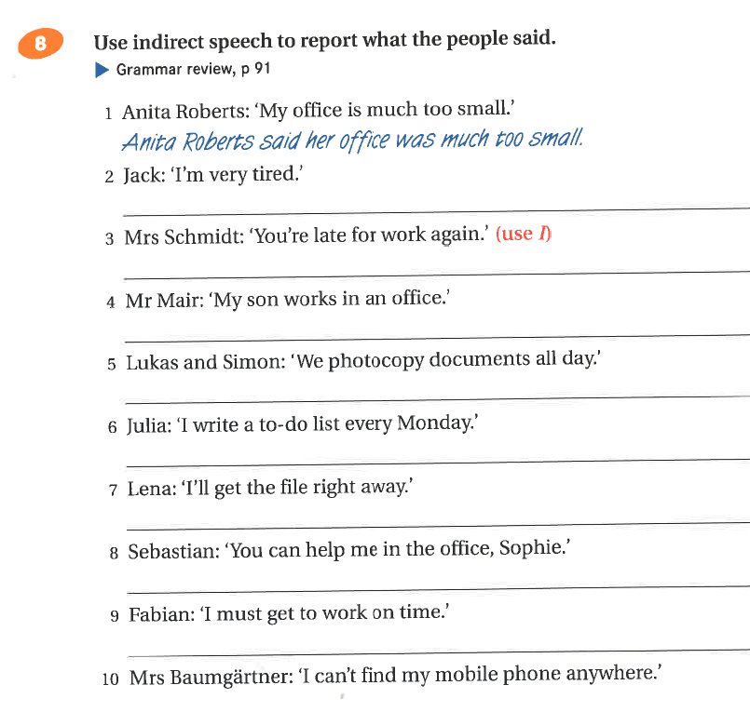
Why would anyone want to report these…?
Announcing something important /interesting?
Neutral (distanced) reporting?
Doubt or distrust?
Past, and no longer valid?
Focus on Modern Careers 2, BMS, p. 90

Slide 29
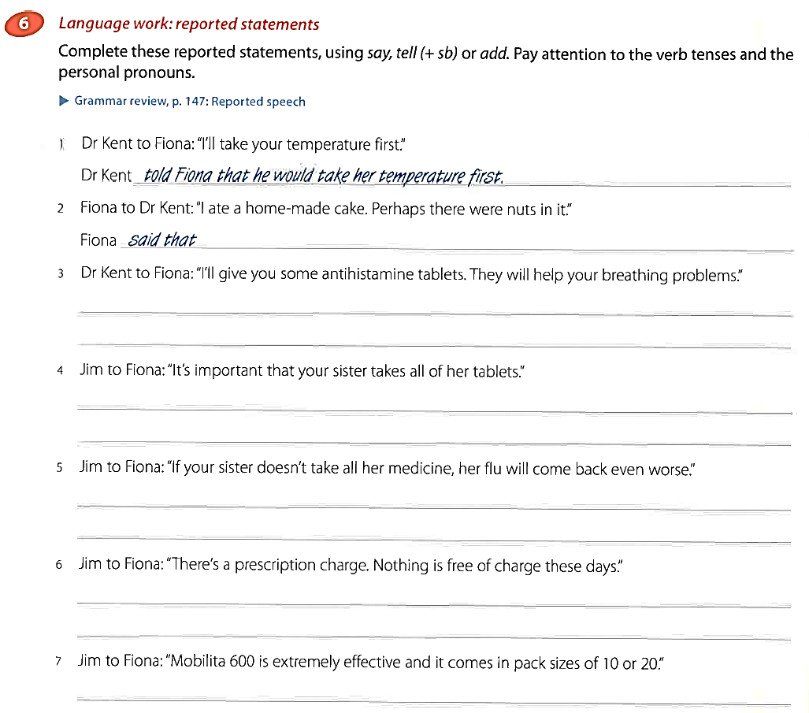
Why would anyone want to report these…?
Announcing something important /interesting?
Neutral (distanced) reporting?
Doubt or distrust?
Past, and no longer valid?
Focus on Modern Business 2, p. 52

Slide 30
From Rules to Reasons
Grammar as a political statement
Ken Kollman, director of research and a professor at the Center for Political Studies at the University of Michigan, said Trump is challenging the results in Detroit even though there have been only scattered allegations of voting irregularities there in recent years.
Orlando Owens, chair of the Milwaukee North branch of the county’s Republican Party, said the GOP effort in Wisconsin is aimed at counties that have high concentrations of Democratic voters.
“It just so happens that a lot of Black voters are Democrats,” he said, noting that the University of Wisconsin at Madison is in Dane County, where there are a number of college voters but only 6 percent of county residents are Black.

Slide 31

From Rules to Reasons:
Grammar as a political statement
“I don’t believe race has anything to do with it,” said Rick Baas, who heads the Republican Party of Milwaukee County’s media committee.
Bauer and other legal experts have repeatedly stressed that Trump’s efforts to block the certification of votes in Michigan’s Wayne County or reverse the outcome of the race in Wisconsin is unlikely to succeed.
“People are anxious over that slim glimmer that he could somehow actually change the outcome,” said Fred Royal, president of the Milwaukee chapter of the NAACP. “But more than that, he’s trying to do all of this in the middle of this pandemic, where people are tired, and people are unemployed, and they are trying to feed their family, and teach their children who are not in school, and now he is putting us back through this recount process.”
Royal and other community leaders said they are angered that Trump is suggesting that there are more votes than people.
BUT: Trump claims: https://www.washingtonpost.com/graphics/politics/trump-claims/
If you want to express your distance, doubt or mistrust and say that the claims are false, use TENSES to do this.

Slide 32
Trump‘s false claims…
Trump: "I've been talking about mail-in voting for a long time. It's really destroyed our system. It's a corrupt system and it makes people corrupt.“
Trump: "They mailed out tens of millions of unsolicited ballots without any verification measures."
Mexico Will Pay For the Wall
“The Democrats are really looking at something that is very dangerous for our country. . . .They want to have illegal immigrants pouring into our country, bringing with them crime, tremendous amounts of crime,” said Trump on December 6, 2017.
Can you think of a few more…?
https://www.forbes.com/sites/stuartanderson/2020/10/26/fact-checkers-say-trump-built-a-wall-of-false-claims-on-immigration/?sh=7858cdb57d73

Slide 33
Grammar rules must be:
valid or true: they cannot be de-verified by examples
transparent : understandable by learners
systematic: e.g. in the use of terminology
economic: not contain unnecessary information

Slide 34
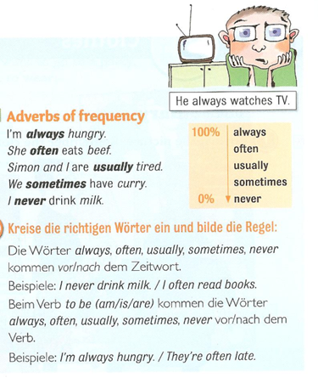
Is this rule efficient?
Adverbs of frequency
Our friend helps us. (always)
I go shopping in Paris. (never)
She is late. (usually)
I get headaches. (often)
He forgets my birthday. (always)
You are right. (usually)
They stay in bed late. (sometimes)

Slide 35
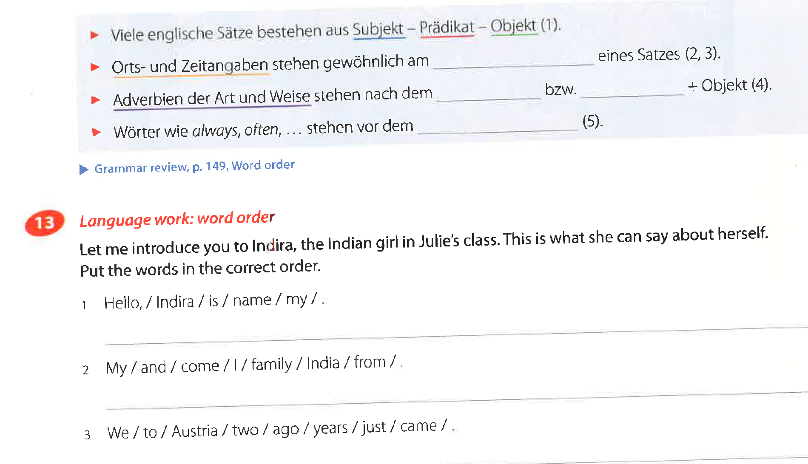
Is this rule transparent and economic?
Focus on Modern Business 1, p.18

Slide 36
Example: She always goes to school by bus.
Use the HELP CARD.
Work with a partner.
Think of a classmate.
Say TRUE sentences about him/her.
How far can you go before your partner finds out who it is?
He/she
often…
He/she
rarely…
He/she
sometimes
START
He/she
usually…
He/she
never…
He/she
usually…
He/she
never…
He/she
rarely…
END
He/she
always…
He/she
sometimes
He/she
usually...
He/she
rarely…
He/she
never…
He/she
often
He/she
normally..
He/she
never…
He/she
sometimes…
He/she
rarely
He/she
always…
He/she
never…
He/she
often…
He/she
always…

Slide 37

Help-card
Use these verbs:
eats
goes to school,
wears jeans / t-shirt/ colorful sweaters…
watches…
does…
rides his/her bike
takes the bus
takes the tram
plays…
practices vocabulary
plays soccer
goes home…
has …. for breakfast / lunch/ dinner
fights with…
forgets…
speaks very loudly / quietly
plays … on his/her mobile phone
reads…
talks on the phone with…
Examples:
He always eats the vegetarian meal in the school cafeteria.
She never drinks Coke. She hates it.
She sometimes practices vocabulary before dinner but she usually does it after dinner.

Slide 38
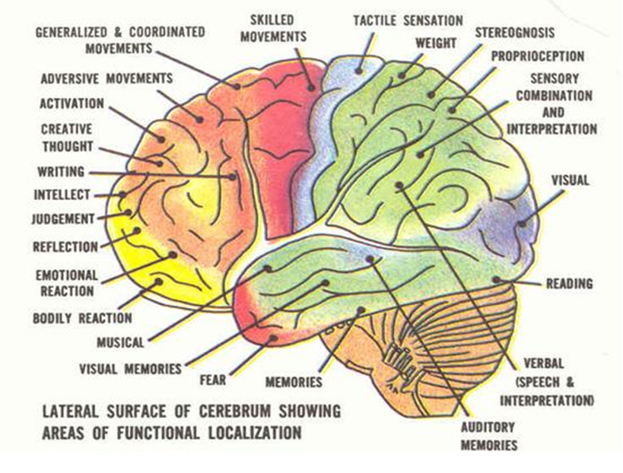
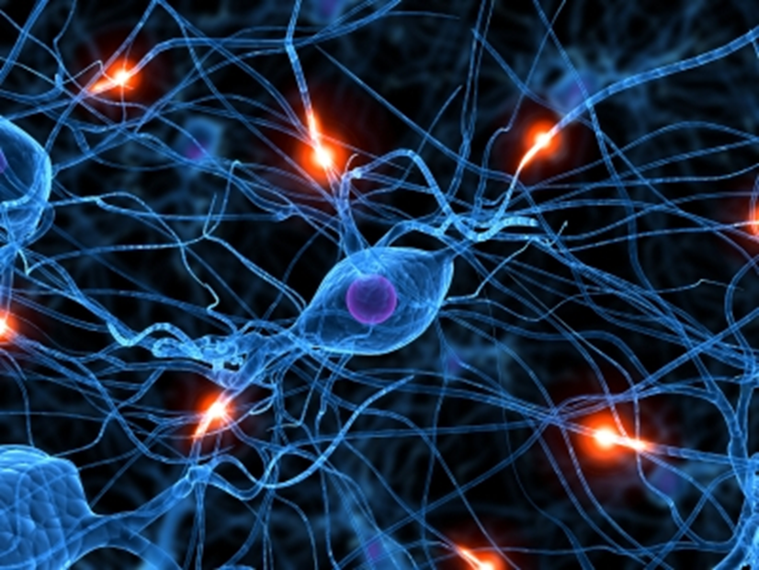
Grammar and our Brain
Meanings (Notions) into Form
Grammar = Patterns in our brains
(Tanushree, 2011)

Slide 39
Advantages of a notional « meaning into form » approach
A « meaning into form » approach
reflects the way that grammar is used in real life
makes it possible to teach and practice one meaning at a time
avoids the danger of confusing different meanings
provides a more systematic and reliable system (no exceptions)
assists in grading (step by step, one meaning at a time)

Slide 40
Examples of grammatical notions
Future Notions
Notion | Form
[arranged activity] | I'm playing tennis tonight.
[expressing intention] | I’m going to use my new racket.
[interpreting signs] | It’s going to be a tough match.
[making a prediction] | I’ll probably be back by six.
[spontaneous decisions] | I think I’ll change my racket.

Slide 41
More examples…
Notion | Form
[Experience] | I’ve never been to England.
[Changes/completion] | You’ve had a haircut!
[Duration - state] | I’ve been here since yesterday.
[Duration – activity] | They’ve been playing tennis for an hour.
[Recentness – state] | I’ve been on holiday.
[Recentness – event] | I’ve just seen a car accident.
[Recentness – activity] | I’ve been watching television.

Slide 42
Form based (structural grammar) or meaning based (notional) grammar?
Focus on Modern Business 2
the by-agent in passive sentences
impersonal passive
if sentences types 1,2,3
reported statements,
reported advice, orders, requests
infinitive constructions
progressive tenses
the passive
relative clauses
uses of the –ing form
Focus on Modern Careers 2
talking abou twhat usually happens: the simple present
describing what‘s happening now: the present progressive
describing past events: the simple past
making plans and predictions: the future
considering the consequences: if sentences 1-3
passing the message on: reported speech
giving more information about people and things: relative clauses
Unfortunately, these promises do not always come true…

Slide 43

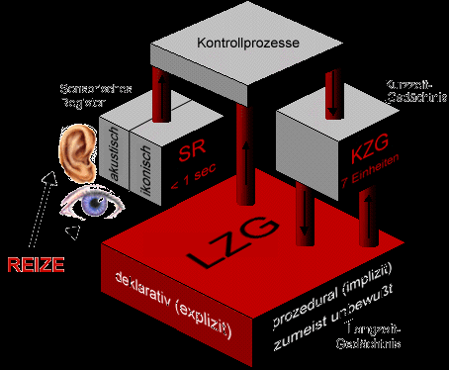
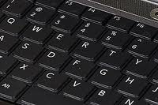
Types of Memory
The brain stores different types of information in different ways and different places.
Ultra short-term
Short-term
Long-term
Working memory
Semantic and episodic memory
Procedurales GD Deklaratives GD
http://arbeitsblaetter.stangl-taller.at/GEDAECHTNIS/ModelleSpeicher.shtml
Notes:
Vor allem Procedurales und Deklaratives Ged. Erklären
Werner Stangls Arbeitsblätter :, http://arbeitsblaetter.stangl-taller.at/GEDAECHTNIS/ModelleSpeicher.shtml

Slide 44
Regular and irregular verbs: Do you know the rules?
Procedural knowledge
Ich « moodle » gerne und oft. Auch gestern habe ich ……………….
Meine Nachbarn « pferden » gerne. Letztes Wochenende haben sie den ganzen Tag ………………….
Wir « hirnen » hier den ganzen Tag. Heute habe ich schon um 6 Uhr früh ………………………………….
Ich « neuroliere » gerne. Auch gestern habe ich ganz ausführlich ……………………………….
Verben auf ---ieren bilden das Partizip Perfekt mit
--iert
Kennen Sie die Regel für die Bildung des Partizip Perfekt im Deutschen?
Können Sie die Regel anwenden?
Notes:
Wer kennt die Regel? Wer könnte das erklären? Hand heben?
Wer kann die Formen bilden…. Ohne die Regel zu kennen….

Slide 45
How does explicit and implicit SLT affect production and processing of syntax?
Declarative knowledge
Procedural knowledge
Do L1 speakers and L2 learners use different brain activation patterns?
How do they use procedural and declarative memory?
Are L1 and L2 learning different?

Slide 46
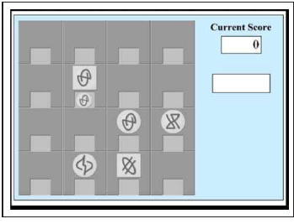
Kara Morgan-Short, Karsten Steinhauer, Cristina Sanz and Michael T. Ullman, „Explicit and Implicit Second Language Training Differentially Affect the Achievement of Native-like Brain Activation Patterns“ Journal of Cognitive Neuroscience, 24:4, pp. 933-947
Brocanto 2: artificial language for a computer game.
Explicit training versus implicit training
Tested 2x (at low proficiency and high proficiency at end of training)
2 test-types:
  proficiency test (play the game)
  ERP (event related potentials – show brain patterns in real time) show reaction to syntactic irregularities

Slide 47
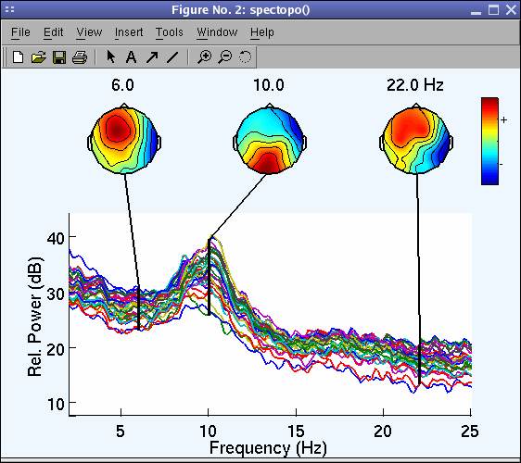
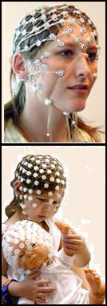
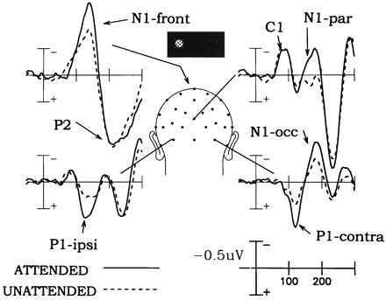
ERP:
Event Related Potential voltage maps
Notes:
image 1: Swartz Center for Computational Neuroscience, 2014)http://cognitrn.psych.indiana.edu/busey/temp/eeglabtutorial4.301/maintut/ERP_image_plotting.html (3.10.
image 2: Jewish General Hospital, Clinical Neuroscience and Applied Cognition Laboratory: http://jgh.ca/en/EEG-ERP (3.10.2014)
image 3: Steven A. Hillyard and Lourdes Anllo-Vento, „Event-related brain potentials in the study of visual selective attention“ , Proceedings of the National Academy of Sciences of the USA, vol. 95 no.3, 781 – 787 , http://www.pnas.org/content/95/3/781.figures-only (3.10.2014)

Slide 48
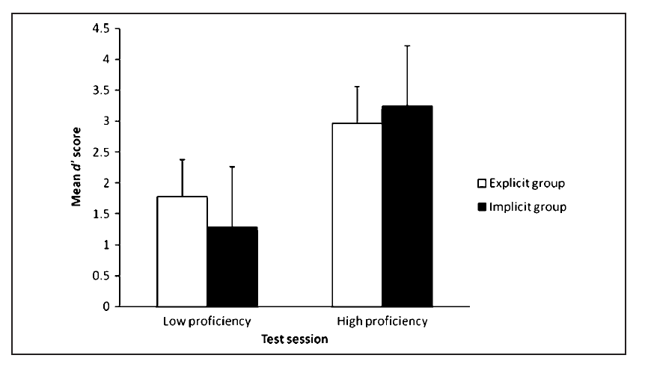
Behavioral data
Don‘t forget that this was a very limited set of possible phrases
Both training methods yield fairly comparable outcomes.
Notes:
at low proficiency the explicit group has learned a bit faster – but at end of training (high proficiency) the implicit goup had passed the explicit group. –

Slide 49
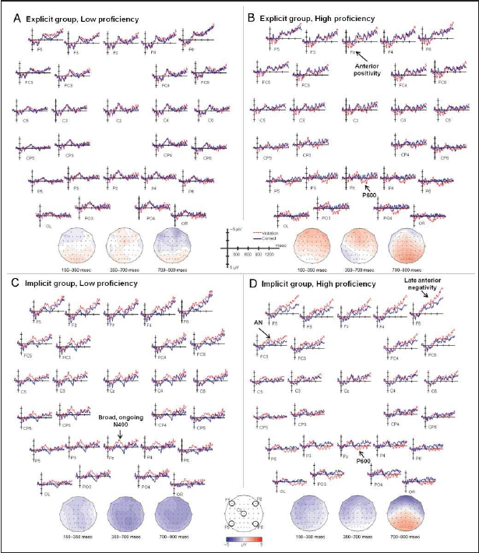
ERP data revealed striking differences between the groups‘ neural activity at both proficiency levels in response to syntactic violations.
This effect was EVEN STRONGER after months of no exposure.
 | Implicit group | Explicit group
High proficiency | leads to L1-like brain processing for syntax. Syntactic processing relied on the same rule-governed automatic structue building that is typical of procedural memory in L1. | Although explicit training is sufficient to develop the ability for structural reanalysis that may be under conscious (explicit) control, it does not reliably lead to the automatic early syntactic processing that is found in L1 and may depend on procedural memory.
Low proficiency | morpho-syntactic processing relies, at least in part, on lexical/semantic mechanisms and declarative memory and shows that this reliance can result from implicit training. (no rules needed) | Explicit training does not lead to a systematic and consistent reliance of syntax on either lexical/semantic or L1-like grammatical processes at low proficiency nor does their syntax rely on any other neurocognitive processes that would be reflected in ERP components.
Notes:
ERP image: p. 941
quotes: p. 942 – 943
effect stronger after months of no exposure: Morgan-Short K, Finger I, Grey S, Ullman MT (2012) Second Language Processing Shows Increased Native-Like Neural Responses after Months of No Exposure. PLoS ONE 7(3): e32974. doi:10.1371/journal.pone.0032974

Slide 50
What does this mean for teaching?

Slide 51
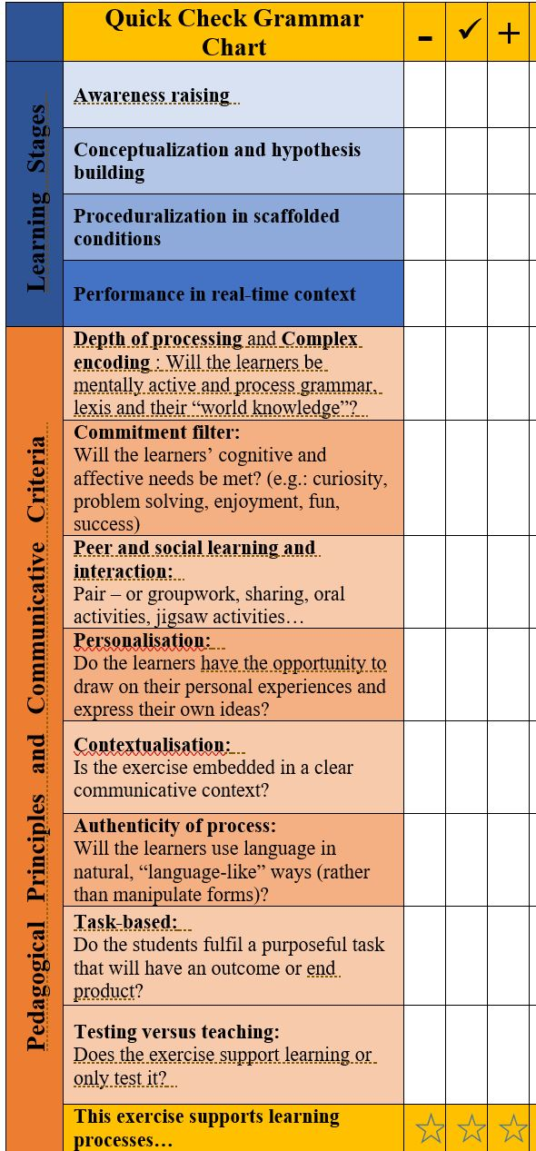
How can we teach C+C grammar
Efficient grammar teaching must consider the necessary learning stages:
Awareness raising
Conceptualization
Proceduralization in scaffolded conditions
Performance in real-time context

Slide 52
…and the following pedagogical principles:
depth of processing
commitment filter
peer and social learning and interaction
contextualisation
authentic processing
task-based (real world)

Slide 53

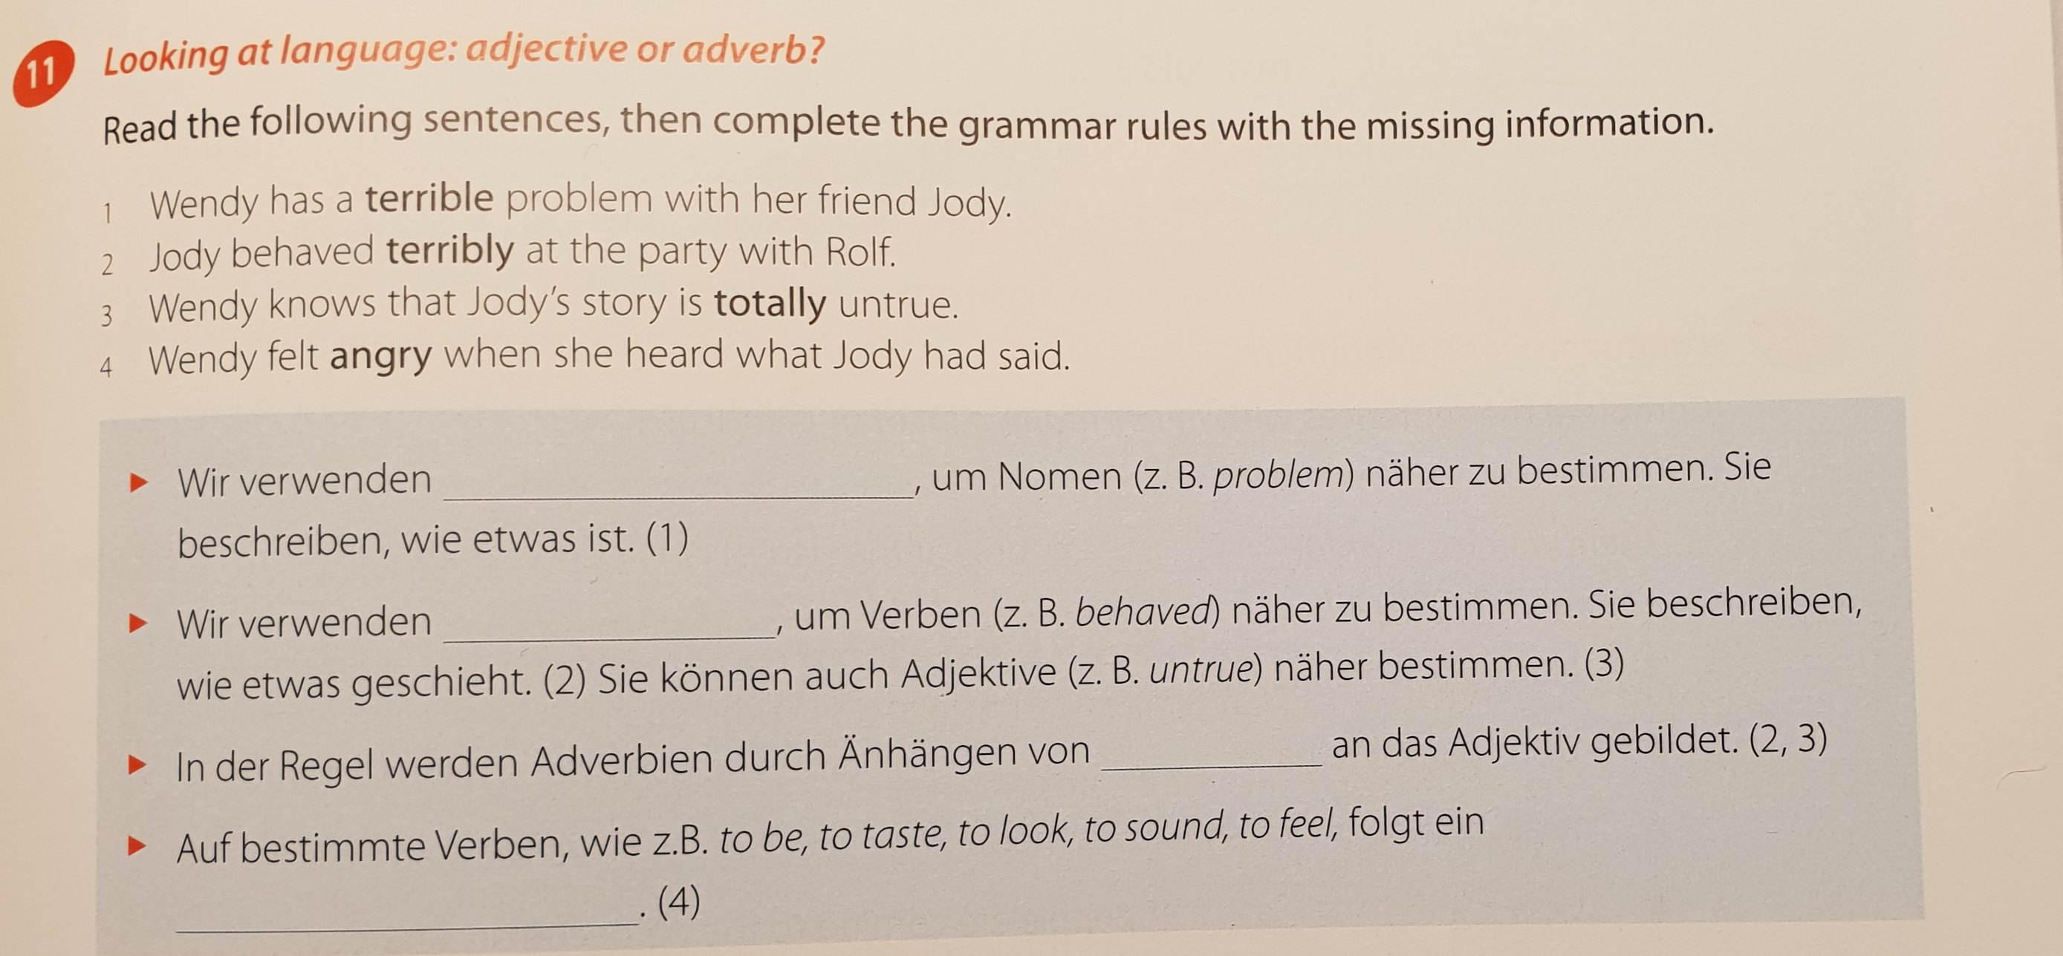
All my uni students know these rules, …but in their reflections they write…
…some kids shout very aggressive and they write very sloppy in their books. They do not take student-teachers serious when I tell them to be quiet.
Why???

Slide 54

Awareness Raising
Teachers‘ Conference: What your teachers have said about you….
Most students of 2b do their homework regularly. | Some students are a bit disorganized and forget to hand in their homework.
Most students do their work carefully. | Some kids hand in sloppy work.
Most kids work quietly in class. | A few kids are very noisy.
Most students work quickly and efficiently in class. | Many students are nervous during tests.
Some students work slowly but very carefully. | Some kids are impatient.
The class can sing beautifully. | The reading diaries are really beautiful.
The students of 2b work well in projects and workshops. | The workshops are excellent.
The students can think creatively and they can use the new language creatively. | The kids can write very creative stories.
The students act very responsibly and treat their classmates well. | The teachers would like to know who is responsible for collecting the mobile phones.
What do you notice?
Find the rule.
another option: Grammar-book 2

Slide 55


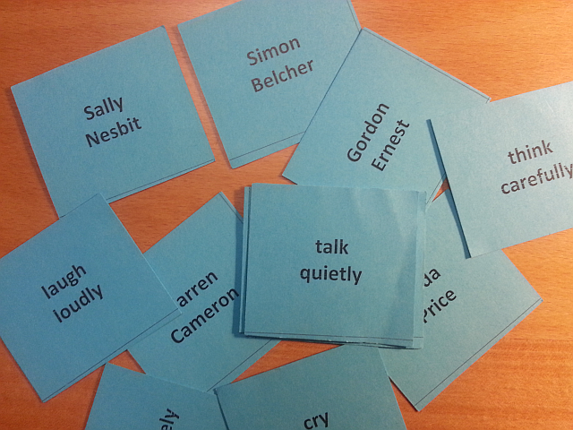
Conceptualization --Proceduralization
Manner Mimes
Simon
Hertz
smokes heavily
Robert
Quinn
reads quickly

Slide 56



Let‘s play some variations of this game…
What do you think?
How do these people…
speak French
dance
smile
sing
ski
run / jog
type
knit
https://thispersondoesnotexist.com/

Slide 57
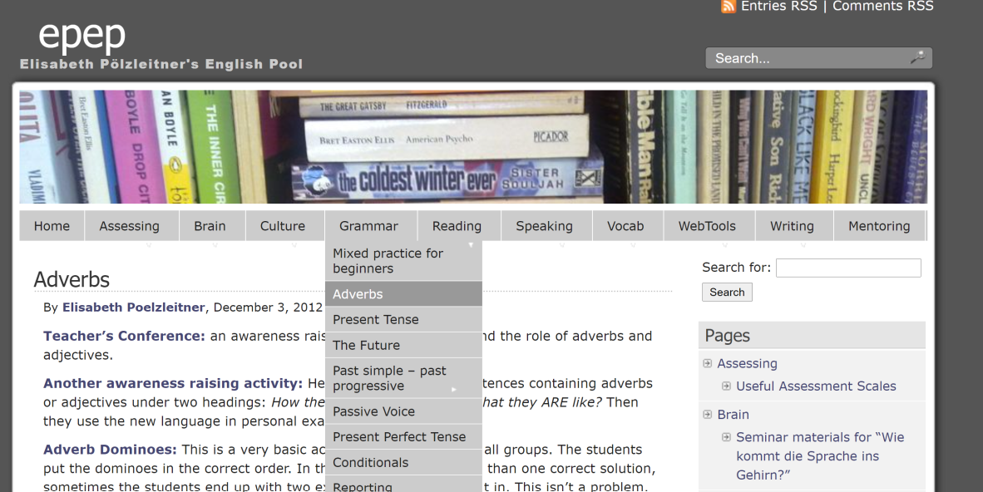
Exploring more exercises
In your breakout-room, go to www.epep.at and compare the activities that you find there to the ones in your textbook. Which of the criteria on the „grammar checkers“ do the exercises meet?

Slide 58
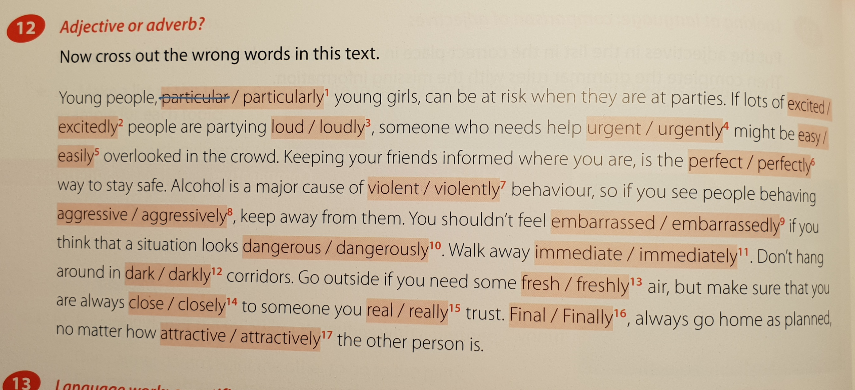
Focus on Modern Business 1
The minefield approach

Slide 59

Depth of processing and mental activity
Dual processing (world and language)

Slide 60
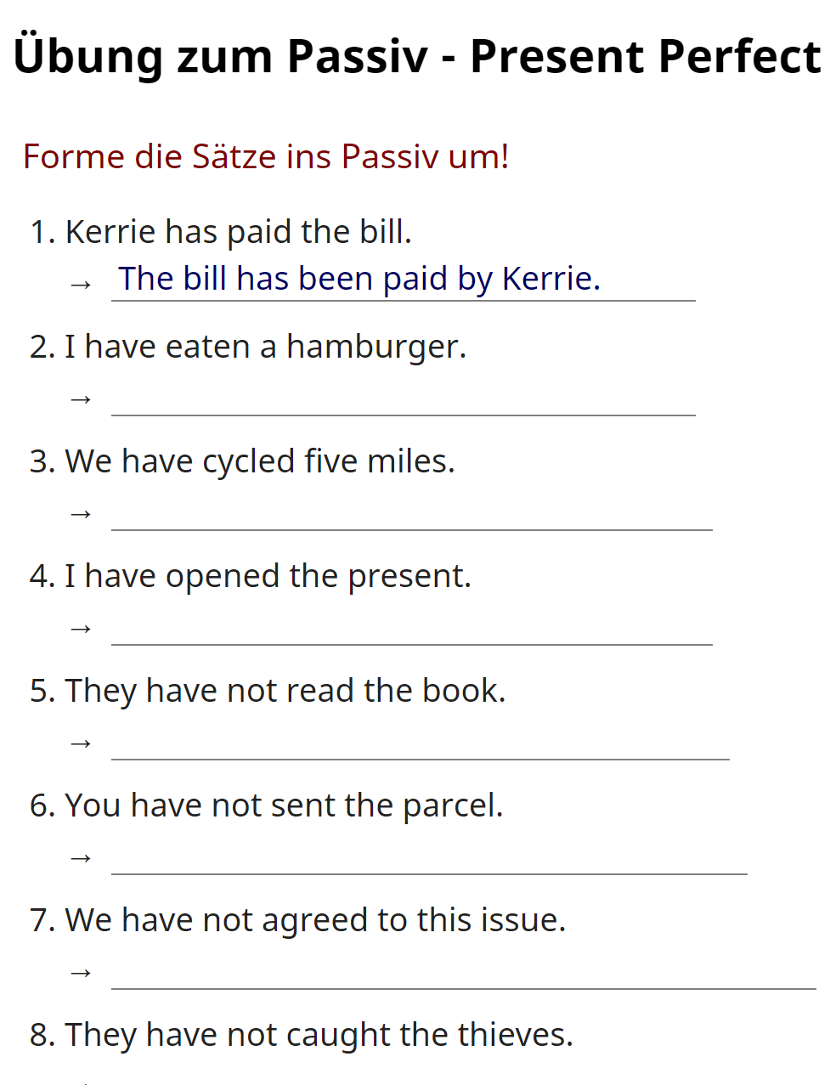
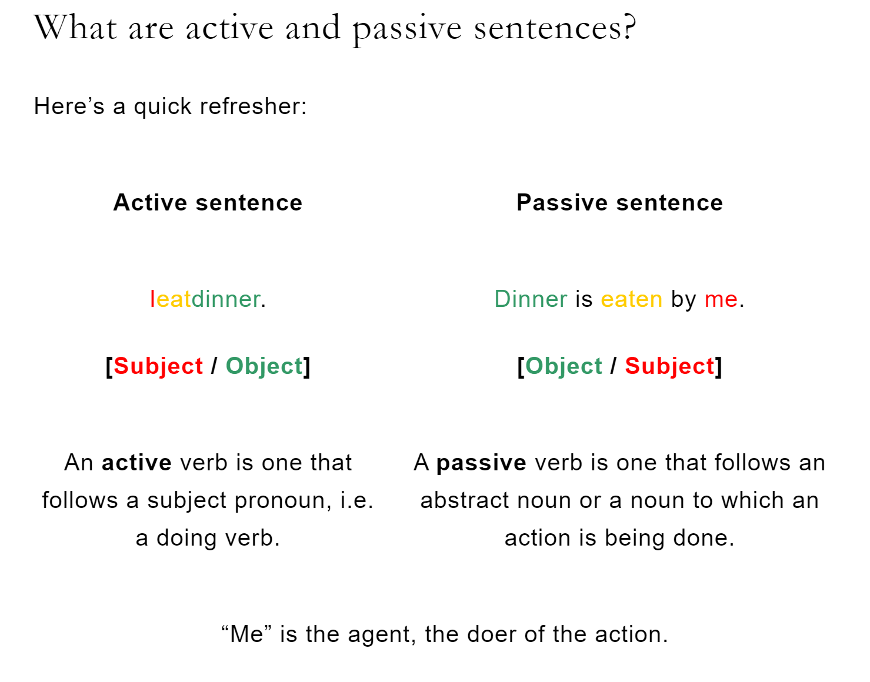
What kinds of processing will learners be doing here?
https://www.ego4u.de/de/cram-up/grammar/passive/exercises?present-perfect

Slide 61
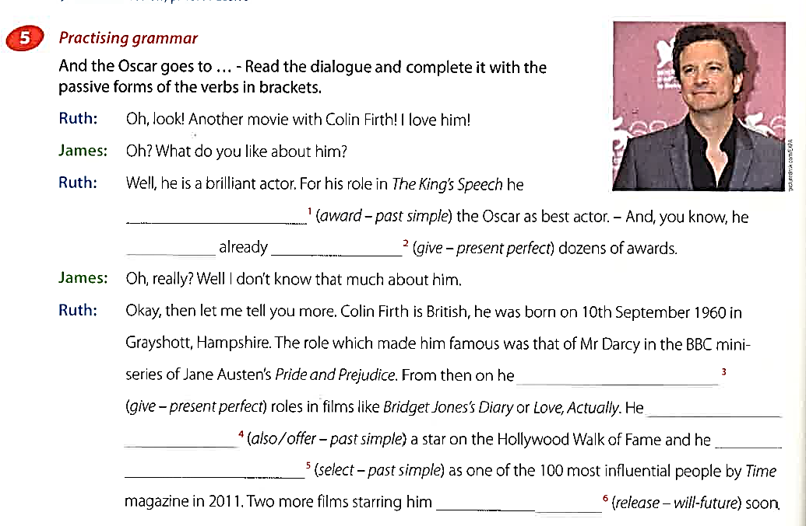
Passive : How much processing do ss need here?
How can you improve this very easily?
Focus on Modern Business 1, p. 120

Slide 62


What can you do instead?
Do you know how ketchup is made?
Do you know how chocolate is made?
Do you know how I-phones are made?
Go to epep.at – Grammar – Passive Voice for some examples. See how the learners have to process meanings (world knowledge) and forms.

Slide 63
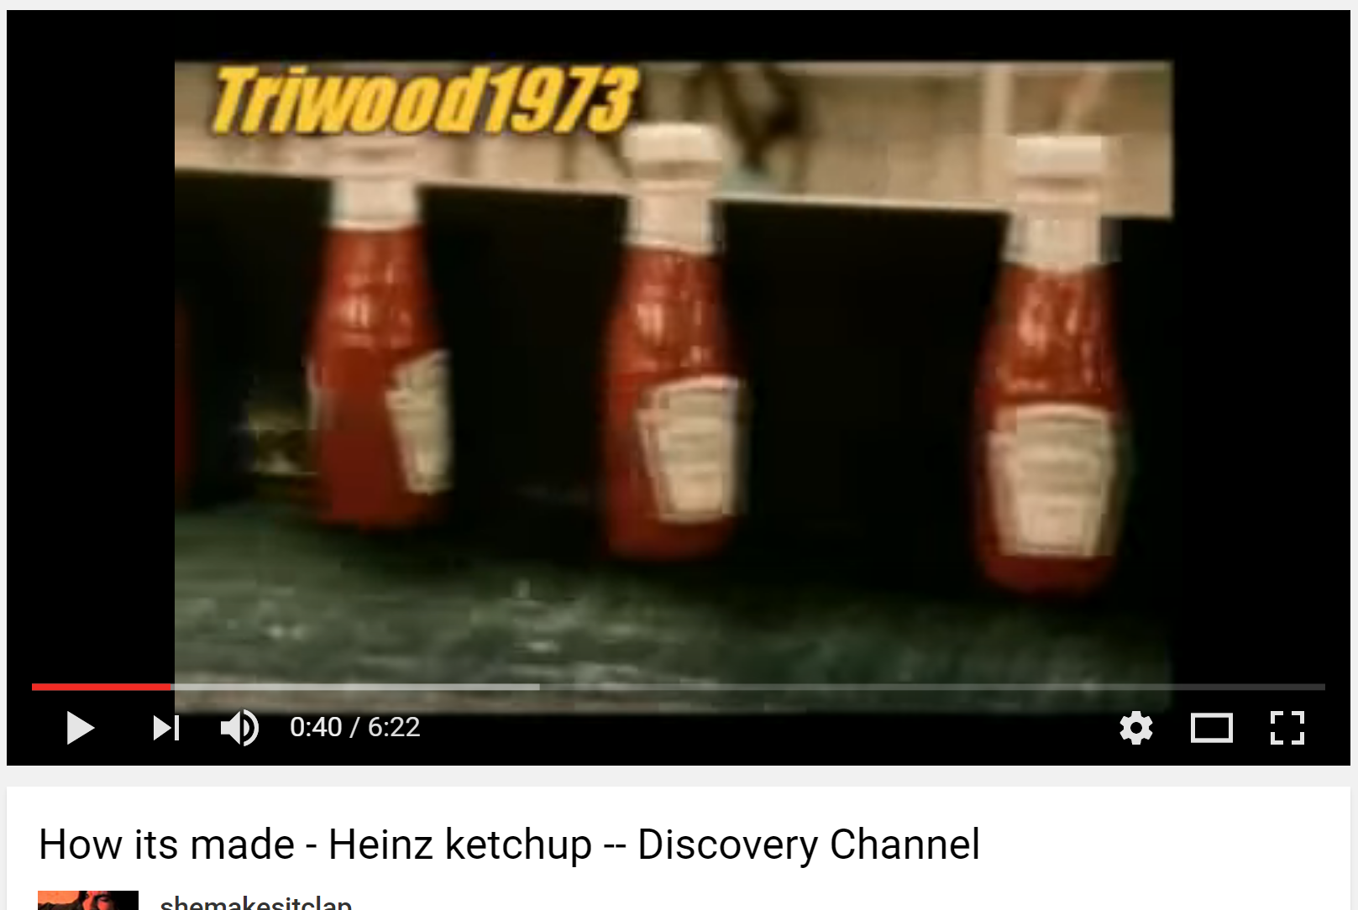
How Ketchup is Made

Slide 64
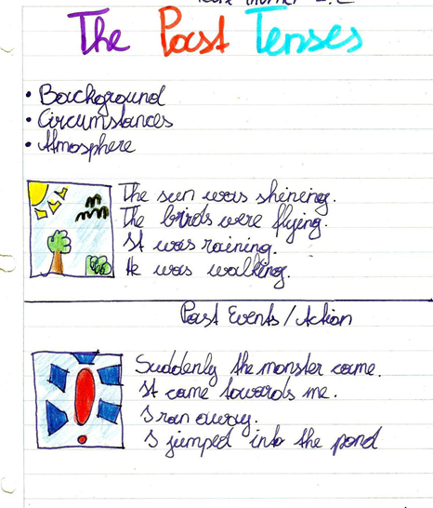


What’s behind it?
Conceptualization and hypothesis building
More examples of concept « logos »

Slide 65


Conceptualization and Hypothesis building
https://epep.at/?page_id=2229
More examples of concept « logos »

Slide 66


Performance in real-time contexts

Slide 67



Grammatical Concepts = Notions
Background and Circumstances
Notes:
Konzept von background /circumstanes verstehen
Past progressive --- imparfait – imperfetto….

Slide 68

Personalization

Slide 69
Peer/social learning and interaction

Slide 70

Personalisation and Groupwork

Slide 71

Testing grammar in meaningful, communicative contexts.
Can the learners USE the grammar
or do they only have declarative knowledge of the rules

Slide 72

Knowing or using grammar in the test

Slide 73


Writing an application
Your EXPERIENCE counts!

Slide 74
Let’s try out more activities
Grammar workshop in groups
Look at more examples and use your grammar checkers to answer the following questions:
What learning stage does this support?
Which of the pedagogical principles does it fulfill?
What’s going on in your brain?
If –clauses
Duration (pres.perf.tense)
General Experience
Past events
Circumstance-Background
Routines – Present Activities

Slide 75
How efficient are the exercises in your textbook?
Choose a topic that you are going to teach in the near future.
Use the grammar quick checker to analyse the exercises that your book offers for this topic
Improve them if necessary and add other activities to provide practice for all the learning stages.
Feel free to use – change – adapt some of the ideas on epep.at

Slide 76


Sources
Newby, D., Grammar for Communication, Vienna, Bundesverlag: 1989*
Newby, D., Grammar for Communication: Exercises and Activities, Vienna, Bundesverlag: 1992*
Newby, D., 'Theory and Practice in Communicative Grammar' in R. de Beaugrande, M. Grosman, B. Seidlhofer, (eds.) (1998) Language Policy and Language Education in Emerging Nations, Series: Advances in Discourse Processes Vol. LXIII, pp 151-164. Stamford, Conneticut: Ablex Publishing Corporation
National Education Association. Doubts & Certainties, January/February 1994. Material adapted from Renate Nummela Caine and Geoffrey Caine, Making Connections: Teaching and the Human Brain, ASCD, 1991; Addison Wesley, 1994. online: http://www.nea.org/teachexperience/braik030925.html , 25.02.2014

