Slide 1
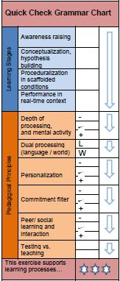
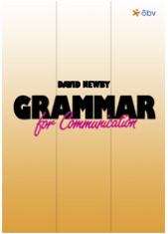
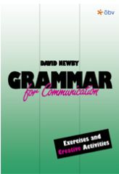
Knowing Grammar or Using Grammar
Creative Approaches to teaching Communicative Grammar

Slide 2
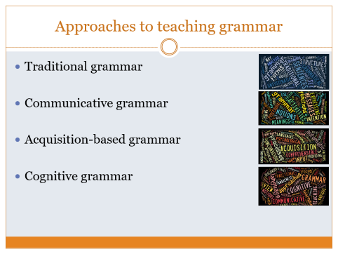
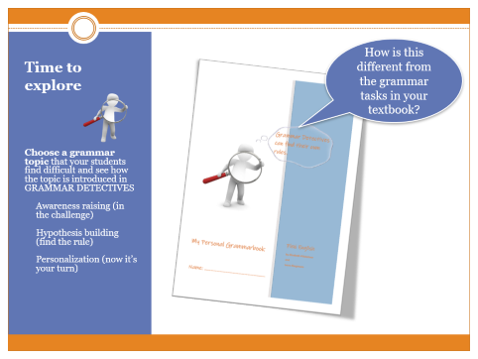
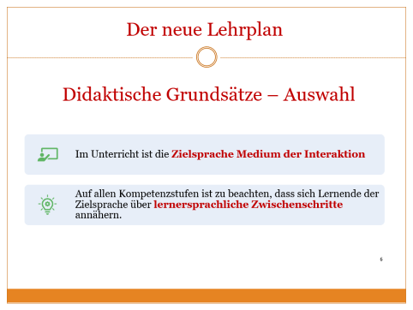
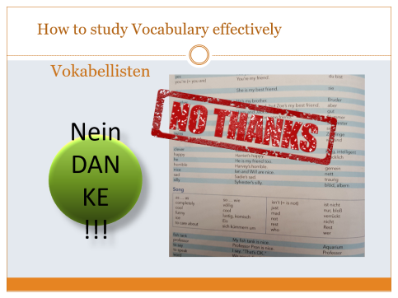
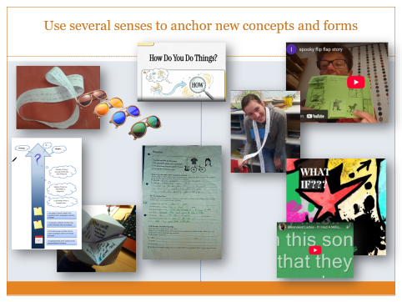
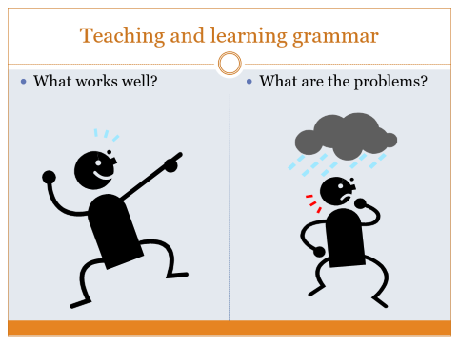
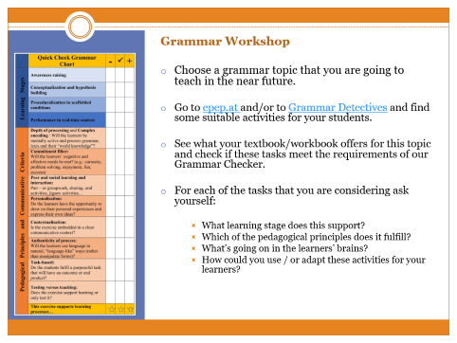
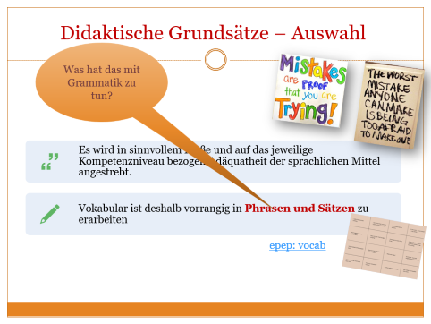
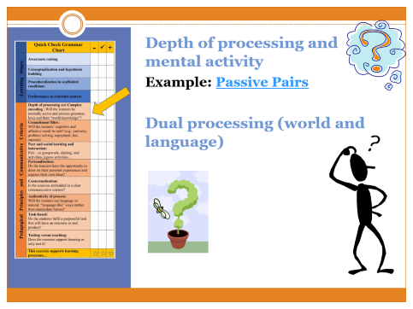
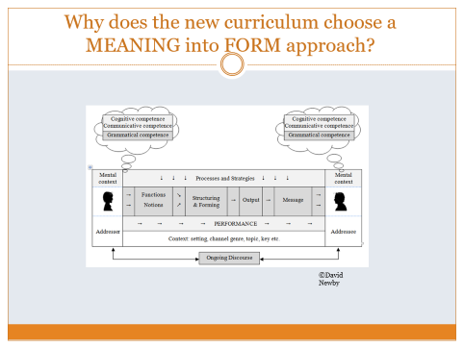
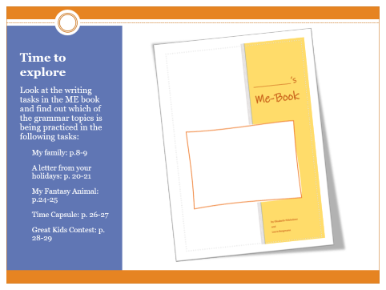
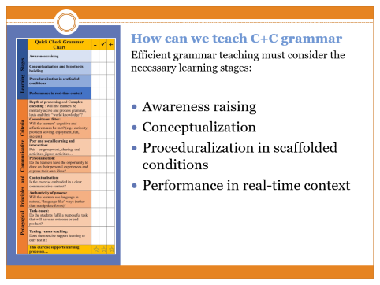
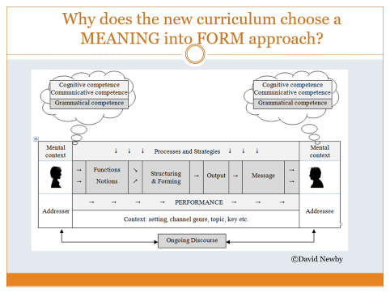
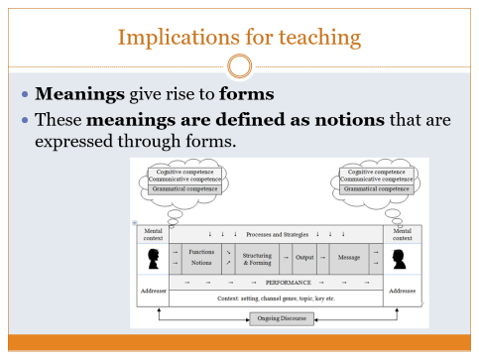
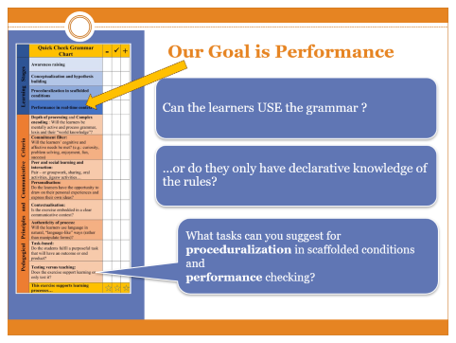
Our Plan for Today

Slide 3
Teaching and learning grammar
What works well?
What are the problems?

Slide 4
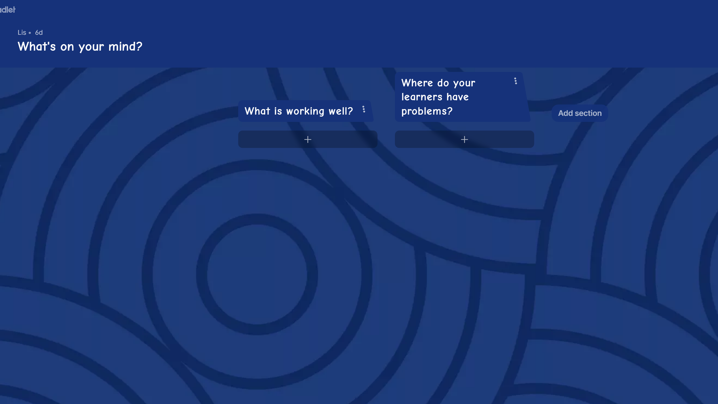
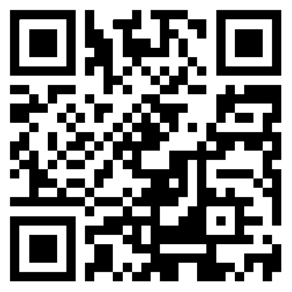
What’s the status quo?
https://tinyurl.com/whats-on-your-mind-today

Slide 5
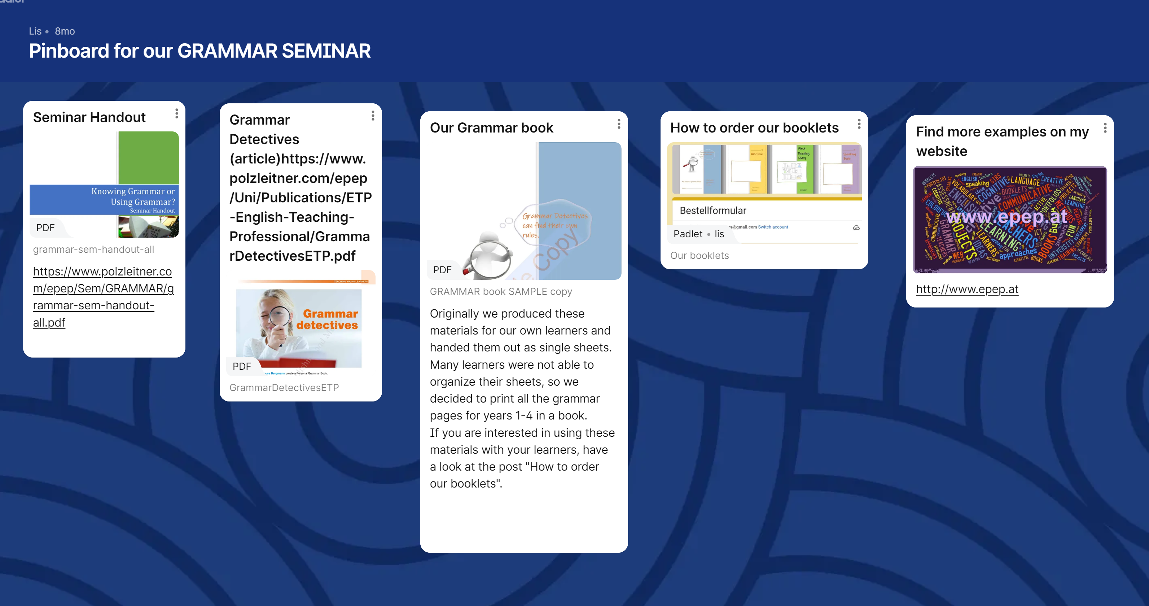
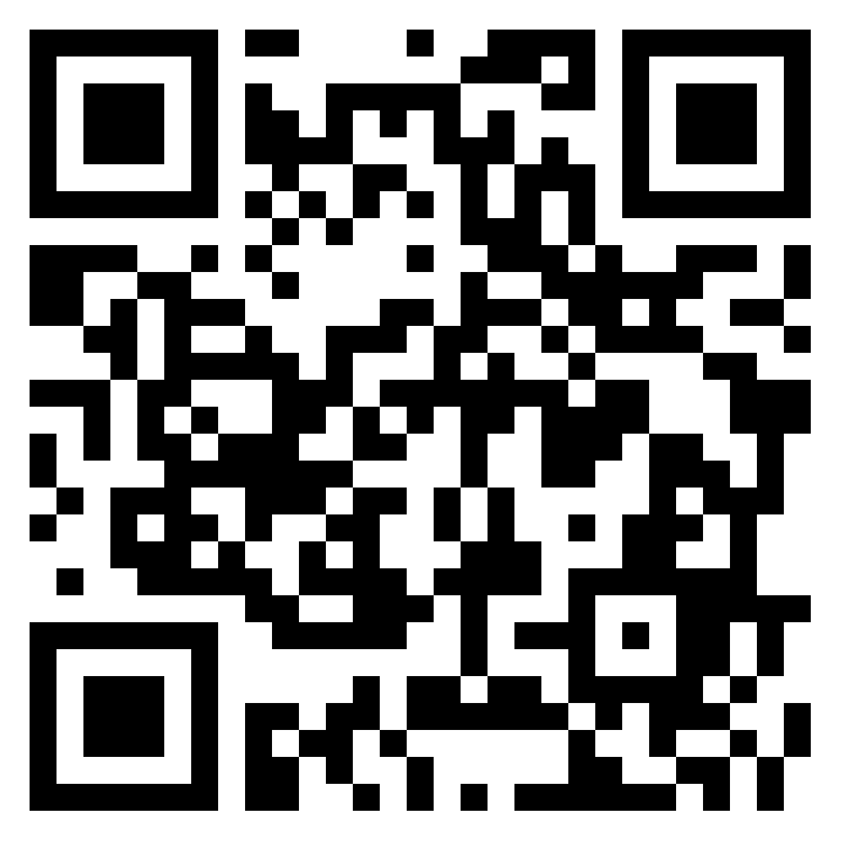
Save this padlet for future reference
https://tinyurl.com/grammar-pinboard

Slide 6
Der neue Lehrplan
Didaktische Grundsätze – Auswahl
Im Unterricht ist die Zielsprache Medium der Interaktion
Auf allen Kompetenzstufen ist zu beachten, dass sich Lernende der Zielsprache über lernersprachliche Zwischenschritte annähern.

Slide 7
Zentrale fachliche Konzepte: Bedeutung und Form
Sprache dient als Mittel des Ausdrucks. Sprachliche Bedeutungen werden durch bestimmte sprachliche Formen ausgedrückt. Der Inhalt bedingt dabei die Form. Sprachliche Strukturen werden als Instrumente entdeckt und verstanden, um bestimmte Bedeutungen zu verbalisieren.
In diesem zentralen fachlichen Konzept steht bewusst die Bedeutung an erster Stelle. Es handelt sich also um einen “Meaning into Form” Approach, der vor allem im Grammatikunterricht zum Tragen kommt. Das Hauptaugenmerk soll immer darauf liegen, WAS ausgedrückt werden soll und daraus ergibt sich eine sprachliche Form, die dafür verwendet werden kann/muss.

Slide 8
Kompetenzmodel - die Rolle der „sprachlichen Mittel“
Die Basis für die Entwicklung der Kompetenzen in den Bereichen Hören, Lesen, Sprechen und Schreiben sind die sprachlichen Mittel (Vokabular und Grammatik). Diese bilden das Fundament aller formen des Sprachhandelns und müssen integrativ in sinnvollen, kommunikativen Kontexten entwickelt werden.
So ist es zum Beispiel sinnvoll, Vokabular in kurzen, typischen Sätzen in konkreten Kontexten und den dafür notwendigen Strukturen zu erarbeiten. Beispiel: Vokabular + Grammar für eine spooky story: “the owl was hooting, the moon was shining, the wind was howling …”.

Slide 9
Didaktische Grundsätze – Auswahl
Über meine Pläne sprechen
Der funktionale Aspekt der Grammatik hat Vorrang gegenüber dem formalen Aspekt. Die situative Einführung und das induktive Erschließen grammatischer Sachverhalte aus kommunikativen Zusammenhängen und Textbeispielen sind anzustreben.
Grammatische Teilsysteme dürfen nicht zum direkten Lernziel werden.
I am going to…
Das Ziel ist KOMMUNIKATION!
Using the language in communicative contexts and situations.

Slide 10
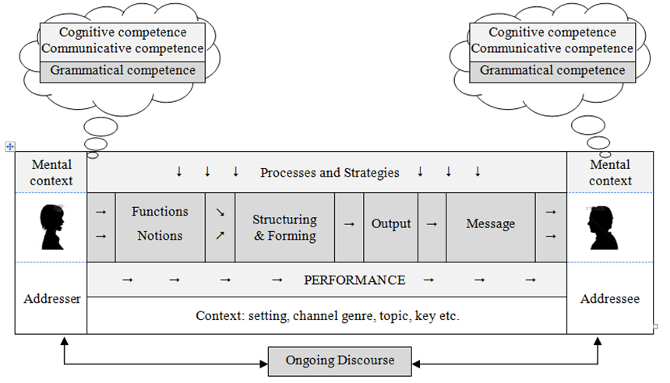
Why does the new curriculum choose a MEANING into FORM approach?
©David Newby

Slide 11
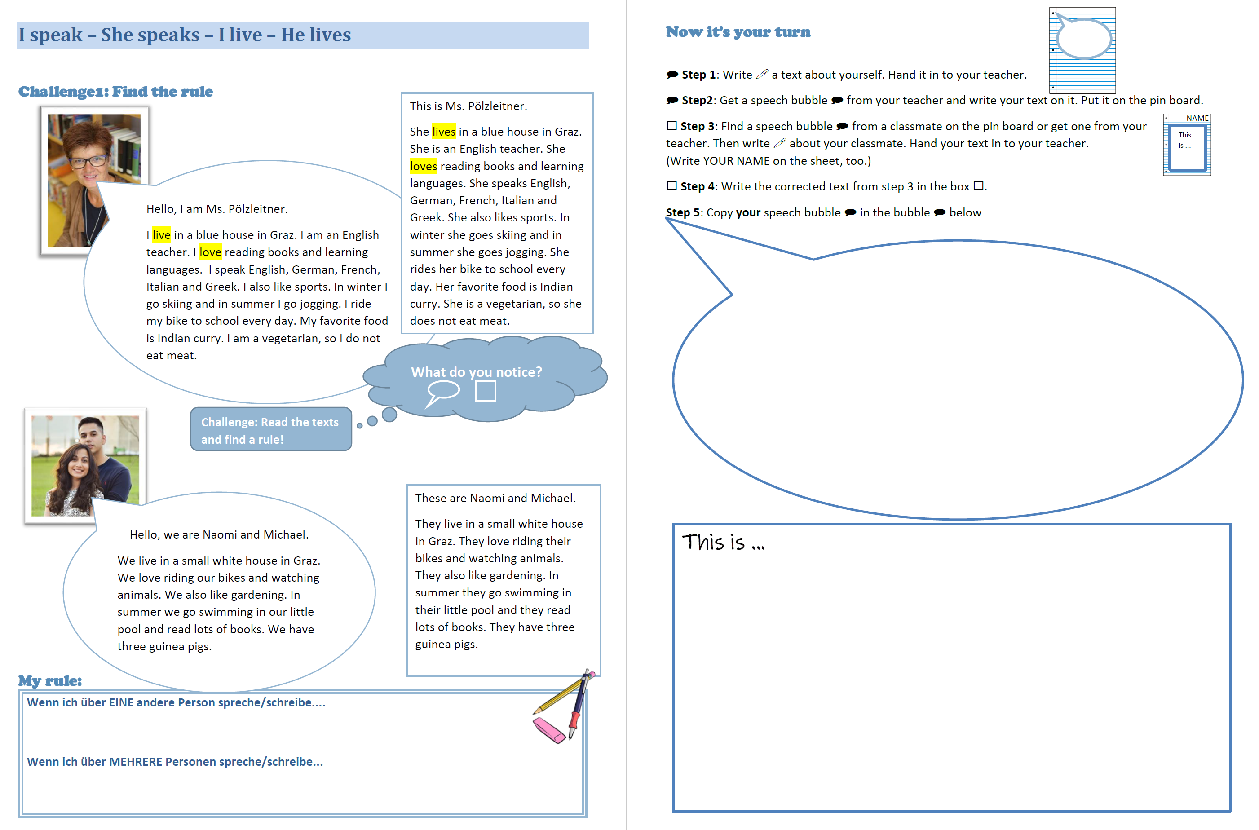
Inductive approach
Students find a match between MEANING and FORM
A first example: Meaning into Form
Personalized practice in a communicative context

Slide 12
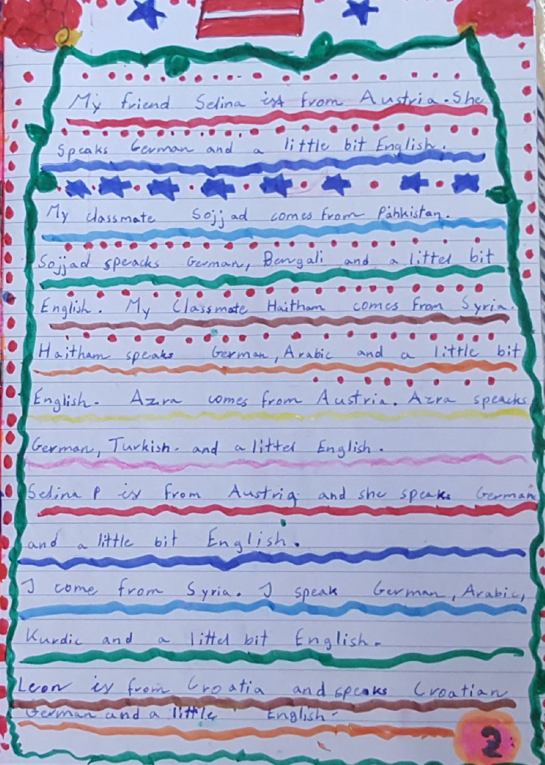
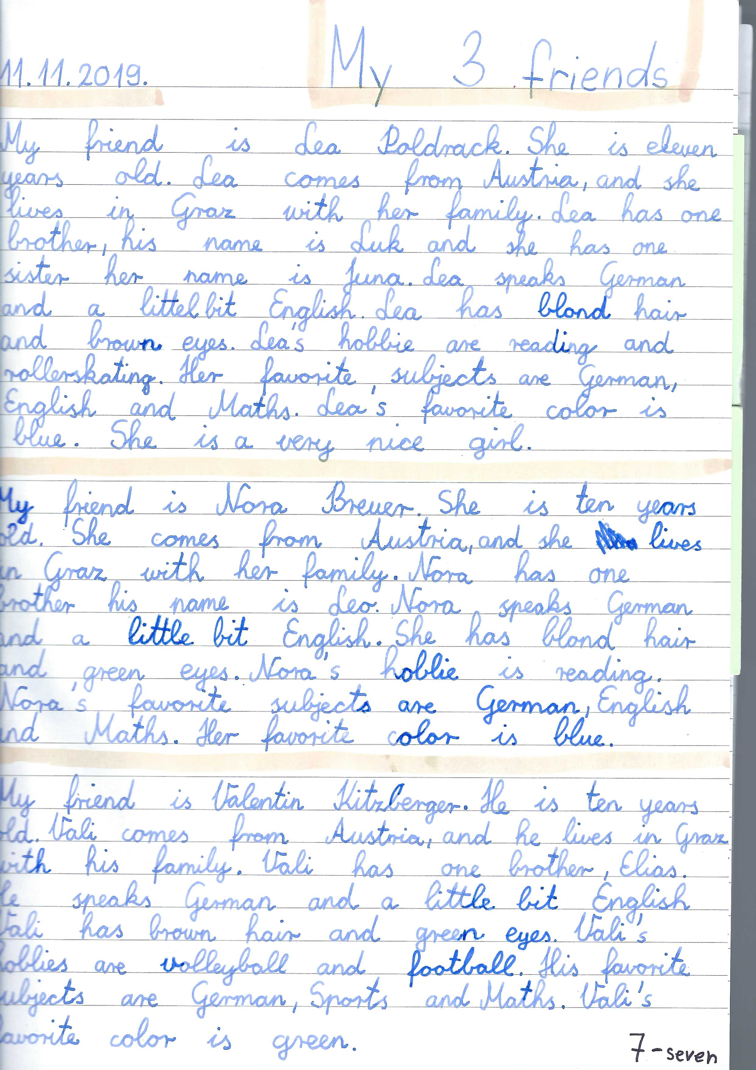
Performance
I can write about another person
Lehrplanziel:
I can write or speak about another person or thing.

Slide 13
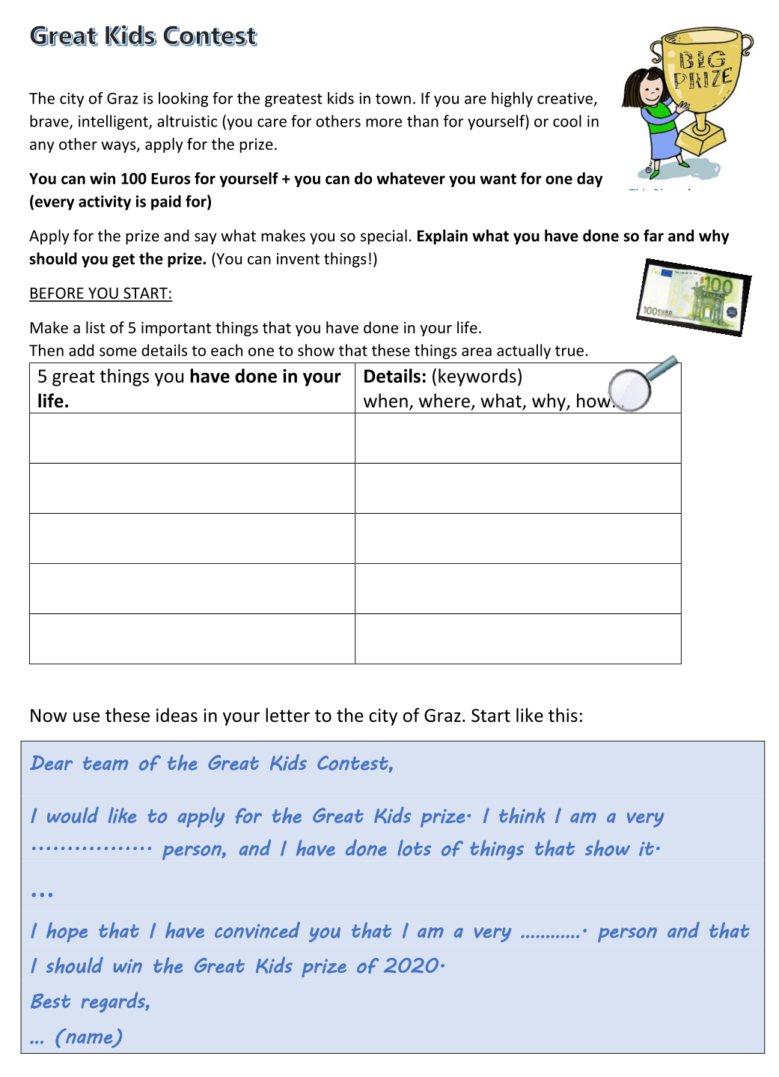
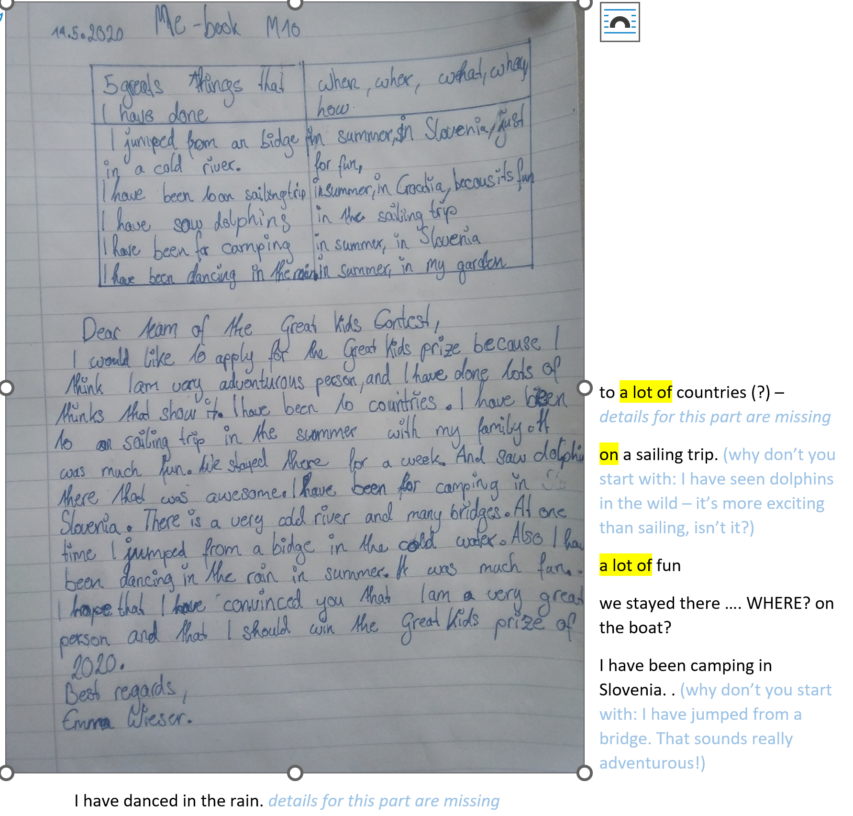
Performance
Show us that you can write about your general experiences and specific details

Slide 14
Why does the new curriculum choose a MEANING into FORM approach?
©David Newby

Slide 15
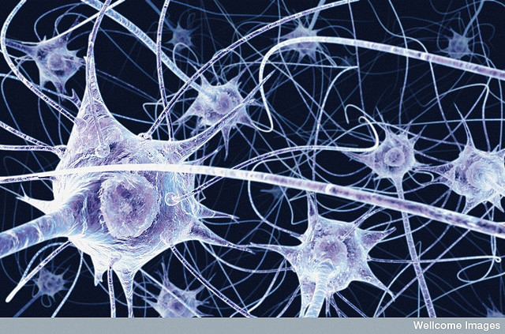
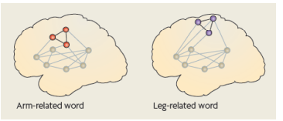
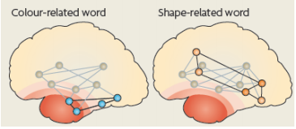
Learning = creating new connections in the neural networks
Macedonia et. al, 2011, Hum Brain Mapping: http://www.percepp.com/macedonia.pdf
Relationships are established through temporal association (simultaneous activation).
Notes:
p. 147 Neurodidaktik: Aufgabe des präfrontalen Kortex:…

Slide 16
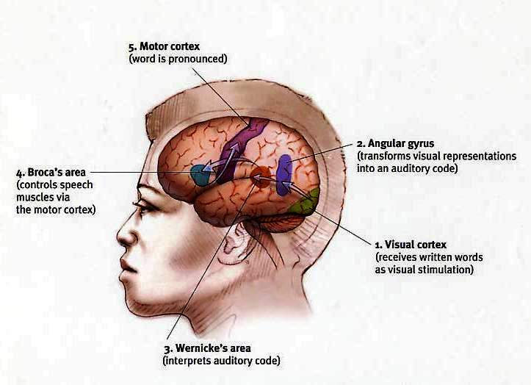
See, hear, speak, and gesture
The brain can do many things at once.
Diverse input promotes learning.
Prinzip 4:
ISM Model von Ahsen
Images
Somatic Markers
Meaning

Slide 17
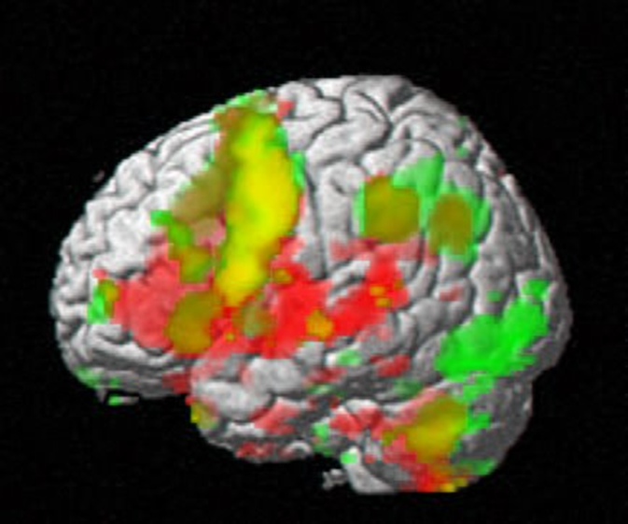
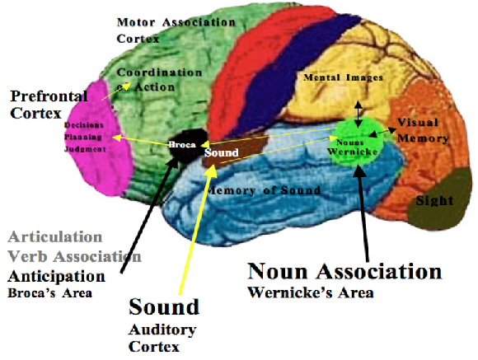
Snyg
What is happening in this brain?
Michael Drew: http://www.beneaththecover.com/2007/10/31/surprising-broca/

Slide 18
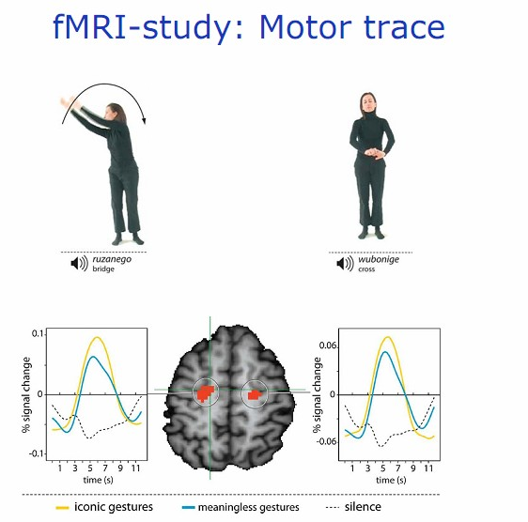
Using many senses simultaneously
The Role of Movement
Movement leaves traces in the brain
VMI: Manuela Macedonia
Notes:
Bewegungen aller Art fördern das Lernen:
nicht nur « iconic gestures » wie hier, sondern alle Bewegungen (siehe Diagramm). Auch kleine unbewusste Bewegungen wie das Angreifen von Kärtchen, Spielfiguren … sendet Reize ans Gehirn. Stricken – alle « runden Bewegungen » sind besonders hilfreich und aktivieren das Gehirn: Gehen, Radfahren (Studie am Max Plank Institut, Leipzig)…
Walk and Talk and write and check
Watch Macedonia on youtube!

Slide 19
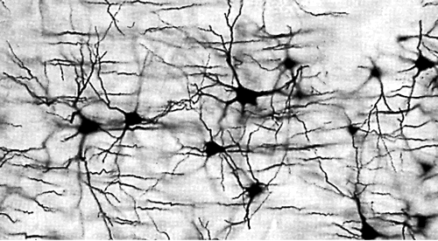
Making it meaningful through personalization
Lasting learning only takes place in meaningful contexts.
When information has no personal meaning and does not trigger an emotional response, the neural networks necessary for creating long-term memories are not formed.
The personal meaning of each learner depends on their own previous experiences as encoded in neural networks.
Notes:
Beispiel: Passiv
Aus dem Zusammenhang gerissene Konstruktion von Sätzen oder Umwandlung von aktiv ins passive ist kontraproduktiv:
zB: el fuego/ destruir/ bibliotheka
the fire / destruct / library
Bedeutungen können sogar in ganz kleinen Grammatikübungen von den SchülerInnen sinnvoll konstruiert werden.
Beispiel: Passive Bricks oder Passive Pairs
Si-Sätze // If-clauses

Slide 20
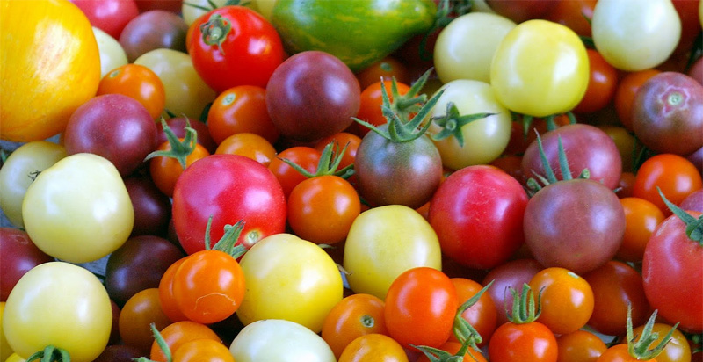
Our brain extracts patterns automatically
Ein Hirn voller Tomaten?
« Gehirne besitzen diese Fähigkeit zum spontanen Generieren von Regeln aufgrund von Beispielen « Alles was es hierzu braucht, sind die richtigen Beispiele, und zwar viele davon.
(Spitzer)» (Spitzer)
Rules (patterns) are built from examples provided the examples are:
novel / interesting
significat / meaningful
can be linked to episodic memory
Notes:
Im Vocab Sem nur ganz kurz!
zb: Laufdiktat kurz vor dem Schlafengehen: ideal, da vom Hippocampus über Nacht in die Großhirnrinde übertragen…(siehe run-dic 1000 in handout)

Slide 21

From examples to rules/patterns
Students create personalized examples
Peter’s house is very big.
Susan’s brother lives in Paris.
Mary’s dad is a great skier.
Your turn: Anna …………..............
‘s cat is ill.
Notes:
Verben: irregular verbs raps auch in den romanischen Sprachen
statt der 3 Formen könnten Kleingruppen je 5-10 neue oder schwierige Verben vorspielen in allen 6 Personen.
Moodle:

Slide 22
How does explicit and implicit SLT affect production and processing of syntax?
Do L1 speakers and L2 learners use different brain activation patterns?
How do they use procedural and declarative memory?
Are L1 and L2 learning different?

Slide 23
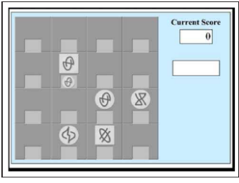
Kara Morgan-Short, Karsten Steinhauer, Cristina Sanz and Michael T. Ullman, „Explicit and Implicit Second Language Training Differentially Affect the Achievement of Native-like Brain Activation Patterns“ Journal of Cognitive Neuroscience, 24:4, pp. 933-947
Brocanto 2: artificial language for a computer game.
Explicit training versus implicit training
Tested 2x (at low proficiency and high proficiency at end of training)
2 test-types:
  proficiency test (play the game)
  ERP (event related potentials – show brain patterns in real time) show reaction to syntactic irregularities

Slide 24
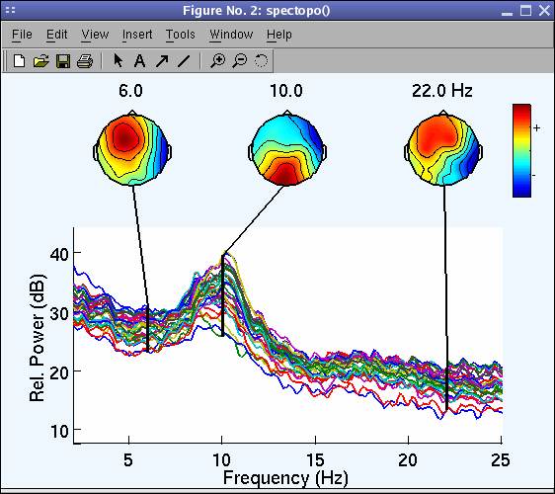
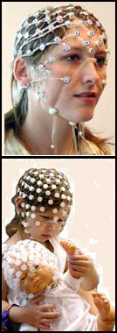
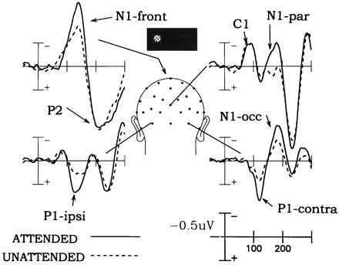
ERP:
Event Related Potential voltage maps
Notes:
image 1: Swartz Center for Computational Neuroscience, 2014)http://cognitrn.psych.indiana.edu/busey/temp/eeglabtutorial4.301/maintut/ERP_image_plotting.html (3.10.
image 2: Jewish General Hospital, Clinical Neuroscience and Applied Cognition Laboratory: http://jgh.ca/en/EEG-ERP (3.10.2014)
image 3: Steven A. Hillyard and Lourdes Anllo-Vento, „Event-related brain potentials in the study of visual selective attention“ , Proceedings of the National Academy of Sciences of the USA, vol. 95 no.3, 781 – 787 , http://www.pnas.org/content/95/3/781.figures-only (3.10.2014)

Slide 25
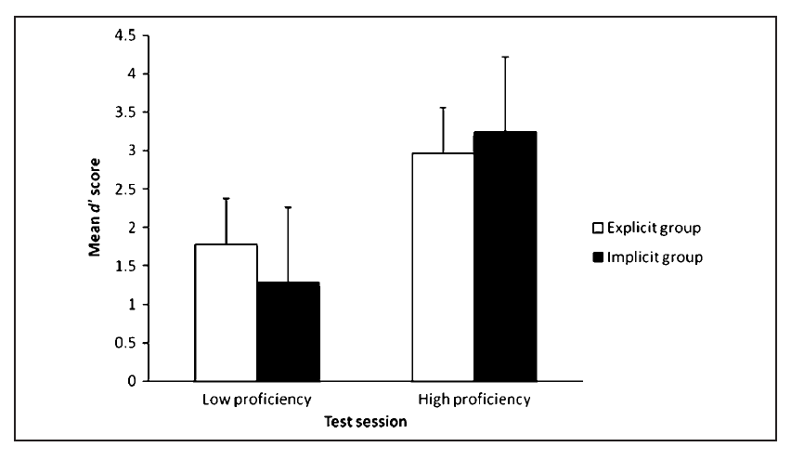
Behavioral data
Don‘t forget that this was a very limited set of possible phrases
Both training methods yield fairly comparable outcomes.
Notes:
at low proficiency the explicit group has learned a bit faster – but at end of training (high proficiency) the implicit goup had passed the explicit group. –

Slide 26
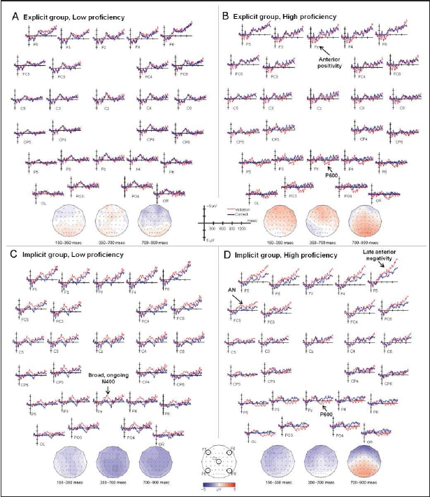
ERP data revealed striking differences between the groups‘ neural activity at both proficiency levels in response to syntactic violations.
This effect was EVEN STRONGER after months of no exposure.
 | Implicit group | Explicit group
High proficiency | leads to L1-like brain processing for syntax. Syntactic processing relied on the same rule-governed automatic structue building that is typical of procedural memory in L1. | Although explicit training is sufficient to develop the ability for structural reanalysis that may be under conscious (explicit) control, it does not reliably lead to the automatic early syntactic processing that is found in L1 and may depend on procedural memory.
Low proficiency | morpho-syntactic processing relies, at least in part, on lexical/semantic mechanisms and declarative memory and shows that this reliance can result from implicit training. (no rules needed) | Explicit training does not lead to a systematic and consistent reliance of syntax on either lexical/semantic or L1-like grammatical processes at low proficiency nor does their syntax rely on any other neurocognitive processes that would be reflected in ERP components.
Notes:
ERP image: p. 941
quotes: p. 942 – 943
effect stronger after months of no exposure: Morgan-Short K, Finger I, Grey S, Ullman MT (2012) Second Language Processing Shows Increased Native-Like Neural Responses after Months of No Exposure. PLoS ONE 7(3): e32974. doi:10.1371/journal.pone.0032974

Slide 27
What does this mean for teaching?
Our brain builds unconscious language patterns automatically
…if we „feed“ it with lots of meaningful example
…if we use all our senses– hearing and speaking are most important
…similar examples help build these patterns more than working with contrastive exercises

Slide 28
Let‘s do a little experiment
Do you know how to build the past participle in German?
Meine Nachbarn pferden gerne. Auch gestern haben sie ……………….
Meine Schüler moodlen fast jeden Tag. Auch letzte Woche haben sie fleißig ……………….
Wir neurolieren hier dass die Köpfe rauchen. Auch gestern habe ich den ganzen Tag ……………………

Slide 29
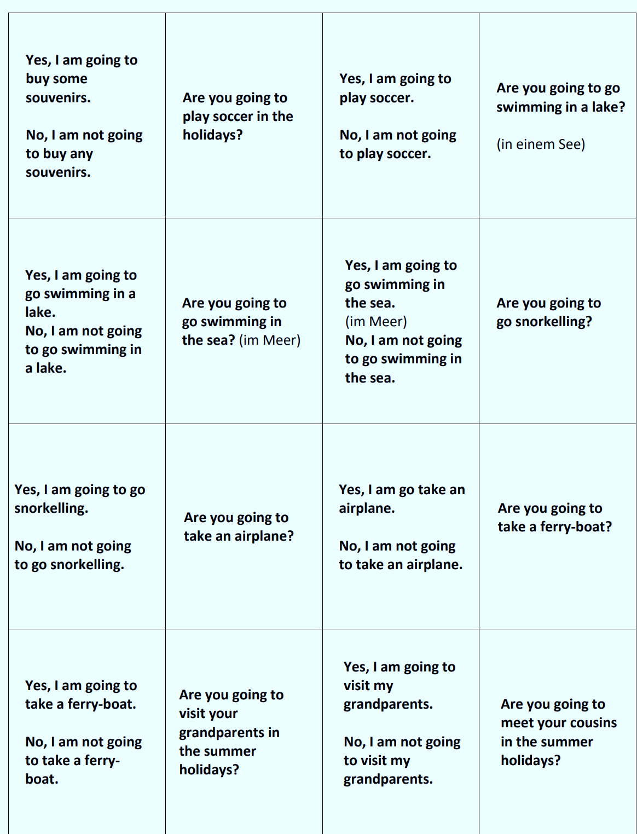
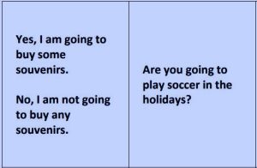
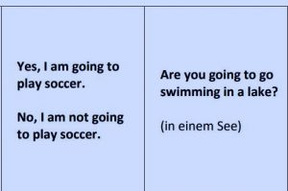
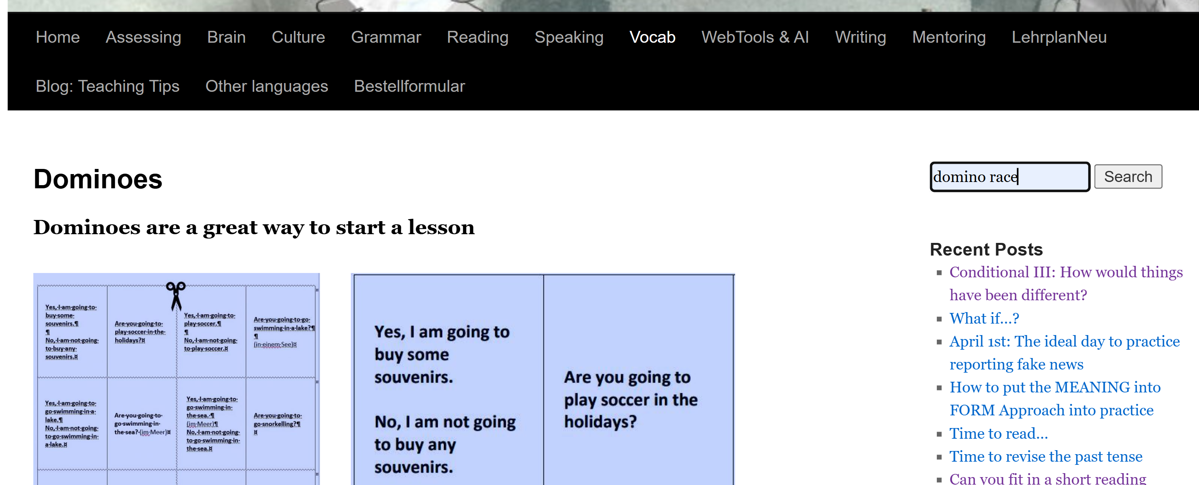
A first example: Domino Race

Slide 30

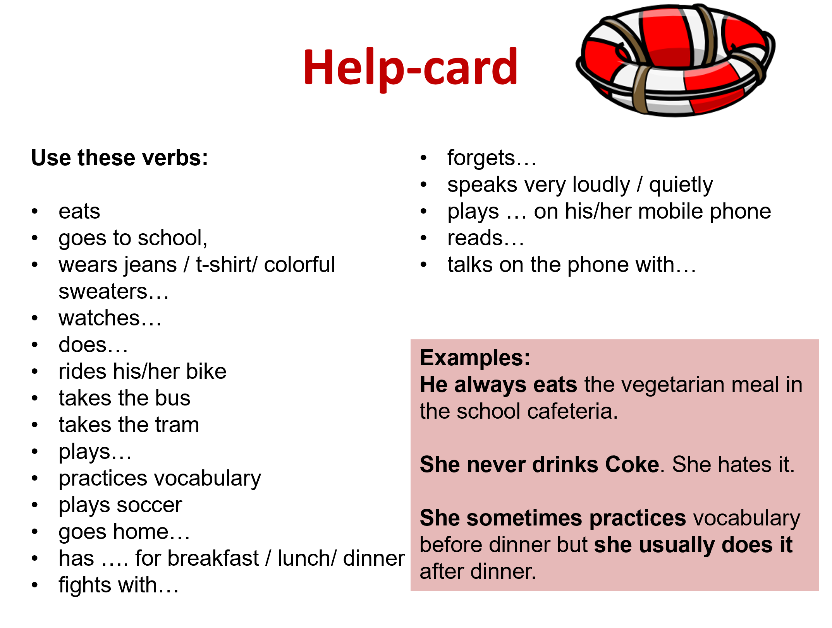
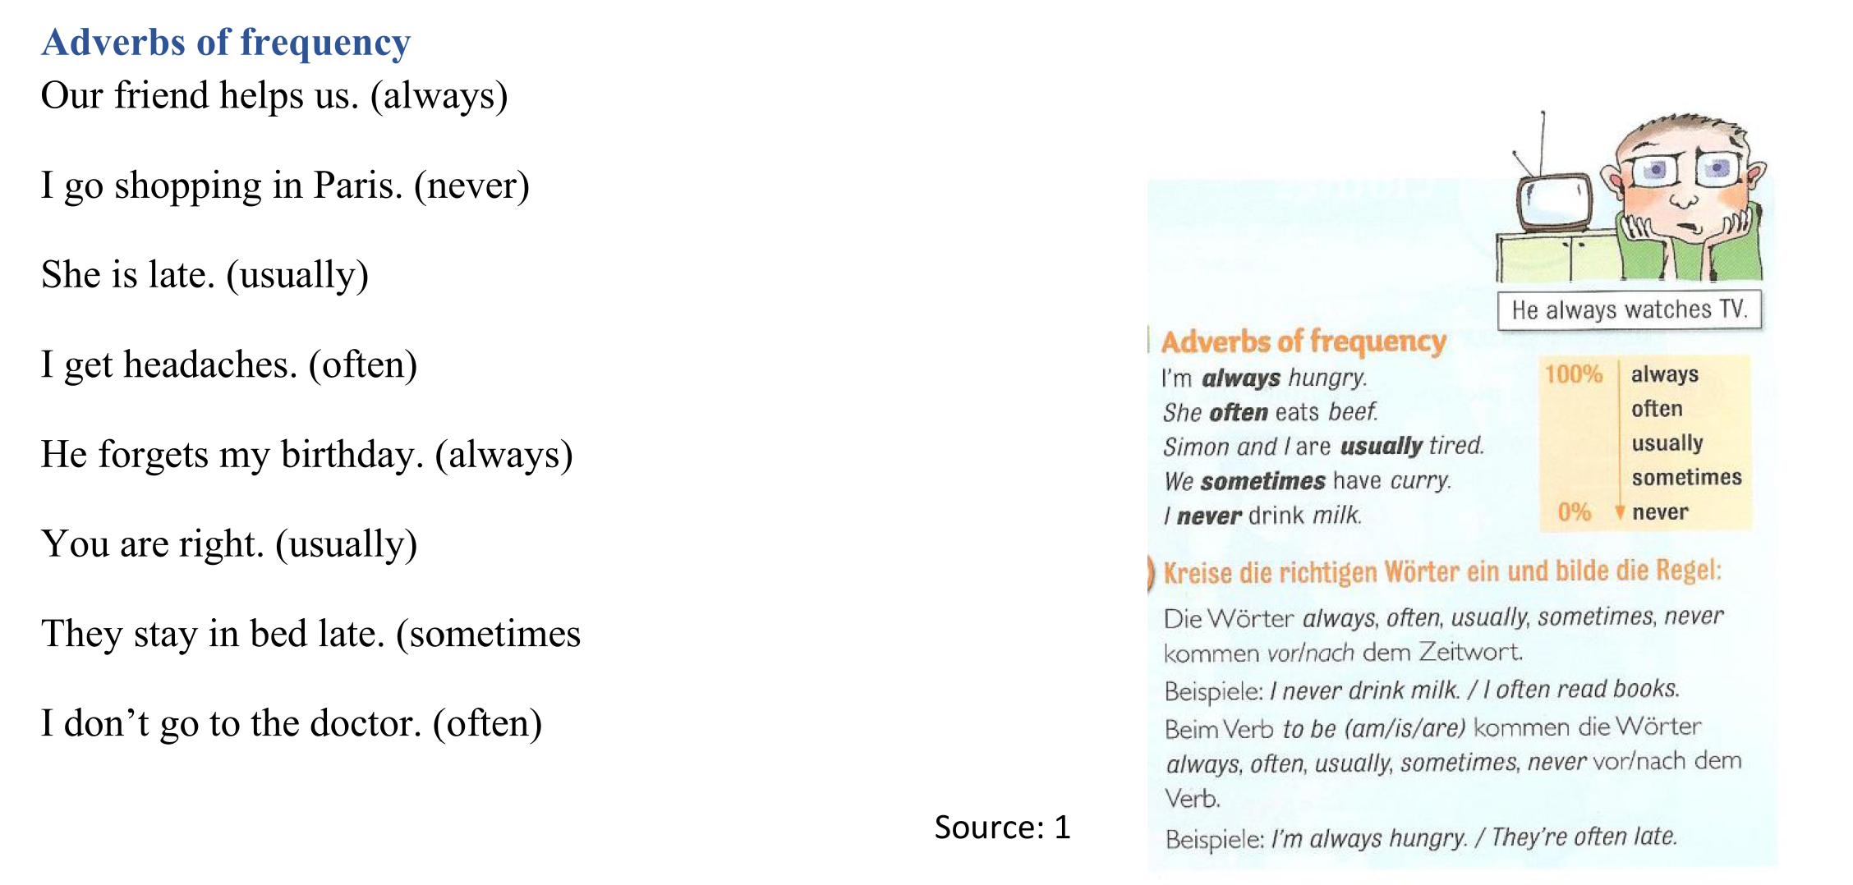
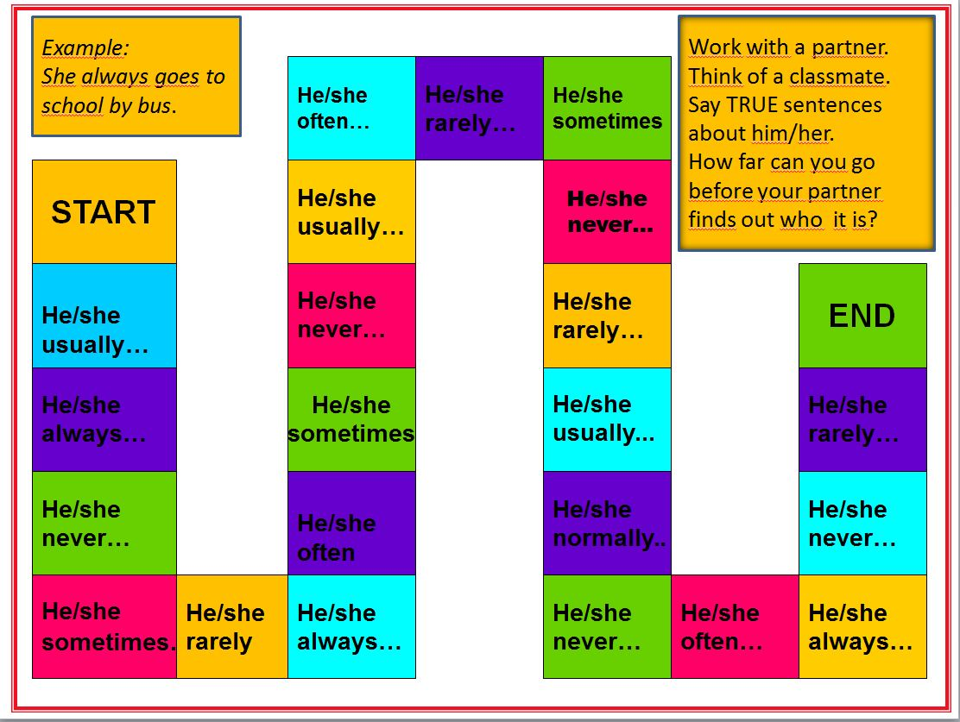


How efficient are these activities
Focus on form
Focus on Meaning

Slide 31





I ……….. have chicken for dinner.
I ……….. have eggs for breakfast.
I ……….. have chocolate for lunch.
I ……….. have soup for dinner.
I ……….. have potatoes for lunch.
I ……….. have orange juice for breakfast.
I ........... have hot dogs for dinner.
I ........... have fish for breakfast.
Write sentences that are true for you
I sometimes…..
I never ….
I often ….
My mum usually …
My dad always…
My friend … never…
More 1 workbook, p.62

Slide 32

Learning question formation through repetition in a
meaningful personalized context.

Slide 33



Didaktische Grundsätze – Auswahl
Was hat das mit Grammatik zu tun?
Es wird in sinnvollem Maße und auf das jeweilige Kompetenzniveau bezogen Adäquatheit der sprachlichen Mittel angestrebt.
Vokabular ist deshalb vorrangig in Phrasen und Sätzen zu erarbeiten
epep: vocab

Slide 34


Vokabellisten
How to study Vocabulary effectively
Nein
DANKE !!!

Slide 35


Arbeit mit der Vocab Box
Vocab practice book
neue Karten
This Photo by Unknown Author is licensed under CC BY

Slide 36





1. Walk and Talk
I am an only child.
I am an only child.
I am an only child
Sprechen
Gehen

Slide 37
Walk and Talk
My mother is called Renate..
My mother is called Renate.
My mother is called Renate.
Sprechen
Gehen

Slide 38




2. Write and Check
I do not have a sister
This Photo by Unknown Author is licensed under CC BY-SA
This Photo by Unknown Author is licensed under CC BY-NC-SA

Slide 39


Write and check
Where does your onkl live?
uncle
This Photo by Unknown Author is licensed under CC BY-NC-SA

Slide 40

Faustregel
10 Kärtchen pro Tag
oder
10 Minuten pro Tag

Slide 41


Warum ist das so Wichtig?

Slide 42

Stretch your memory

Slide 43




Stretch your memory

Slide 44



Überprüfen CHECK !!!
It is small, but I like it.
Ich merke mir einen Satz…
I have a very nice room.
In my room there is a bed.
Gehe …..möglichst weit… zu meinem Tisch…..
Ich gehe zurück und merke mir den nächsten Satz.
… und schreibe den Satz in mein Heft.
I have a very nice room.
It is small, but I like it.
there is
In my room, is a bed.

Slide 45




Approaches to teaching grammar
Traditional grammar
Communicative grammar
Acquisition-based grammar
Cognitive grammar

Slide 46
Remember:
Grammar rules found in textbooks or grammar books do not come from God but are formulated by human beings.
Many rules found in traditional grammar books can be de-verified and prove unreliable.

Slide 47
Grammar rules must be:
valid or true: they cannot be de-verified by examples
transparent : understandable by learners
systematic: e.g. in the use of terminology
economic: not contain unnecessary information

Slide 48

Is this rule valid?
Reported speech:

Slide 49
Let’s look at a few examples
Stocker and Babler: « We promise there won’t be any more side-letters or other clandestine agreements between our parties. »
Queen Elisabeth: « I will not retire – I regard being queen as a job for life. »
  But commentators quickly noted that Elizabeth — who seems to be in excellent health — has said in the past that she regards being queen as a "job for life.“ (Daily Herald)
Where do you come from?
  She said that ….she comes from… or
  She said that …. she came from….
What are you going to do in the upcoming holidays?
  She said that she is going to…
  She said that she ways going to…
  « I love Greece. I live there for 6 months every year. »
  Maxi, aged 3: « I have stroked an aligator and I have ridden on a tiger.
Why does the shifting rule not always work?
Notes:
Questions: ask individual participants to whisper their answers into my ear. I will then report what they have said.
Why does shifting not work? Because English speakers do not shift!!! They express their ideas… The process is totally different. (deixis points the way)

Slide 50

The Reporting Circle

Slide 51



Let‘s see an alternative approach
Work with a partner. Do the activities on pages 70-75

Slide 52

Implications for teaching
Meanings give rise to forms
These meanings are defined as notions that are expressed through forms.
Notes:
By seeing grammar as part of a communicative system, we recognise that in actual language use meanings give rise to forms and not vice-versa.

Slide 53
Advantages of a notional « meaning into form » approach
A « meaning into form » approach
reflects the way that grammar is used in real life
makes it possible to teach and practice one meaning at a time
avoids the danger of confusing different meanings
provides a more systematic and reliable system (no exceptions)
assists in grading (step by step, one meaning at a time)

Slide 54
Examples of grammatical notions
Teach ONE notion at a time!
Future Notions
Notion | Form
[arranged activity] | I'm playing tennis tonight.
[expressing intention] | I’m going to celebrate at my grandparents’ house in Linz.
[interpreting signs] | It’s going to be a tough match.
[making a prediction] | I’ll probably be back by six.
[spontaneous decisions] | I think I’ll change my racket.
What are you going to do in the X-mas holidays?

Slide 55
More examples…
Teach ONE notion at a time!
Notion | Form
[Experience] | I’ve never been to England.
[Changes/completion] | You’ve had a haircut!
[Duration - state] | I’ve had my computer for 5 years
[Duration – activity] | They’ve been playing tennis for an hour.
[Recentness – state] | I’ve been on holiday.
[Recentness – event] | I’ve just seen a car accident.
[Recentness – activity] | I’ve been watching television.

Slide 56

How can we teach C+C grammar
Efficient grammar teaching must consider the necessary learning stages:
Awareness raising
Conceptualization
Proceduralization in scaffolded conditions
Performance in real-time context

Slide 57


Awareness Raising
Hello, I am Mrs. Pölzleitner.
I live in a blue house in Graz. I am an English teacher. I love reading books and learning languages. I speak English, German, French, Italian and Greek. I also like sports. In winter I go skiing and in summer I go jogging. I ride my bike to school every day. My favorite food is Indian curry. I am vegetarian, so I do not eat meat.
What do you notice?
Find the rule.

Slide 58

Proceduralization in scaffolded conditions
… and many similar little tasks.

Slide 59



Communicative Grammar

Slide 60
Awareness Raising
Teachers‘ Conference: What your teachers have said about you….
Most students of 2b do their homework regularly. | Some students are a bit disorganized and forget to hand in their homework.
Most students do their work carefully. | Some kids hand in sloppy work.
Most kids work quietly in class. | A few kids are very noisy.
Most students work quickly and efficiently in class. | Many students are nervous during tests.
Some students work slowly but very carefully. | Some kids are impatient.
The class can sing beautifully. | The reading diaries are really beautiful.
The students of 2b work well in projects and workshops. | The workshops are excellent.
The students can think creatively and they can use the new language creatively. | The kids can write very creative stories.
The students act very responsibly and treat their classmates well. | The teachers would like to know who is responsible for collecting the mobile phones.
What do you notice?
Find the rule.
another option: Grammar-book 2

Slide 61


Another example…

Slide 62



Conceptualization --Proceduralization
Manner Mimes

Slide 63





Adverbs… Performance Tasks

Slide 64


Awareness Raising:
Describing Setting and Atmosphere
https://epep.at/?page_id=2366

Slide 65



Grammatical Concepts = Notions
Background and Circumstances
Building automatic language patterns from examples
Notes:
Konzept von background /circumstanes verstehen
Past progressive --- imparfait – imperfetto….

Slide 66



Using all our senses and modes
Conceptualization and hypothesis building
More examples of concept « logos »
Drawing the concept, rather than putting it into words

Slide 67

Performance in real-time contexts
Watch some of the examples of AHS and MS students here: https://epep.at/?page_id=2490

Slide 68
Depth of processing and mental activity
Example: Passive Pairs
Dual processing (world and language)

Slide 69

Personalization

Slide 70
Peer/social learning and interaction

Slide 71

Personalisation and Groupwork

Slide 72










Use several senses to anchor new concepts and forms

Slide 73

What‘s the right time to teach a grammatical meaning and form?

Slide 74



What‘s the right time to practice a notion or form?
Plans and Intentions
Past Events

Slide 75


What‘s the right time to practice a notion or form?
Reporting Fake News
Looking into the Future

Slide 76


Time to explore
How is this different from the grammar tasks in your textbook?
Choose a grammar topic that your students find difficult and see how the topic is introduced in GRAMMAR DETECTIVES
Awareness raising (in the challenge)
Hypothesis building (find the rule)
Personalization (now it’s your turn)

Slide 77
Our Goal is Performance
Can the learners USE the grammar ?
…or do they only have declarative knowledge of the rules?
What tasks can you suggest for
proceduralization in scaffolded conditions
and
performance checking?

Slide 78

Basic writing: 3rd person s

Slide 79

Testing in a communicative context
What grammar topics and vocabulary are being tested here?
Vocabulary for daily routines
Time / hour
3rd person s
Basic text organization, additional vocabulary expressions

Slide 80
Past Events
Your Easter holidays
Write a letter to your English pen friend. Tell him/her about your Easter holidays. Give lots of details and make your letter interesting.
Where did you go? What did you do?
Describe what was going on around you (past progressive: …when we got there the sun was shining… everybody was chatting…)
and by using lots of adverbs (quickly, dangerously, beautifully…)
If your holidays were really boring you can invent a few plausible details.
Write about 200 – 250 words.
plausible details are details that I will easily believe are true (glaubhaft)

Slide 81

Future plans and vague predictions

Slide 82

Book project: grammar: general experiences (present perfect tense, past events – past simple)

Slide 83

Circumstances – and – past events
Writing – Part 3
Write the beginning of a spooky story. Describe the atmosphere and the setting of the first two pictures in detail. What can you see/hear/smell? What happened in picture 3 (plot, story: Suddenly…)
Then describe what happened after picture 3 in 4-6 sentences.

Slide 84


General experiences (pres.perf.tense)
and
Specific details – events (past simple)
Test M10
Full test, incl. Notenschlüssel

Slide 85

Duration: how long – since when?

Slide 86

2nd Conditionals
Choose one…
Offer situations that the learners can relate to.
Give them some choice to follow their interests.

Slide 87

How to use reading projects to check grammar (and much more) in a test
A Diary entry from another point of view
Choose an interesting character (not Amy or Dan) and an interesting scene from your book.
Write a diary entry from this person's point of view.
Remember: In a good diary entry the character describes
the events of the day
the scenes in some detail so that the reader can picture what was happening
how they felt about these events
their plans for the next steps
Remember to use the correct tense forms (past / past progressive (-ing) / past perfect)
Make your diary interesting to read. Write a maximum of one page.

Slide 88

Time to explore
Look at the writing tasks in the ME book and find out which of the grammar topics is being practiced in the following tasks:
My family: p.8-9
A letter from your holidays: p. 20-21
My Fantasy Animal: p.24-25
Time Capsule: p. 26-27
Great Kids Contest: p. 28-29

Slide 89
Grammar Workshop
Choose a grammar topic that you are going to teach in the near future.
Go to epep.at and/or to Grammar Detectives and find some suitable activities for your students.
See what your textbook/workbook offers for this topic and check if these tasks meet the requirements of our Grammar Checker.
For each of the tasks that you are considering ask yourself:
    What learning stage does this support?
    Which of the pedagogical principles does it fulfill?
    What’s going on in the learners’ brains?
    How could you use / or adapt these activities for your learners?

Slide 90


Sources
Newby, D., Grammar for Communication, Vienna, Bundesverlag: 1989*
Newby, D., Grammar for Communication: Exercises and Activities, Vienna, Bundesverlag: 1992*
Newby, D., 'Theory and Practice in Communicative Grammar' in R. de Beaugrande, M. Grosman, B. Seidlhofer, (eds.) (1998) Language Policy and Language Education in Emerging Nations, Series: Advances in Discourse Processes Vol. LXIII, pp 151-164. Stamford, Conneticut: Ablex Publishing Corporation
National Education Association. Doubts & Certainties, January/February 1994. Material adapted from Renate Nummela Caine and Geoffrey Caine, Making Connections: Teaching and the Human Brain, ASCD, 1991; Addison Wesley, 1994. online: http://www.nea.org/teachexperience/braik030925.html , 25.02.2014

Slide 91

More useful resources for teaching grammar
Useful books for teachers on epep.at

