Slide 1
Reporting

Slide 2
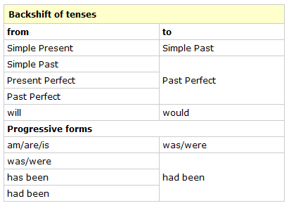
Is this rule valid?
Reported speech:

Slide 3
Let’s look at a few examples
Obama: « I am going to introduce a new health care system for all Americans. »
Queen Elisabeth: « I will not retire – I regard being queen as a job for life. »
  But commentators quickly noted that Elizabeth — who seems to be in excellent health — has said in the past that she regards being queen as a "job for life.“ (Daily Herald)
Where do you come from?
  She said that ….she comes from… or
  She said that …. she came from….
What are you going to do in the semester break?
  She said that she is going to…
  She said that she ways going to…
« I work at GIBS and at Graz university. «
« I love Greece. I go there every summer. »
Maxi, aged 3: « I have stroked an aligator and I have ridden on a tiger.
Why does the shifting rule not always work?
Notes:
Questions: ask individual participants to whisper their answers into my ear. I will then report what they have said.
Why does shifting not work? Because English speakers do not shift!!! They express their ideas… The process is totally different. (deixis points the way)

Slide 4
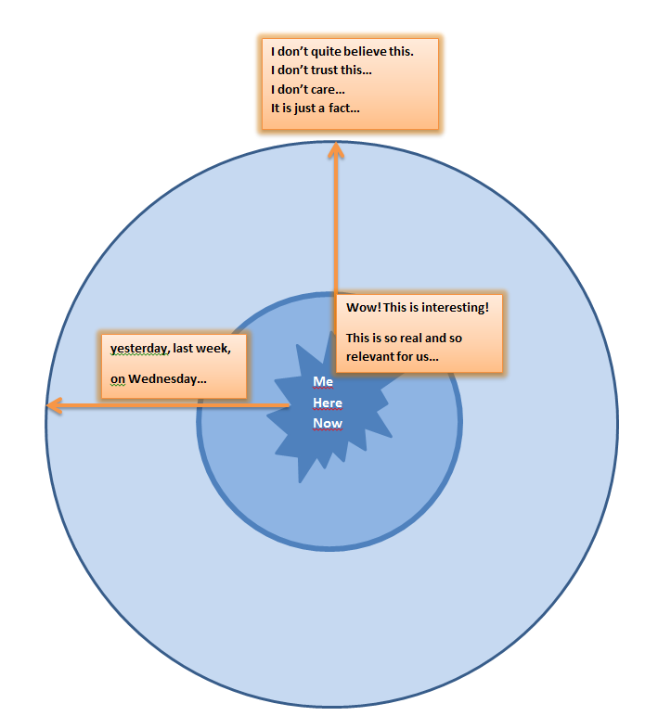
The Reporting Circle

