Slide 1
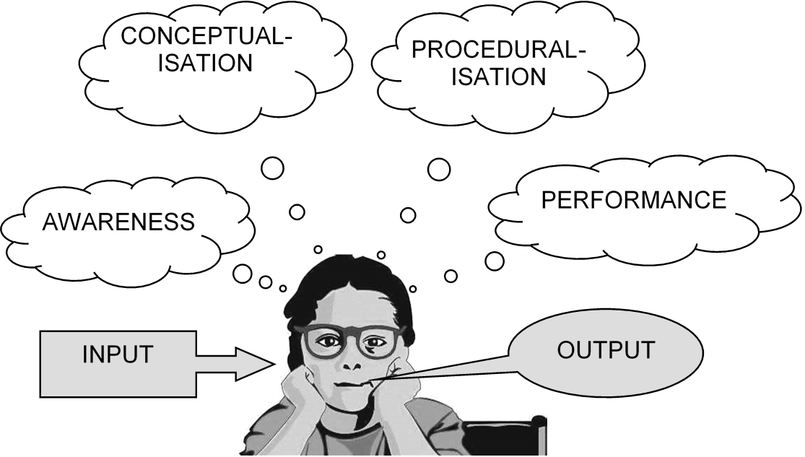
Communicative Grammar in Practice
L2 Grammar Acquisition, Salzburg, July 2015
David Newby, Univ. Graz, Vienna, Bergen
Elisabeth Pölzleitner, BG GIBS and Univ. Graz

Slide 2

Teaching Objectives
My students should be able to write effective, spooky stories.
  In order to do this they need to be able to SET THE SCENE and
  describe the BACKGROUND and CIRCUMSTANCES in detail (sound effects, dark shadows dancing on the walls….)
  and develop the plot by describing a series of EVENTS
EVENTS
past simple
SETTING THE SCENE
past progressive

Slide 3

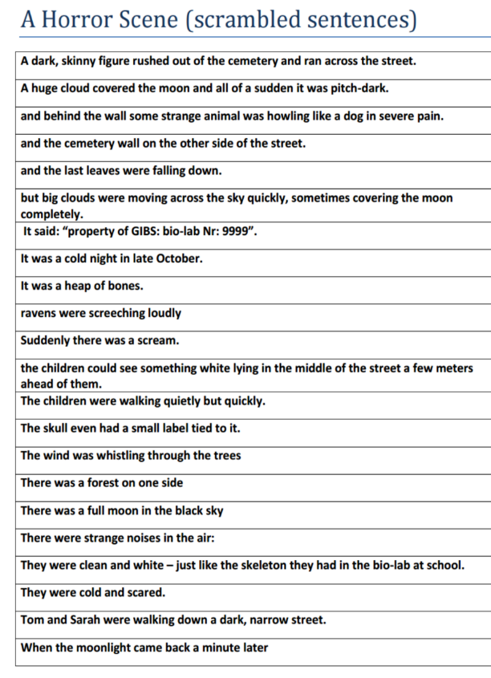



Practical Examples of Communicative Grammar Tasks
Quick Check Grammar Chart |  | - | ✓ | +
Learning Stages | Awareness raising
 | Conceptualization and hpothesis building
 | Proceduralization in scaffolded conditions
 | Performance in real-time context
Pedagogical Principles and Communicative Criteria | Depth of processing and Complex encoding : Will the learners be mentally active and process grammar, lexis and their “world knowledge”?
 | Commitment filter: Will the learners`cognitive and affective needs be met? (e.g.: curiosity, problem solving, enjoyment, fun, success)
 | Peer and social learning and interaction: Pair – or groupwork, sharing, oral activities, jigsaw activities…
 | Personalisation: Do the learners have the opportunity to draw on their personal experiences and express their own ideas?
 | Contextualisation: Is the exercise embedded in a clear communicative context?
 | Authenticity of process: Will the learners use language in natural, “language-like” ways (rather than manipulate forms)?
 | Task-based: Do the students fulfil a purposeful task that will have an outcome or end product?
 | Testing versus teaching: Does the exercise support learning or only test it?
This exercise supports learning processes…
I. Awareness raising
Reading and sorting sentences
Noticing the new forms and meanings
Acting out and SEEING the scene

Slide 4
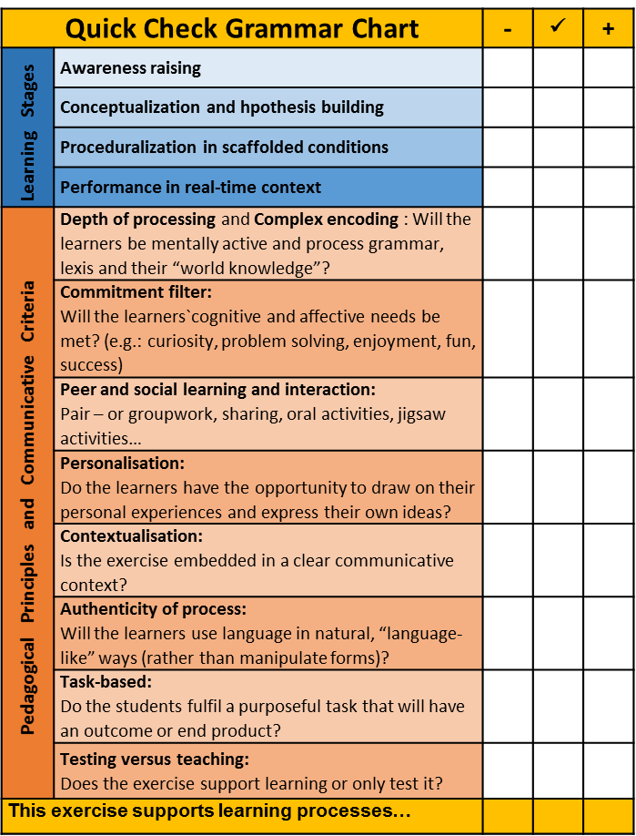
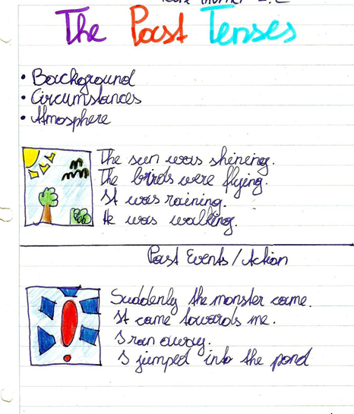
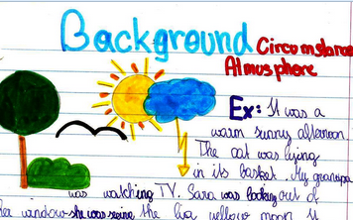

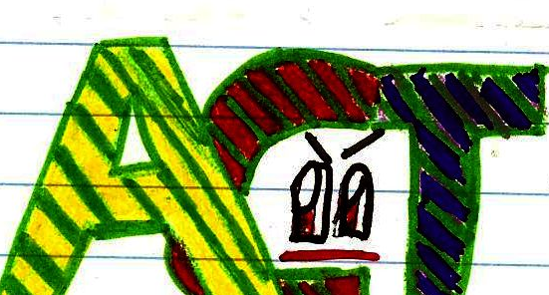
II. Conceptualization and hypothesis building
Students work out their rules and design their own grammar-rule pages. For each notion they find some typical examples and draw a logo that will remind them of this notion.
More examples of concept « logos »

Slide 5
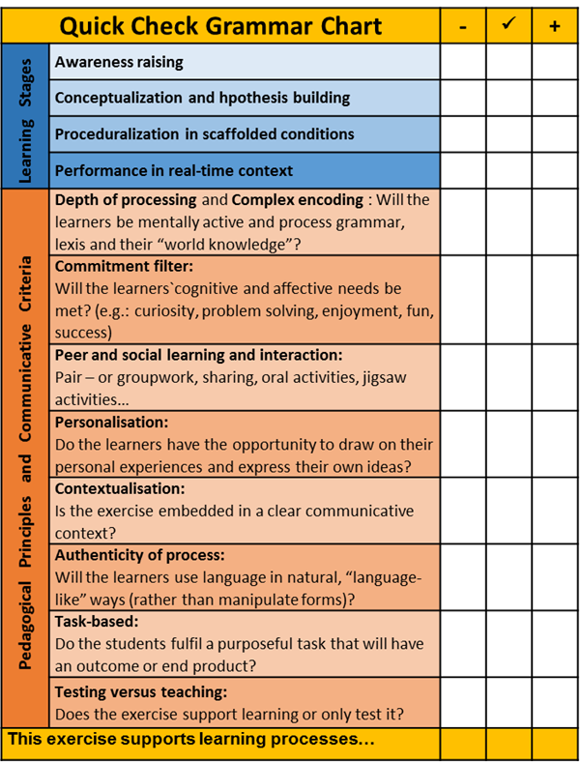

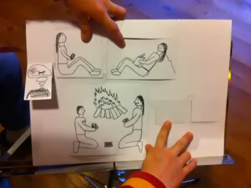
Flip-Flap Stories
III. Proceduralising in scaffolded conditions
Flip-Flap stories
Plan a short spooky story that you can tell in about 10 sentences.
Decide which parts of your story are PAST EVENTS
and which parts describe the BACKGROUND and CIRCUMSTANCES.
To prepare your fold an A4 sheet in half. Draw simple pictures for the CIRCUMSTANCES on the front of the sheet. Then cut some windows or doors into the sheet and draw pictures for the EVENTS behind these doors.
Practice telling your story. Then record it on Eyejot and post it on Moodle.

Slide 6
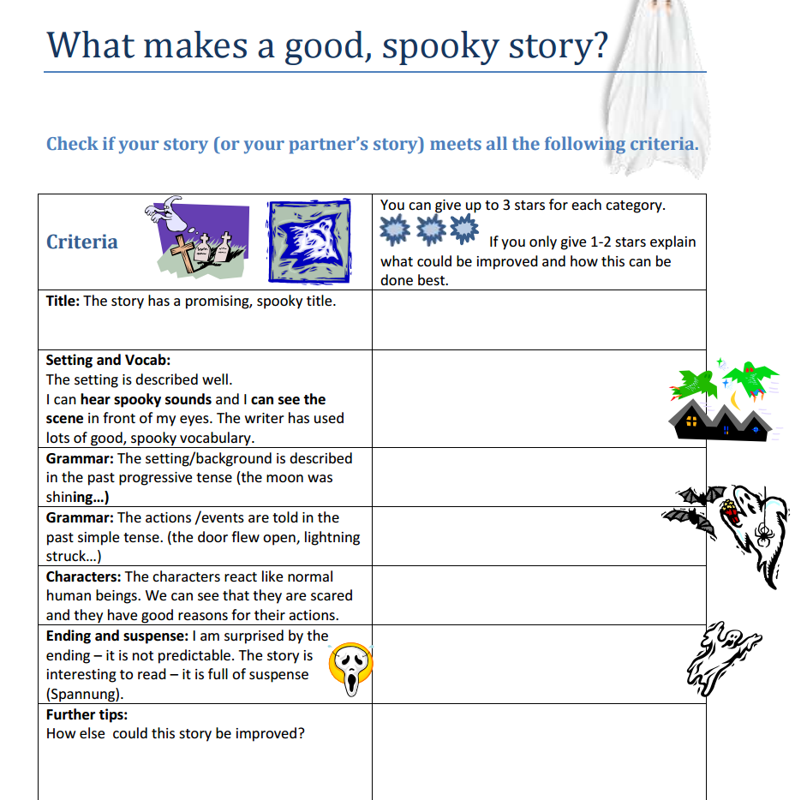

IV. Performance TASK: Write a spooky story
Reading sample stories and collecting spooky vocabulary phrases (the moon was shining, the owl was hooting…)
Planning the stories according to the given criteria.s
Peer feedback and revisingy story?“
Grammar Focus

Slide 7
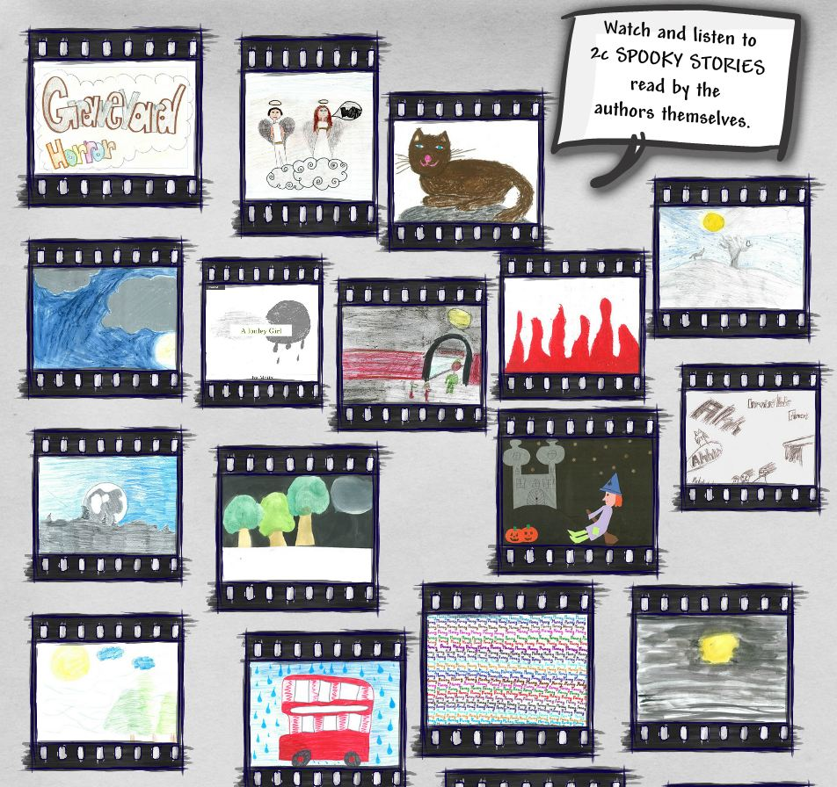

…Performance in real-time contexts
Notes:
Click on the picture to go to the glogster on epep.at

Slide 8
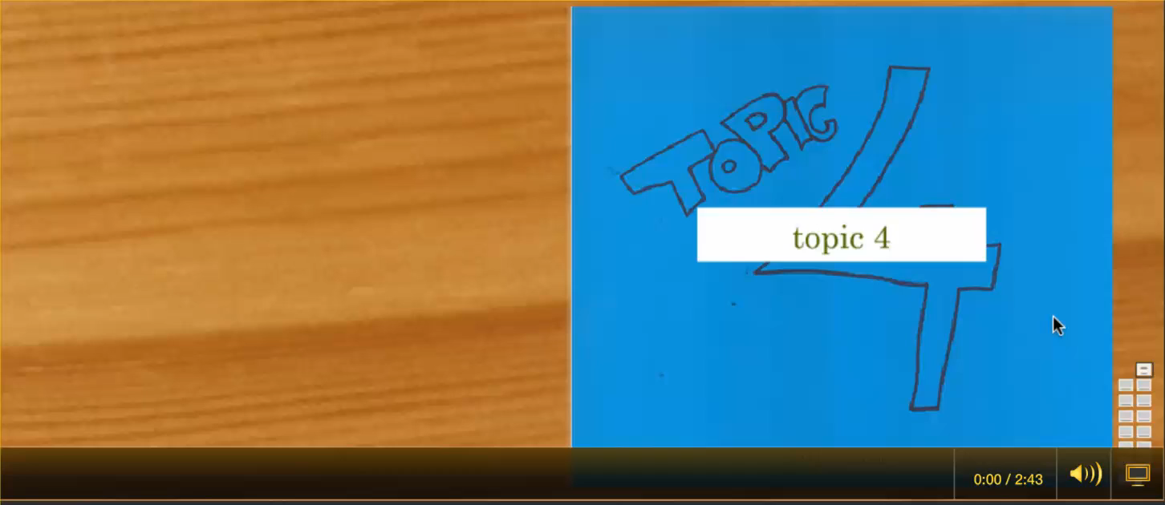
One of the finished stories
Go to www.epep.at to see all the stories

Slide 9

Thank you for listening.
Any questions?

