Slide 1
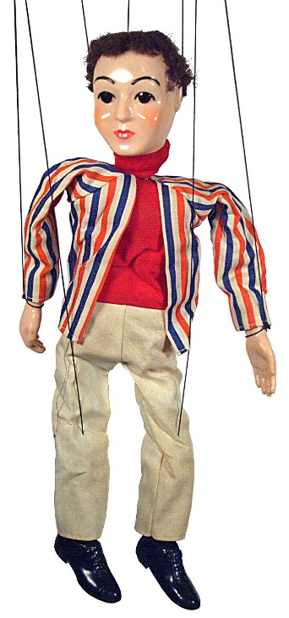
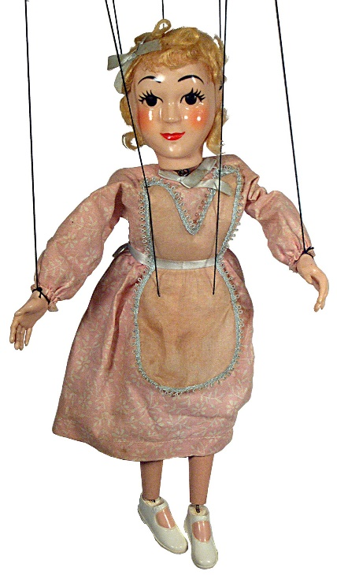
Why Puppets on a String don‘t learn well…
… and how we can change this.
Notes:
Introduce myself…
Achtung…Folien auf Engl, spreche aber Deutsch

Slide 2
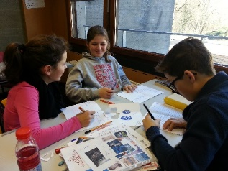
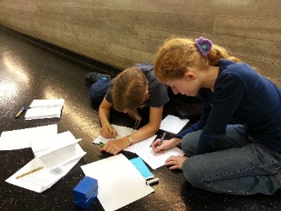
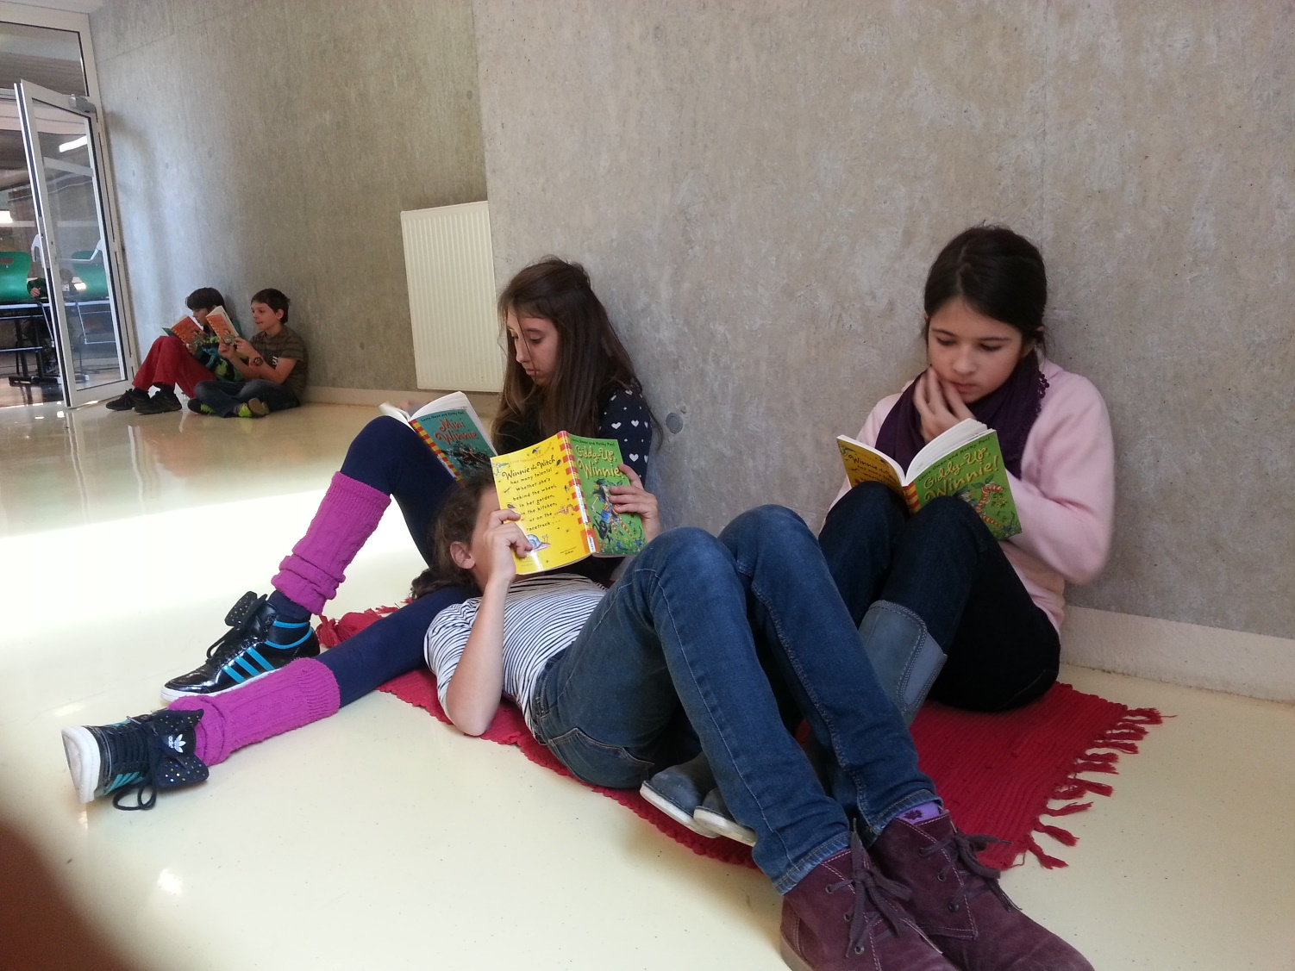
Overview of today‘s presentation
Who-Where-What?
Framework and setting of my work
Why?
Why do learners need autonomy and choice?
How?
How to implement elements of autonomous learning in secondary school
Discussion and questions

Slide 3
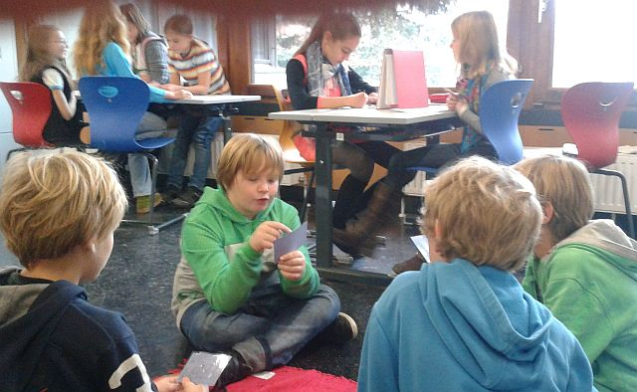
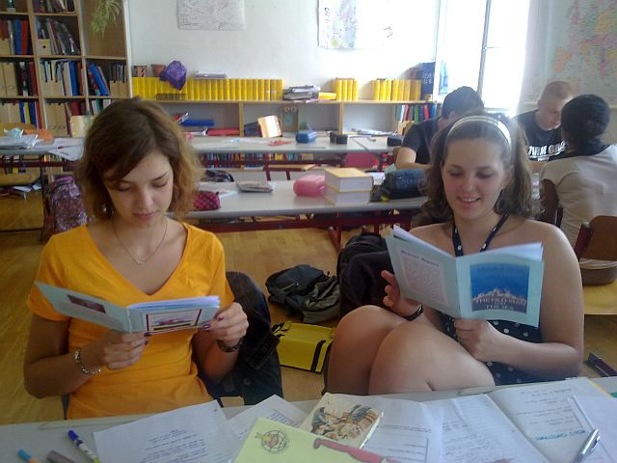
The Settings
Learners at secondary school in Austria
Two types of schools: AHS and MS
Groupsize: ~22-25 students in each class
Different readiness levels
National curriculum (based on CEF)
No / hardly any use of textbook
Use of technology

Slide 4
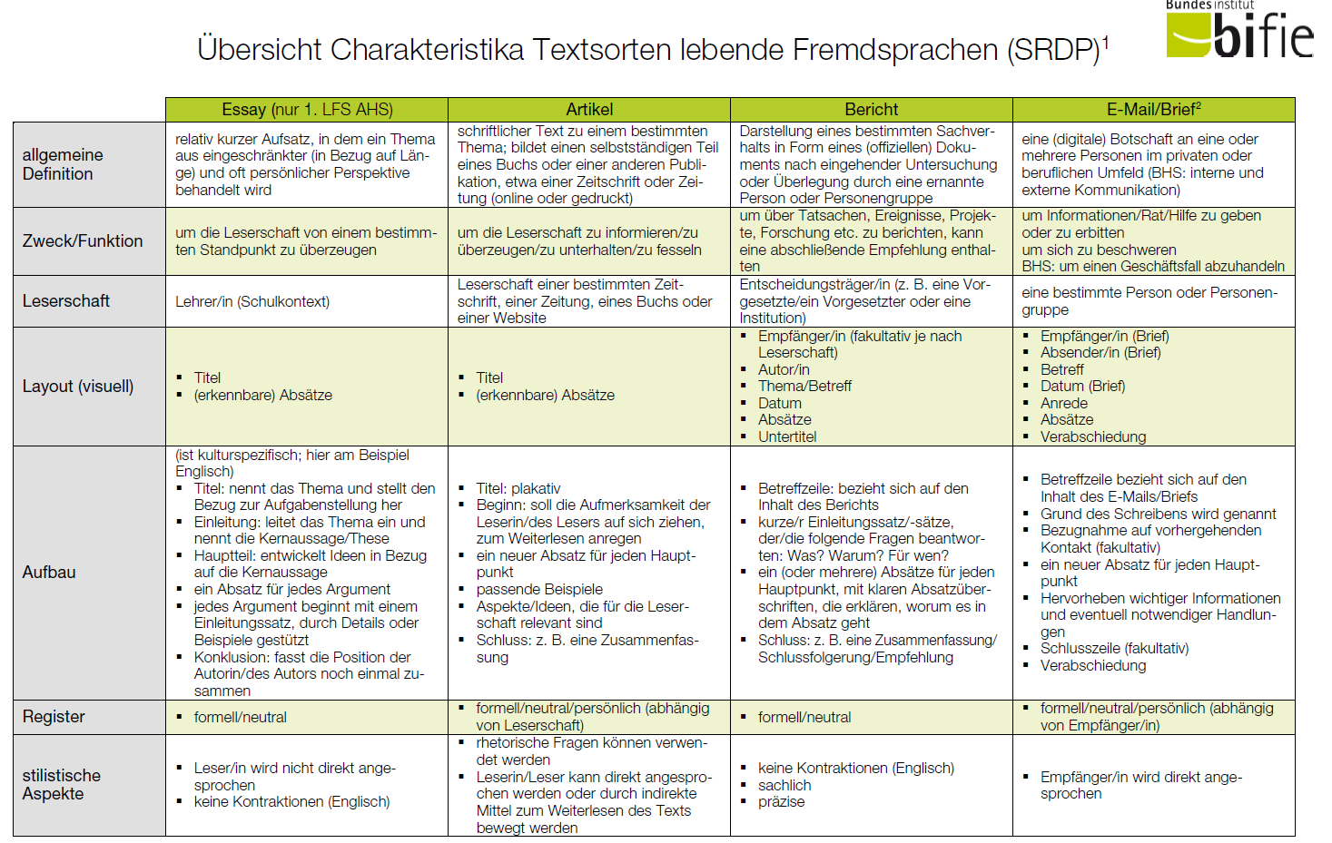
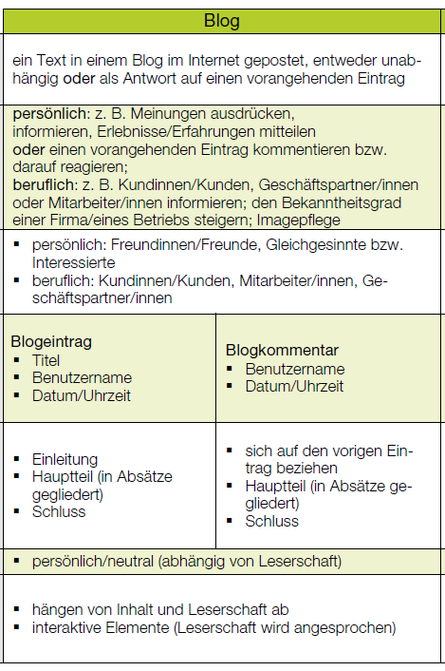
Curriculum Requirements
Austrian national curriculum + CEF
Standardized final exams: B2
Required texttypes: essay, article, letter or e-mail, blog post or blog comment, report)
Learners need to understand that they are writing for a specific AUDIENCE for a specific PURPOSE.
Teachers must create authentic situations and tasks that learners can relate to.

Slide 5

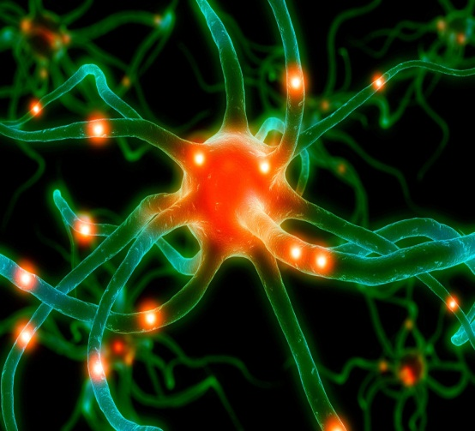
My goal: bridging the gap between the curriculum, BIST /CEF ….. and ….higher order skills /learning for life
Learning involves the whole person – body, mind and soul.
Long-term learning only happens in relevant, meaningful contexts.
Emotional and social aspects play a key role.
(Bauer, Spitzer , Hüther, Roth, in Caspary 2006) (Zull 2002: 224 ) Macedonia M.
National standards /CEF competences
4 skills - testability
Test formats
Texttypes
Education for life
learner centered
skills for life-long learning
higher order skills
social skills and transcultural understanding
curiosity and openness
experimenting and hypothesis building
Der Schüler ist kein Nürnberger Trichter, erst recht kein wandelnder Aktenordner, und der Lehrer kein blutleeres Wissenslexikon.
(Bauer 2006: 47)
Notes:
Knowledge and understanding cannot be transferred from the teacher‘s brain to the learners‘ brains.
Students‘ brains are very different from databanks or file-systems and
Teachers are not walking encyclopedias.

Slide 6

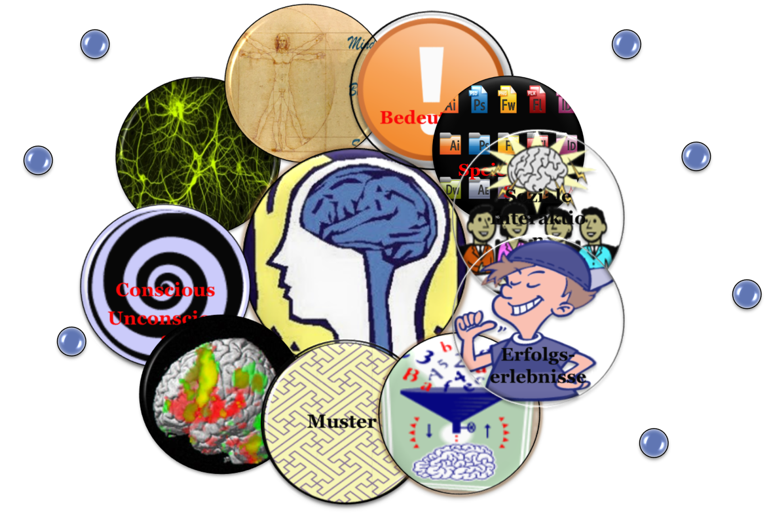
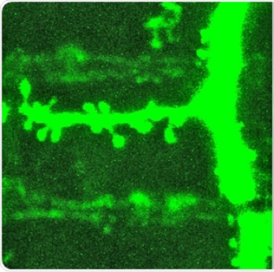



How learning works Why we don‘t write into notebooks
What does this have to do with autonomous learning?
“Importance is physical” :
Acetylcholine
Long-term learning only happens in meaningful contexts
Notes:
Celebrate success and achievements – dopamine shower!

Slide 7

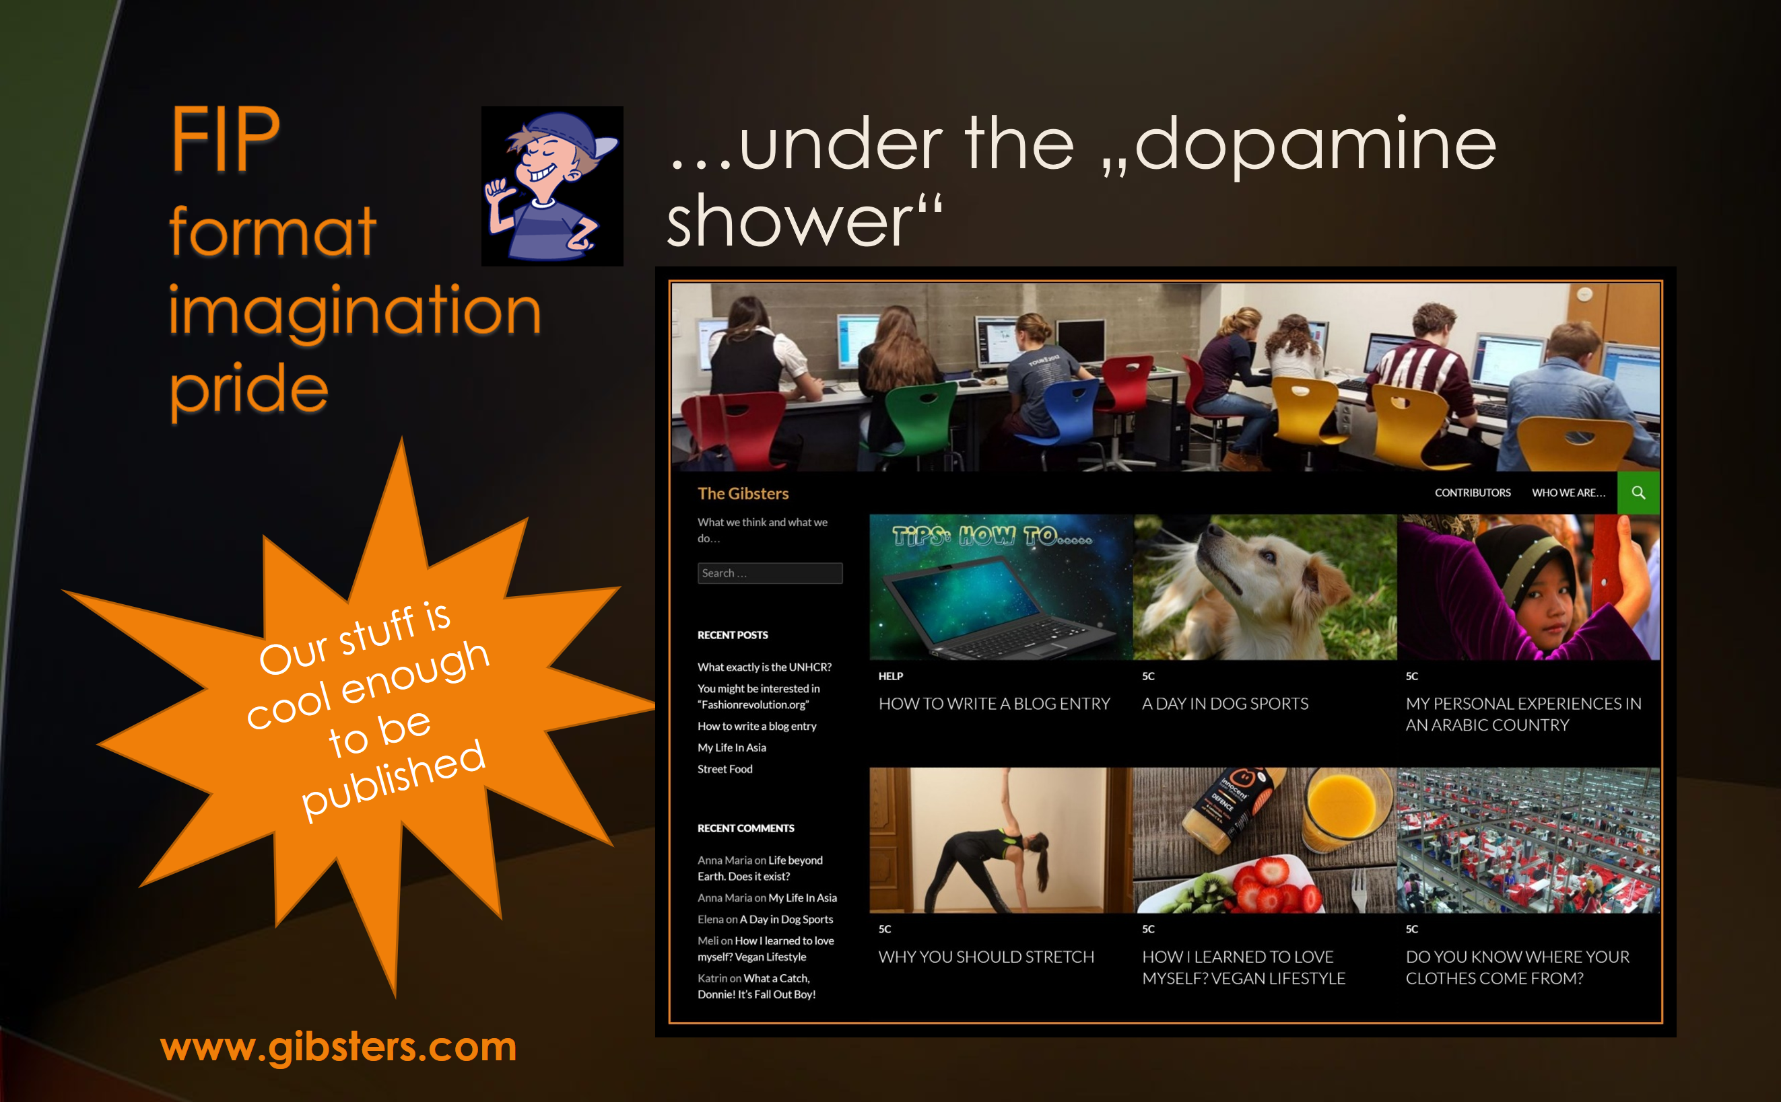


In other words…
Autonomy
Mastery
Connection
Choice
Challenge
Social connections, peers
Self-determination
FIP
Format- Imagination- Pride
Ownership
Personal Meaning
Notes:
Überblick – wir schauen uns jeden der drei Bereiche genauer an. Alle drei sind psychologisch wichtig und haben aber Folgen auf chemisch – neuronaler Ebene. (Transmitter – Synapsenwachstum… growth cones…)
Intrinsic Motivation: Dopaminspirale!!! Will mehr und mehr von diesem Erfolg.
Mastery: Stolz auf den Erfolg

Slide 8
Autonomy: Choice theory (William Glasser)
Five basic needs
In an effective classroom…
Basic survial
Need for belonging
Need for power
Need for freedom
Need for fun
We address these needs by creating opportunities for the students to express themselves individually or to work with others
By allowing students to choose activities of interest that are playful yet challenging
And by empowering students through active learning and decision making.
(Judith Dodge, Differentiation in Action, p. 51)
Our 5 basic needs drive our choices. We choose to behave in a way that will satisfy most of these needs.
Notes:
Ich muss in der Klasse versuchen möglichst viele dieser Bedürfnisse zu befriedigen. Sonst findet wenig Lernen statt.

Slide 9

From the Neurosciences to Autonomous Learning
„The autonomous learner is one that constructs knowledge from direct experience, rather than one who responds to someone‘s instruction“
„Our job is to create learning opportunities, not to impose a method“ There‘s more than one way to learn a language.“ (Benson 2001)
Effective teachers can navigate between the two poles.

Slide 10

How do we do this?
TBL
Task based learning
FIP
Format
Imagination
Pride
Choice
Time

Slide 11


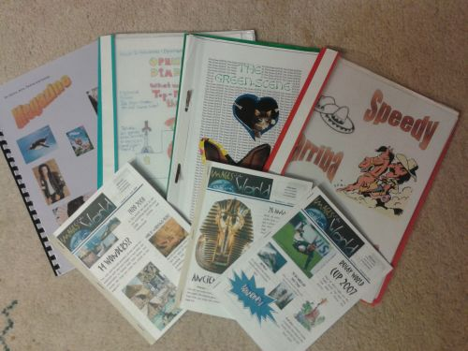
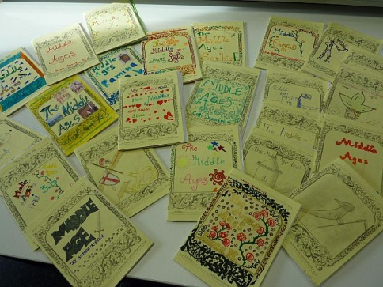

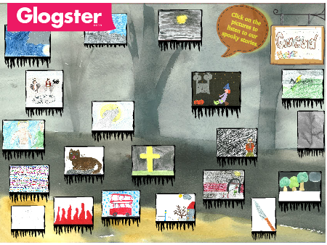


TBT: Task Based Teaching
What is a TASK
„A piece of classroom work which involves learners in comprehending, manipulating, producing, or interacting in the target language while their attention is principally focused on meaning rather than form.“ (Nunan 1989)
Tasks vs Exercises (Willis 2007)
Does the activity engage learners‘ interest?
Is there a primary focus on meaning?
Is there an outcome?
Is success judged in terms of outcome?
Is completion a priority?
Does the activity relate to real world activities?

Slide 12

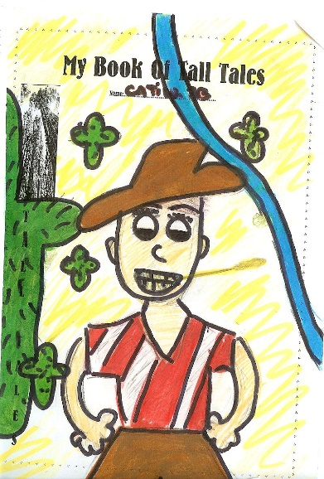

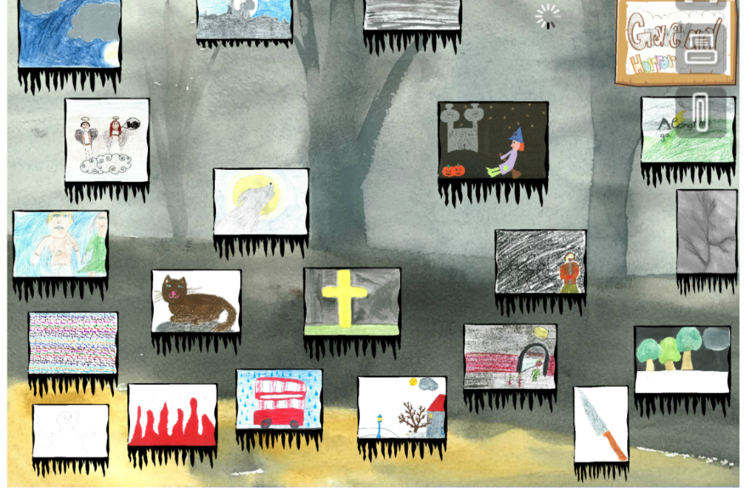
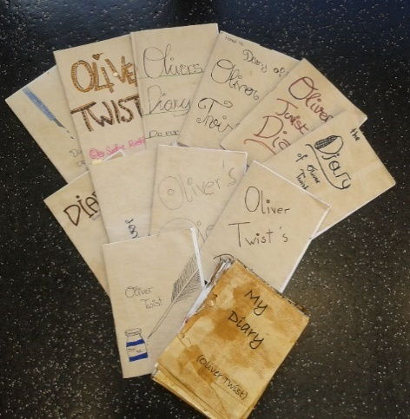
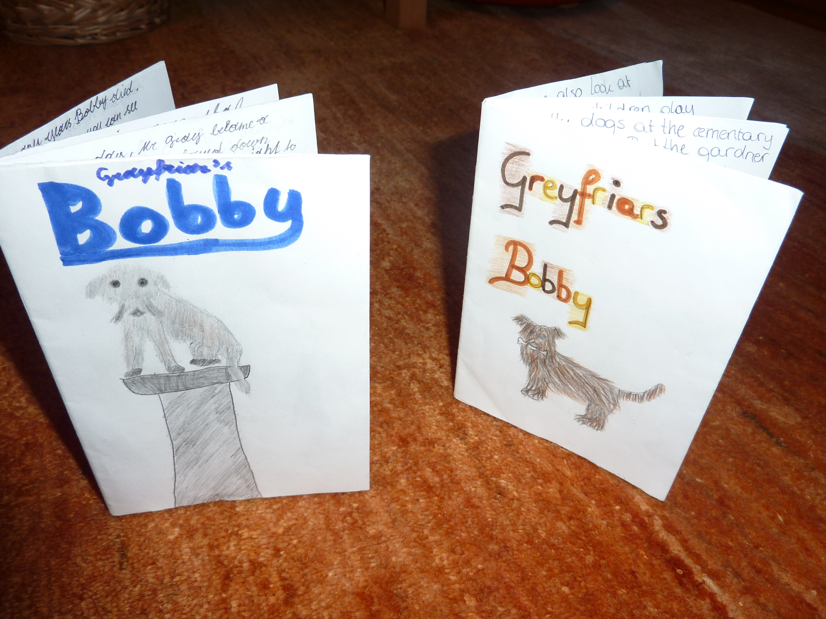
F I P: Format – Imagination – Pride
“Complex learning is enhanced by challenge and inhibited by threat”
(Caine & Caine 2000)
Challenge them!
Our stuff is cool enough to be published
Trust them!
–

Slide 13

The pedagogy of the blank sheet Hannelore and Helmut Zehnpfennig (2009)
Reduction of materials and input
Basic reference materials or online search
The blank sheet: no tasks, no questions, no instructions
Forces learners to actively search for meaning, fosters learner creativity, problem solving and interaction, encourages the construction of meanings and concepts
Choice = Power

Slide 14
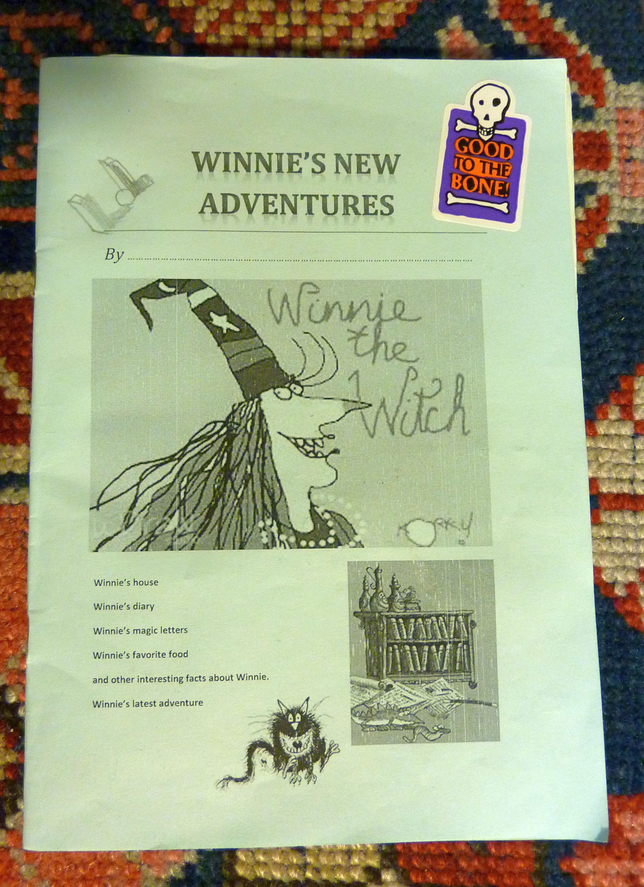
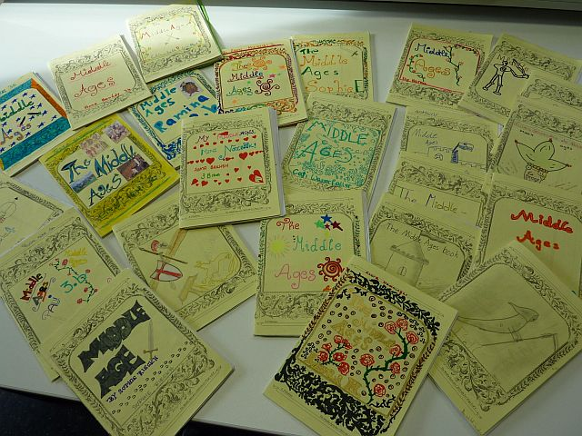
A few examples such booklets

Slide 15
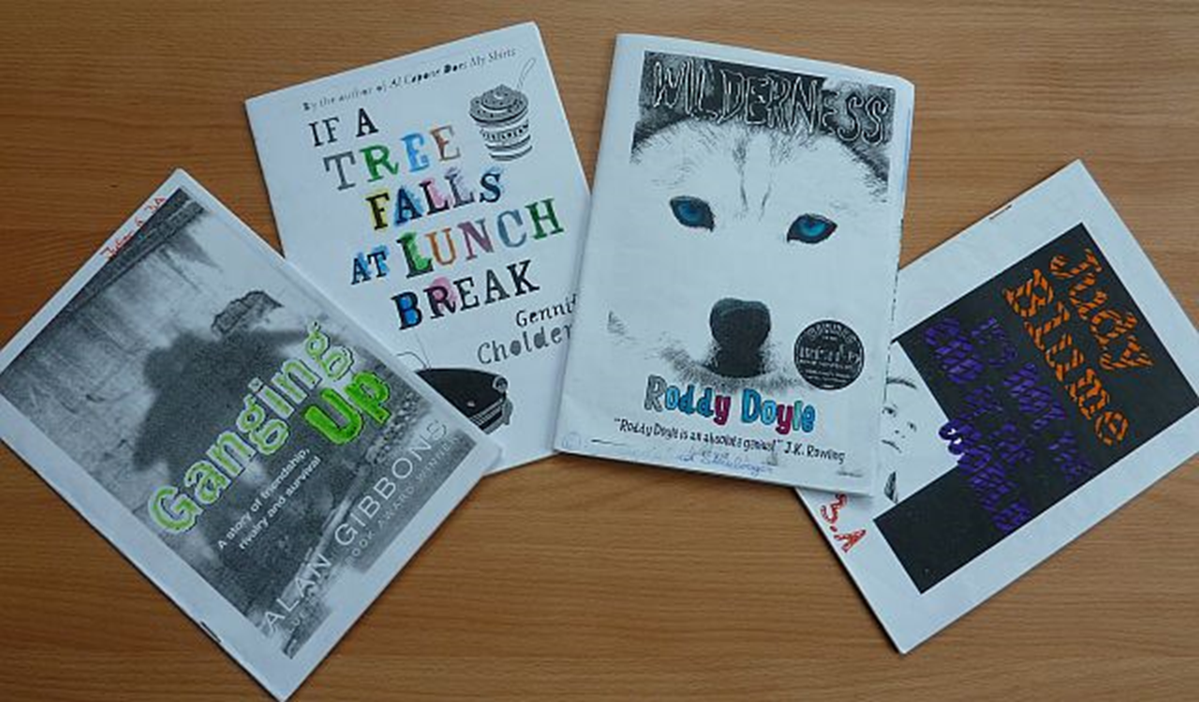
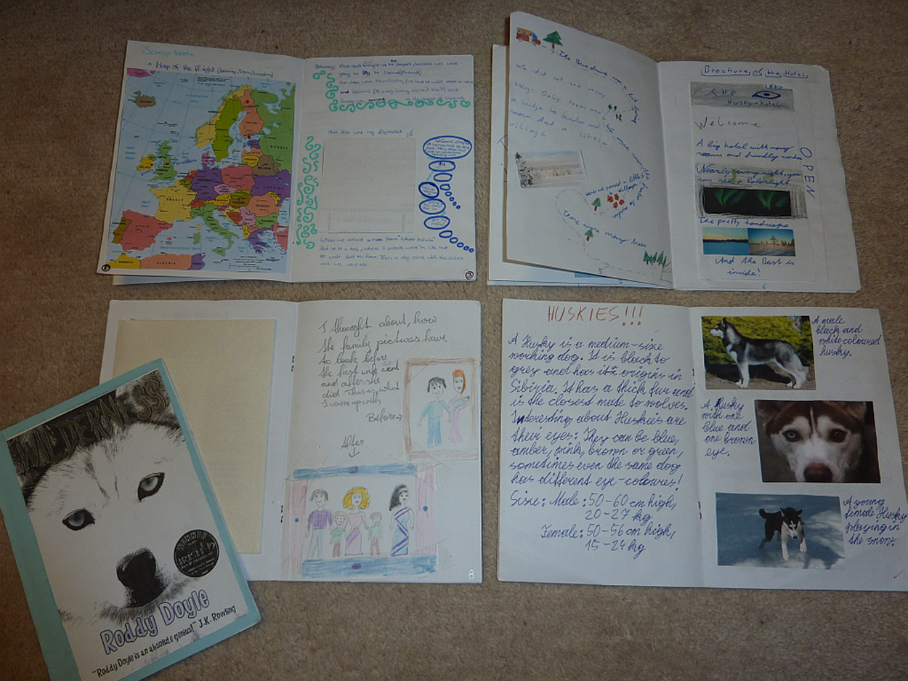
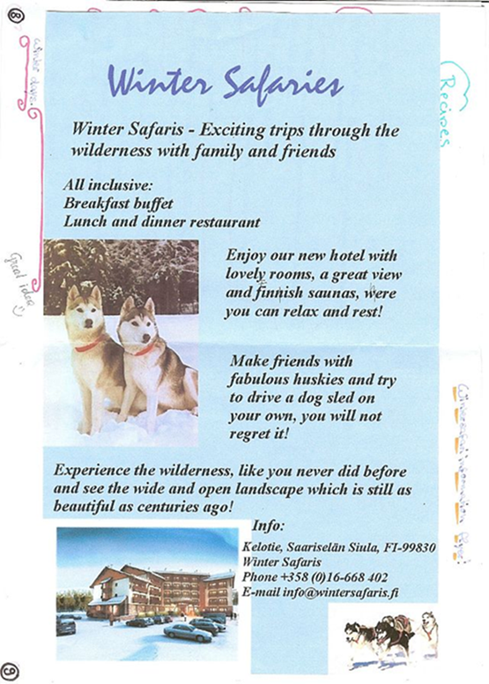
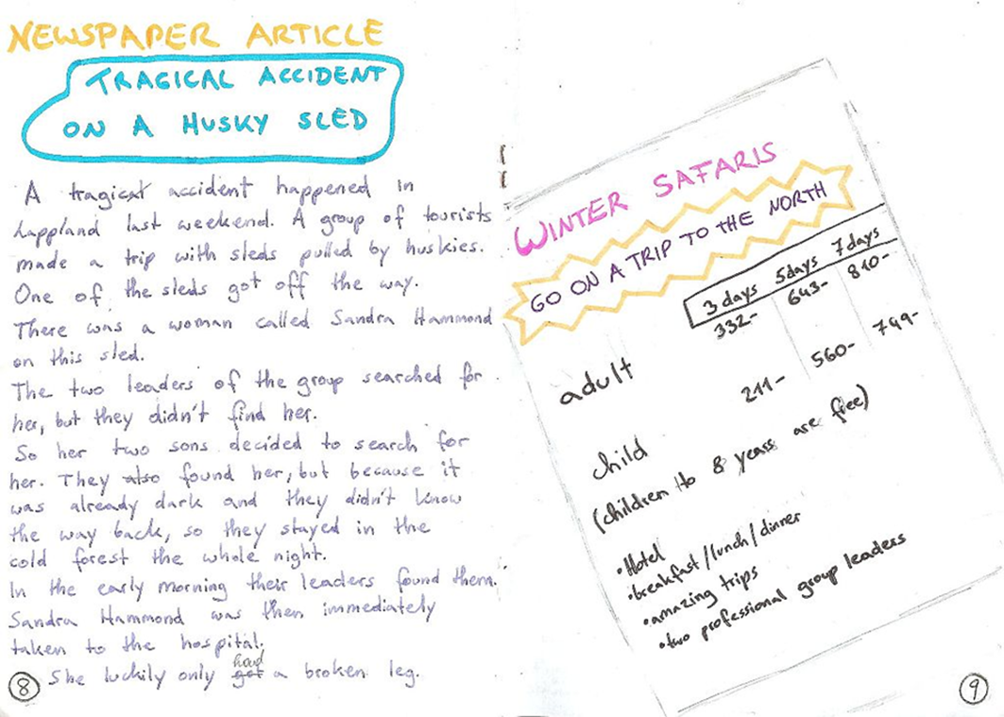
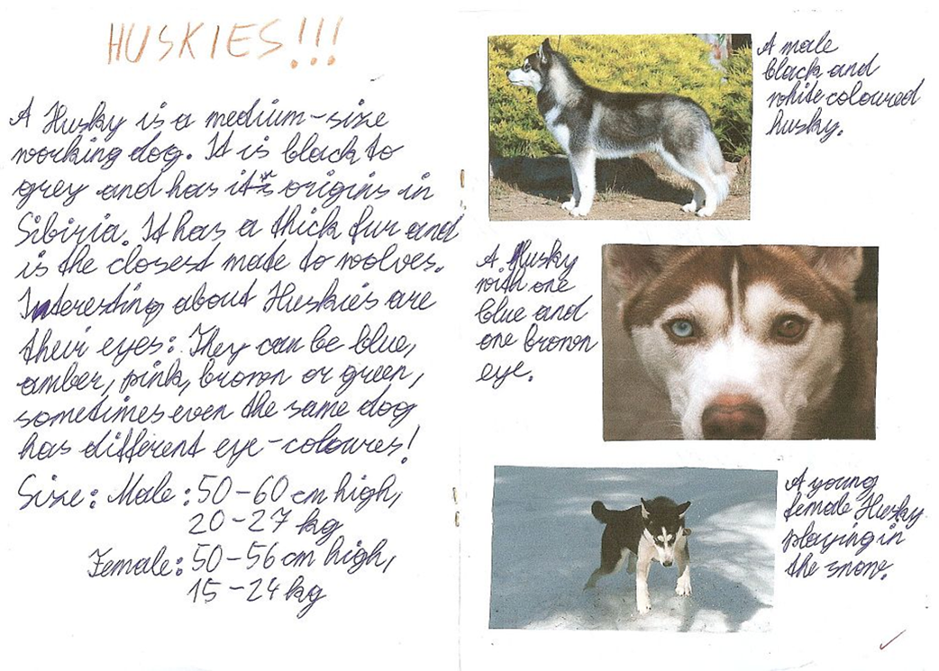
Extensive Reading: Booklets about Novels
Typical text types
Letters, postcards, e-mails
Newspaper articles
Travel brochures
Diary entries
Background info, factsheets
Recipes
Maps
Character pages

Slide 16
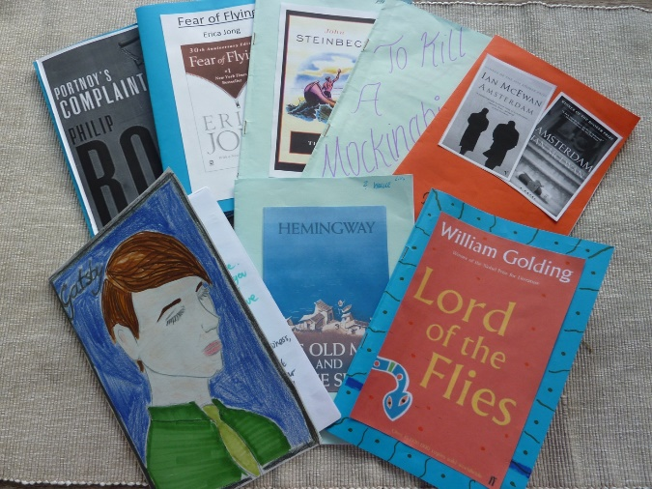
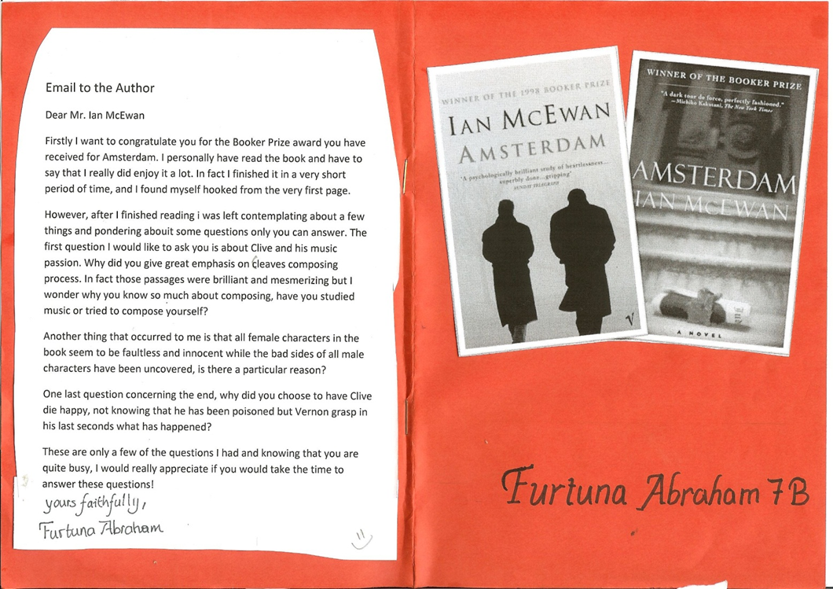
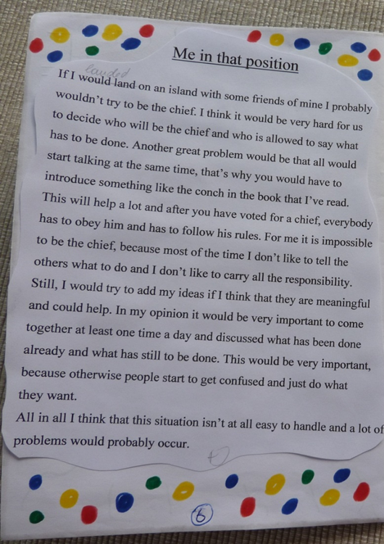
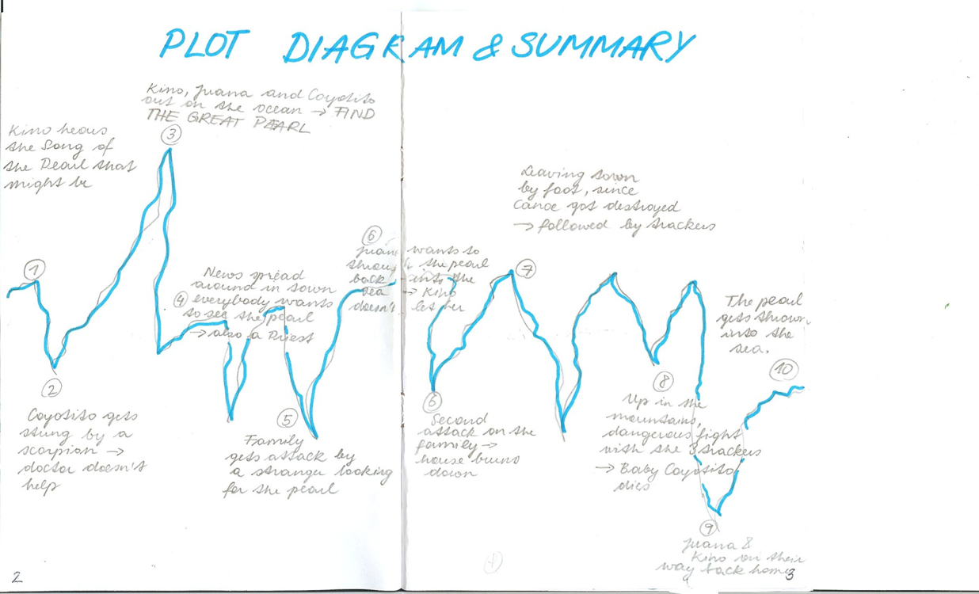
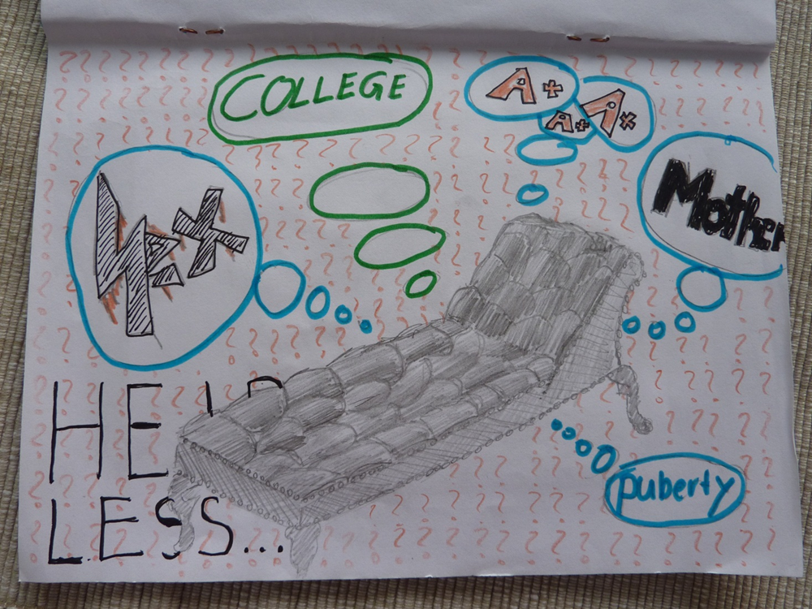
Upper-school Examples
More text-types
Alternative endings
Letters to the author
What I would have done…
Plot diagrams
Interesting quotes
Alternative covers and blurbs

Slide 17

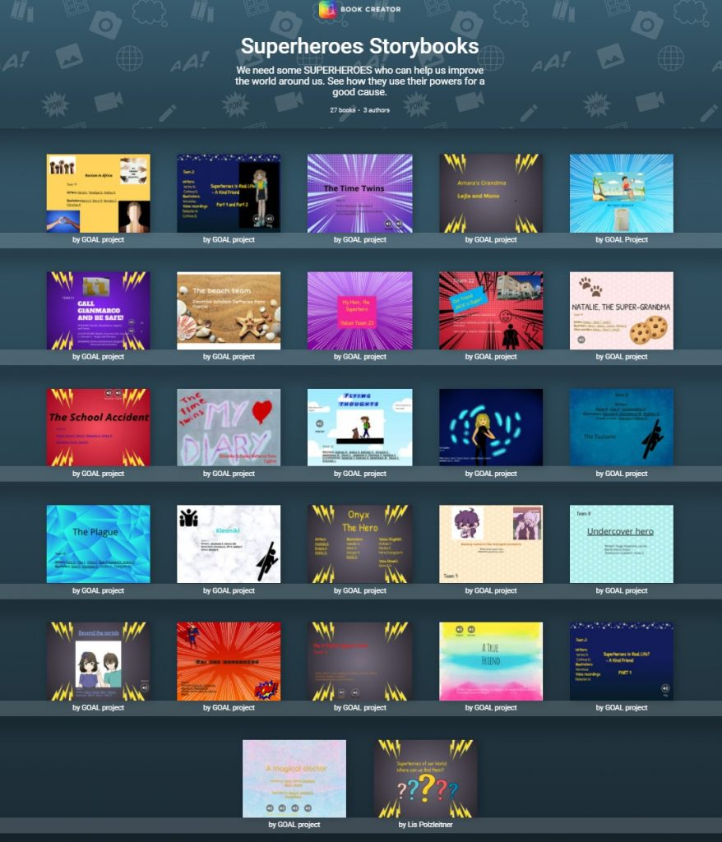
Other formats that wait to be filled creatively
Digital books
Blogs

Slide 18
Where can we give students choice?
Choice
Themes and topics of interest
Resources and materials
Route and strategy: how do you want to learn this?
Real questions: students ask questions based on their own sense of wonder
Product: how do you want to show that you have learned it? (Video, audio, texttype, format…)
Scaffolding: what kind of help do you need? (Textbook, handout, instruction video, peers, teacher…)
Setting and social preferences: groupwork, individual work, quiet place, classroom, outside…
Pace: how much time do you need?
Self assessment: where are you? What will be the next step?

Slide 19

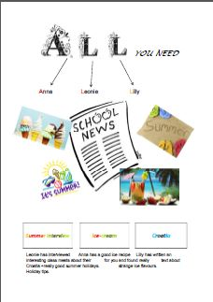
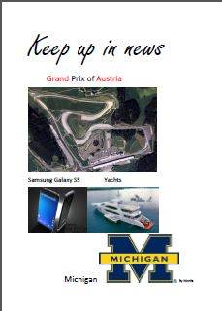


Choice of topic

Slide 20
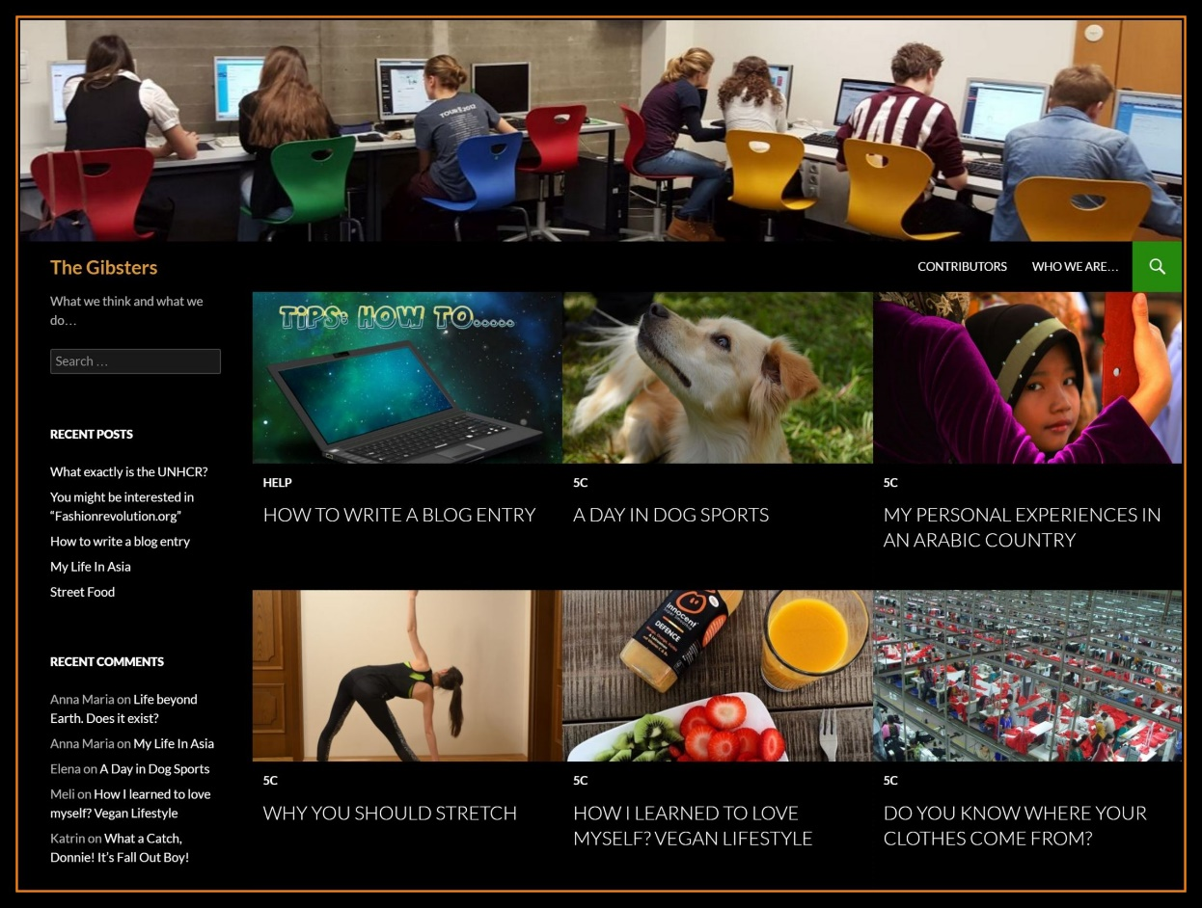
Choice of topic
Blogging
www.gibsters.com

Slide 21
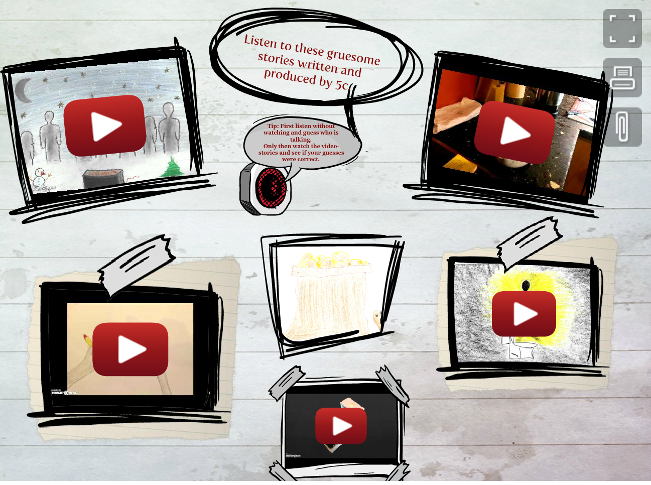
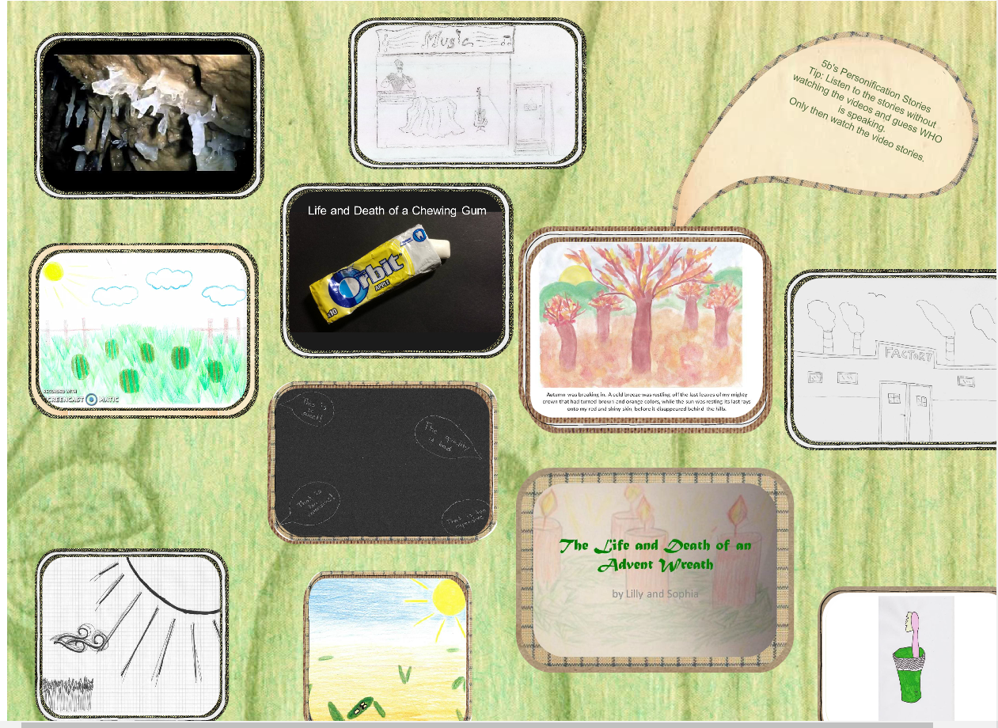
Examples: Upper Intermediate Learners

Slide 22
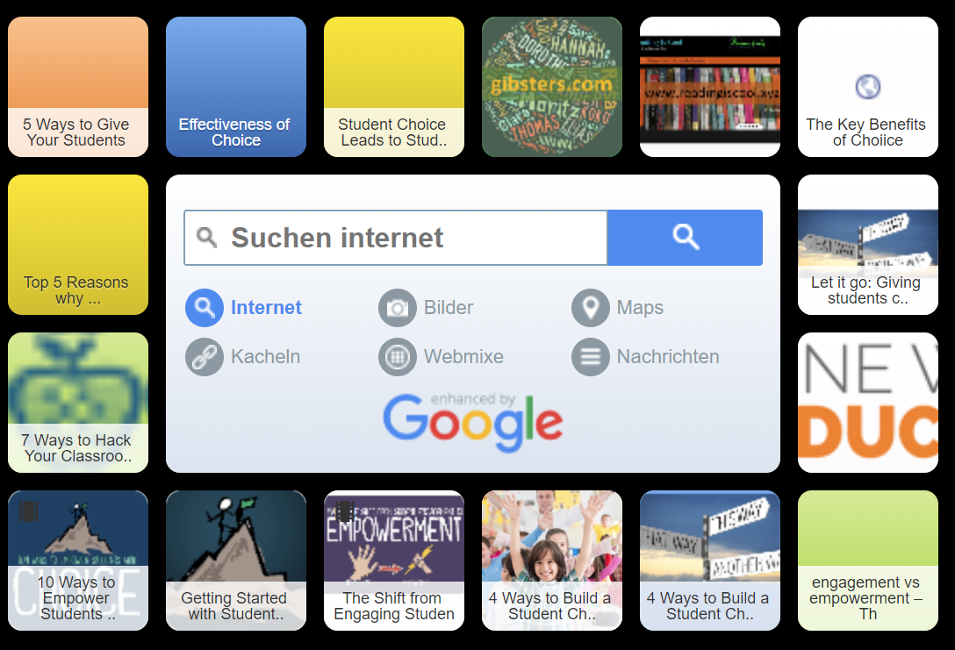
Choice of resources and materials

Slide 23
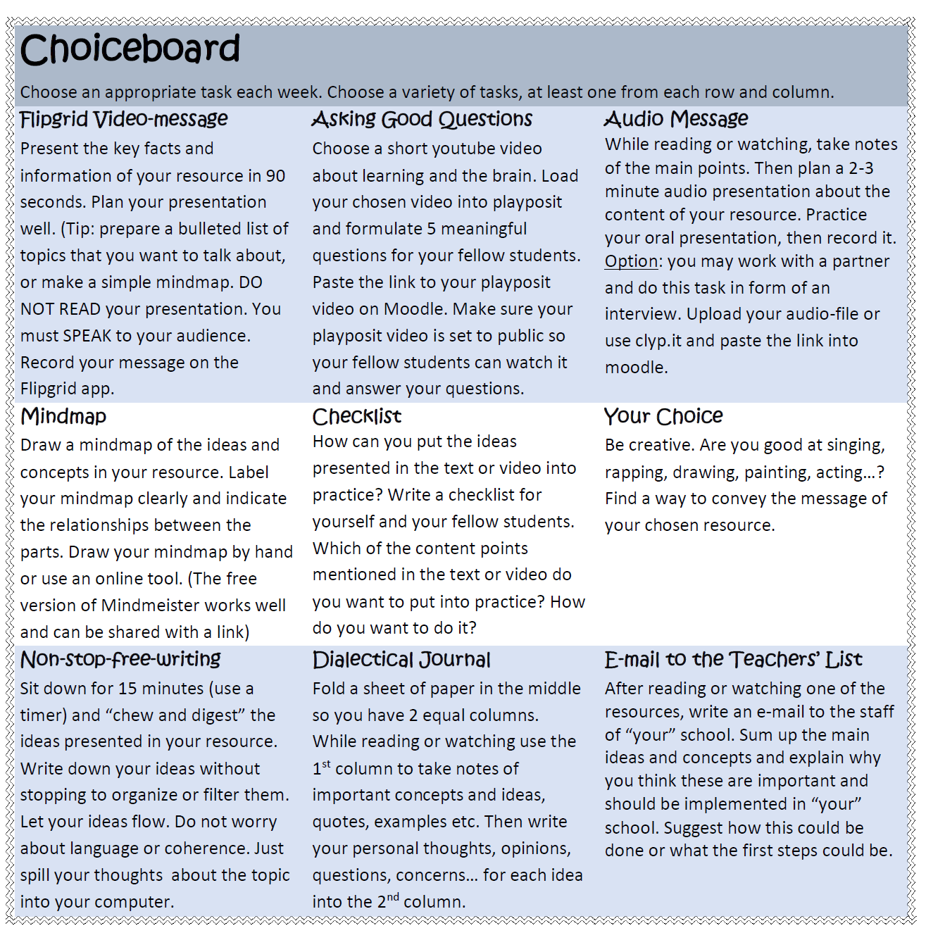
Choice of product

Slide 24
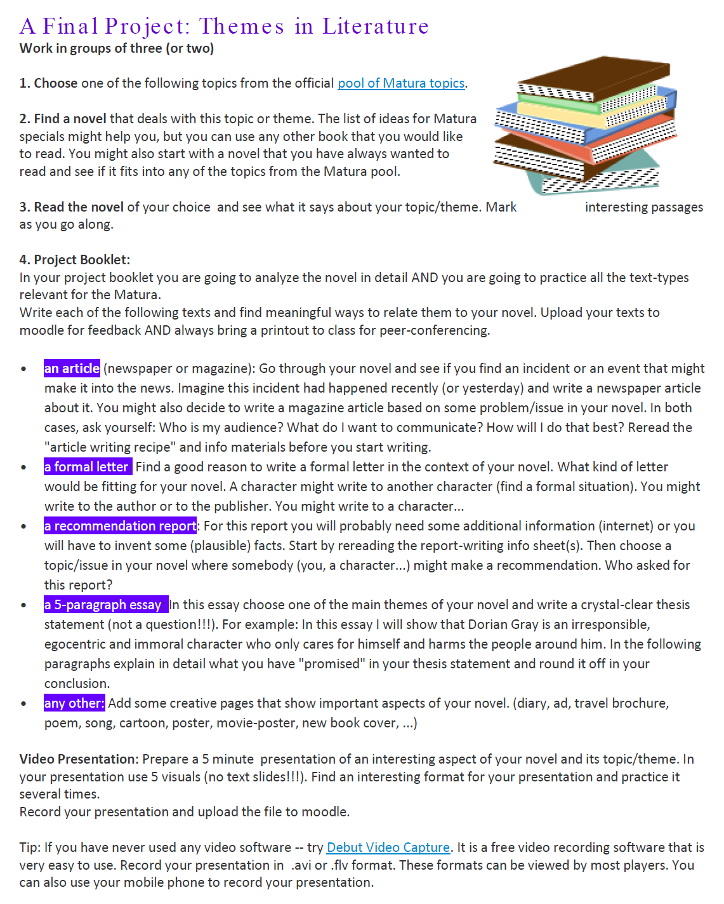
Choice of
resource (book)
and
topic / perspective / message /opinion

Slide 25
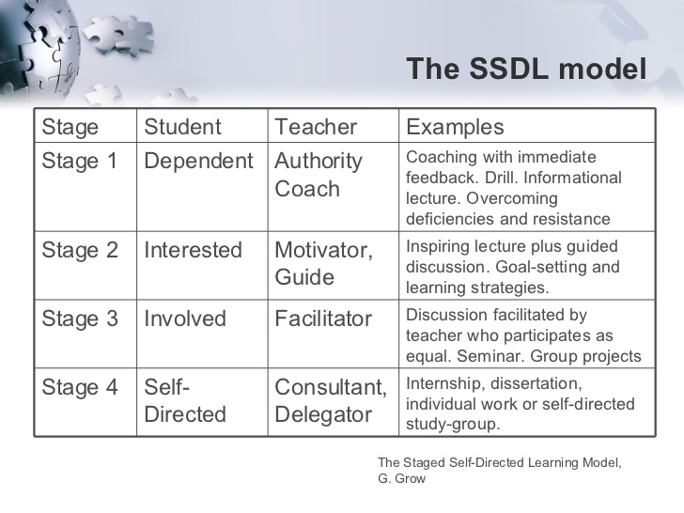

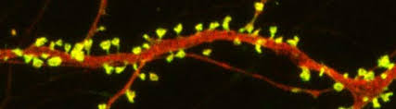
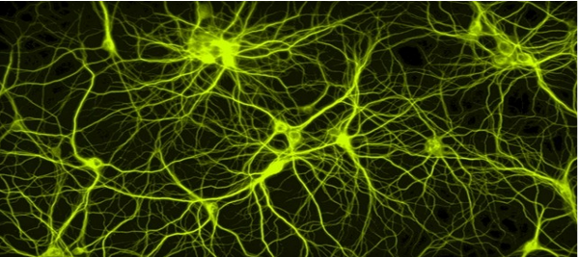
Creating Learning Opportunities in autonomous settings
Focus on a goal and are proud of their products
Actively engage with the topic
Are emotionally involved
Make form-meaning connections
https://www.slideshare.net/bstokes/theories-of-teaching-and-learning-the-staged-selfdirected-learning-model-ggrow

Slide 26
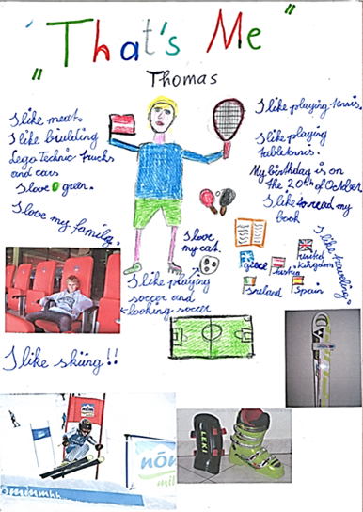
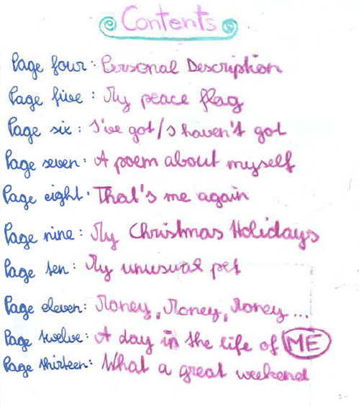
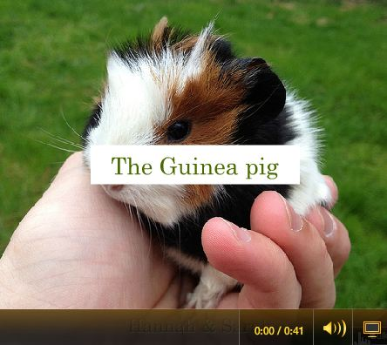
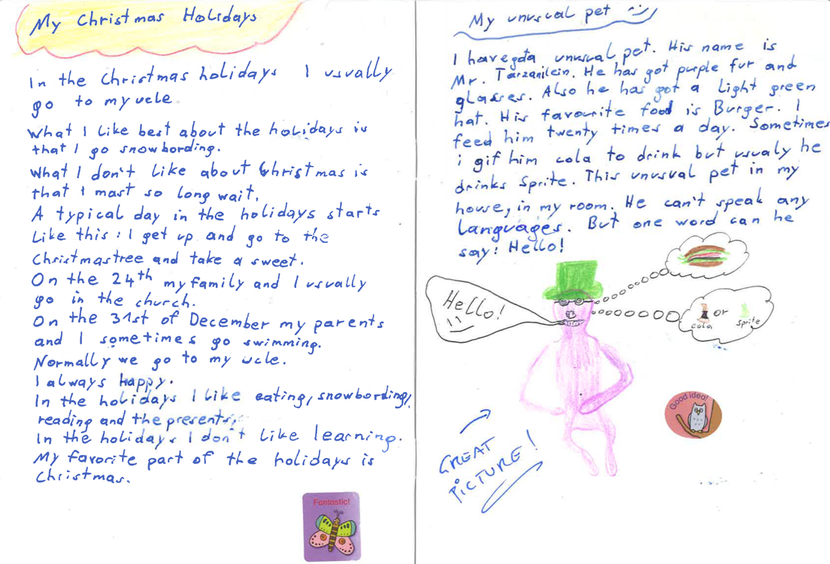
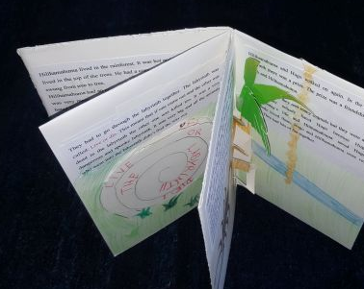
Examples: Ways into autonomous writing

Slide 27
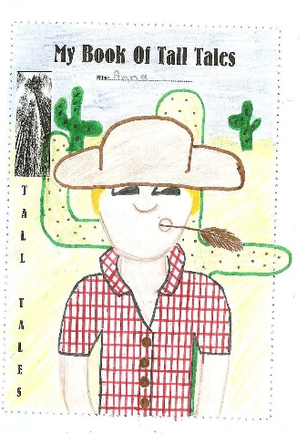




Examples: Lower intermediate writing

Slide 28




In all these projects the learners...
make lots of choices, take decisions
do activities that seem relevant to them
are actively involved and use the language
actively cooperate and communicate with others
persue personal goals and group goals
manage time and resources
are proud of their results
build growth-oriented mindsets

Slide 29

Flexible Timing
Flexible Timing enhanced by digital tools
Notes:
Ich habe in meinem abstract versprochen ein System vorzustellen, in dem Vorbereitungszeit, Ihre Korrekturzeit und Ihr Administrationsaufwand um 50% gesenkt sind, und Sie diese Zeit stattdessen dafür aufwenden können, um mit den Schülern und Schülerinnen einzeln oder in Kleingruppen zu arbeiten, sodass diese besser lernen können?.
Zu schön, um wahr zu sein?
Genau das tun wir in den Flexiklassen der PraxisNMS der PH Steiermark.

Slide 30


The learners work at their own speed
The Moodle platform organizes their steps and progress
Learners have the chance to reach mastery and build a solid foundation for further learning

Slide 31


Systematic presentation of all materials and steps on Moodle
Ziele
Produktive Abschlussaufgaben
FoF, Listening, Reading
https://www.eduvidual.at/my/
Notes:
12 Module für 2 Jahre

Slide 32

Practice activities for all 4 skills
HILFE
Wiederholung
Leseverstehen
Sprechen

Slide 33

Liveworksheets.com
Reading
Listening
Videos
drag-and- drop
gapfilling
order a jumbled text
immediate feedback
flexible design

Slide 34




Learningapps.com
KEY
H5P exercises

Slide 35

Speaking tasks online
z.B. Sprechaufgaben
z.B. Sprechaufgaben

Slide 36



Book chats and book presentations in class and online

Slide 37


Tests for FoF and receptive skills online
The students choose WHEN to take the test
Less stress, the learners can retake a similar test if they fail....
New role of the teacher!

Slide 38



Wrap-it-up tasks: Writing and Speaking

Slide 39

Advantages for the learners
Learners decide how much practice they need and when / where they want to do it.
Interactive exercises
More intensive speaking practice with online speaking tasks (Flipgrid)
Immediate feedback for all closed formats
FoF and grammar exercises
Listening (audio and video)
Reading
Learners have a clear understanding of
The learning goals and objectives
The learners see their progress clearly
Feedback and grading is always accessable to the learners

Slide 40


More advantages for the learners
For fast learners
No waiting time
Experience of success
Time for more depth for fast learners
Work at different readiness levels
For slower or struggling learners
The learning goals can be reached because they get more time
Experience of success
Time to develop real understanding
3rd year: in the same social group
AHS level can be reached– further schooling is possible

Slide 41


Transparent documentation of the learning goals each student has reached

Slide 42


Teachers know exactly who needs help and how far students are

Slide 43



The teacher is free to work with individuals and small groups Tea and talk, Book chats, individual help

Slide 44

High success rate in spite of challenging circumstances

Slide 45




Would „Flexi“ be possible without digital tools?
Not really, because…
Teachers would not have a clear overview of each learner‘s progress
Activities can be repeated as necessary. Additional exercises are available
Solutions and immediate feedback for all closed exercises are provided online
Learners have access at any time and any place and can do extra work at home.
Perfect system for distance learning during lockdowns

Slide 46

The End
Thank you for your attention.
For more ideas and examples visit
http://epep.at

Slide 47



Time for questions

Slide 48


Let‘s take a first step…
Which of the ideas in this presentation seem most relevant for your own teaching?
Plan one first step to give your students more choice: what is it going to be?
This Photo by Unknown Author is licensed under CC BY-NC-ND
This Photo by Unknown Author is licensed under CC BY-SA

Slide 49




Browsing student products
You now have 10 minutes to look at different examples of booklets in detail.
Collect any questions and comments that you would like to discuss.

Slide 50
References
Benson, P. (2001). Teaching and Researching Autonomy in Language Learning, Harlow: Pearson Education
Littlewood, W. (1996). "Autonomy”: an anatomy and a framework. System, 24/4, 427-435. Quoted from: http://www.finchpark.com/afe/l.html, 19.05.2012
Nunan, D. (1997). Designing and adapting materials to encourage learner autonomy. In P. Benson, & P. Voller. Autonomy and Independence in Language Learning. Harlow: Longman, 192 - 203.
Willis, D. and Willis J. 2007. Doing Task-based Teaching, Oxford: Oxford Handbooks for Language Teachers
Zehnpfenning, H. und Zehnpfenning H. 2008. online: http://www.zeugner.at/files/nachlese/010909/Go_OffUnt_Didaktik_des_weissen_Blattes.pdf

