Slide 1
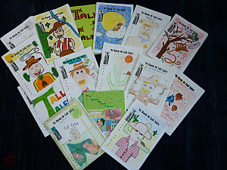
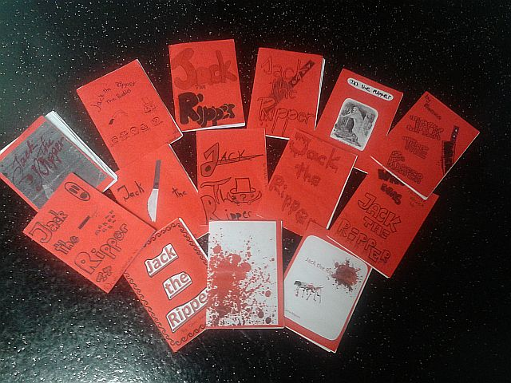
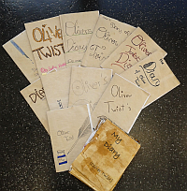
Creative Booklets
The Pedagogy of the Blank Sheet
Dr. Elisabeth Pölzleitner
GIBS: Graz International Bilingual School
and
Institut für Anglistik, Uni Graz

Slide 2
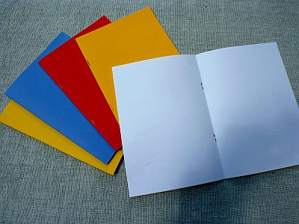
Overview
The Setting
My Goals
Theoretical Framework and Background
  Language learning and language acquisition theories
  Neuroscientific findings about learning
  Transactional approach to reading,: constructivist meaning-making
  Task-based learning (TBL) and Learner Autonomy
H. and H. Zehnpfennig‘s pedagogy of the blank sheet
  The reading-writing connection
  Practical Examples
    Reading projects for different age-groups
    Oral formats of the same idea
      Video-presentations
    Bookmaking
      Online books (using bookr and Jing)
Exploring learner products
Discussion and questions

Slide 3
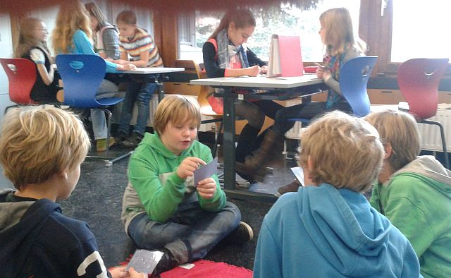
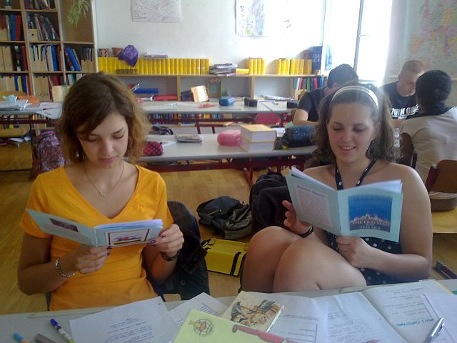
The Setting
Learners at secondary school (ages 10 – 18)
Groupsize: ~25 students in each class
English lessons only (no open learning periods)
Workshops about 90% of the time
No use of textbook
Mainly TBT (task based teaching) (Willis 2007)

Slide 4

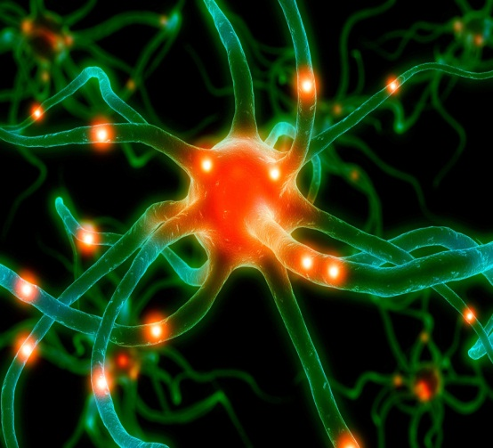
My goal: bridging the gap between
BIST /CEF ….. and ….higher order skills /learning for life
Lernen ist ein ganzheitlicher Prozess. Dauerhaftes Lernen findet nur in bedeutungsvollen Kontexten statt. Emotionale und soziale Aspekte des Lernens spielen eine mindestens ebenso wichtige Rolle für das Schulgeschehen wie die intellektuell-kognitiven.
(Bauer, Spitzer , Hüther, Roth, in Caspary 2006) (Zull 2002: 224 ) Macedonia M.
BIST/CEF competences
  output orientation and testability
  4 skills
  texttypes
Education for life
  learner centered
  skills for life-long learning
  higher order skills
  social skills and transcultural understanding
  curiosity and openness
  experimenting and hypothesis building
Der Schüler ist kein Nürnberger Trichter, erst recht kein wandelnder Aktenordner, und der Lehrer kein blutleeres Wissenslexikon. (Bauer 2006: 47)

Slide 5
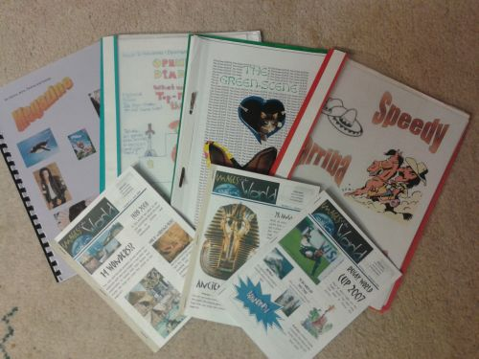
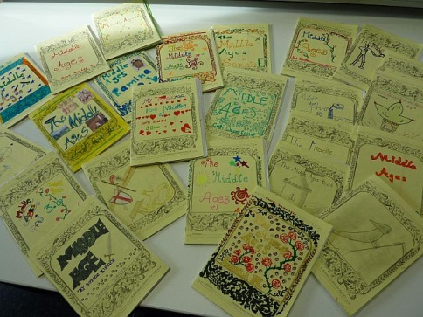
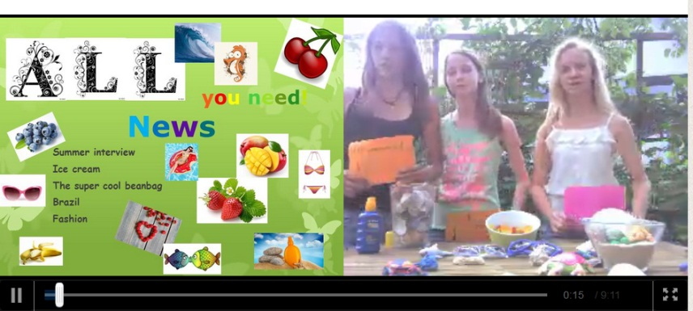

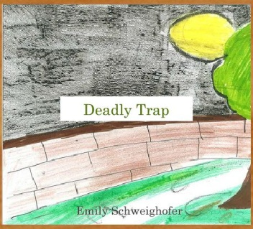
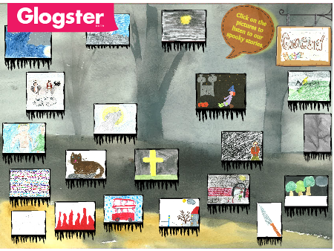
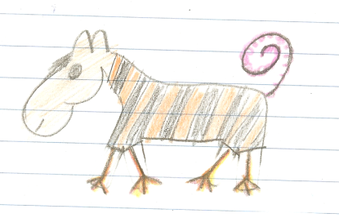
TBT: Task Based Teaching
„A piece of classroom work which involves learners in comprehending, manipulating, producing, or interacting in the target language while their attention is principally focused on meaning rather than form.“ (Nunan 1989)
Tasks vs Exercises (Willis 2007)
  Does the activity engage learners‘ interest?
  Is there a primary focus on meaning?
  Is there an outcome?
  Is success judged in terms of outcome?
  Is completion a priority?
  Des the activity relate to real world activities?

Slide 6
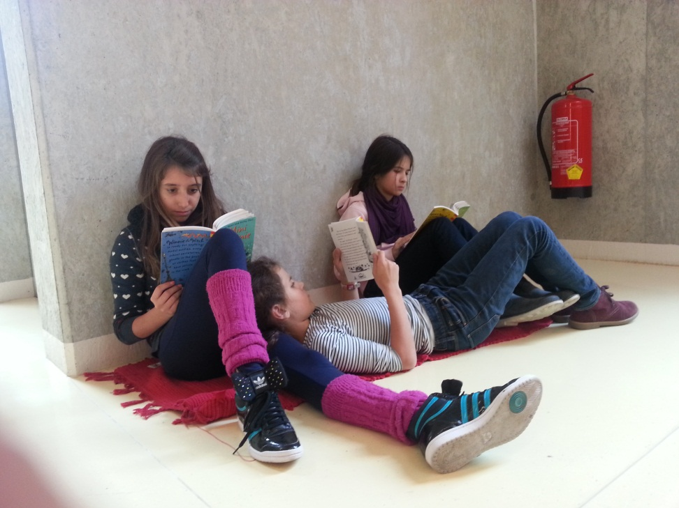
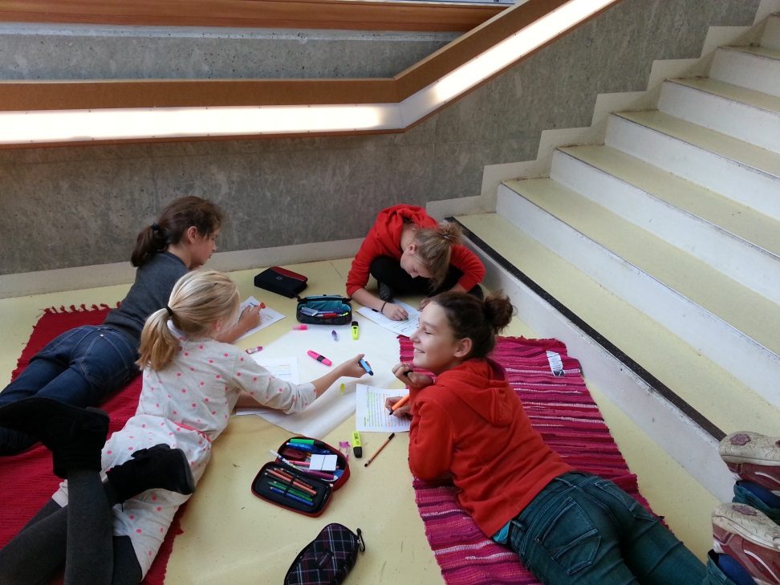
Literature can bridge the gap
dialog between reader and text
emotional involvement/
affective filter
mirror neurons
natural language ACQUISITION
change of perspective
active construction of meaning
genuine interest
identification and empathy
social interaction
curiosity
(acetylcholine)
building and testing hypotheses
i + 1
comprehensible input
idiomatic use of grammar, pattern building
vocab expansion
transcultural understanding
text writing skills
(Bland J. & Lütge: 2013) (Bredella &Hallet: 2007) (Krashen: 2011) Delanoy ( )
Notes:
Rezeptionsästhetik nach Bredella,

Slide 7

Fostering learner autonomy
„Our job is to create learning opportunities, not to impose a method“ There‘s more than one way to learn a language.“
(Benson 2001)

Slide 8

The pedagogy of the blank sheet
Hannelore and Helmut Zehnpfennig (2009)
No use of textbooks
Reduction of materials and input
Basic reference materials or online search
The blank sheet: no tasks, no questions, no instructions
Forces learners to actively search for meaning, fosters learner creativity, problem solving and interaction, encourages the construction of meanings and concepts

Slide 9

Das weiße Blatt
„Unser wichtigstes Arbeitsmaterial ist das weiße Blatt Papier, unseres Erachtens das
kreativste Material, das es gibt. Es stellt "wahrscheinlich die größte Herausforderung
an die Imagination der Kinder dar" stellt Peschel (1996, S.38) fest, nachdem er unsere
"Pädagogik des weißen Blattes" kennengelernt hatte. Das leere Blatt fordert oder
provoziert geradezu die kindliche Phantasie es zu füllen. Wie, das sagt ihm weder das
leere Blatt, noch sagen wir´s. Das Kind muss selber entscheiden und gestalten. Ein
Arbeitsergebnis ist zu dokumentieren, ein Sachthema zusammengefasst
darzustellen, um in ein gemeinsames Buch zu kommen. Welche Informationsquellen
benutzt werden und wie, überlassen wir vollständig dem Kind. (Zehnpfennig/ Zehnpfennig
1992)“
FIP: Format, Imagination and Pride
clear, attractive formats invite creative work
high expectations and attractive „packaging“ lead to high quality work

Slide 10
Creative Booklets
The Pedagogy of the Blank Sheet
FIP
Format – Imagination -- Pride

Slide 11
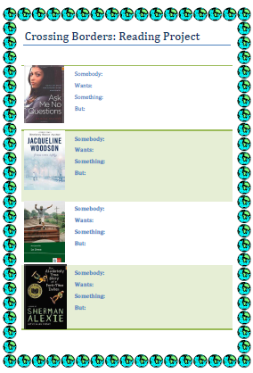
Reading projects for different age groups
Typical steps
Bookchoosing
Reading stage
Discussion and project-work in groups
Presentation phase:
  Open tasks: written and/or oral production

Slide 12
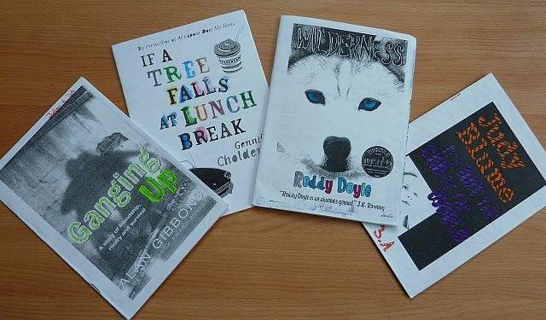
Example: Reading project year 3

Slide 13
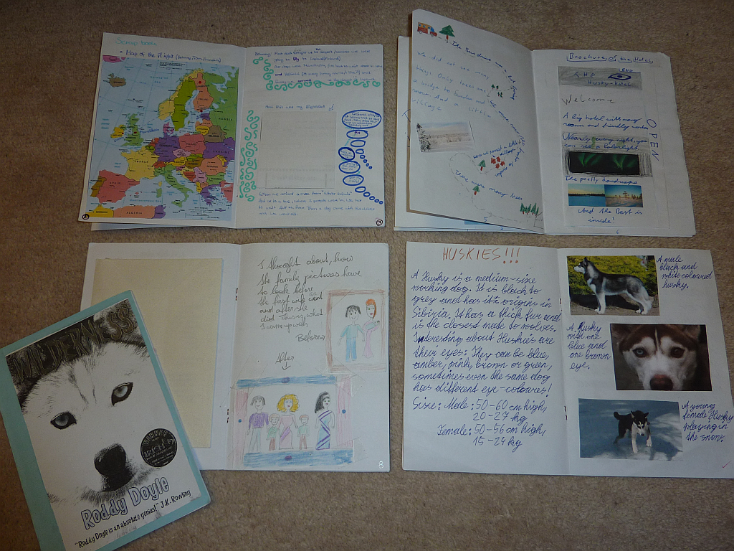

Slide 14
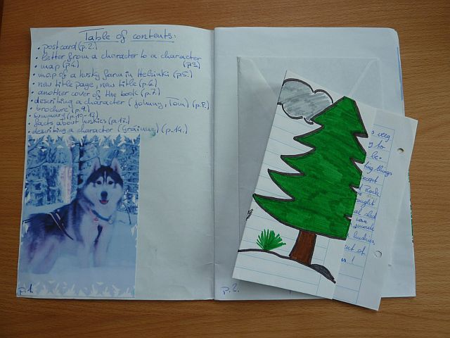
Table of contents

Slide 15
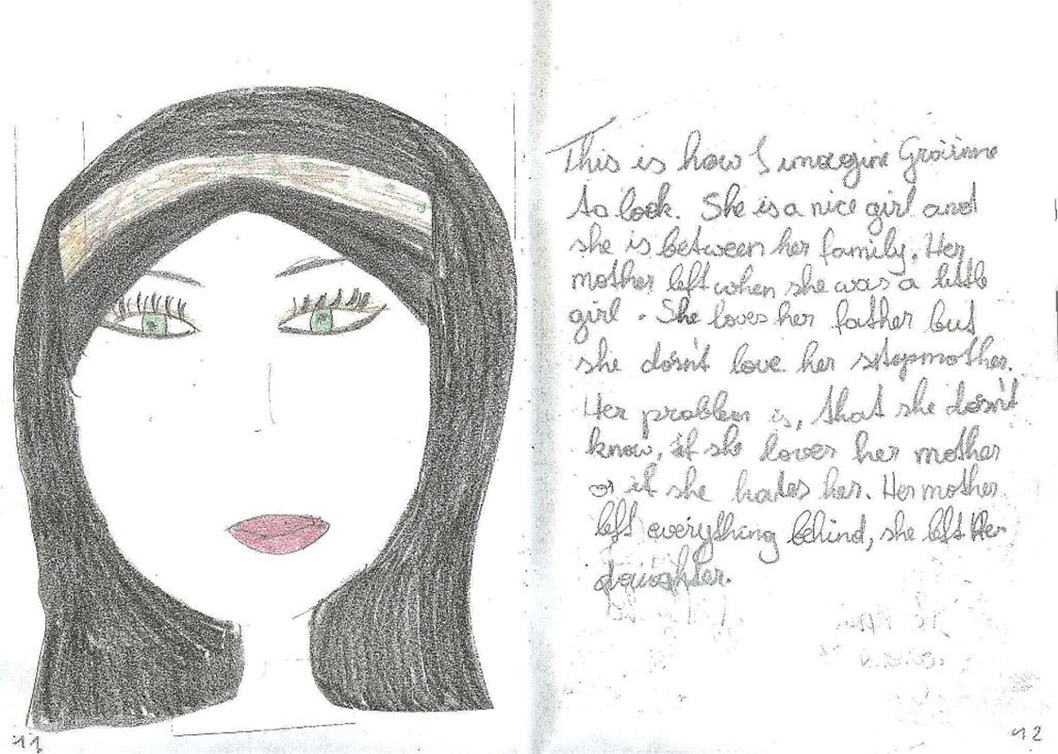
Character portraits

Slide 16
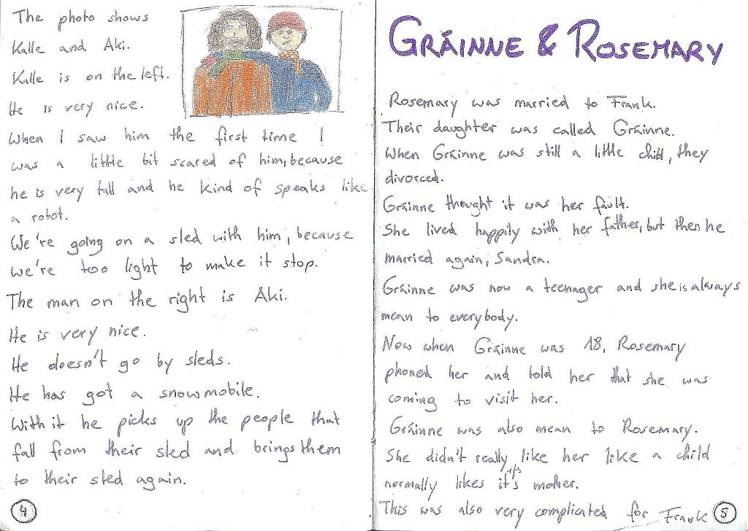
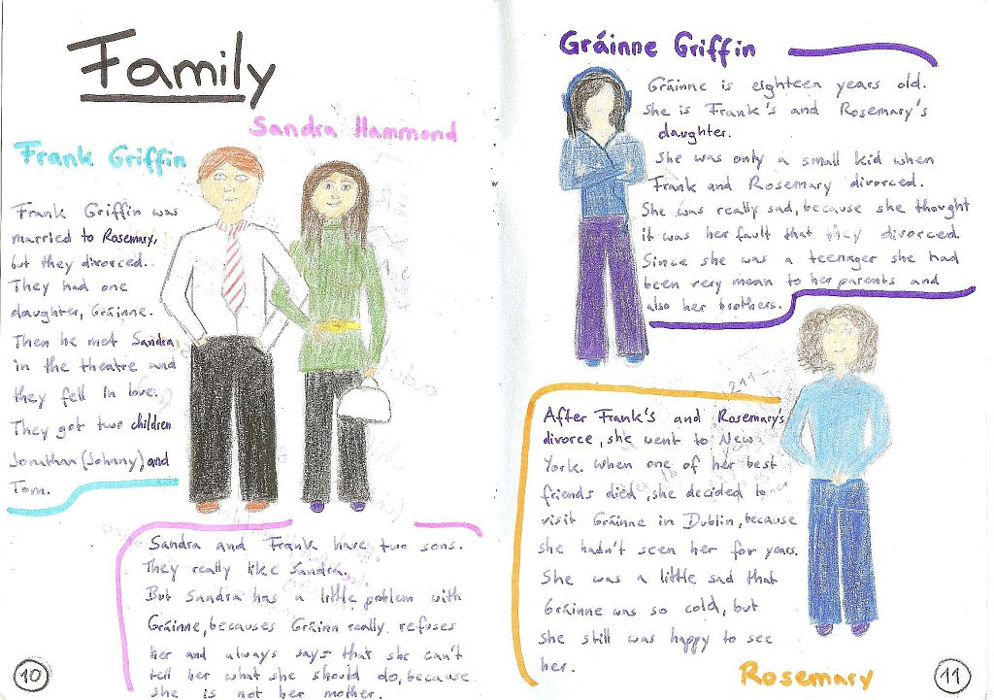

Slide 17
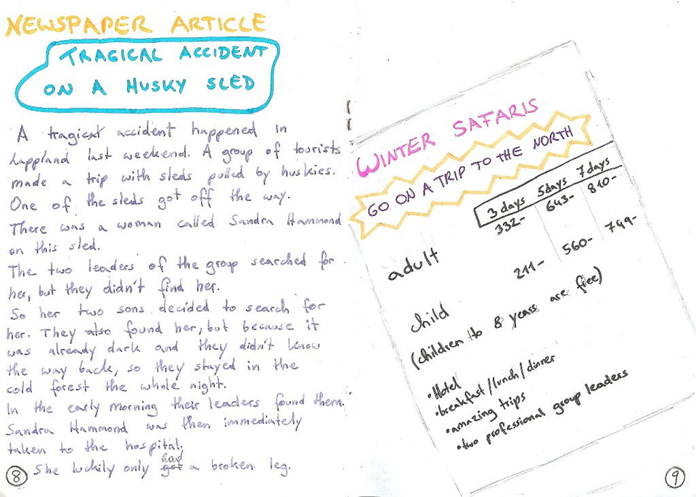
Newspaper articles and ads

Slide 18

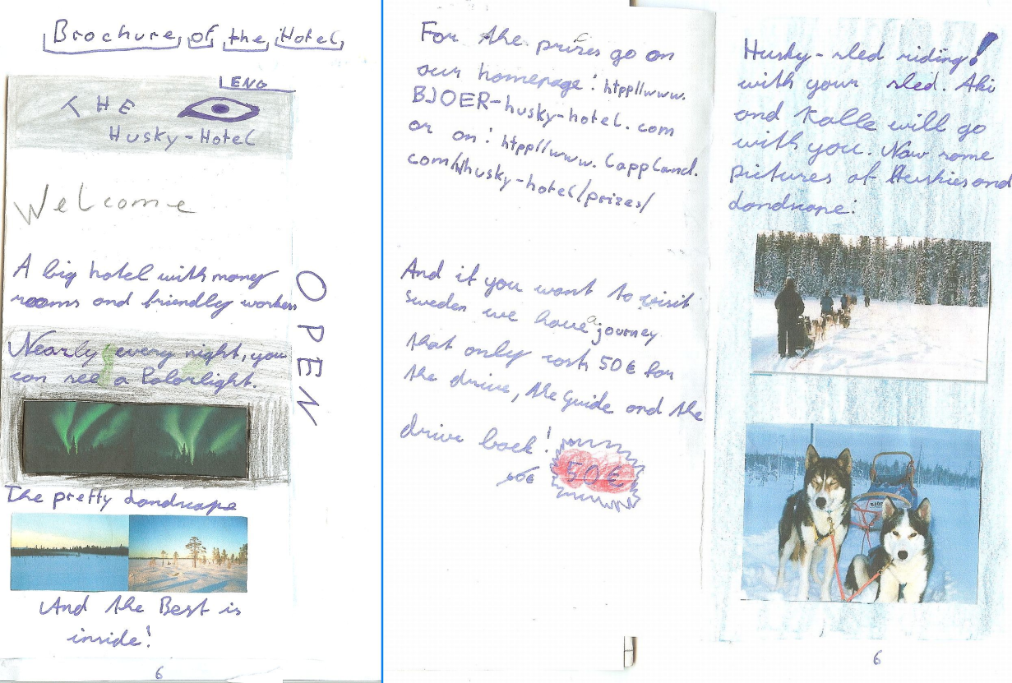
Ads and brochures

Slide 19
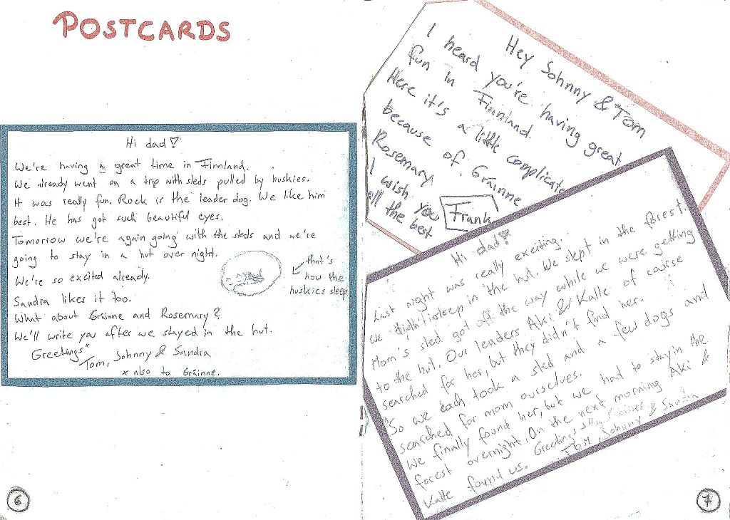
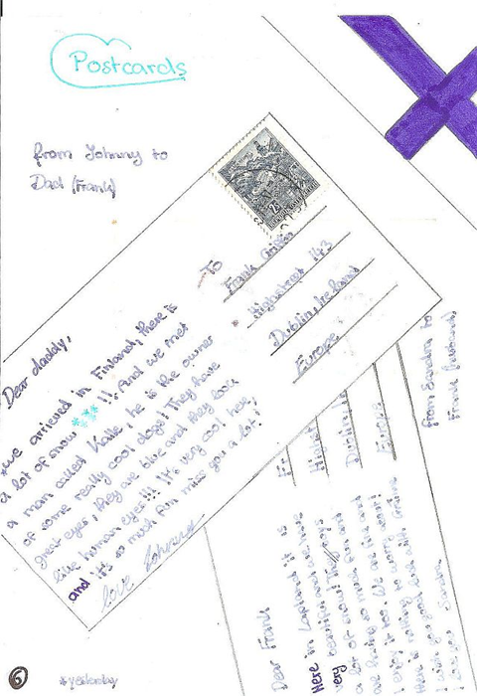
Letters and postcards

Slide 20
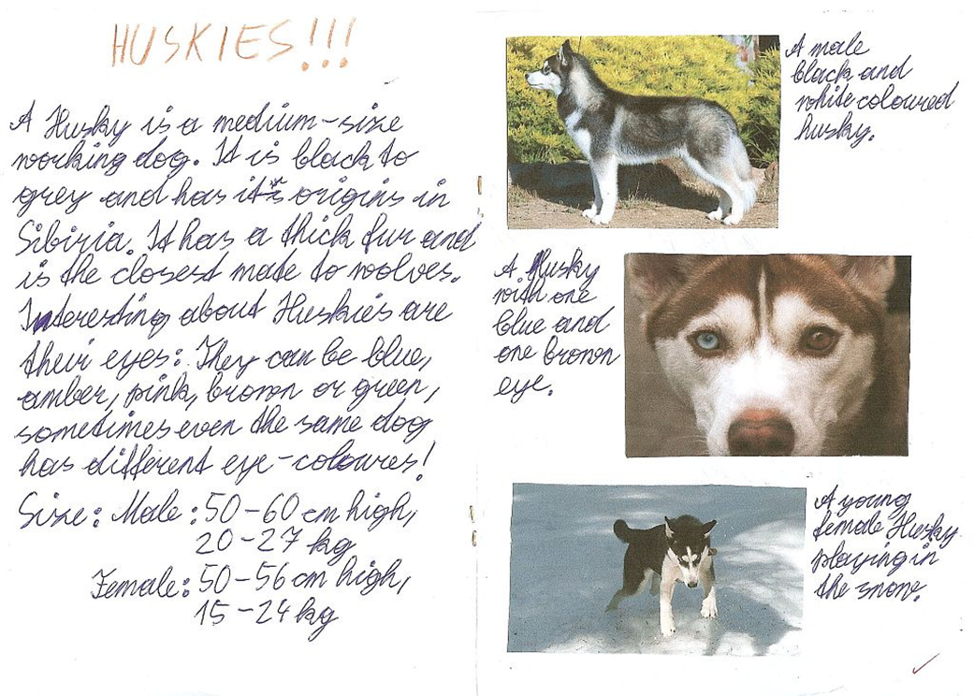
Background information and research

Slide 21
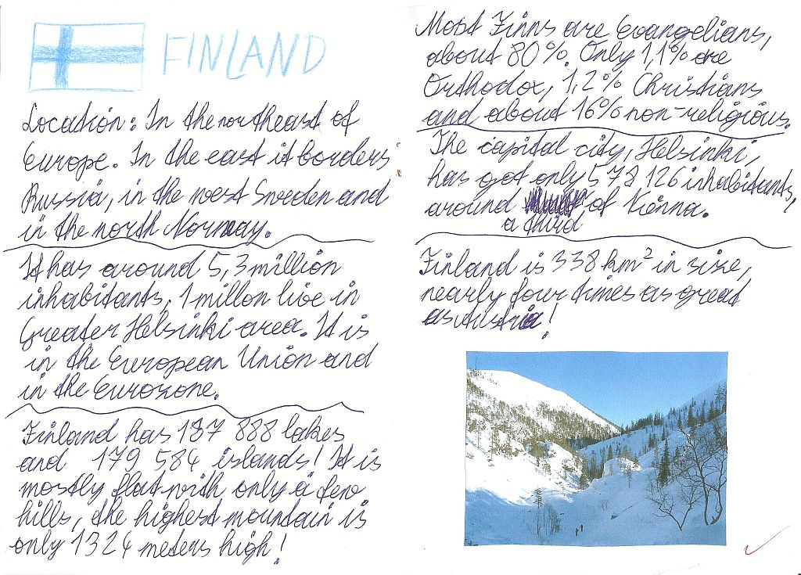

Slide 22
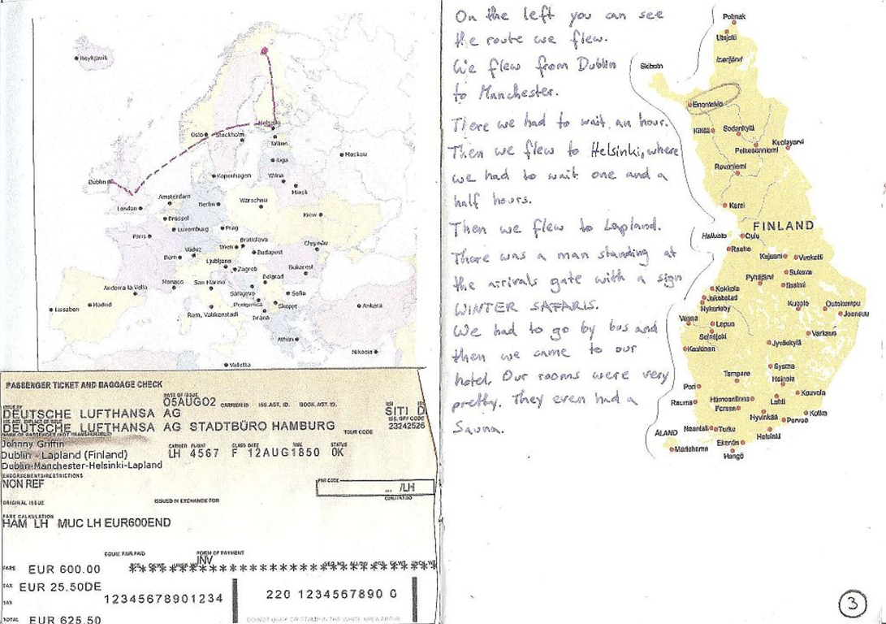
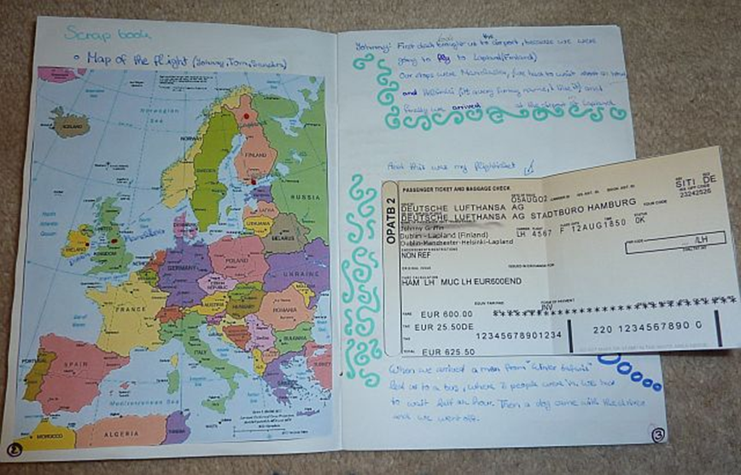
Maps and tavel information

Slide 23
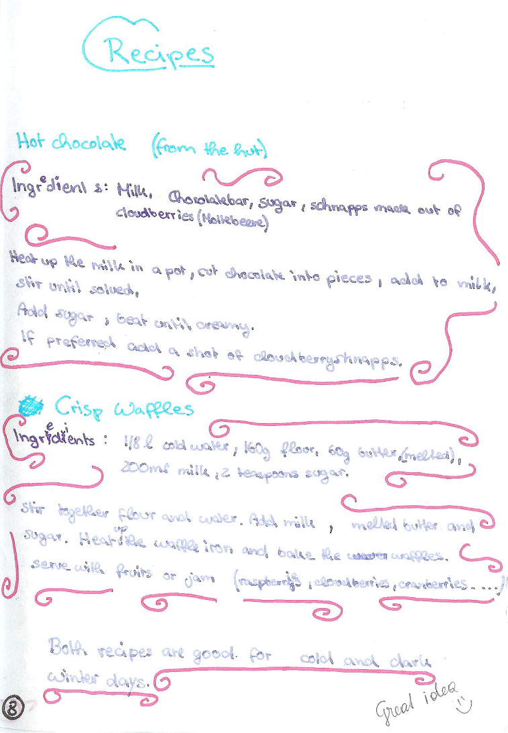
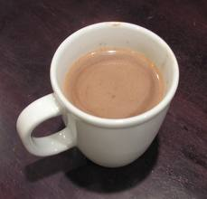
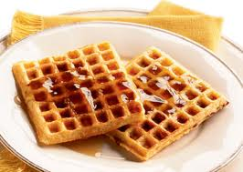
Food and Recipes

Slide 24
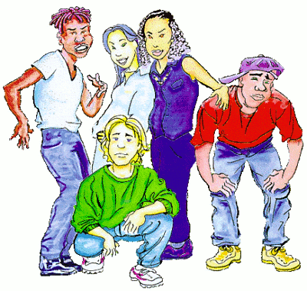
Example year 4: Teens in Trouble
Choice of books
Holes
Stone Cold
Gangsta Rap
Boot Camp

Slide 25
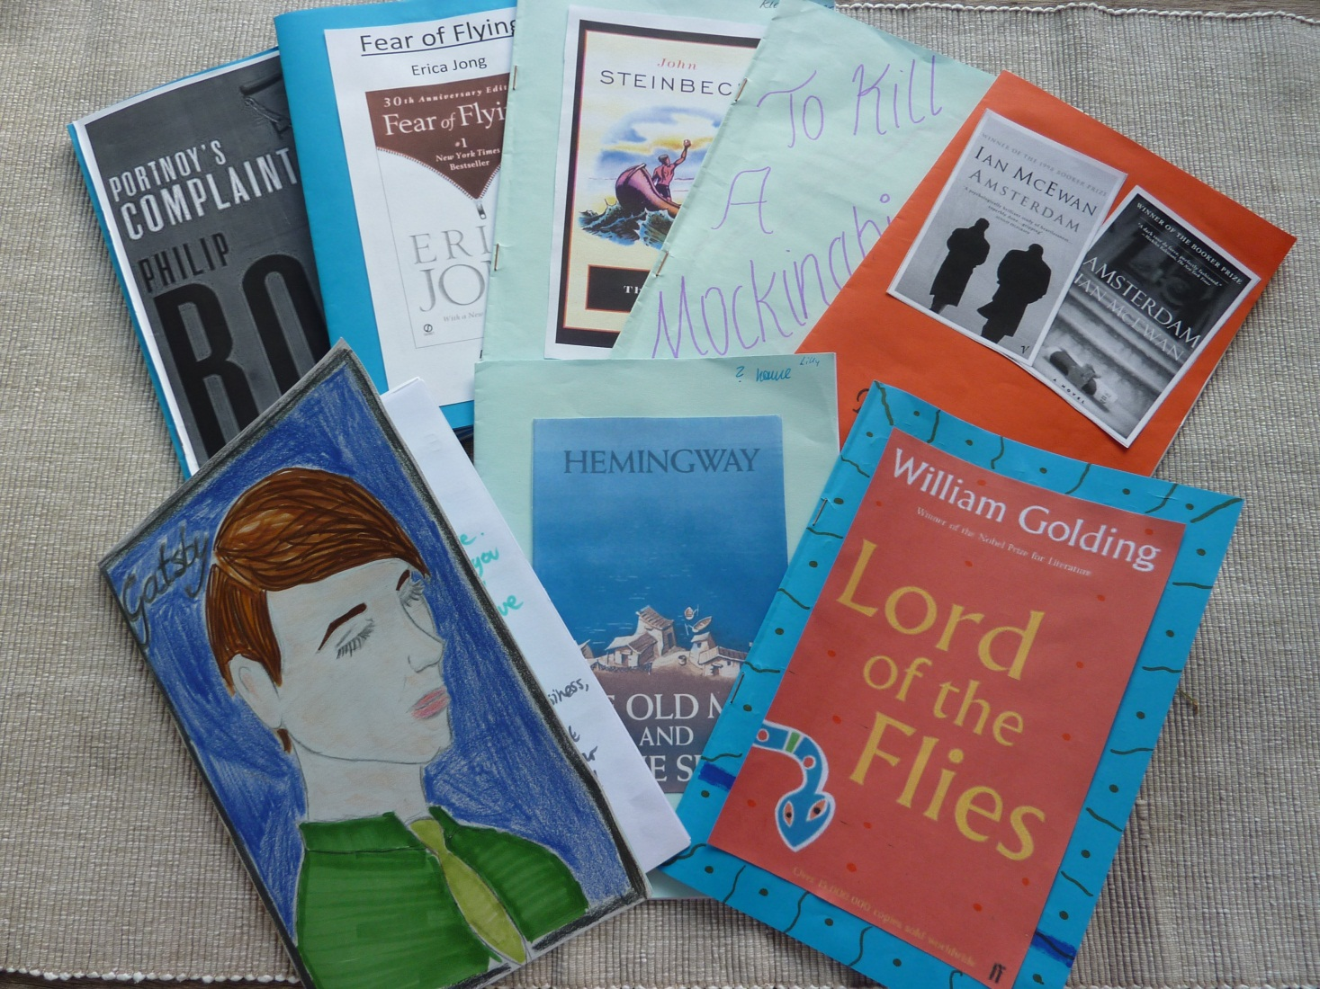
Upper-school Examples

Slide 26
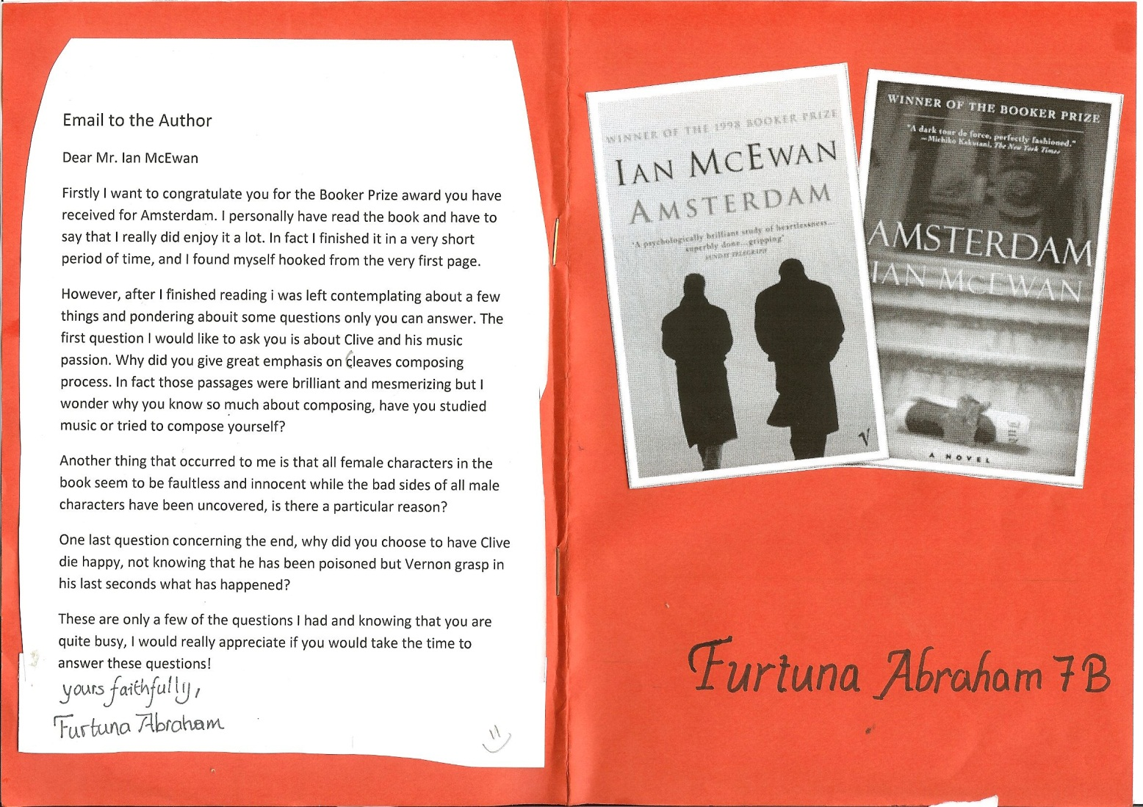
Cover page and letter to the author

Slide 27
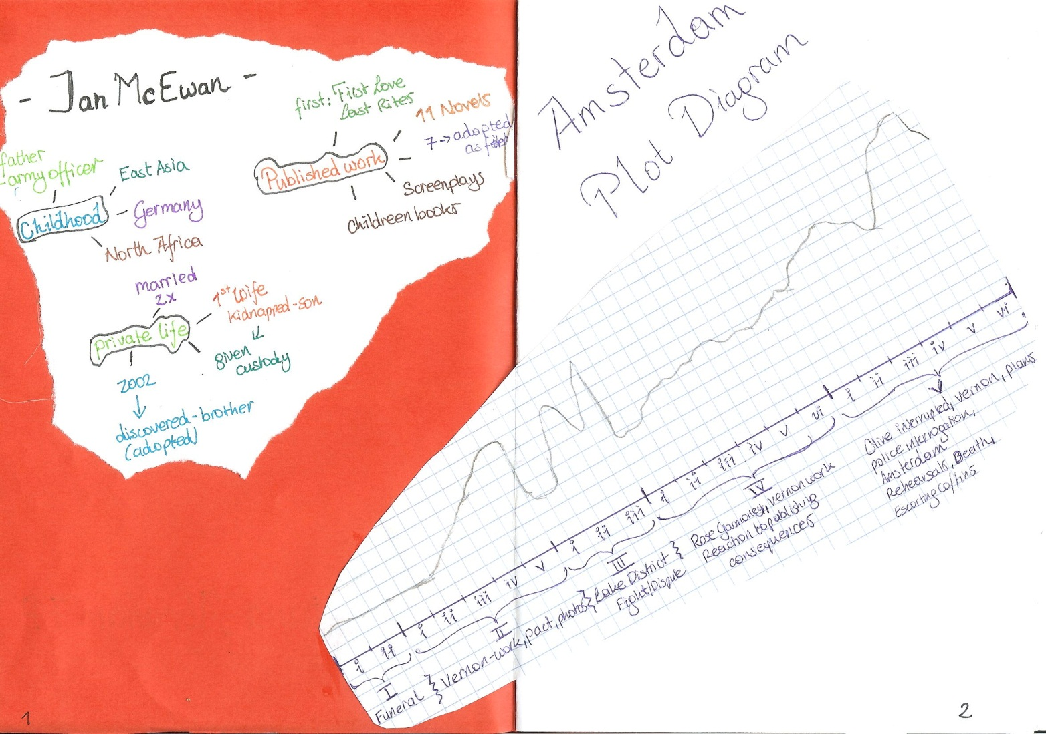
Author info and Plot diagram

Slide 28
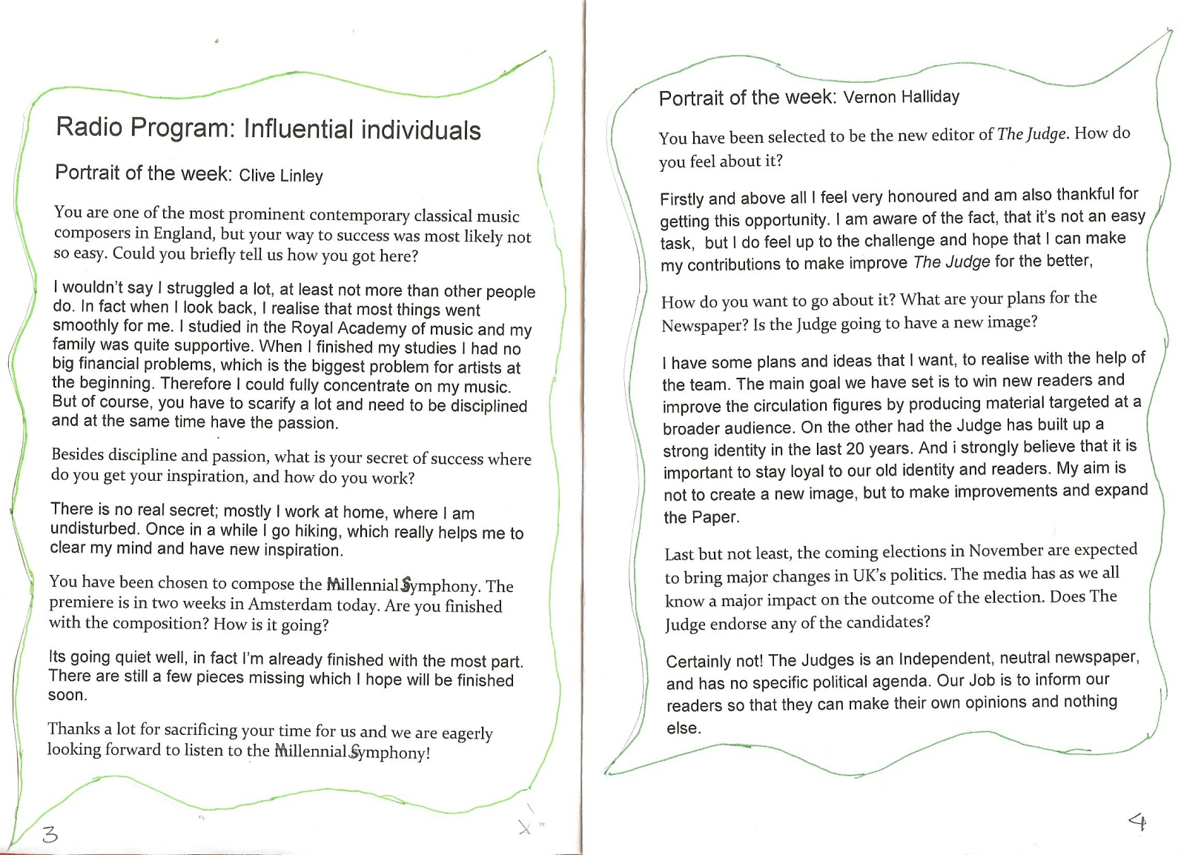
Character portraits

Slide 29
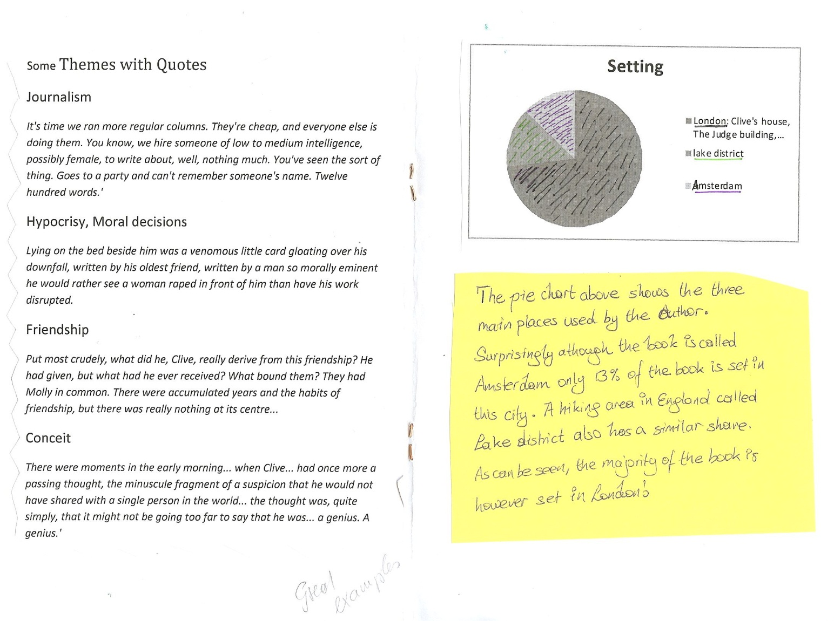
Quotes and Setting

Slide 30
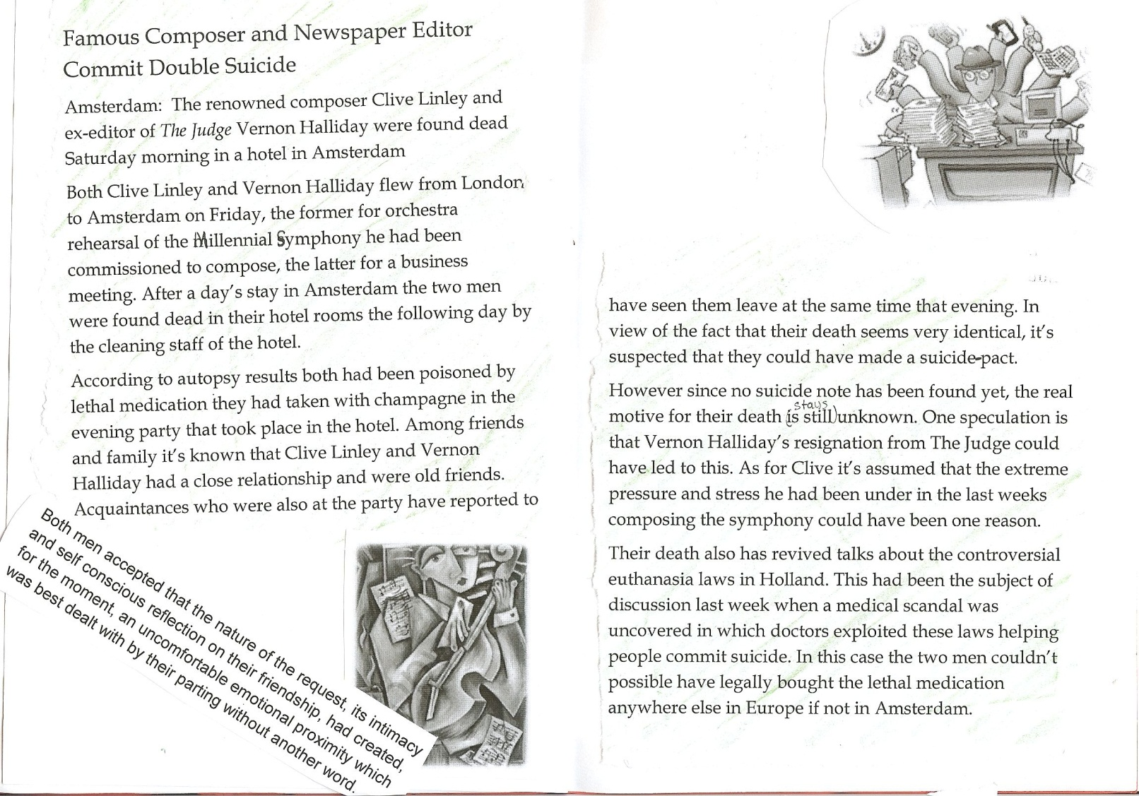
Newspaper article

Slide 31
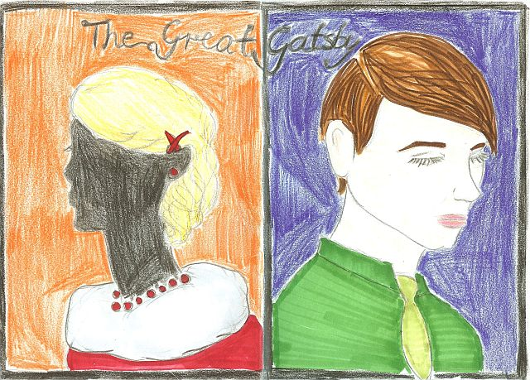
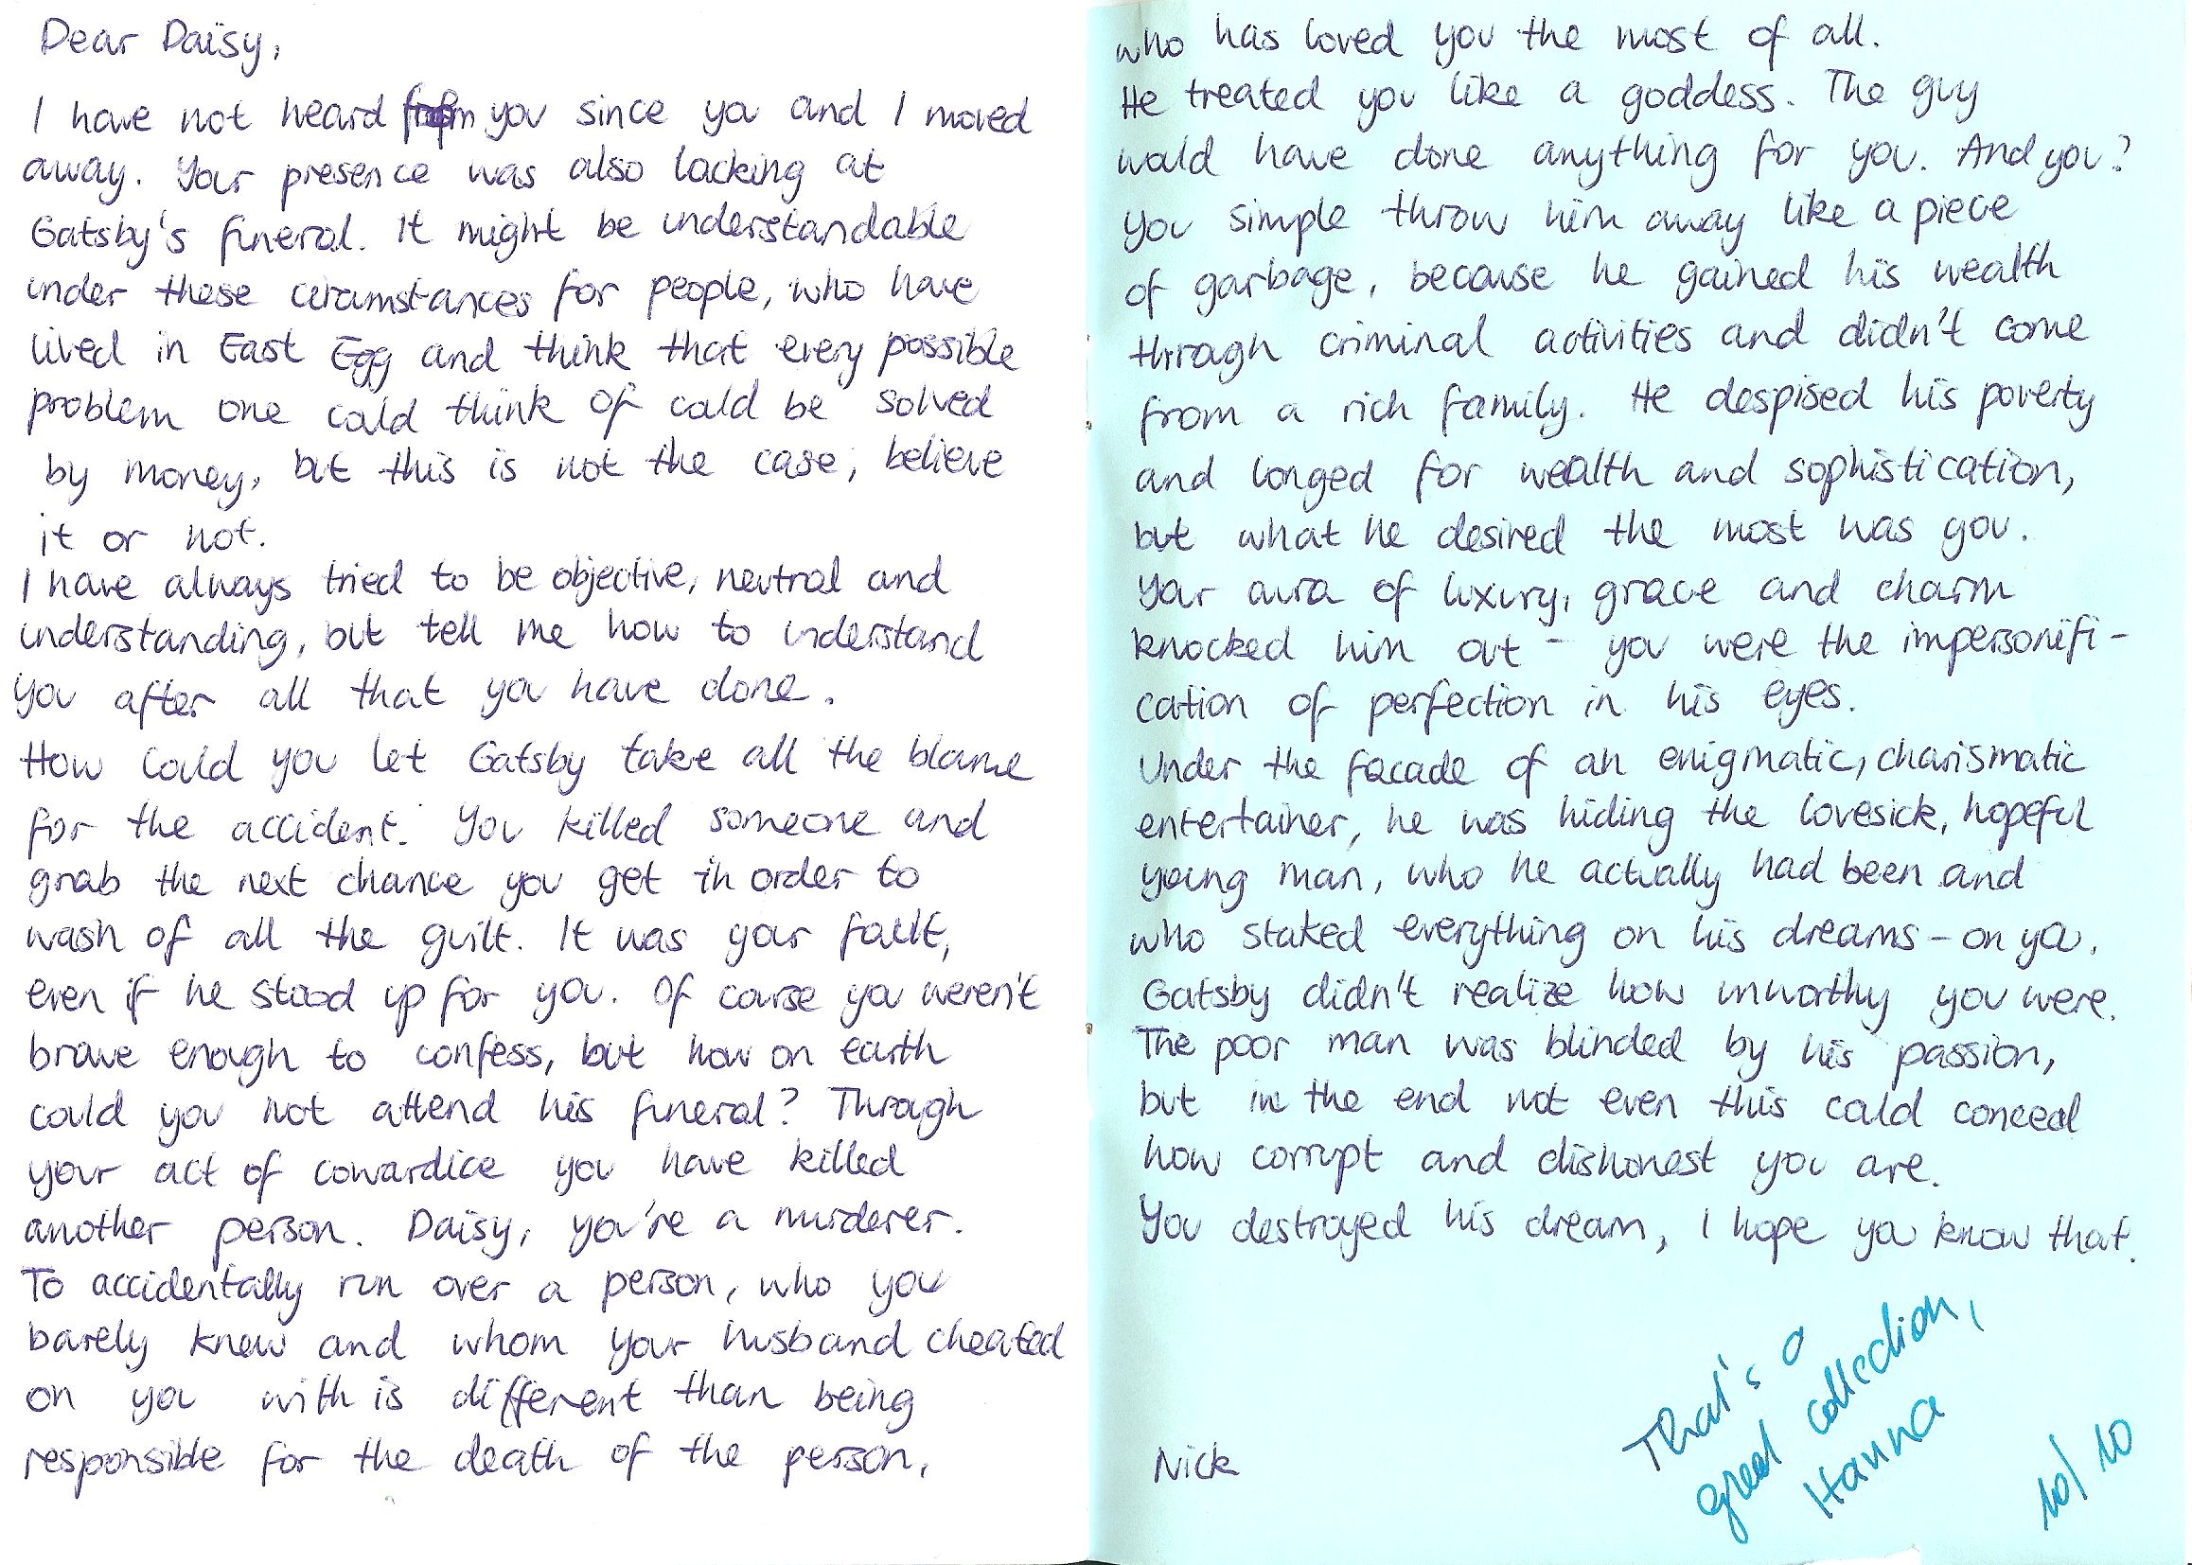
Diary entries

Slide 32
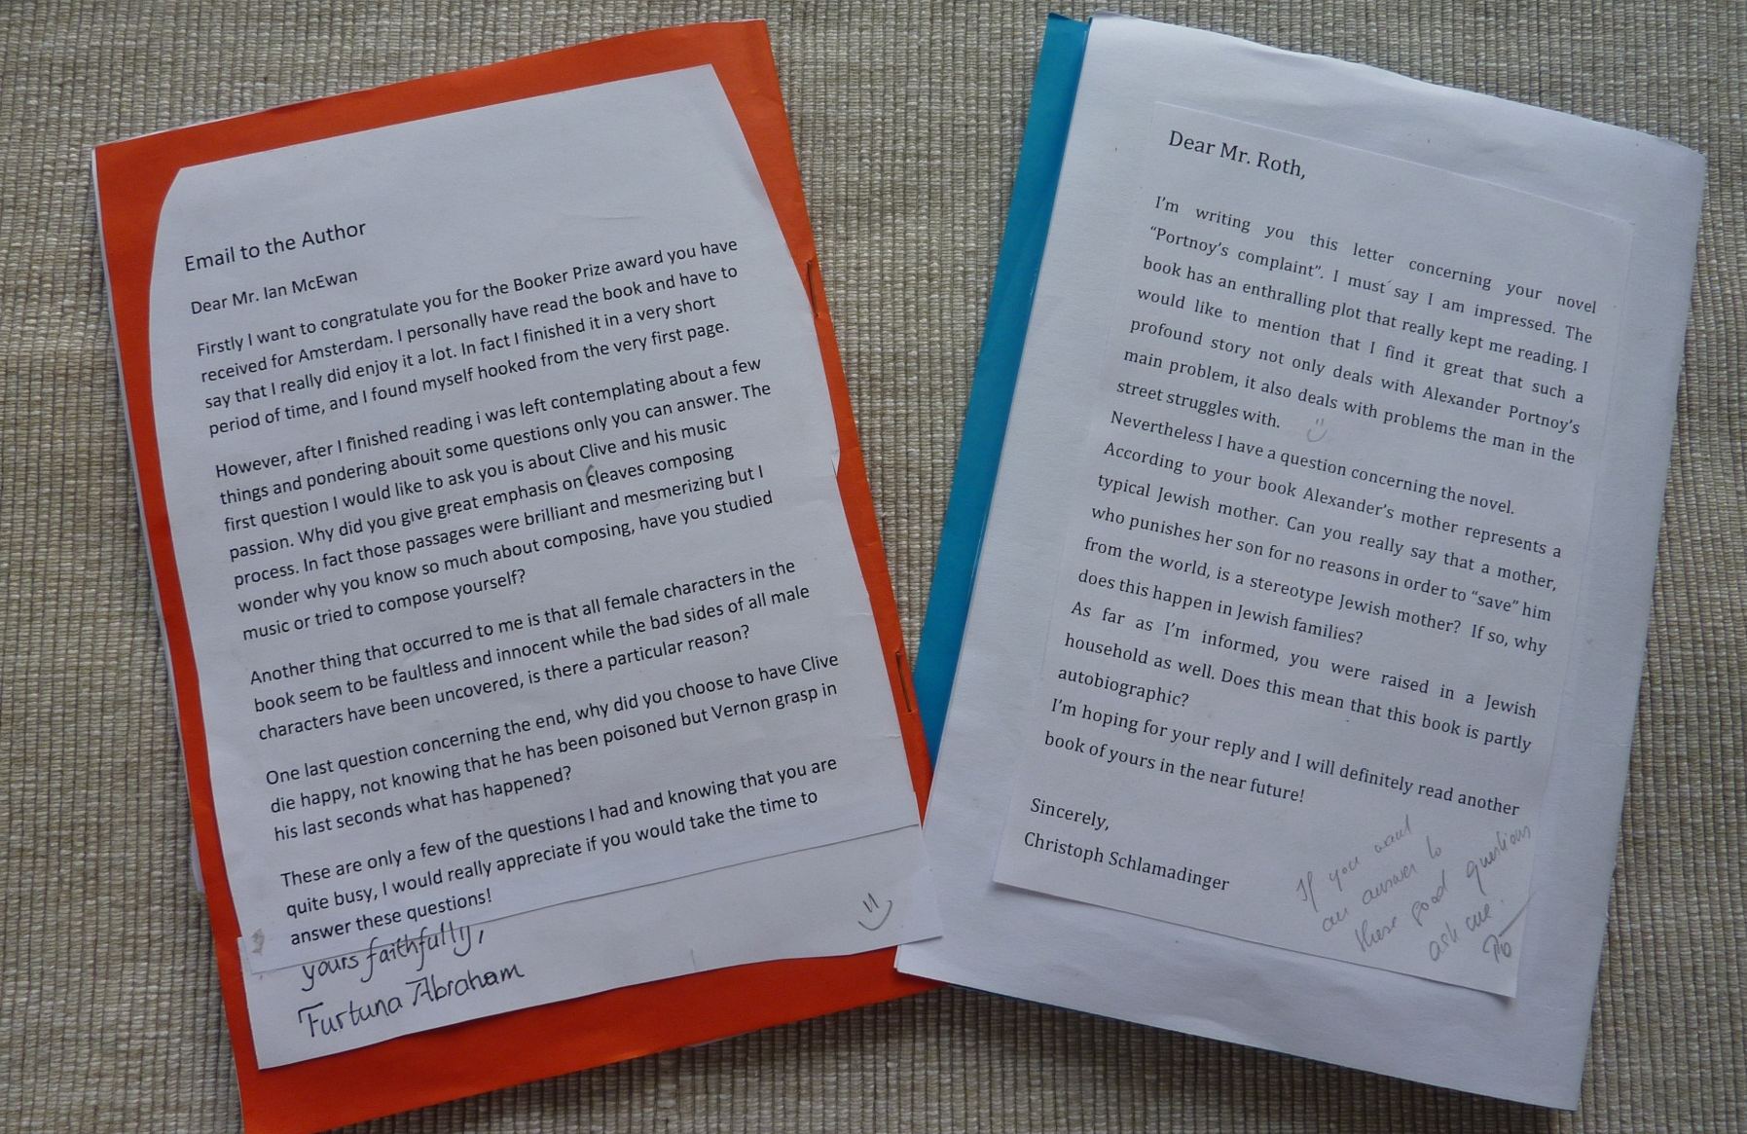
Letter to the author and drawings

Slide 33
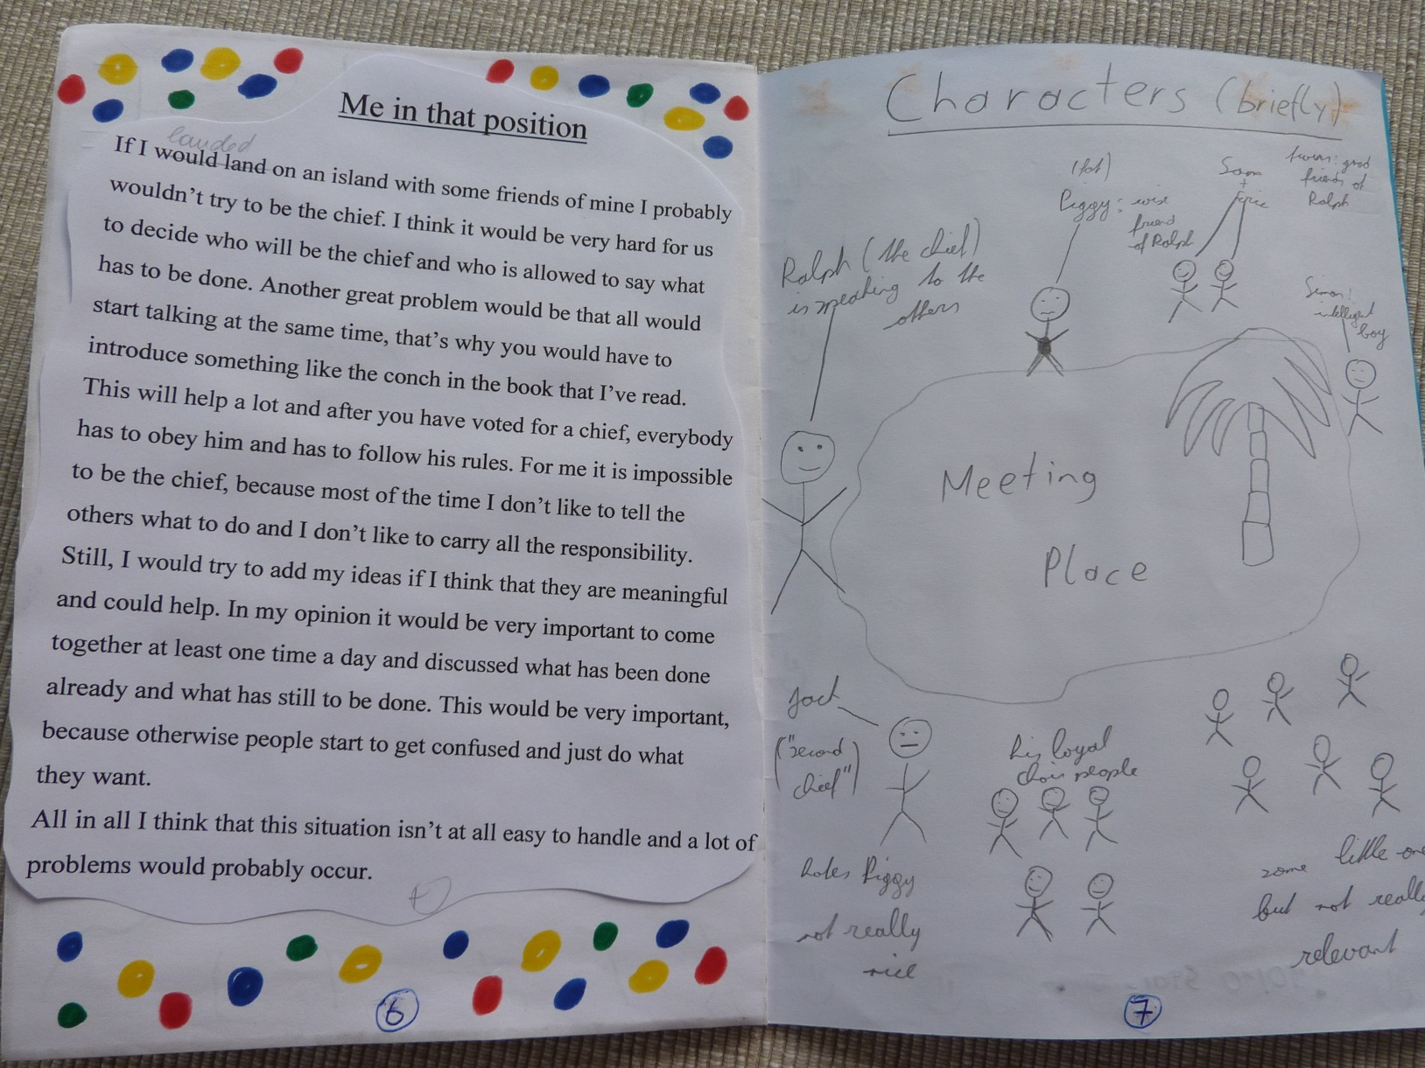
If I had been in this place...

Slide 34
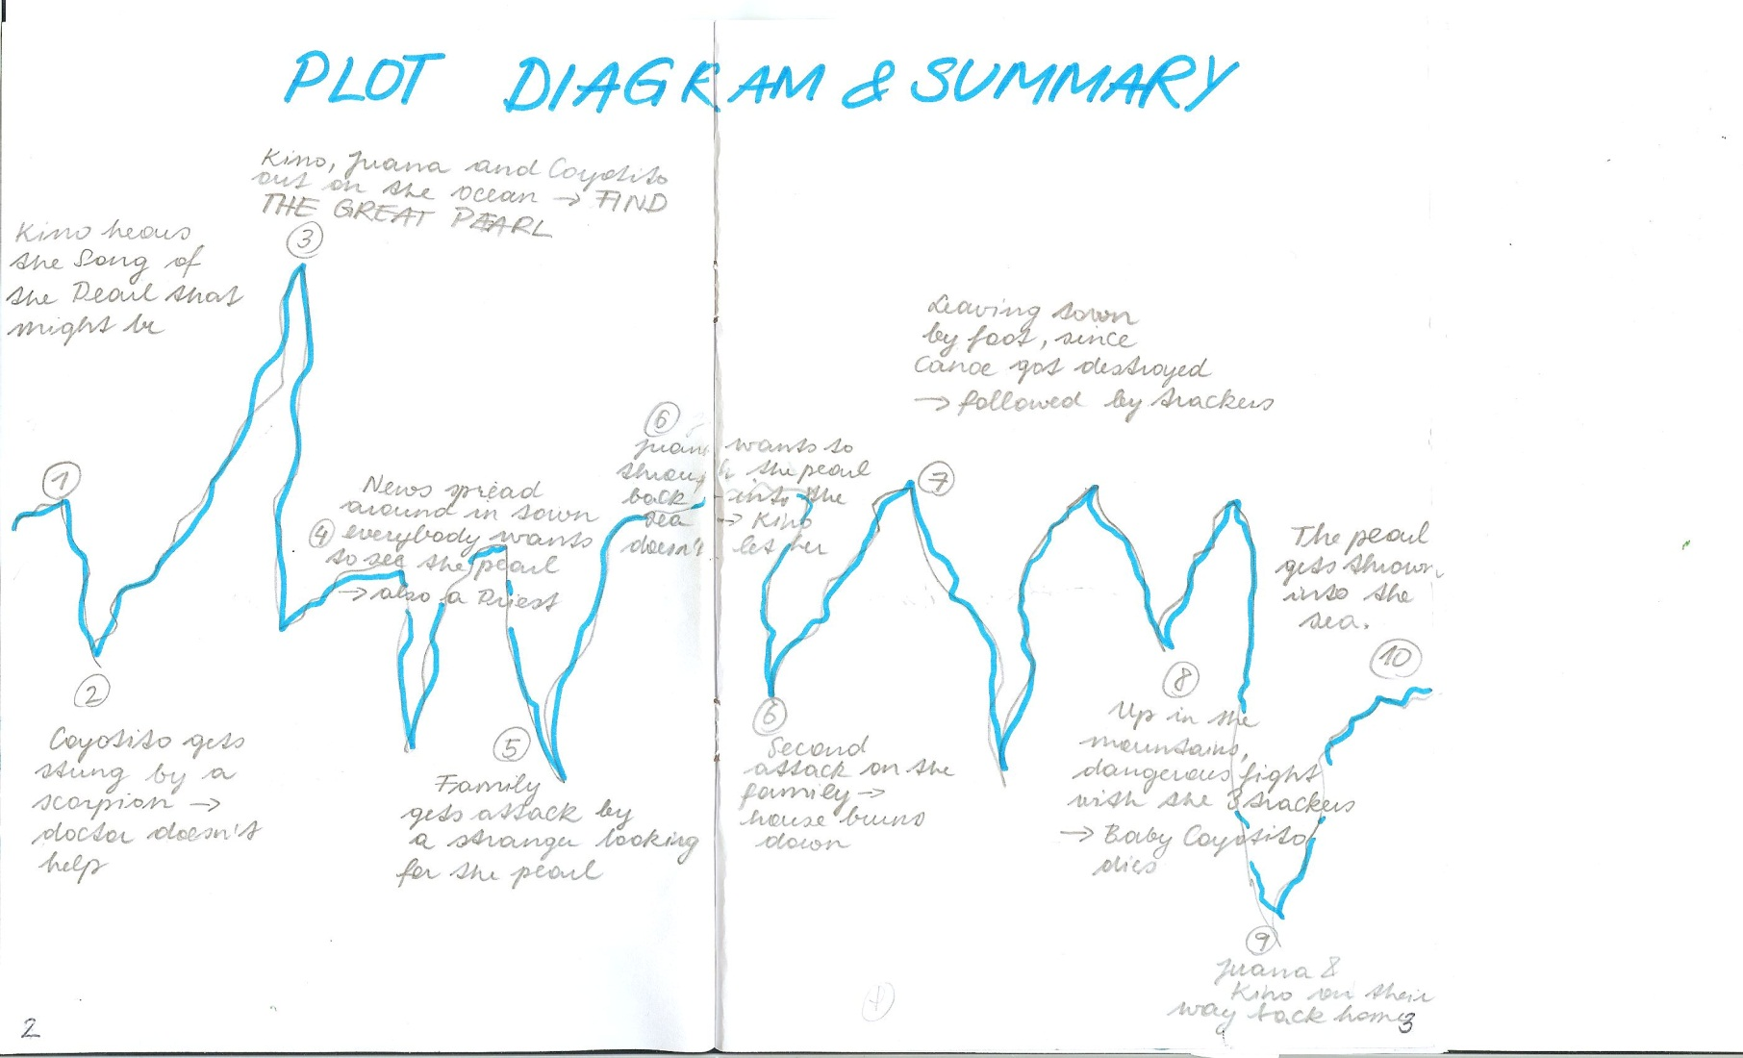
Plot diagram (The Pearl)

Slide 35
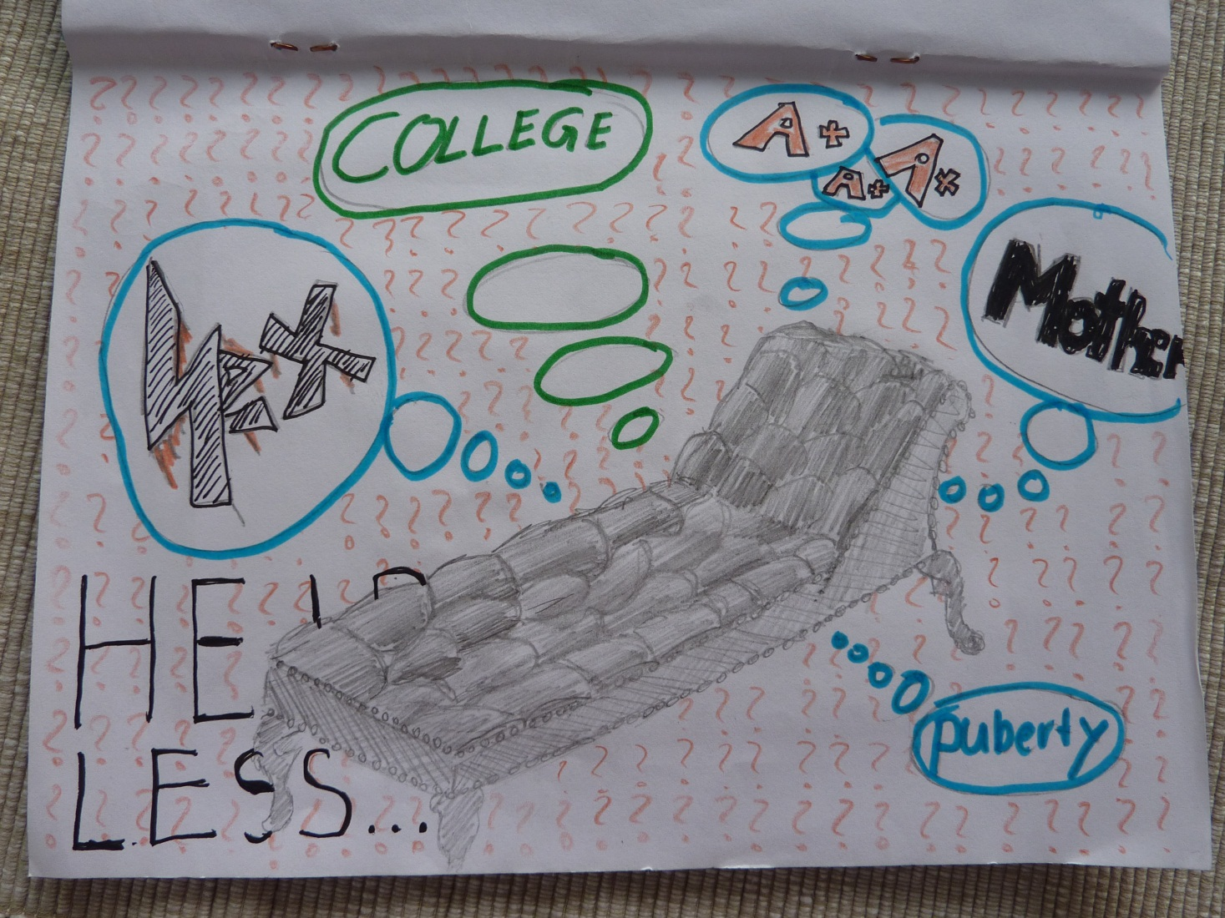
Drawings

Slide 36
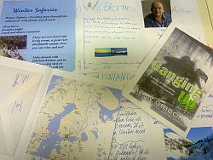

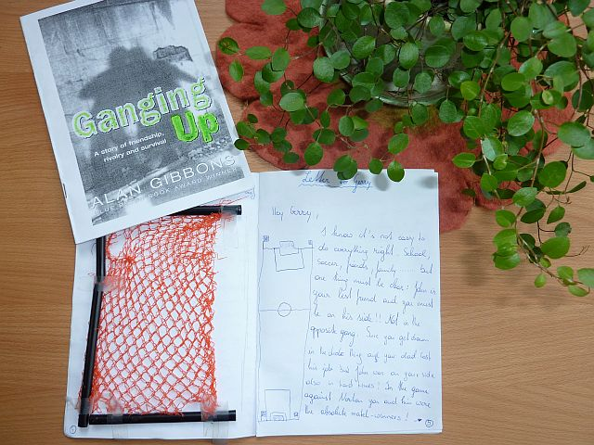
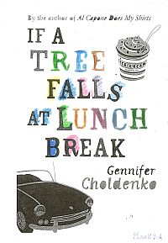
Booklet Browsing
You will now have time to look at different examples of booklets in detail.
What skills and strategies have the learners used/ practiced in these projects? Make a list.

Slide 37
In these projects the learners...
make lots of choices, take decisions
do activities that seem relevant to them
are actively involved and use the language actively (receptively and productively)
cooperate and communicate with others
manage time and resources
persue personal goals and group goals
are proud of their results
build growth-oriented mindsets

Slide 38
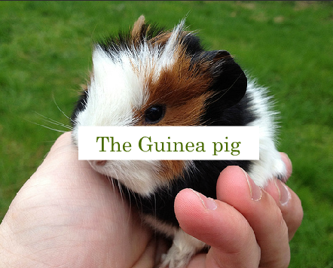

Online Books: Same idea – other media
Beginners: year 1
A book about Guinea pigs
Superman

Slide 39

More examples: From reading to writing
The Spooky Story Project

Slide 40




Oral formats of the same idea
Instructions for the learners:
  Show your understanding of the book using Mybrainshark.com. Do not use any writing.
  Examples:
  The Curious Incident of the Dog in the Night-time
    Example 1: Walking in Christopher‘s shoes
    Example 2: A normal schoolday
    Example 3: Walking in someone else‘s shoes
  The Man Who Loved Clowns
  Freak the Mighty
  Bluefish

Slide 41

Let‘s recap the main facts:
Why should we read?
How can booklets help?
grammar
vocab
motivating TASKS
output oriented
language acquisition, „flow“
reading comp
readers are better writers
foster autonomy and creativity
learners interact with the text and construct meanings
developing intercultural/ transcultural competence
work well in mixed ability groups
developing higher thinking skills
practice writing skills, even text-types for final exams

Slide 42

The End
Thank you for your attention.
For more ideas and examples visit
http://epep.at

Slide 43
References
Bauer, J. (2006). „Spiegelneurone: Nervenzellen für das intuitive Verstehen sowie für Lehren und lernen“ in Ralf Gaspary (Hg.) Lernen und Gehirn: Der Weg zu einer neuen Pädagogik. Herder.
Benson, P. (2001). Teaching and Researching Autonomy in Language Learning, Harlow: Pearson Education.
Bland J. and Lütge C. (2013). Children‘s Literature in Second Language Education. Bloomsbury, London and New York.
Bredella L. und Hallet W. (2007). Literaturunterricht, Kompetenzen und Bildung. Wissenschaftlicher Verlag Trier.
Caspary, R. (Hg.) Lernen und Gehirn: Der Weg zu einer neuen Pädagogik. Herder 2006 (Beiträge von Gerald Hüther, Gerhard Roth, Manfred Spitzer, Joachim Bauer, Ulrich Hermann, Heinz Schirp, …)
Krashen, S. 2004. The power of reading. Portsmouth, NH: Heinemann and Westport, CT: Libraries Unlimited.
Krashen, S. 2011. Free Voluntary Reading. Libraries Unlimited, Santa Barbara
Littlewood, W. (1996). "Autonomy”: an anatomy and a framework. System, 24/4, 427-435. Quoted from: http://www.finchpark.com/afe/l.html, 19.05.2012
Nunan, D. (1997). Designing and adapting materials to encourage learner autonomy. In P. Benson, & P. Voller. Autonomy and Independence in Language Learning. Harlow: Longman, 192 - 203.
Willis, D. and Willis J. 2007. Doing Task-based Teaching, Oxford: Oxford Handbooks for Language Teachers.
Zehnpfenning, H. und Zehnpfenning H. 2008. online: http://www.zeugner.at/files/nachlese/010909/Go_OffUnt_Didaktik_des_weissen_Blattes.pdf
Zull, J. (2002). The Art of Changing the Brain: Enriching the Practice of Teaching by Exploring the Biology of Learning. Stylus Publishing, Sterling Virginia.

Slide 44
The End
Thank you for your attention.
For more ideas and examples visit
http://epep.at

