Slide 1

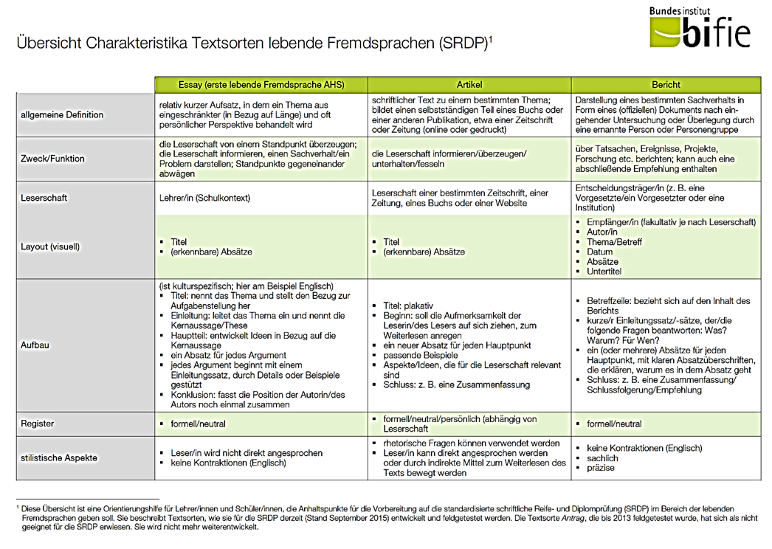
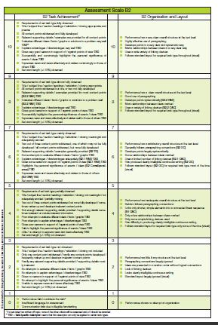
Welcome to…
Writing between Creativity and Task Achievement

Slide 2

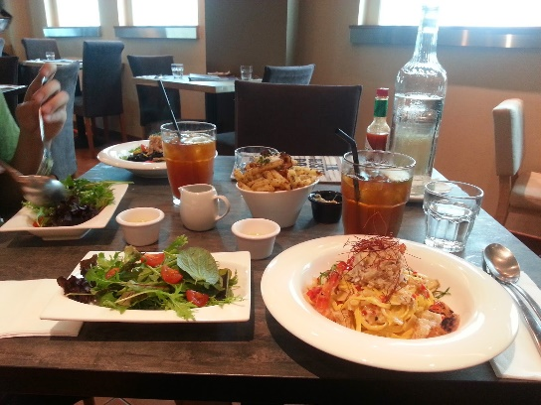
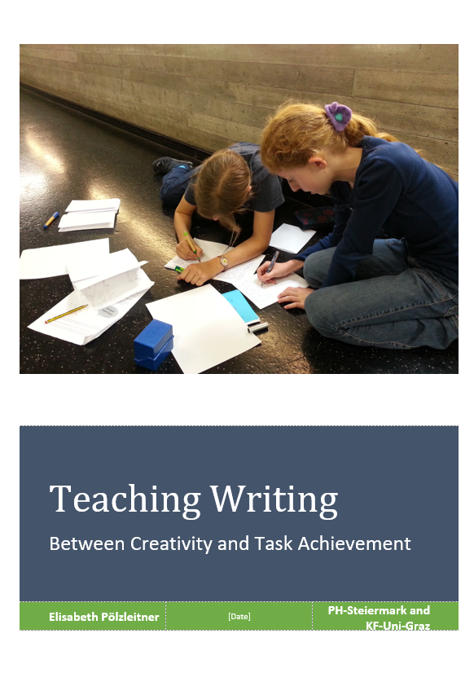
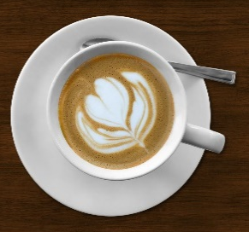

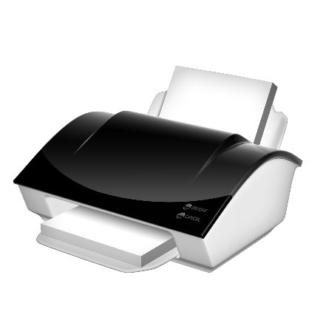

Let‘s get ready…
Today, you will need
Lunchbreak: 12:30 – 14:00

Slide 3


What‘s on your mind?
https://tinyurl.com/whats-on-your-mind-today

Slide 4
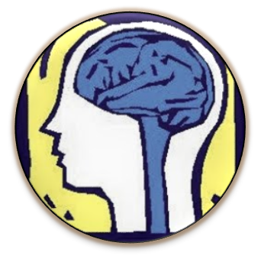
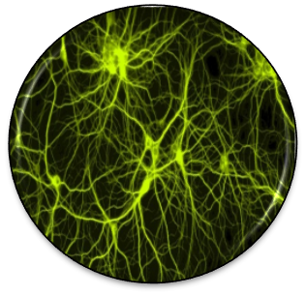
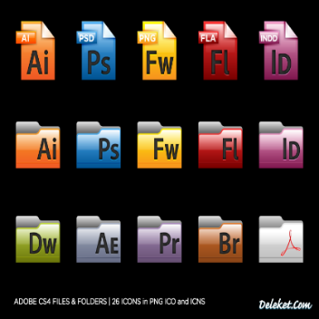
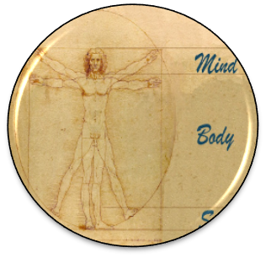



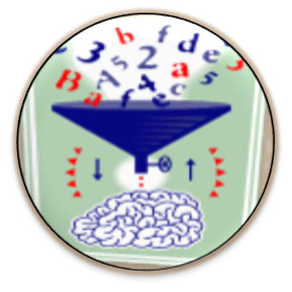
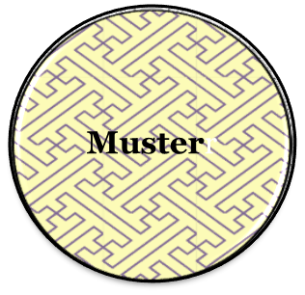
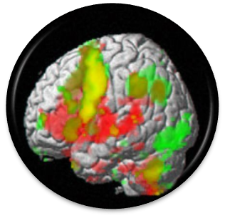

How does our brain learn?
Speicherung
Learning is a chemical process
that changes the brain.
Turning the brain “on”:
The role of the limbic
system
Constructing new concepts
and knowledge
Notes:
10 principles of learning Caine and Caine – abgeändert 1990 – 2000 --…

Slide 5
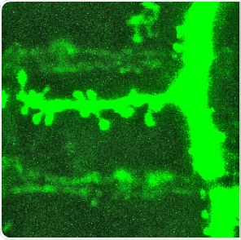
Part 1: Learning is a physical-chemical process
“Teaching is the art of changing the brain. …. I mean, creating conditions that lead to change in a learner’s brain.”
James E. Zull, p.5
© MPI von Neurobiologie Meyer, in http://www.news-medical.net/news/20140422/791/German.aspx
Notes:
Learning is BIOLOGY – not PSYCHOLOGY
Wir wollen uns heute anschauen was das bedeutet und WIE wir das als LehrererInnen tun können.
Wir wollen uns anschauen warum gewisse Methoden und Übungstypen wirksamer sind als andere.
Wir haben wenig Zeit – Kompetenzen – Matura – wir wollen die wenige Zeit im Unterricht EFFIZIENT nützen und das lernen nicht nach Hause auslagern.
Die Neurowiss. Können uns Hinweise geben was wirkt und wo “das Hirn kalt bleibt.”

Slide 6

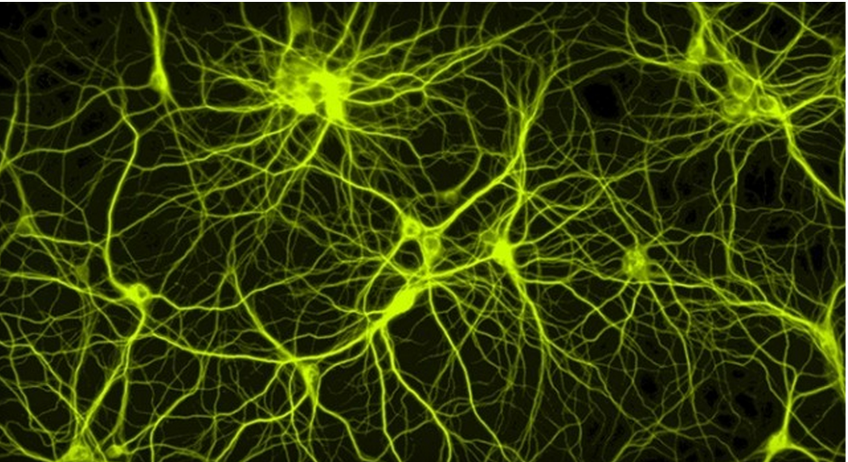

What are the practical consequences?
Neurons that fire together
wire together
A little experiment….
http://www.extremetech.com/extreme/179223-the-first-real-time-non-invasive-imaging-of-neurons-forming-a-neural-network
Notes:
Was bedeutet das in der Praxis: Wir wissen: Neurons that fire together wire together… -- d.h. das gesamte Netz wird aktiviert wenn es an einer Stelle ausgelöst wird.
Let’s try this out: Schließen Sie kurz die Augen und denken Sie an Vannillekipferl. ……… tauschen Sie ganz kurz aus.. (sehen, schmecken, riechen, x-mas, bröselt… …)
Bild:
Hohn Hewitt, “The first real-time, non-invasive imaging of neurons forming a neural network”, 28.3. 2014, www.ExttremeTech.com,
http://www.extremetech.com/extreme/179223-the-first-real-time-non-invasive-imaging-of-neurons-forming-a-neural-network am 03.10.2015

Slide 7
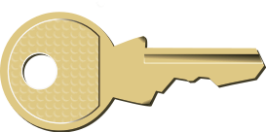


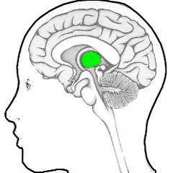
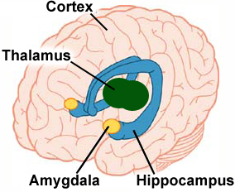



Emotions are the to the brain
Stimulus
Thalamus
Amygdala
Hippocampus and Cortex
Important
Ok, harmless
unimportant
dangerous
Alarm-system!
fight
flight
Notes:
click
Let’s follow the brain along the typical steps from input to learning.
A stimulus – in this case let’s assume it is sound waves – the teacher’s voice – enters the brain and reaches the (click) Thalamus. The Thalamus is an important part of our limbic system – our emotional center.
Here we have 2 options: (click) The Thalamus filters incoming information: if the incoming signal is marked as irrelevent, it will be discarded – in our picture it goes into the (click) bin. This is an important filter – we do not want to worry about all kinds of background noise, cars passing by and other irrelevant signals in our environment.
(click)
If the stimulus is perceived as important –(click) or at least potentially important, the Thalamus will let it through – and pass it on to the (click) Amygdala. In our picture we see two of these yellow, almond-shaped objects. Here incoming signals are checked for their emotional content. Is the incoming stimulus associated with (click) danger? … or does it seem (click) harmless? Some of these « danger » signals are innate – we are born with them. Humans and many animals are afraid of fire – even if we have not yet been burned. Other dangers need to be learned and acquired in the course of our lives.
Whenever an incoming stimulus is marked as dangerous, the amagdala sends signals to the Hypothalamus and the brain stem and our body prepares for (click) flight or (click) fight. Adrenalin and other neurotransmitters are released, our blood pressure and pulse frequence rise, oru muscle tonus rises. (click)
As our body is preparing for fight or flight reflexes – higher order thinking is turned off.
This cycle can save lives (in the wild!!) but does it help in exams?
I like to call this the AAA reaction: Amygdala-Adrenalin-Anxiety
It produces a cognitive style that facilitates basic, automatic routines
but prevents free associations and higher order thinking.
Let’s go back to the incoming signal and assume that the amygdala has decided that it is(click) harmless.
Only then is the stimulus passed on to the (click) hippocampus and the cortex and only then will any (click) higher order processing(click) take place in the cortex. (click)
What does this mean: fear and anxiety prevent learning – we must create a relaxed, safe atmosphere to open our learners’ brains.
This is really important for speaking activities – here danger may not only come from a teacher who penalizes every little mistake – danger might also come from classmates, who laugh at you or find fault in your presentation. In all these cases no learning will happen.

Slide 8

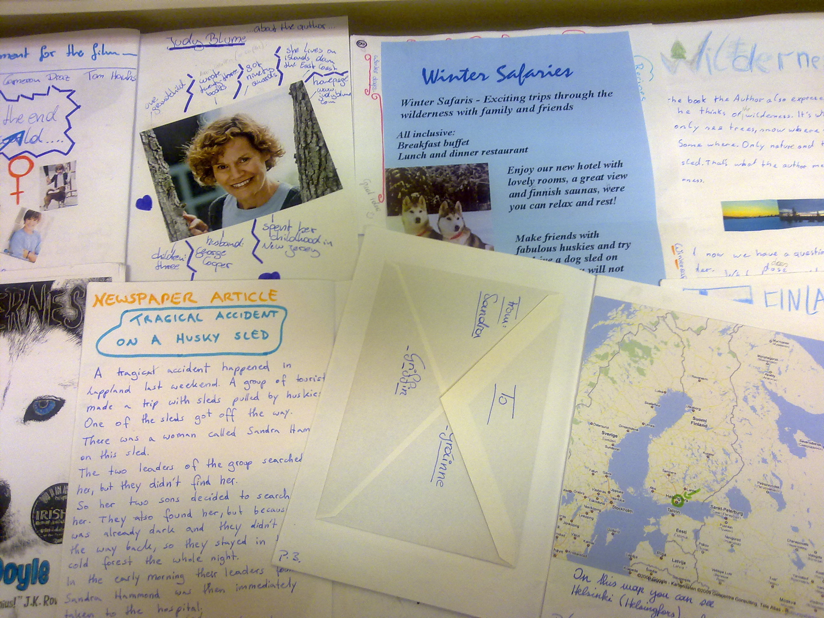


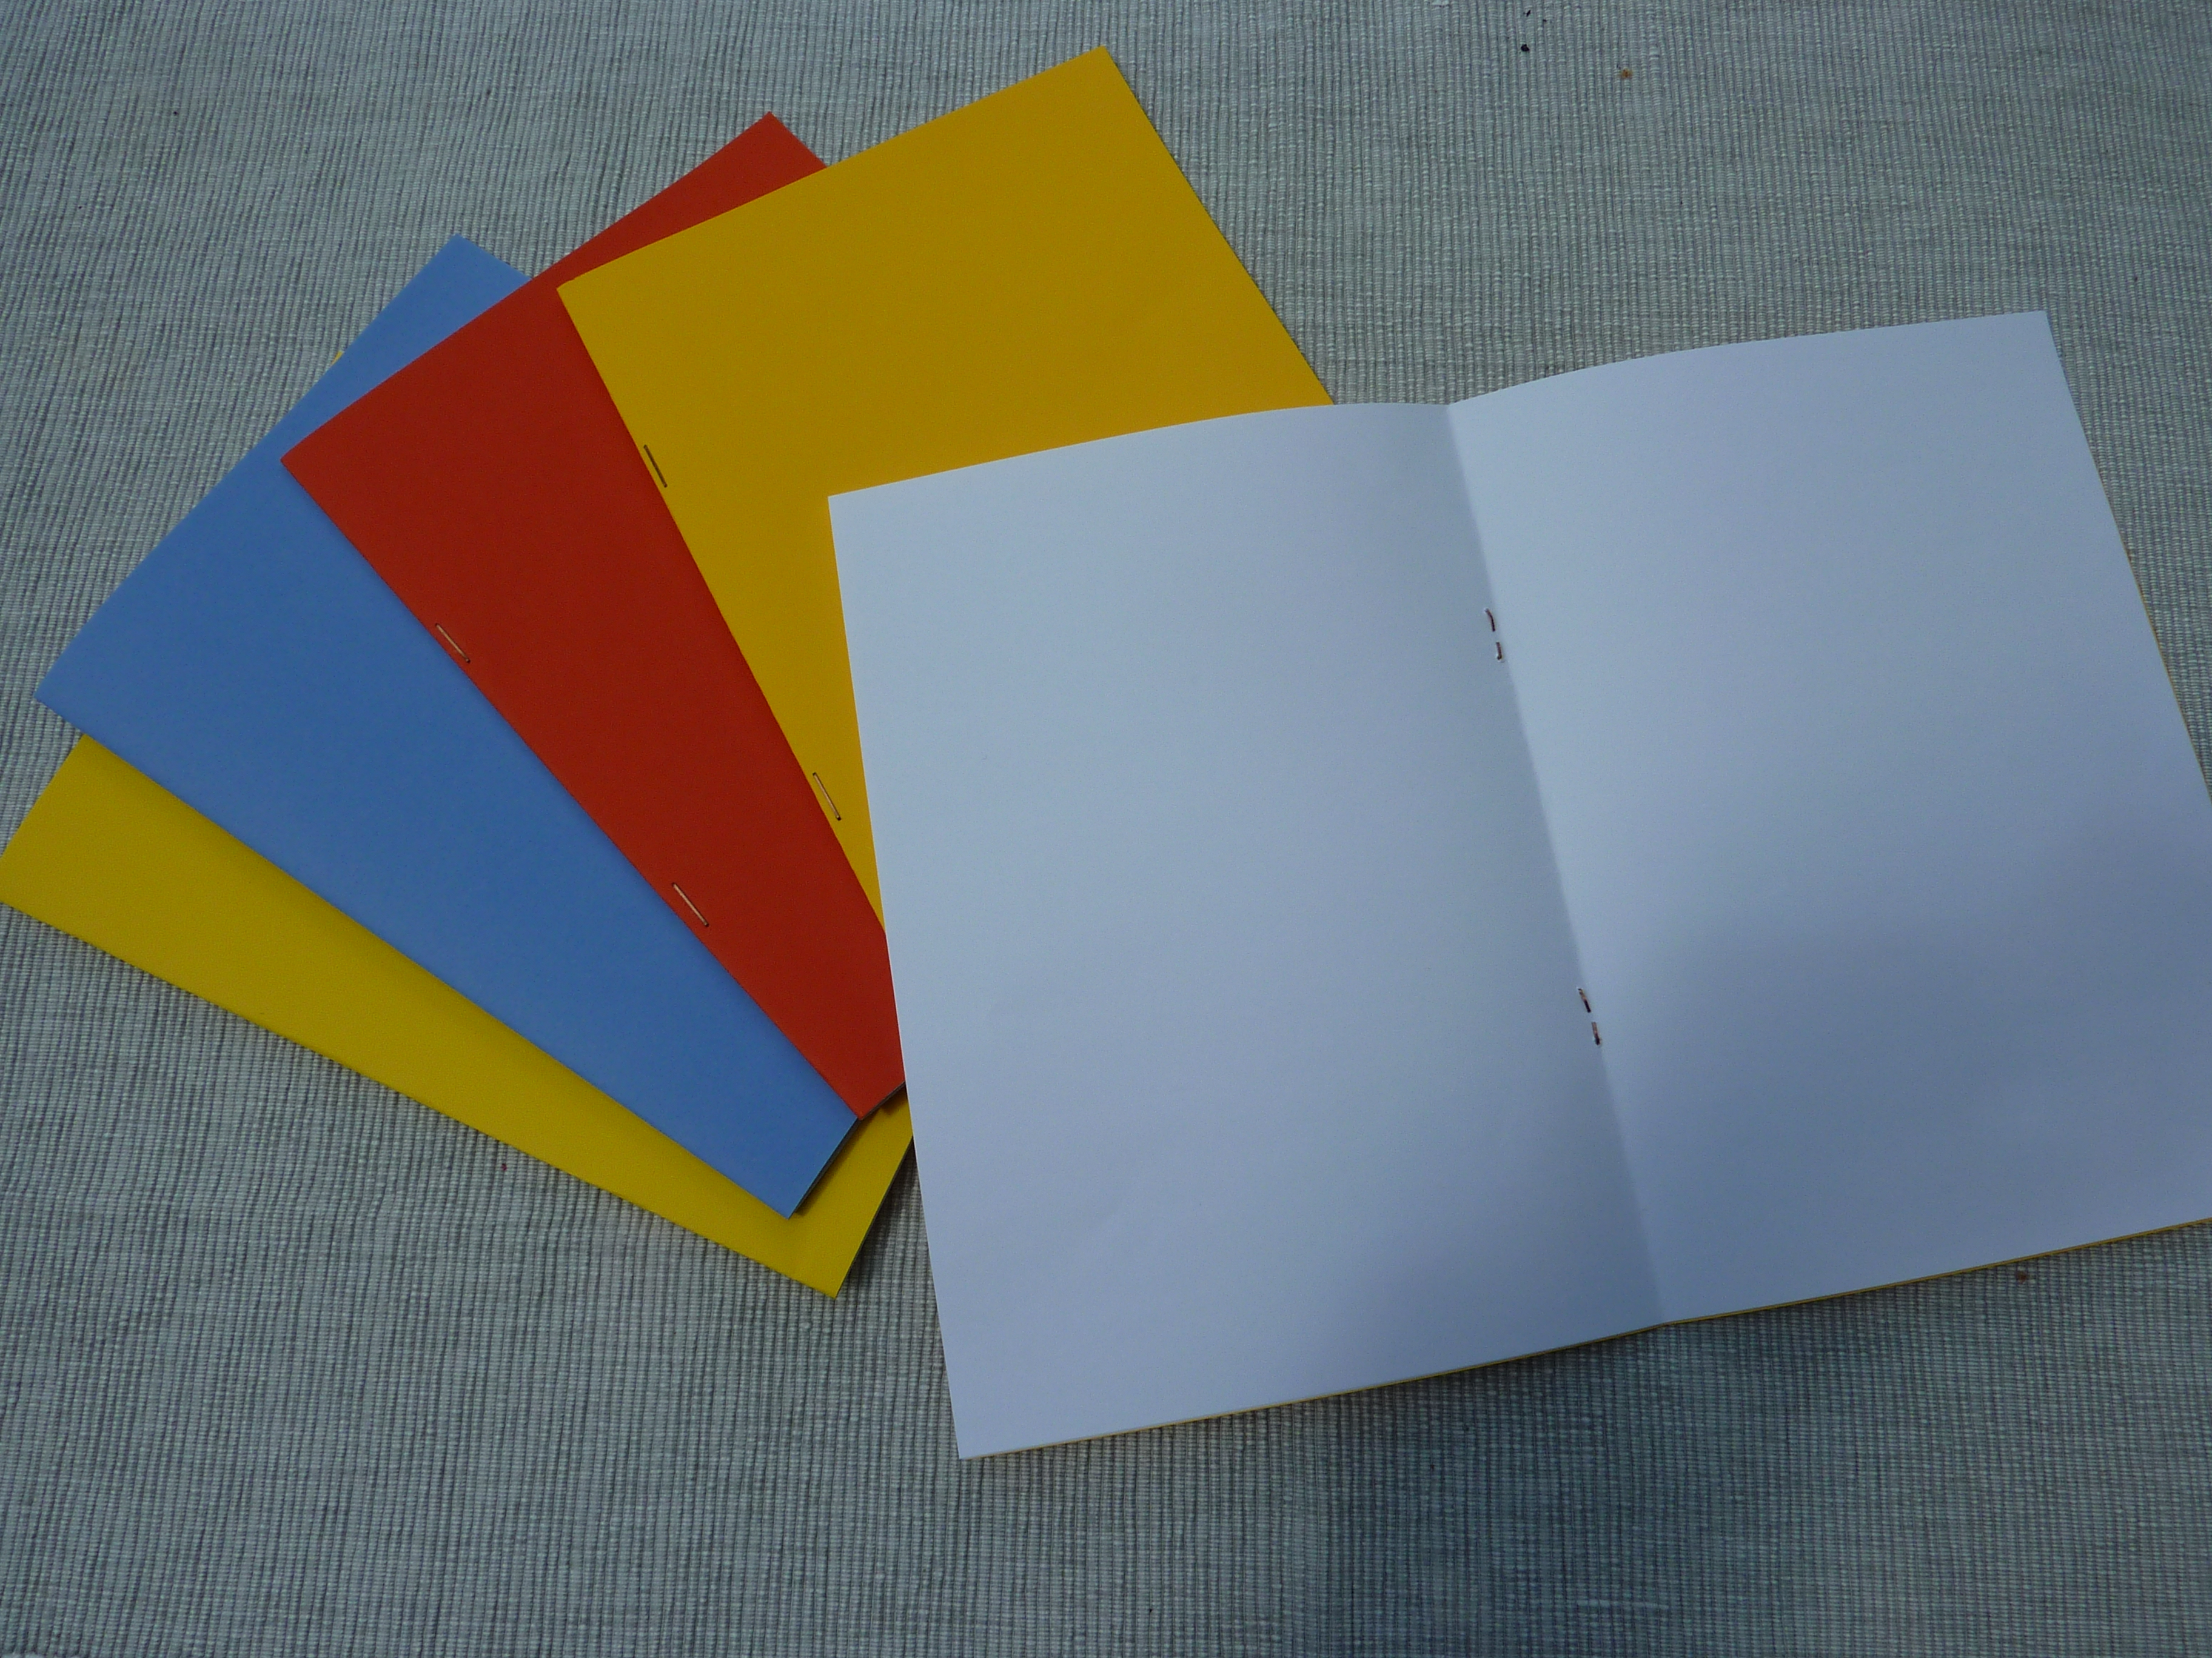
Yes, I did it!
5th Principle
Challenge and success facilitate learning and motivate learners to take up the next challenge.
« Dopamine-cycle »
Notes:
Stolz und Erfolgserlebnisse: Dopamindusche – verlangt nach Wiederholung! – positive Motivationsspirale .. Internes Belohnungssysstem
Portfolios (epep)
und Tall Tales (epep) Klick on pictures – hyperlinks!

Slide 9


FIP format imagination pride
…under the „dopamine shower“
Our stuff is cool enough to be published
www.gibsters.com
http://www.cainelearning.com/wp-content/uploads/2013/08/Principles-Wheel.png

Slide 10



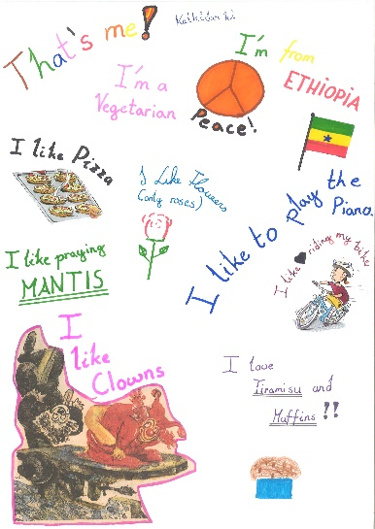
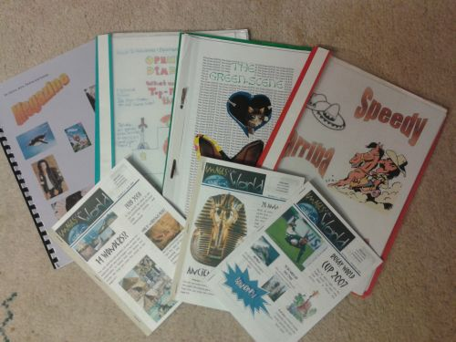

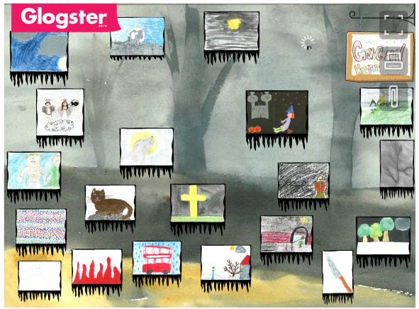
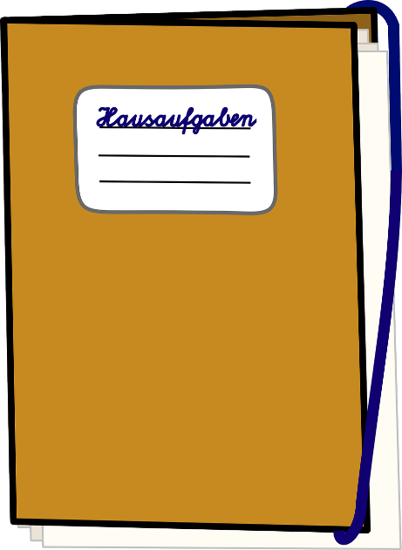

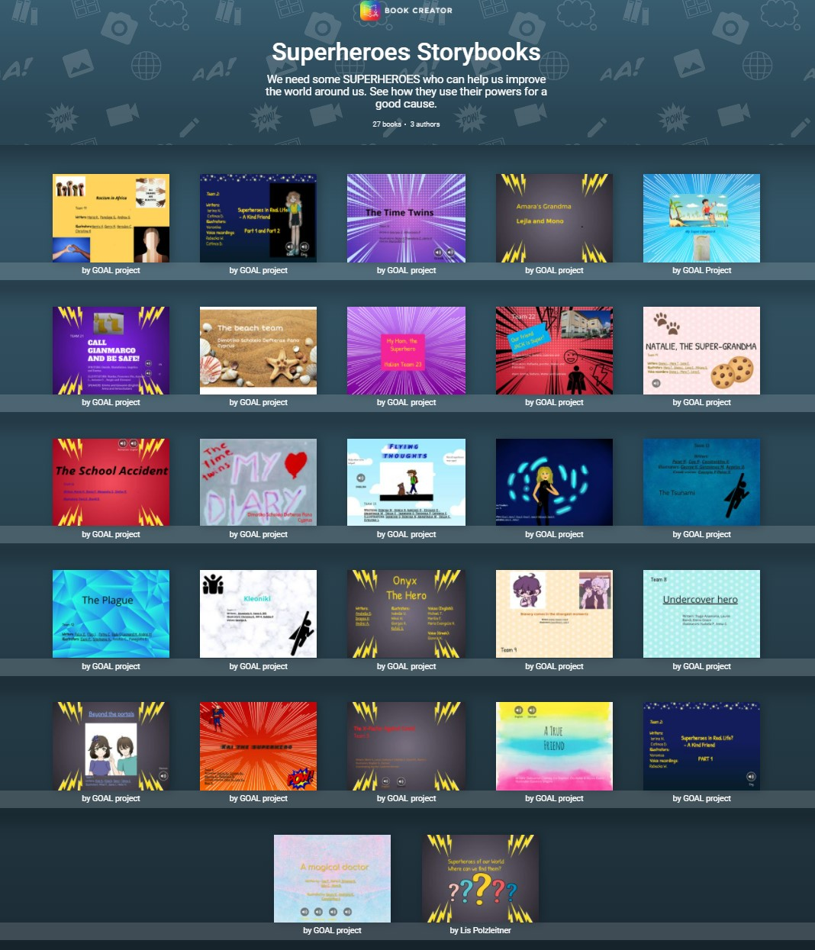

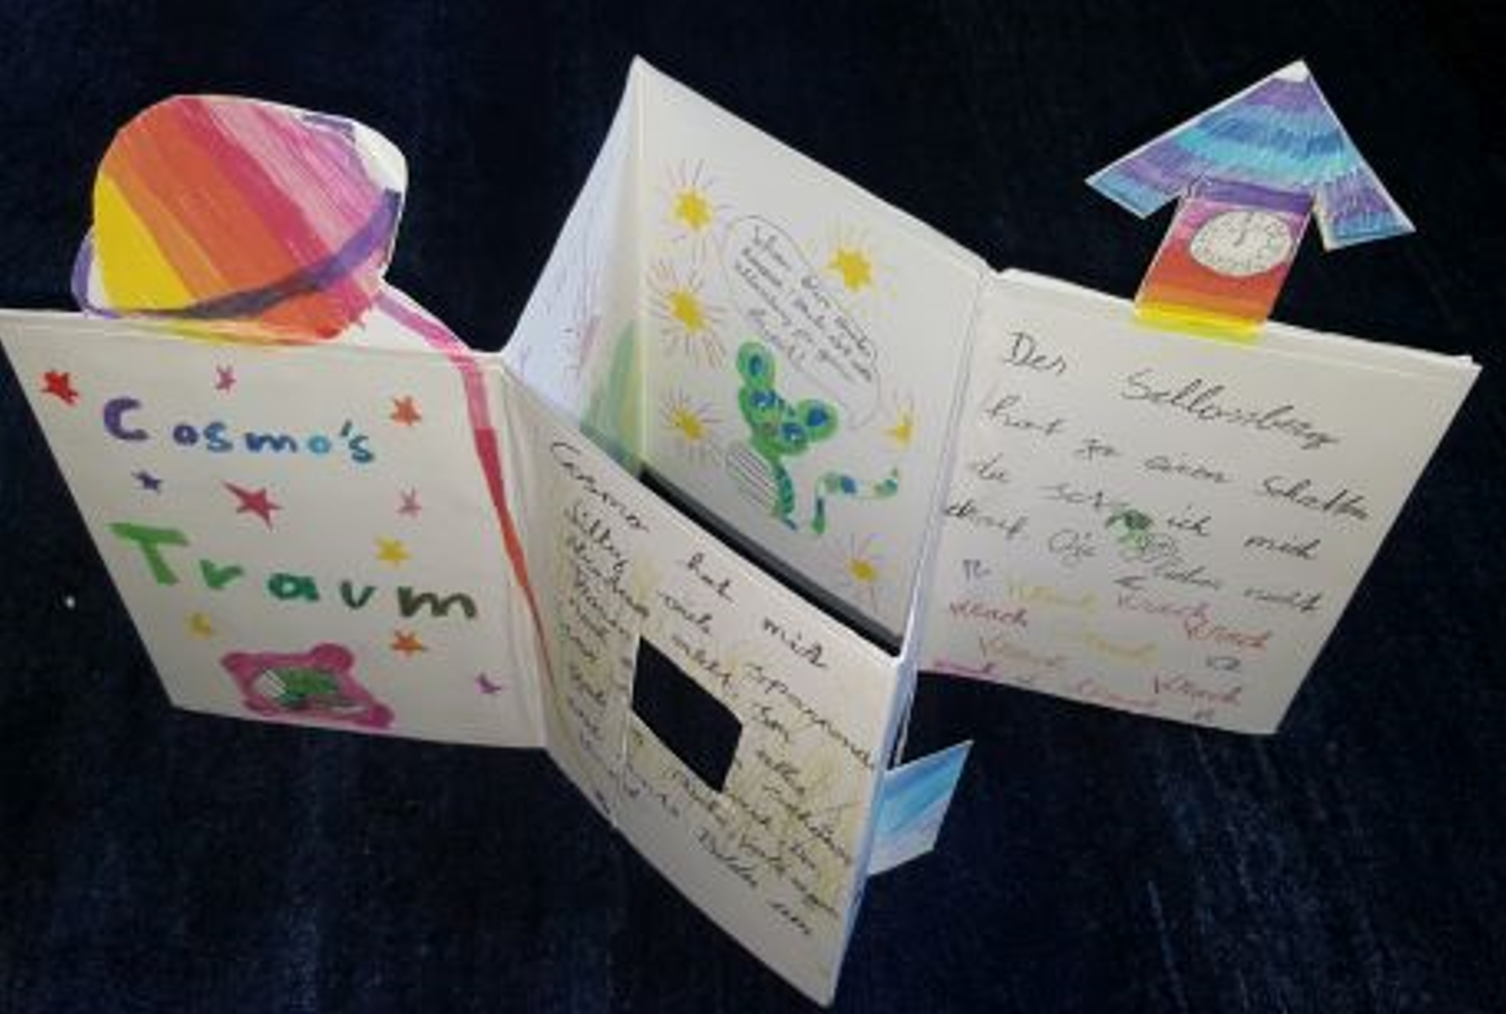
The key to high quality writing

Slide 11
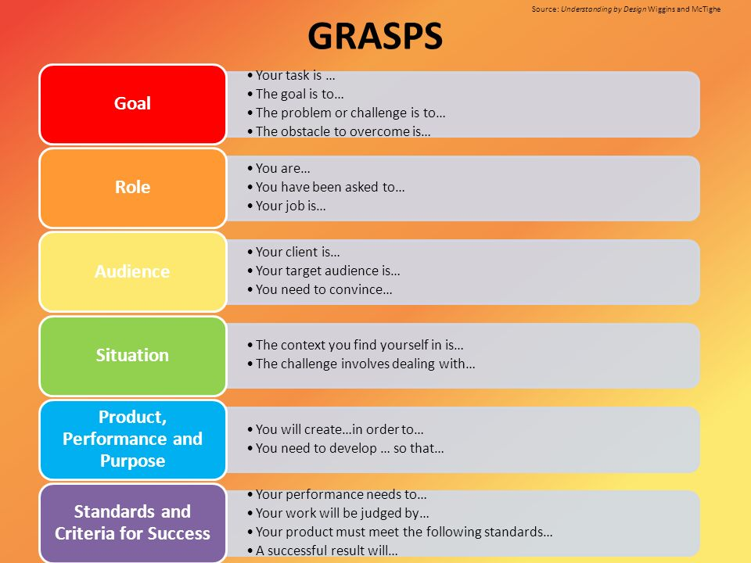
The GRASPS Frame
Source: Understanding by Design, Wiggins and McTighe

Slide 12

To cut the long story short… Learning works best if…
Speicherung
Notes:
10 principles of learning Caine and Caine – abgeändert 1990 – 2000 –
Vergleiche meine Checkliste für gehirngerechten Unterricht…

Slide 13
