Slide 1
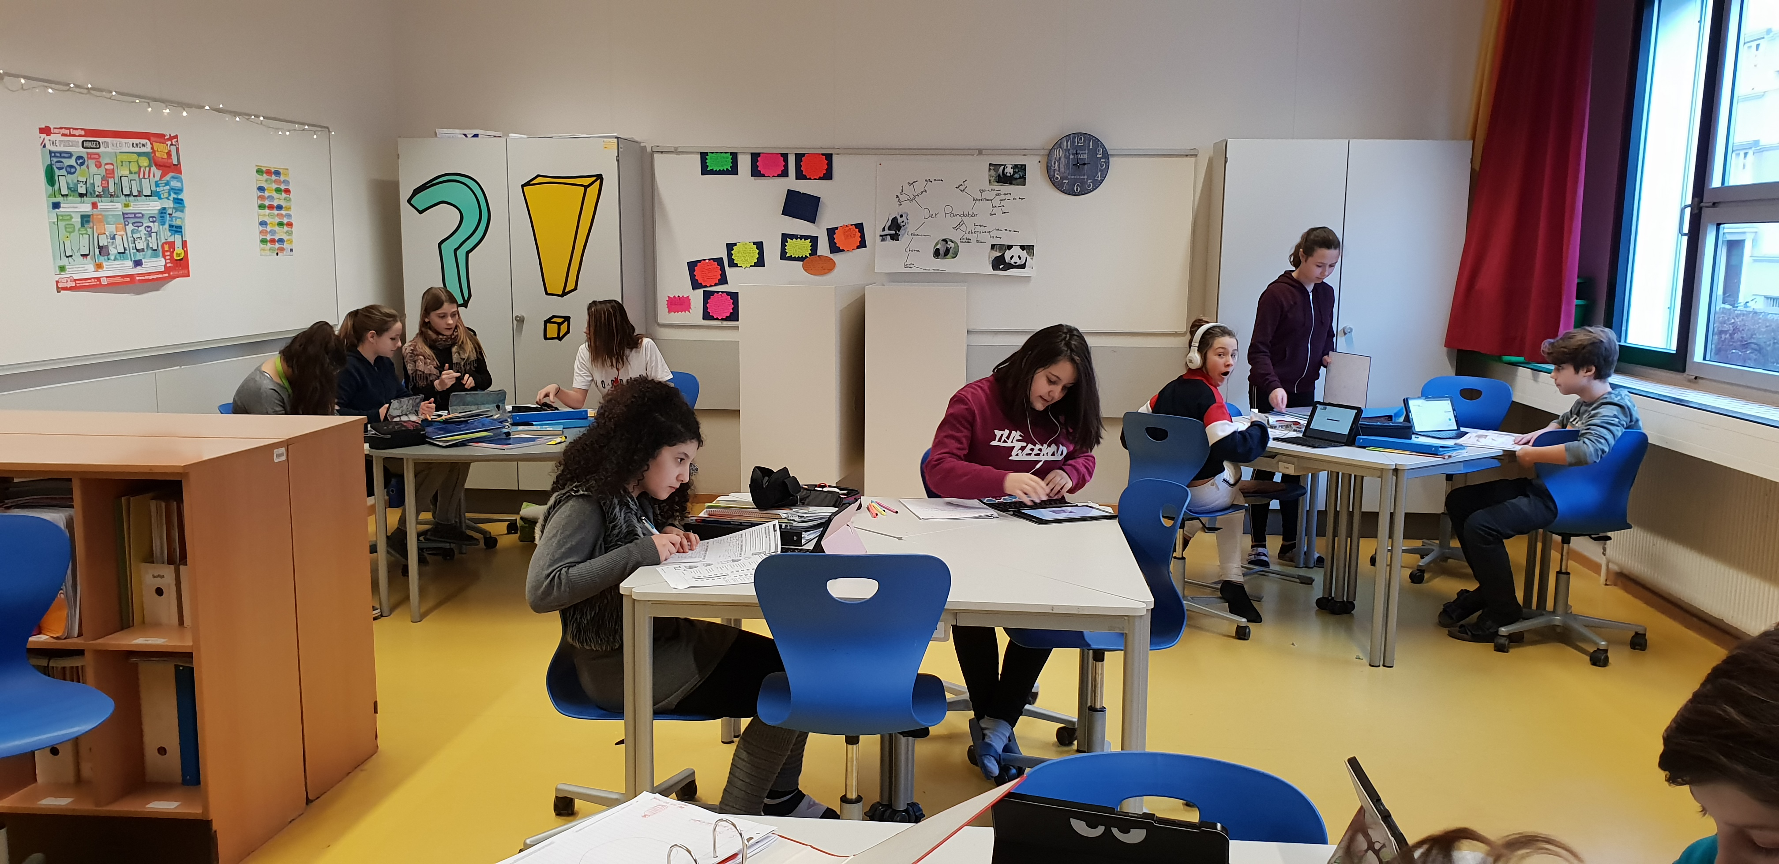
Flipped Classroom
Online Elisabeth Pölzleitner

Slide 2
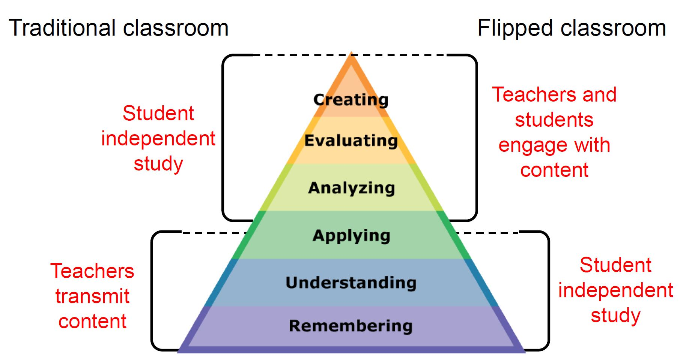
Traditional classroom vs Flipped classroom

Slide 3
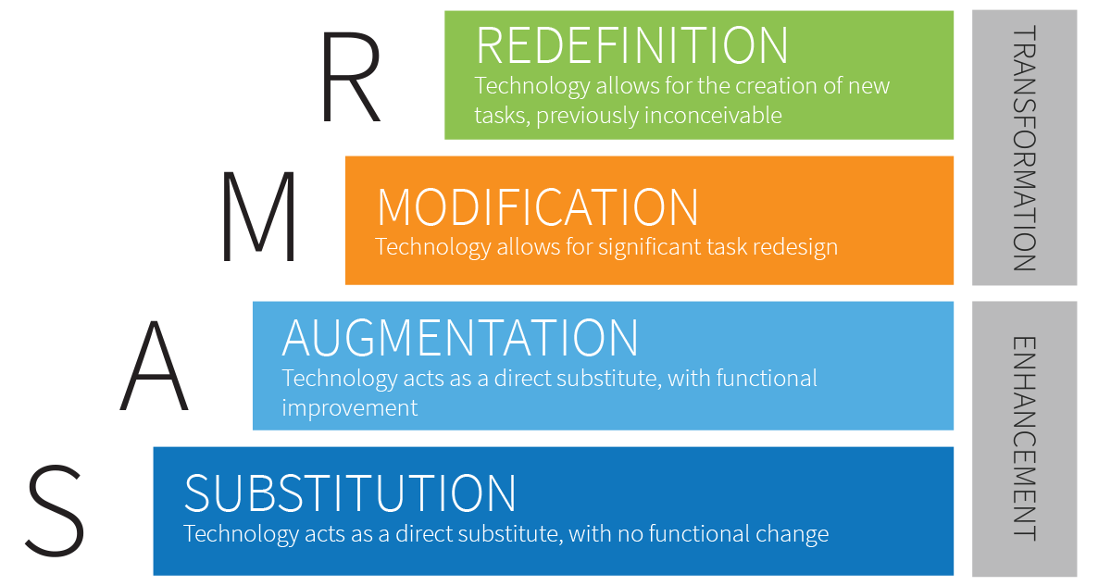
How can technology help?
Students design online teaching materials: Moodle, liveworksheets, H5P, learningapps …
Choiceboards based on online resources Choiceboards for student products: video, audio, written…
Forum discussions, Q&A, brainstorming and collecting questions on Padlets
Files on Moodle Video presentation on Moodle Lecture on a video-conferencing tool

Slide 4
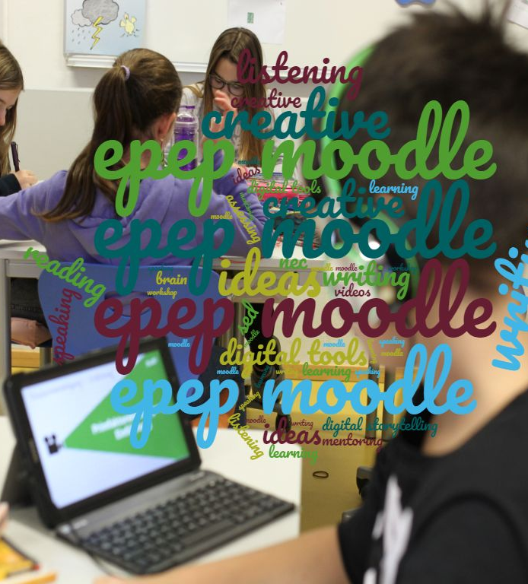

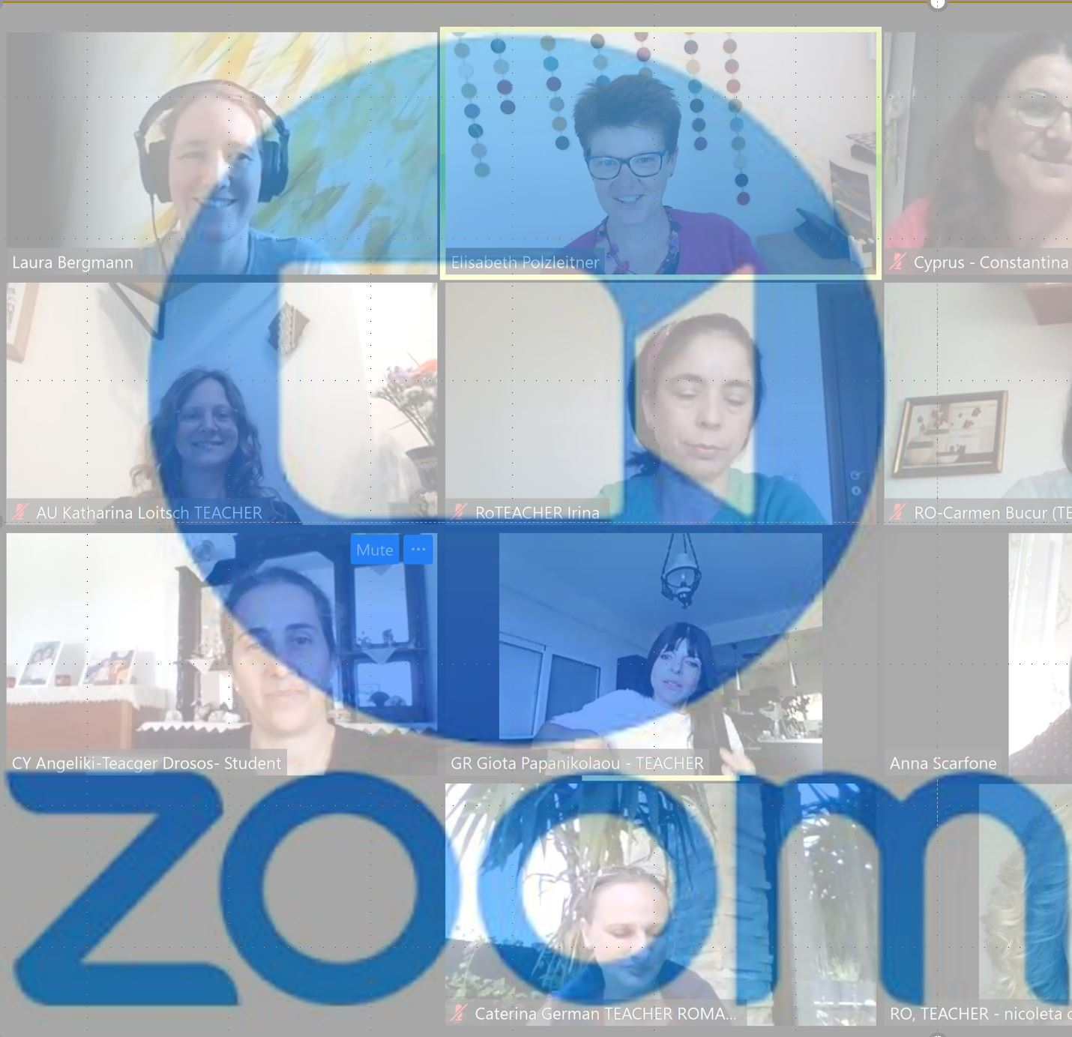
3 main elements of my flipped classrooms

Slide 5
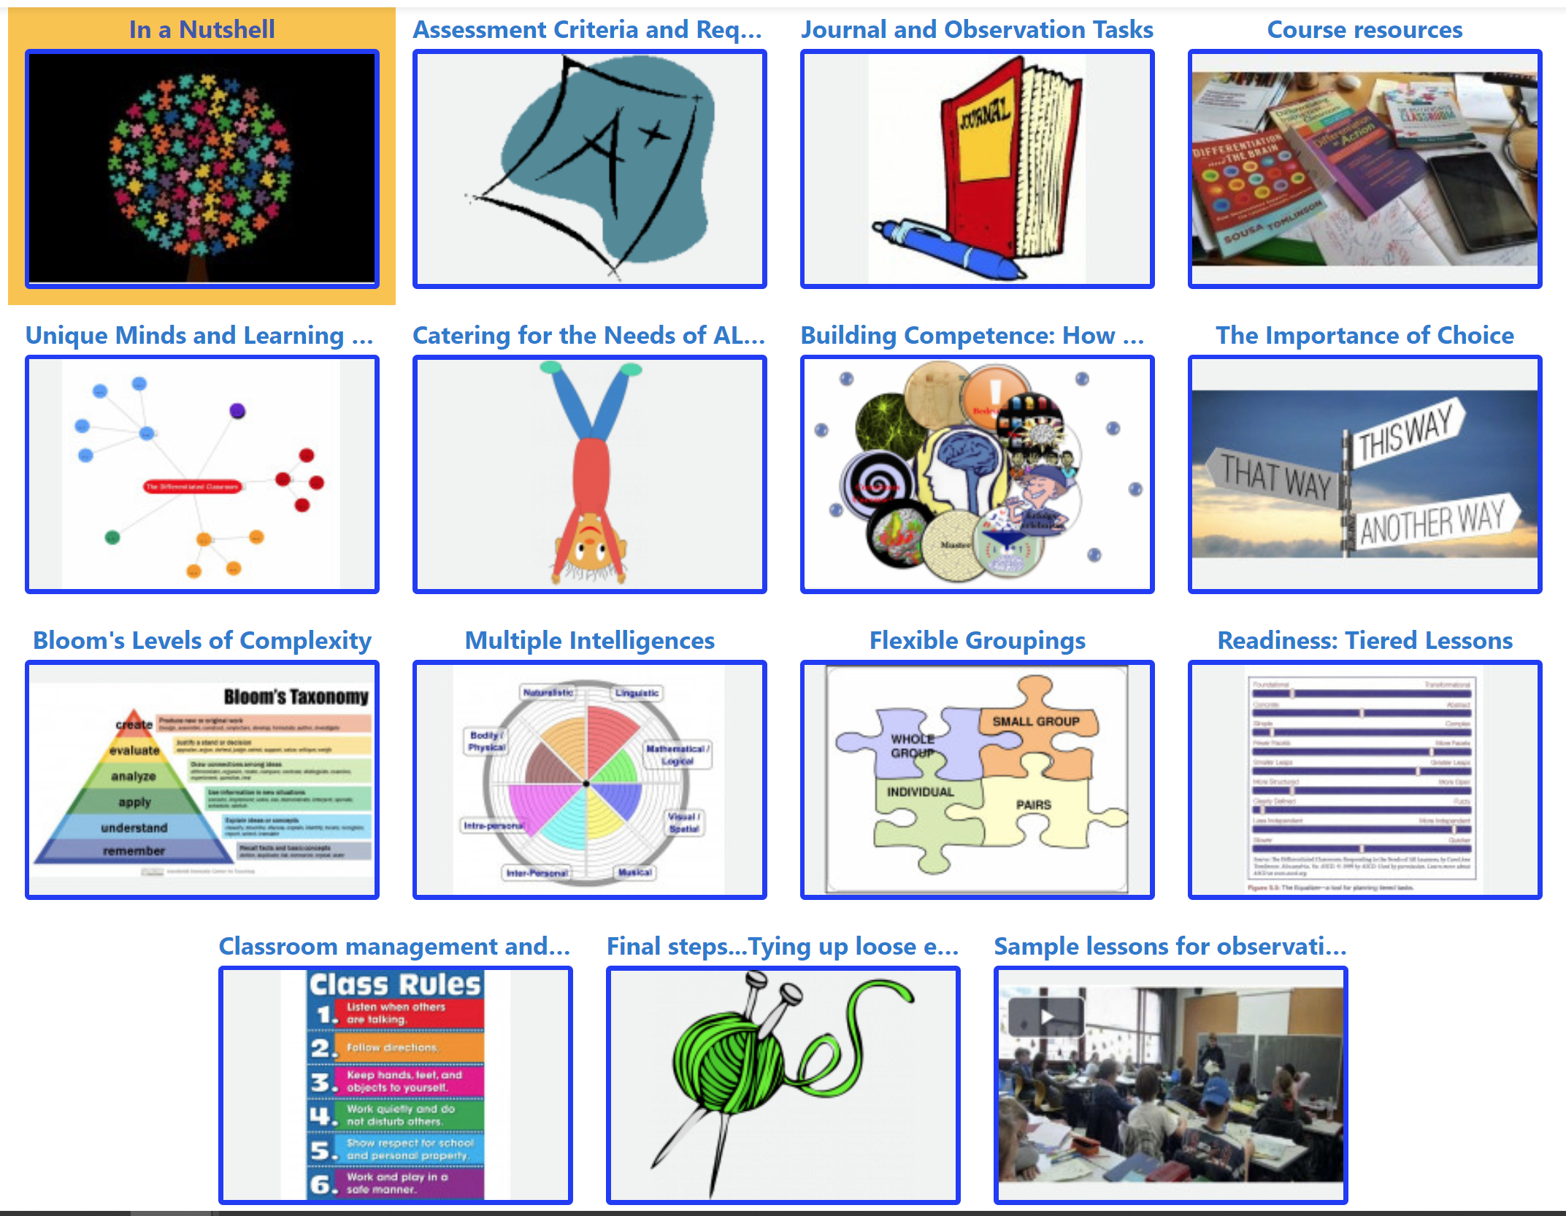
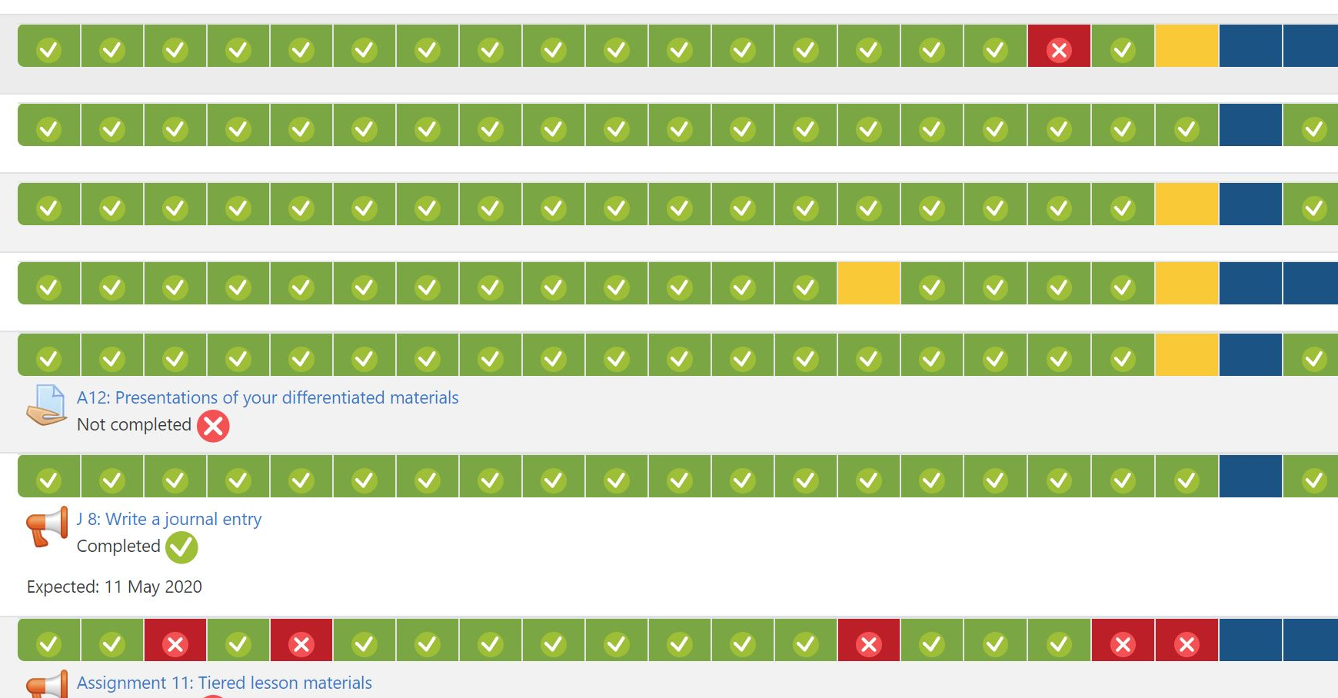

Slide 6
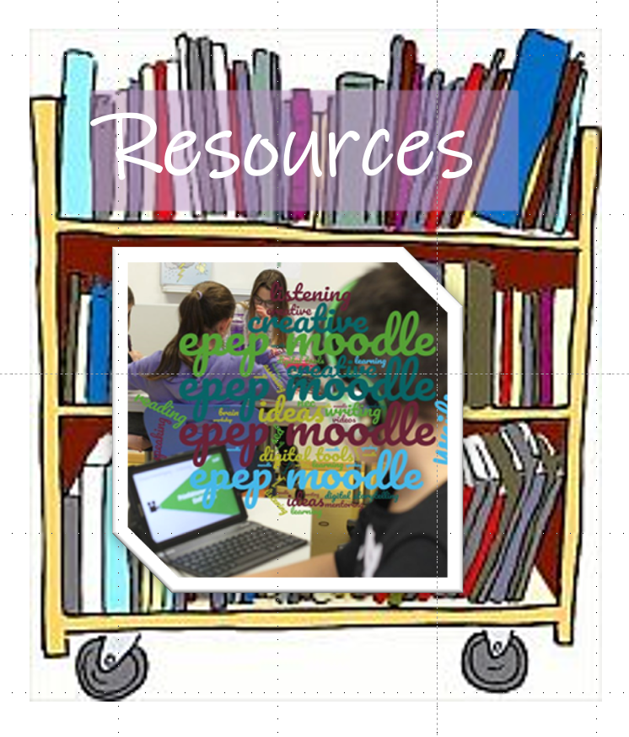
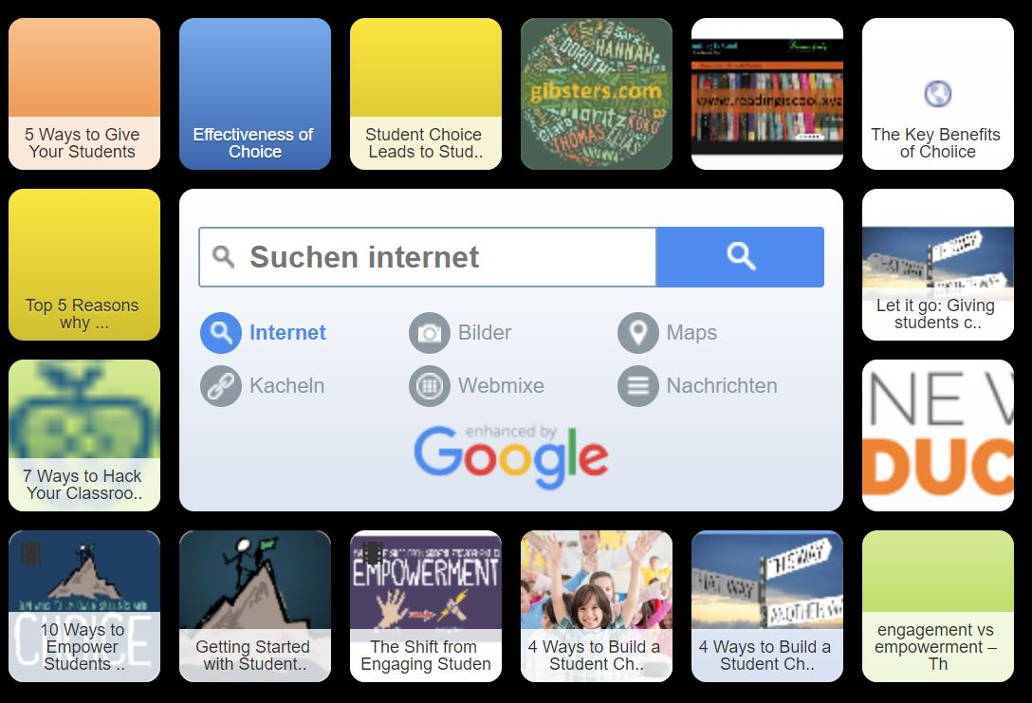
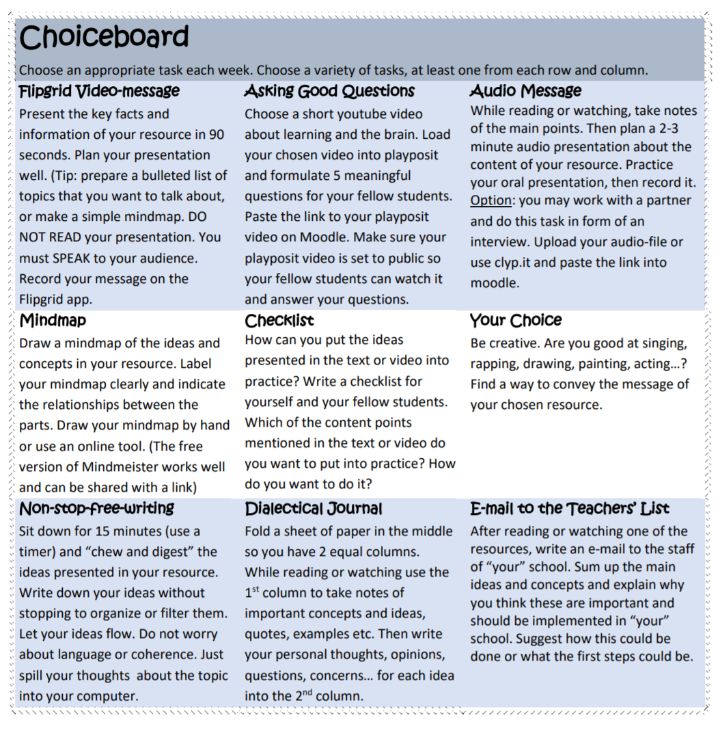
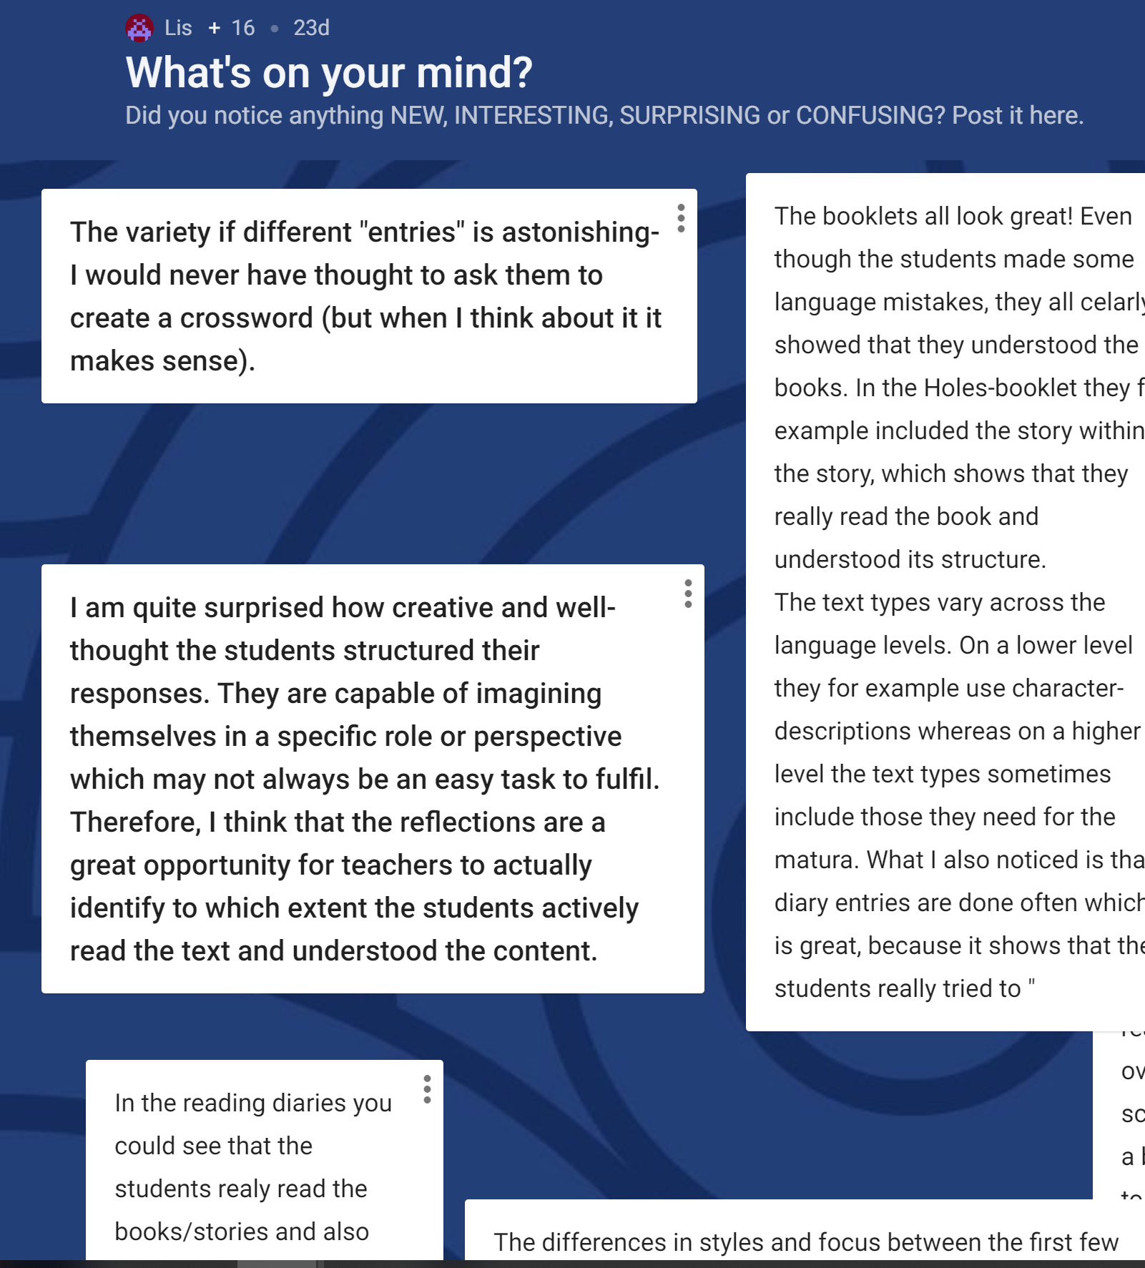
At home: before the course session
symbaloo.com
padlet.com

Slide 7
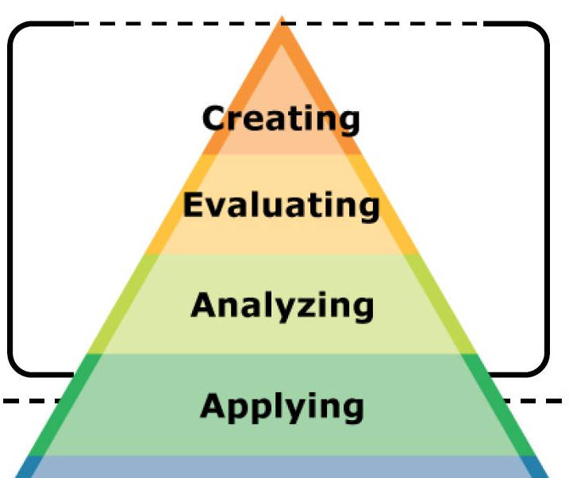
group-sharing and plenary discussions
online meeting

Slide 8
References and links (examples)
website: www.epep.at
samr model: https://www.schoology.com/blog/samr-model-practical-guide-edtech-integration
padlet: padlet.com
ein Beispiel: https://padlet.com/lispolzleitner/v1salvctg51b
symbaloo webmixes: ein Beispiel: https://www.symbaloo.com/home/mix/13ePBi27VS

