Slide 1
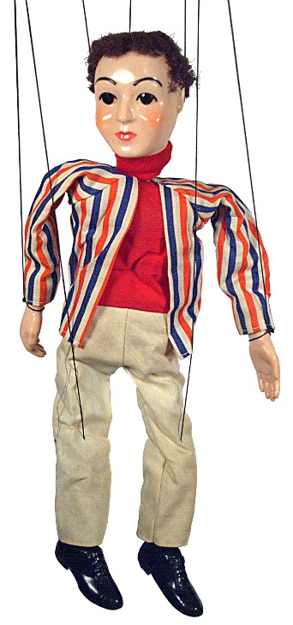
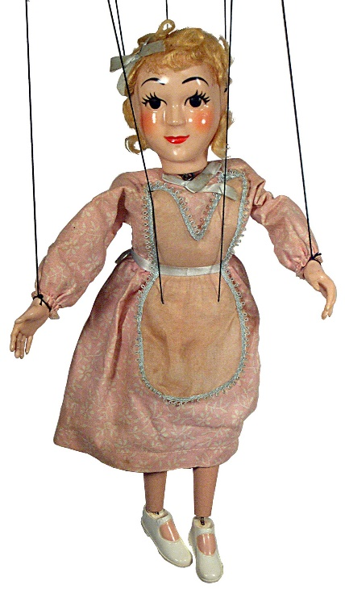
Zum Lernen Verführt
Lernen unter der Dopamindusche
Warum Marionetten nicht gut Sprachen lernen
… und wie es besser klappt
Notes:
Introduce myself…
Achtung…Folien auf Engl, spreche aber Deutsch

Slide 2
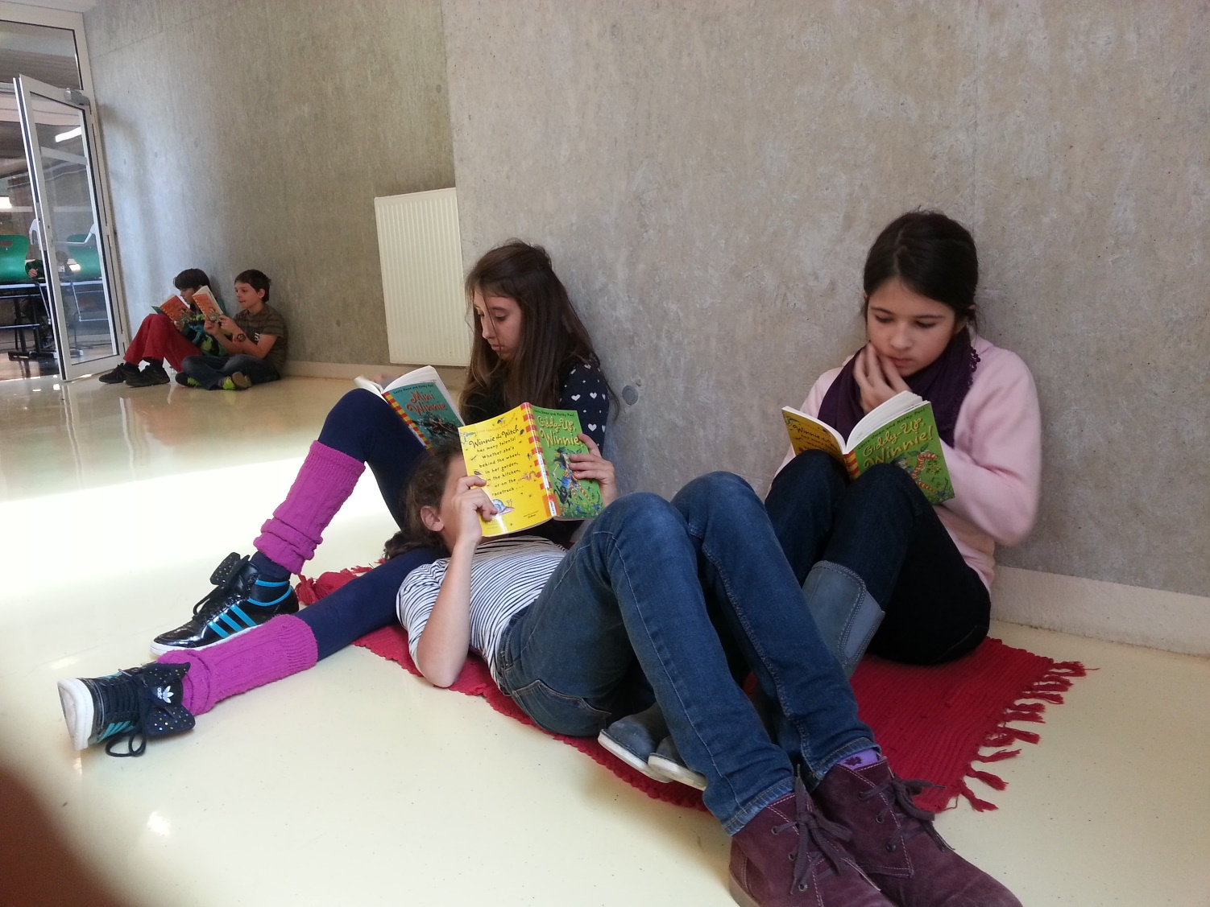
Was erwartet Sie in diesem Workshop?
Wer und wo?
  Beispiele aus AHS und MS
Was?
  Was sagt uns die Gehirnforschung über effizientes Sprachenlernen?
Wie?
  Wie können wir das konkret im Unterricht umsetzen? Beispiele aus der Praxis
Fragen und Diskussion

Slide 3
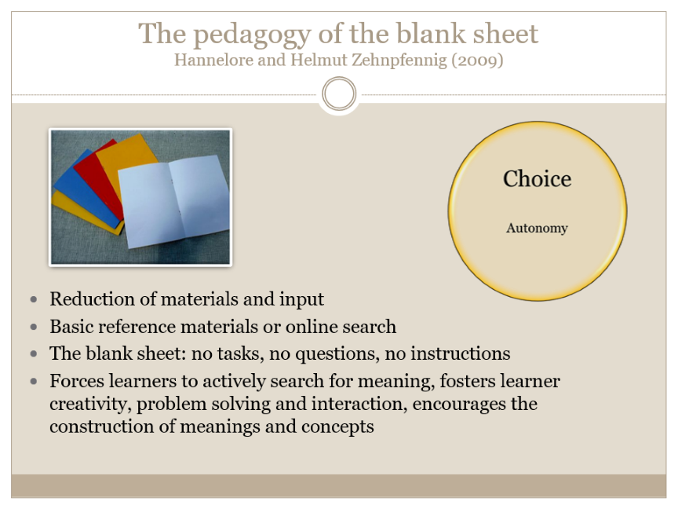
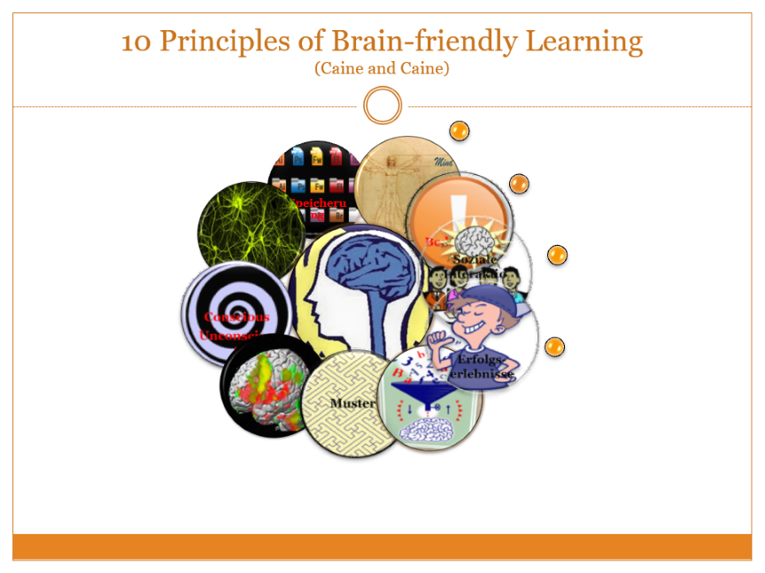
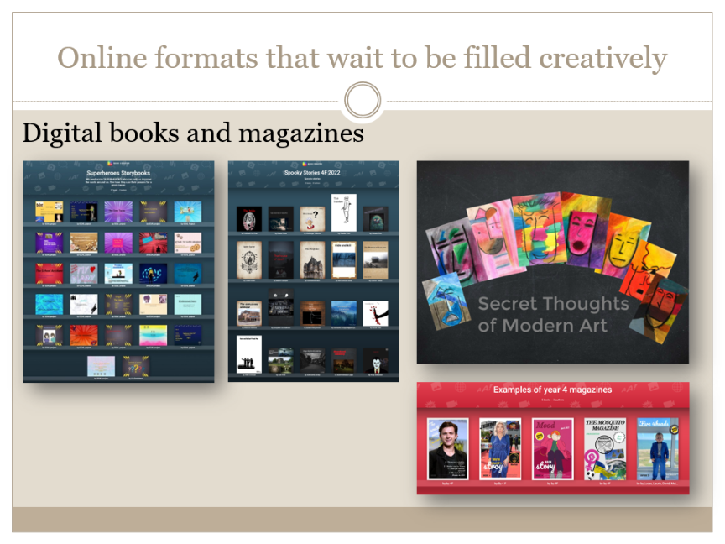
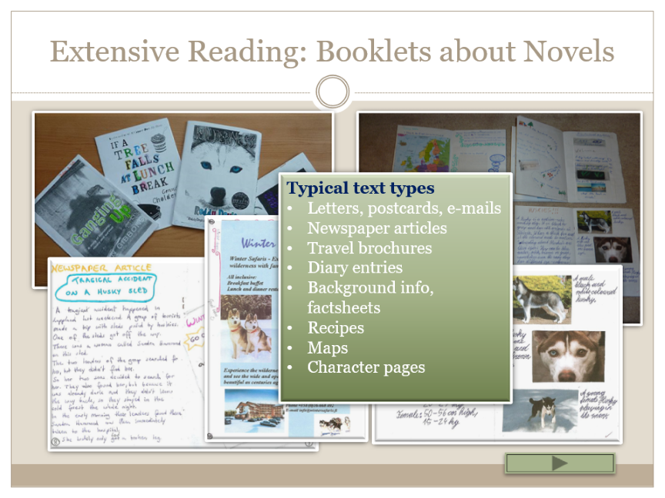
… what to expect today…

Slide 4

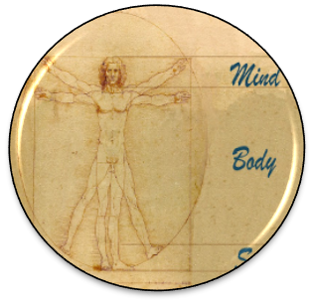
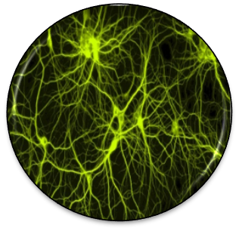





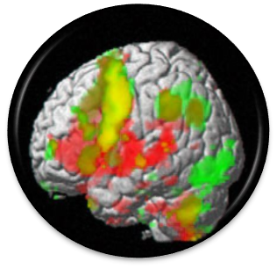
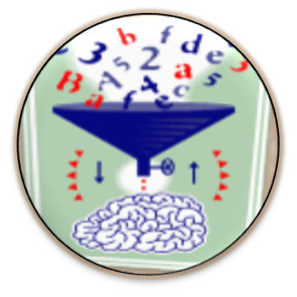

10 Principles of Brain-friendly Learning
(Caine and Caine)
Speicherung
Notes:
10 principles of learning Caine and Caine – abgeändert 1990 – 2000 –
Vergleiche meine Checkliste für gehirngerechten Unterricht…

Slide 5
10 Principles of Brain-friendly Learning
(Caine and Caine)
Speicherung
Notes:
10 principles of learning Caine and Caine – abgeändert 1990 – 2000 –
Vergleiche meine Checkliste für gehirngerechten Unterricht…

Slide 6


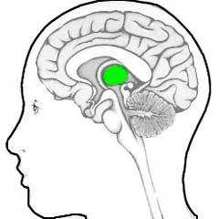
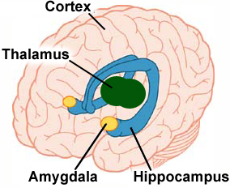



Hijacking the Brain : Emotions are the key to the brain
How learning works
Stimulus
Thalamus
Amygdala
Hippocampus and Cortex
Important
Ok, harmless
unimportant
dangerous
Alarm-system!
fight
flight
Notes:
Let’s follow the brain along the typical steps from input to learning.
A stimulus – in this case let’s assume it is sound waves – the teacher’s voice – enters the brain and reaches the (click) Thalamus. The Thalamus is an important part of our limbic system – our emotional center.
Here we have 2 options: (click) The Thalamus filters incoming information: if the incoming signal is marked as irrelevent, it will be discarded – in our picture it goes into the (click) bin. This is an important filter – we do not want to worry about all kinds of background noise, cars passing by and other irrelevant signals in our environment.
(click)
If the stimulus is perceived as important –(click) or at least potentially important, the Thalamus will let it through – and pass it on to the (click) Amygdala. In our picture we see two of these yellow, almond-shaped objects. Here incoming signals are checked for their emotional content. Is the incoming stimulus associated with (click) danger? … or does it seem (click) harmless? Some of these « danger » signals are innate – we are born with them. Humans and many animals are afraid of fire – even if we have not yet been burned. Other dangers need to be learned and acquired in the course of our lives.
Whenever an incoming stimulus is marked as dangerous, the amagdala sends signals to the Hypothalamus and the brain stem and our body prepares for (click) flight or (click) fight. Adrenalin and other neurotransmitters are released, our blood pressure and pulse frequence rise, oru muscle tonus rises. (click)
As our body is preparing for fight or flight reflexes – higher order thinking is turned off.
This cycle can save lives (in the wild!!) but does it help in exams?
I like to call this the AAA reaction: Amygdala-Adrenalin-Anxiety
It produces a cognitive style that facilitates basic, automatic routines
but prevents free associations and higher order thinking.
Let’s go back to the incoming signal and assume that the amygdala has decided that it is(click) harmless.
Only then is the stimulus passed on to the (click) hippocampus and the cortex and only then will any (click) higher order processing(click) take place in the cortex. (click)
What does this mean: fear and anxiety prevent learning – we must create a relaxed, safe atmosphere to open our learners’ brains.
This is really important for speaking activities – here danger may not only come from a teacher who penalizes every little mistake – danger might also come from classmates, who laugh at you or find fault in your presentation. In all these cases no learning will happen.

Slide 7



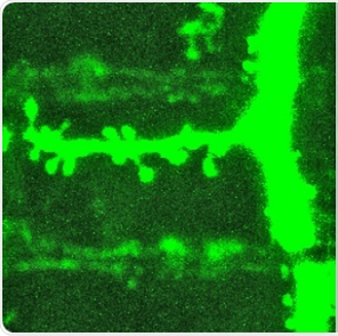
How learning works
Why we need more than just workbook exercises
Long-term learning only happens in meaningful contexts
“Importance is physical” : Acetylcholine
Notes:
Celebrate success and achievements – dopamine shower!

Slide 8

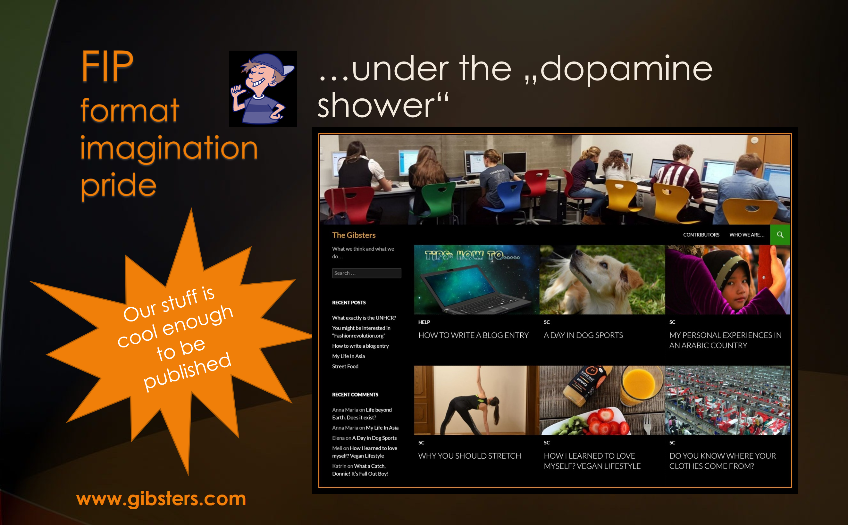
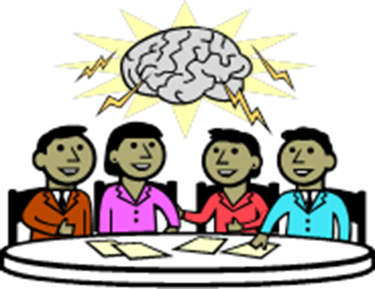

In other words…
Autonomy
Mastery
Connection
Choice
Challenge
Social connections, peers
Self-determination
FIP
Format- Imagination- Pride
Ownership
Personal Meaning
Notes:
Überblick – wir schauen uns jeden der drei Bereiche genauer an. Alle drei sind psychologisch wichtig und haben aber Folgen auf chemisch – neuronaler Ebene. (Transmitter – Synapsenwachstum… growth cones…)
Intrinsic Motivation: Dopaminspirale!!! Will mehr und mehr von diesem Erfolg.
Mastery: Stolz auf den Erfolg

Slide 9
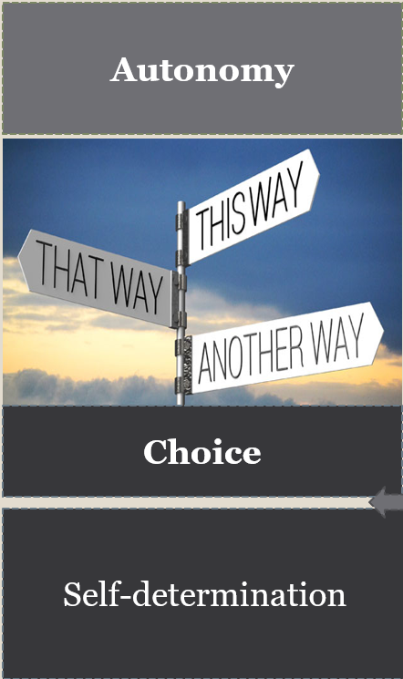
Autonomy: Choice theory
(William Glasser)
Five basic needs
In an effective classroom…
Basic survial
Need for belonging
Need for power
Need for freedom
Need for fun
We address these needs by creating opportunities for the students to express themselves individually or to work with others
By allowing students to choose activities of interest that are playful yet challenging
And by empowering students through active learning and decision making.
(Judith Dodge, Differentiation in Action, p. 51)
Our 5 basic needs drive our choices. We choose to behave in a way that will satisfy most of these needs.
Notes:
Ich muss in der Klasse versuchen möglichst viele dieser Bedürfnisse zu befriedigen. Sonst findet wenig Lernen statt.

Slide 10

From the Neurosciences to
Autonomous Learning
„The autonomous learner is one that constructs knowledge from direct experience, rather than one who responds to someone‘s instruction“
„Our job is to create learning opportunities, not to impose a method“ There‘s more than one way to learn a language.“ (Benson 2001)
Effective teachers can navigate between the two poles.

Slide 11
How do we do this?
TBL
Task based learning
FIP
Format
Imagination
Pride
Choice
Autonomy

Slide 12
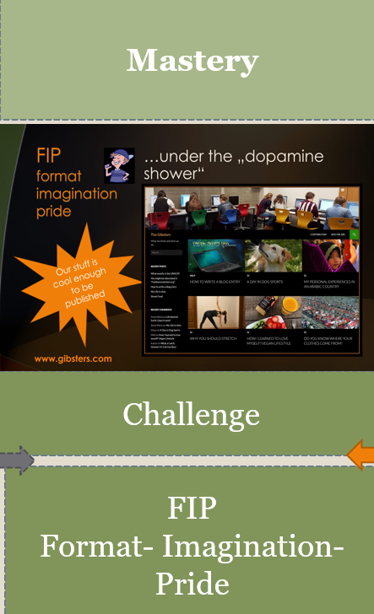
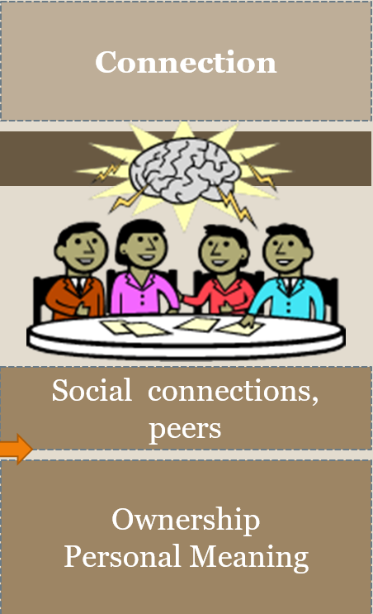

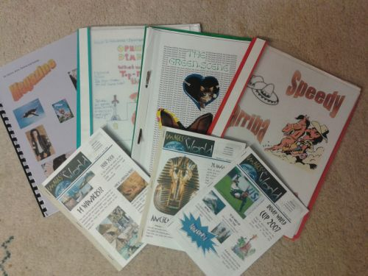
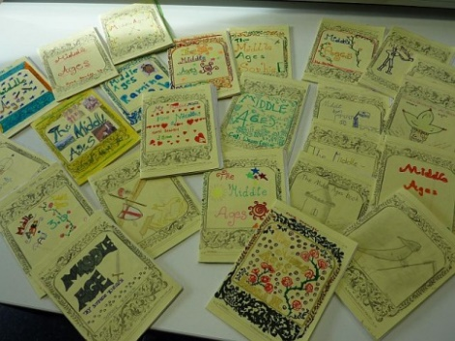

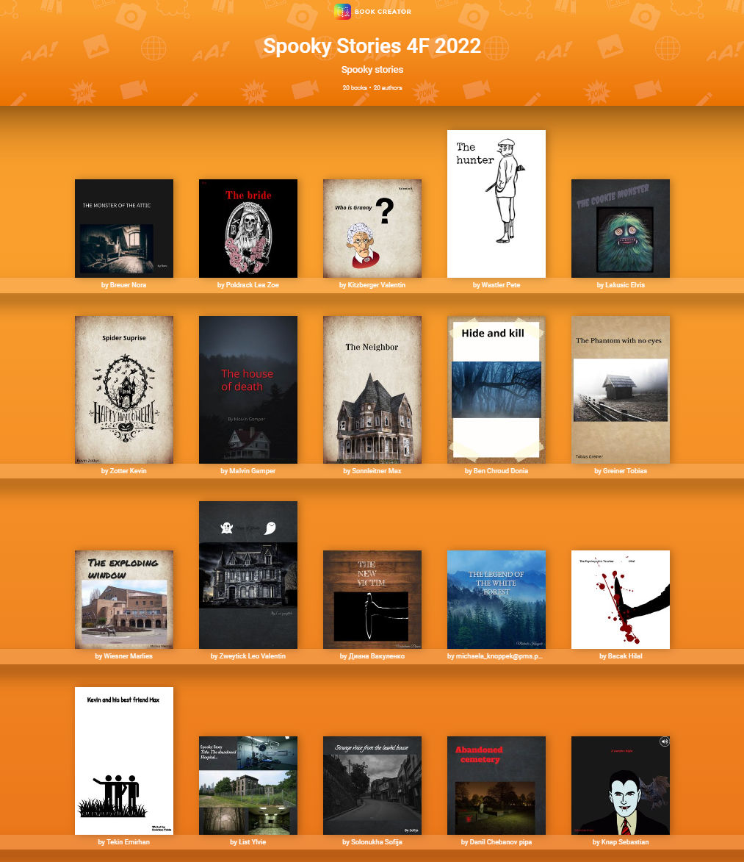

TBT: Task Based Teaching
What is a TASK
„A piece of classroom work which involves learners in comprehending, manipulating, producing, or interacting in the target language while their attention is principally focused on meaning rather than form.“ (Nunan 1989)
Tasks vs Exercises (Willis 2007)
  Does the activity engage learners‘ interest?
  Is there a primary focus on meaning?
  Is there an outcome?
  Is success judged in terms of outcome?
  Is completion a priority?
  Does the activity relate to real world activities?
Magazine Writing
My book about Life in the Middle Ages
TBL
Task based learning
Blog writing
Spooky Stories
A radio show: Aliens have landed in Fürstenfeld
Notes:
Ich brauche ein interessantes, herausforderndes TASK – aber das ist noch nicht genug: -- next slide: FORMAT

Slide 13

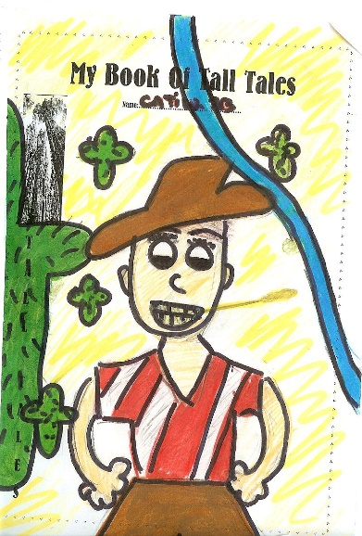

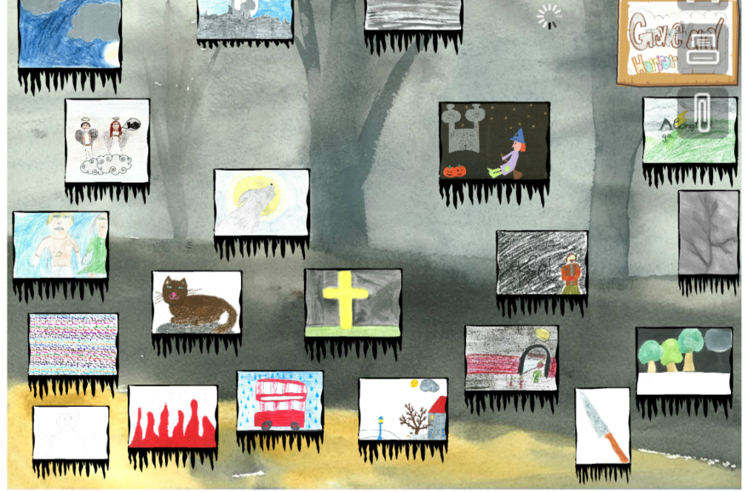
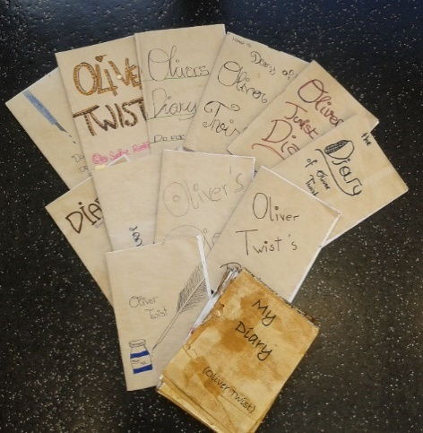
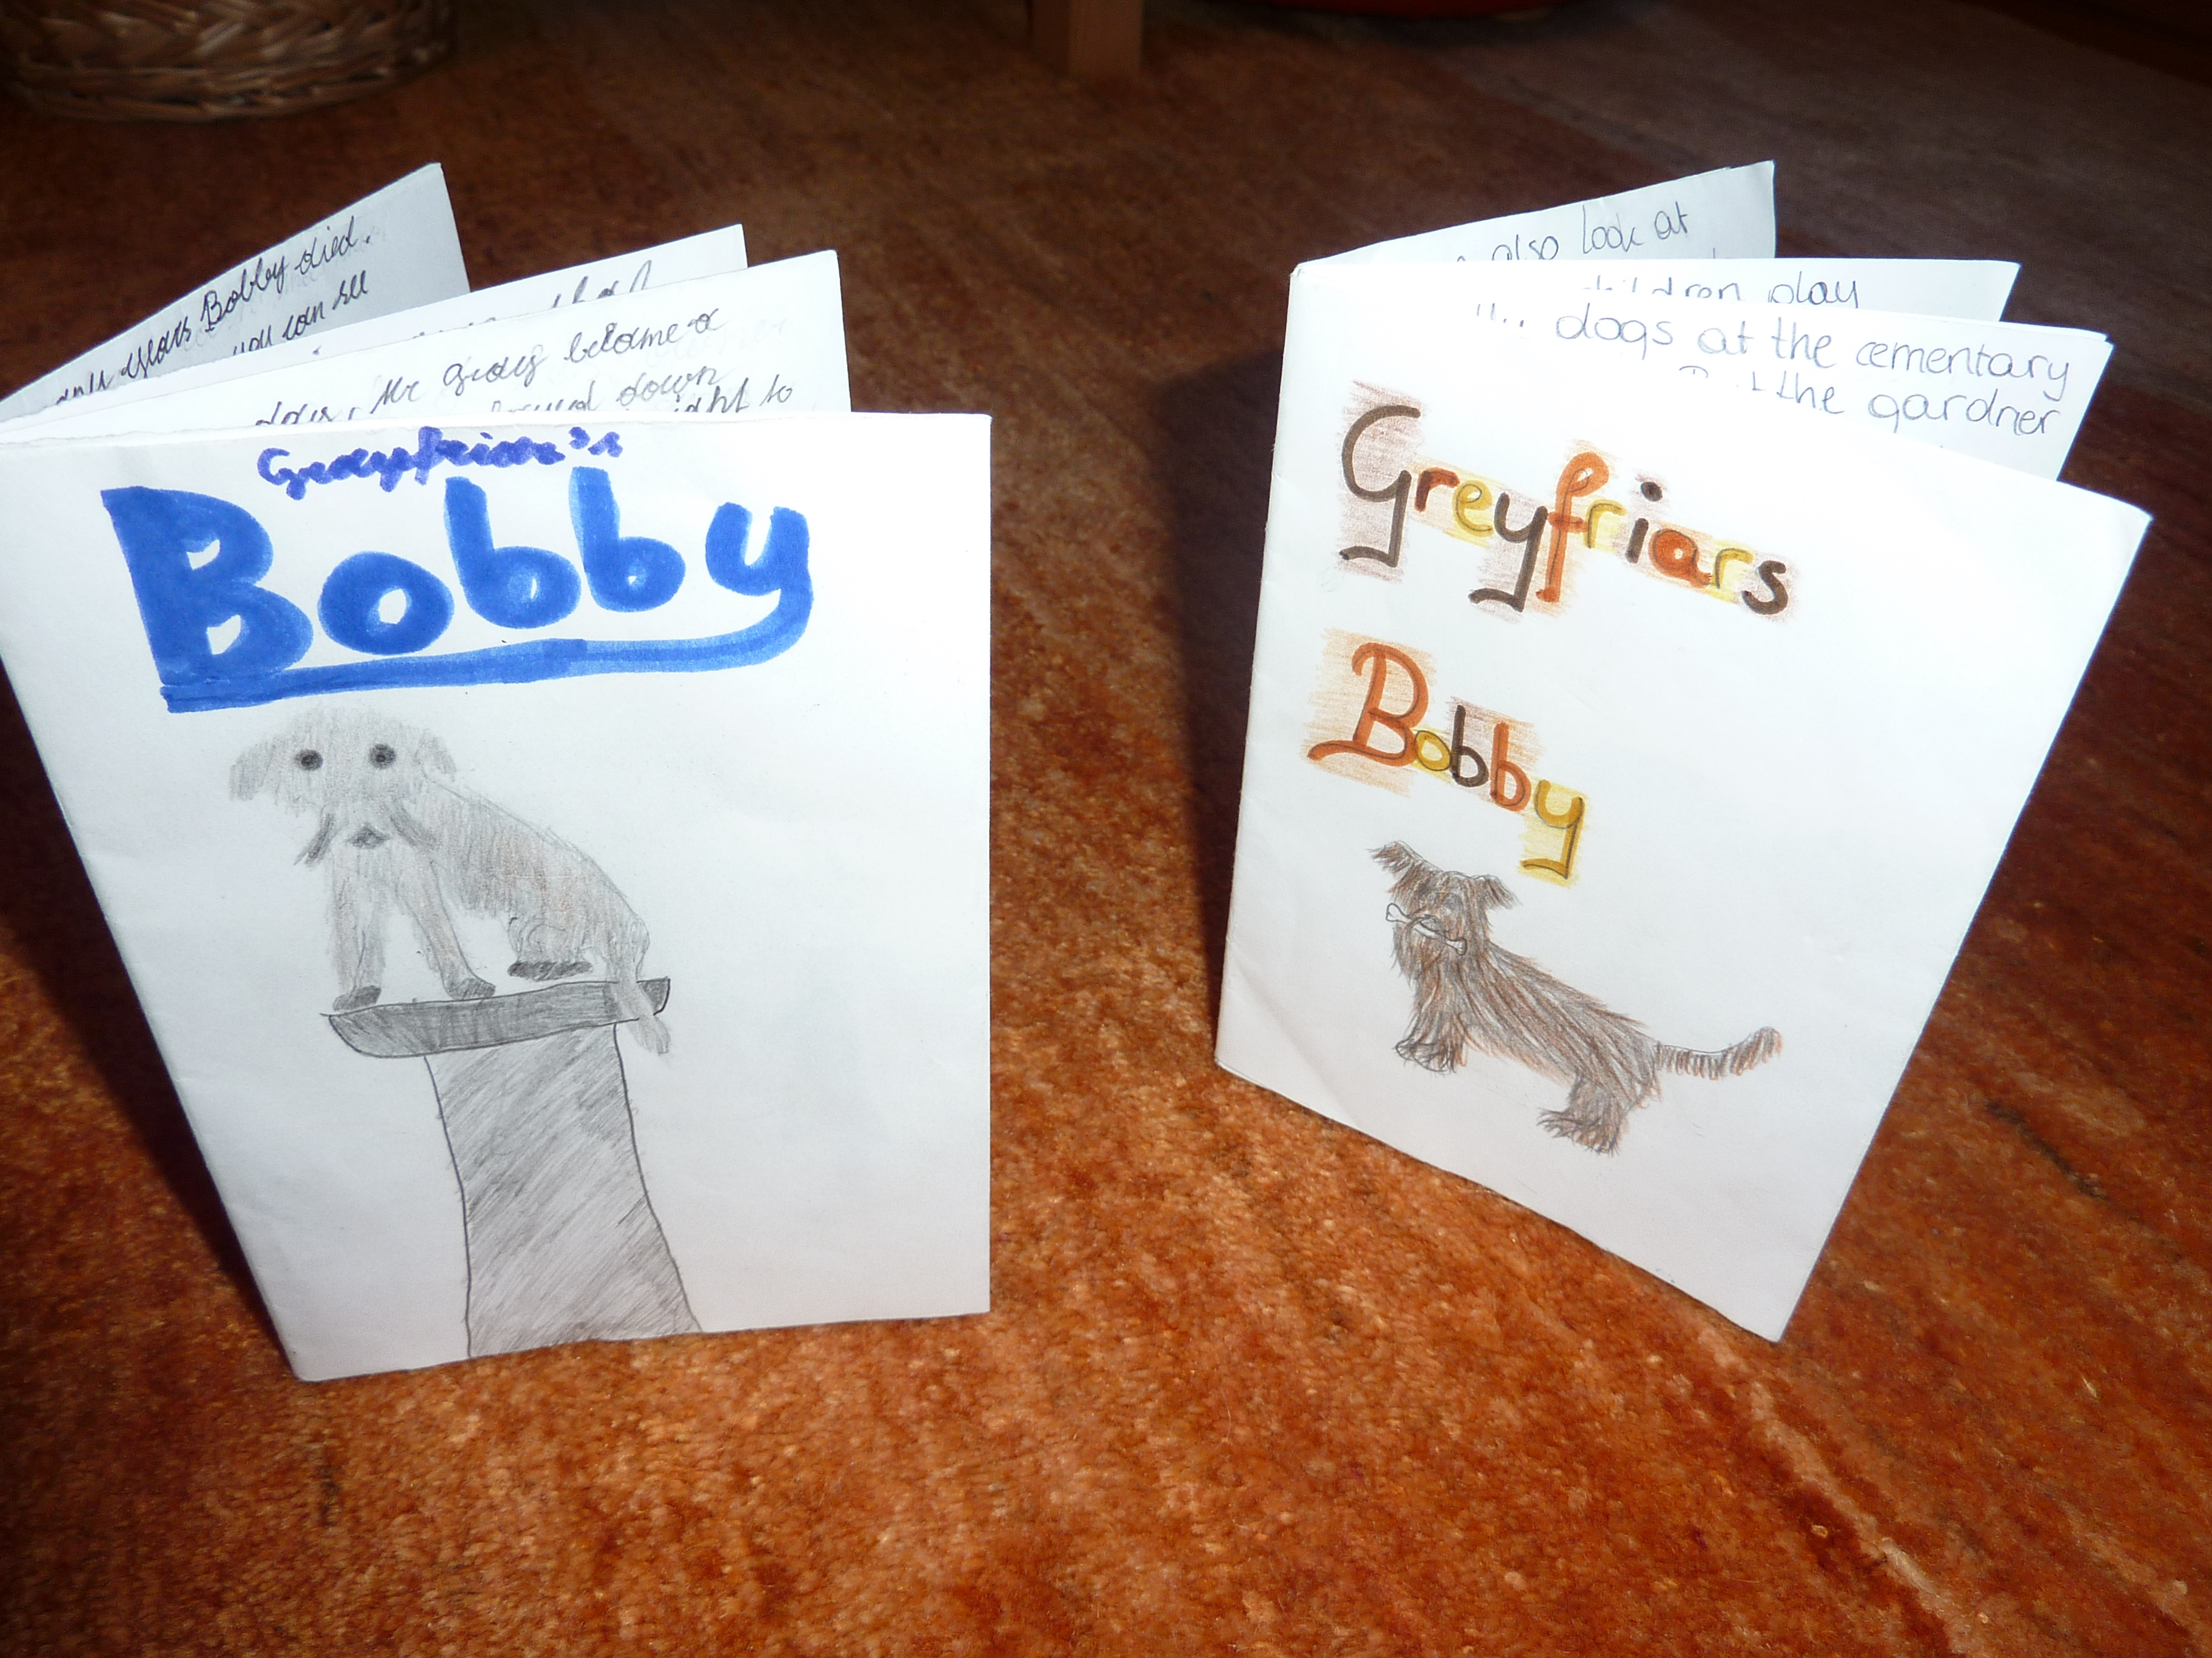
F I P: Format – Imagination – Pride
Our stuff is cool enough to be published
“Complex learning is enhanced by challenge and inhibited by threat”
(Caine & Caine 2000)
FIP
Format
Imagination
Pride
Trust them!
–
Tipp: alle Beispiele finden Sie auf www.epep.at

Slide 14
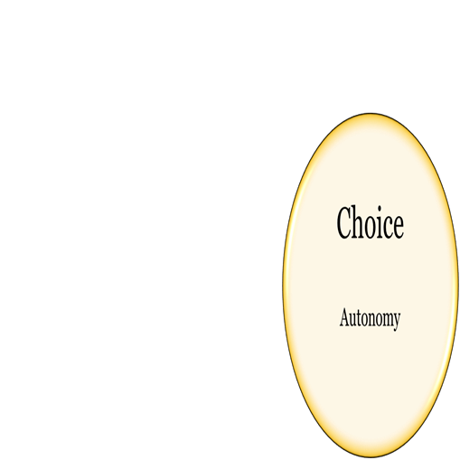

The pedagogy of the blank sheet
Hannelore and Helmut Zehnpfennig (2009)
Reduction of materials and input
Basic reference materials or online search
The blank sheet: no tasks, no questions, no instructions
Forces learners to actively search for meaning, fosters learner creativity, problem solving and interaction, encourages the construction of meanings and concepts

Slide 15
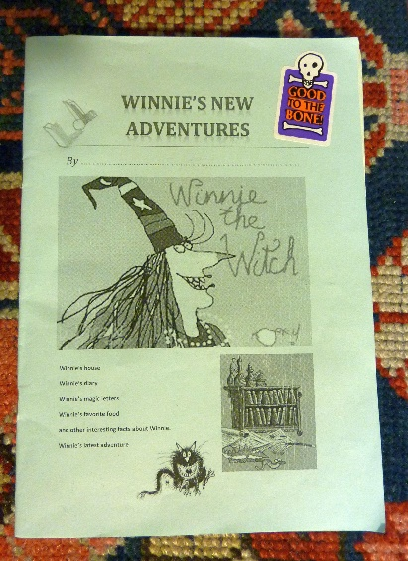
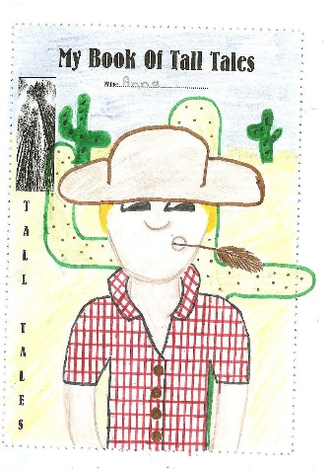
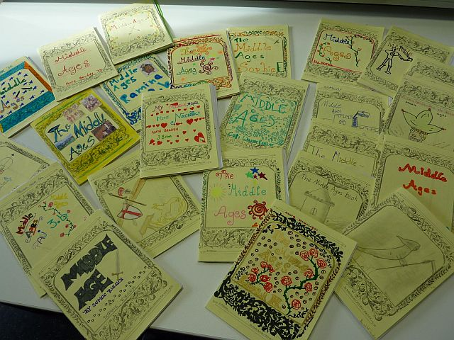
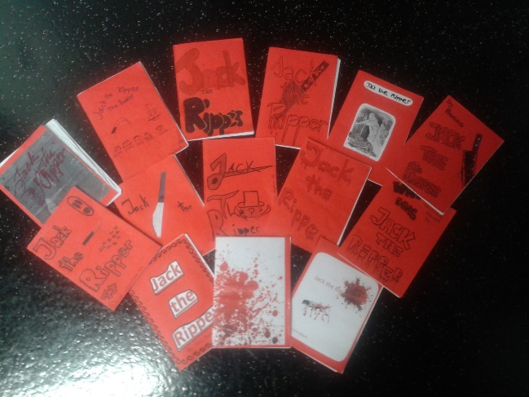
Examples: Pedagogy of the blank sheet

Slide 16
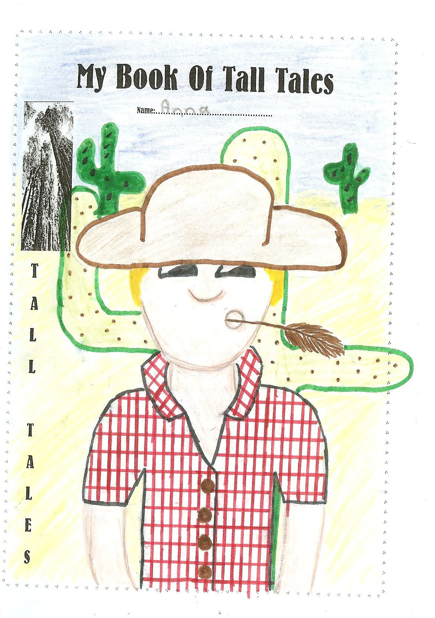
Tall Tales, year 2

Slide 17
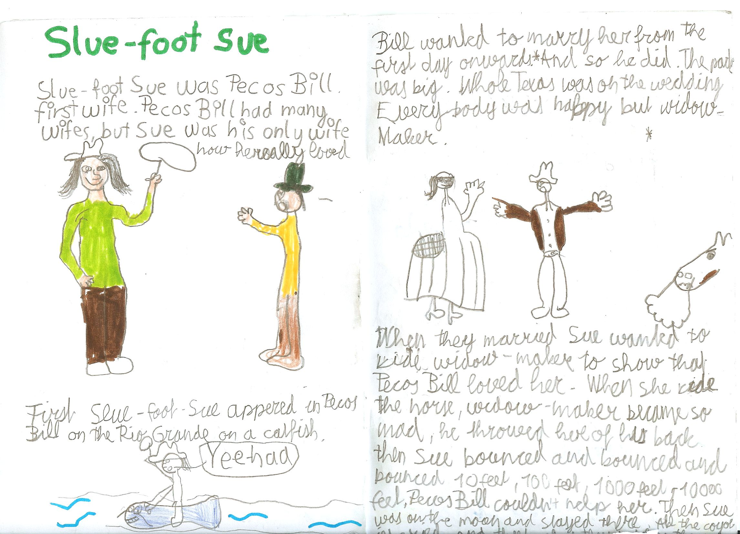
Tall Tales, year 2

Slide 18
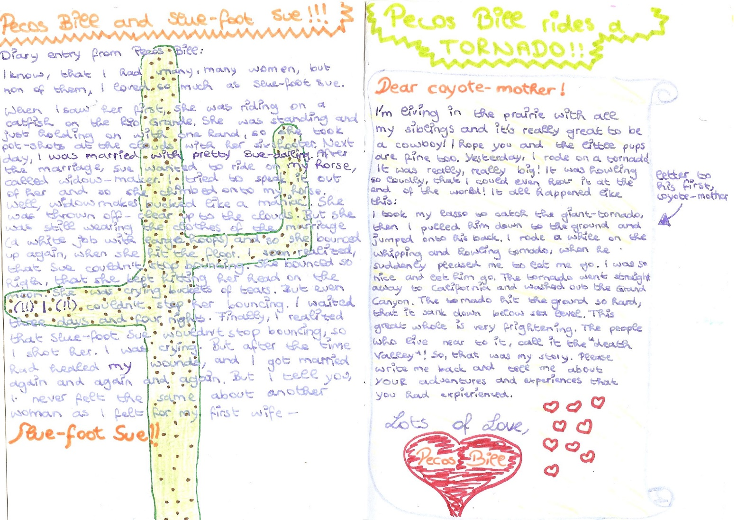
Tall Tales, year 2

Slide 19
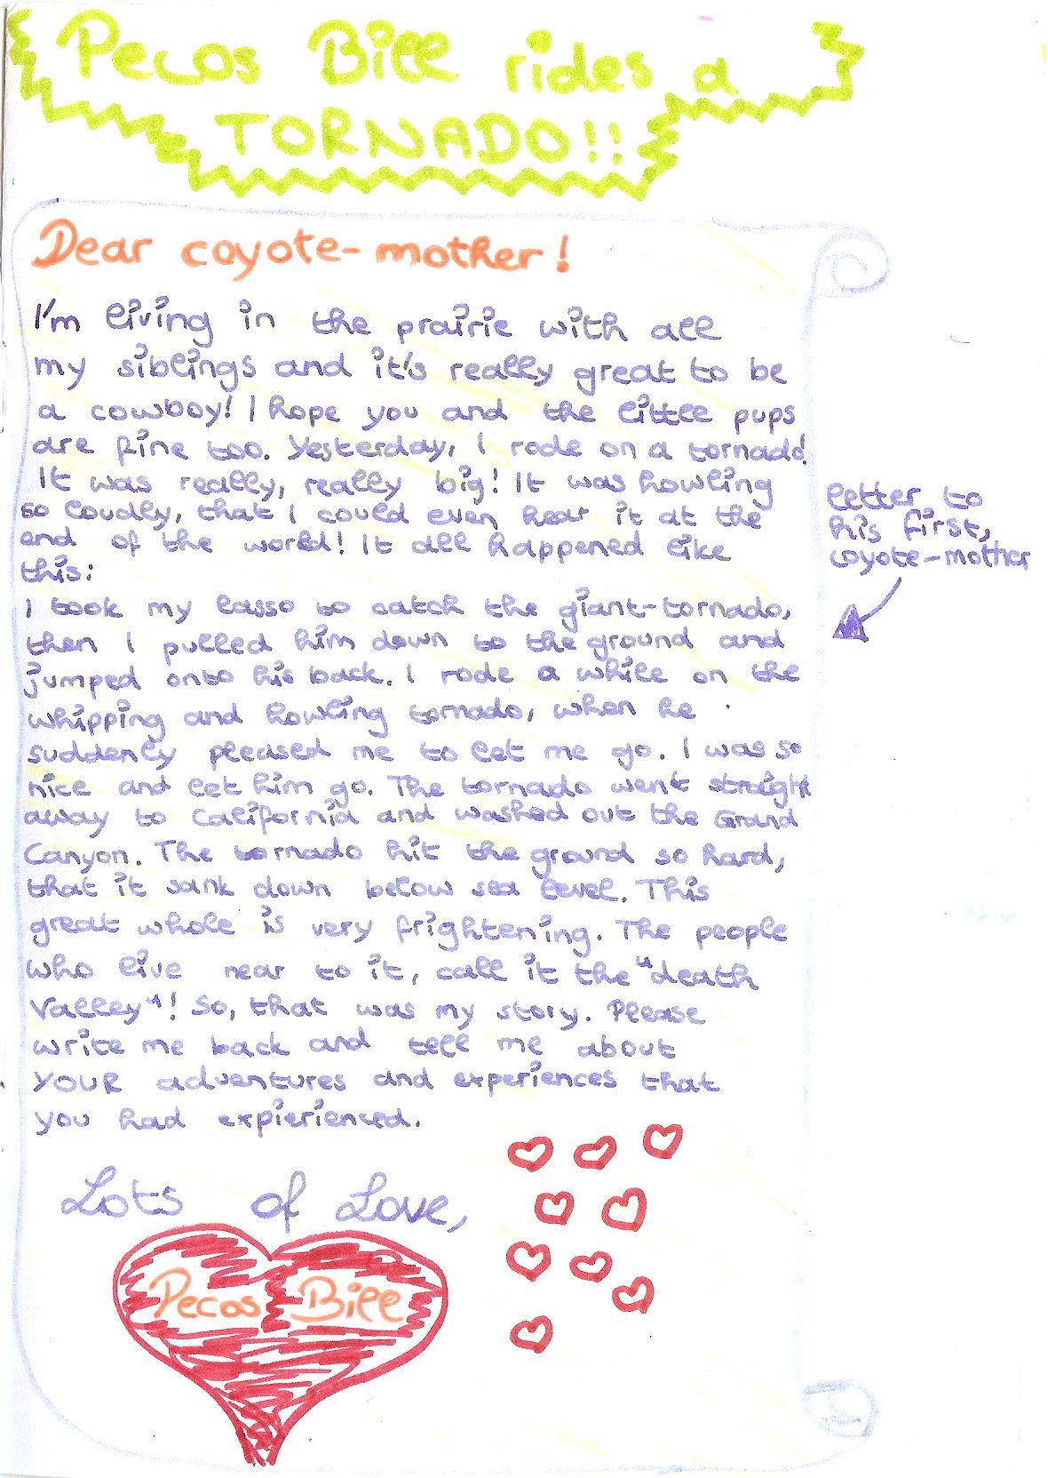
Tall Tales, year 2

Slide 20
Life in the Middle Ages

Slide 21
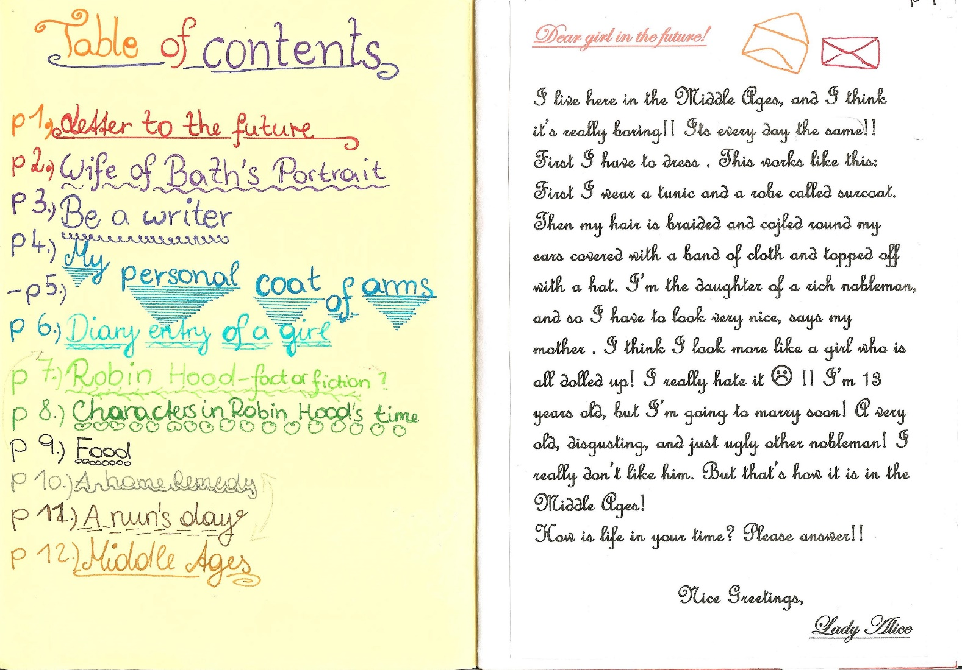
Life in the Middle Ages

Slide 22
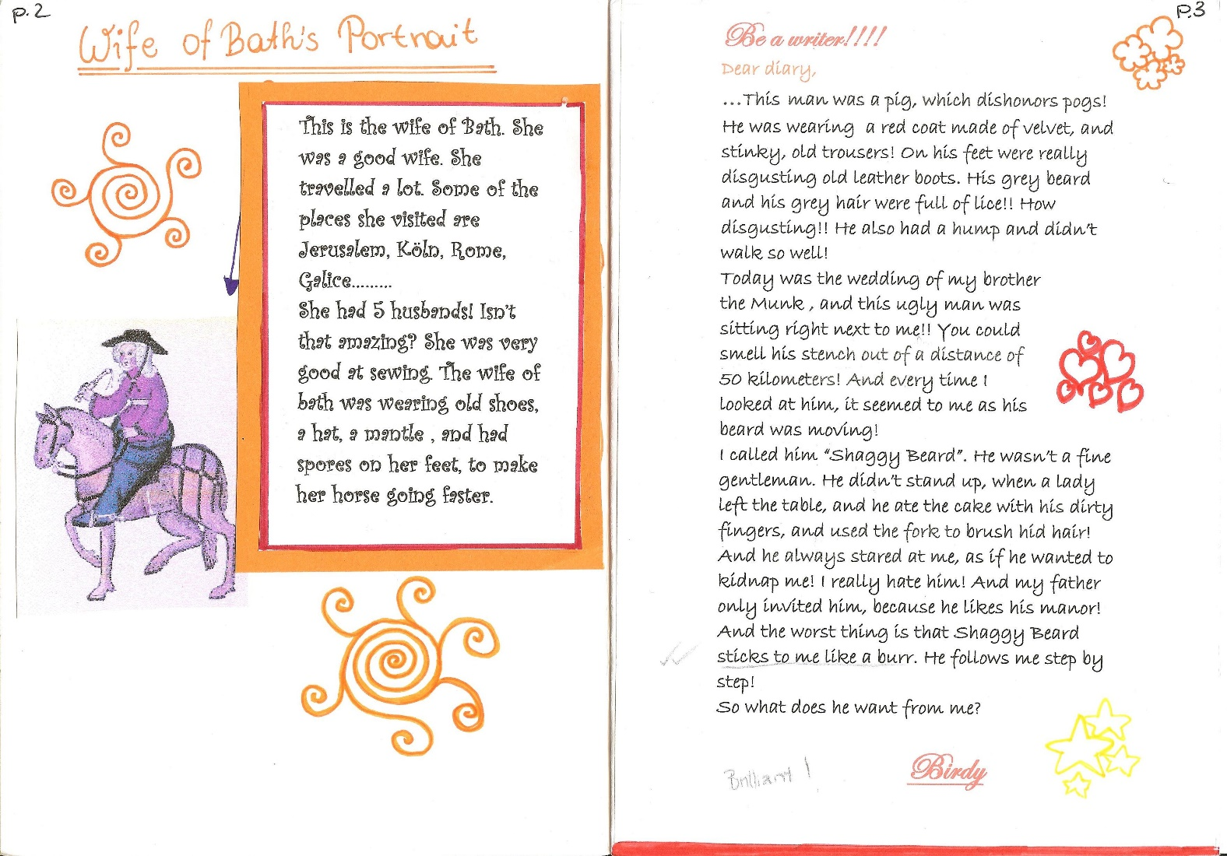
Life in the Middle Ages

Slide 23
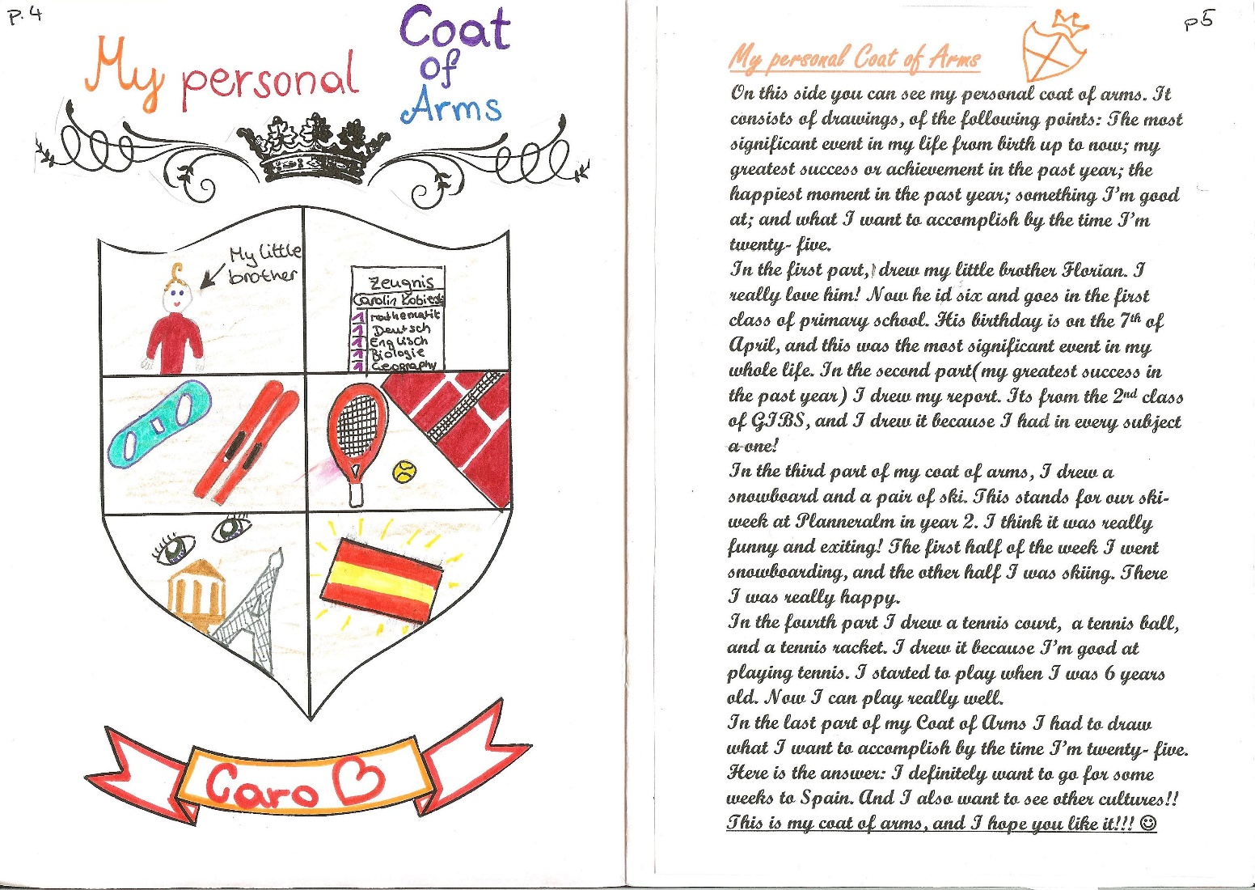
Life in the Middle Ages

Slide 24
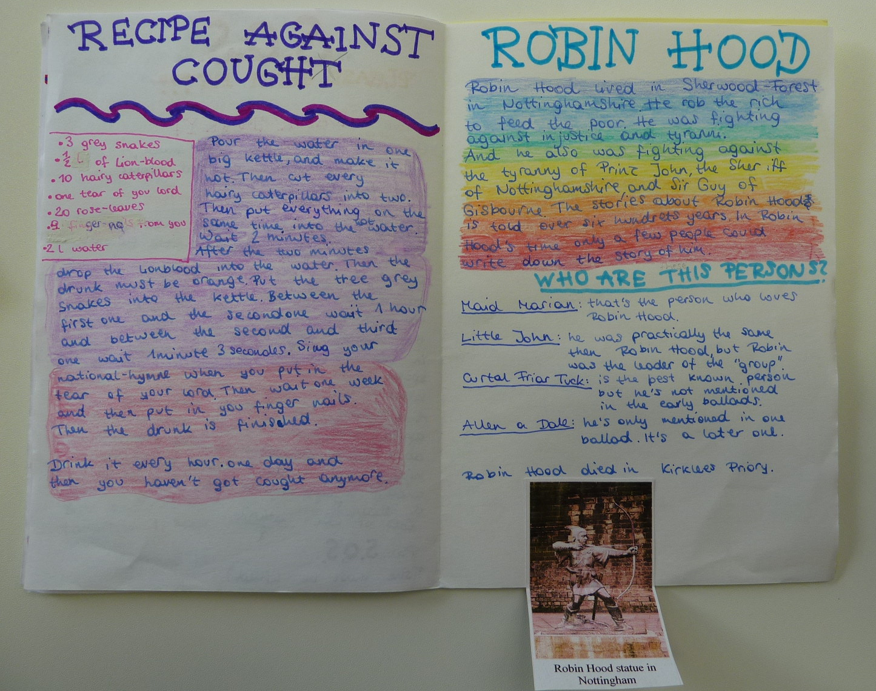
Life in the Middle Ages

Slide 25
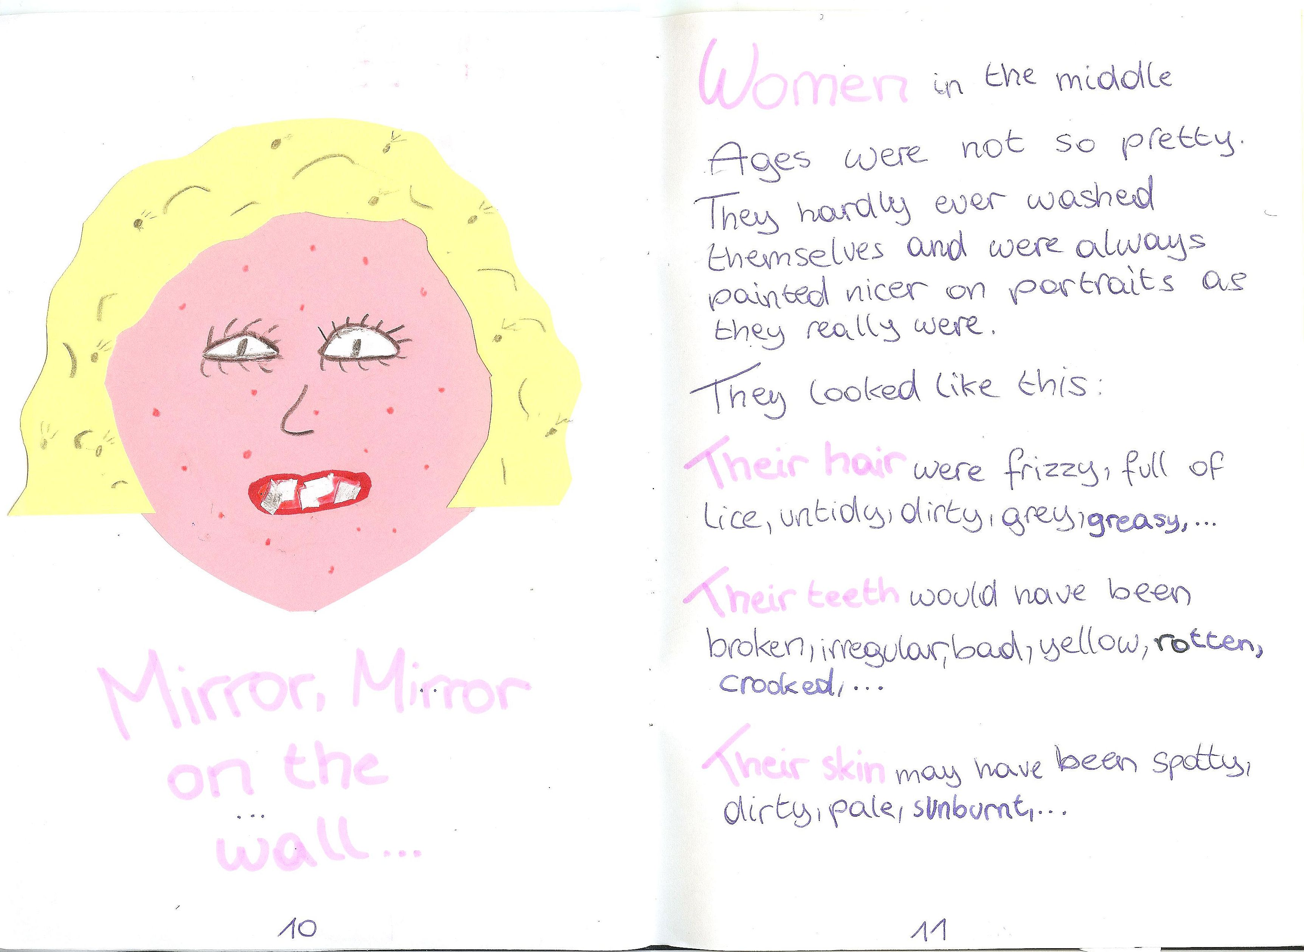
Life in the Middle Ages

Slide 26
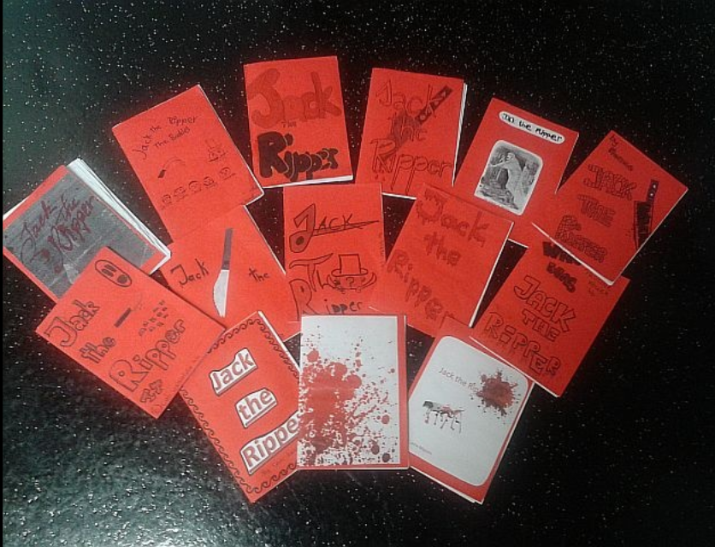
Jack the Ripper, year 4

Slide 27
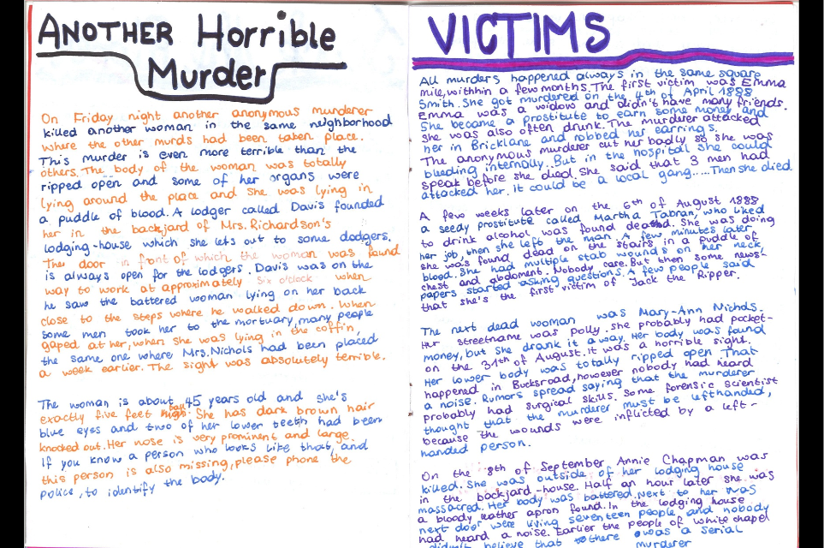
Jack the Ripper, year 4

Slide 28
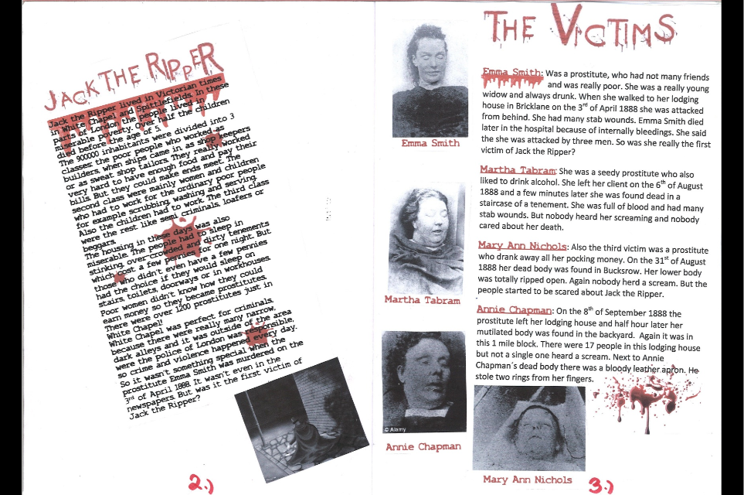
Jack the Ripper, year 4

Slide 29
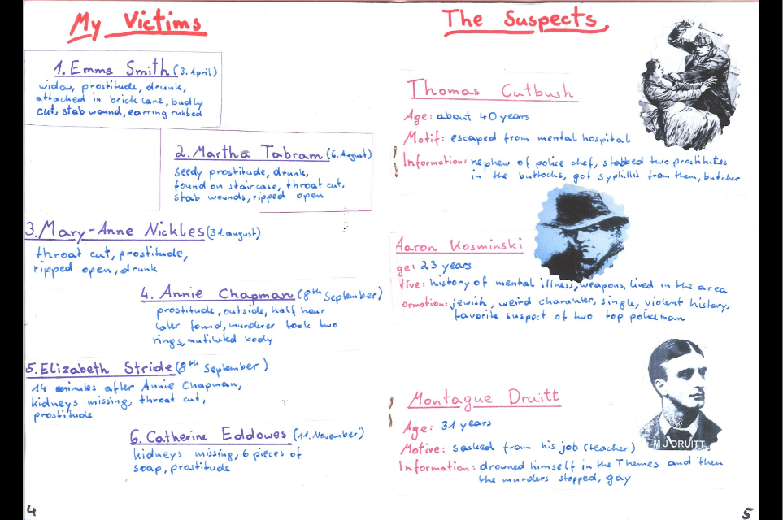
Jack the Ripper, year 4

Slide 30
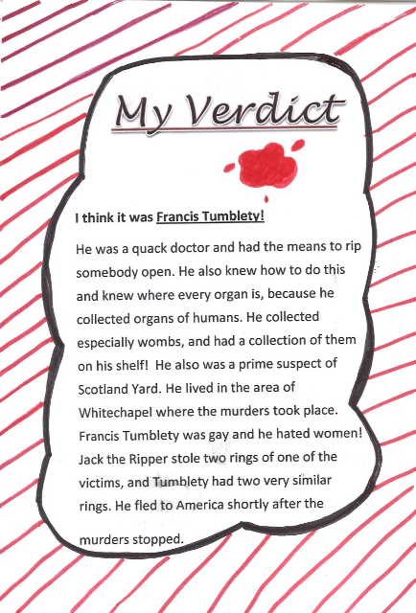

Slide 31
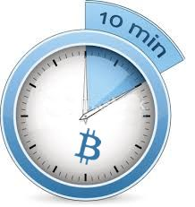
Let’s explore…

Slide 32
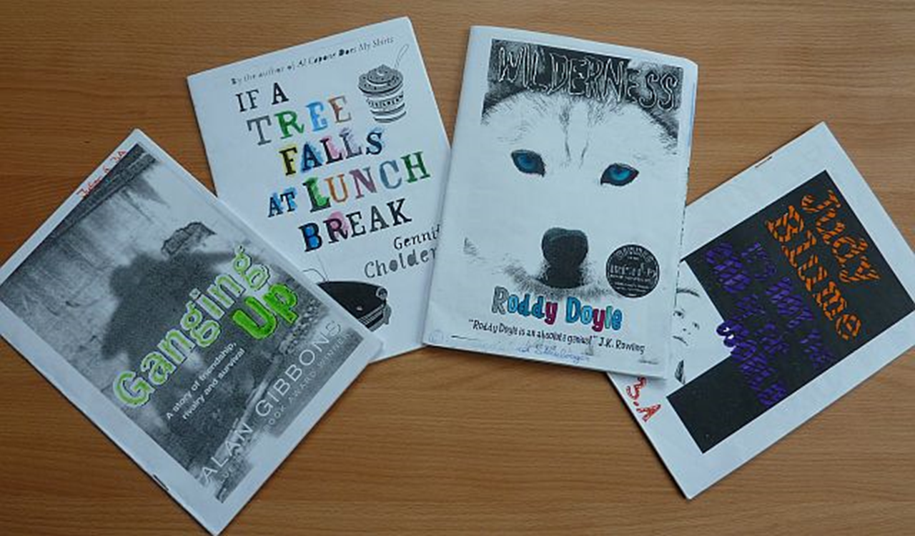
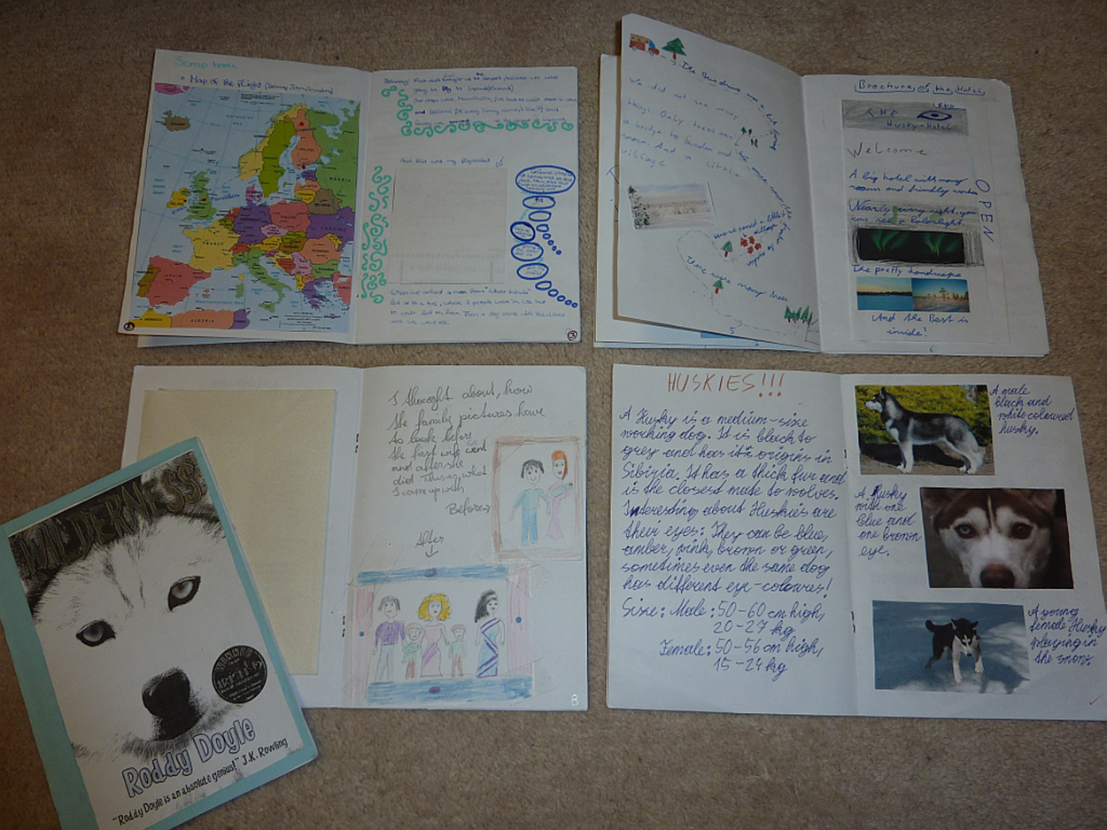
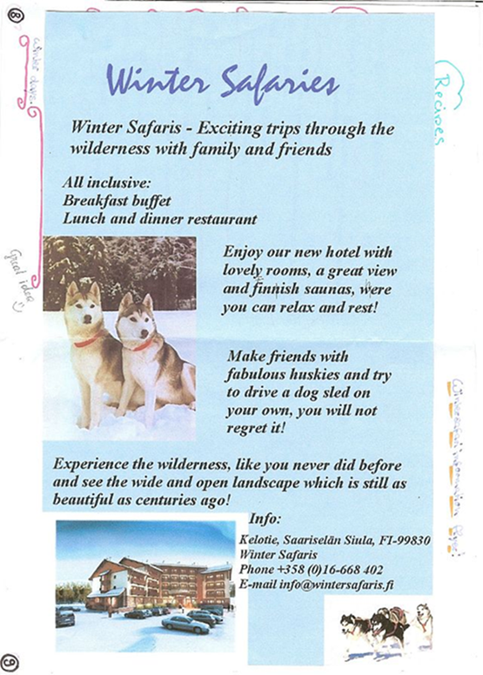
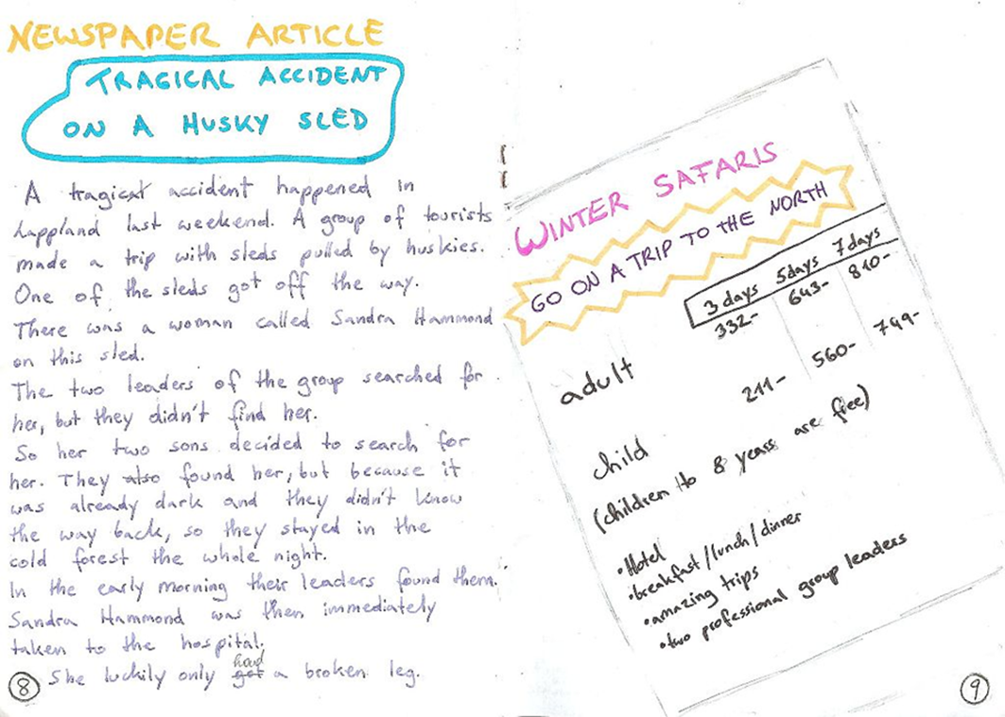

Extensive Reading: Booklets about Novels
Typical text types
Letters, postcards, e-mails
Newspaper articles
Travel brochures
Diary entries
Background info, factsheets
Recipes
Maps
Character pages

Slide 33


Slide 34

Table of contents

Slide 35

Character portraits

Slide 36



Slide 37

Newspaper articles and ads

Slide 38


Ads and brochures

Slide 39


Letters and postcards

Slide 40

Background information and research

Slide 41


Slide 42


Maps and tavel information

Slide 43





Upper-school Examples
More text-types
Alternative endings
Letters to the author
What I would have done…
Plot diagrams
Interesting quotes
Alternative covers and blurbs

Slide 44

Cover page and letter to the author

Slide 45

Author info and Plot diagram

Slide 46

Plot diagram (The Pearl)

Slide 47

Drawings

Slide 48

Character portraits

Slide 49

Newspaper article

Slide 50


Diary entries

Slide 51

Letter to the author and drawings

Slide 52
Let’s explore…

Slide 53




Online formats that wait to be filled creatively
Digital books and magazines

Slide 54

Blogs and Book-trailers

Slide 55





Examples: Ways into autonomous writing

Slide 56



In all these projects the learners...
make lots of choices, take decisions
do activities that seem relevant to them
are actively involved and use the language
actively cooperate and communicate with others
persue personal goals and group goals
manage time and resources
are proud of their results
build growth-oriented mindsets

Slide 57



Thank you for your attention
For more ideas and examples visit
https://epep.at
https://gibsters.com
https://readingiscool.xyz

Slide 58



Time for questions

Slide 59
References
Benson, P. (2001). Teaching and Researching Autonomy in Language Learning, Harlow: Pearson Education
Littlewood, W. (1996). "Autonomy”: an anatomy and a framework. System, 24/4, 427-435. Quoted from: http://www.finchpark.com/afe/l.html, 19.05.2012
Nunan, D. (1997). Designing and adapting materials to encourage learner autonomy. In P. Benson, & P. Voller. Autonomy and Independence in Language Learning. Harlow: Longman, 192 - 203.
Willis, D. and Willis J. 2007. Doing Task-based Teaching, Oxford: Oxford Handbooks for Language Teachers
Zehnpfenning, H. und Zehnpfenning H. 2008. online: http://www.zeugner.at/files/nachlese/010909/Go_OffUnt_Didaktik_des_weissen_Blattes.pdf

Slide 60
Basisliteratur
Caine, R.N. and G. Caine. "Understanding a Brain-Based Approach to Learning and Teaching." Educational Leadership 48.2 (1990): 66-70. 06 11 2011. <http://www.sedl.org/scimath/compass/v03n02/1.html>.
Caspary, Ralf. "Dopamindusche im Klassenzimmer." Caspary, Ralf. Lernen und Gehirn. Freiburg im Breisgau: Herder, 2006.
Herrmann, Ulrich. "Gehirnforschung und die neurodidaktische Revision schulisch organisierten Lehrens und Lernens." Herrmann, Ulrich. Neurodidaktik. Weinheim und Basel: Beltz, 2006.
Roth, Gerhard. "Warum sind Lehren und Lernen so schwierig?" Herrmann, Ulrich. Neurodidaktik: Grundlagen und Vorschläge für gehirngerechtes Lehren und Lernen. Weinheim und Basel: Belz, 2006.
Spitzer, Manfred. Lernen. Gehirnforschung und die Schule des Lebens. Heidelberg/Berlin, 2002.
Spitzer, Manfred. "Medizin für die Schule." Caspary, Ralf. Lernen und Gehirn. Freiburg im Breisgau: Herder, 2006.
Zull, James. The Art of Changing the Brain: enriching teaching by exploring the biology of learning. Sterling, Virginia: Stylus Publishing, 2002.

