Slide 1
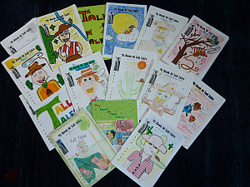
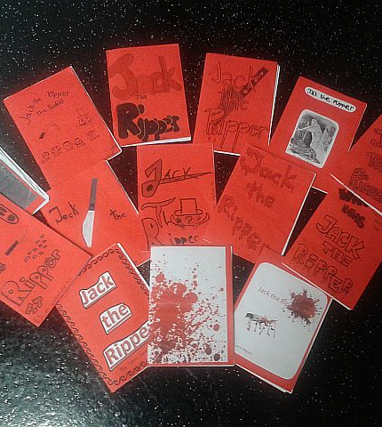
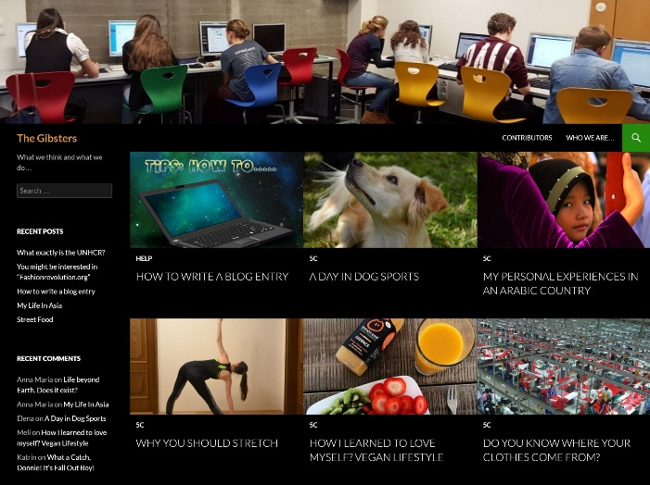
Engaging Students with Writing Developing competence through autonomous learning in Secondary School
Elisabeth Pölzleitner
GIBS: Graz International Bilingual School
and
Institut für Anglistik, Uni Graz

Slide 2
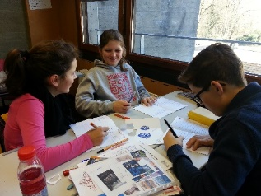
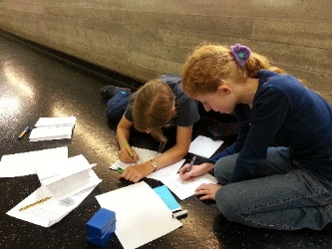
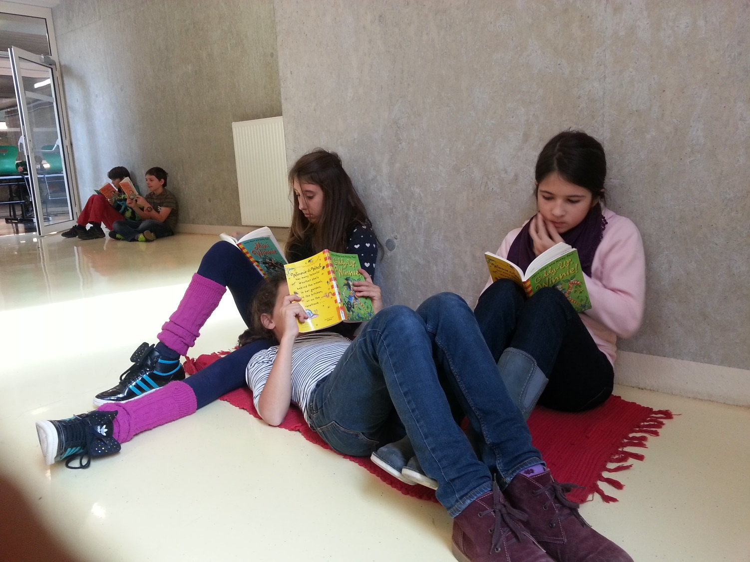
Overview of today‘s presentation
Framework/ setting / possibilities and limitations
My goals
How to implement autonomous writing in secondary school
Exploring learner products
Discussion and questions

Slide 3
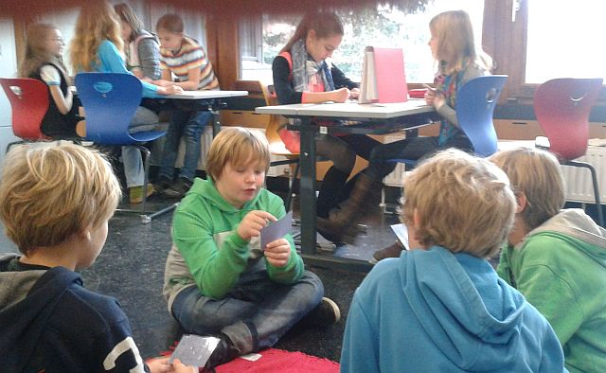
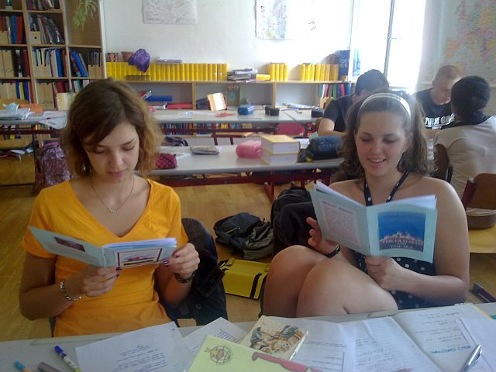
The Setting
Learners at secondary school (ages 10 – 18)
Groupsize: ~25 students in each class
English lessons only (no open learning periods)
Workshops about 90% of the time
No use of textbook
Mainly TBT (task based teaching) (Willis 2007)

Slide 4
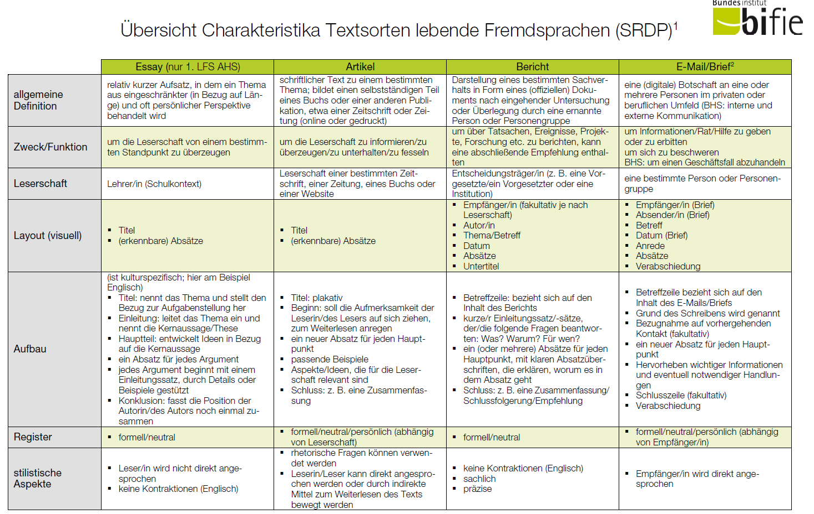
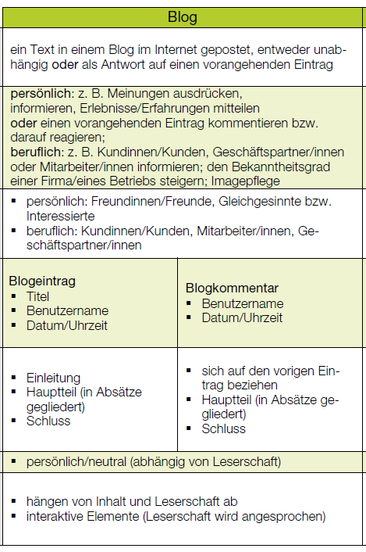
Curriculum Requirements
Austrian national curriculum + CEF
Standardized final exams: B2
Required texttypes: essay, article, letter or e-mail, blog post or blog comment, report)
Learners need to understand that they are writing for a specific AUDIENCE for a specific PURPOSE.
Teachers must create authentic situations and tasks that learners can relate to.

Slide 5

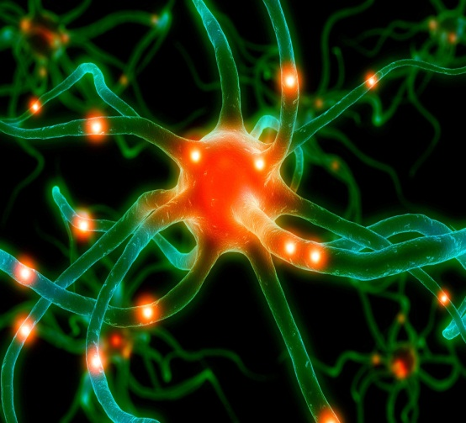
My goal: bridging the gap between the curriculum, BIST /CEF ….. and ….higher order skills /learning for life
Learning involves the whole person – body, mind and soul.
Long-term learning only happens in relevant, meaningful contexts.
Emotional and social aspects play a key role.
(Bauer, Spitzer , Hüther, Roth, in Caspary 2006) (Zull 2002: 224 ) Macedonia M.
BIST/CEF competences
4 skills - testability
Test formats
Texttypes
Education for life
learner centered
skills for life-long learning
higher order skills
social skills and transcultural understanding
curiosity and openness
experimenting and hypothesis building
Der Schüler ist kein Nürnberger Trichter, erst recht kein wandelnder Aktenordner, und der Lehrer kein blutleeres Wissenslexikon.
(Bauer 2006: 47)
Notes:
Knowledge and understanding cannot be transferred from the teacher‘s brain to the learners‘ brains.
Students‘ brains are very different from databanks or file-systems and
Teachers are not walking encyclopedias.

Slide 6

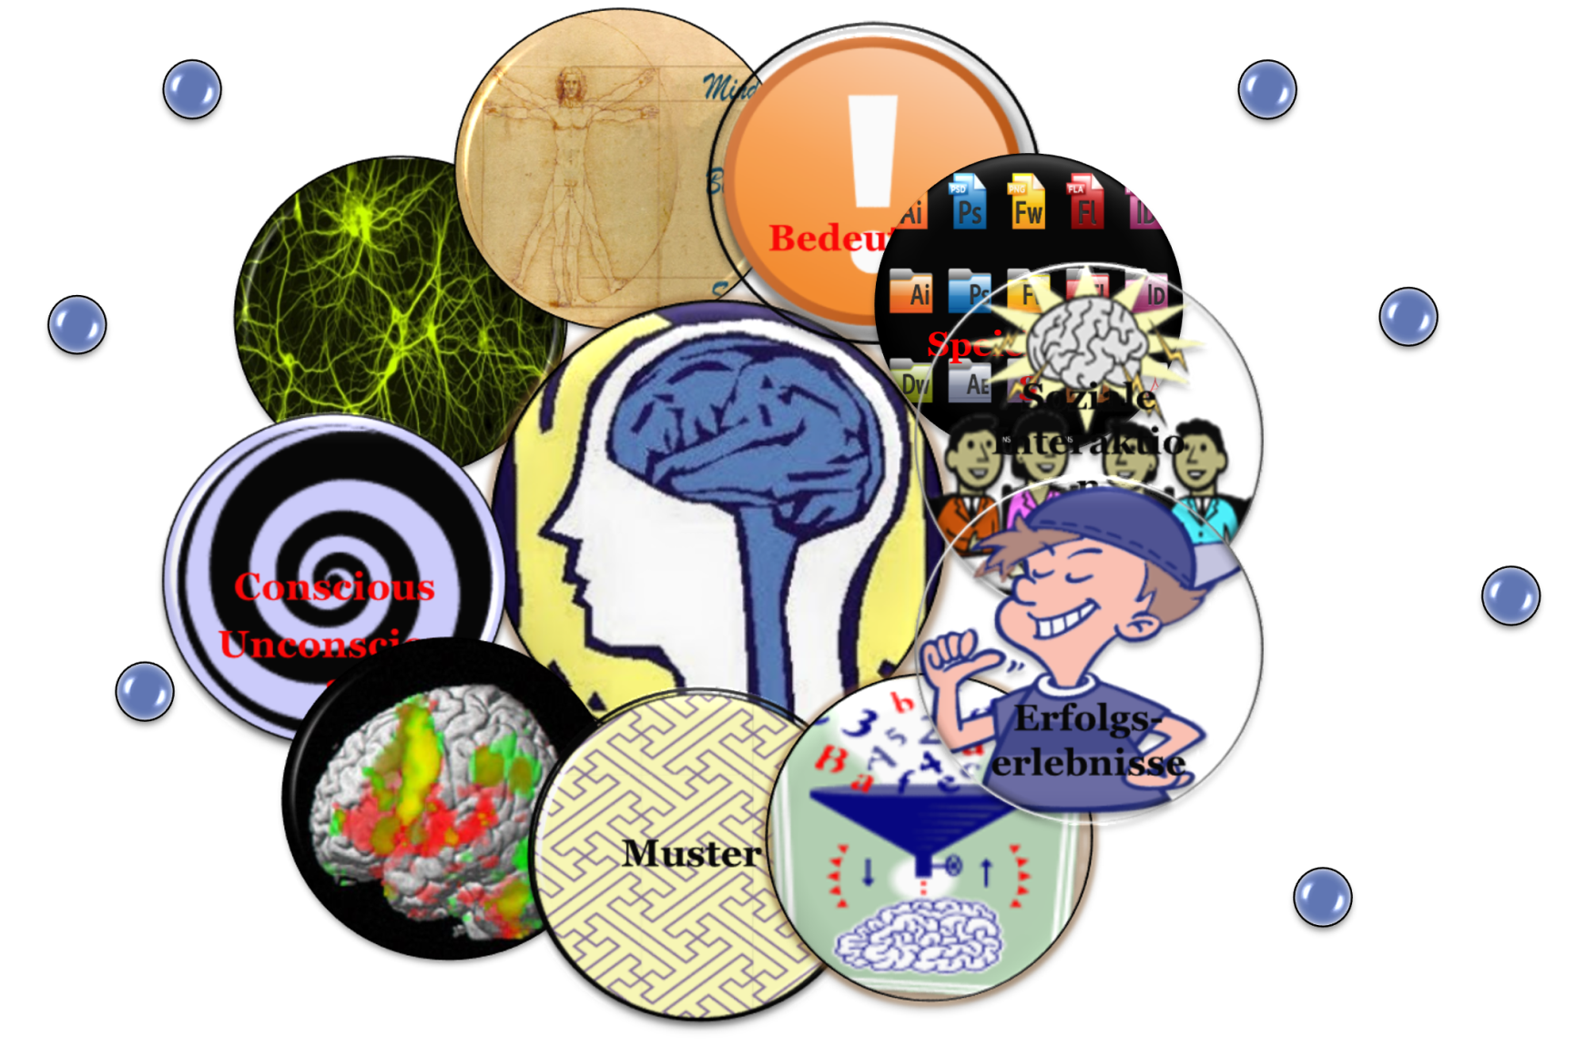
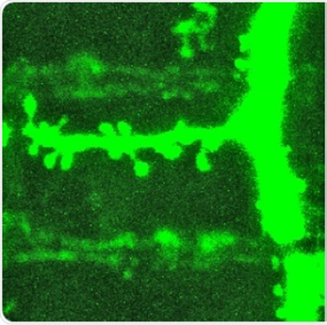



How learning works Why we don‘t write into notebooks
What does this have to do with autonomous learning?
“Importance is physical” :
Acetylcholine
Long-term learning only happens in meaningful contexts
Notes:
Celebrate success and achievements – dopamine shower!

Slide 7

From the Neurosciences to Autonomous Learning
„The autonomous learner is one that constructs knowledge from direct experience, rather than one who responds to someone‘s instruction“
„Our job is to create learning opportunities, not to impose a method“ There‘s more than one way to learn a language.“
(Benson 2001)

Slide 8



Methods and Approaches
TBT
Task Based Teaching
Pedagogy of the
Blank sheet
FIP
Format
Imagination
Pride

Slide 9

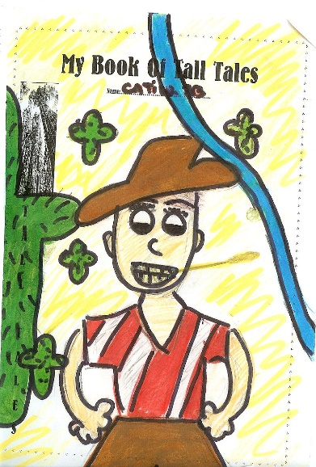
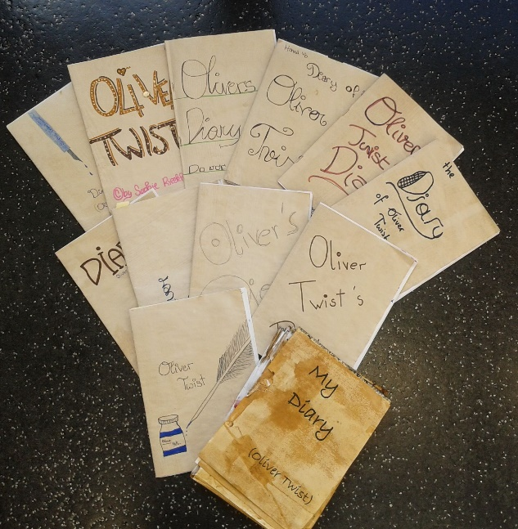
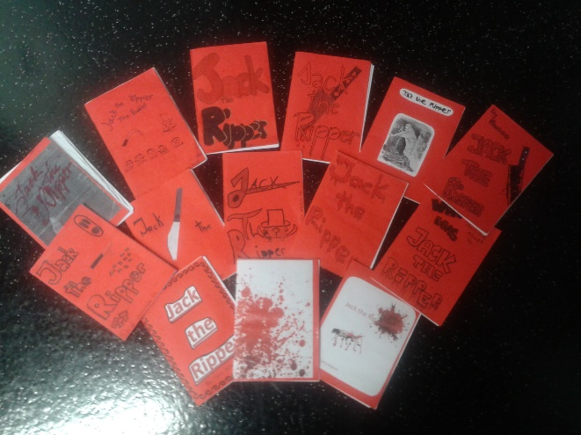
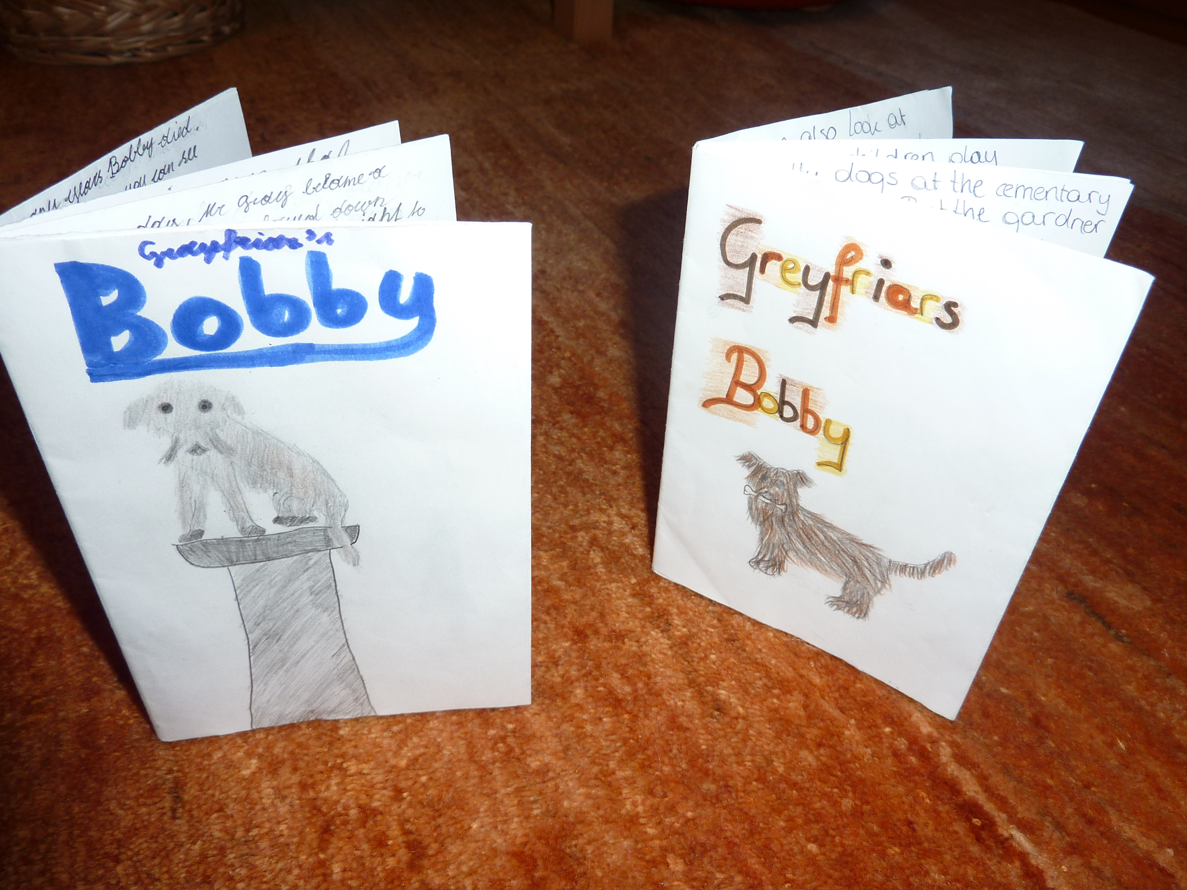
F I P: Format – Imagination – Pride
“Complex learning is enhanced by challenge and inhibited by threat”
(Caine & Caine 2000)
Challenge them!
Our stuff is cool enough to be published
Trust them!
–

Slide 10


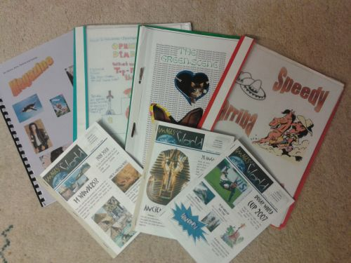
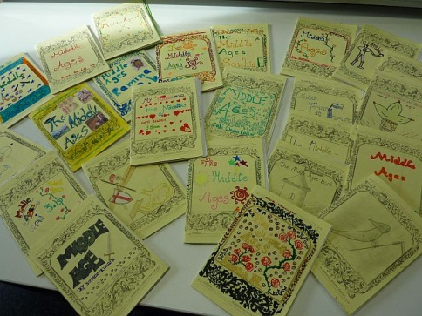

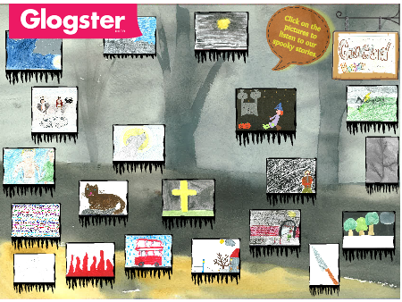
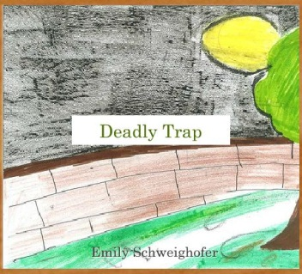

TBT: Task Based Teaching
What is a TASK
„A piece of classroom work which involves learners in comprehending, manipulating, producing, or interacting in the target language while their attention is principally focused on meaning rather than form.“ (Nunan 1989)
Tasks vs Exercises (Willis 2007)
Does the activity engage learners‘ interest?
Is there a primary focus on meaning?
Is there an outcome?
Is success judged in terms of outcome?
Is completion a priority?
Does the activity relate to real world activities?

Slide 11

The pedagogy of the blank sheet Hannelore and Helmut Zehnpfennig (2009)
Reduction of materials and input
Basic reference materials or online search
The blank sheet: no tasks, no questions, no instructions
Forces learners to actively search for meaning, fosters learner creativity, problem solving and interaction, encourages the construction of meanings and concepts
Choice = Power

Slide 12
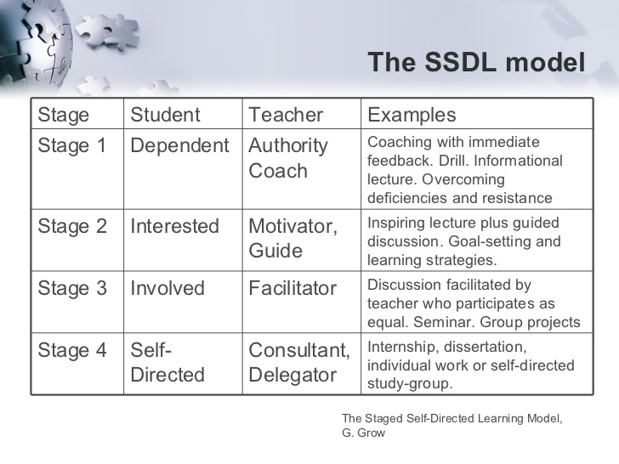

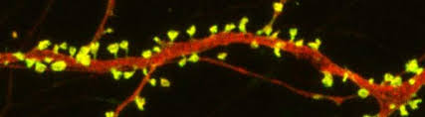
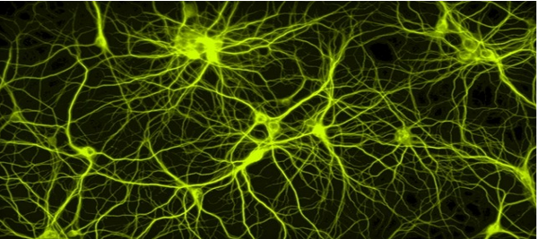
Creating Learning Opportunities in autonomous settings
Focus on a goal and are proud of their products
Actively engage with the topic
Are emotionally involved
Make form-meaning connections
https://www.slideshare.net/bstokes/theories-of-teaching-and-learning-the-staged-selfdirected-learning-model-ggrow

Slide 13
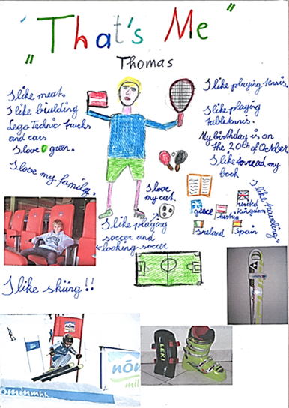
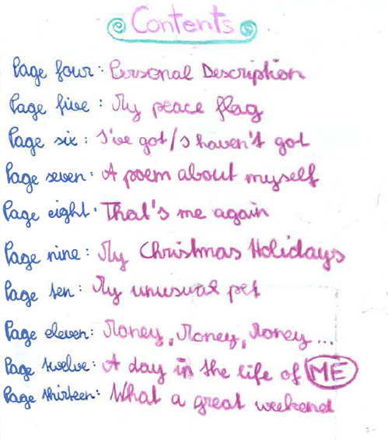
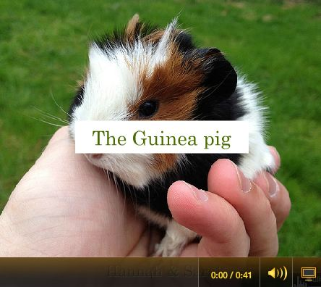
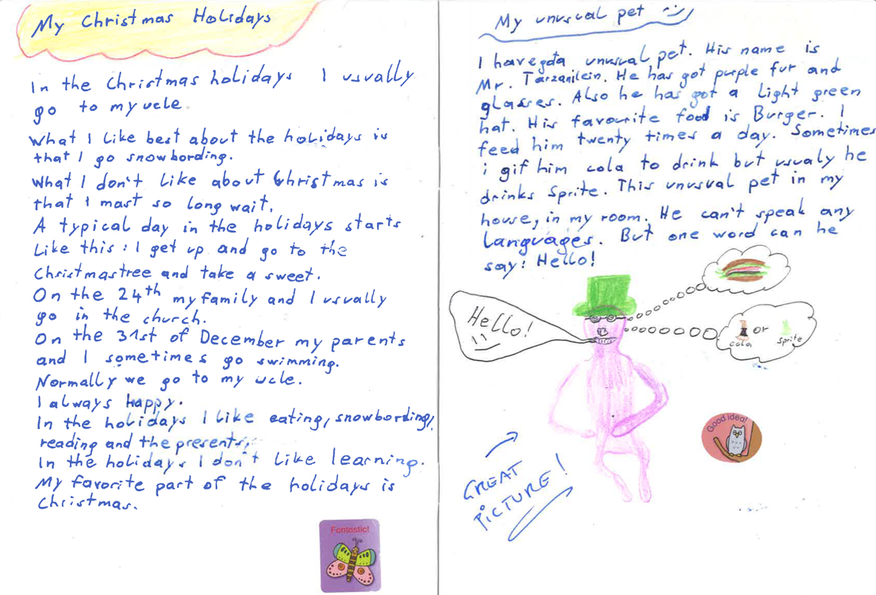
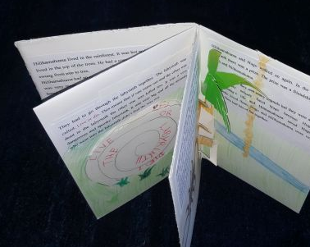
Examples: Ways into autonomous writing

Slide 14

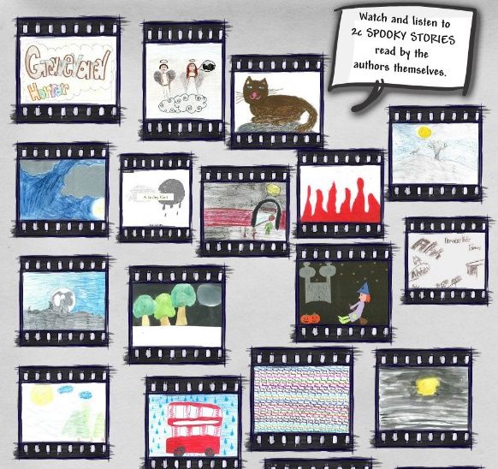
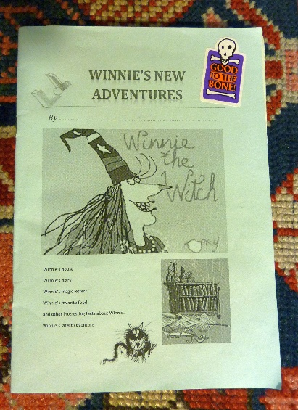


Examples: Lower intermediate writing

Slide 15
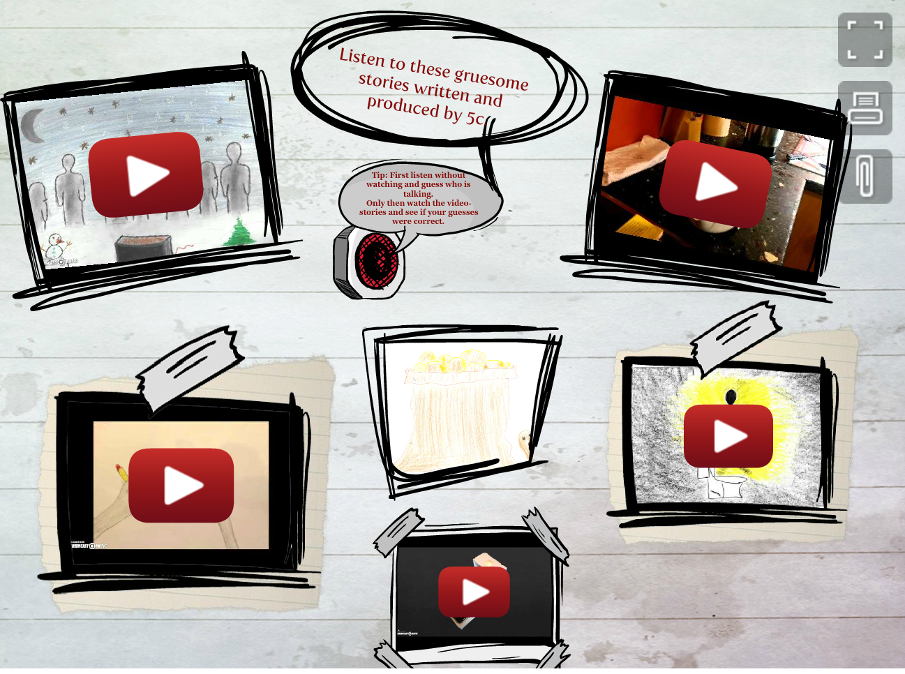
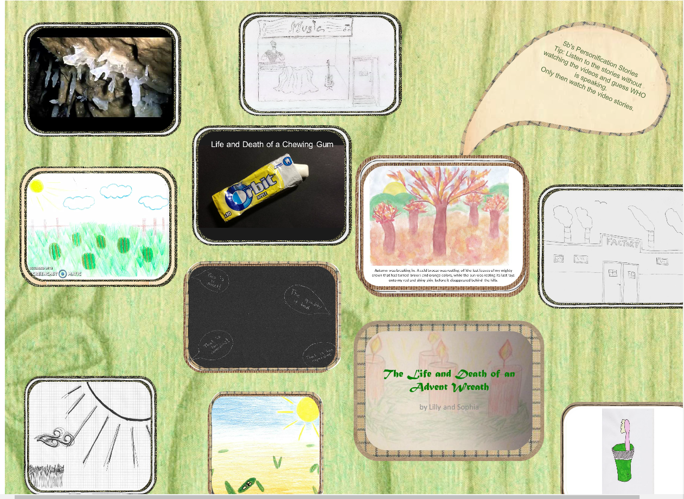
Examples: Upper Intermediate Learners

Slide 16
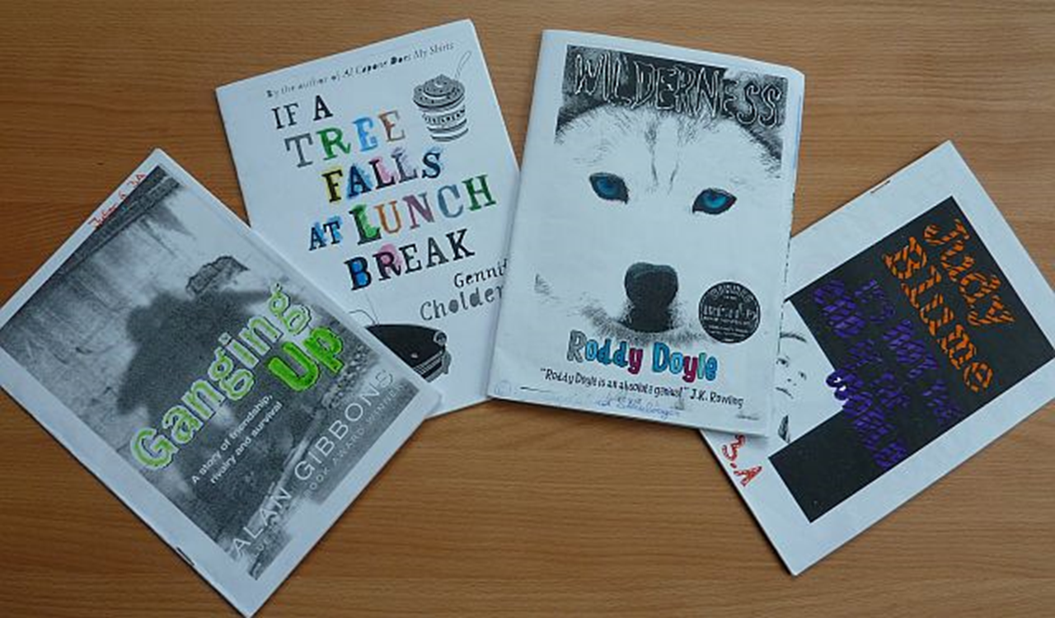
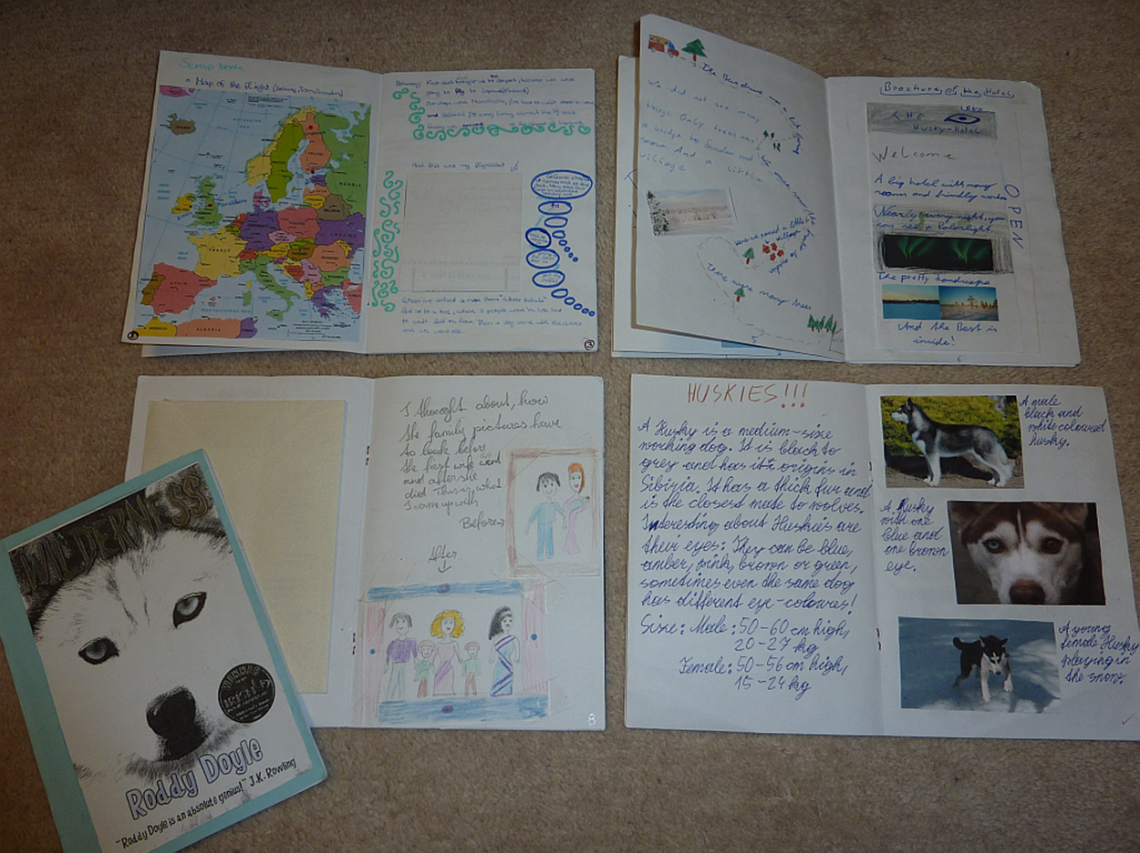

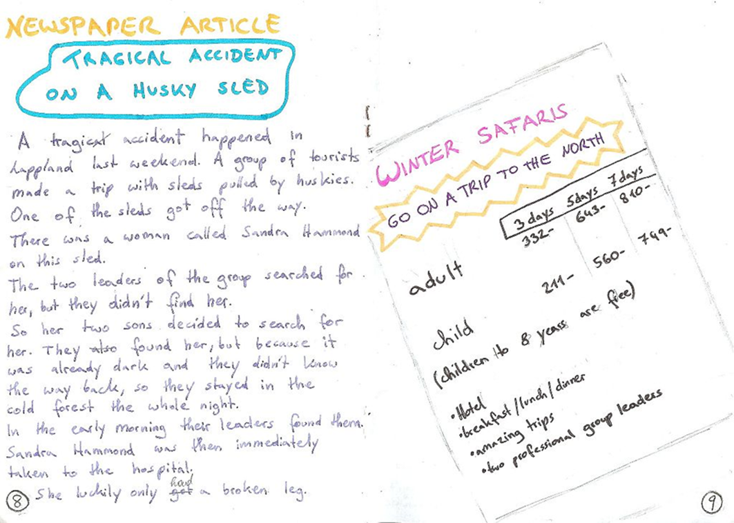
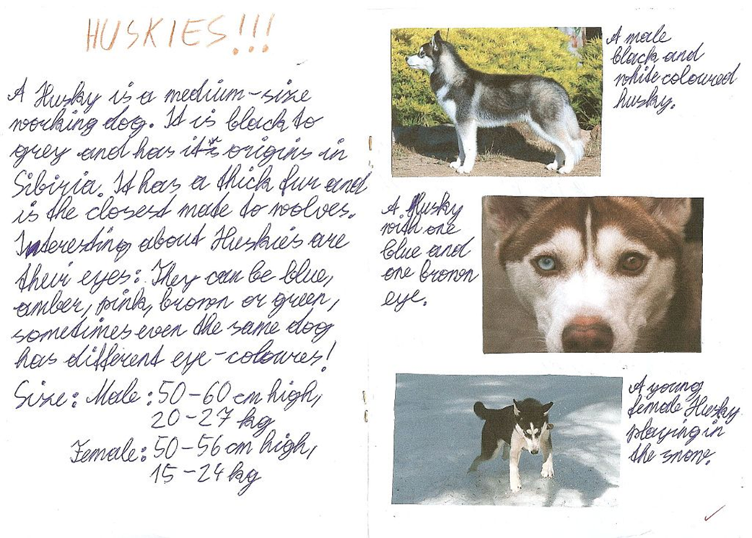
Examples: Booklets about Novels
Typical text types
Letters, postcards, e-mails
Newspaper articles
Travel brochures
Diary entries
Background info, factsheets
Recipes
Maps
Character pages

Slide 17
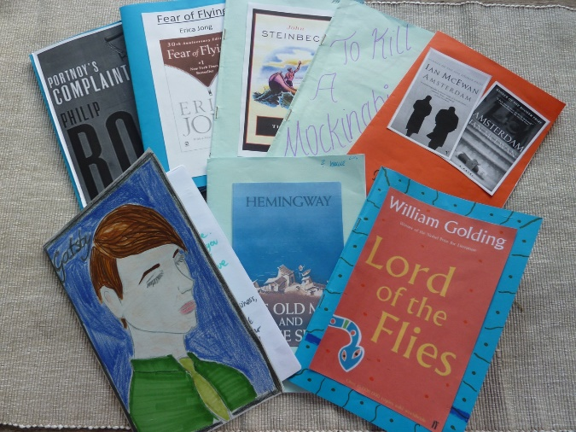
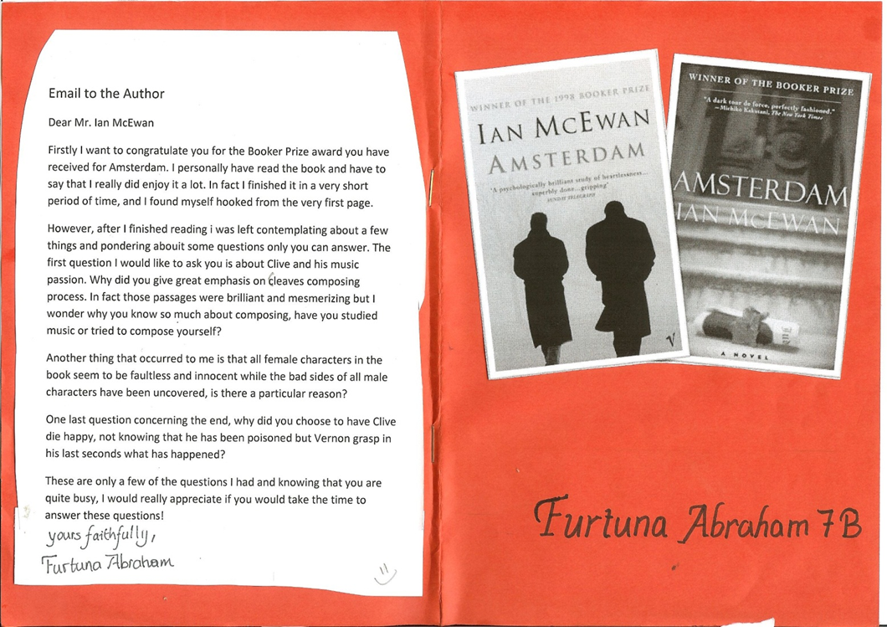
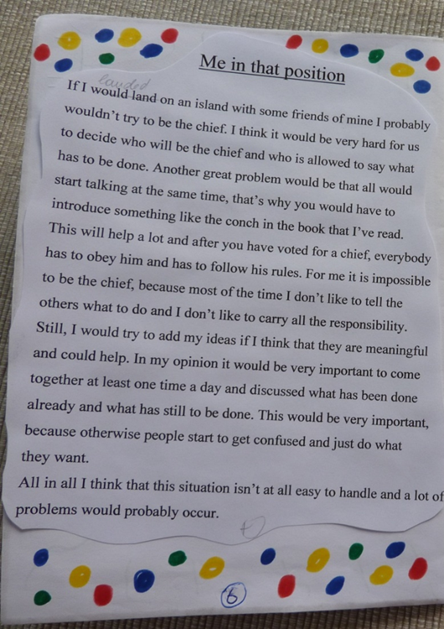
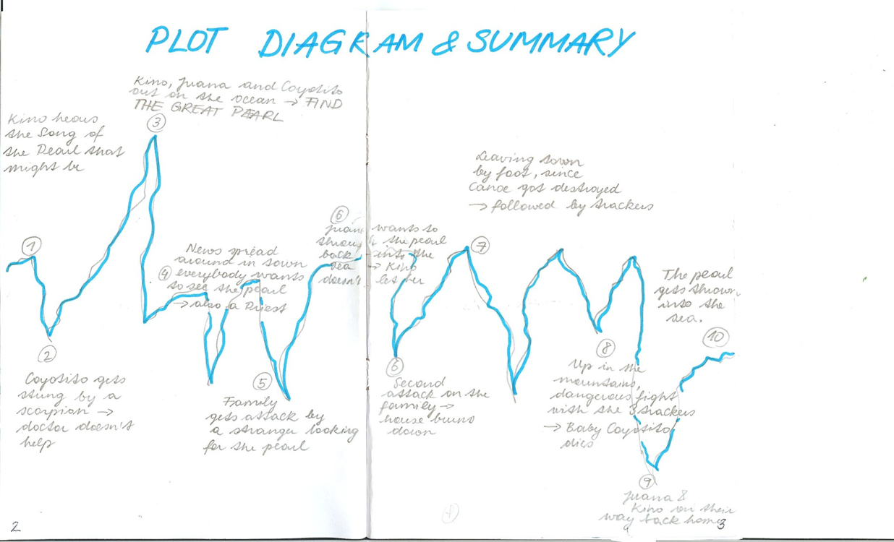
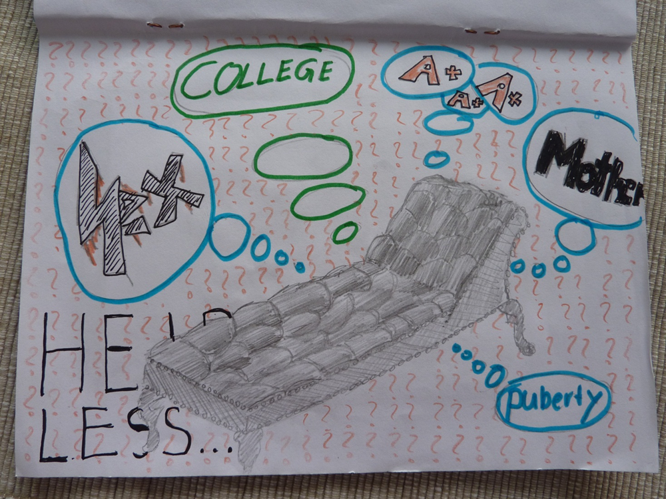
Upper-school Examples
More text-types
Alternative endings
Letters to the author
What I would have done…
Plot diagrams
Interesting quotes
Alternative covers and blurbs

Slide 18




In all these projects the learners...
make lots of choices, take decisions
do activities that seem relevant to them
are actively involved and use the language
actively cooperate and communicate with others
persue personal goals and group goals
manage time and resources
are proud of their results
build growth-oriented mindsets

Slide 19
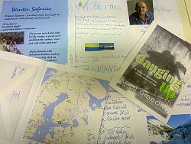

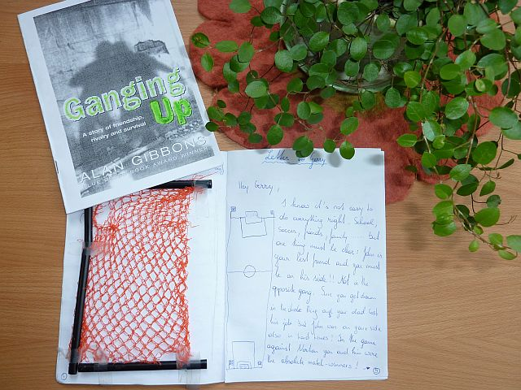

Browsing student products
You now have 10 minutes to look at different examples of booklets in detail.
Collect any questions and comments that you would like to discuss.

Slide 20



Time for questions

Slide 21

The End
Thank you for your attention.
For more ideas and examples visit
http://epep.at

Slide 22
References
Benson, P. (2001). Teaching and Researching Autonomy in Language Learning, Harlow: Pearson Education
Littlewood, W. (1996). "Autonomy”: an anatomy and a framework. System, 24/4, 427-435. Quoted from: http://www.finchpark.com/afe/l.html, 19.05.2012
Nunan, D. (1997). Designing and adapting materials to encourage learner autonomy. In P. Benson, & P. Voller. Autonomy and Independence in Language Learning. Harlow: Longman, 192 - 203.
Willis, D. and Willis J. 2007. Doing Task-based Teaching, Oxford: Oxford Handbooks for Language Teachers
Zehnpfenning, H. und Zehnpfenning H. 2008. online: http://www.zeugner.at/files/nachlese/010909/Go_OffUnt_Didaktik_des_weissen_Blattes.pdf

