Slide 1

CLIL
A dual focused educational approach.
Using English ( any additional language) for the learning and teaching of both CONTENT and LANGUAGE.
M.C.Escher‘s Sky and Water I represents the idea of interwovenness that characterises the CLIL approach.
All

Slide 2

Benefits of CLIL for Learners
Extra motivation for the subject by developing language skills along with the subject.
Developing cognitively/ working harder to complete a task.
Developing communication skills in both general and more specialised topics.
Making personal meaning in another language.
CLIL learners‘ language progresses more.
CLIL learners receive a lot of input and work effectively with that input.
CLIL learners interact meaningfully.
CLIL learners learn about the „culture“ of a subject, the particular way of thinking.
CLIL learners are prepared for studying in another language.
CLIL learners learn in different ways.³

Slide 3
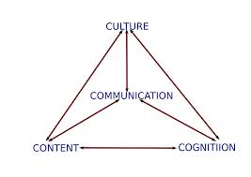
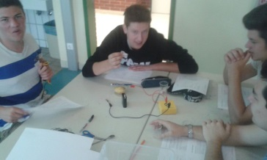
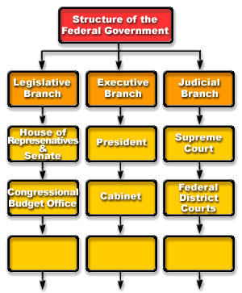

Activating Prior Knowledge
e.g.
visuals
⁴
hands-on activities
⁵
graphic organisers
6 6 7
Talking to each other about what learners know about the topic.

Slide 4

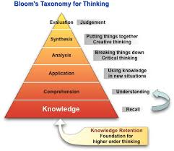
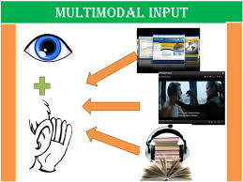
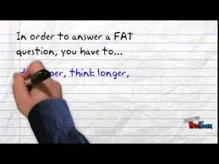
Guiding Understanding
e.g.
Multimodal Input
¹¹
Different kinds of questions ( LOTS and HOTS: lower order thinking skills-higher order thinking skills)
¹²
Interacting in pair and group work.
Graphic organizers or other forms of support to help understand input.
Number of strategies to help with skills development.

Slide 5

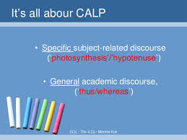

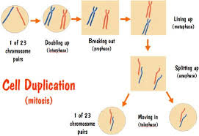
Focus on Language
Variety of activities to help recycle vocabulary.
¹³
Noticing how the language is used in the subject.
¹⁴
Noticing similarities and differences between English and the learners‘ first language.
15 16
Learning and using subject-specific terminology.

Slide 6
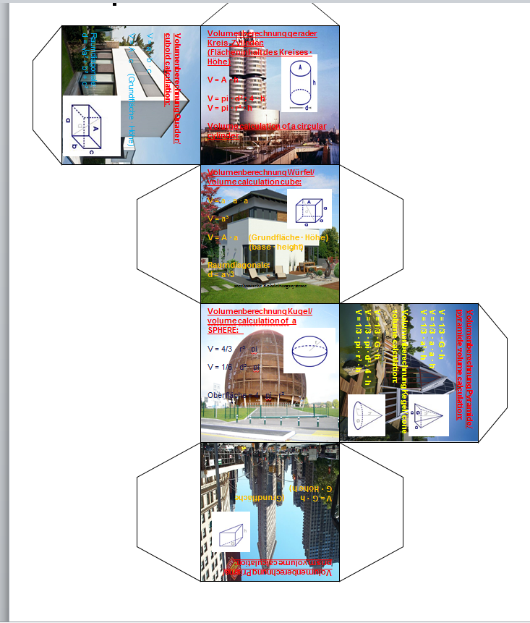
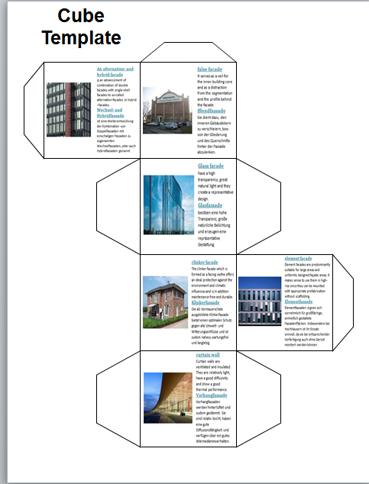
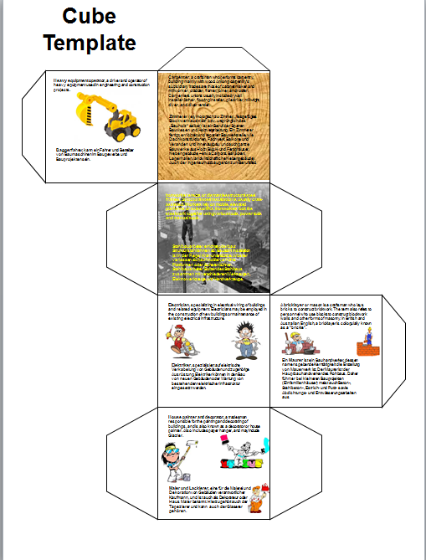
Focus on Differentiation
Instructional strategies to consider a concept from
a variety of different perspectives.
Cubing e.g. different perspectives in construction:
jobs, facades, materials, shapes and dimensions,
state of the art architecture, etc.
¹⁹

Slide 7
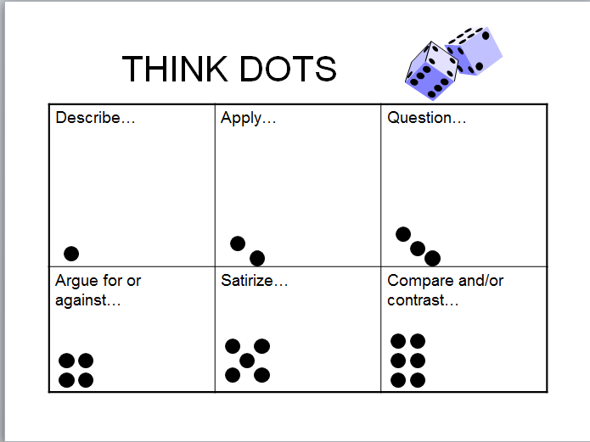
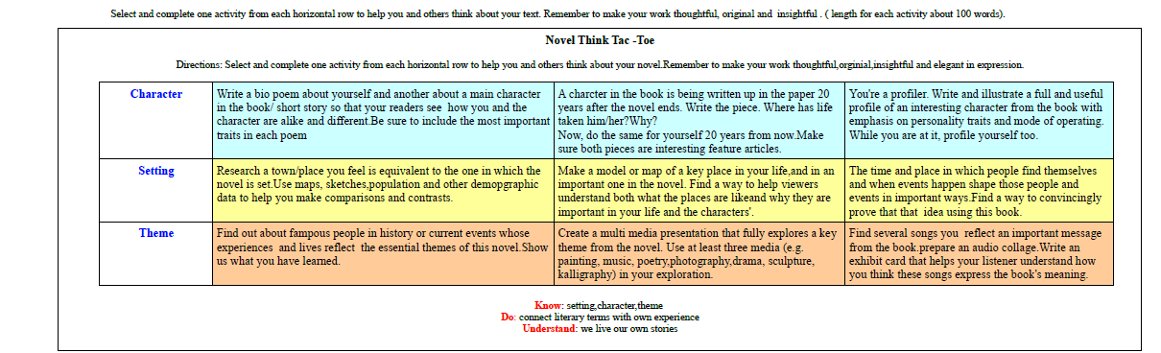
Focus on Differentiation
e.g.Think Dots
²⁰
e.g.Think Tac Toes ²¹

Slide 8
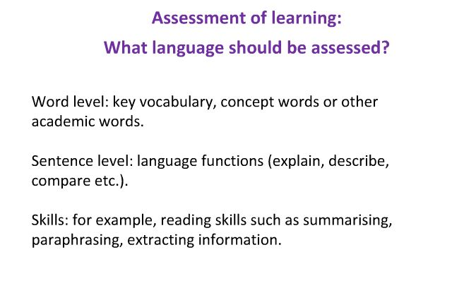
Assessment, Review, Feedback

Slide 9
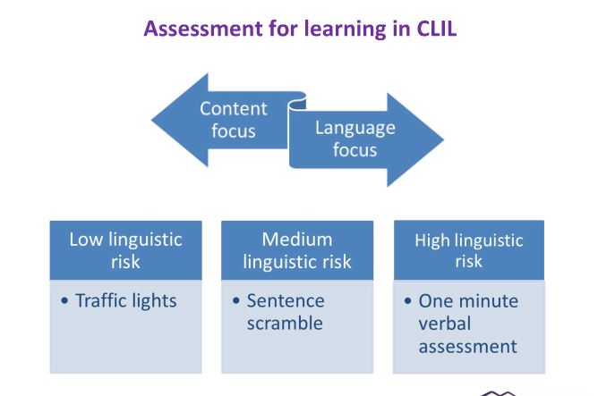
Assessment,Review,Feedback

Slide 10
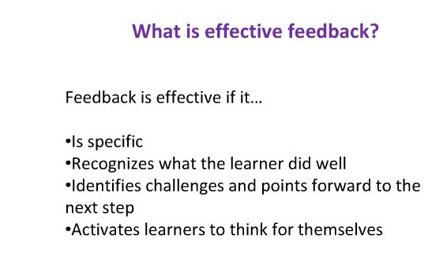
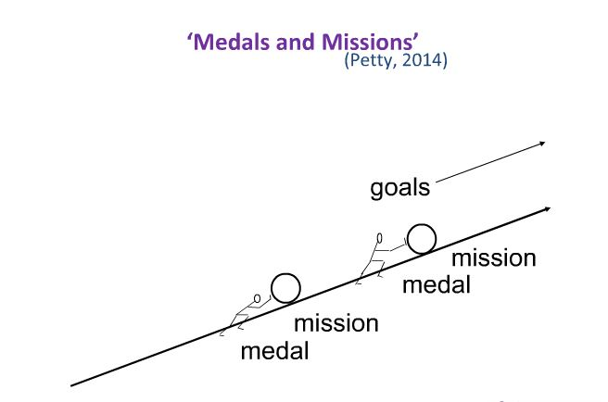
Assessment,Review,Feedback
→
²⁴
Reviewing Activities: e.g Baloon Debate
The principle is that a number of speakers are asked to win the approval of an audience,
who are described a scenario which entails a number of participants in a hot air balloon
which is rapidly sinking. One individual must be thrown from the hot air balloon so that
the others can survive.
Reviewing Activities: e.g Relay Debate
A rather different way of getting the whole class involved in a debate is to pass it around the class. Two people are told which (opposite) positions to take and argue for a little while. At some point (decided by the teacher, by the student speaking or the student who will take over) a different person takes over from one of those two people, using new arguments .This is repeated until the whole class has spoken or the debate draws to a halt.
etc.

Slide 11
References
Google Images
Activities from HTL Ortwein: STU- CLIL in the language classroom.
Dale,L.(2012).Clil Activities With Cd-Rom: A Resource for Subject and Language Teachers.New York:CUP
Jason Skeet: https://www.nile-elt.com/news/feedback-and-assessment-in-clil---free-webinar/460
Carol Tomlinson: https://daretodifferentiate.wikispaces.com/Cubing+and+Think+Dots
:

