Slide 2
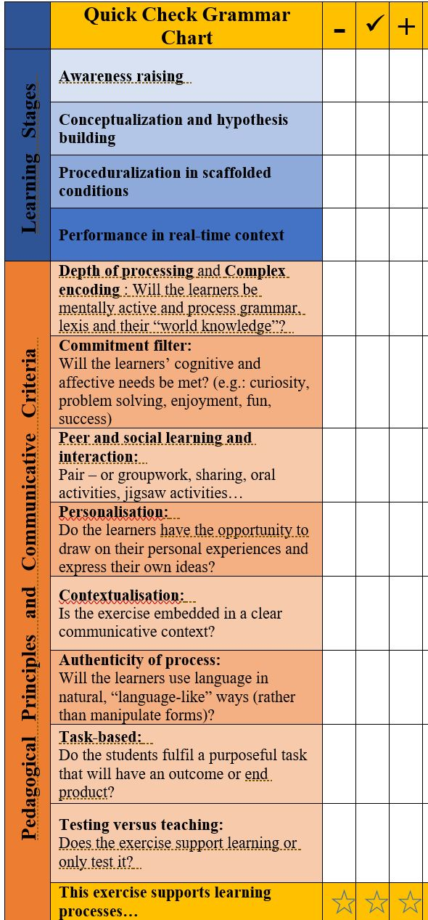


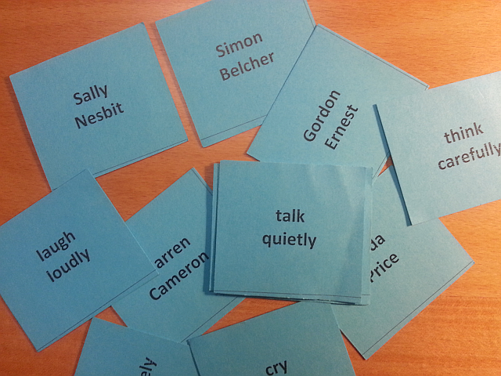
Conceptualization --Proceduralization
Manner Mimes
Simon
Hertz
smokes heavily
Robert
Quinn
reads quickly
Wilma Park
waits patiently
Sebastian
Summers
sits
stiffly
Yasmin
Little
yawn lazily

