Slide 1
How does explicit and implicit SLT affect production and processing of syntax?
Do L1 speakers and L2 learners use different brain activation patterns?
How do they use procedural and declarative memory?
Are L1 and L2 learning different?

Slide 2
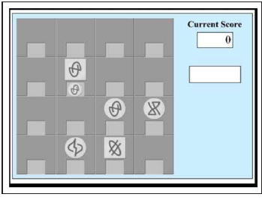
Kara Morgan-Short, Karsten Steinhauer, Cristina Sanz and Michael T. Ullman, „Explicit and Implicit Second Language Training Differentially Affect the Achievement of Native-like Brain Activation Patterns“ Journal of Cognitive Neuroscience, 24:4, pp. 933-947
Brocanto 2: artificial language for a computer game.
Explicit training versus implicit training
Tested 2x (at low proficiency and high proficiency at end of training)
2 test-types:
proficiency test (play the game)
ERP (event related potentials – show brain patterns in real time) show reaction to syntactic irregularities

Slide 3
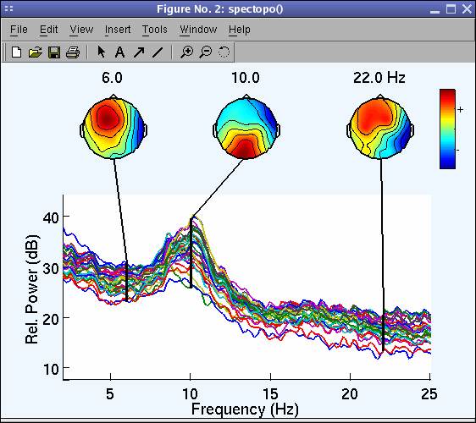

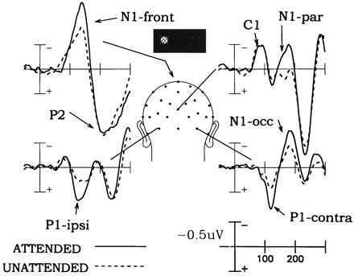
ERP: Event Related Potential voltage maps
Notes:
image 1: Swartz Center for Computational Neuroscience, 2014)http://cognitrn.psych.indiana.edu/busey/temp/eeglabtutorial4.301/maintut/ERP_image_plotting.html (3.10.
image 2: Jewish General Hospital, Clinical Neuroscience and Applied Cognition Laboratory: http://jgh.ca/en/EEG-ERP (3.10.2014)
image 3: Steven A. Hillyard and Lourdes Anllo-Vento, „Event-related brain potentials in the study of visual selective attention“ , Proceedings of the National Academy of Sciences of the USA, vol. 95 no.3, 781 – 787 , http://www.pnas.org/content/95/3/781.figures-only (3.10.2014)

Slide 4
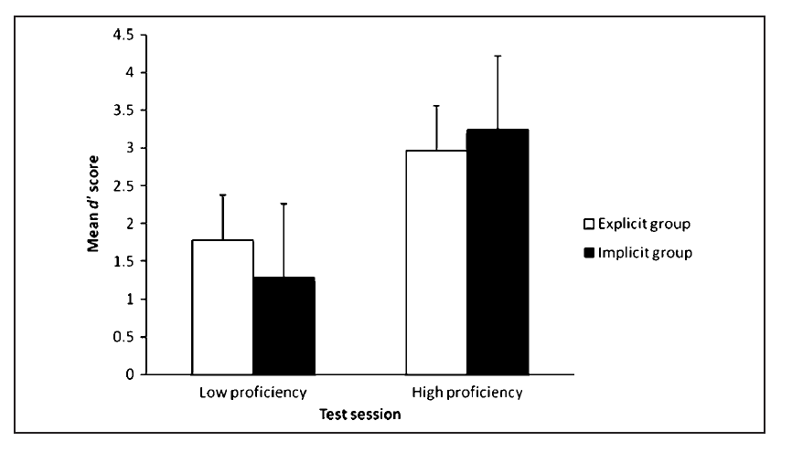
Behavioral data
Don‘t forget that this was a very limited set of possible phrases
Both training methods yield fairly comparable outcomes.
Notes:
at low proficiency the explicit group has learned a bit faster – but at end of training (high proficiency) the implicit goup had passed the explicit group. –

Slide 5
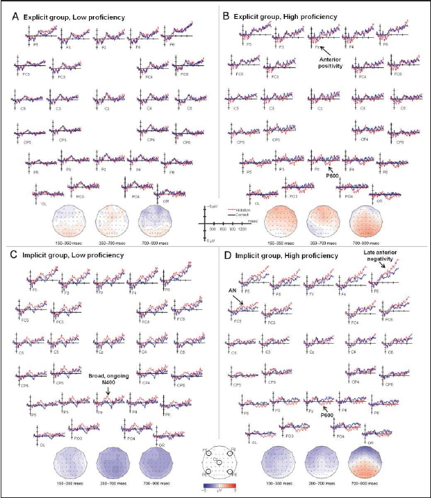
ERP data revealed striking differences between the groups‘ neural activity at both proficiency levels in response to syntactic violations.
This effect was EVEN STRONGER after months of no exposure.
 | Implicit group | Explicit group
High proficiency | leads to L1-like brain processing for syntax. Syntactic processing relied on the same rule-governed automatic structue building that is typical of precedural memory in L1. | Although explicit training is sufficient to develop the ability for structural reanalysis that may be under conscious (explicit) control, it does not reliably lead to the automatic early syntactic processing that is found in L1 and may depend on procedural memory.
Low proficiency | morpho-syntactic processing relies, at least in part, on lexical/semantic mechanisms and declarative memory and shows that this reliance can result from implicit training. (no rules needed) | Explicit training does not lead to a systematic and consistent reliance of syntax on either lexical/semantic or L1-like grammatical processes at low proficiency nor does their syntax rely on any other neurocognitive processes that would be reflected in ERP components.
Notes:
ERP image: p. 941
quotes: p. 942 – 943
effect stronger after months of no exposure: Morgan-Short K, Finger I, Grey S, Ullman MT (2012) Second Language Processing Shows Increased Native-Like Neural Responses after Months of No Exposure. PLoS ONE 7(3): e32974. doi:10.1371/journal.pone.0032974

Slide 6
What does this mean for teaching?

