Slide 1
Open the Doors!
Did you ask her | what … if … when … where … why …

Slide 2
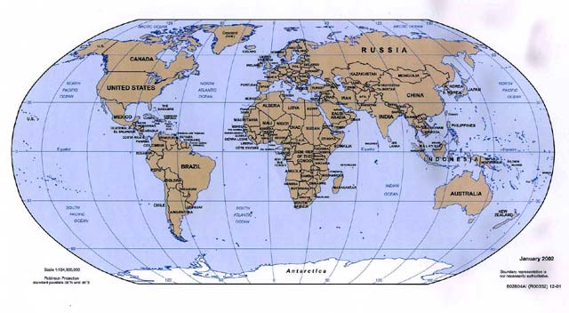

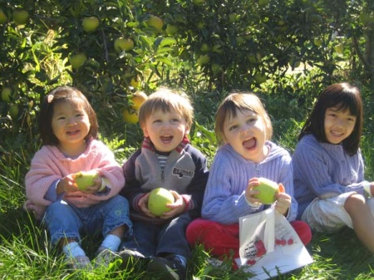











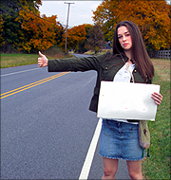

C
C
Dai,
1 year
Wales
N
J
Gwen
A
H
H
L
Bryn
?

Slide 3
C
C
Dai,
1 year
Wales
N
J
Gwen
A
H
H
L
Bryn
?

Slide 4

Dai,
1 year
Wales
Gwen
Bryn
?

