Slide 1


Eric‘s Intercultural Experiences
A Reading-Writing Project to Prepare Language Learners for an Exchange Trip Abroad
Jennifer Schumm and Elisabeth Pölzleitner

Slide 2
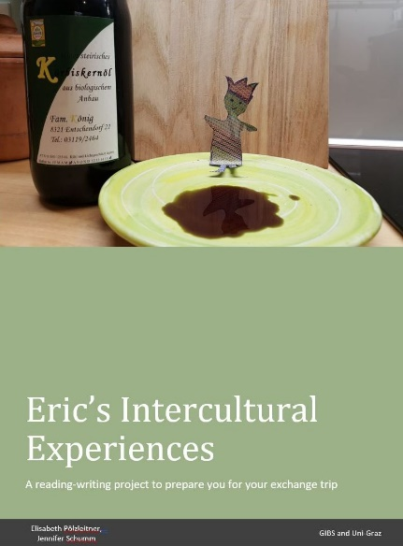
Overview
Theoretical Framework
The Story ‘Eric’ by Shaun Tan
Context & Teaching Goals of the Project
The Project Tasks
Teachers’ Observations

Slide 3
The Language Learner
“The learner does not simply acquire two distinct, unrelated ways of acting and communicating. The language learner becomes plurilingual and develops interculturality.”
“The linguistic and cultural competences in respect of each language are modified by knowledge of the other and contribute to inter-cultural awareness, skills and know-how. They enable the individual to develop an enriched, more complex personality and an enhanced capacity for further language learning and greater openness to new cultural experiences.”
(Council of Europe- CEFR, 2001, p. 43)

Slide 4

Language Teaching
“Thus, developing the intercultural dimension in language teaching involves recognising that the aims are:
to give learners intercultural competence as well as linguistic competence;
to prepare them for interaction with people of other cultures;
to enable them to understand and accept people from other cultures as individuals with other distinctive perspectives, values and behaviours; and
to help them to see that such interaction is an enriching experience.”
(Byram, Gribkova & Starkey, 2002, p.6)

Slide 5
Intercultural Competence Model
Attitudes: curiosity, openness, decentering
Knowledge: of social groups and their products and practices in one’s own and in one’s interlocutor’s country
Skills of interpreting and relating: ability to interpret a document /event from another culture, to explain it and relate it to those in one’s own
Skills of discovery and interaction: ability to acquire new knowledge of cultural practices; ability to operate under the constraints of real-time communication
Critical cultural awareness: ability to evaluate critically perspectives, practices and products in one’s own and other cultures
(Byram, 1997)

Slide 6
Intercultural learning during a stay abroad
“While intercultural experience is likely to enhance participants’ intercultural learning and personal development in many ways, immersion itself does not guarantee success” (Hua, 2014, p. 159).
Recommendation: “well-trained cultural mentor” (Vande Berg et al., 2009, p. 32)

Slide 7
3 phases of preparing learners for class trips (Byram et al., 2002)
Preparatory Phase - learners “externalise their thoughts, anxieties and excitements about their visit” (p. 14).
Fieldwork Phase - “opportunity for withdrawal from the demands of being in a new environment, an opportunity for reflection alone and together with others” (p. 14).
Follow-up Phase – “the emphasis should be on further reflection on individuals’ experience during the visit and, by sharing and comparing, on an attempt to analyse and conceptualise what has been experienced as a basis for understanding (some aspects of) the other environment and the people who live there” (p. 15).

Slide 8

Input: ‘Eric’ by Shaun Tan (2008)
Why a picture book?
Pictures and minimal words create more questions than answers
“[A] successful picture book is one in which everything is presented to the reader as a speculative proposition, wrapped in invisible quotation marks, as if to say `what do you make of this?´”(Tan, 2001).

Slide 9
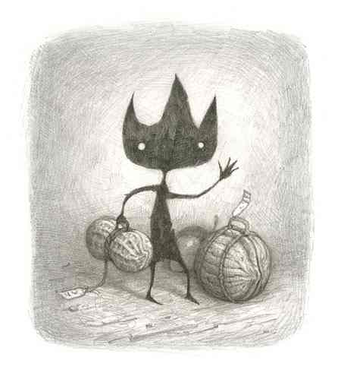
The story

Slide 10
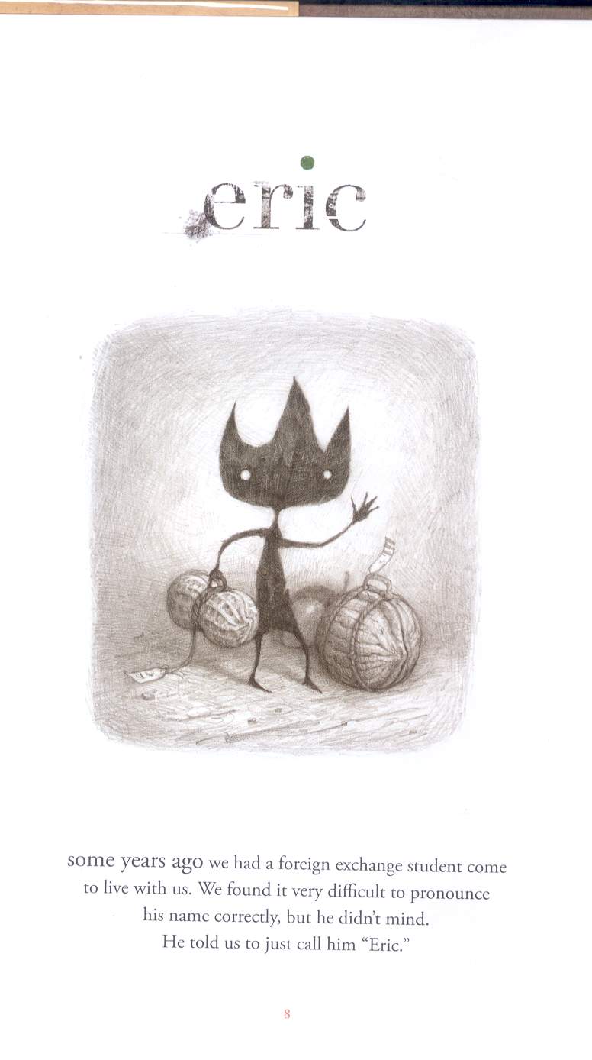
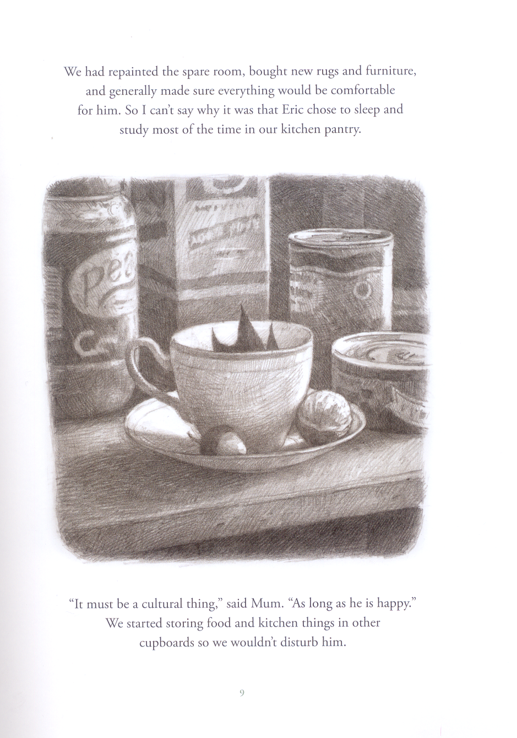

Slide 11
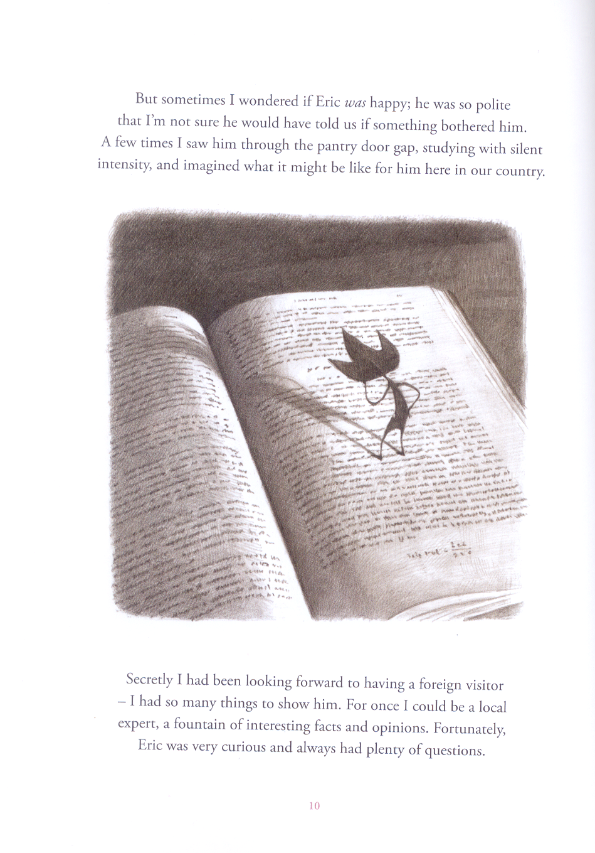
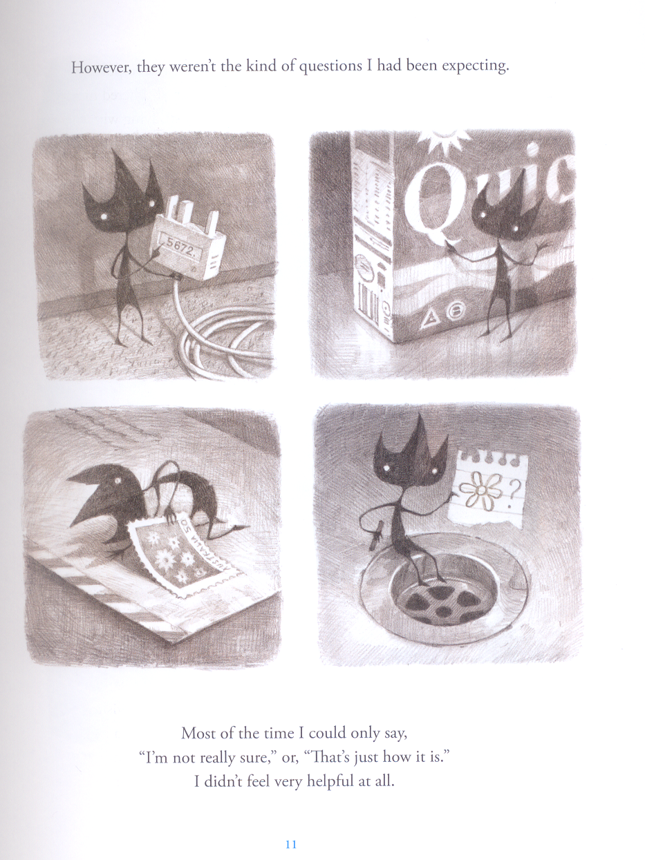

Slide 12
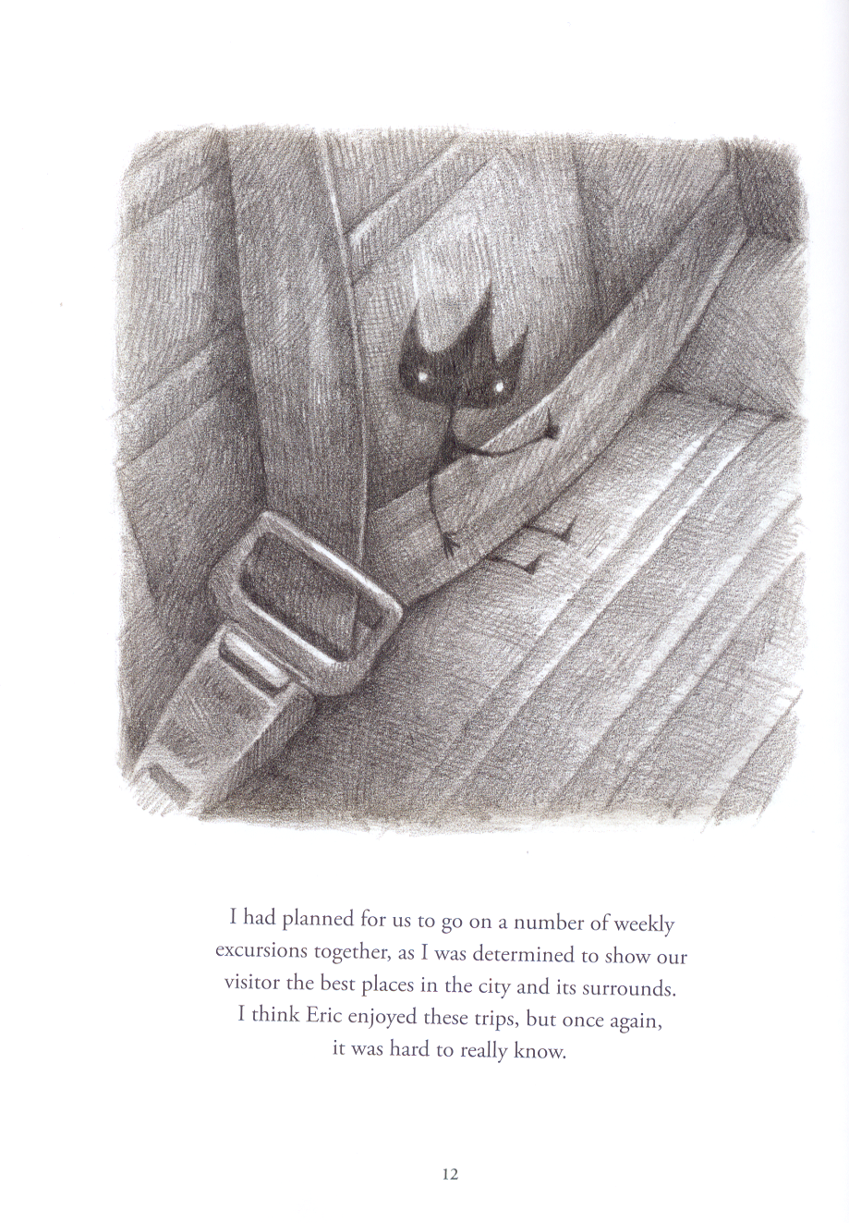
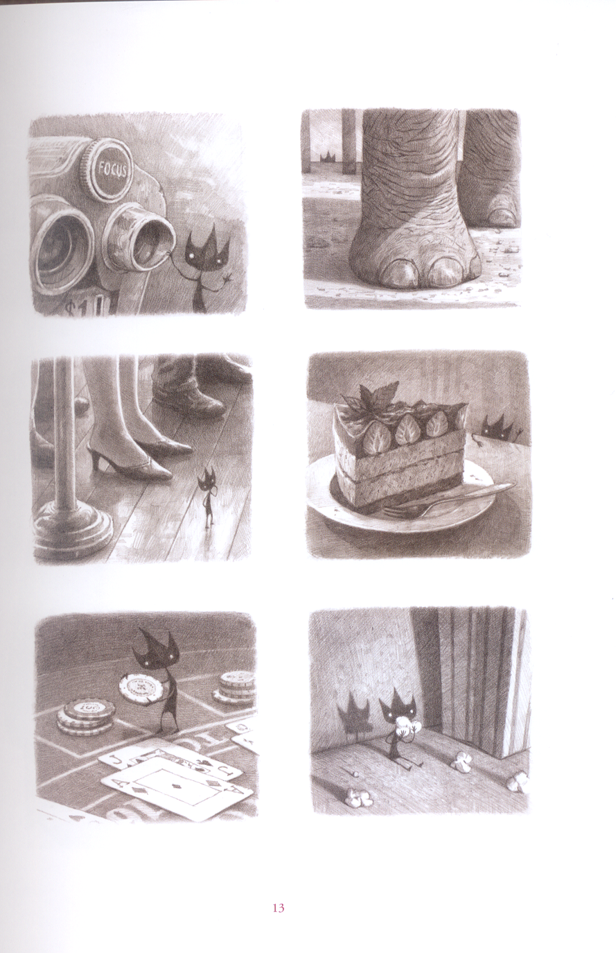

Slide 13
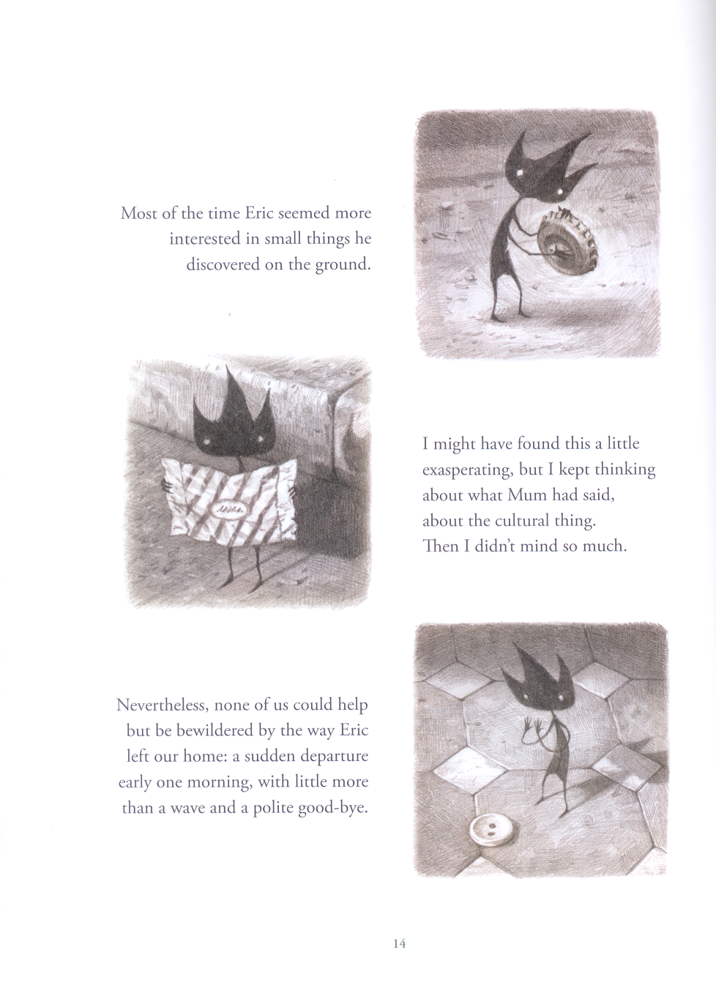
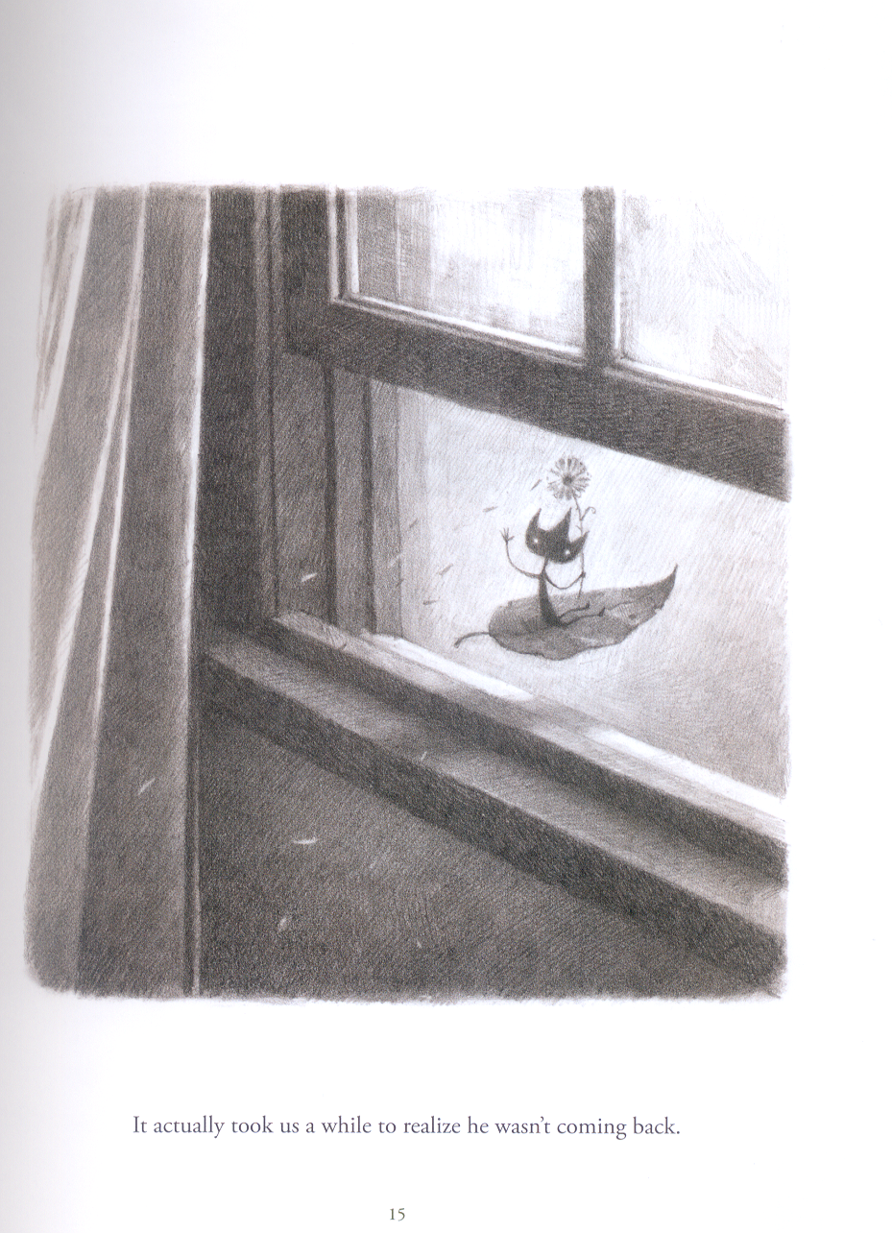

Slide 14
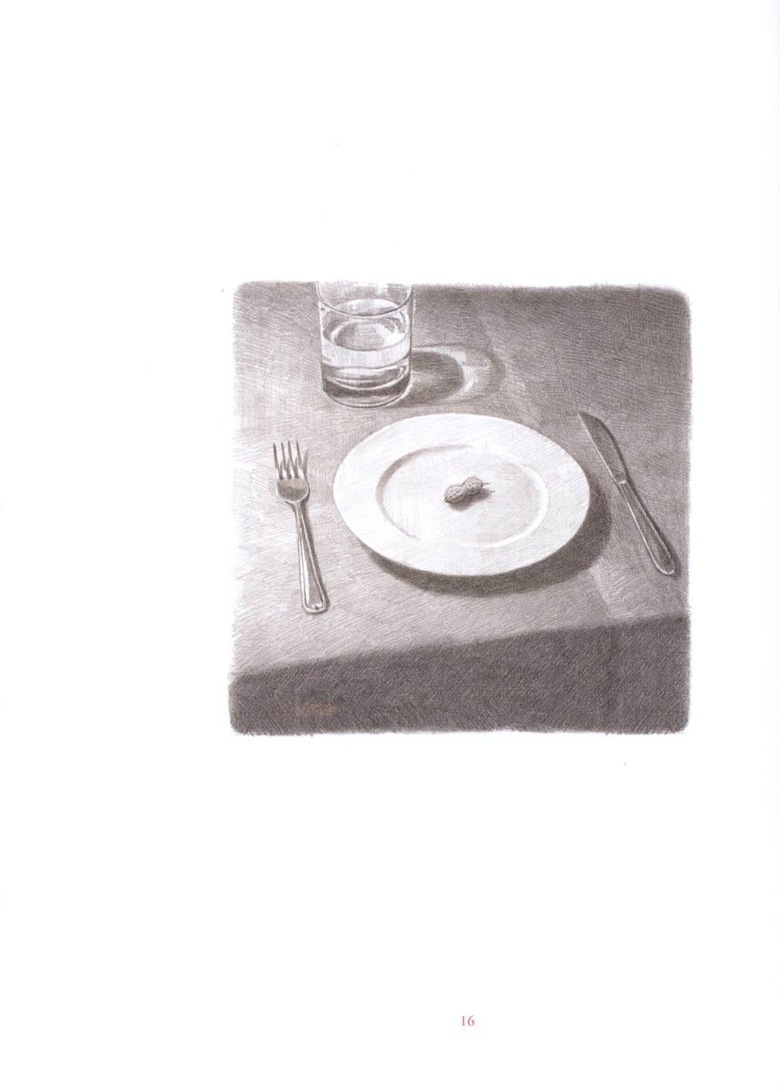
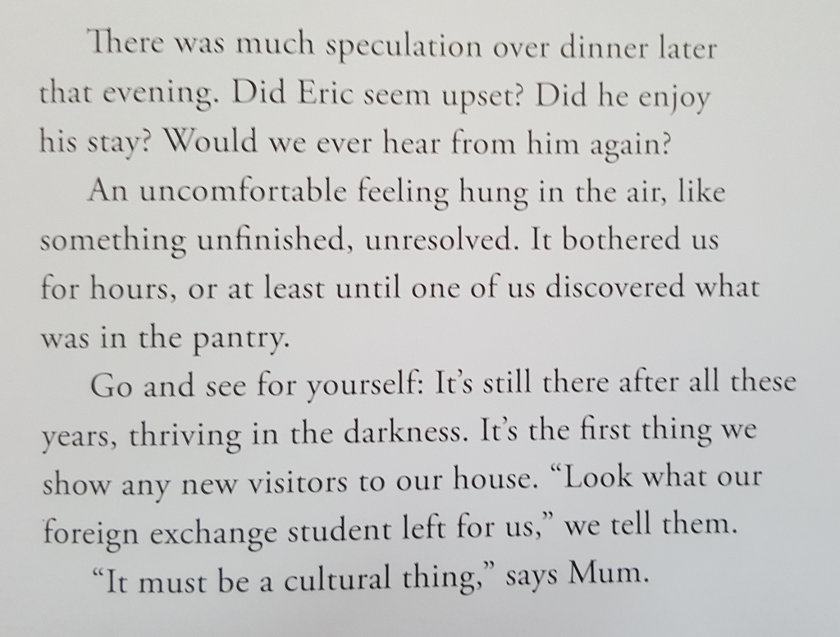

Slide 15
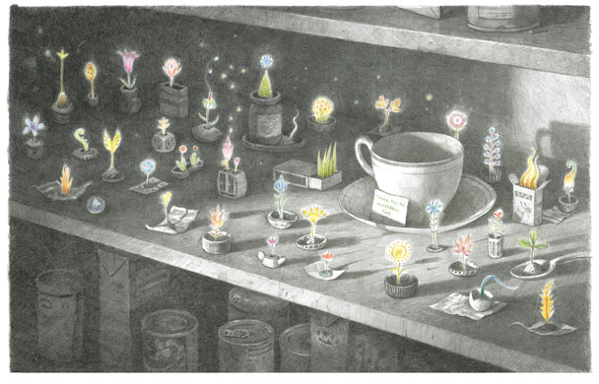

Slide 16
Eric’s Intercultural Experiences
A reading-writing project to prepare language learners for an exchange trip abroad
Participants: 15-year-old students in Austria preparing for class trips to Spain or France.
Class trips to France and Spain lasted a week and followed by return visits of the foreign students at the Austrian school
Project: cross-curricular carried out in learners’ first and second foreign languages
The main part of the project was carried out in English (learners in 5th year of learning the language), smaller parts were done in the learners’ second foreign language (learners in 3rd year of Spanish or French).

Slide 17
The Main Teaching Goals of Project
to develop learners’ curiosity about new cultures and experiences
to raise learners’ awareness of cultural aspects of their everyday lives
to challenge learners’ attitudes including preconceived notions and stereotypes
to develop learners’ understanding of the various layers of “culture” (surface culture, deep culture) and their influence on human behavior (universal / cultural / personal dimensions of human behavior)
to develop learners’ skills of interpretation (observing, comparing/contrasting)
to improve learners’ story-writing skills in English (L2)
to teach the language of “thank-you cards” and “describing personal experiences” in the learners’ L3 (French or Spanish)

Slide 18
The Project Tasks
“Secretly I had been looking forward to having a foreign visitor – I had so many things to show him. For once I could be a local expert, a fountain of interesting facts and opinions. Fortunately, Eric was very curious and always had plenty of questions.”
What kind of questions would you have expected from Eric?

Slide 19
Teacher‘s observations for task 1
What is your WIFI-password?
“Fortunately, Eric was very curious and always had plenty of questions.
However, they weren’t the kind of questions I had been expecting.”
The students‘ questions focussed mainly on
Everyday routines in the family and in school
Questions about the program, meeting times and places
Questions about local sights and shopping opportunities
Where will we have lunch?
How do we get to school?
What time do we have to get up?
Where can I get a tram ticket?

Slide 20

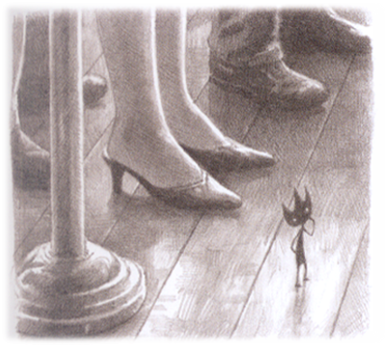
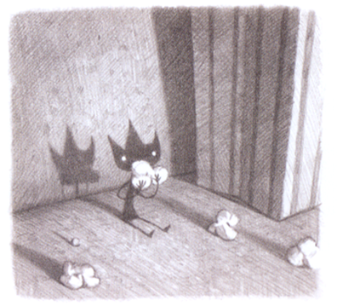
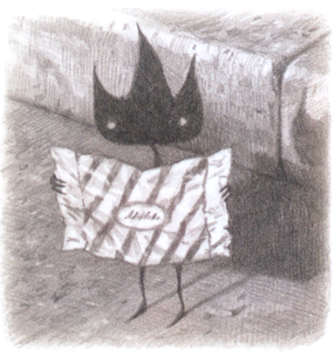
Eric‘s questions
What kinds of questions do you think Eric actually asked? Look at the pictures taken from the story and speculate what kind of questions Eric might have asked.
Attitudes and behaviors concerning the environment
switching perspectives
Why is each piece of candy wrapped individually?
Why do we all eat popcorn in the movie theater?
Typical foods eaten at special occasions
Why do women wear different shoes than men?
Gender roles

Slide 21
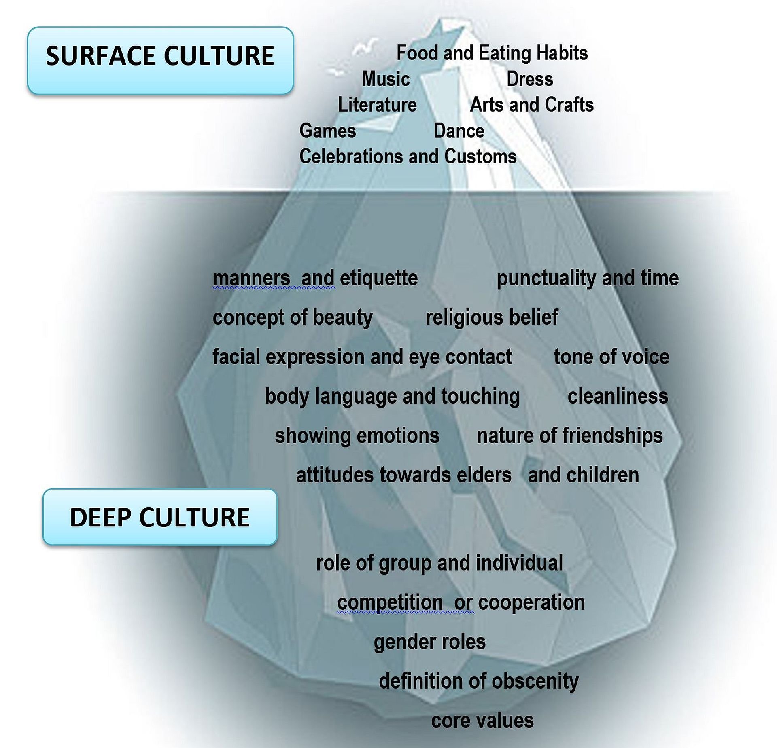
The Cultural Iceberg
Before the trip:
  Students draw cultural icebergs for
  AUSTRIA
  and for the country they are going to visit.
After the trip and the return visit of their exchange partner.
  Students add new findings to their icebergs.

Slide 22
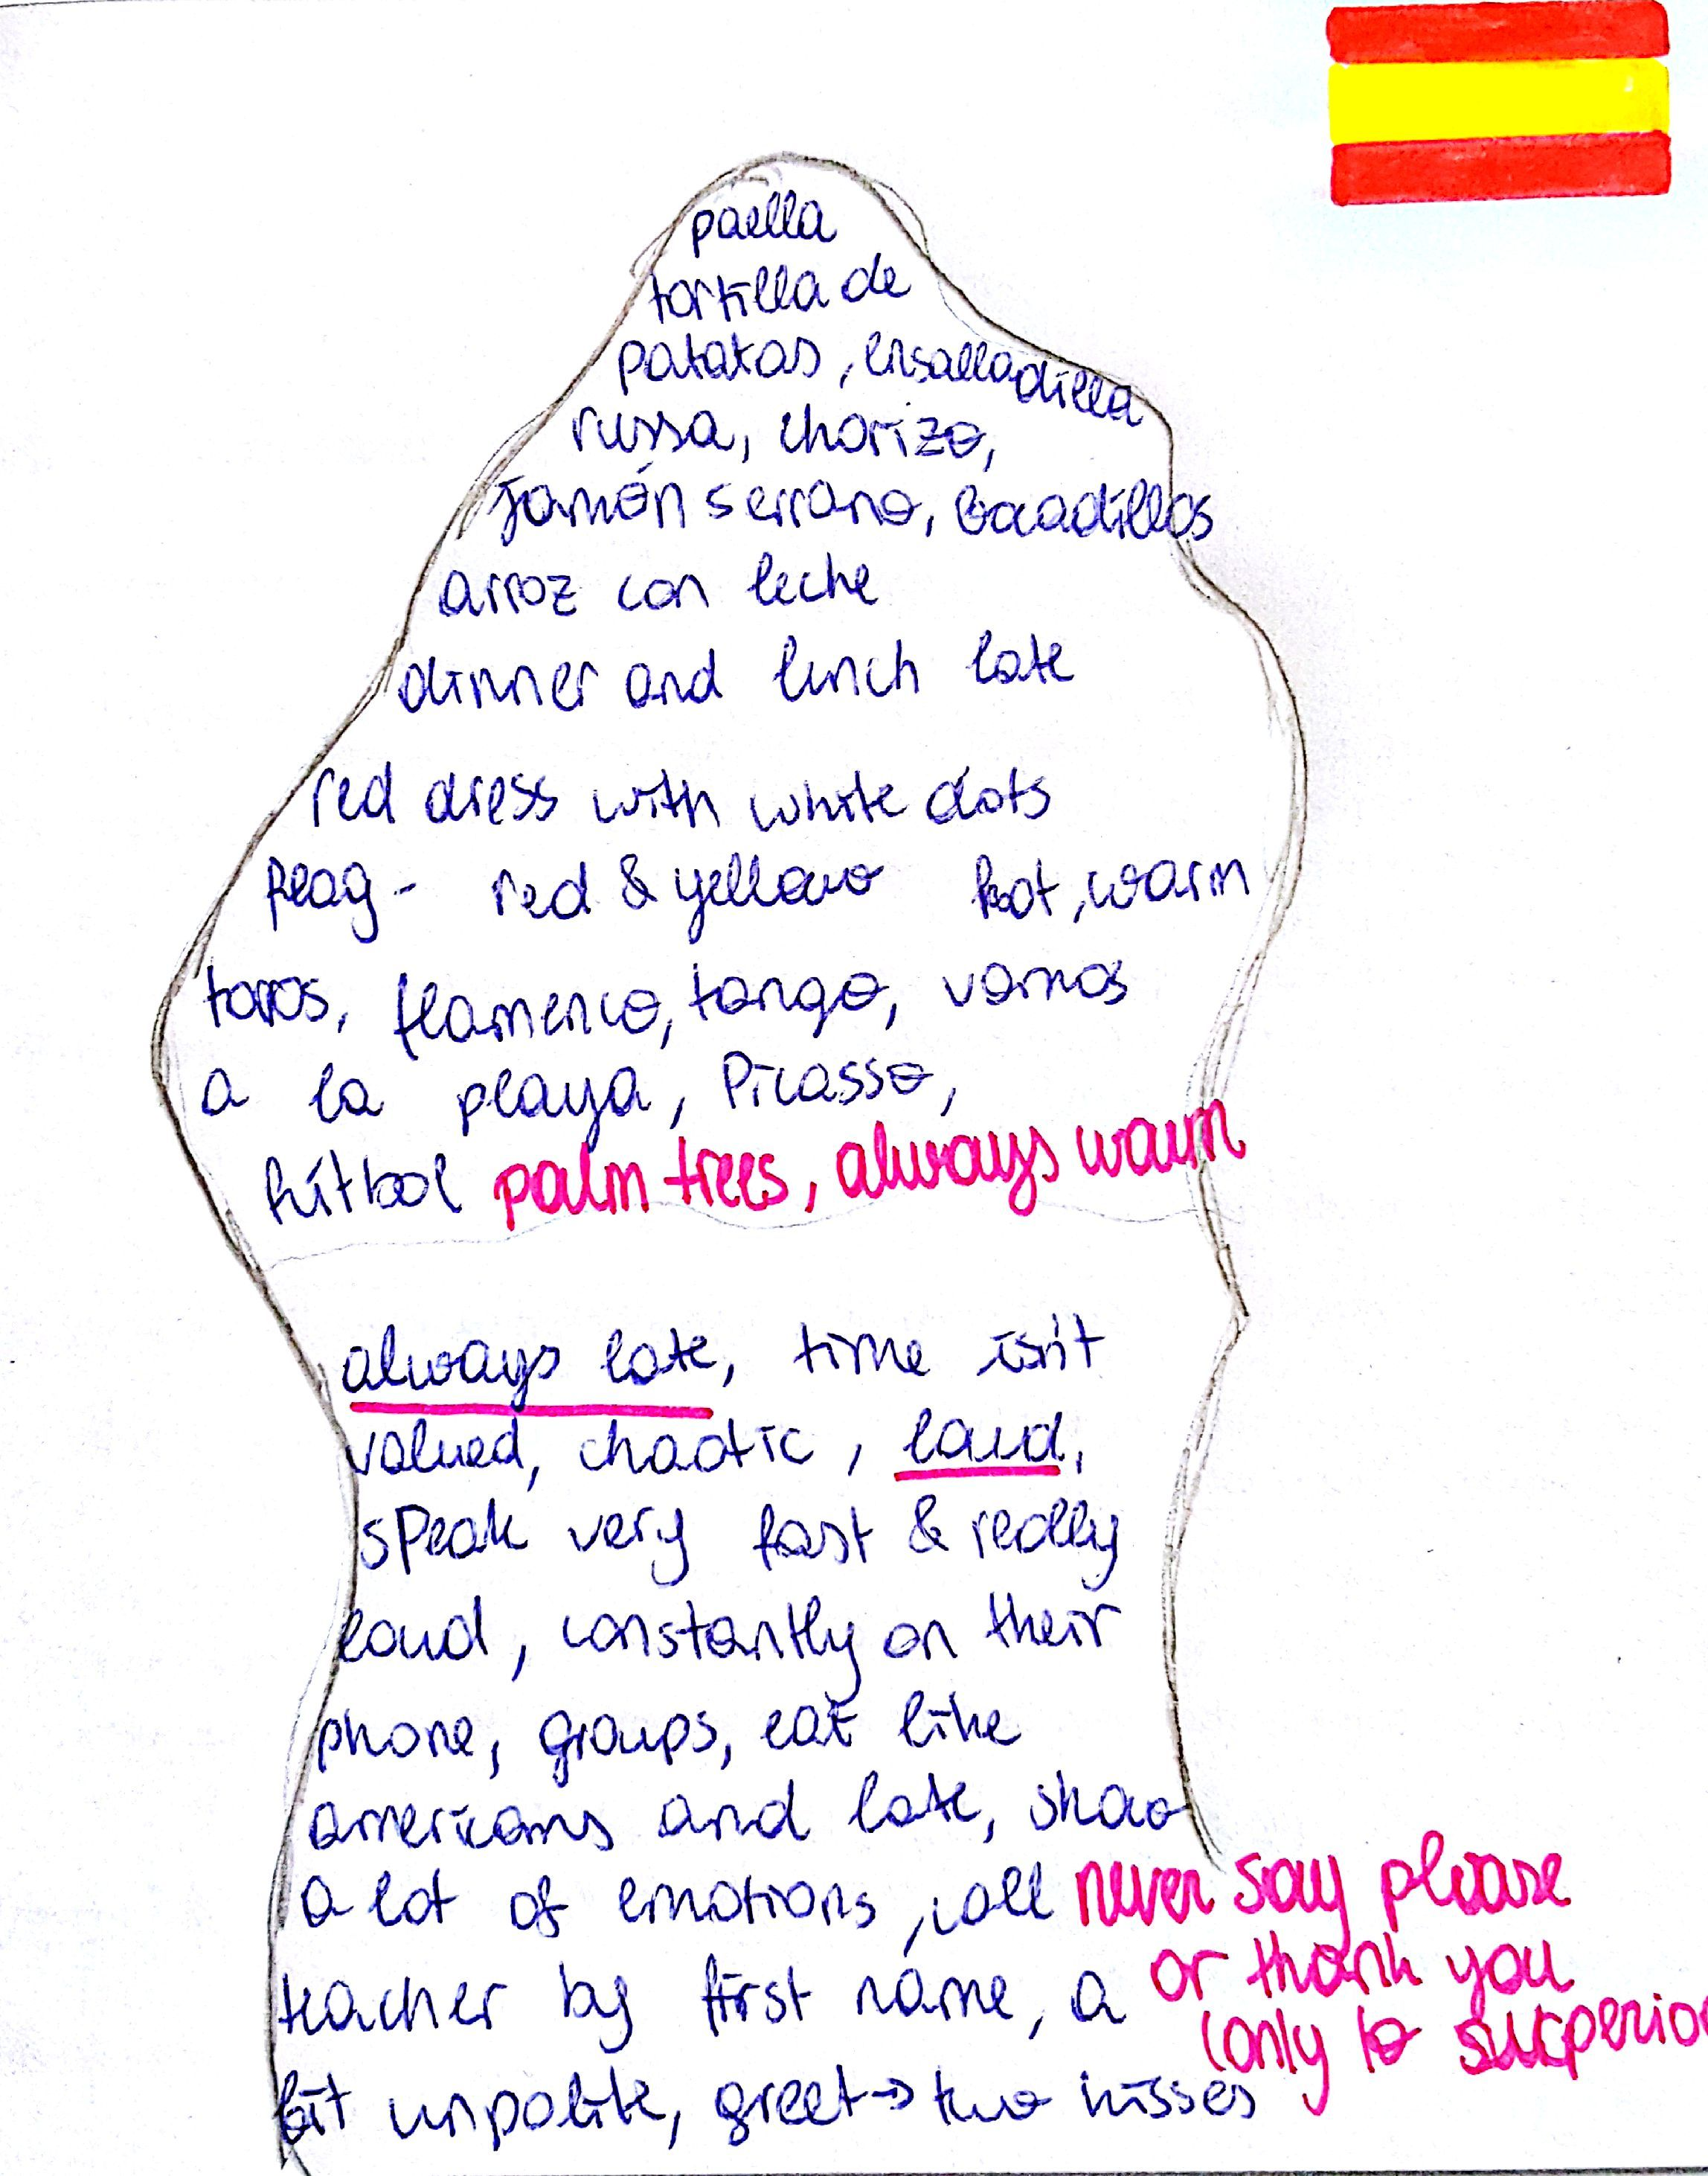
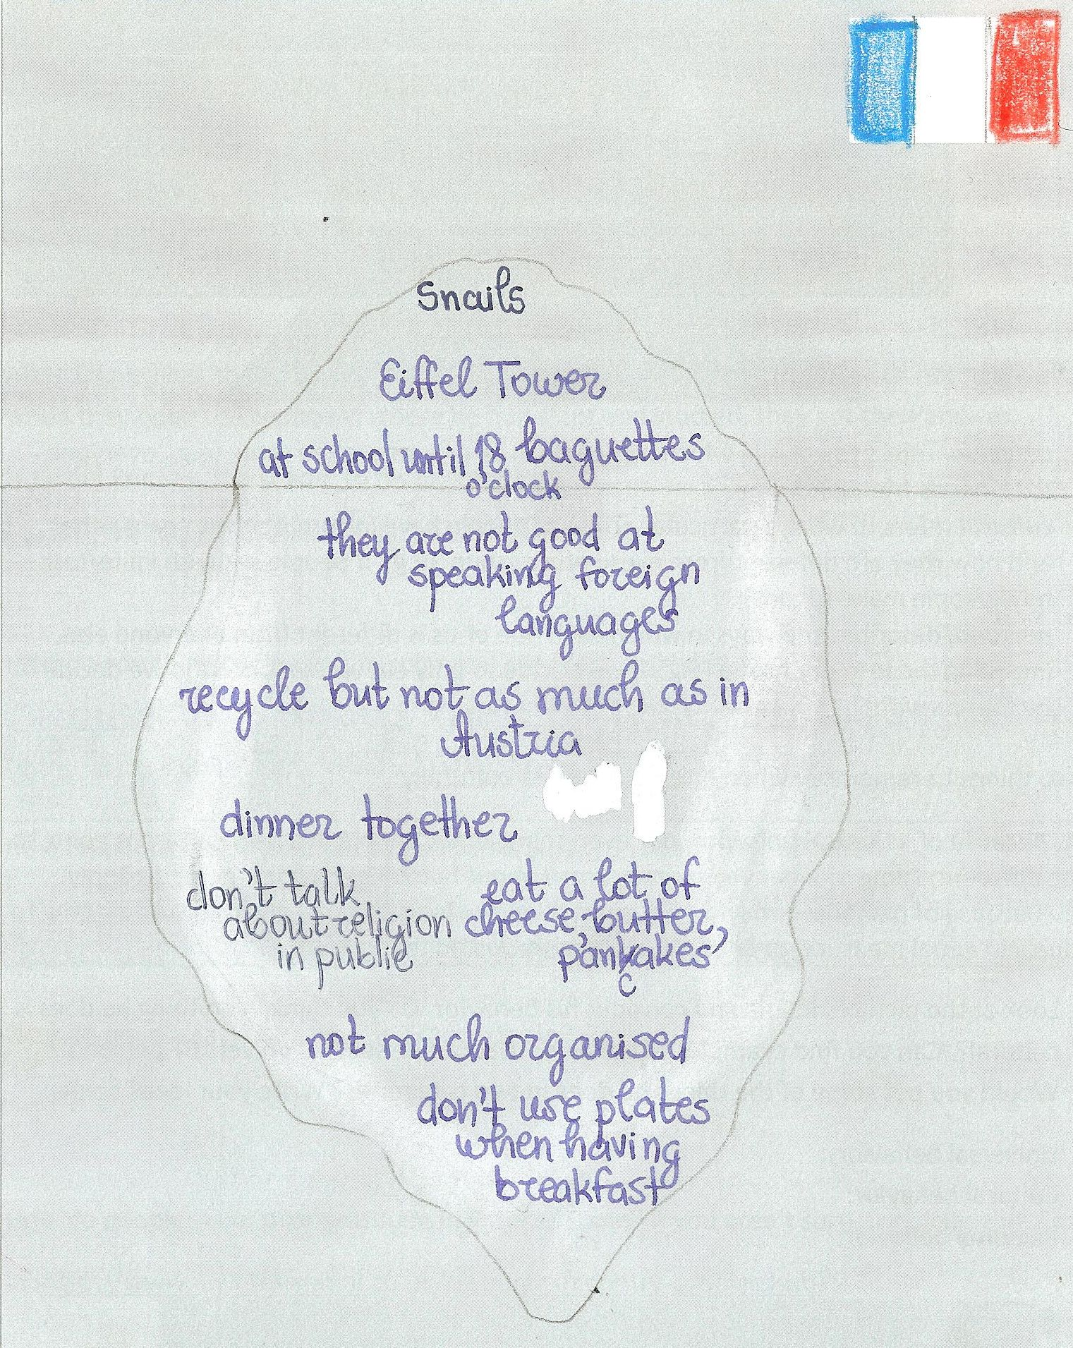

Slide 23
The Learners‘ Perceptions anld Expectations BEFORE the Trips.
Austria | France | Spain
Food | Food | Food
Kaiserschmarrn, Germknödel, Wienerschnitzel, Kernöl, Mozartkugeln, Sachertorte, apple strudel, beer | Baguette, cheese, snails, oysters, frogs | Tortillas, paella, potatoes, tapas, spicy food
Dress | Dress | Dress
Dirndl and Lederhosen (even though they do not wear them!)
Music and Arts | Music and Arts | Music and Arts
Mozart and Beethoven (although he was actually German), folk music, yodeling, dancing the waltz, traditional Austrian folk dancing, accordion music, Klimt, Vienna Opera Ball |  | Dance, Tango, Flamenco, bullfights
Sports and games | Sports and games | Sports and games
Skiing, soccer, card games (Schnapsen) |  | Swimming, beaches
Celebrations | Celebrations | Celebrations
Christchild (rather than Santa), Bleigießen
Surface Culture

Slide 24
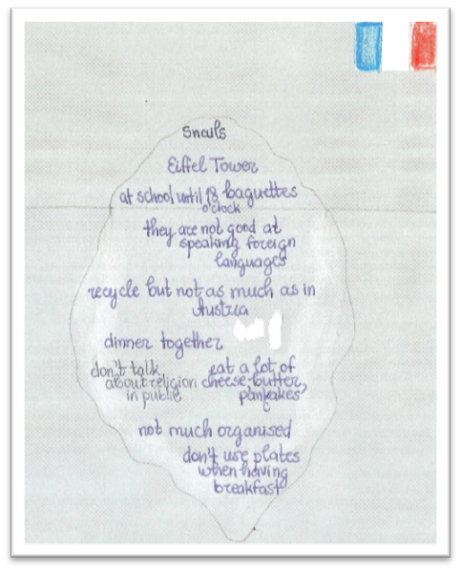
Icebergs AFTER the Trips
Greetings | Kissing, number of expected hugs…
At home | Taking off shoes, drinking tap water,
Food | No dark bread
Table manners | How to use knife and fork in different cultures Bowls for tea, no plates for breakfast,
Time | Concept of time, being on time, being late, dinner times
Politeness | Respect towards teachers, use of firstnames, saying thank you not expected,
Showing emotions | Spanish people seemed to show their emotions (+/-) more openly
Volume, Speed and Tone of Voice | Higher volume and speed as well as more emotional modulation amng Spanish peers
Religion | Not visible in France, crosses forbidden in school. Spanish students wearing crosses and practicing their Catholic religion very visibly.

Slide 25
Not all Spanish children eat junk-food and drink juice-boxes on a daily basis.
Awareness of health issues and socio-economic status
The host family explains Eric‘s strange behavior by saying:
Not all French people wear designer clothes, they actually go to school in jogging pants.
Personal
Inherited and learned
Cultural
learned
Universal
inherited
„It must be a cultural thing.“
Look at the pictures in Eric and consider his behavoir. Do you think everything he does is cultural?
Now do the same for your host families and friends abroad.
(Hofstede,1997)

Slide 26
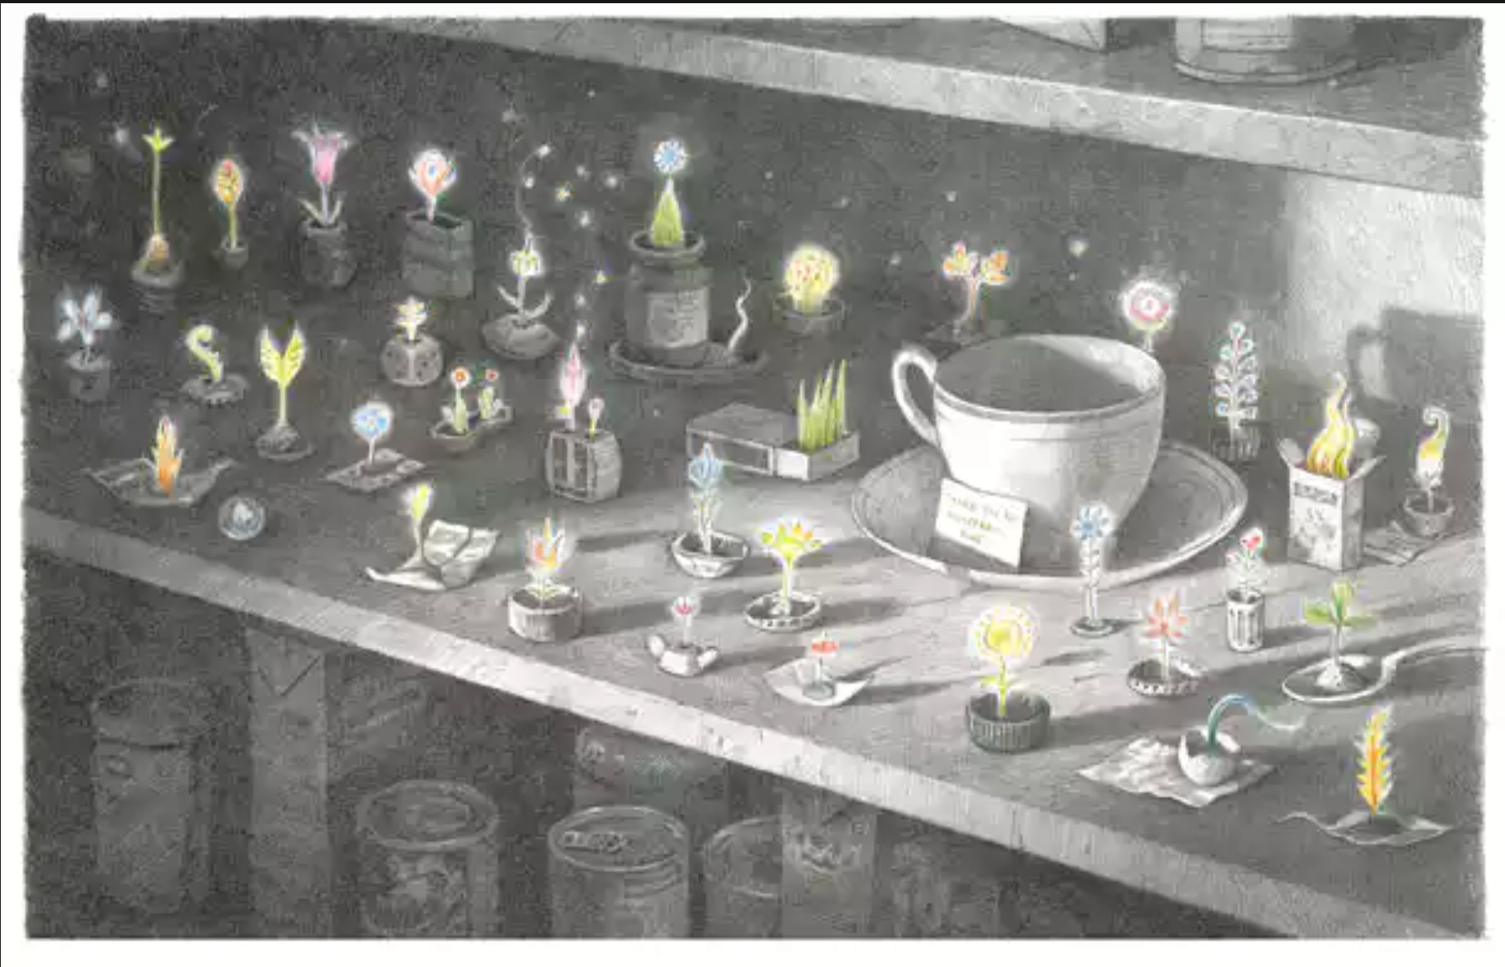
After Eric leaves, the family isn‘t really sure whether he enjoyed his stay or not. However, when they open the cupboard where he had slept and studied, they got their answer.
How did Eric say „thank you“ to his host family?
Why do you think this page is in color?
How do people show their gratitude in Austria/ your culture?
How do people say „thank you“ in France/Spain?

Slide 27


Writing a Thank you card
Say THANKS for 2-3 specific things that your host family has done for you.

Slide 28
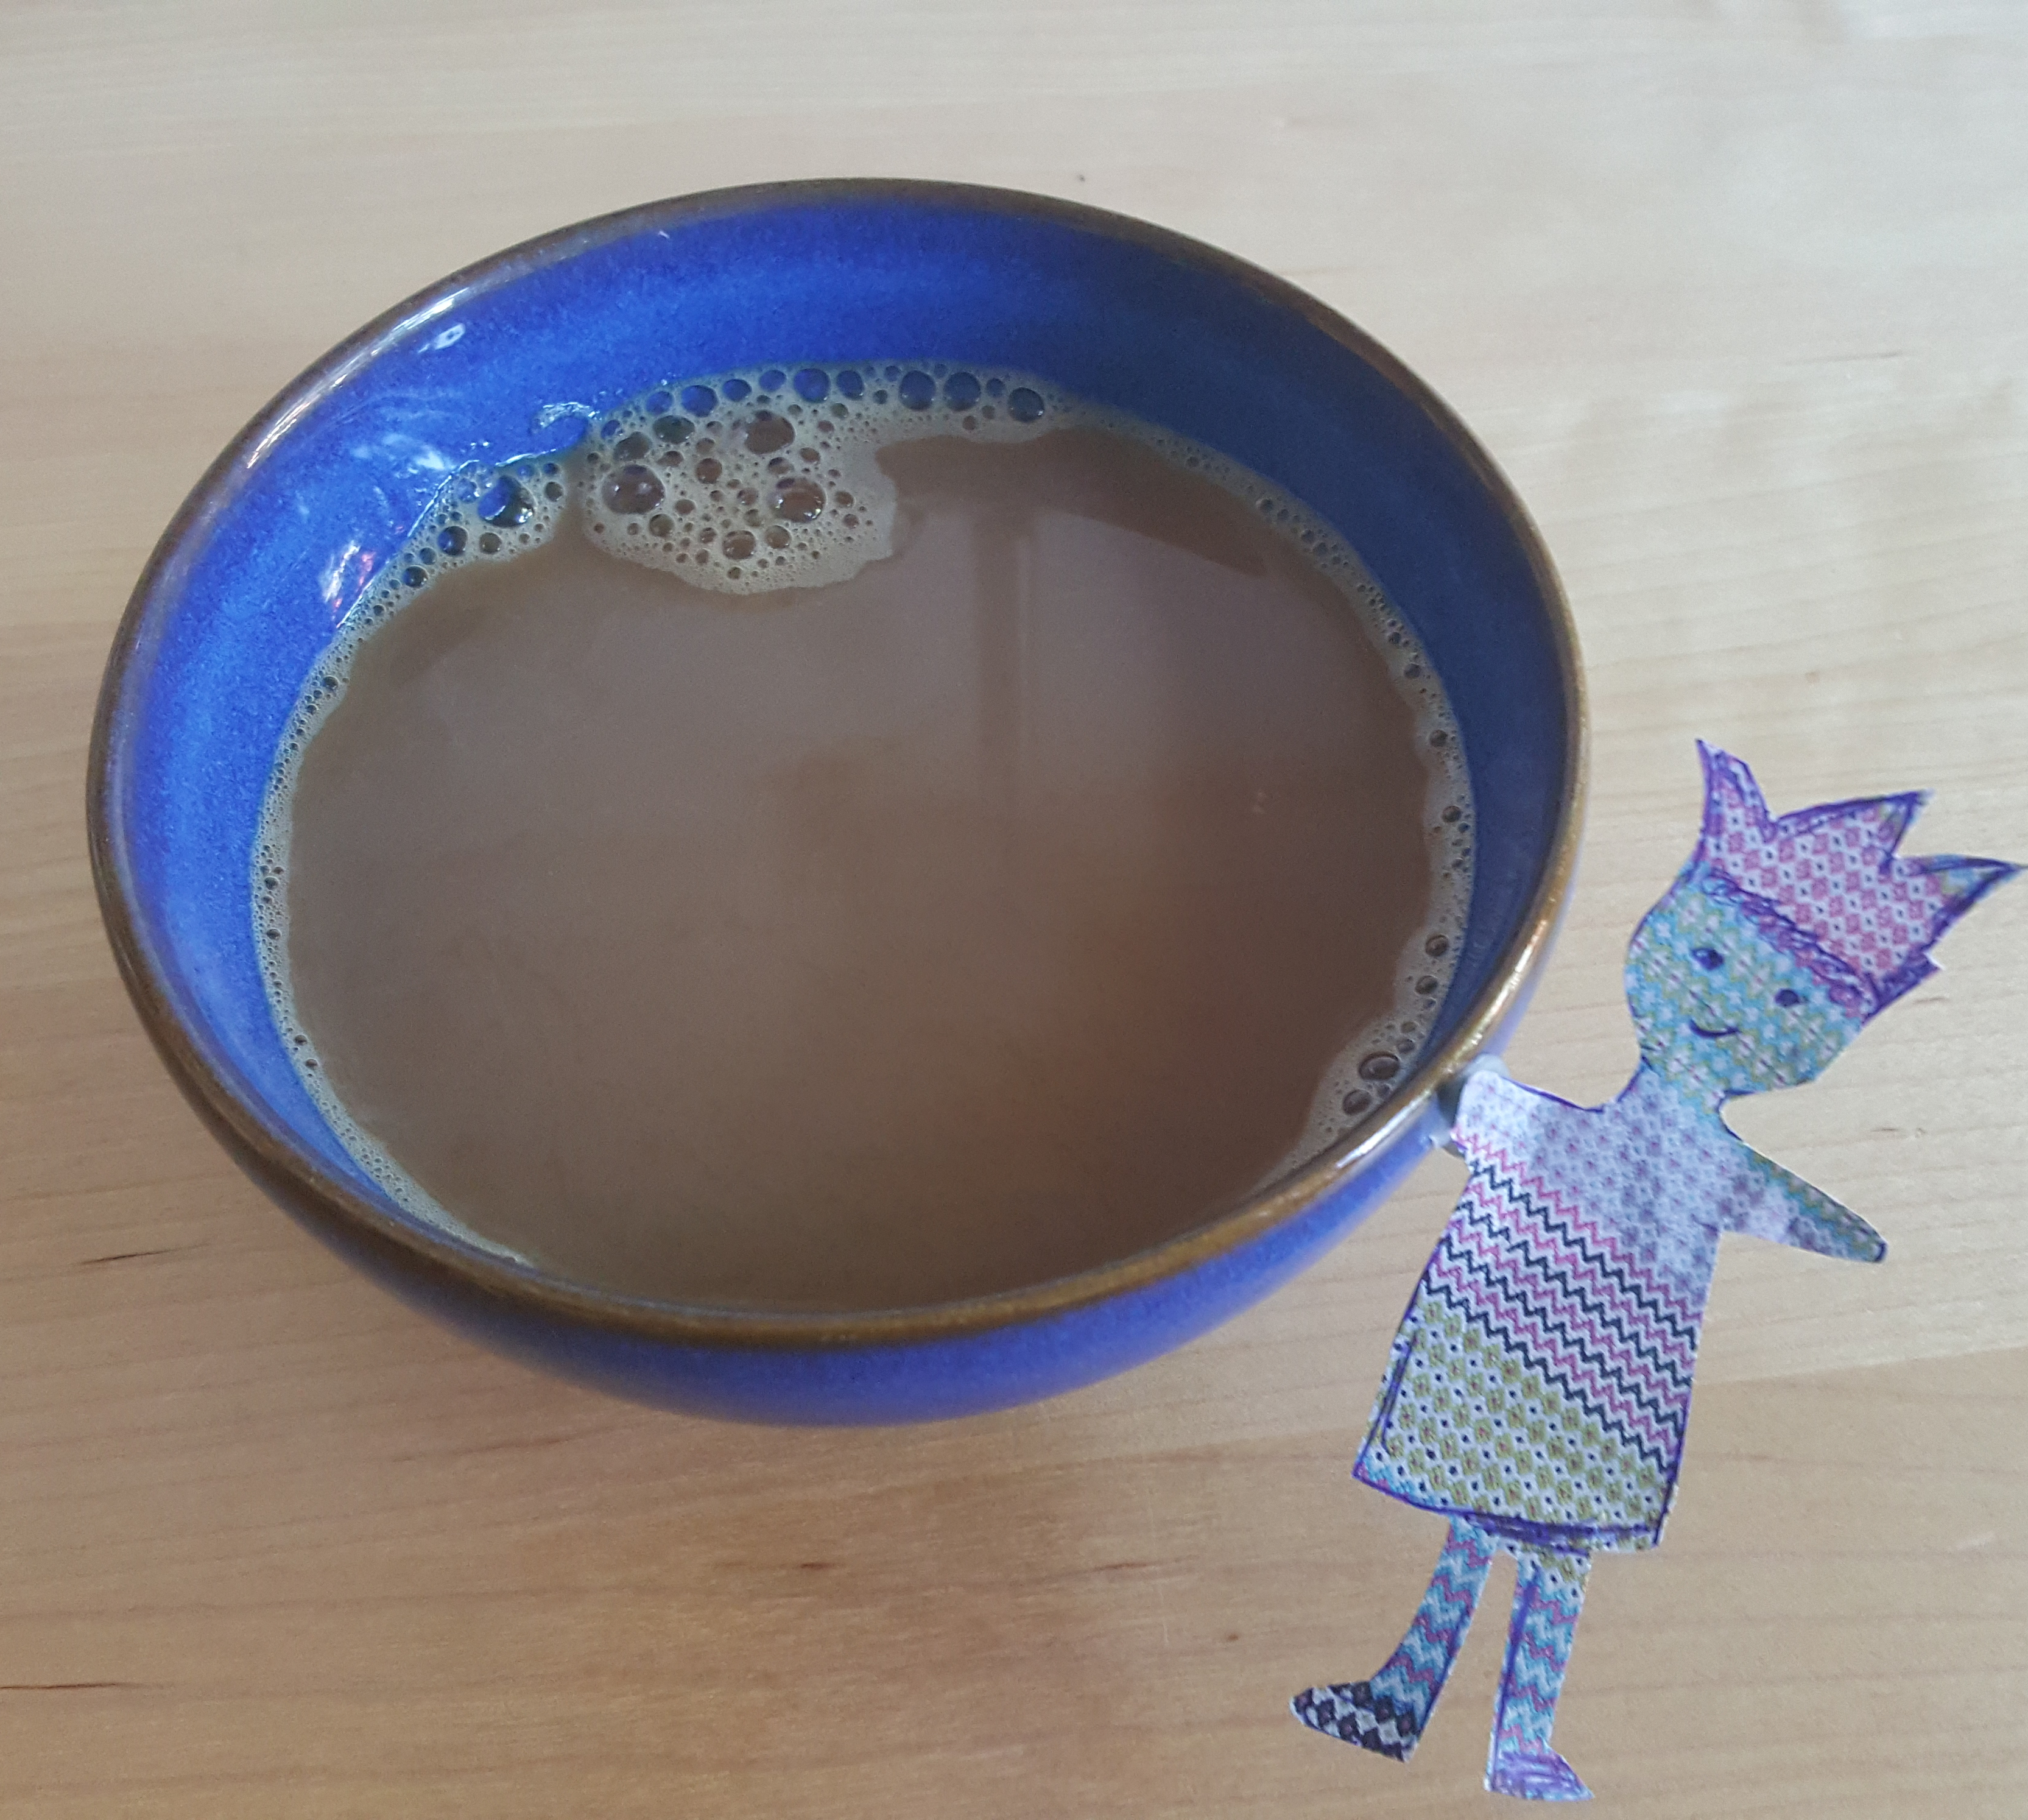
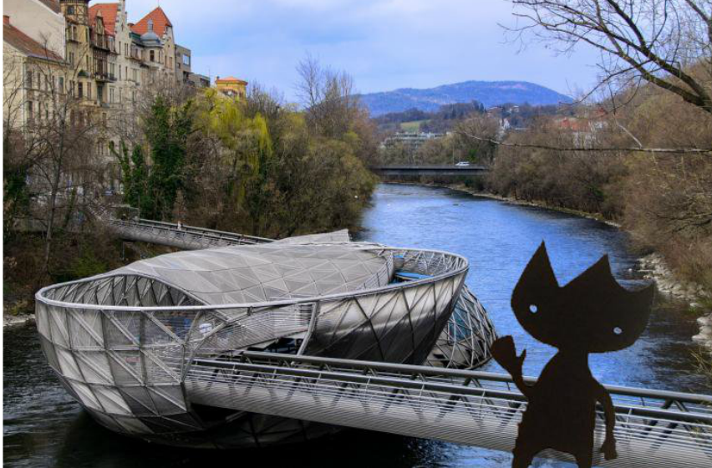
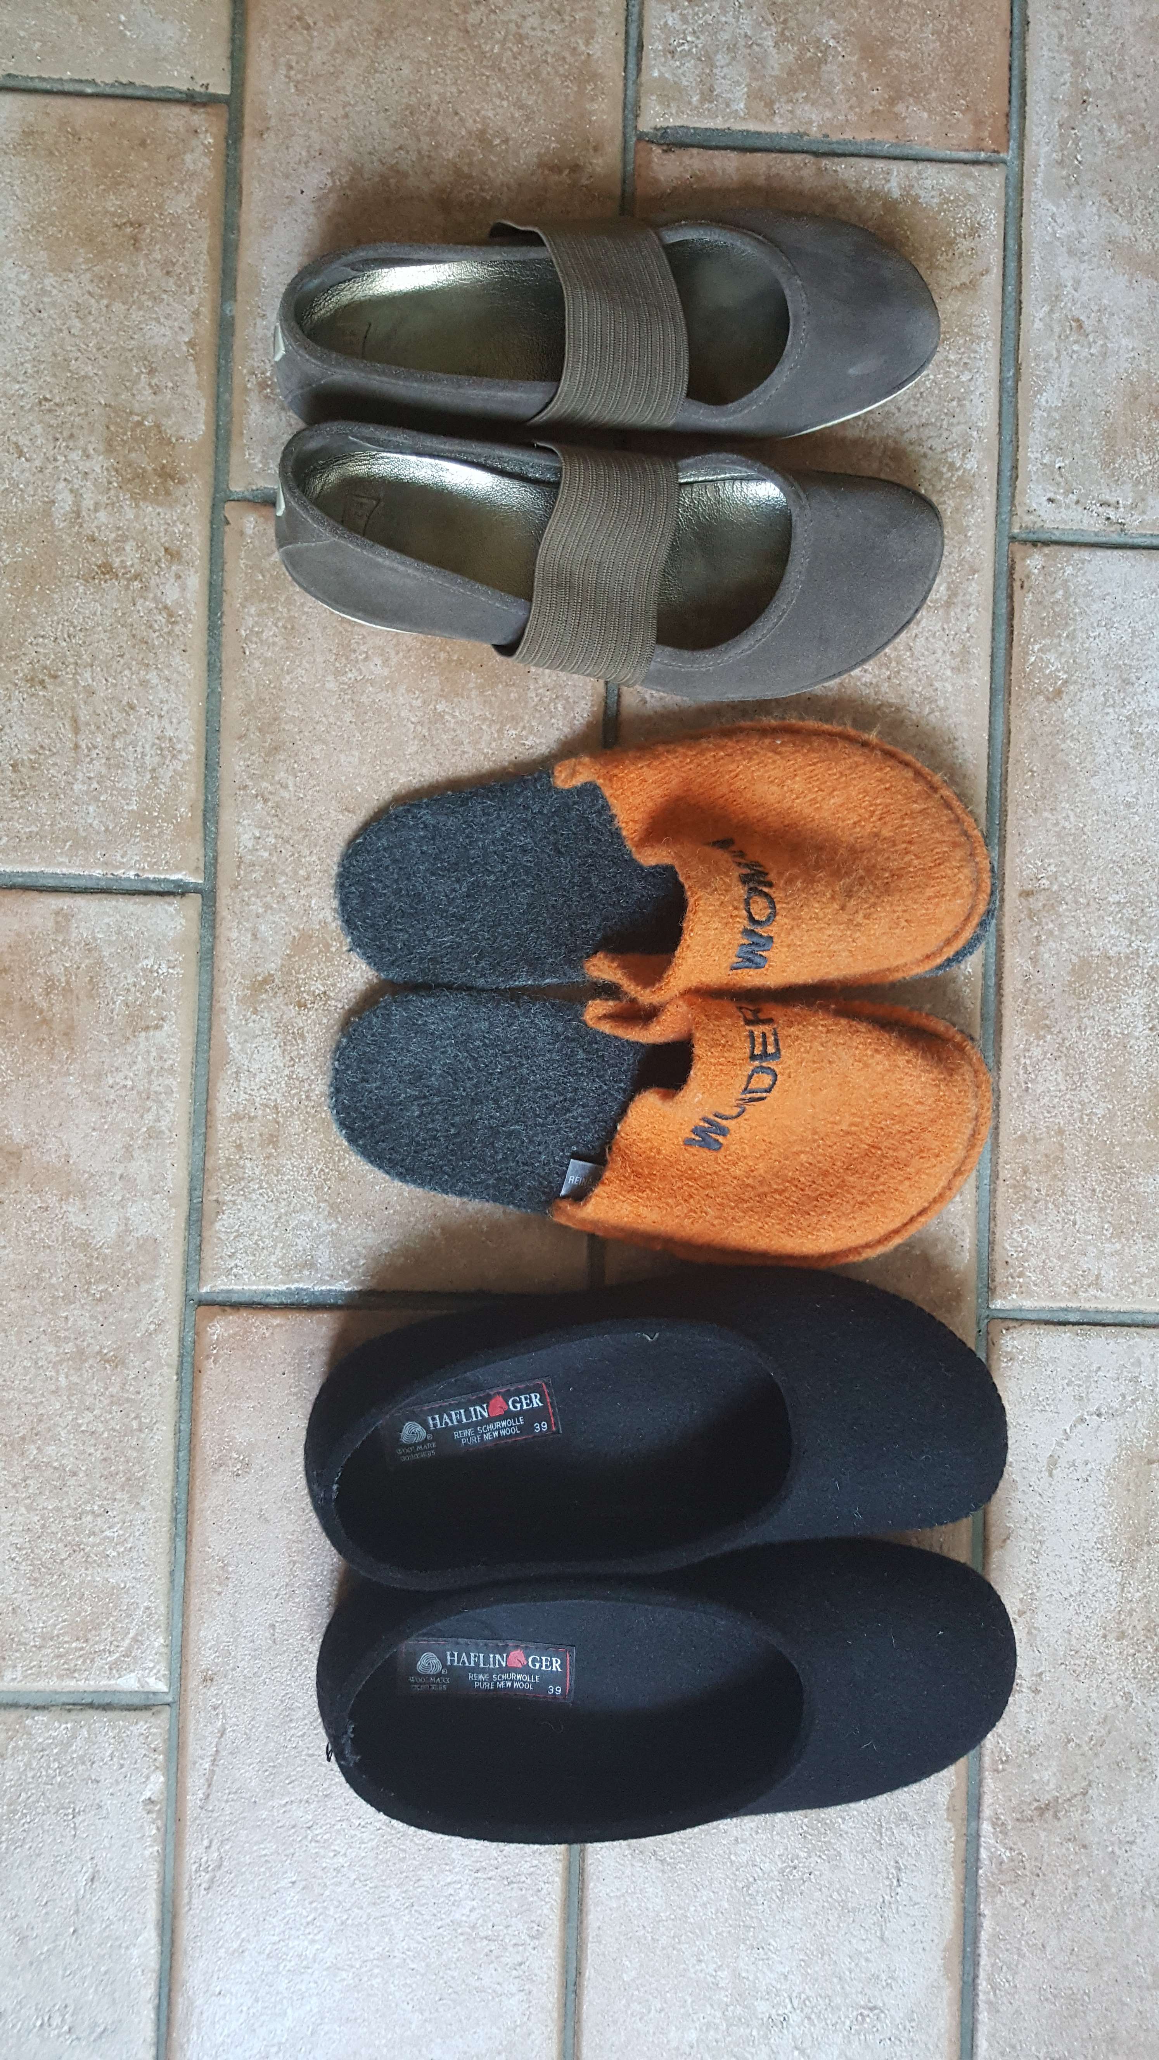
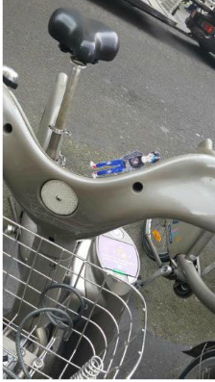
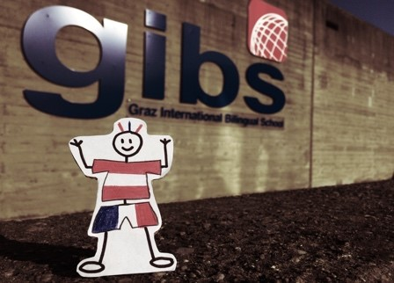
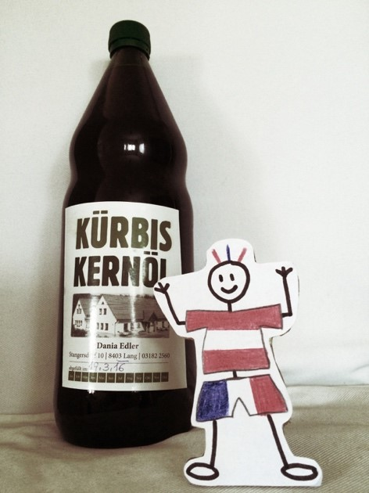
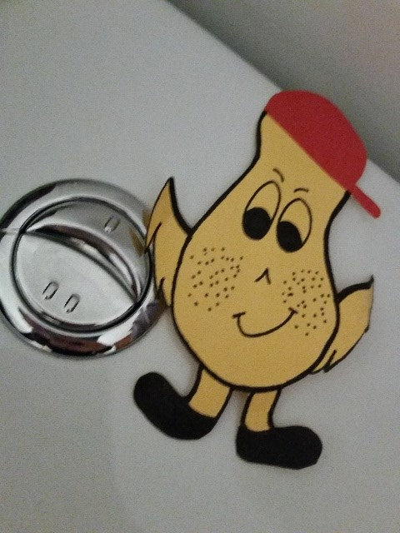
Story writing
Slipping into Eric‘s Mind and Walking in his Shoes

Slide 29
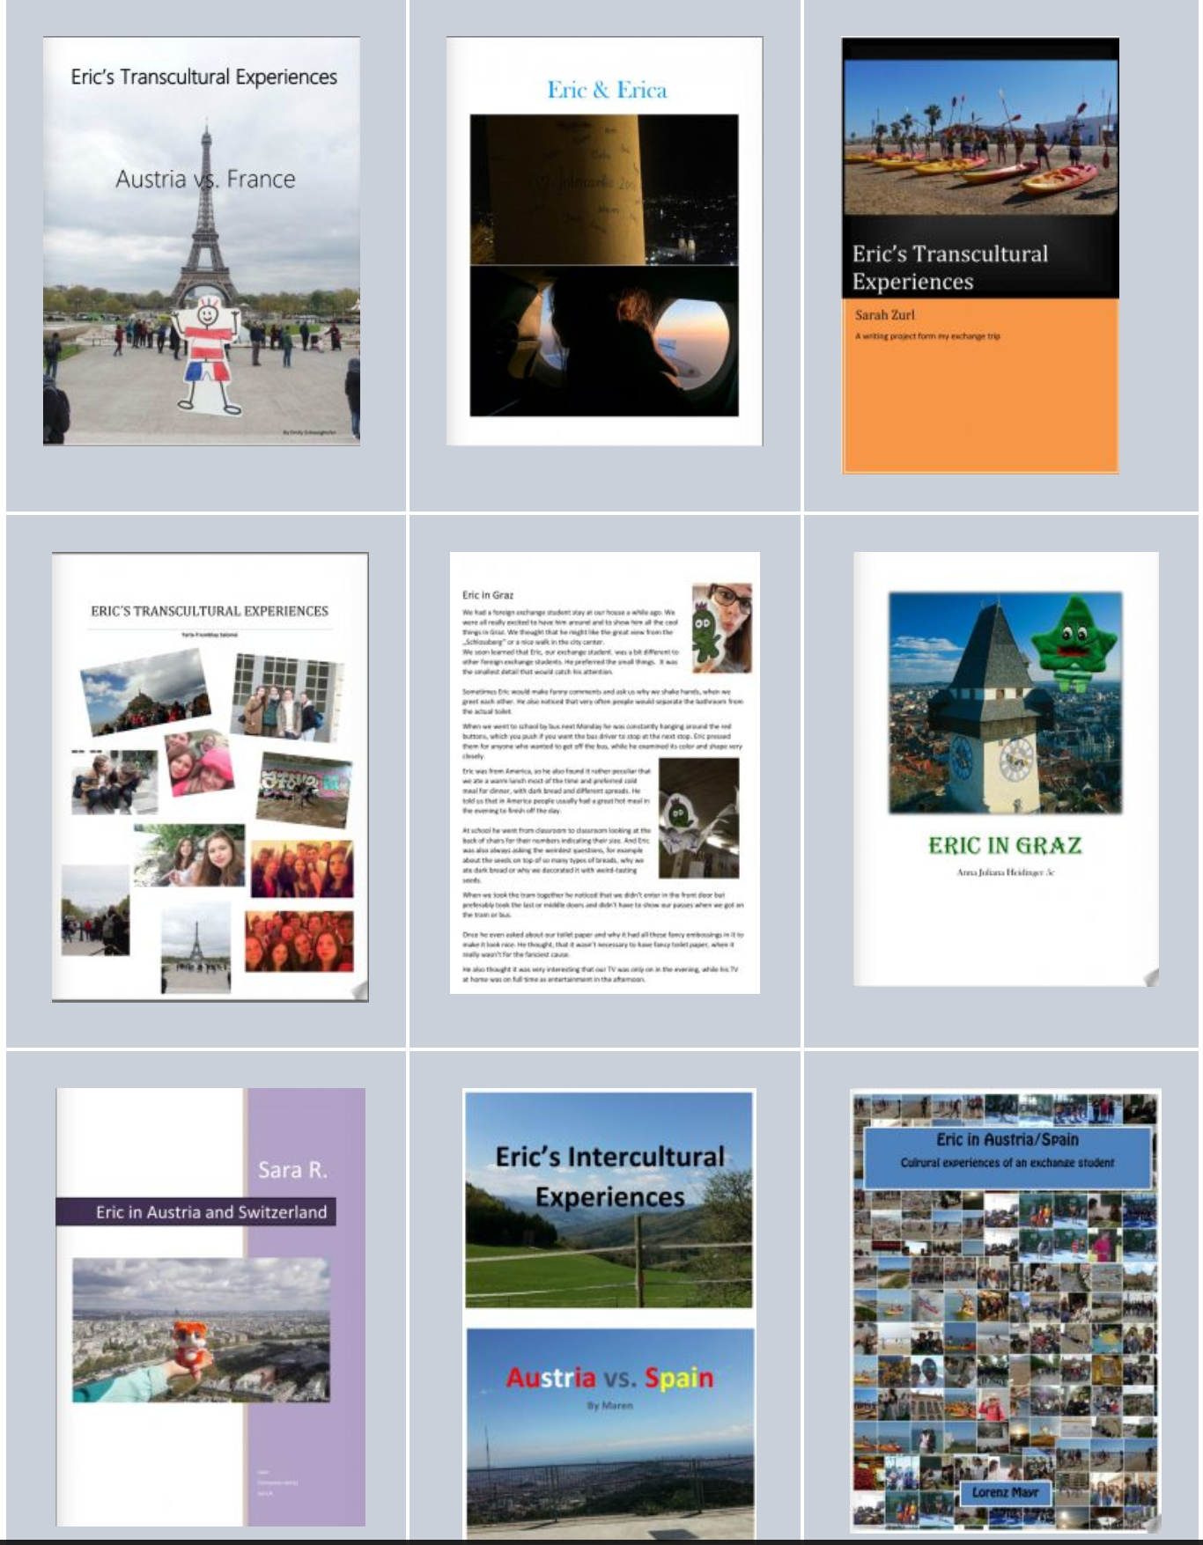
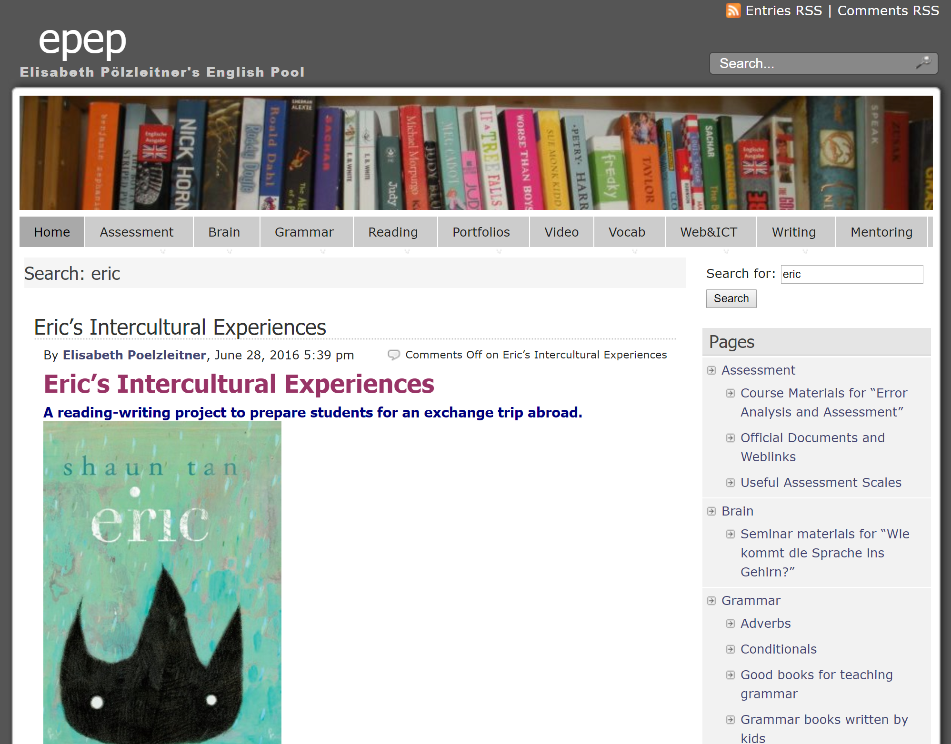
Find the students‘ stories here
Find all the project details, materials and student products on
www.epep.at
Seach for: eric
FIP

Slide 30

The final stories show that…
Learners have shown curiosity about their hosts‘ cultures.
They have noticed many small cultural details.
They have discussed cultural differences with their host families and exchange partners and clarified misunderstandings.
They have actively questioned their stereotypes and deverified some of them.
They have noticed cultural aspects of their own country.
…and last, but not least
They have produced final products that they are proud of and have published their stories online.
FIP

Slide 31
Conclusions
Reading Eric combined with discussion and writing tasks seemed to help to mediate learners’ intercultural competence, especially concerning attitudes, knowledge and skills of interpreting and relating.
This project seems to show the importance of preparing learners for class-trips abroad in every stage of the experience
This project also seems to show the important role that teachers have in ensuring that learners are given the support and space they need to profit from the intercultural experience.

Slide 32
REFERENCES
Byram, M. (1997). Teaching and Assessing Intercultural Communicative Competence. Clevedon: Multilingual Matters.
Byram, M. (2000). Assessing Intercultural Competence in Language Teaching. Sprogforum, 18 (6), 8–13. Retrieved from: http://library.au.dk/fileadmin/www.bibliotek.au.dk/ Campus_Emdrup/Sprogforum_arkiv/ SPROGFORUM_ NO._18_Interkulturel_kompetence.pdf [04.13.2011].
Byram, M., Gribkova, B., & Starkey, H. (2002). Developing the Intercultural Dimension in Language Teaching: A Practical Introduction for Teachers. Strasbourg: Council of Europe.
Council of Europe. (2001). Common European Framework of Reference for Languages. Retrieved from: https:// www.coe.int/t/dg4/linguistic/Source/Framework_EN.pdf [21.07.2016].
Ghosn, I. (2002). Four good reasons to use literature in primary school ELT. ELT Journal, 56(2), 172–179.
Hofstede, G. (1997). Cultures and Organizations. Software of the Mind. New York, NY: McGraw-Hill.
Hua, Z. (2014). Exploring Intercultural Communication. Language in Action. London: Routledge.
Kearney, E. (2016). Intercultural Learning in Modern Language Education. Bristol: Multilingual Matters.
Kramsch, C. (2009). Cultural Perspectives on language learning and teaching. In K. Knapp & B. Seidlhofer (eds.), Handbook of Foreign Language Communication and Learning (pp. 219–246). Berlin: Mouton de Gruyter.

Slide 33
Miller, M. (2014). Interkulturelles Lernen ohne Worte! Shaun Tan’s Graphic Novel “The Arrival.” Unterrichtpraxis, 2, 7–11. Retrieved from: www.praxis-fremdsprachen unterricht.de [10.2.2014].
Moeller, A. J., & Nugent, K. (2014). Building intercultural competence in the language classroom. In S. Dhonau (ed.), Unlock the Gateway to Communication. Central States Conference Report (pp. 1–18). Eau Claire, WI: Crown Prints.
Müller-Hartmann, A., & Schocker-v. Ditfurth, M. (2009). Introduction to English Language Teaching. Stuttgart: Klett Lerntraining.
Spitzberg, B. H., & Changnon, G. (2009). Conceptualizing Intercultural Competence. In D.K. Deardorff (ed.), The Sage handbook of intercultural competence. 2nd ed. (pp. 2–52). Thousand Oaks, CA: Sage.
Tan, S. (2001). Picture Books: Who Are They For? Retrieved from shauntan.net: http://shauntan.net/images/whypicbooks.pdf [20.06.2016]
Tan, S. (2008). Eric. In S. Tan, Tales from Outer Suburbia (pp. 8–18). New York: Scholastic.
Tomalin, B., & Stempelski,S. (1993). Cultural Awareness. Oxford: Oxford University Press.
Utley, D. (2004). Intercultural Resource Pack. Intercultural communication resources for language teachers. Cambridge: Cambridge University Press.
Vande Berg, M., Connor-Linton, J., & Paige, M. R. (2009). The Georgetown Consortium Project: Interventions for student learning abroad. Frontiers: The Interdisciplinary Journal of Study Abroad, 18, 1-75.
Zull, J. (2002). The Art of Changing the Brain. Sterling, Virginia: Stylus Publishing.

Slide 34

Have a look at the students‘ stories
Do you have any questions?

