Slide 1

Differentiation Tomlinson‘s model

Slide 2
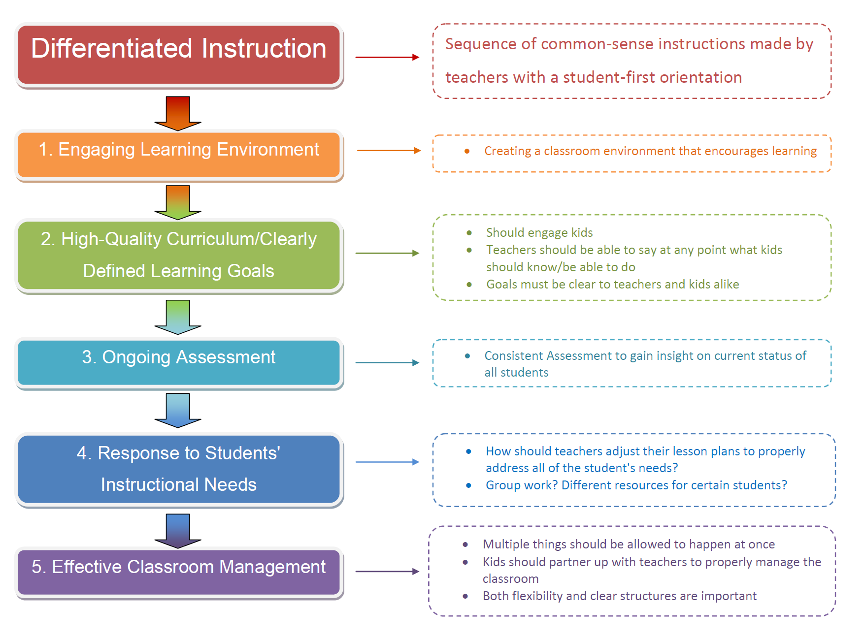

Slide 3

Strong Curriculum means…
Focus on K-U-D
KNOW (Information, Facts)
UNDERSTAND
CAN DO
Focus on
PERSON (relevance & personal connection)
GROUP (society of learners)
Long term Focus on
TRANSFER

Slide 4
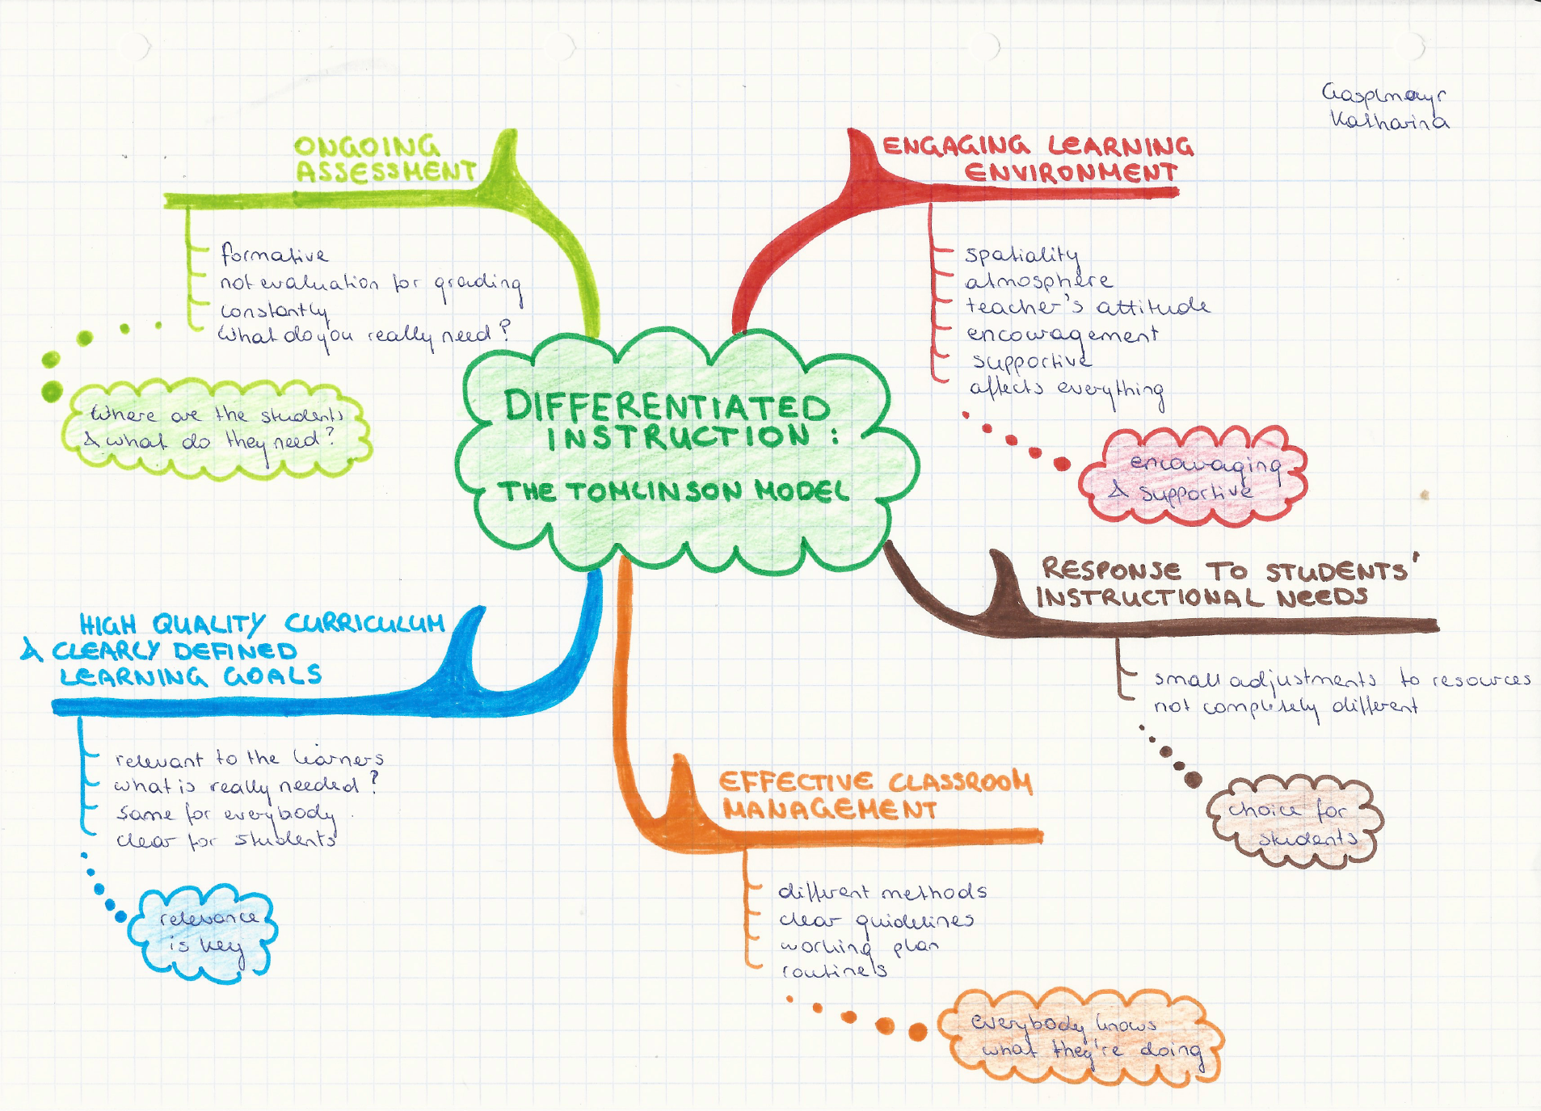

Slide 5
Differentiation is...
We taken into account that students have different
Readiness
Learning profiles
Interests
In order to differentiate:
Content
Products
Process
Affect / Environment
According to the principles:
Strong curriculum
Continous Assessment
Respecful
Tasks
Flexible Grouping

Slide 6
Matrix
 | Readiness | Interest | Learning Profile
Content
Prozess
Product
Environment / Affect

