Slide 1
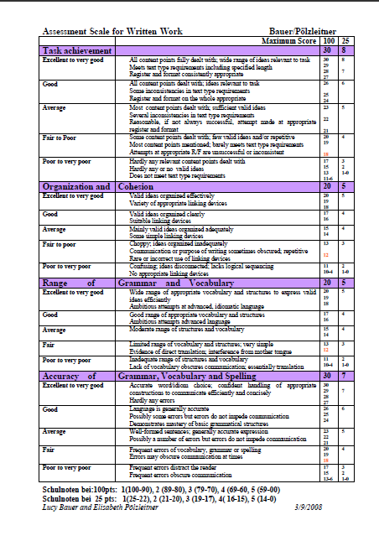
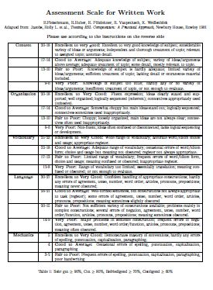
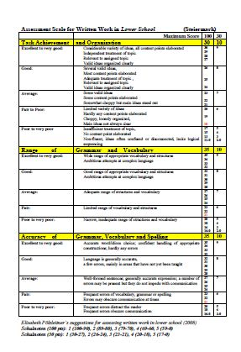
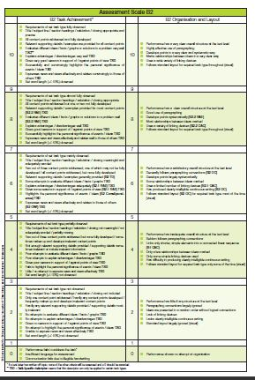
Using the New Assessment Scales

Slide 2
Five Minutes of History
Old assessment scale (1991):COVLM
New Matura - new task types and text types
Need for higher reliability and validity
New Styrian assessment scale
  Pölzleitner/Bauer, 2008
BIFIE Scale B2 , 2011

Slide 3
Assessment Matura OLD
„Steirische Assesssment Scale alt“: (1991)

Slide 4
New Matura – New Needs
First joint tasks for written exam in Styria (2007/08)
ARGE group suggested criteria for a new assessment scale
  Better suited for new text types
  B2 level, according to CEFR
  5 grades/marks, should also be used throughout upper-school
  Should be user friendly for the teachers
  transparent for students, should give clear feedback of strenths and weaknesses

Slide 5
Our Models
Old Styrian assessment scale for written work, (1991)
ESL Composition Profile, Jacobs et al. (1981)
Hungarian Assessment Scale, Tankó (2005)
FCE General Marking Scheme, British Council.Org
CEFR descriptors, B2
NÖ Assessment Scale for Writing, Friedl & Auer (2008)

Slide 6
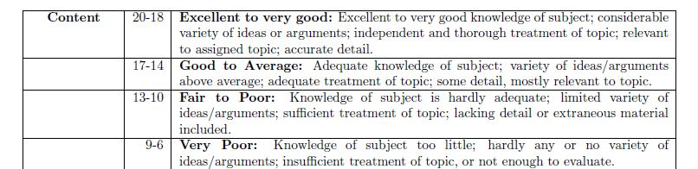
Content: in 1991

Slide 7
The New Assessment Scale:
Task achievement |  | 30
Excellent to very good | All content points fully dealt with; wide range of ideas relevant to task Meets text type requirements including specified length Register and format consistently appropriate | 30 29 28 27
Good | All content points dealt with; ideas relevant to task Some inconsistencies in text type requirements Register and format on the whole appropriate | 26 25 24
Average | Most content points dealt with; sufficient valid ideas Several inconsistencies in text type requirements Reasonable, if not always successful, attempt made at appropriate register and format | 23 22 21
Fair to Poor | Some content points dealt with; few valid ideas and/or repetitive Most content points mentioned; barely meets text type requirements Attempts at appropriate R/F are unsuccessful or inconsistent | 20 19 18
Poor to very poor | Hardly any relevant content points dealt with Hardly any or no valid ideas Does not meet text type requirements | 17 15 13 11-6

Slide 8
Organization and | Cohesion | 20
Excellent to very good | Valid ideas organized effectively Variety of appropriate linking devices | 20 19 18
Good | Valid ideas organized clearly Suitable linking devices | 17 16
Average | Mainly valid ideas organized adequately Some simple linking devices | 15 14
Fair to poor | Choppy; ideas organized inadequately Communication or purpose of writing sometimes obscured; repetitive Rare or incorrect use of linking devices | 13 12
Poor to very poor | Confusing; ideas disconnected; lacks logical sequencing No appropriate linking devices | 11 10-4

Slide 9
Range of | Grammar and Vocabulary | 20
Excellent to very good | Wide range of appropriate vocabulary and structures to express valid ideas efficiently Ambitious attempts at advanced, idiomatic language | 20 19 18
Good | Good range of appropriate vocabulary and structures Ambitious attempts at advanced language | 17 16
Average | Moderate range of structures and vocabulary | 15 14
Fair | Limited range of vocabulary and structures; very simple Evidence of direct translation; interference from mother tongue | 13 12
Poor to very poor | Inadequate range of structures and vocabulary Lack of vocabulary obscures communication; essentially translation | 11 10-4

Slide 10
Accuracy of | Grammar, Vocabulary and Spelling | 30
Excellent to very good | Accurate word/idiom choice; confident handling of appropriate constructions to communicate efficiently and concisely Hardly any errors | 30 29 28 27
Good | Language is generally accurate Possibly some errors but errors do not impede communication Demonstrates mastery of basic grammatical structures | 26 25 24
Average | Well-formed sentences; generally accurate expression Possibly a number of errors but errors do not impede communication | 23 22 21
Fair | Frequent errors of vocabulary, grammar or spelling Errors may obscure communication at times | 20 19 18
Poor to very poor | Frequent errors distract the reader Frequent errors obscure communication | 17 15 13-6

Slide 11

Thanks for listening
Any questions?

Slide 12
Satisfaction with the new scale

Slide 13
Washback auf den Unterricht
39/42 Kollegen (93%) äußern sich sehr positiv über die nun klarere Kategorie „Task Achievement“
Beispiele der Lehreraussagen:
  Die Hinorientierung zur tatsächlichen Aufgabenstellung ist verbessert. Das Bewusstsein dafür wurde geschärft. Eine klare Aufgabenstellung (Bulletpoints) und eine klare Beantwortung gehen nun Hand in Hand.
  Der größte Unterschied ist natürlich, dass die Textsorte ausdrücklich erwähnt wird; ebenso Länge, Register und Format. So lässt sich besser erklären, worauf es ankommt.
  Man achtet genauer auf den Texttyp
  Konkretere Aufgabenstellungen – Überschaubarkeit für SchülerInnen, kein Schwafeln möglich
  SchülerInnen lernen zwischen Textsorten zu unterscheiden und alle Anforderungen zu erfüllen

Slide 14
Range of Vocabulary and Grammar
Ich liebe sie!!! Endlich kann ich die belohnen, die sich was trauen, und neue komplexere Strukturen und Vokabular ausprobieren. Diese simplen Sätze zur Fehlervermeidung haben mich oft wirklich grantig gemacht. ...
Bessere Anlehnung an GERS, gezieltere Unterrichtsarbeit möglich
Bessere Formulierungen und anspruchsvollere Strukturen können eher gewürdigt werden.
Bessere Beurteilung der Stärken eines Textes

