Slide 1


Speak to us online
Using free and
easy-to-use
online tools
for oral homework
expand vocabulary and improve fluency
practice and proceduralize grammatical patterns and
practice structuring convincing arguments

Slide 2
Speak to us online In this presentation I will…
argue that speaking to an audience is one of the most active and effective ways to improve one’s language skills.
explain how speaking and presenting orally can help learners to expand their vocabulary
show how speaking can help proceduralize grammatical patterns
show how presenting a topic can help learners to understand the topic and structure their thoughts coherently
show how we can use free and easy-to-use online tools to give learners more speaking time to practice all of the above.

Slide 3
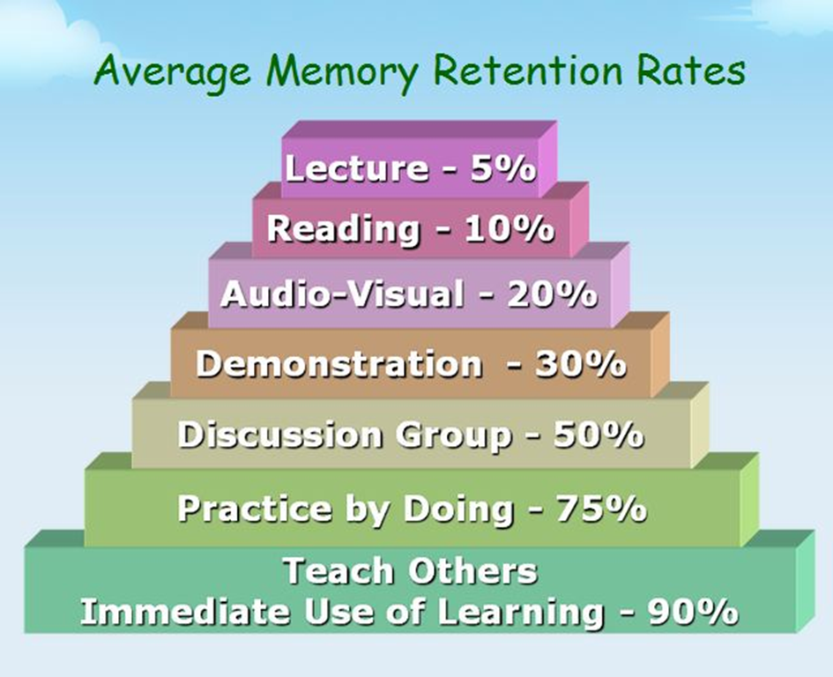
Speaking to an audience: the most active and efficient way to learn.

Slide 4
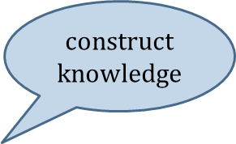
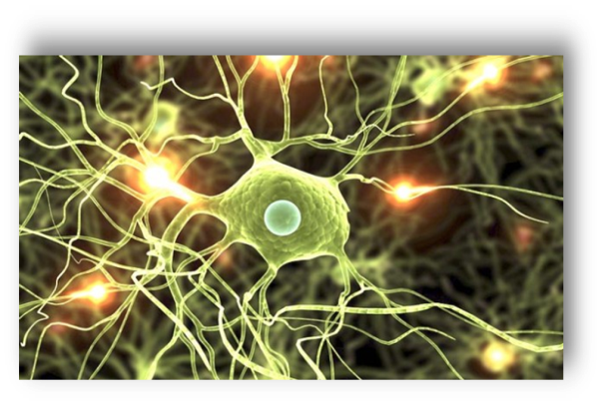
How does learning work?
neurons that fire together wire together
actively engage
This happens best when we speak.
We want to create situations where our learners actively use as many areas of their brains as possible and thus create, expand and strengthen their neural networks.
Notes:
In a nutshell learning is ONE thing: it is neurons that fire together – that are active simultaneously and thus build neural networks.
These active networks will get stronger and faster the more they area used. --- This means learning: patterning, understanding.

Slide 5
What happens when we speak?
In addition to other processes involved in language production (e.g. recalling items from memory, making connections, planning and assembling language in the Broca area) speaking requires the use and control of a large number of muscles in the face, tongue, mouth, and hands as well as hearing our own words and message.
Speaking thus activates more different areas of our brains than any other language-related activity.

Slide 6
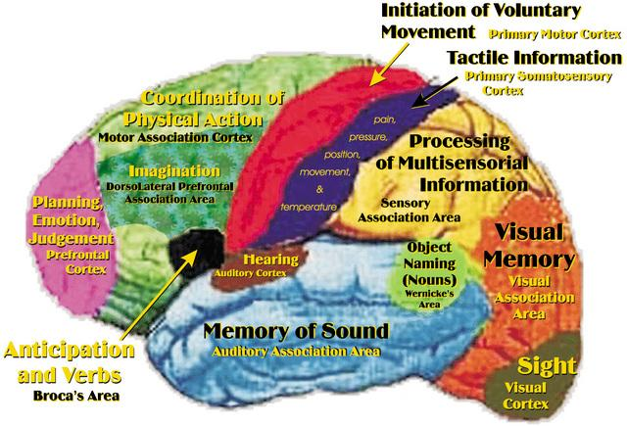
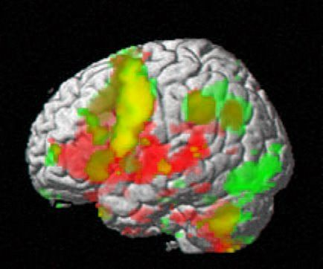
What is this brain doing?
Notes:
https://fbcdn-sphotos-g-a.akamaihd.net/hphotos-ak-ash4/384598_10152001520430121_1171687489_n.jpg

Slide 7

Why speaking to an audience is so efficient
Depth of processing In order to speak about a topic and present it to the class learners must
actively engage with the topic in order to understand it
actively decide what is important and relevant for their presentation
actively plan how to present it (outline)
plan and prepare the necessary language
practice their presentation a few times – listen to themselves critically before posting their final version
and in all these steps activate huge neural networks across their whole brains.

Slide 8

Practical Examples Year 1: Practice vocabulary: My room
active use of new vocab in a
meaningful context
use of visuals / real objects
personalized activity/episodic memory
repeated use of vocab in planning
and recording phase
high quality due to public viewing

Slide 9

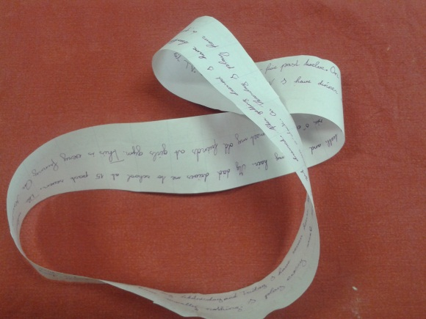
Year 1: Grammar practice Proceduralization of present routines
scaffolded activity to practice the use of the present simple to talk about routines
personalized activity – strong link between episodic memory and grammatical form
high motivation due to choice of favorite day
active engagement in planning the necessary language
students try to do their best
Notes:
show Moebius strips first!

Slide 10
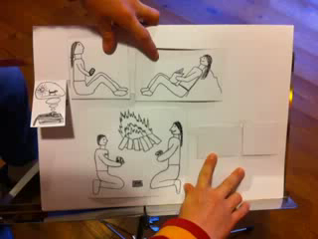
Building grammatical concepts Notions: Past events vs. circumstances
designing story-flip-flaps
developing/experimenting with the two concepts
actively designing examples
repeated practice in a typical context

Slide 11
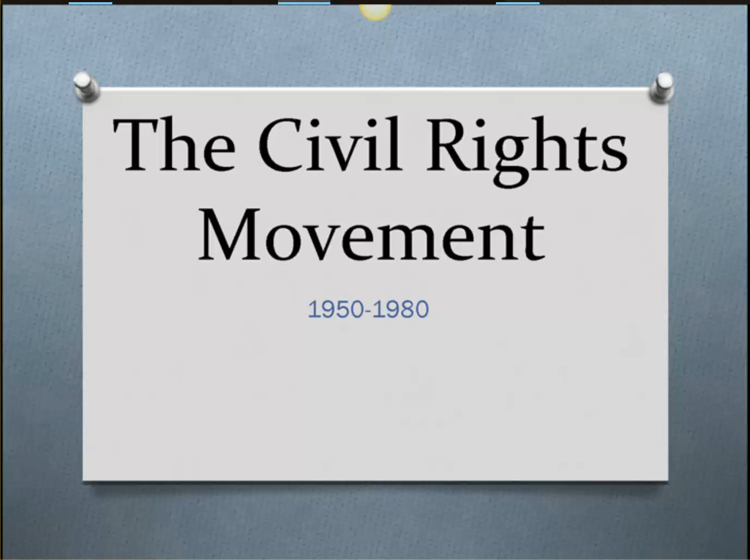

Presenting a topic or book
using new language actively in a meaningful context
presenting ideas coherently

Slide 12

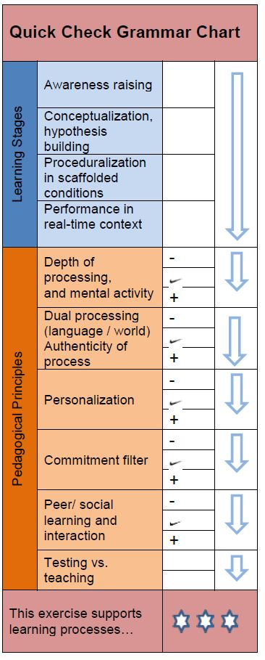

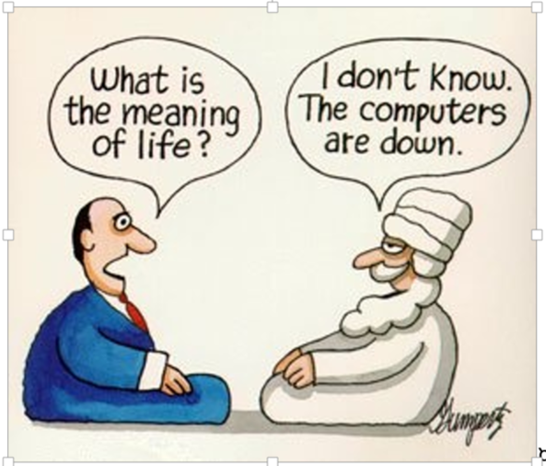
Elevator Speeches
Uni student explaining:
What is notional grammar?
A highschool student talking about:
Is technology taking over our lives?

Slide 13

Thank you for listening
Find more examples and detailed instructions on http://epep.at on the page Web&ICT

Slide 14
Let‘s try it out
Sharing platforms: Moodle, Blogger
Sound only: Vocaroo (on PC) or Clyp (on phone)
Video: Eyejot or Youtube
Screencast and voice:
Jing
Screencast-o-matic
Present.Me

