Slide 1
Quo Vadis
Cultural Learning and Language Education?
Symposium chair: Werner Delanoy
Panel: Simona Bartoli-Kucher, Werner Delanoy, Frauke Matz, Elisabeth Pölzleitner
SLTED, University of Vienna, 17 September 2022

Slide 2
Abstract
In a globalized modernity, where change has become the norm, the question arises how to reframe culture and langugae learning in teacher education. In this symposium a foundation for a timely concept of cultural learning and language education will be discussed. The approach suggested aims for creating dialogic relationships between universities, schools and key players outside educational institutions to encourage mutual transformation in the light of current educational and socio-cultural challenges.

Slide 3
Panel
Werner Delanoy (Klagenfurt): Quo Vadis Cultural Learning and Language Education?
Elisabeth Pölzleitner (Graz): Extensive Reading, Cultural Learning and Teacher Education: Challenges and New Horizons
Simona Bartoli-Kucher (Graz): Developing Transcultural Competence: Student Teachers of Italian Meet Cross-cultural Authors and Their Texts
Frauke Matz (Münster): Rethinking Cultural Learning in Teacher Education: Cosmopolitan Citizenship and Human Rights Education

Slide 4
Quo Vadis Cultural Learning and Language Education ?
Werner Delanoy (University of Klagenfurt)

Slide 5
What are the hallmarks of a timely concept of cultural learning and language education ?
A focus on topical socio-cultural and educational challenges;
Inclusion of multimodal and digital dimensions;
A dialogic life approach;

Slide 6
Foundations?
(1) Dialogue as a basis
(2)Transculturality as the new paradigm for cultural learning?
(3) Cosmopolitanism and Global Citizenship Education as new directions for cultural learning
(4) Language Education: Communicative competence as symbolic competence
(5) Transforming conflict into dialogue: Cultural mediation as a central learning objective
(6) Assemblage Theory

Slide 7
1. Dialogue
All human understanding is limited;
Limitations can be partly overcome through engagement with different perspectives;
An open-ended and creative process;
Mutual respect & subject-relevant analytical tools;
A meeting of equal partners;
Focus on issues of power;
Dialogue as a non-elitest program;
Education for dialogue is language education;

Slide 8
2. Transculturality as the new paradigm for cultural learning?
Transculturality: Culture-mixing and cultural interpenetration in a globalized modernity;
Interculturality as a no longer relevant paradigm?
Making a case for (self)-critical concepts of transculturality;
Marwan Kraidy (2005: 55):“Rather, our approach to hybridity should be framed by the type of hybridity put forward, the motivation for advancing it, its rhetorical topoi and its material effects“;

Slide 9
3. Cosmopolitanism
Gerard Delanty (2012: 19): „complex connectivity = the rapidly developing and ever densening network of interconnections and interdependencies that characterize globalisation“;
Cosmopolitanism as a controversial perspective;
Towards a dialogic and critical cosmopolitanism (Benhabib 2002; Delanty 2012; Sobre-Denton & Bardhan 2014: „diversity of universals“);

Slide 10
Definitions of CP
Delanty (2012: 4): „In the broadest sense possible, cosmopolitanism is about the extension of the moral and political horizons of people, societies, organizations and institutions. It implies an attitude of openness as opposed to closure“;
Sobré-Denton & Bardhan (2013: 5): CP is a concept discussed by different disciplines (e.g. philosophy, law , anthropology …) „that promises hope for a world increasingly connected through technology, media and travel, and yet plagued by continuing neo-colonial and global injustices, terrorism, poverty, ethnic conflicts and wars.“ They add that „there is a growing realization that we live in a world where we must find ways to address problems that are global in scope and cannot be solved by any one country or group of people alone, e.g. global warming, arms proliferation, world hunger.“
Making attempts to further global co-operation, peaceful conflict resolution and a more equitable distribution of resources ;

Slide 11
4. Global Citizenship Education
CP and GCE: similar debates and objectives; different histories and disciplinary affiliations;
Citizenship: „one‘s legal and political status, and a sense of belonging“ (Sant et. al. 2018:3); Gaudelli (2016: 163): from „isolated to integrated, disconnected to interconnected, and separable to inseparable“;
Vanessa Andreotti (2014): „soft“ and „critical“ GCE; „soft GCE“: only promotes acts of charity without calling unjust power systems into question;
Andreotti‘s notion of criticality (2014: 27): She writes that criticality „is not about ‚unveiling‘ the truth […] but about providing the space for [people] to reflect on their context and on their own and others‘ epistemological and ontological assumptions“;

Slide 12
5. Language Education: Communicative competence as symbolic competence
Language Education: (E)LT approaches combining language learning with socio-cultural learning;
Against dominant focus on referential uses of language serving the exchange of conventional meanings;
Kramsch (2009: 7): Symbolic competence draws attention to „the construction of perceptions, attitudes, beliefs, aspirations, values through the use of symbolic forms“; „the ability to take symbolic action and exercise symbolic power“ (p. 199);
Multiliteracies (Kalantzis & Cope, 2012: 250): „how written-linguistic modes of meaning interface with oral, visual, audio, gestural, tactile, and spatial patterns of meaning (ibid.: 2); Digital communication practices;

Slide 13
6. Transforming conflict into dialogue: Cultural mediation as a learning aim
Focus on conflict;
Mediation as external and all-partial counselling for conflict where strong emotion severely impacts communication and conflict resolution;
Mediation to help avoid further escalation of conflict;
From the win-win-model (Harvard-School of Mediation) to Transformative Mediation (Fechler 2013: 176);
Grassroots mediation;

Slide 14
7. Assemblage Theory
Assemblage = complex systems with interdependent components acting upon each other; assemblages include human and non-human actants; they are dynamic entities with uncertain and unexpected outcomes;
Bennet (2010): „mutual dependency with friction and violence between the parts“;
Delanda (2016): Assemblage = a well-working ensemble of interacting parts with emergent properties („The archer riding a horse in battle“);
Delanda‘s main interest lies in the new possibilities emerging from the components‘ interactions;

Slide 15
Assemblage Theory and Teacher Education Research
AT invites systemic engagement with complex learning spaces comprising human and non-human actants;
AT and Action Research
AT is focussed on concrete social wholes/ concrete practice;
AT draws attention to both workplan design and implementation with a particular interest in emerging possibilities;

Slide 16
Bibliography
Benhabib, Seyla. (2002). The Claims of Culture. Equality and Diversity in the Global Era. Princeton: Princeton Univ. Press.
Besemer, Christoph. (2014). Politische Mediation. Prinzipien und Bedingungen gelingender Vermittlung in öffentlichen Konflikten. Bonn: Stiftung Mitarbeit.
Delanda, Manuel. (2016). Assemblage Theory. Edinburgh: Edinburgh University Press.
Delanoy, Werner. (2014). „Transkulturalität als begriffliche und konzeptuelle Herausforderung an die Fremdsprachendidaktik“. In: Matz, Frauke; Rogge, Michael & Siepmann, Philipp (Eds.). Transkulturelles Lernen im Fremdsprachenunterricht. Frankfurt/M.: Peter Lang, 19-35.
---. (2006). „Transculturality and (Inter-)Cultural Learning in the EFL Classroom“. In: Delanoy, Werner & Volkmann, Laurenz (Eds.). Cultural Studies in the EFL Classroom. Heidelberg: Carl Winter, 233-248.
Delanty, Gerard. (2009). The Cosmopolitan Imagination. The Renewal of Critical Social Theory. Cambridge: C.U.P.
Fechler, Bernd. (2013). „Interkulturelle Mediationskompetenz. Umrisse einer differenz-, dominanz- und kontextsensiblen Mediation. In: Auernheimer, Georg (Hrsg.). Interkulturalität und pädagogische Professionalität. Wiesbaden: Springer, 173-200.
Gaudelli, William. (2016). Global Citizenship Education. Everyday Transcendence. New York & London: Routledge.
Kalantzis, Mary & Cope, Bill. (2012). Literacies. Cambridge: C.U.P.
Kraidy, Marwan M. (2005). Hybridity or the Cultural Logic of Globalization. Philadelphia: Temple Univ. Press.
Kramsch, Claire. (2009). The Multilingual Subject. Oxford & New York: Oxford University Press.
Piller, Ingrid. (2011). Intercultural Communication. A Critical Introduction. Edinburgh: Edinburgh Univ. Press.
Welsch, Wolfgang. (1999). „Transculturality: The Puzzling Form of Cultures Today“. In: Featherstone, Mike & Lash, Scott (Eds.). Spaces of Culture. City, Nation, World. London: Sage, 194-213.

Slide 17
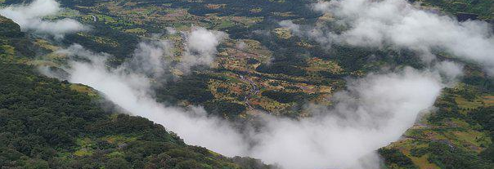
Quo Vadis Cultural Learning and Language Education?
The Status Quo: What is happening on ground level?
How can we move on from here?
Language Teacher Education: Challenges and New Horizons
Symposium: Vienna, September 2022

Slide 18


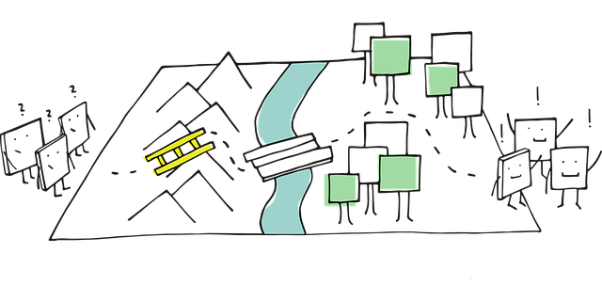
What to expect in the next 15 Minutes
The Practitioner Perspective: My Background
Status Quo: University and PH students’ experience with culture and reading
Goals: The role of culture and reading in the new curriculum for lower secondary schools in Austria
Next Steps – how to get there: What do future language teachers need in order to integrate more literature and culture into their classrooms?
What’s in the way? What challenges do they meet?

Slide 19

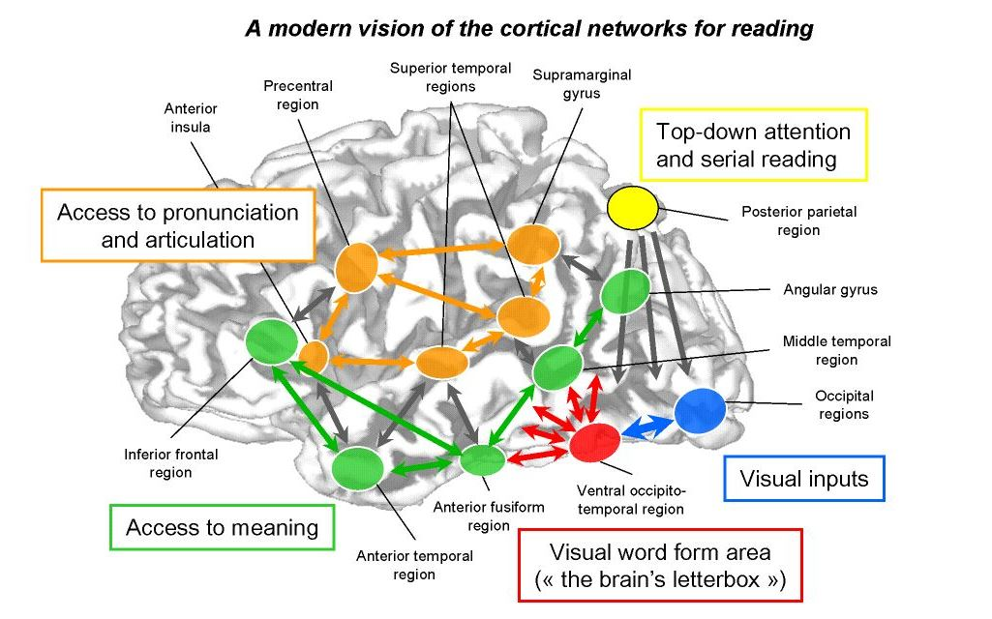

1- My Background / Experience / Beliefs
Extensive reading is one of the most efficient ways
  to improve students’ language skills
  to explore cultural differences and to raise cultural awareness
  to make “personal” cultural experiences by walking in other people’ shoes
  ……………………………………………………………
  Students must be allowed to choose the books they want to read.
  Books for different reading levels, interests and preferences must be offered.
  Tasks must be interesting and challenging.
BHS
UNI Graz FD
GIBS (bilingual AHS)
In-service Seminars
PH-ST
PraxisMS

Slide 20

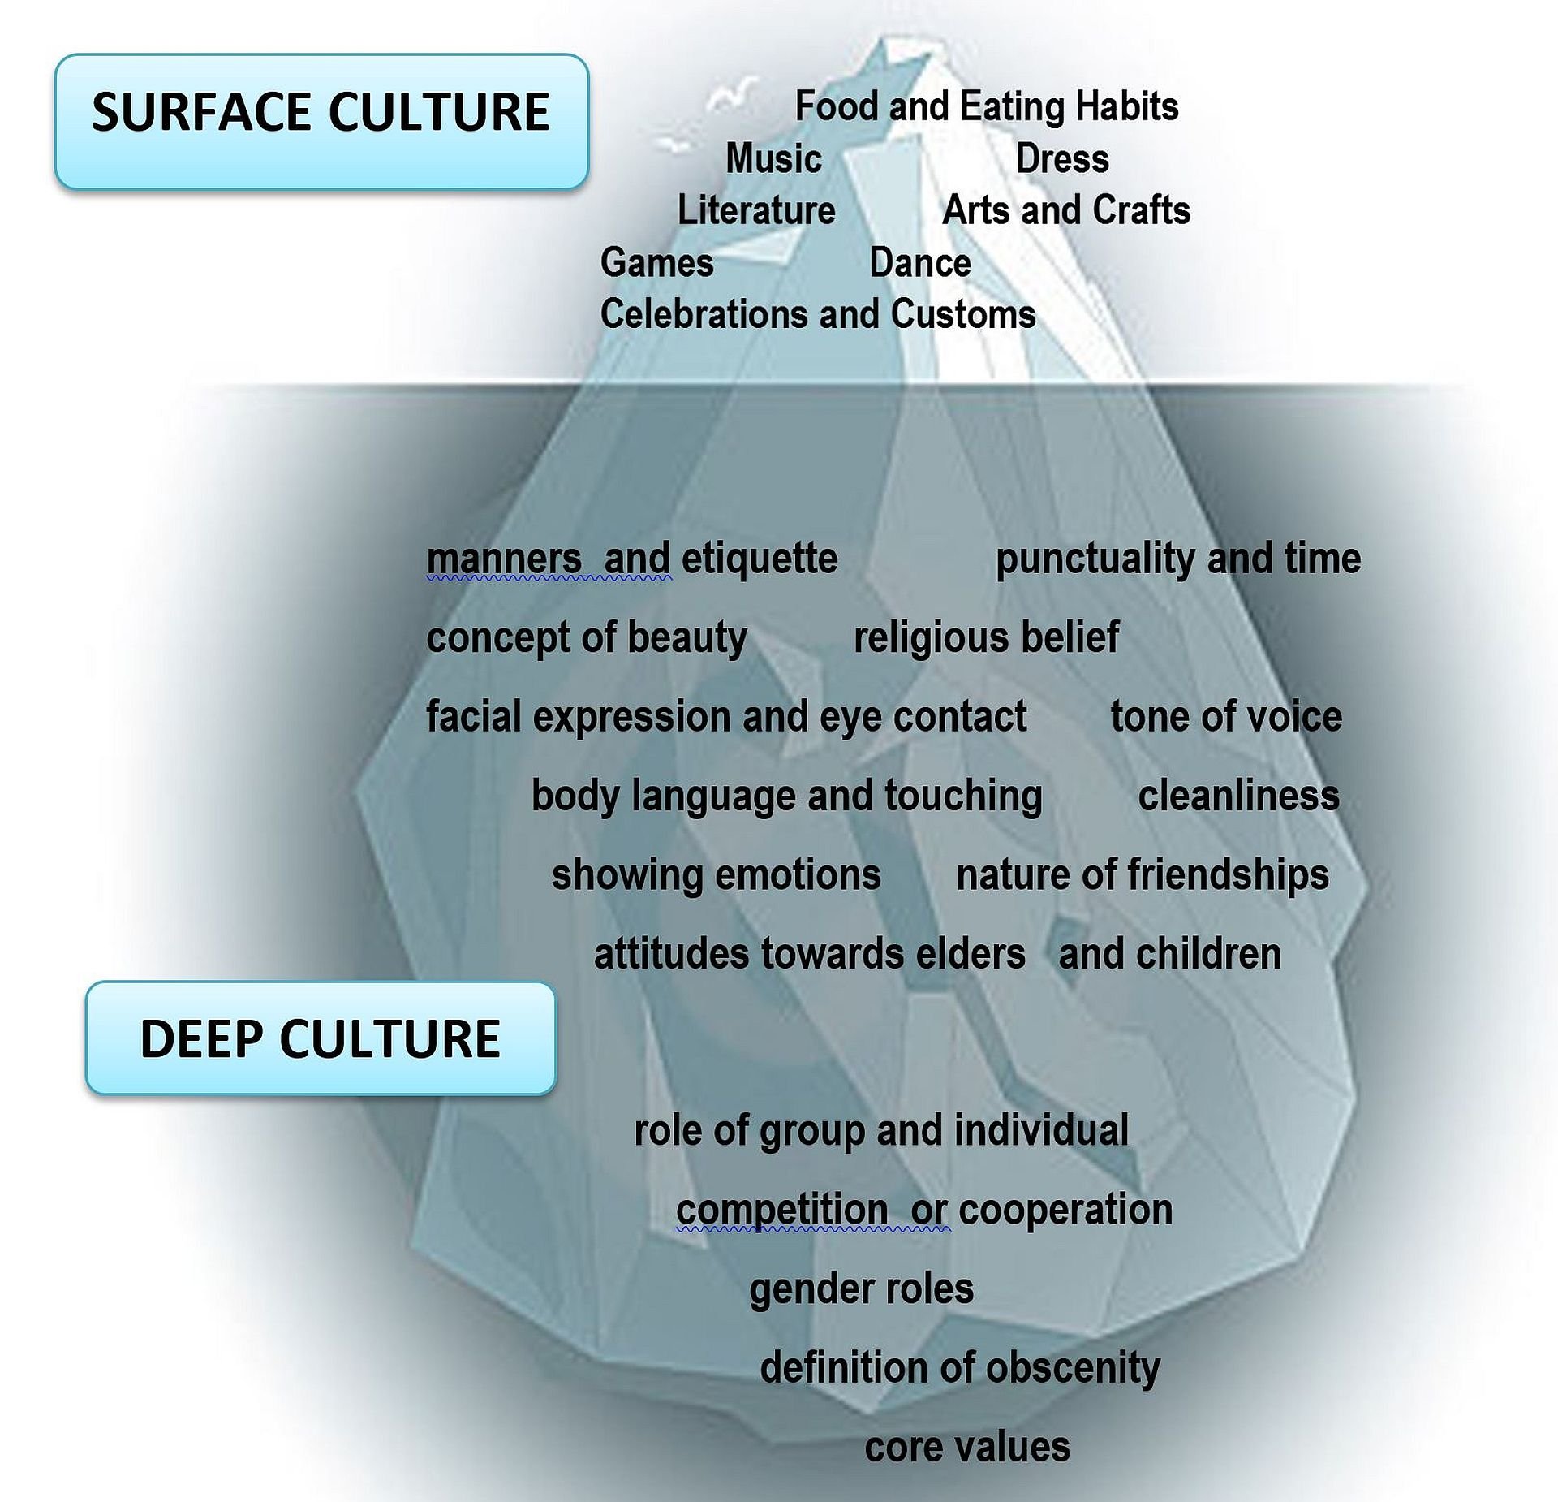

2.1- University Students’ understanding of Culture

Slide 21

2.2-University Students’ Experiences with Reading
“As far as I can remember, our teacher had us reading at least one book per semester. I never enjoyed reading books since i either did not like the genre or the fact that it was forced on us. I always disliked teen novels back then since I thought they seem to belittle the reader.”
“Reading in school was always a thing I did not like. I loved reading in my free time (and still do) but reading for school was never fun. Even if the book was good, I could not get over the fact that someone had told me that I have to read it - which was more than enough reason for me to not want to read it. That said, the books were seldom good. Additionally, I was well above the other students' reading level in English back then, so whatever book we all had to read together was always kind of easy and boring to me.”
“We all had to read at the same pace, and we were not allowed to read a book all at once which I did not like. And if we already knew the book, we had to read that again and did not get another book.”
“I took English additionally as a "Wahlfach". This was honestly one of the very few times that we read proper books in class. So I have very little experience with reading literature in school unfortunately...”
“Reading was mostly focused on comprehension. Reading literature was not covered in my English lessons.”

Slide 22

…and a more positive one…
In MS we did not really read a lot of books, but we had one book project in our final class which I can remember. We were allowed to choose an English book from our school library and create a portfolio where we had to fulfil certain tasks such as writing a summary, character description and writing down our own opinion about the book.
Later, in AHS Oberstufe our teacher was not as excited about reading although she was head of the library. Fortunately, we got a student-teacher in year two whom we had one entire year. She provided us with a selection of books, and we had to choose from four or five. I picked “Coppers Sun", a slave narrative based on a true story which was pretty fascinating. Short of that we only read scripts of plays that were performed in our school.

Slide 23

3-The role of Culture and extensive reading in the new curriculum for lower secondary school
Bildungs- und Lehraufgabe:
…
Fremdsprachenkenntnisse ermöglichen einen Zugang zu und den Austausch von Wissen, Erfahrungen und Informationen über Kulturen und Ideen,⁴ die in der Erstsprache nicht verfügbar sind, die Auseinandersetzung mit inter- und transkulturellen Themen und die Teilhabe an demokratischen Prozessen.⁴ Das bewusste Aufgreifen solcher Themen ist in einer globalisierten, mehrsprachig geprägten Welt die Aufgabe von Schule und Gesellschaft. Dies soll zu einer verstärkten Sensibilisierung der Lernenden für kulturelle Gemeinsamkeiten und Unterschiede führen und ihr Verständnis für die Vielfalt von Kulturen, Ideen und Lebensweisen vertiefen.^{4, 5} Durch den Fremdsprachenunterricht soll ein Bewusstsein für die Bedeutung von Mehrsprachigkeit und Interkulturalität geschaffen werden.

Slide 24

Zentrale Fachliche Konzepte in the New curriculum
Kultur und Gesellschaft
Sprache als beziehungsgestaltendes Element ermöglicht es, das eigene Lebensumfeld eingebettet in Kultur bzw. Gesellschaft darzustellen und andere kulturelle Zugänge auf Basis der inter- und transkulturellen Kommunikation zu entwickeln. Sprache befähigt dazu, Haltungen kritisch zu reflektieren und einen offenen, toleranten und respektvollen Umgang mit anderen Kulturen zu entwickeln.⁴
This Photo by Unknown Author is licensed under CC BY-ND

Slide 25
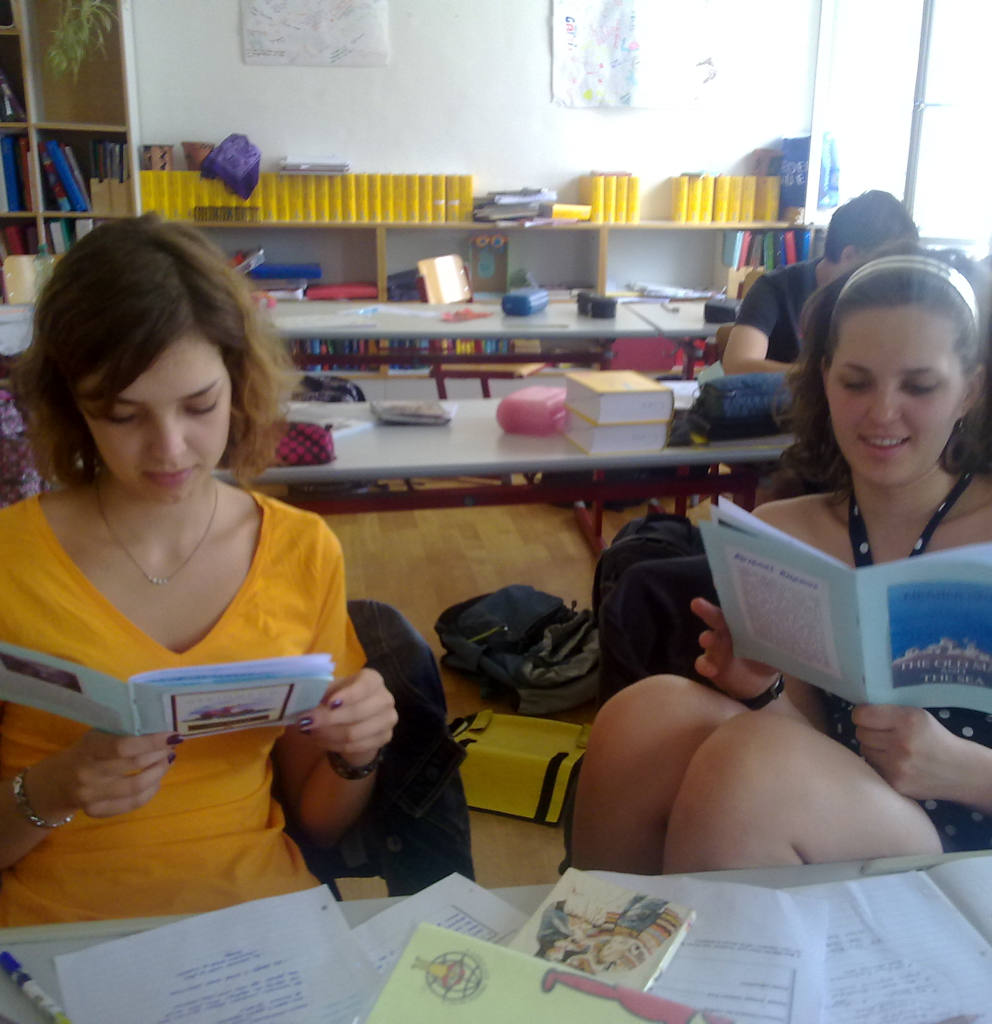
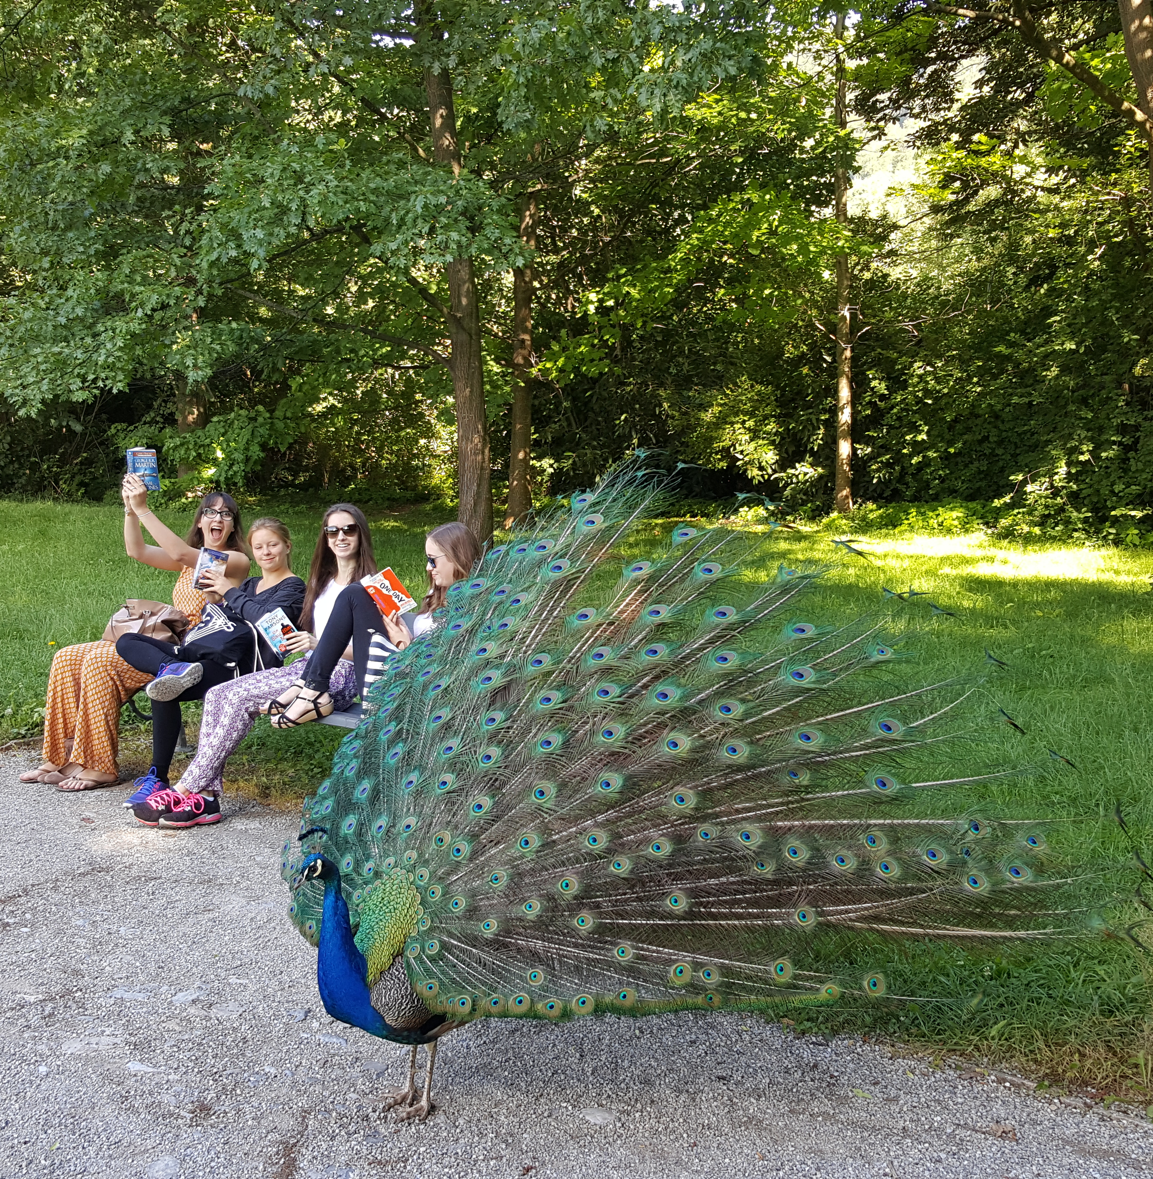
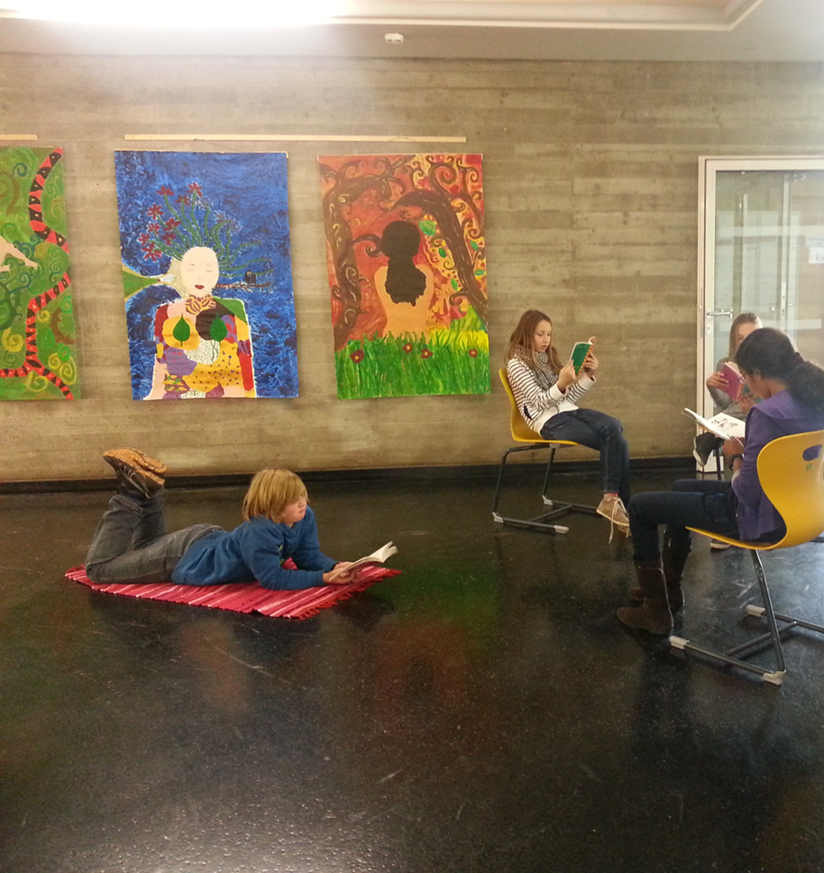
Practical Examples for different levels

Slide 26
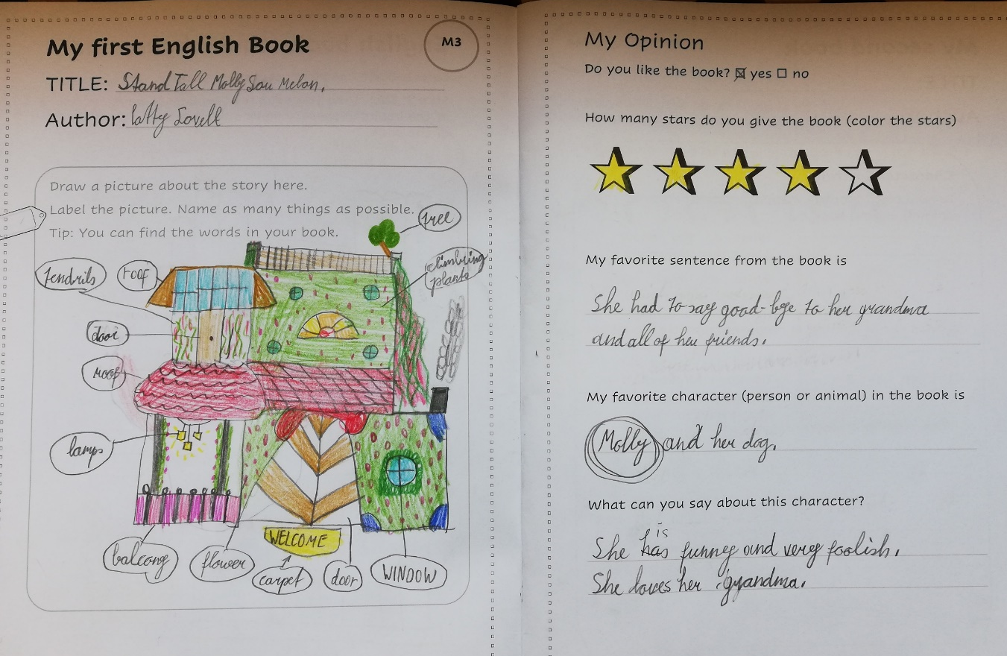

First reading / Reading Diary – erster Eintrag
Kompetenzbereich 2: Lesen - 1. Klasse
Die Schülerinnen und Schüler können
  • einfache Arbeitsanweisungen und Mitteilungen verstehen
  • sehr einfache Texte über vertraute Themen verstehen
Draw a picture about the story. Label the picture. (Wortebene)
Quelle:
My first reading diary
Pölzleitner / Bergmann

Slide 27
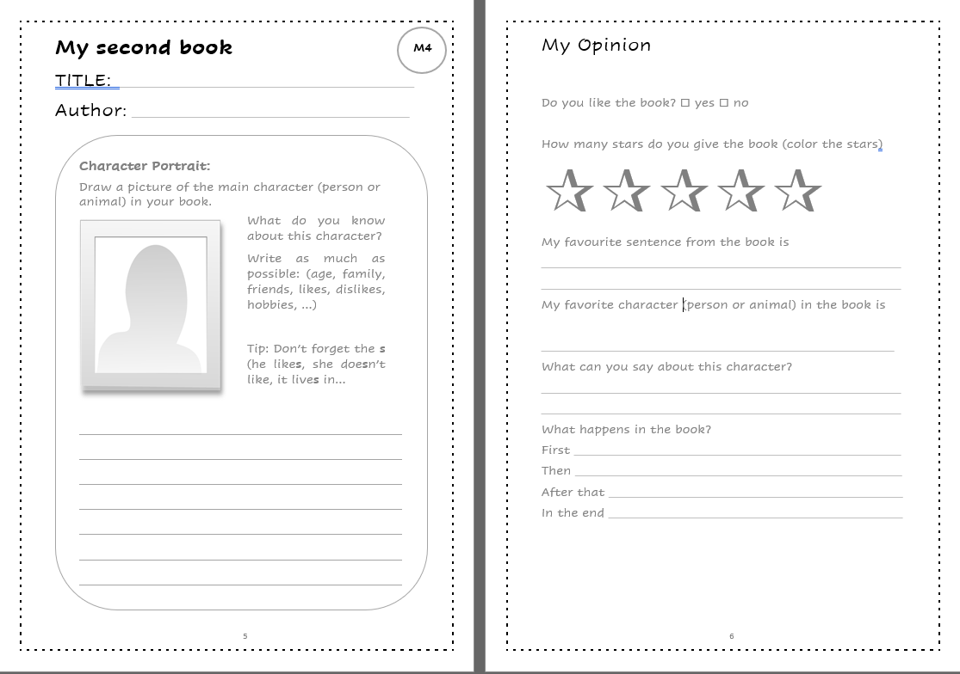
First reading / Reading Diary – erster Eintrag
Kompetenzbereich 2: Lesen 1. Klasse
Die Schülerinnen und Schüler können
  • einfache Arbeitsanweisungen und Mitteilungen verstehen
  • sehr einfache Texte über vertraute Themen verstehen
Kombination von Lesen und neuen sprachlichen Strukturen
Quelle:
My first reading diary
Pölzleitner / Bergmann

Slide 28
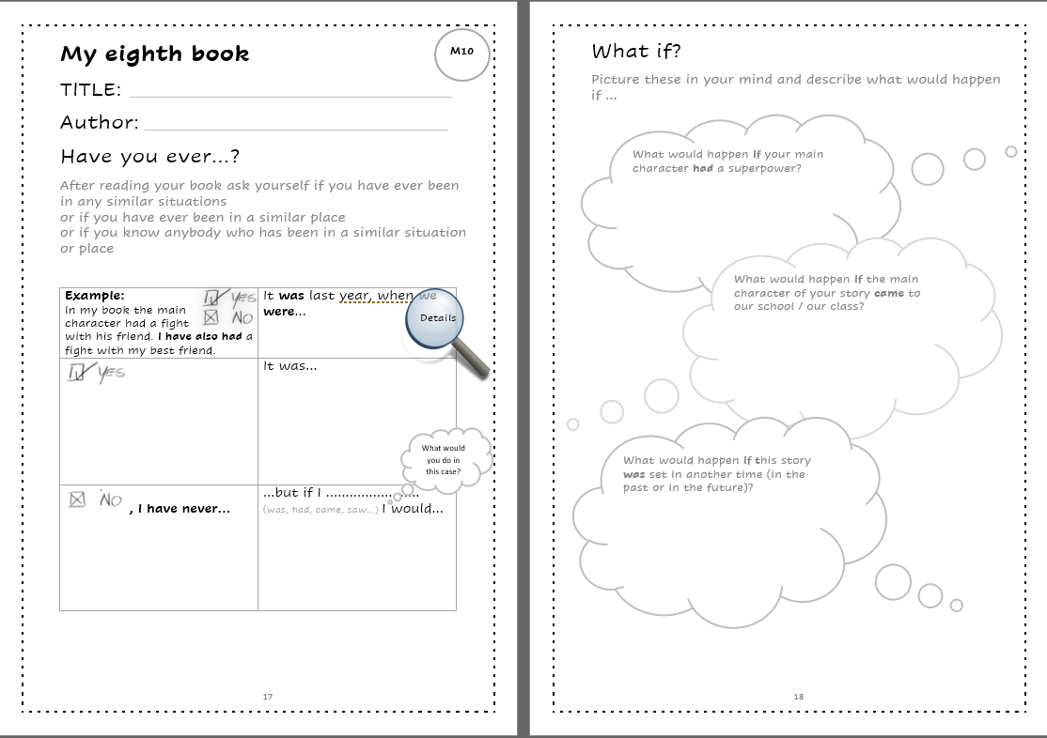
Reading Diary – year 2
Kompetenzbereich 2: Lesen 2. Klasse
Die Schülerinnen und Schüler können
  • kurze einfache Geschichten, Briefe, Emails oder bebilderte Sachtexte verstehen
Kombination von Lesen und neuen sprachlichen Strukturen
Kompetenzbereich 4: Schreiben
Die Schülerinnen und Schüler können
  Aspekte des persönlichen Lebensumfeldes beschreiben (u.a. Personen, Orte, Pläne, Wünsche)
  die eigene Meinung ausdrücken und begründen
  einfache Geschichten und Gebrauchstexte (u.a. E-Mail, Mitteilungen) schreiben und dabei auch über vergangene und zukünftige Ereignisse berichten.
Quelle:
My first reading diary
Pölzleitner / Bergmann

Slide 29

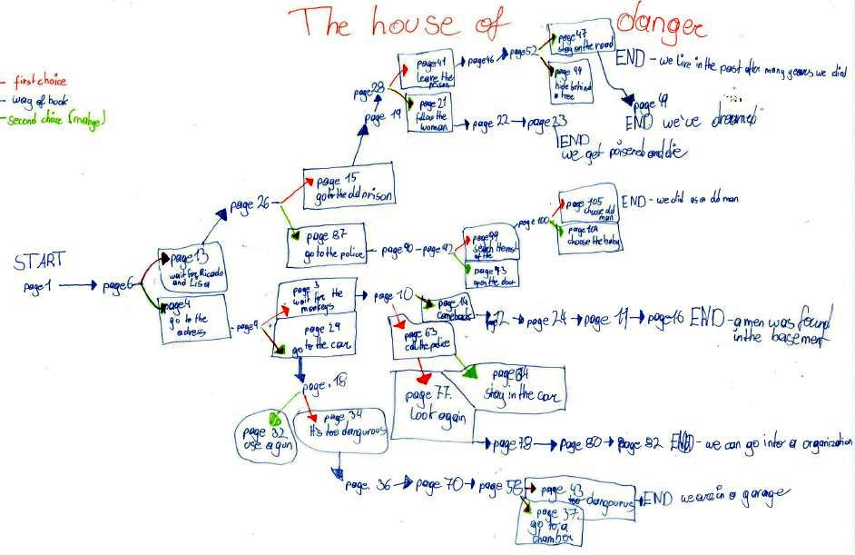
Beispiel: Lesen - Sprechen - Schreiben
Kompetenzbereich 2: Lesen 3. Klasse
Die Schülerinnen und Schüler können
• einfache klar strukturierte Jugendliteratur oder Sachliteratur mit befriedigendem Verständnis lesen Einstellungen (u.a. der handelnden Personen oder Autoren) erkennen
• einfache altersadäquate Texte verstehen und spezifische Informationen entnehmen
In this project you will again choose an interesting book. This time you are going to work with a partner and read the book in class. These books are different: every few pages you will have to decide how you want to continue.
Discuss the advantages and disadvantages of each option with your partner.
Keep track of your decisions on your "decision tree" sheet. You need this so you do not get lost in the story.
Tip: Use your discussion phrases sheet. How many phrases can you use?
Mehr über Choose your own adventure

Slide 30
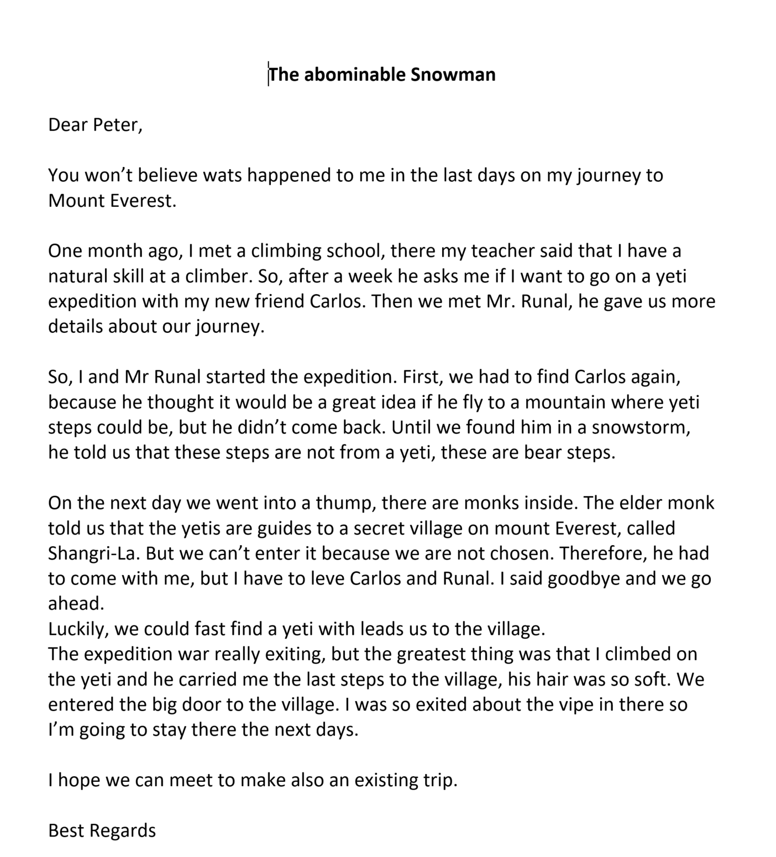
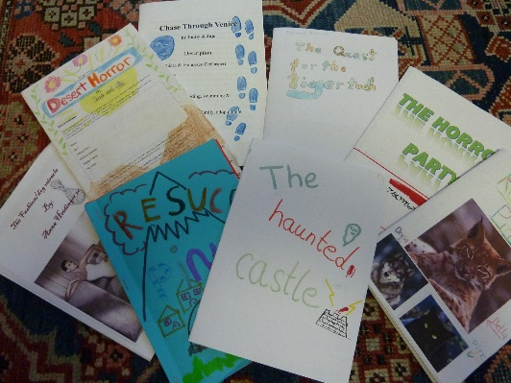
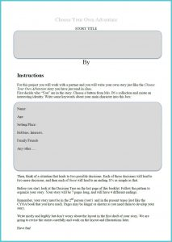
Letter to a friend (Assignment)
After reading the book and finding a good way out of the maze, write a letter to a friend telling him/her about your exciting and dangerous adventure in the last few days.
A more complex post reading assignment:
Write your own CYOA story. Follow the instructions in the booklet.
https://tinyurl.com/cyoa-writing

Slide 31
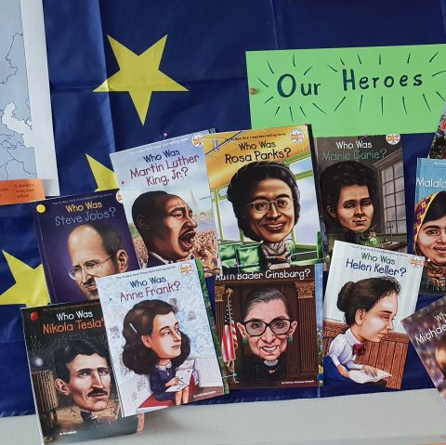
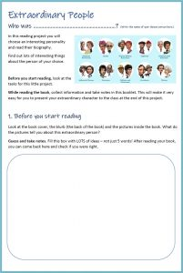
Reading –Speaking
3. oder 4. Klasse
  3. Klasse: über vertraute Themenbereiche erzählen und einfach (Buch-)Präsentationen halten
  4. Klasse: einfache Präsentationen zu vertrauten Themen, Büchern, Filmen oder Themen und Ideen von persönlichem Interesse halten
Choose a famous character that interests you
Read about this person’s life
Present the famous person to your classmates (museum displays)
https://tinyurl.com/who-was-instructions

Slide 32
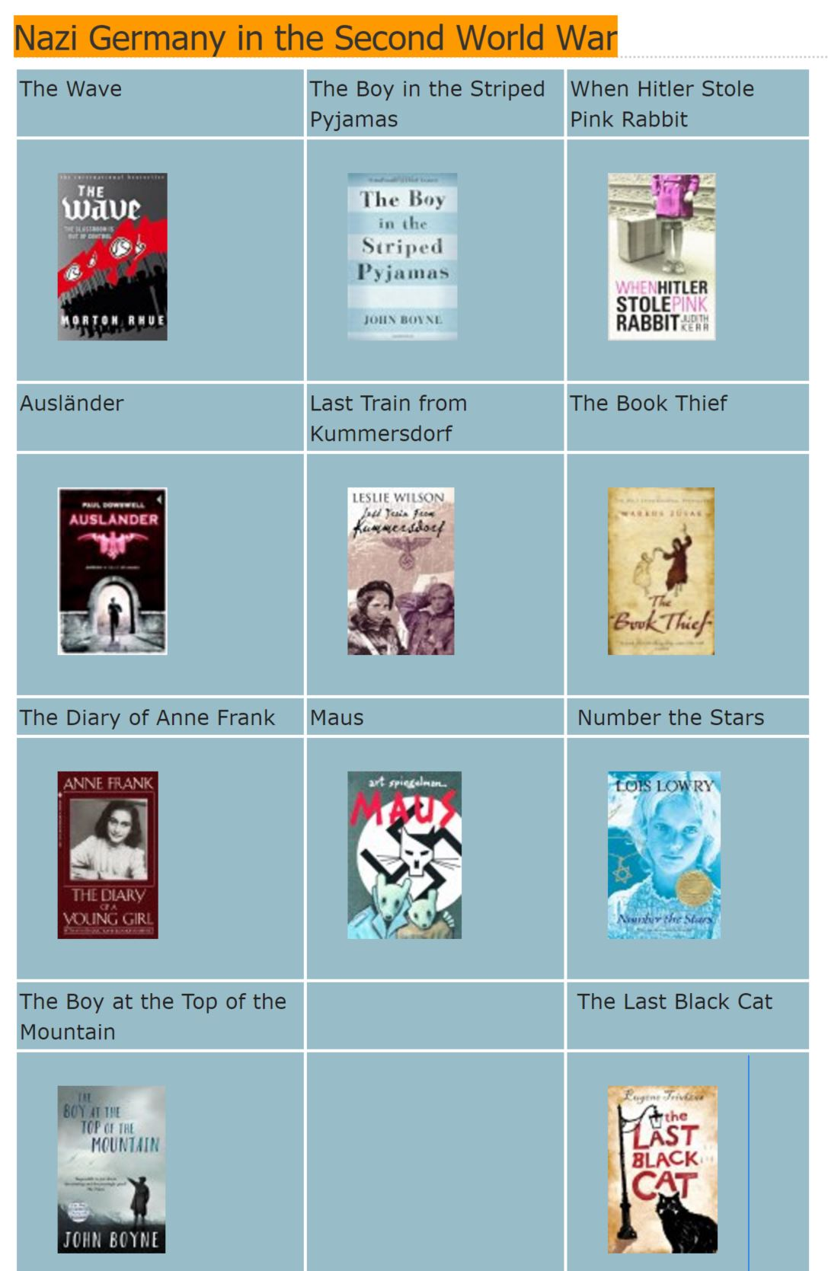
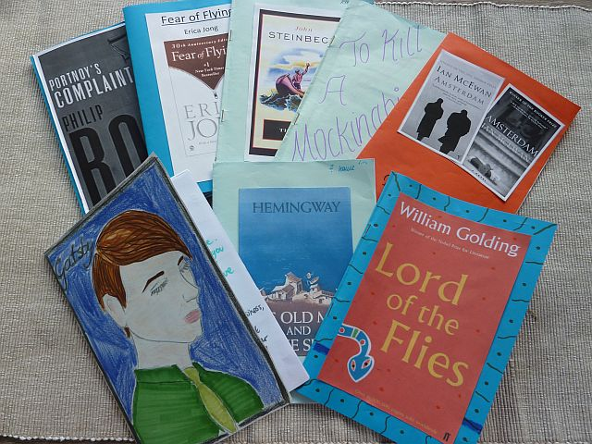


Reading in upper Secondary School

Slide 33
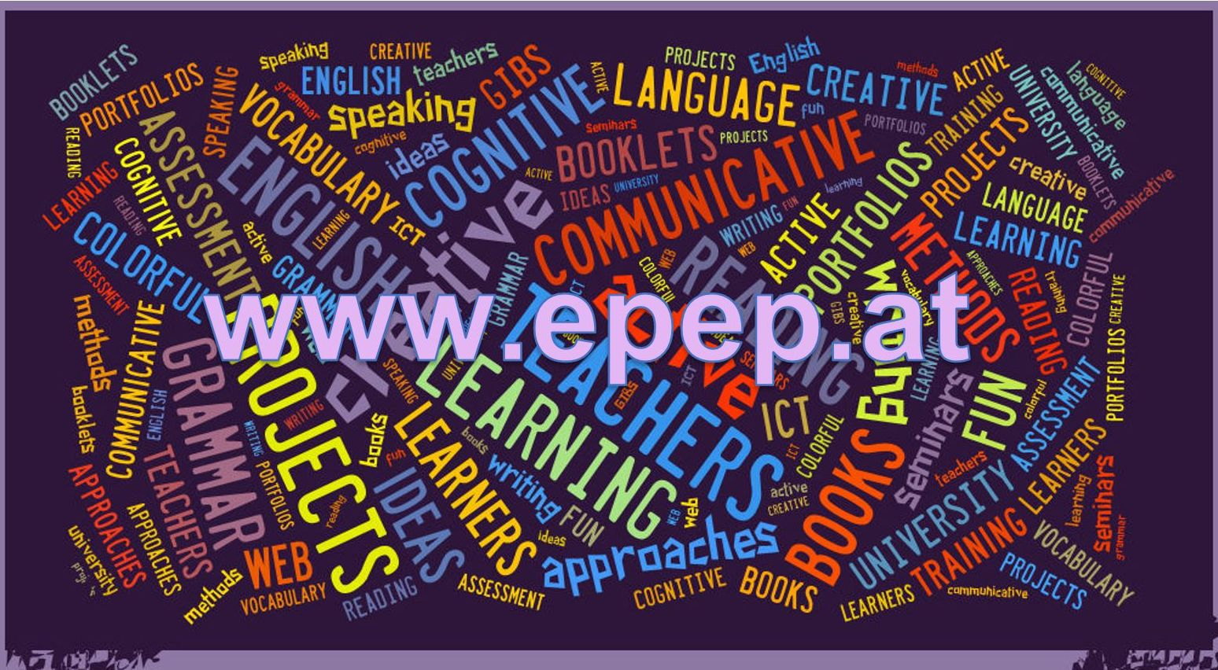


4-What do future language teachers need in order to integrate more literature and culture into their classrooms?
Positive reading experiences at University
A large repertoire of children’s books, YAL books and contemporary novels for different age groups and reading levels
Examples of engaging projects and methods for the classroom. Some ready-made projects to get them started.

Slide 34

5-What Challenges will young teachers meet?
This Photo by Unknown Author is licensed under CC BY

Slide 35
… and how to overcome them…
If teachers want to overcome these challenges …
they need to understand the importance and effectiveness of extensive reading for vocabulary expansion and for language acquisition in general
they must be able to explain their reasoning to the students, parents and colleagues
they must have experienced free, voluntary reading themselves and enjoyed it
they must have read a wide range of books for different age-groups and reading levels
they must have access to good project examples that have worked in the classroom.
they must be willing to put in some extra time needed to develop their own materials
This Photo by Unknown Author is licensed under CC BY

Slide 36
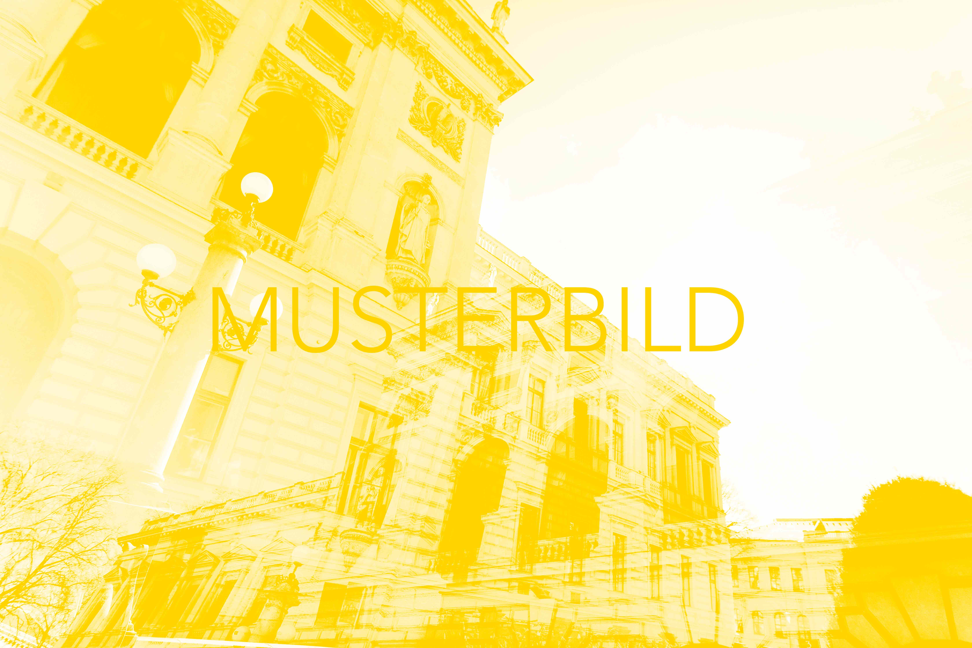
Developing Transcultural Competence: Student Teachers of Italian Meet Cross-cultural Authors and Their Texts
Simona Bartoli Kucher
Department of Romance Studies
SLTED 2022 Vienna

Slide 37

Personal Data
language teacher educator
and
researcher

Slide 38
My teaching attitude
The power of positive emotions
The power of co-operation
Active participation

Slide 39
My Presentation
Ital Transcultural Texts, Cross cultural Learning
Language class as Third space
My Projekt Scritture in viaggio/ كتابات مسافرة /Schreiben unterwegs
How do we assess Transcultural and global competence?

Slide 40

1.Transcultural narrative texts
literary texts born in our century in the interstices between languages and cultures (Bhabha), from experiences of migration - lived in first person or linked to experiences close to one's own experience - often in autobiographical stories in which there are multilingual codes
Notes:
With the term 'transcultural narrative texts' we mean literary texts situated in the interstices between languages and cultures (Bhabha 1994, p.4), referring to experiences of migration - lived in first person or linked to experiences close to one's own, often structured as autobiographical stories in which there are multilingual codes. Their authors can’t be traced back to a particular national literary space, because they have a complex dimension that connects them for their social, linguistic and cultural specificity to multiple and borderline spaces (Schulze, 2007).

Slide 41
Martha Nussbaum. 2010. Not for Profit. Why Democracy Needs the Humanities. Princeton: Princeton University Press, 96.
AT THE ROOF OF IMAGINATION
„the ability to think what it might be like to be in the shoes of a person different from oneself, to be an intelligent reader of that person‘s story, and to understand the emotions and wishes and desires that someone so placed might have“.

Slide 42

2. Language class as Third space
“I will try to describe what the emerging ‚third place‘ could be, that grows in the interstices between the cultures the learners grew up with and the new cultures he or she is being introduced to. I will use successively three different frames: a sociological, an educational, and a politic frame. […]
Each will provide a different conclusion to the argument made throughout this book for teaching the interdependence of language and culture“
C. Kramsch, 2009.

Slide 43
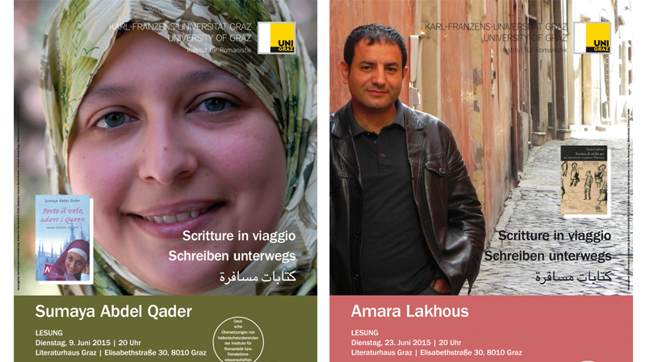
3.
Notes:
L’incontro con i testi letterari e multimodali e con i loro autori/con le loro autrici può determinare negli apprendenti una forte e duratura motivazione se gli studenti stessi diventano attori del processo educativo, come ormai da anni stiamo osservando nel corso del Progetto “Scritture in viaggio/ كتابات مسافرة /Schreiben unterwegs” che ha portato a Graz, in dialogo con gli studenti dell’Istituto di Romanistica Sumaya Abdel Qader, Amara Lakhous, Igiaba Scego, Laila Wadia, Carmine Abate e l’8 giugno scorso Takoua Ben Mohamed:
Con ‚didattica cooperativa‘ intendiamo una forma sistematica e continua di cooperazione tra gli attori del processo educativo, cioè tra insegnanti e apprendenti, nel segno di un’inversione dei ruoli (Transformative Research Action, García/Klein 2016, p.49), nel segno della collaborazione e del dialogo tra chi fa ricerca e insegna nell’ambito della didattica delle lingue e delle letterature e gli insegnanti di lingua in formazione nel loro ruolo di mediatori nelle classi in cui viene insegnata la lingua straniera che studiano.

Slide 44

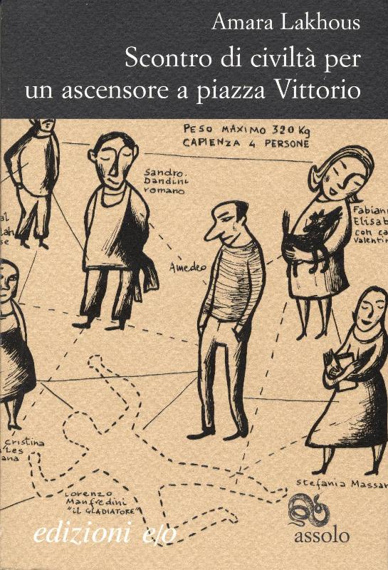
Notes:
Es ist hier festzuhalten, dass Bildsignale im Verhältnis zum geschriebenen Text meist unmittelbare affektive Reaktionen hervorrufen, die eine mehr oder weniger direkte Identifikationsmöglichkeit offerieren, sowie Emotionen ansprechen, die mit individuellen Erfahrungen und Erinnerungen verknüpfbar sind (Hecke 2010, 168).

Slide 45
Amara Lakhous: On the Quest to write in a Third Language. Amara Lakhous dreams of Green Cheese and Being Reborn into New York City. May, 4, 2016.
I write in Arabic and Italian but my life encompasses Berber, French and English. I can say that I am a linguistic polygamist of sorts, and so linguistic mediators, such as interpreters and translators, have always fascinated me. My own literary goal has become to mix and ‚contaminate‘ my many languages with each other through literature.
Notes:
Amara Lakhous: On the Quest to write in a Third Language. Amara Lakhous dreams of Green Cheese and Being Reborn into New York City. May, 4, 2016. Zit. nach: http://lithub.com/on-the-quest-to-write-in-a-third-language/ (Letzter Zugriff: 30.5.2016)

Slide 46
08/11/2016
Simona Bartoli Kucher

Slide 47
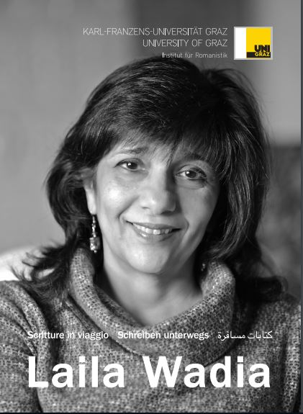
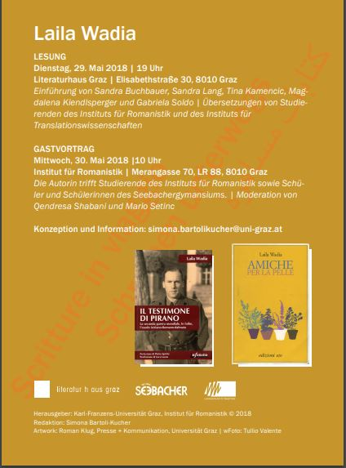

Slide 48
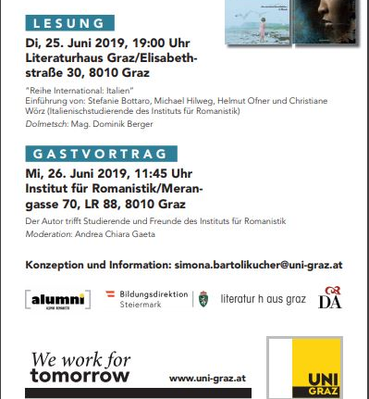
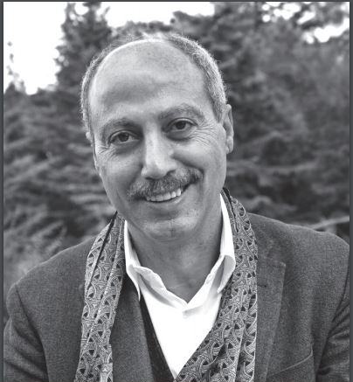

Slide 49
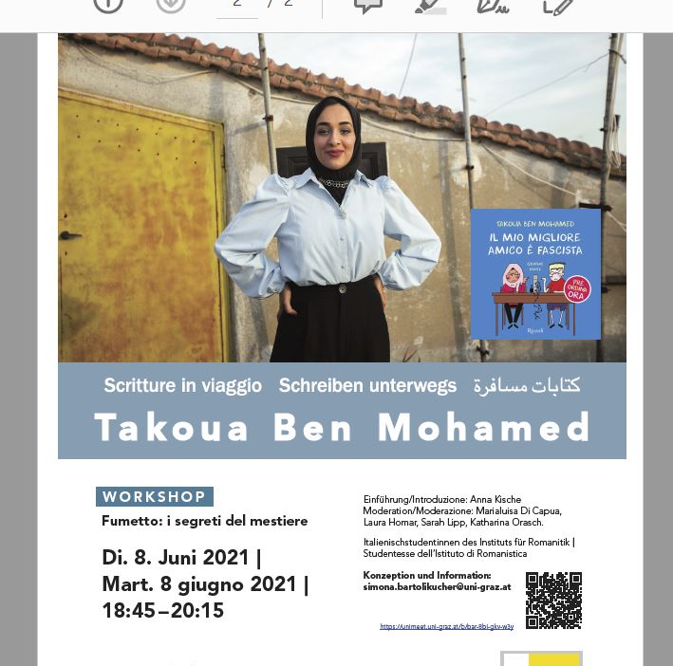
Sektion alumni Romanistik: Workshop mit Takoua Ben Mohamed - alumni UNI graz (uni-graz.at)
LH GRAZ
24.11.2022
Takoua Ben Mohamed
Notes:
Nel nostro paradigma didattico, sono il dialogo e la contestualizzazione a costituire l’approccio privilegiato al testo letterario/multimodale. Secondo i principi della didattica cooperativa, a partire dal semestre estivo 2015 abbiamo concepito il progetto Scritture in viaggio - كتابات مسافرة - Schreiben unterwegs, realizzandolo di volta in volta con la collaborazione dei diversi attori del processo di insegnamento/apprendimento. L’ombrello teorico per l’implementazione del progetto è stato quello della ricerca azione, della Transformative Research Action: una prospettiva di lavoro e di ricerca in base alla quale il ruolo e la divisione dei compiti tra chi conduce la ricerca e la mette in pratica, si modifica in base al confronto con gli altri attori coinvolti nello stesso processo (García & Klein 2016, 49).
Nel nostro caso, gli insegnanti di italiano in formazione dei corsi di laurea abilitanti all’insegnamento dell’italiano come lingua straniera, hanno presentato e disseminato tra gli scolari di italiano – con il sostegno degli insegnanti in servizio – i risultati del lavoro di ricerca condotto all’università. Il titolo di Scritture in viaggio - كتابات مسافرة - Schreiben unterwegs tiene conto di quanto abbiamo detto in precedenza, mettendo al centro dei testi letterari transculturali la dimensione della vita tra due mondi, la difficile formazione identitaria di chi ha vissuto e subito l’esperienza traumatica del viaggio, della fuga e dello spostamento da un paese a un altro.
La Transformative Research Action “inverts the power position of researchers and teachers, as each brings their own expertise into the process, becoming co-learners” (Id.).

Slide 50

My father spent winter in the village because the road construction site he worked for in Hamburg closed due to Schlechtwetter, and generally reopened in early March.
Even though I did not know the meaning, as a child I loved the word Schlechtwetter as I associated it with the sweetest time of year, that when the family was reunited. As time went by, I convinced myself that Schlechtwetter was a kind employer who allowed his laborers to spend winters in the village.
And so I was greatly disappointed when my father explained what the word actually meant, after a gentle ribbing: “You’re such a bala bala as the Germans say when one is a bit out of whack. Schlechtwetter isn’t a person but moti i lig, a spate of bad weather”. © TRANSLATED BY LAILA WADIA
Notes:
Mio padre trascorreva l‘inverno in paese perché il cantiere stradale, in cui lavorava ad Amburgo, chiudeva grazie a Schlechtwetter e riapriva, di solito, ai primi di marzo.
Anche se non conoscevo il significato, da bambino amavo la parola Schlechtwetter perché l‘associavo al periodo più zuccherigno dell‘anno, quello della mia famiglia unita. E con il passare del tempo mi ero convinto che Schlechtwetter fosse un padrone buono, che mandava un suo fatigatòre a svernare in paese. Perciò restai deluso quando mio padre me ne tradusse il senso, dopo avermi preso in giro: „Sei proprio bala bala, come i tedeschi chiamano chi tiene la capa un pochicello sballata. Schlechtwetter non è una persona, ma moti i lig, il cattivo tempo“.
Allora pregai Sant‘Antonio che in Germania il gelo, la neve, la pioggia non finissero mai e che mio padre non dovesse ripartire, perché tanto con quel tempaccio perenne non avrebbe potuto svolgere il suo lavoro: incatramare le strade (Il sapore della cuntentizza (da: Carmine Abate. 2016. Il banchetto di nozze e altri sapori. Milano: Mondadori)
So I prayed to St. Anthony to make the frost, the snow and the rain in Germany never stop, so that father would never have to leave. Perpetual bad weather would mean that he would not have been able to carry out his job of tarring roads.

Slide 51
LEARNER‘S
Empowerment
Make decisions
Express their voice

Slide 52
LEARNER‘S
Empowerment
Action
Participation

Slide 53
STUDENT TEACHERS?
Initiating engagement with Learning tasks
Introducing author and texts at the LH
Writing own linguistic and intercultural autobiography
Writing autobiographies of their cross-cultural encounters
Writing reflective journals

Slide 54
PUPILS
Initiating engagement with Learning tasks
Writing their linguistic and intercultural autobiography
Put themselves in the author‘s and charachter‘s shoes
Preparing dialogues
Writing journal entries
Listening online interviews
Learning how to interview authors

Slide 55
Engagement about action
S. Mercer, Z. Dörnyei. 2020. Engaging Language Learners in Contemporary Classrooms.

Slide 56
Dialogues in terms of written reflections are a process of interaction with the other and, at the same time of openness to the other, which allows a personal and also a social transformation (Buber, 1993.)
CONCLUSION
Through effective reflection, students can engage in an examination of their personal opinions, attitudes, and positionalities; explore their relation to others and the work in which they are engaged; and bridge their day-to-day interactions with individuals to broader social and cultural issues (Deardoff, 2011, 75)
Notes:
A partire da un approccio teorico multimodale, multidimensionale e multiprospettico (Deardoff 2011) sono stati proposti compiti relativi alla riflessione sui testi letterari transculturali, basati sulla capacità degli apprendenti di valutare il definirsi della loro competenza interculturale.
Le riflessioni degli studenti rappresentano una comprensione profonda delle competenze individuali in quanto si concentrano sugli aspetti culturali delle proprie esperienze con i testi e verso il proprio sé, incoraggiando l’esame consapevole dell’esperienza con il testo e mettendo in moto una comprensione empatica.
L’esperienza della lettura apre in questo modo spazi per processi educativi che sono resi evidenti tramite il vissuto delle studentesse e degli studenti, che è processo di appropriazione trasformativa perché si entra ‘in relazione con’ il testo/l’autore/ i personaggi/ la storia per trasformare anche se stessi (Zadra 2022, p.111)

Slide 57
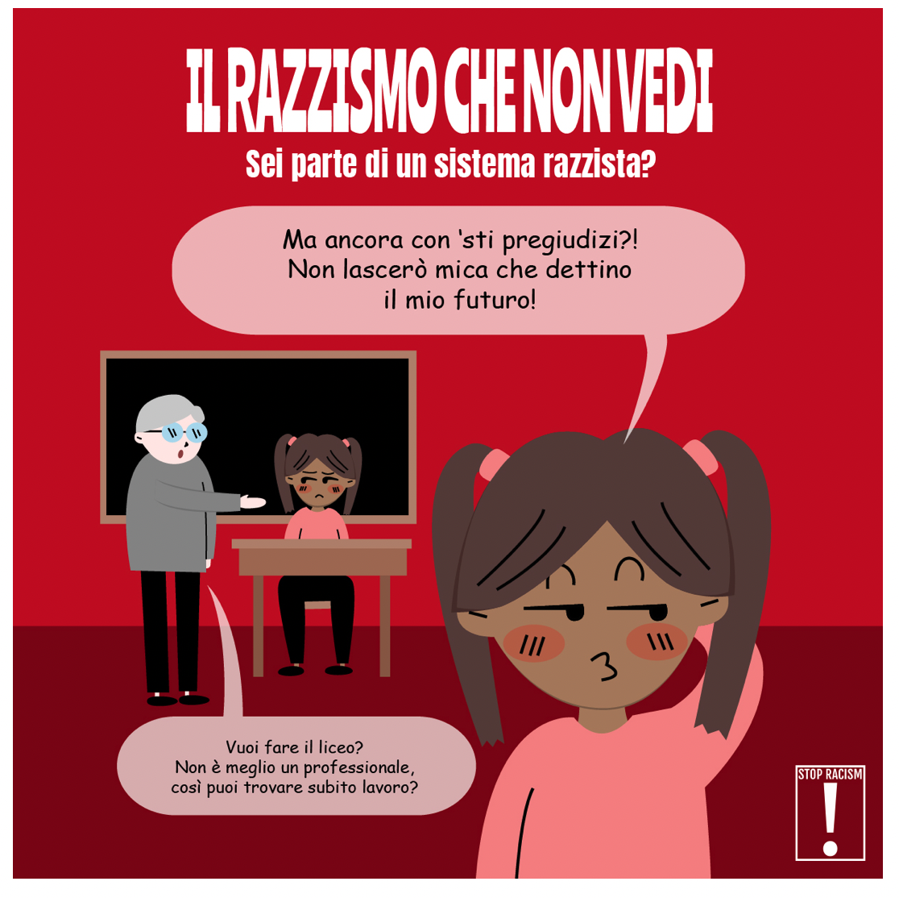
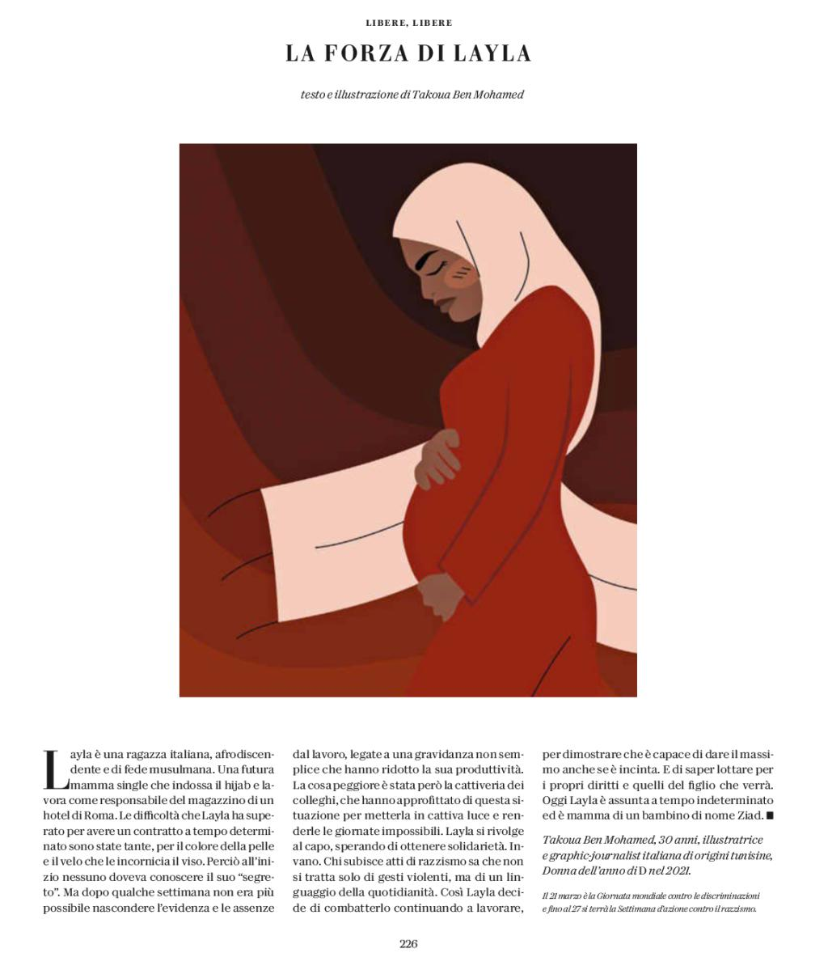
Notes:
Relativamente al potenziale che i testi transculturali offrono allo sviluppo di competenze interculturali e di cittadinanza globale, proponiamo di far uso – per la valutazione dello sviluppo del processo interculturale – di attività basate sulla riflessione personale e sull’autovalutazione degli apprendenti stessi. Facciamo riferimento a testi riflessivi orali e/o scritti, che da un lato facilitano la percezione intuitiva di riflessioni e atteggiamenti personali, altrimenti non facili da giudicare; e dall’altro contribuiscono allo sviluppo della personalità e della riflessione personale: qualità considerate essenziali per la formazione interculturale (Byram 1997; Byram, Gribkova und Starkey, 2002; Deardorff 2009, 2011).

Slide 58
Grazie per la vostra attenzione
simona.bartolikucher@uni-graz.at

