Slide 1
Words of the Day
Always copy the word of the day into your vocab book and make an effort to learn and remember it on the same day.
Tip: Try to use the new words as soon as possible. This is the best way to remember them forever.

Slide 2
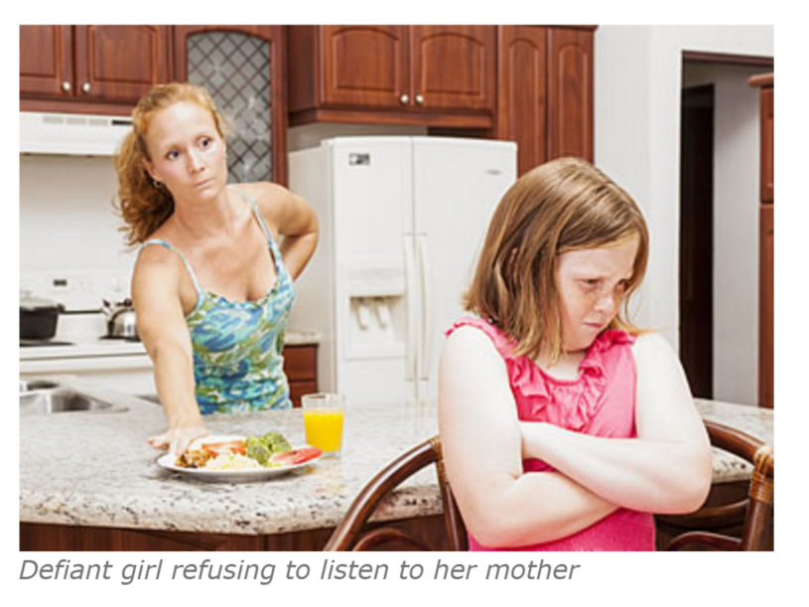
defiant
trotzig
refusing to obey something or someone : full of defiance
defiant rebels
a defiant act
He's taken a defiant stand/stance on the issue.
— defiantly adverb
He's spoken out defiantly against the new law.

Slide 3
To discriminate (against)
[no object] : to unfairly treat a person or group of people differently from other people or groups
The school is not allowed to discriminate.
It is illegal to discriminate on the grounds/basis of race/sex. [=it is illegal to treat someone differently because of his or her race/sex]
— often + against
The firm discriminated against him because of his race.

Slide 4
to prevail
Which side will prevail in the conflict?
Each tradition wanted to prevail over the others.
Let’s hope Putin won’t prevail on the issue of Syria.
The students prevailed upon the teacher to extend the deadline.
Good will prevail over evil
Definition:
To succeed in convincing

Slide 5
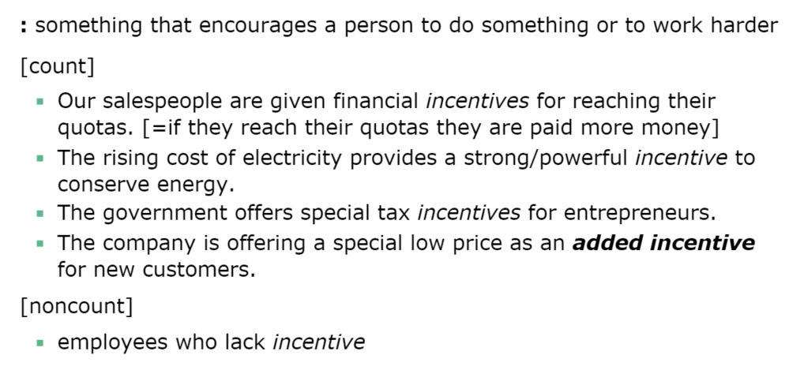

incentive
The store is offering 50 percent off – as an incentive for shoppers

Slide 6
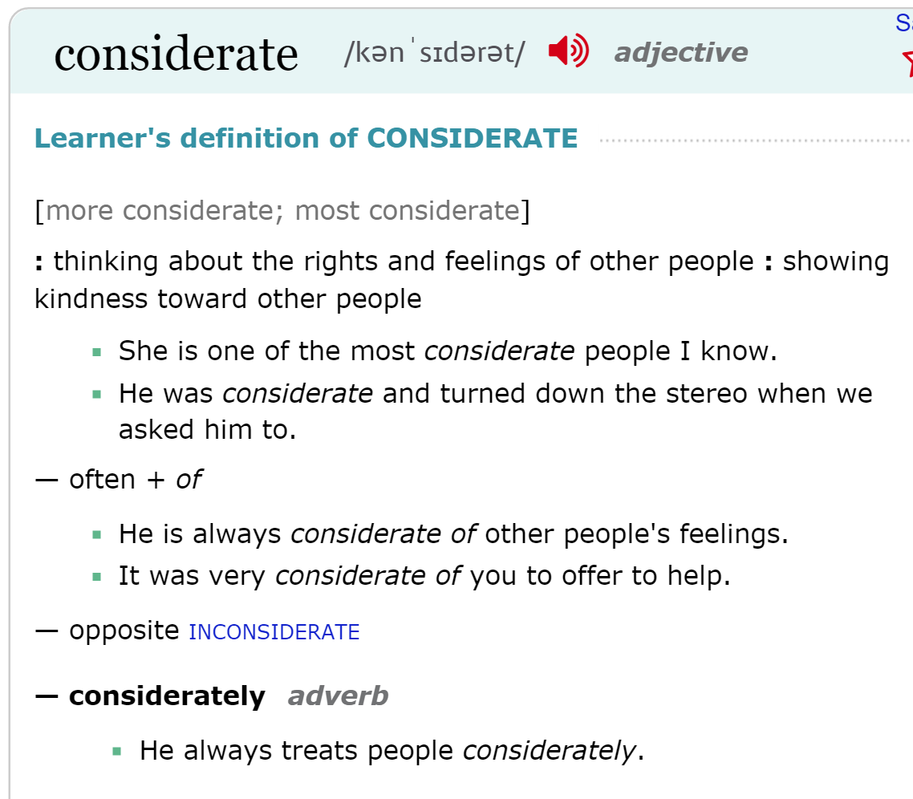
considerate
rücksichtsvoll, bedacht, aufmerksam

Slide 7
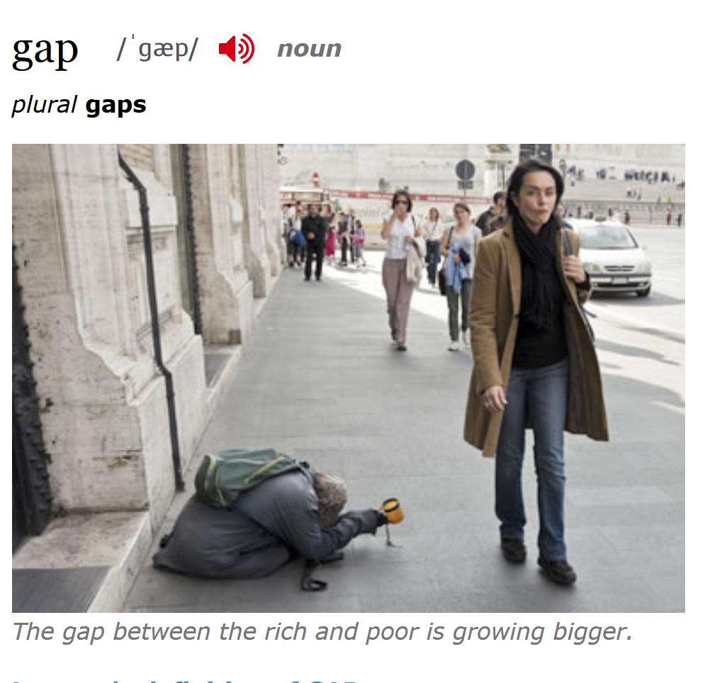
gap I’m sure you know what that means… but can you use it?
The child had a gap between her two front teeth.
The gap between the lead runner and the rest of the field continued to widen.
The sheep got through a gap in the fence.
There are unexplained gaps in his story.
The class filled in the gaps in my knowledge of biology.
She had taken several years off to raise a family, so there was a large gap in her work history.
There is a widening gap between the rich and the poor.
We hope to close the gap between well-funded suburban schools and the struggling schools in poorer communities.
His work bridges the gap between popular fiction and serious literature. [=his work has qualities of both popular fiction and serious literature]

Slide 8
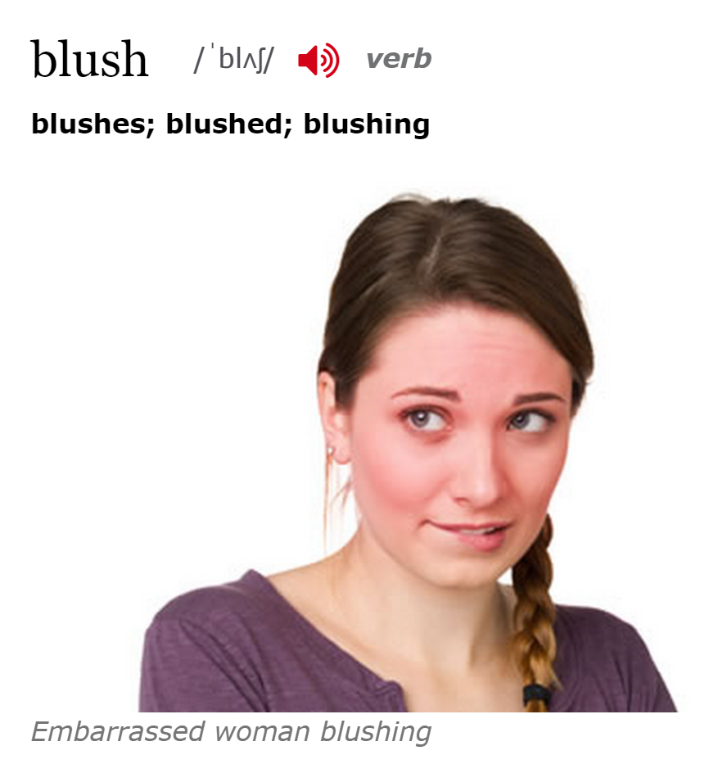
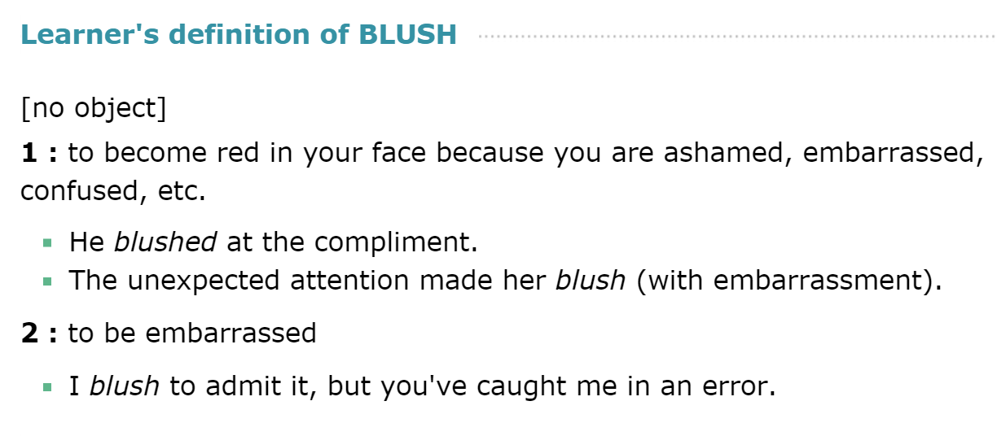
blush

Slide 9
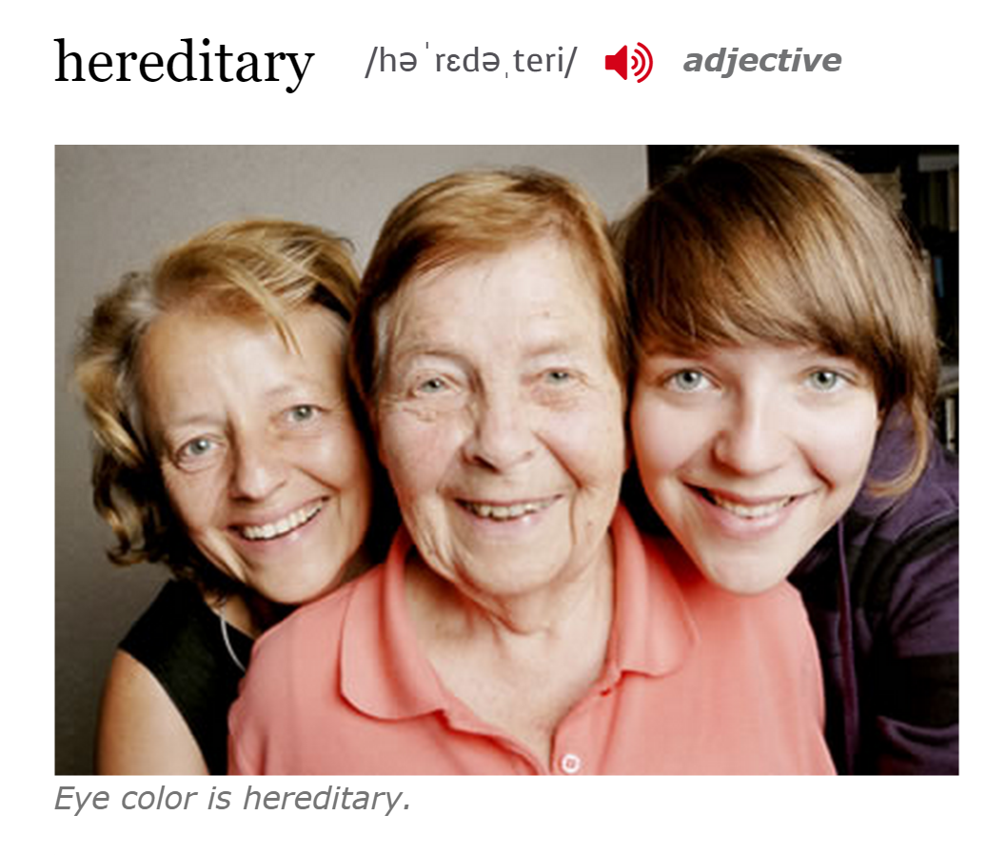
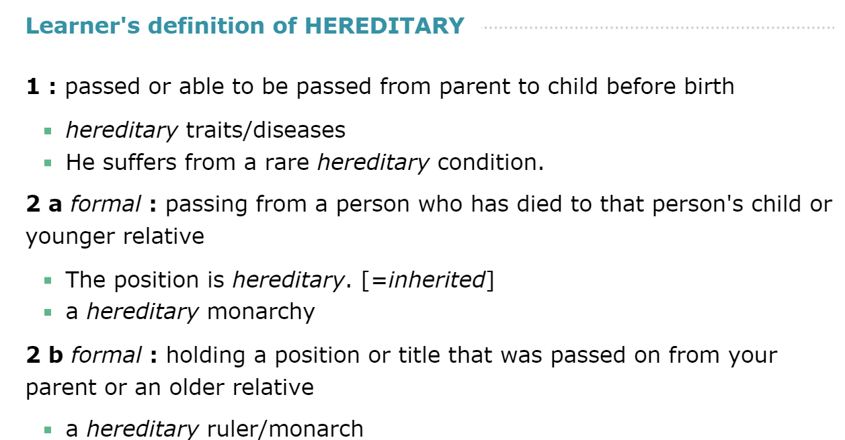
hereditary

Slide 10
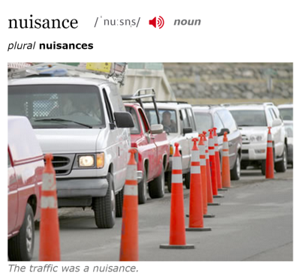
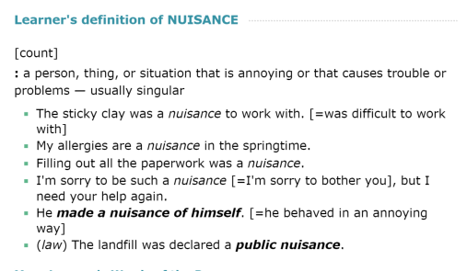
nuisance

Slide 11
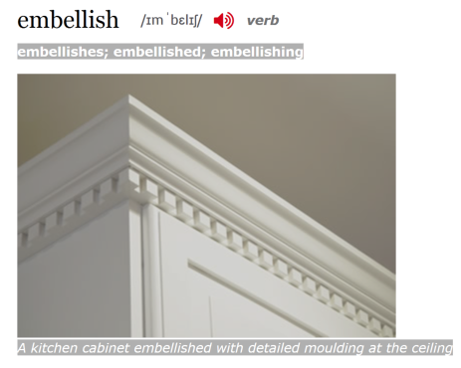
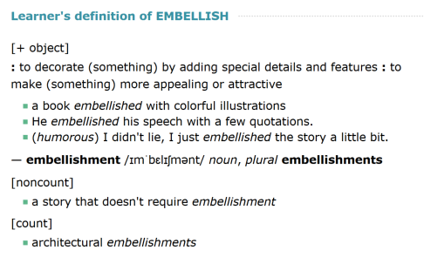
embellish

Slide 12
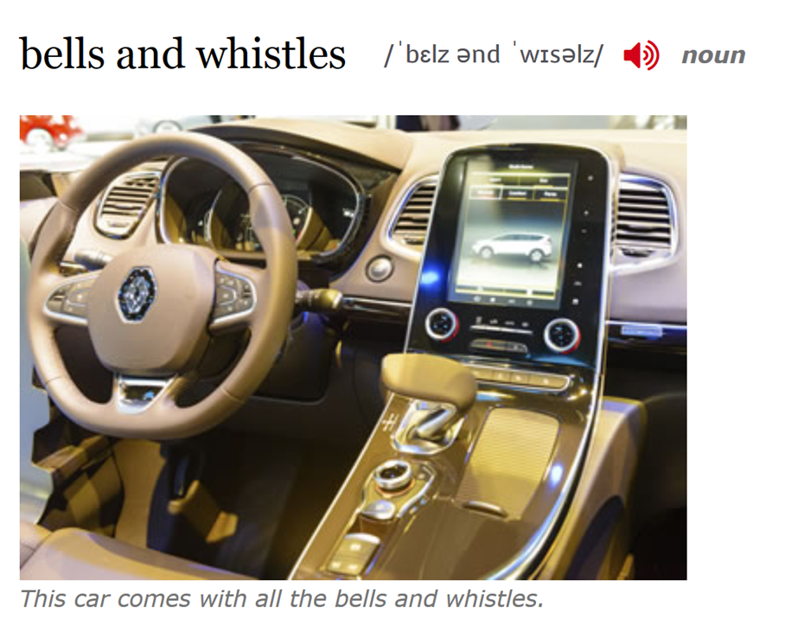
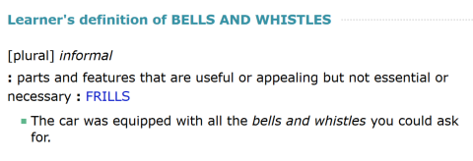
bells and whistles

Slide 13
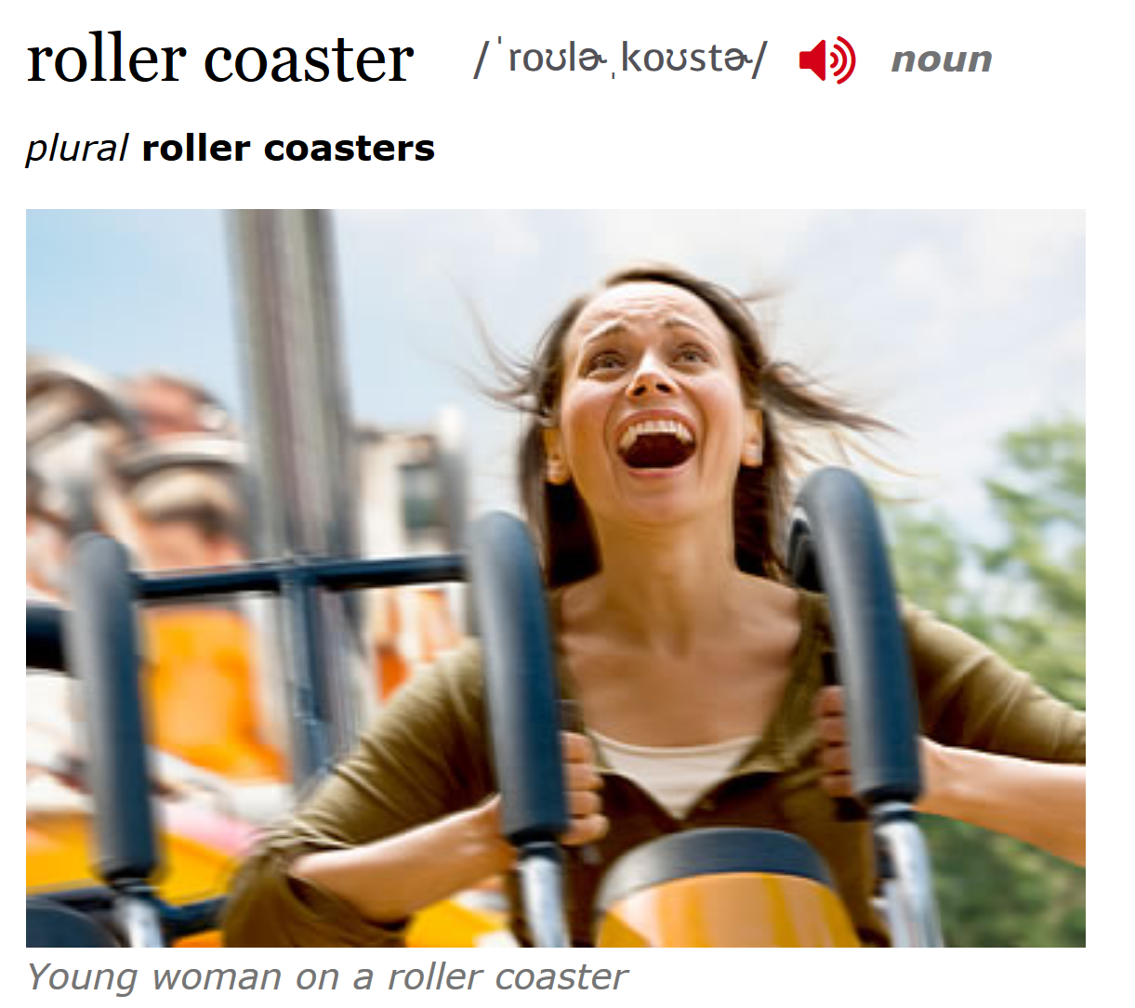
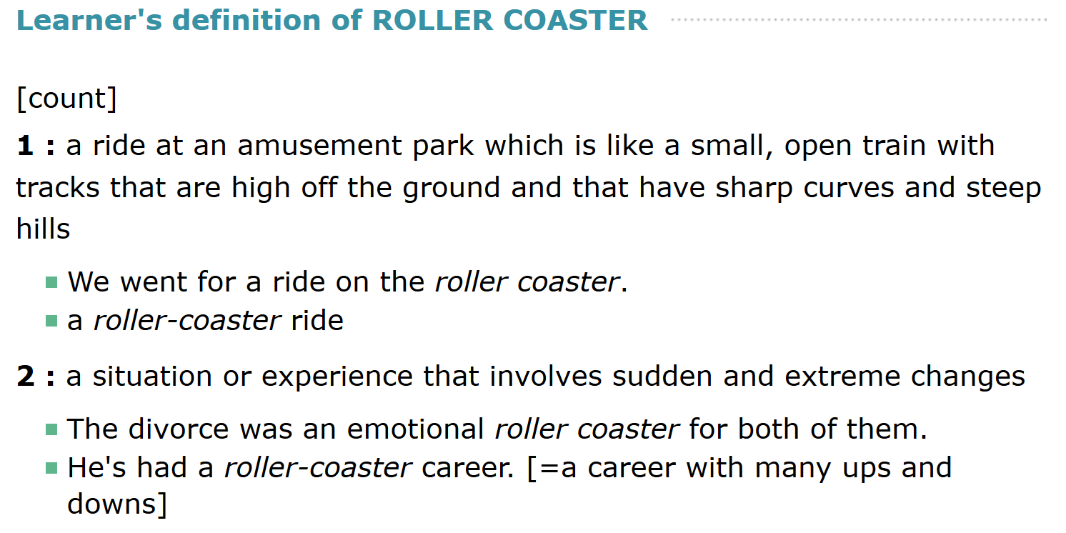
roller coaster

